Slide 1
2018 European Thyroid Association Guideline for the Management of Graves’ Hyperthyroidism
Eur Thyroid J 2018;
7:167–186
Presented By
G. Taghipour, MD

Slide 2
Epidemiology and Pathogenesis
Hyperthyroidism occurs due to an inappropriately high synthesis and secretion of thyroid hormone (TH) by the thyroid.
TH increases tissue thermogenesis and the basal metabolic rate, and reduces serum cholesterol levels and systemic vascular resistance.

Slide 3
Epidemiology and Pathogenesis
The complications of untreated hyperthyroidism include:
Weight loss, Osteoporosis, Fragility fractures, Atrial fibrillation, Embolic events, and Cardiovascular dysfunction
The most frequent causes are Graves’ disease (GD) and toxic nodular goiter.
GD is the most prevalent cause of hyperthyroidism in iodinereplete geographical areas, with 20–30 annual cases per 100,000 individuals.
GD occurs more often in women and has a population prevalence of 1–1.5%. Approximately 3% of women and 0.5% of men develop GD during their lifetime.
The peak incidence of GD occurs among patients aged 30–60 years, with an increased incidence among African Americans

Slide 4
Graves’ disease (GD)
GD is an organ-specific autoimmune disease whose major manifestations are owing to circulating autoantibodies (Ab) that stimulate the thyroid-stimulating hormone receptor (TSH-R) leading to hyperthyroidism and goiter.
TSH-R-stimulating Ab are predominantly of the IgG1 isotype and bind to a discontinuous epitope in the leucine-rich domain of the TSH-R extracellular domain, bounded roughly by amino acids 20–260.
TSH-R also interacts with IGF1 receptors (IGF1R) on the surface of thyrocytes and on orbital fibroblasts, with the TSH-R-Ab interaction with TSH-R activating both IGF1R downstream pathways and TSH-R signaling.

Slide 5
Epidemiology and Pathogenesis
Circulating stimulatory TSH-R-Ab binding to the TSH-R enhance the production of intracellular cyclic AMP, leading to the release of TH and thyrocyte growth.
About 30% of GD patients have family members who also have GD or Hashimoto’s thyroiditis. Twin studies have shown that 80% of the susceptibility to GD is genetic.
A noncoding variant within the TSH-R gene itself also confers susceptibility.
Environmental factors, such as Cigarette smoking, High dietary iodine intake, Stress, and Pregnancy, also Predispose to GD.

Slide 6
Diagnosis
Serology:
Serum TSH measurement has the highest sensitivity and specificity of any single blood test used in the evaluation of suspected hyperthyroidism and should be used as an initial screening test.
Imaging:
In addition to thyroid function and TSH-R-Ab determination, most clinicians would request thyroid ultrasound (US) and less often isotope scanning .

Slide 7
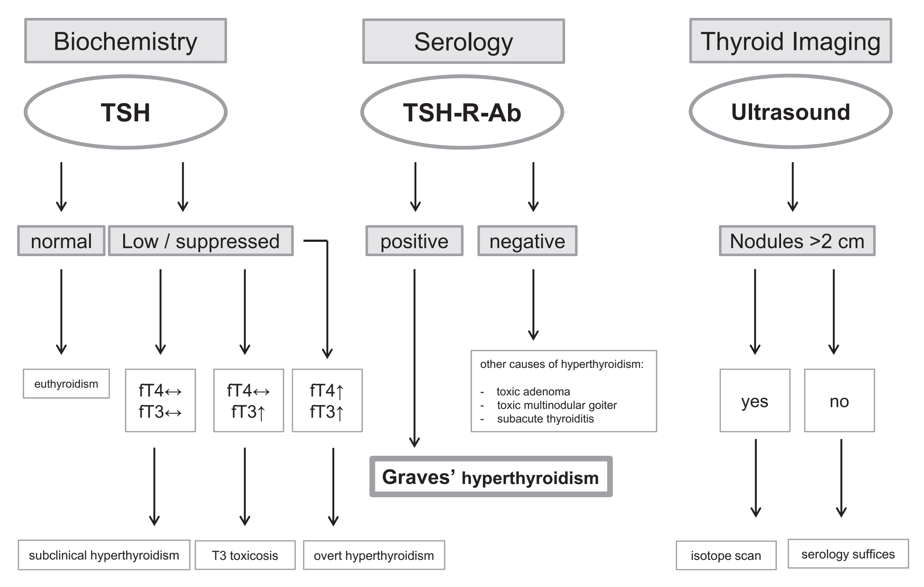
Diagnosis
Algorithm for investigating a patient with suspected Graves’ hyperthyroidism.

Slide 8
Serology
Diagnostic accuracy improves when both a serum TSH and free T4 are assessed at the time of the initial evaluation.
The relationship between free T4 and TSH (when the pituitary-thyroid axis is intact) is an inverse log-linear relationship; therefore, small changes in free T4 result in large changes in serum TSH concentrations.
Serum TSH levels are considerably more sensitive than direct TH measurements for assessing TH excess.
In overt hyperthyroidism, both serum free T4 and T3 concentrations are elevated, and serum TSH is suppressed;
however, in milder hyperthyroidism, serum total T4 and free T4 levels can be normal, only serum free T3 may be elevated, with an undetectable serum TSH.

Slide 9
Serology
TSH-R-Ab are specific biomarkers for GD.
Also, TSAb is a highly sensitive and predictive biomarker for the extrathyroidal manifestations of GD as well as a useful predictive measure of fetal or neonatal hyperthyroidism.
Finally, the incorporation and early utilization of TSAb into current diagnostic algorithms conferred a 46% shortened time to diagnosis of GD and a cost saving of 47%.

Slide 10
Serology: Recommendations
The measurement of TSH-R-Ab is a sensitive and specific tool for rapid and accurate diagnosis and differential diagnosis of Graves’ hyperthyroidism.
When technically available, differentiation of TSH-RAb functionality is helpful and predictive in Graves’ patients during pregnancy/postpartum, as well as for extrathyroidal manifestations.

Slide 11
Imaging
Ordinarily, there is no indication for CT scan, MRI, or PET-CT of the thyroid gland.
Thyroid US is a convenient, noninvasive, rapid, and accurate tool in the initial work-up of GD patients.
It aids in the diagnosis, without exposing the patient to ionizing irradiation, and assists in determining the underlying etiology of thyrotoxicosis and detecting concomitant thyroid nodules.
Imaging results are highly dependent on equipment and the experience of the investigator. A high-frequency linear probe should be used.
GD is often, but not invariably, characterized by diffuse thyroid enlargement and by hypoechogenicity, both assessed by US and conventional grey scale analysis

Slide 12
Imaging
A color-flow or power Doppler examination characterizes vascular patterns and quantifies thyroid vascularity.
The latter is significantly increased in untreated GD and typically shows a pulsatile pattern called “thyroid inferno” that is multiple small areas of increased intrathyroidal flow seen diffusely throughout the gland.
Typical US patterns combined with positive TSH-R-Ab obviate the need for scintigraphy in the vast majority of cases.
However, thyroid scintigraphy may be useful in the assessment of patients prior to radioactive iodine (RAI) treatment, especially when facing coexistent multinodular goiter.

Slide 13
Imaging: Recommendations
US examination, comprising conventional grey scale analysis and color-flow or power Doppler examination is recommended as the imaging procedure to support the diagnosis of Graves’ hyperthyroidism.
Scintigraphy of the thyroid is suggested when thyroid nodularity coexists with hyperthyroidism, and prior to RAI therapy.

Slide 14
Management
Medical Treatment:
Graves’ hyperthyroidism is treated by reducing TH synthesis, using ATD, or by reducing the amount of thyroid tissue with RAI treatment or total thyroidectomy
RAI Treatment
Surgery

Slide 15
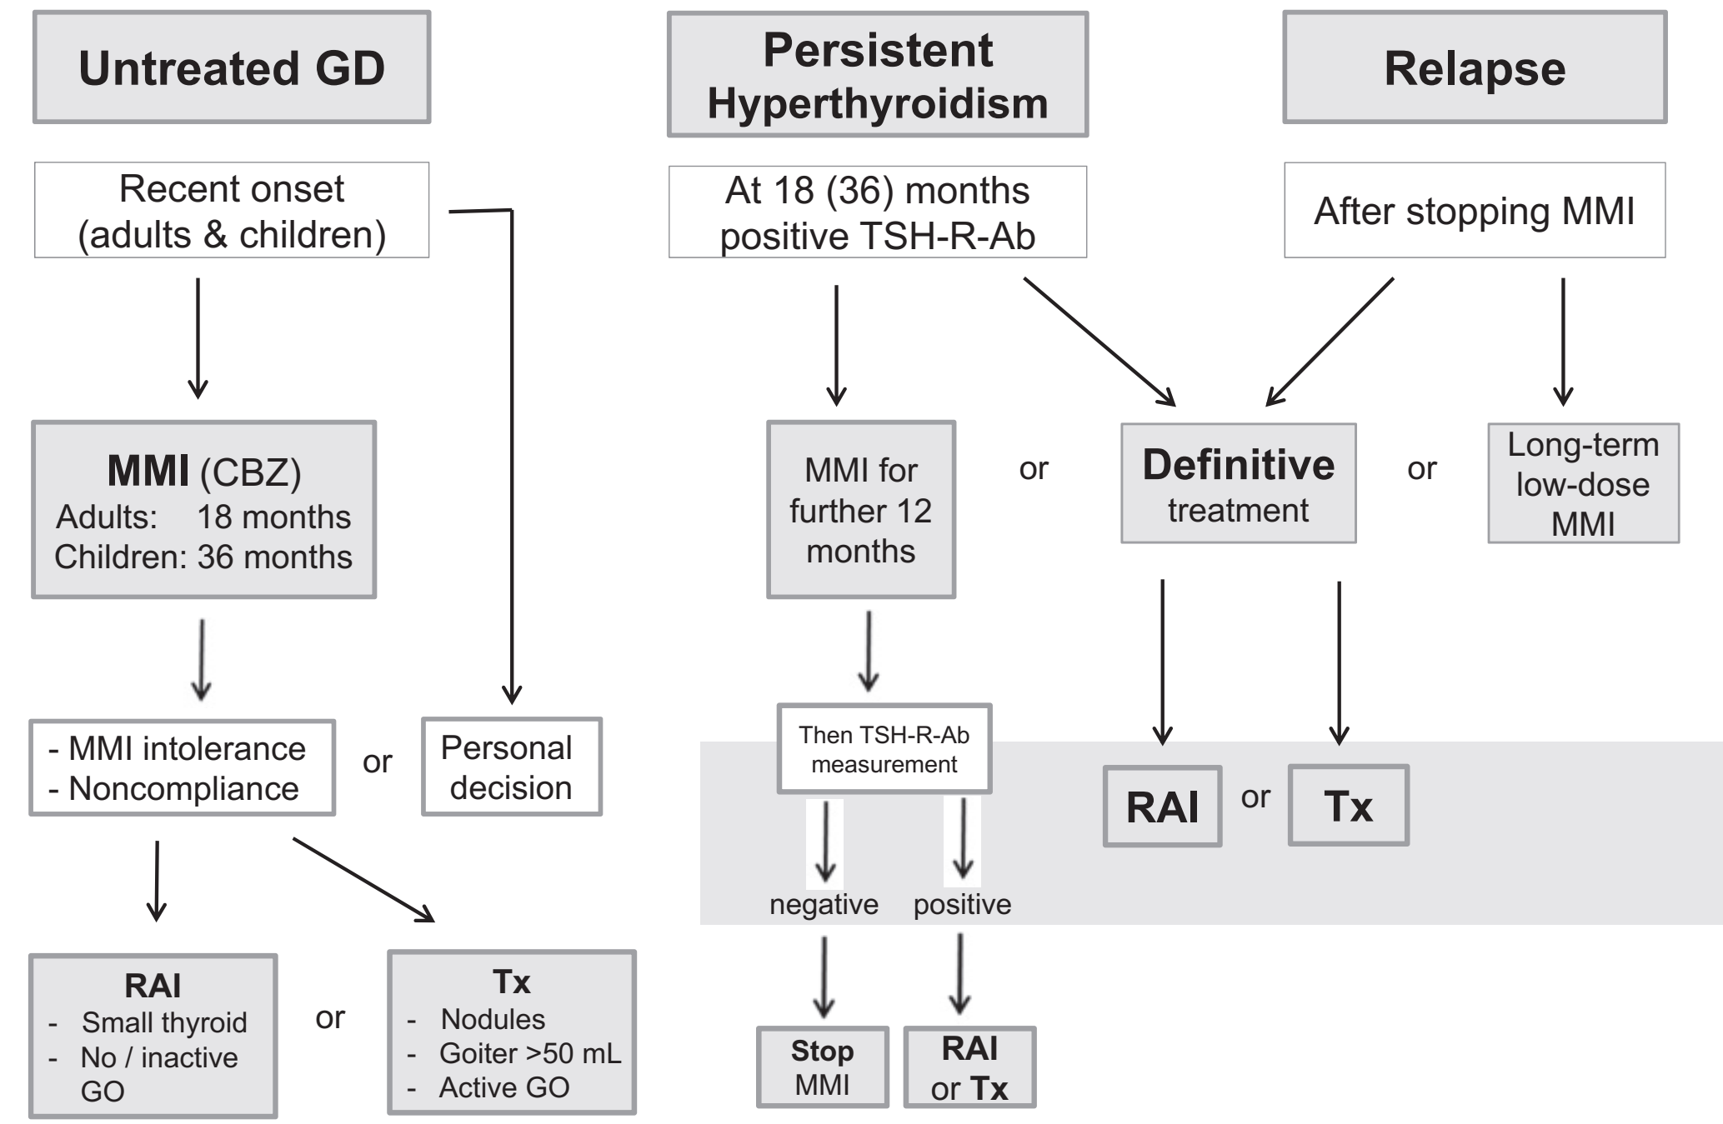
Management
Algorithm for the management of a patient with Graves’ hyperthyroidism.

Slide 16
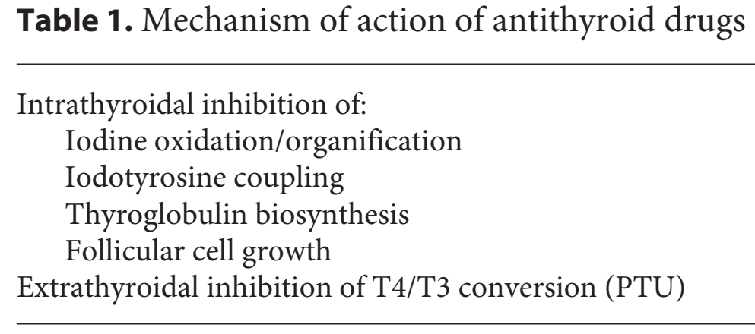
Medical Treatment
ATD represent the predominant therapy in Europe, Asia, and in the meantime in the USA. The main ATD are thionamides, such as propylthiouracil (PTU), carbimazole (CBZ), and the active metabolite of the latter, methimazole (MMI).
CBZ is not an active substance; it has to be decarboxylated to MMI in the liver. Thionamides inhibit the coupling of iodothyronines and hence reduce the biosynthesis of TH.
All inhibit the function of
thyroperoxidase, reducing
oxidation and the organification
of iodide.

Slide 17
Medical Treatment
ATD are indicated as a first-line treatment of GD, particularly in younger subjects, and for short-term treatment of GD before RAI therapy or thyroidectomy.
ATD reduce TSH-RAb levels and enhance rates of remission compared to no therapy.
PTU at higher doses inhibits deiodination of T4 to T3. The initial dose of MMI is usually 10–30 mg once daily depending on the severity of hyperthyroidism (CBZ 15–40 mg/day).
PTU is given at a dose of 100 mg every 8 h, and divided doses are given throughout the course. The starting dose of ATD can be gradually reduced (titration regimen) as thyrotoxicosis improves.

Slide 18
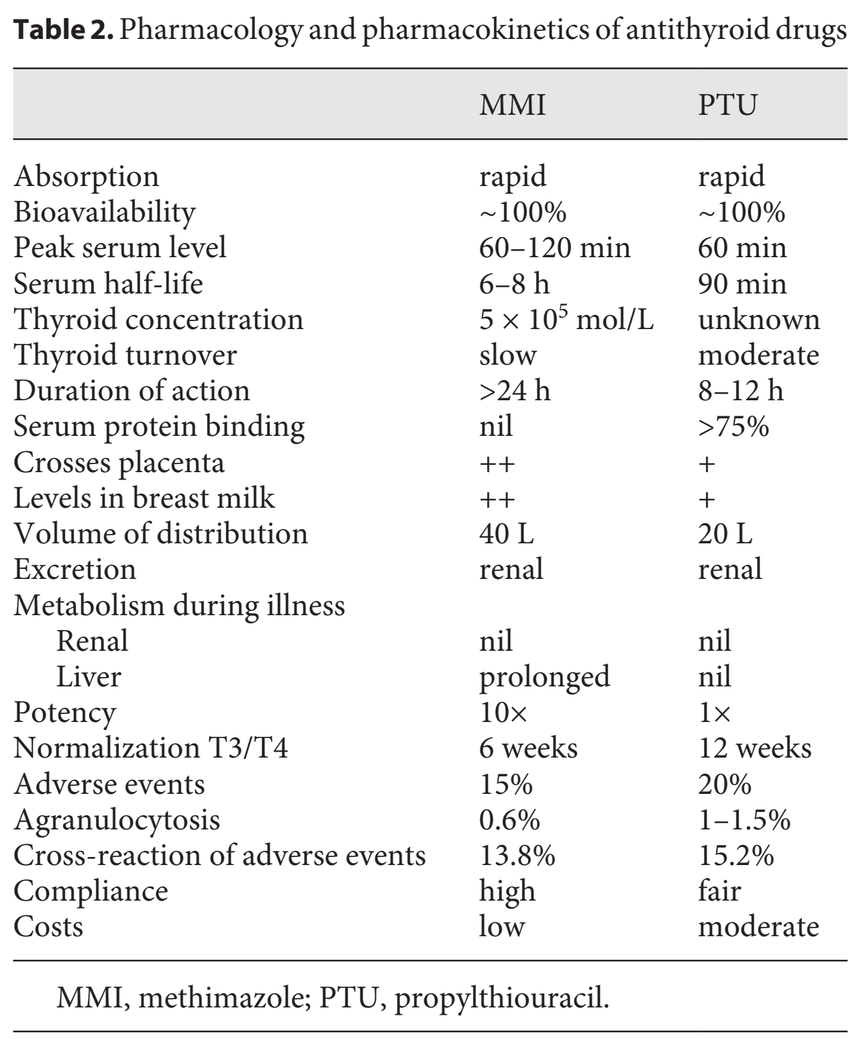
Medical Treatment

Slide 19
Medical Treatment
Thyroid function tests are reviewed 3–4 weeks after starting treatment, and the dose is titrated based on free T4 and free T3 levels.
The usual daily maintenance doses of ATD in the titration regimen are 2.5–10 mg of MMI and 50–100 mg of PTU.
Alternatively, MMI daily doses of 30 mg may be given combined with levothyroxine (L-T4) supplementation (block and replace regimen) to avoid drug-induced hypothyroidism.
Initial reports suggesting superior remission rates with the block-replace regimen have not been reproduced.

Slide 20
Medical Treatment
The optimal duration of ATD therapy for the titration regimen is 12–18 months. Continued L-T4 treatment following initial ATD therapy does not provide any benefit in terms of the recurrence of hyperthyroidism.
Monitoring the titers of functional stimulatory and blocking TSH-R-Ab during treatment help in predicting the outcome. Patients with persistently high TSH-R-Ab at 12–18 months can continue MMI therapy, repeating the TSH-R-Ab measurement after an additional 12 months, or opt for RAI or thyroidectomy. In line with this, arguments for an extended use of ATD in both adults and children with GD have been published.
Relapse is most likely within the first 6–12 months after ATD withdrawal, but may occur years later. Patients with severe hyperthyroidism, large goiters, or persistent high titers of TSH-R-Ab are most likely to relapse when treatment stops, but the outcome is difficult to predict.

Slide 21
Medical Treatment: Recommendations
Patients with newly diagnosed Graves’ hyperthyroidism should be treated with ATD. RAI therapy or thyroidectomy may be considered in patients who prefer this approach.
MMI (CBZ) should be used in every non-pregnant patient who chooses ATD therapy for Graves’ hyperthyroidism.
MMI is administered for 12–18 months then discontinued if the TSH and TSH-R-Ab levels are normal.

Slide 22
Medical Treatment: Recommendations
Measurement of TSH-R-Ab levels prior to stopping ATD therapy is recommended, as it aids in predicting which patients can be weaned from the medication, with normal levels indicating a greater chance of remission.
Patients with persistently high TSH-R-Ab at 12–18 months can continue MMI therapy, repeating the TSH-R-Ab measurement after an additional 12 months, or opt for RAI or thyroidectomy.

Slide 23
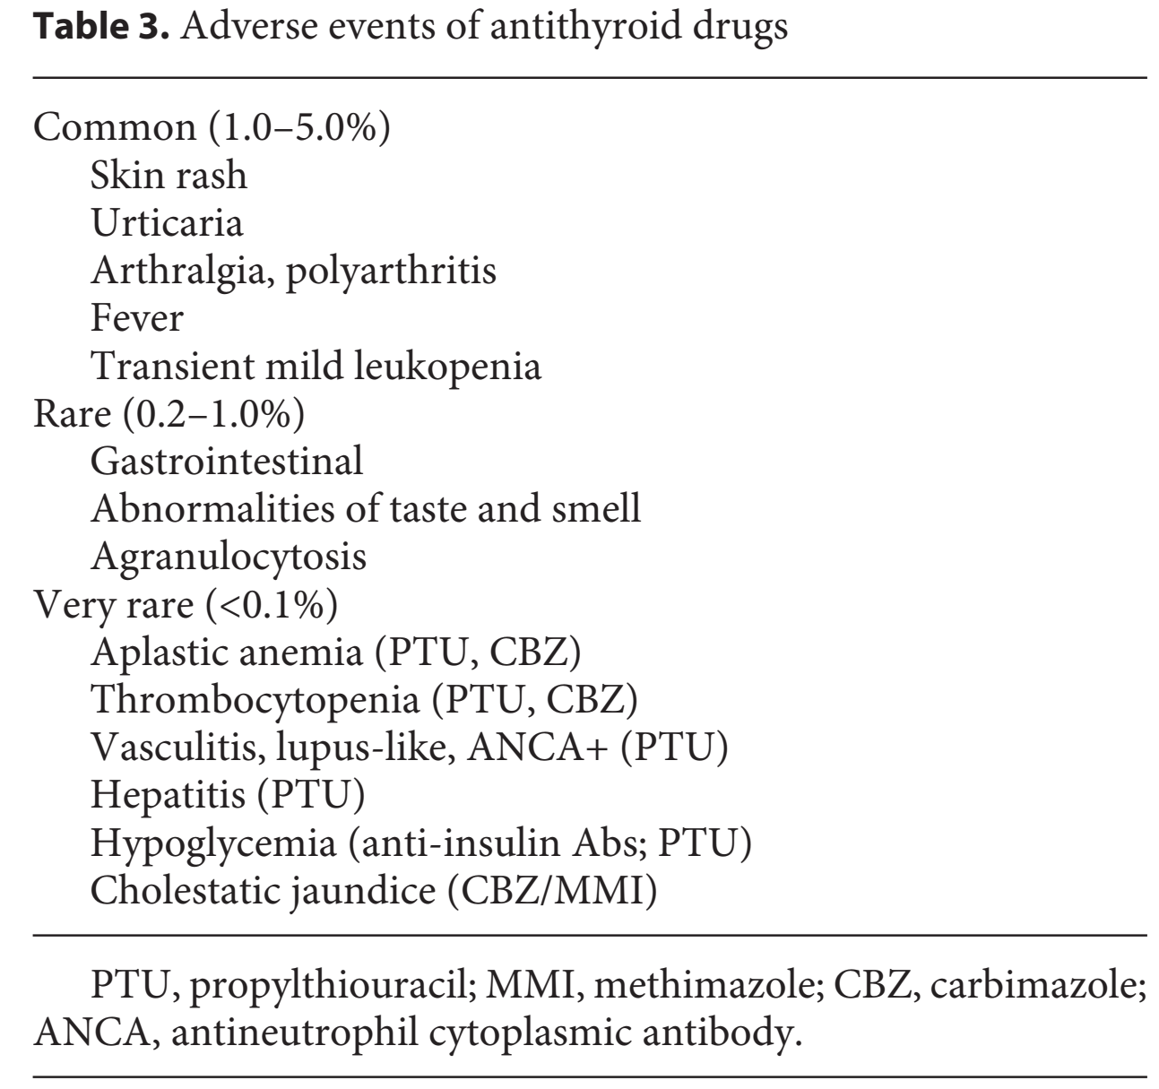
Adverse Events
Common side effects of ATD are rash, urticaria, and arthralgia (1–5%).
Minor cutaneous reactions are managed with concurrent antihistamine therapy without stopping the ATD.
These may resolve spontaneously or after substituting an alternative ATD.
In the case of a serious allergic reaction, prescribing the alternative drug is not recommended.

Slide 24
Adverse Events
Rare but major side effects include hepatitis, a lupus-like syndrome, and agranulocytosis (neutrophil count <500/mL), which occurs in 0.1–1.0% of cases.
Agranulocytosis tend to occur abruptly within 3 months after the initiation of ATD therapy. MMI (CBZ) and PTU exert dissimilar incidence rates of hepatotoxicity.
PTU-associated hepatotoxicity occurs foremost in children in contrast to that associated with MMI, which is usually milder with a cholestatic pattern.
ATD are stopped and not restarted if a patient develops major side effects. Patients should be given written instructions regarding the symptoms of possible agranulocytosis (e.g., sore throat, fever, mouth ulcers) and the need to stop treatment pending a complete blood count.
The use of routine hematological and liver function tests is not useful, as the onset of agranulocytosis is abrupt

Slide 25
Adverse Events: Recommendations
Patients should be informed of potential side effects of ATD and the necessity of informing the physician promptly if they should develop jaundice, light-colored stools, dark urine, fever, pharyngitis, or cystitis.
In patients taking ATD, a differential white blood cell count should be obtained during febrile illness and/or pharyngitis, and liver function should be assessed in those who experience jaundice, light-colored stools, or dark urine.

Slide 26
Beta-Adrenergic Blockade
Propranolol (20–40 mg every 6 h) or longer acting beta-blockers (i.e., atenolol/bisoprolol), are useful to control adrenergic symptoms such as palpitations and tremor, especially in the early stages before ATD take effect.
High doses of propranolol (40 mg 4 times daily) inhibit peripheral conversion of T4 to T3. Cardioselective betablockers with higher cardioprotective effects and superior prevention of atrial fibrillation represent an alternative choice, especially for patients with asthma.
Anticoagulation with warfarin or direct oral anticoagulants should be considered in all patients with atrial fibrillation.
If digoxin is used, increased doses are often needed in the thyrotoxic state

Slide 27
Beta-Adrenergic Blockade: Recommendations
Beta-adrenergic blockade is recommended in all suitable patients with Graves’ hyperthyroidism.

Slide 28
Relapse after a Course of ATD Treatment
Orbitopathy, smoking, thyroid volume, free T4, total T3, and TSH-R-Ab were significantly associated with relapse.
Lower age, higher serum TSH-R-Ab and free T4, larger goiters at diagnosis, PTPN22 C/T polymorphism, and HLA subtypes DQB1*02, DQA1*05, and DRB1*03 were independent predictors for recurrence.
On the other hand, the benefits of long-term ATD treatment after recurrence were shown in patients with GD relapse after the discontinuation of ATD therapy for 12–24 months.
Either RAI treatment and L-T4 replacement or MMI (2.5–7 mg/daily) were used. No notable side effects were observed.
Thus, low MMI doses were efficient, safe, and offered better outcomes for GO than RAI treatment.

Slide 29
Relapse after a Course of ATD Treatment: Recommendations
If a patient with GD becomes hyperthyroid after completing a first course of ATD, definitive treatment with RAI or thyroidectomy is recommended. Continued long-term low-dose MMI can be considered in patients not in remission who prefer this approach.

Slide 30
Subclinical Graves’ Hyperthyroidism
In addition, in the presence of TSH-R-Ab indicating “subclinical” GD, the rate of progression to overt hyperthyroidism is up to 30% in the subsequent 3 years.
Therefore, despite the absence of randomized trials, treatment is indicated in patients older than 65 years with a TSH that is persistently <0.1 mIU/L to potentially avoid these serious adverse events and the risk of progression to overt hyperthyroidism.
Treatment might be considered in patients older than 65 years with TSH levels of 0.1–0.39 mIU/L because of their increased risk of atrial fibrillation, and might also be reasonable in younger (<65 years) symptomatic patients with TSH <0.1 mIU/L because of the risk of progression, especially in the presence of risk factors or comorbidity.

Slide 31
Subclinical Graves’ Hyperthyroidism: Recommendations
Treatment of SH is recommended in Graves’ patients >65 years with serum TSH levels that are persistently <0.1 mIU/L.
15 ATD should be the first choice of treatment of Graves’ SH.

Slide 32
Thyroid Storm
With a mortality rate estimated at 10%, the life-threatening thyroid storm demands a rapid diagnosis and emergency treatment.
The condition manifests as decompensation of multiple organs with impaired consciousness, high fever, heart failure, diarrhea, and jaundice.
Diagnostic criteria for thyroid storm in patients with severe Graves’ thyrotoxicosis include hyperpyrexia, tachycardia, arrhythmia, congestive heart failure, agitation, delirium, psychosis, stupor, coma, nausea, vomiting, diarrhea, hepatic failure, and the presence of an identified precipitant.
The “Burch-Wartofsky Point Scale” system grades the severity of individual manifestations, with a point total of ≥45 consistent with thyroid storm, 25–44 points classified as impending thyroid storm, and <25 points indicating that thyroid storm as unlikely.

Slide 33
Thyroid Storm
Nationwide surveys in Japan have revealed the high morbidity and mortality rates of this condition and have subsequently offered a multimodality treatment, including intravenous MMI or PTU (40 or 400 mg every 8 h), glucocorticoids (methylprednisolone 50 mg i.v.), beta-blockers (propranolol 40 mg every 6 h), and monitoring in an intensive care unit.
The most common cause of death from thyroid storm was multiple organ failure, followed by heart and respiratory failure, arrhythmia, disseminated intravascular coagulation, gastrointestinal perforation, hypoxic brain syndrome, and sepsis

Slide 34
Thyroid Storm: Recommendations
A multimodality treatment approach to GD patients with thyroid storm should be used, including ATD therapy, glucocorticoid administration, beta-adrenergic blockade, cooling blankets, volume resuscitation, nutritional support, respiratory care, and monitoring in an intensive care unit.

Slide 35
RAI Treatment
The cellular effect of the ionizing radiation leads to genetic damage, mutations, or cell death.
The DNA damage from radiation is mediated via a combination of direct effects, through breakage of molecular bonds, or indirectly through the formation of free radicals.
This leads to a decrease in thyroid function and/or reduction in thyroid size.
There are neither good measures of individual radiosensitivity nor ideal methods of predicting the clinical response to RAI therapy.

Slide 36
Indications and Applied RAI Dose
Patients with side-effects to or recurrence after a course of ATD, cardiac arrhythmias, and thyrotoxic periodic paralysis are candidates for RAI. Only one study has compared the ATD, surgery, and RAI head-to-head.
In that randomized study, the risk of relapse was highest after ATD, but there were no significant differences in sick leave or satisfaction with the therapy.
RAI is contraindicated in pregnancy and during breast feeding, and conception should be postponed until at least 6 months after the therapy.

Slide 37
Indications and Applied RAI Dose
There is no evidence of detrimental effects on long-term fertility, miscarriage, stillbirths, or congenital defects in the offspring.
The same 6-month period applies for males.

Slide 38
Effect on Thyroid Function and Size
Thyroid function is normalized within 3–12 months after RAI therapy in 50–90% of patients.
The patient should be informed that repeated doses of RAI may be needed. The incidence rate of hypothyroidism is 5–50% after the first year, and is positively associated with the thyroid RAI dose.
This is followed by a yearly hypothyroidism rate of 3–5%, which is largely independent of the RAI dose. Even with low-dose RAI, which increases persistent/recurrent disease, hypothyroidism is inevitable.
Thyroid size is normalized within a year of RAI.
RAI is not contraindicated in large goiters, even if partially retrosternal or intrathoracic. ATD should be temporarily paused for a week before and after RAI therapy

Slide 39
Adverse Effects of RAI Therapy
There may be thyroid pain, swelling, and sialoadenitis.
GD is associated with increased morbidity and mortality.
Its treatment decreases mortality, while RAI per se does not increase mortality.
There is neither evidence of increased thyroid cancer nor total cancer mortality following RAI therapy.
Transient hyperthyroidism can be prevented by pre-RAI ATD treatment, but only if ATD are resumed post-RAI.

Slide 40
Adverse Effects of RAI Therapy
Post therapy flare-up relates to high TSH-R-Ab levels.
It is difficult to differentiate between treatment failure and transient hyperthyroidism.
However, if thyrotoxicosis has not improved after 3 months, treatment failure is likely.
Transient hypothyroidism is seen in 3–20% of cases and does not invariably lead to permanent hypothyroidism, but treatment with TH is generally recommended to avoid the development of or a flare-up of GO.
De novo or flare-up of GO is seen in 15–33% of cases after RAI therapy.
Prophylactic glucocorticoids prevent this without influencing the ultimate outcome of thyroid function

Slide 41
RAI Treatment: Recommendations
There are no absolute indications for RAI therapy, but it is often recommended for patients with side-effects to or recurrence after a course of ATD.
Verbal as well as written information on all aspects of efficacy and potential side-effects of RAI therapy should be provided.
If ATD are used before RAI therapy they should be paused around 1 week before and after therapy in order not to decrease the efficacy of RAI therapy.

Slide 42
RAI Treatment: Recommendations
No dose calculation can secure long-term euthyroidism and it is fully acceptable to offer a fixed dose of RAI.
Pregnancy and breast feeding constitute absolute contraindications to RAI therapy.
Conception should be postponed until at least 6 months after RAI in both males and females.
If used in children, ablative doses aiming at rapid hypothyroidism should be administered.

Slide 43
Surgery
Thyroidectomy is the least commonly selected treatment for newly diagnosed Graves’ hyperthyroidism.
However, thyroidectomy is an effective treatment when goiter is large, there is coincident primary hyperparathyroidism or suspicion of malignant nodules, the patient wishes to avoid exposure to ATD or RAI, or facilities for RAI treatment are not available.
Advantages of thyroidectomy include the absence of radiation risk, the rapid control of hyperthyroidism, and the usual absence of detrimental effects on GO (Table 4).

Slide 44
Surgery
However, thyroidectomy is a high-cost procedure requiring hospitalization, it bears an anesthetic and surgical risk, a permanent scar is left, and there may be complications. Similar to RAI, long-term L-T4 replacement therapy is required to maintain euthyroidism.

Slide 45
Surgery
If surgery is selected, total thyroidectomy is the procedure of choice, because it bears the same risk of complications as bilateral subtotal thyroidectomy, while the rate of recurrent hyperthyroidism is lower.
Whether thyroidectomy is more effective than RAI as a definitive treatment preventing relapses of hyperthyroidism is a matter of debate due to conflicting results of two systematic reviews – favoring thyroidectomy, or showing no significant differences between the two treatments.
To minimize the risk of complications (hypoparathyroidism, laryngeal nerve palsy, wound infection, hemorrhage), surgery should be performed by a skilled highvolume surgeon.
To minimize the risk of intra- or postoperative exacerbation of thyrotoxicosis, hyperthyroidism should be adequately controlled by ATD treatment prior to surgery.

Slide 46
Surgery
The use of a saturated solution of potassium iodide (SSKI) is helpful in the immediate preoperative period (10 days) to decrease thyroid vascularity and intraoperative blood loss.
However, this preparation is used by less than 40% of thyroidologists. When thyroidectomy must be performed before an adequate control of hyperthyroidism is achieved, in addition to ATD, beta-blockers, glucocorticoids, and eventually SSKI may be helpful.
Vitamin D deficiency should be corrected prior to surgery to reduce the risk of postoperative hypocalcemia.

Slide 47
Surgery: Recommendations
If surgery is selected, total thyroidectomy is the procedure of choice, and should be performed by a skilled surgeon with high annual volumes of thyroidectomies.
Euthyroidism should be restored by ATD prior to surgery to avoid peri- or postoperative exacerbation of
thyrotoxicosis.
Vitamin D deficiency should be corrected to reduce the postoperative risk of hypocalcemia.
A solution containing potassium iodide can be given for 10 days prior to surgery. .

Slide 48
Treatment of Graves’ Hyperthyroidism in Patients with Orbitopathy
Thyroid dysfunction, both hyper- and hypothyroidism, can influence the course of GO. Prompt restoration and stable maintenance of euthyroidism are priorities in patients with GO.
How to manage hyperthyroidism when GO is present is,
however, a challenging dilemma.

Slide 49
Treatment of Graves’ Hyperthyroidism in Patients with Orbitopathy
ATD per se do not influence the natural course of GO, but might be beneficial for GO indirectly, as a consequence of the restoration of euthyroidism.
Hypothyroidism can also cause the progression of GO. RAI causes the progression or de novo occurrence of GO, particularly in smokers, those with preexisting and recent-onset GO, late correction of post-RAI hypothyroidism, and high TSH-RAb levels.
In patients at risk of RAI-associated GO occurrence or progression, oral low-dose steroid prophylaxis is effective, as shown by two RCTs and two meta-analyses.
Steroid prophylaxis can be avoided in patients with absent or inactive GO if other risk factors for RAI-associated progression of GO are absent. Thyroidectomy does not seem to impact the natural history of GO

Slide 50
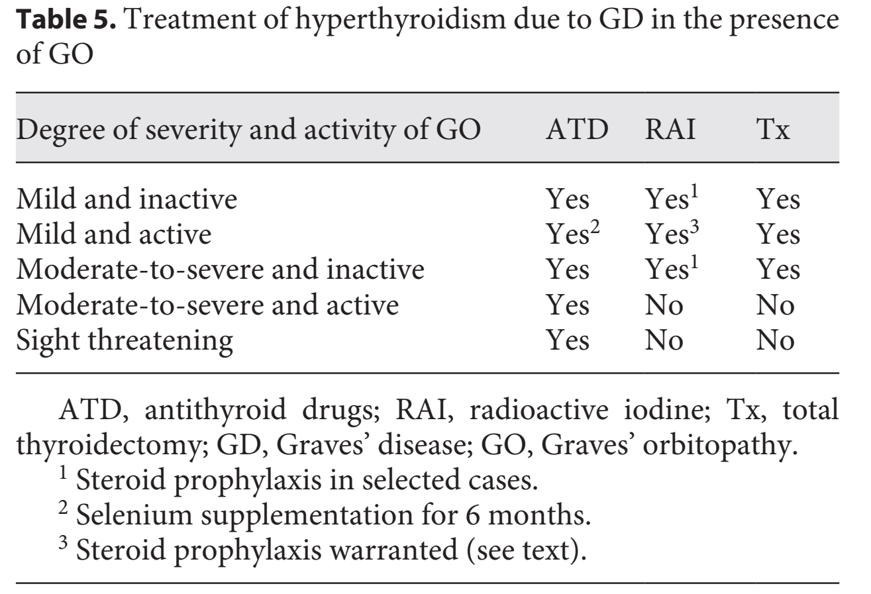
Treatment of Graves’ Hyperthyroidism in Patients with Orbitopathy

Slide 51
Mild and Inactive
Treatment for hyperthyroidism is unlikely to cause ocular changes and, therefore, is chosen irrespective of GO.
If RAI treatment is selected, steroid prophylaxis is not indicated unless other risk factors for GO progression exist.
Rehabilitative surgery may be required for cosmetic or functional reasons.

Slide 52
Mild and Active GO
Treatment of hyperthyroidism is mostly independent of GO and relies on established criteria.
There is no RCT evidence that the long-term outcome of GO of this degree is better using ATD than definitive treatment.
Steroid prophylaxis is indicated if RAI treatment is employed.
If ATD treatment is chosen, a 6-month selenium supplementation improves mild and active GO and prevents its progression to more severe forms.

Slide 53
Moderate-to-Severe
and Inactive GO
The choice of thyroid treatment is mostly independent of GO.
If RAI is selected, steroid prophylaxis can be avoided if other risk factors for GO reactivation are absent.
and Active GO
Rapid correction of hyperthyroidism with ATD and stable maintenance of euthyroidism are, per se, beneficial for GO and therefore strongly recommended.
Thyroid ablation has been alternatively advocated.
Prompt therapy for GO is warranted.

Slide 54
Sight-Threatening GO
Sight-threatening GO is an endocrine emergency because of the risk of sight loss due to dysthyroid optic neuropathy and/or corneal breakdown.
Hyperthyroidism must be treated with ATD and immediate treatment with high-dose intravenous steroids is imperative with subsequent orbital decompression if response to steroids is inadequate within 2–4 weeks.

Slide 55
Patients with Orbitopathy: Recommendations
In patients with GO, hyperthyroidism should be promptly controlled by ATD, and euthyroidism stably maintained.
Patients treated with RAI should receive steroid prophylaxis if mild and active GO preexists or there are risk factors for RAI-associated GO occurrence or progression.

Slide 56
Patients with Orbitopathy: Recommendations
In patients with moderate-to-severe and active GO, treatment of GO should be the priority. Euthyroidism should be promptly restored with ATD and stably maintained.
Patients with sight-threatening GO should be treated with ATD.
Treatment for hyperthyroidism in patients with inactive GO can be selected independently of GO.

Slide 57
Pregnancy and Postpartum
The choice of therapy depends on the patient’s preference, disease history, the presence of high TSH-R-Ab levels, and the timescale for conception

Slide 58
Women Planning Pregnancy
Pregnancy should be postponed if hyperthyroidism is inadequately controlled until euthyroidism is reached and confirmed on two occasions over 2 months on a stable therapeutic regimen. Patients should be informed about:
the increased risk of ATD-associated birth defects;
the possibility of stopping ATD during gestational weeks 6–10;
the preference for PTU, when ATD are necessary before/during the first trimester of pregnancy;
(4) the advice to switch from PTU to MMI after 16 weeks of pregnancy;
(5) not to use block-replacement therapy.
Pregnancy should be delayed for 6 months post-RAI, and contraception is advised during that period.
Thyroidectomy is indicated in the case of contraindications/rejection of ATD/RAI.
After surgery, euthyroidism should be confirmed prior to conception.

Slide 59
Women Planning Pregnancy: Recommendations
Women with GD of reproductive age should be offered preconception counseling and be stably euthyroid before attempting pregnancy.
Women with GD should be instructed to immediately confirm pregnancy and contact their physician.
Women treated with MMI should be switched to PTU when planning pregnancy and/or during the first trimester of pregnancy.

Slide 60
Pregnant Women and GD
The initial ATD daily dose depends on the severity of hyperthyroidism: MMI 5–15 mg, CBZ 10–30 mg, PTU 50–200 mg.
MMI (CBZ) embryopathy, including dysmorphic facies, aplasia cutis, choanal or esophageal atresia, abdominal wall defects, umbilicocele, and ventricular septal defects, affects 2–4% of children who have been exposed to MMI, especially during gestational weeks 6–10.
The prevalence of birth defects is the same with PTU, but the spectrum of defects is less severe, primarily consisting of face and neck cysts and urinary tract abnormalities in males.

Slide 61
Pregnant Women and GD
Propranolol 10–40 mg, 3–4 times daily may be used; however, long-term treatment should be avoided since beta-blockers may cause intrauterine growth restriction, fetal bradycardia, and neonatal hypoglycemia.
Thyroidectomy may be indicated in the case of allergy/contraindications to ATD and should be performed in the second trimester of pregnancy.
Only 5% of TSH-R-Ab-negative patients relapse within 8 weeks after ATD withdrawal.

Slide 62
Pregnant Women and GD
Therefore, when pregnancy is determined and remission is probable, ATD can be withdrawn and thyroid function monitored every 2 weeks during the first trimester of pregnancy.
If the pregnant woman remains euthyroid, thyroid function is monitored every 4 weeks during the second/third trimester.
A treatment period of less than 6 months, a high daily ATD dose, high levels of TSH-R-Ab, low/suppressed serum TSH levels while on medication, and the presence of GO increased the recurrence risk after ATD withdrawal.
Maternal FT4 (or TT4) values should be maintained at the upper limit of the pregnancy-specific thyroid function tests.

Slide 63
Pregnant Women and GD
During the third trimester, discontinuation of ATD is often feasible due to the disappearance of maternal TSH-R-Ab.
In contrast, monitoring for the onset of neonatal dysthyroidism is indicated in the presence of high TSH-R-Ab serum levels (>3 times the cut-off) in the mother in late pregnancy.
In line with this and as a strong recommendation, all patients with a history of autoimmune thyroid disease should have their TSH-R-Ab serum levels measured at the first presentation of pregnancy using either a sensitive binding or a functional cell-based bioassay, and, if they are elevated, again at 18–22 weeks of gestation.
Finally, fetal/neonatal hyperthyroidism requires an acute management, including MMI, beta-blockade, and cardiovascular support therapy

Slide 64
Pregnant Women and GD: Recommendations
All patients with a history of autoimmune thyroid disease should have their TSH-R-Ab serum levels measured at the first presentation of pregnancy using either a sensitive binding or a functional cell-based bioassay and, if they are elevated, again at 18–22 weeks of gestation.
If the maternal TSH-R-Ab concentration remains high (>3 times the cut-off), monitoring of the fetus for thyroid dysfunction throughout pregnancy is recommended.

Slide 65
Pregnant Women and GD: Recommendations
During pregnancy the lowest possible dose of ATD should be given and the block-and-replace ATD regimen is discouraged.
Maternal FT4 (TT4) and TSH should be measured every 2 weeks after the initiation of therapy, and every 4 weeks after achieving the target value.
A change from PTU to MMI should be considered if ATD are required after 16 weeks gestation.
In women on a low dose of MMI (<5–10 mg/day) or PTU (<50–100 mg/day), ATD may be stopped during gestation prior to weeks 6–10.

Slide 66
Postpartum Phase
The risk of GD recurrence was highest 7–9 months postpartum (RR 3.8) in studies conducted in Denmark and Japan.
Only small amounts of ATD enter into breast milk, and low doses of PTU (<250 mg) and MMI (<20 mg) are considered safe for the mother and child.
ATD should be taken after having breastfed the child and in divided doses

Slide 67
Pregnant Women and GD: Recommendations
Lactating women with GD should be offered the same treatments as non-lactating women.
MMI is recommended during lactation, given the concerns about PTU-mediated hepatotoxicity.

Slide 68
The Elderly, Children and Adolescents, and Immune Reconstitution

Slide 69
Elderly
Although the incidence of GD decreases with advancing age, cases may still occur in patients in their 8th and 9th decades of life.
A typical presentation with weight loss, tremor, agitation, and heat intolerance can occur; however, older individuals sometimes present with subtle symptoms such as fatigue, mood disturbance, or breathlessness (termed “apathetic thyrotoxicosis”).
Dramatic presentations with atrial fibrillation, congestive cardiac failure, or ischemic acute coronary syndrome are also more frequent in older people.
Treatment for those with severe thyrotoxicosis should be along similar lines to that in younger people, with an initial course of ATD to render the patient euthyroid, along with beta-blockers if appropriate.

Slide 70
Elderly
If there is atrial fibrillation or other tachyarrhythmia or cardiac compromise, it is good practice to proceed to early definitive therapy, normally with RAI, to prevent any further heart complication from recurrent hyperthyroidism.
In older or frail patients with milder hyperthyroidism and without cardiac compromise, long-term low-dose MMI (CBZ) 2.5–5 mg daily is an effective and well-tolerated treatment, especially when there is no access to RAI and/or contraindication to thyroidectomy.
Older patients are more likely to suffer severe consequences from ATD-induced agranulocytosis, and it is important to be meticulous in warning people about this issue, and providing written information to family or caregivers in the case of cognitive impairment.
In addition, older patients have a higher chance of developing GO, so should be carefully assessed for this: where relevant, smoking cessation advice should be given and treatment-related hypothyroidism should be assiduously avoided.

Slide 71
Elderly: Recommendations
Older patients who have had atrial fibrillation, cardiac failure, or cardiac ischemic symptoms precipitated by hyperthyroidism should undergo definitive therapy, usually RAI.
Long-term MMI (CBZ) should be considered as a satisfactory treatment for older individuals with mild GD.

Slide 72
Childhood and Adolescence
Children and teenagers frequently present late with GD and in retrospect features such as impaired educational performance, change in behavior, anxiety, or sleep disturbance may have been present for years before the cause is recognized.
Importantly, the diagnosis is easily overlooked in teenage girls with weight loss who are assumed to have an eating disorder.
The outcome of ATD treatment of younger people with GD is disappointing, as compared to the results in adults.
Remission rates following 2 or more years of ATD therapy do not exceed 25% and this necessitates longer-term ATD administration in most children.

Slide 73
Childhood and Adolescence
Furthermore, there is a higher prevalence of adverse reactions to ATD in children and this means that PTU is no longer recommended for use in childhood, owing to hepatic failure in up to 1 in 2,000 children exposed.
If children develop adverse reactions while taking ATD, early surgery with total thyroidectomy is generally recommended.
Over recent years, more confidence has been gained about the safety of RAI, particularly in postpubertal younger people.
Thus, long-term low-dose MMI (CBZ) followed, if necessary, by surgery or RAI when the child reaches a suitable age (16 years or older) is frequently the sequence of therapy in this age group.
Any episode of hyperthyroidism or hypothyroidism (as a consequence of treatment), will likely have an effect on educational progress, and this factor should be taken into account in all decision making.

Slide 74
Childhood and Adolescence: Recommendations
PTU should be avoided in children and adolescents.
47 Long-term MMI (CBZ) should be the mainstay of treatment in children with GD.
48 Thyroidectomy is the primary definitive therapy in childhood, but in postpubertal children RAI can be considered.

Slide 75
Immune Reconstitution
The first demonstration of immune reconstitution GD was in multiple sclerosis patients who had received lymphocyte-depleting alemtuzumab (Campath-H1)
antibody treatment.
This treatment causes initial lymphopenia, but 12–24 months later 20–30% of patients developed TSH-R-Ab-positive GD, as lymphocyte populations recover.
A similar pattern of GD has been observed in patients with HIV who have received effective highly active antiretroviral therapy, with hyperthyroidism developing as CD4 lymphocyte counts increase.
Immune reconstitution GD has also been observed in bone marrow transplant patients. In most cases, the hyperthyroidism is manageable and, depending on the underlying condition, it is not an indication to discontinue the immunomodulatory therapy that precipitated it.

Slide 76
Immune Reconstitution
Although initial reports suggested that definitive therapy was warranted in these patients, additional experience now suggests that they can be managed similarly to patients with “spontaneous” GD.
However, as the immunological “insult” may be transient in these cases, a reasonable approach is to treat with ATD until circulating TSH-R-Ab become undetectable.

Slide 77
Immune Reconstitution: Recommendations
Graves’ hyperthyroidism precipitated by an immunomodulatory therapy is not a mandatory indication to stop that precipitating treatment, nor is it a mandatory indication for definitive therapy for hyperthyroidism.
Sequential monitoring of serum TSH-R-Ab levels can be used to guide the duration of ATD therapy in patients with immune reconstitution GD.

Slide 78
THANK YOU!

