Slide 1
Fert ster VOL. 110 NO. 3 / AUGUST 2018

Slide 9
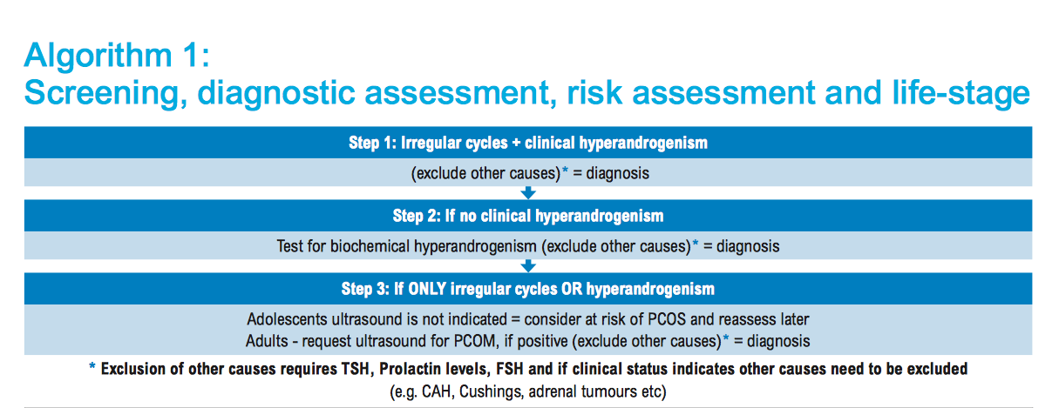

Slide 15
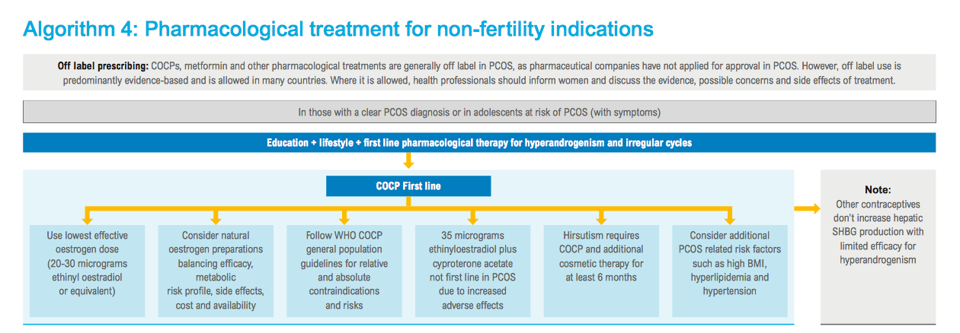

Slide 59
our present results stress that a putative deterioration of the metabolic cardiovas-cular risk profile of PCOS patients during administration of Diane35 is not supported by current scientific evidence and therefore should not be weighed against the use of this drug in any treatment decision making.

