Slide 3
Charcot Foot
Clinical Clues, Diagnostic Strategies, and Treatment Principles
Bijan Iraj,MD
Assistant Professor of Internal Medicine and Endocrinology
Department of Endocrinology and Metabolism
Isfahan Medical School

Slide 4
Acute Charcot neuroarthropathy of the foot
and ankle is often difficult to diagnose
because of limited findings in the patient
history, physical examination, imaging, and
laboratory studies.

Slide 5
Delay in treatment results in the development of rigid foot and ankle deformities, increasing the risk of ulceration, infection, and major lower extremity amputation.

Slide 6
Charcot neuroarthropathy of the foot and ankle is an inflammatory condition affecting the periarticular soft tissues and bone in persons with peripheral neuropathy, resulting in osseous subluxation, dislocation, and fracture, if the lower extremity is not immobilized.

Slide 7
One in four cases of acute Charcot foot is misdiagnosed, most often as cellulitis, gout, deep venous thrombosis, or a minor sprain, which delays diagnosis by an average of seven months.

Slide 8
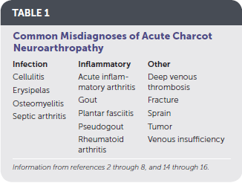

Slide 9
Without prompt treatment, the condition often results in development of rigid foot deformities (i.e., the classic rocker-bottom foot , increasing the risk of major lower extremity amputation by 15- to 40-fold.

Slide 10
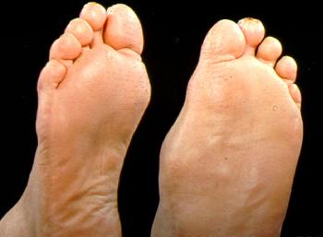

Slide 11
History

Slide 12
History
The diagnosis of acute Charcot neuroarthropathy should be considered in any patient 40 years or older with obesity and peripheral neuropathy who presents with a unilateral swollen limb and minimal or no associated pain.

Slide 13
History
Diabetes mellitus is the most common cause of peripheral neuropathy in the United States. The lifetime prevalence of Charcot neuroarthropathy in patients with diabetes ranges from 0.1% to 10%, increasing to 29% to 35% if peripheral neuropathy is present

Slide 14
History
Patients with type 1 diabetes also tend to be less obese and more prone to recurrent events of Charcot neuroarthropathy than patients with type 2 diabetes. An A1C level greater than 9% is associated with a 30% increased risk of developing Charcot neuroarthropathy.

Slide 15
History
Misdiagnosis of acute Charcot neuroarthropathy may occur when it presents in patients who have peripheral neuropathy from etiologies other than diabetes, such as alcoholism, use of chemotherapeutic agents, inherited disorders, or trauma.

Slide 16
History
Other factors that increase the risk of acute Charcot neuroarthropathy include a history of foot ulceration; retinopathy; nephropathy, renal failure, or renal transplantation; rheumatoid arthritis; iron deficiency anemia; or obesity.

Slide 17
History
Between 25% and 50% of patients recall no trauma or inciting event, and the same number do not report pain. If an inciting event is recalled, it is often minor, such as walking a long distance or sustaining a minor sprain.

Slide 18
History
Patients who recall an inciting event are more likely to report pain, often described as a constant discomfort not severe enough to stop ambulation.

Slide 19
History
Patients with these findings may have been previously treated for cellulitis. Acute Charcot foot should be considered in patients with recurrent cellulitis but no systemic or laboratory findings concerning for infection. Antibiotic therapy does not resolve symptoms, which may have led to previous hospital admission.

Slide 20
History
Symptom resolution may occur during hospitalization because patients spend more time in bed; however, symptoms may return after discharge when patients are ambulatory, which may lead to a misdiagnosis of recurrent cellulitis.

Slide 21
History
Although acute Charcot neuroarthropathy can coexist with cellulitis, osteomyelitis, or open wounds of the lower extremity, the latter two are more common with recurrent episodes.

Slide 22
Physical Examination and Laboratory Studies:

Slide 23
Physical Examination and Laboratory Studies:
Patients with acute Charcot neuroarthropathy are usually afebrile with normal vital signs. More than 70% of the time, patients have unilateral lower extremity edema with associated erythema and increased warmth (2°C to 8°C) with no open wound.

Slide 24
Physical Examination
Peripheral neuropathy can be confirmed with use of a Semmes-Weinstein monofilament test. Deep tendon reflexes are also severely impaired, particularly the Achilles tendon reflex.

Slide 25
Physical Examination
Lower extremity edema extends down to the foot, which is particularly swollen around the affected joints.

Slide 27
Physical Examination
Pedal pulses are most often palpable and can be described as bounding if unobscured by edema.
The increase in skin temperature can assist in diagnosis and resolution of the Charcot process.

Slide 28
Physical Examination
Erythema secondary to the inflammation of acute Charcot neuroarthropathy can be differentiated from infection by elevating the affected extremity above the level of the heart for five to 10 minutes.

Slide 29
Physical Examination
Erythema secondary to acute Charcot neuroarthropathy will dissipate, whereas erythema from infection will not.
Brodsky JW. Outpatient diagnosis and care of the diabetic foot. Instr Course Lect. 1993;42:121-139.

Slide 30
Laboratory Studies:
Laboratory markers of infection, such as white blood cell count, C-reactive protein level, and erythrocyte sedimentation rate, are usually normal.

Slide 31
Imaging Studies

Slide 32
VENOUS DUPLEX ULTRASONOGRAPHY
Venous duplex ultrasonography may be performed when deep venous thrombosis is suspected. Results should be normal in acute Charcot neuroarthropathy.

Slide 33
RADIOGRAPHY
The characteristic bony destruction of Charcot neuroarthropathy can take six to 12 months to become visible on radiography, initial imaging serves as a baseline and allows for detection of subtle changes denoting instability. Subtle subluxations and small flecks of bone secondary to ligamentous avulsion fractures may be present, signaling instability and impending osseous destruction.

Slide 34
RADIOGRAPHY
More than 60% of all Charcot neuroarthropathy events affect the midfoot. Osseous overlap in the midfoot can make subtle subluxations and minimally displaced fractures difficult to visualize.

Slide 35
RADIOGRAPHY
Bilateral weight-bearing radiography is recommended for comparison of both feet.

Slide 36
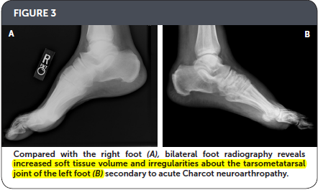

Slide 37
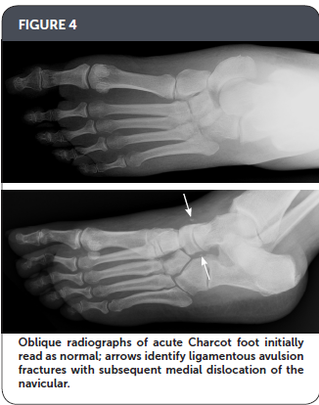

Slide 38
MAGNETIC RESONANCE IMAGING
Bone marrow edema , adjacent soft tissue edema, joint effusion, and microtrabecular or stress fractures when radiography results are normal.

Slide 39
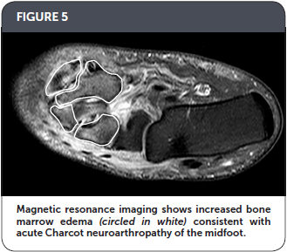

Slide 40
MRI
Performing MRI is recommended when radiography results are inconclusive and patients exhibit key clinical elements outlined in Table 2.

Slide 41
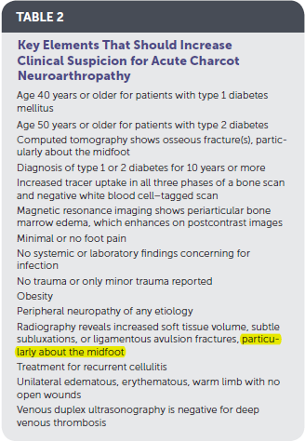

Slide 42
Key Elements That Should Increase Clinical Suspicion for Acute Charcot Neuroarthropathy :
Age 40 years or older for patients with type 1 diabetes mellitus
Age 50 years or older for patients with type 2 diabetes
Computed tomography shows osseous fracture(s), particularly about the midfoot
Diagnosis of type 1 or 2 diabetes for 10 years or more
Increased tracer uptake in all three phases of a bone scan and negative white blood cell–tagged scan
Magnetic resonance imaging shows periarticular bone marrow edema, which enhances on postcontrast images
Minimal or no foot pain

Slide 43
No systemic or laboratory findings concerning for infection
No trauma or only minor trauma reported
Obesity
Peripheral neuropathy of any etiology
Radiography reveals increased soft tissue volume, subtle subluxations, or ligamentous avulsion fractures, particularly about the midfoot
Treatment for recurrent cellulitis
Unilateral edematous, erythematous, warm limb with no open wounds
Venous duplex ultrasonography is negative for deep venous thrombosis

Slide 44
COMPUTED TOMOGRAPHY
Computed tomography is useful for visualizing all bones of the foot, particularly the midfoot, which is difficult to see well on radiography. It is recommended when MRI is contraindicated for the patient.

Slide 45
BONE SCANS
Increased tracer uptake to the affected joint occurs in all three phases of a bone scan when acute Charcot neuroarthropathy is present.
White blood cell–tagged scans are often negative.

Slide 46
BONE SCANS
There is limited literature available on the aid of nuclear bone scanning in the diagnosis of acute Charcot neuroarthropathy. Because of the nonspecific nature of the study, radiography and MRI are recommended over nuclear medicine studies.

Slide 47
Treatment:
IMMOBILIZATION
SURGERY
BISPHOSPHONATES
INTRANASAL CALCITONIN

Slide 48
IMMOBILIZATION
The mainstay of treatment of Charcot neuroarthropathy is immobilization in a total contact cast, which increases the total surface area of contact to the entire lower extremity, distributing pressure away from the foot.

Slide 49
IMMOBILIZATION
Immobilization should continue until lower extremity edema and warmth resolve and serial radiography shows evidence of osseous consolidation, which typically occurs after three to four months but can take up to 12 months.

Slide 50
IMMOBILIZATION
Computed tomography and MRI may also be used to determine resolution. Bone scanning is not recommended for determining resolution because osseous remodeling can continue for up to one year, resulting in prolonged increased uptake in the affected area due to remodeling.

Slide 51
IMMOBILIZATION
Removable walking boots and braces that incorporate the entire lower leg have also been used and are better tolerated by patients than cast immobilization, in addition to reducing the risk of iatrogenic complications that can occur with casting. However, these removable devices require a longer duration of immobilization.

Slide 52
IMMOBILIZATION
A study that followed 71 cases (59 patients) of acute Charcot neuroarthropathy over 12 years concluded that radiography was insufficient in diagnosing midfoot fractures; that any bone marrow edema present on MRI was likely to progress to cortical fracture if unprotected ambulation was allowed; and that cortical fractures were a significant marker for impending deformity development

Slide 53
SURGERY
surgery may be indicated in the acute phase of Charcot neuroarthropathy in cases of severe dislocation or instability, if there is concern for skin breakdown, or if conservative treatment fails to obtain a stable, plantigrade foot.

Slide 54
BISPHOSPHONATES
A systematic review of 10 small heterogeneous studies concluded that the adjunctive use of bisphosphonates during conservative management of acute Charcot neuroarthropathy was not effective.

Slide 55
INTRANASAL CALCITONIN
A single randomized controlled trial of 32 patients with acute Charcot neuroarthropathy who were treated with cast immobilization and oral calcium supplementation compared 200 IU of intranasal calcitonin salmon daily with no adjunctive therapy.

Slide 56
INTRANASAL CALCITONIN
A significantly greater reduction in markers of bone turnover in the intervention group was noted at three and six months, suggesting that daily intranasal calcitonin may be an effective adjunctive treatment.However, no studies of calcitonin have reported patient-oriented outcomes.

Slide 57
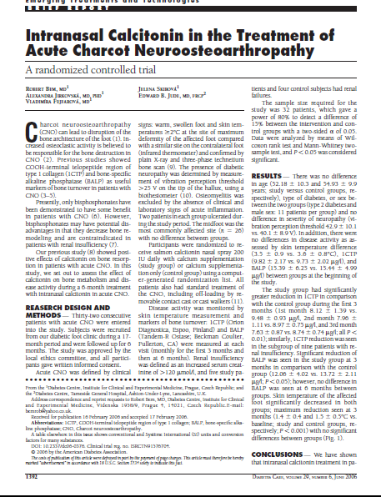

Slide 58
Intranasal Calcitonin in the Treatment of
Acute Charcot Neuroosteoarthropathy
DIABETES CARE, VOLUME 29, NUMBER 6, JUNE 2006

Slide 59
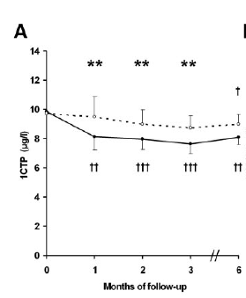

Slide 60
