Slide 1
X-linked Hypophosphatemic Rickets and its Treatment with Anti-FGF23
Bita Alimardani

Slide 2
Causes of Rickets
Vitamin D disorders
Nutritional vitamin D deficiency; Congenital vitamin D deficiency; Secondary vitamin D deficiency; Malabsorption ; Increased degradation; Decreased liver 25-hydroxylase; Vitamin D-dependent rickets type 1; Vitamin D-dependent rickets type 2; Chronic renal failure
Calcium deficiency: Low intake, Calcium deficient Diet, Premature infants (rickets of prematurity), Malabsorption, Dietary inhibitors of calcium absorption

Slide 3
Causes of Rickets
Phosphorus deficiency inadequate intake, Premature infants (rickets of prematurity), Aluminum-containing antacids
Renal Losses
X-linked hypophosphatemic rickets;
Autosomal dominant hypophosphatemic rickets;
Hereditary hypophosphatemic rickets with hypercalciuria;
Overproduction of phosphatonin (Tumor-induced rickets, McCune-Albright syndrome, Epidermal nevus syndrome, Neurofibromatosis),
Fanconi syndrome,
Dent disease
Distal Renal Tubular Acidosis

Slide 4
Clinical features of Rickets
GENERAL Failure to thrive; Listlessness; Protuding abdomen; Muscle weakness (especially proximal); Fractures.
HEAD Craniotabes; Frontal bossing; Delayed fontanelle closure; Delayed dentition; caries; Craniosynostosis
CHEST Rachitic rosary; Harrison groove; Respiratory infections and atelectasis
BACK Scoliosis ,Kyphosis ,Lordosis
EXTREMITIES Enlargement of wrists and ankles; Valgus or varus deformities Windswept deformity (combination of valgus deformity of 1 leg with varus deformity of the other leg); Anterior bowing of the tibia and femur; Coxa vara; Leg pain.
HYPOCALCEMIC SYMPTOMS Tetany ; Seizures; Stridor due to laryngeal spasm

Slide 5
Extra skeletal findings in Rickets
Extraskeletal manifestation of rickets vary depending upon the mineral deficiency.
Hypoplasia of the dental enamel is typical for hypocalcemic rickets, whereas abscesses of the teeth occur more often in phosphopenic rickets.
Hypocalcemic seizures, decreased muscle tone leading to delayed motor milestones, recurrent infections, increased sweating.

Slide 6
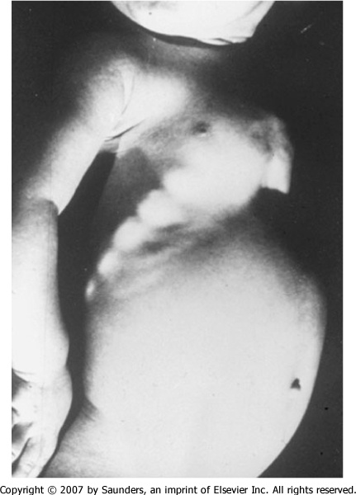

Slide 7
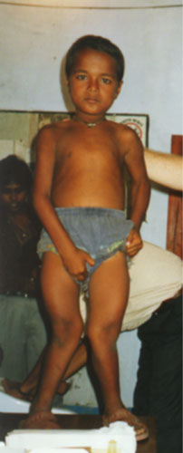
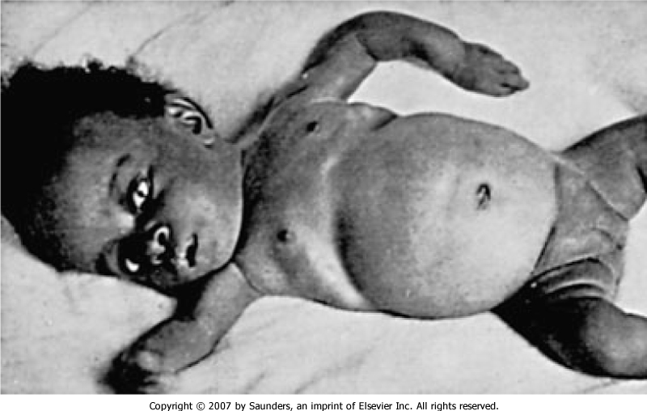

Slide 8
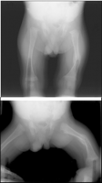
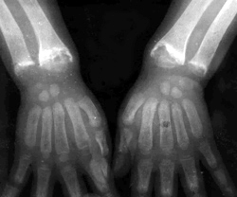
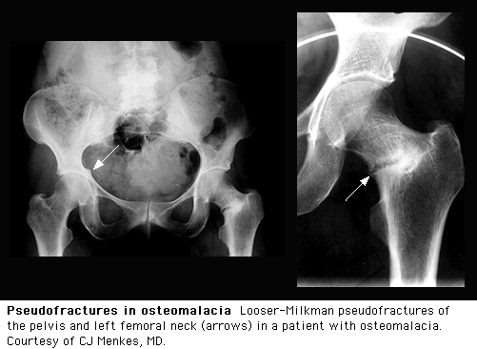
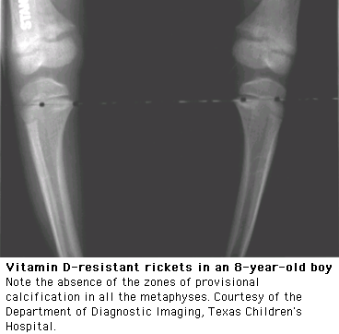

Slide 9
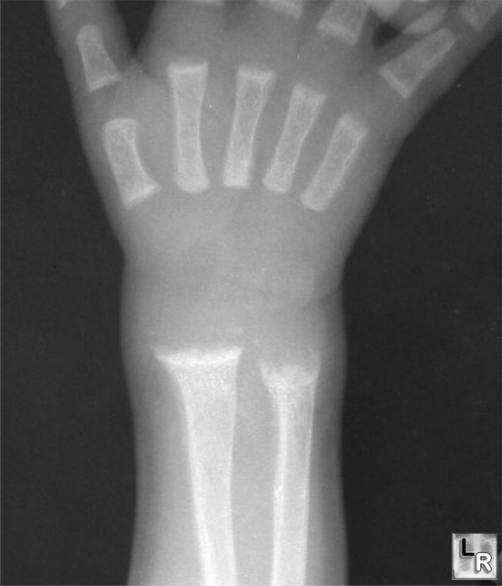

Slide 10
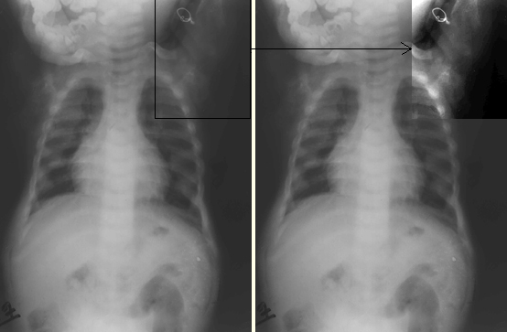

Slide 11
Biochemical findings in rickets
Alkaline phosphatase usually is ↑in all forms of rickets.
Serum phosphorus concentrations usually are↓ in both hypocalcemic and hypophosphatemic rickets.
Serum Ca is ↓only in hypocalcemic rickets.
Serum parathyroid hormone typically is ↑in hypocalcemic rickets, in contrast it is N in hypophosphatemic rickets.
25-OH vitamin D reflect the amount of vitamin D stored in the body, and is ↓in vit D deficiency.
1,25-OH2 vitamin D can be↓, N or ↑in hypocalcemic rickets and usually is N or slightly ↑in hypophosphatemic rickets.

Slide 12
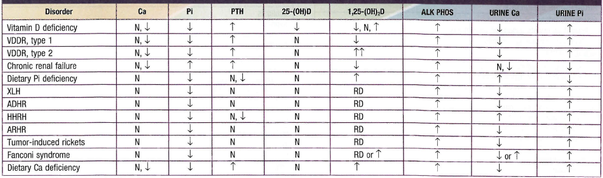

Slide 13
Hypophosphatemic rickets

Slide 14
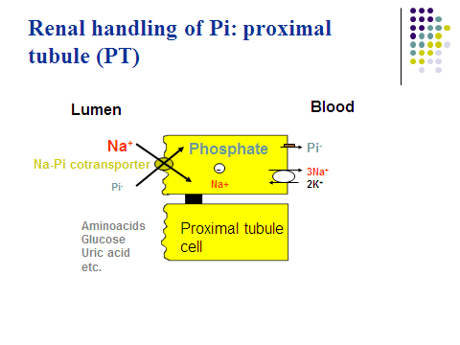

Slide 15
History
It was first described in 1937 by Albright etal who reported that patients afflicted by rickets did not respond to usual vitamin-D treatment
Most of these cases were caused by renal phosphate wasting, leading to the alternate name of "phosphate diabetes."
This disorder is now called hereditary hypophosphatemic rickets because the primary problem is phosphate wasting rather than true vitamin D resistance.

Slide 16
ETIOLOGY
  Genetic hypophosphatemic rickets
    X-linked hypophosphatemic rickets
    Autosomal dominant hypophosphatemic rickets
    Autosomal recessive hypophosphatemic rickets
    Fibrous dysplasia
    Epidermal nevus syndrome
    Hereditary hypophosphatemic rickets with hypercalciuria
  Aquired hypophosphatemia
    Tumor induced osteomalacia
    Fanconi syndrome

Slide 17
In addition to hypophosphatemia, these disorders have:
normal calcium
Normal PTH
Most have high levels of fibroblast growth factor 23 (FGF23), a circulating phosphatonin

Slide 18
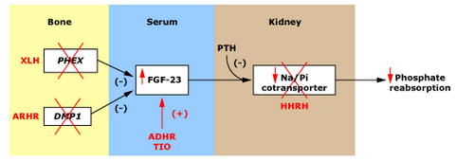
Phosphatonin
Fibroblast growth factor-23 (FGF-23) is the most well characterized phosphatonin.
It is a humoral mediator that decreases renal tubular reabsorption of phosphate and decreases the activity of renal 1α-hydroxylase

Slide 19
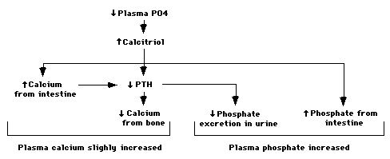
Hormonal Response to hypoPi

Slide 20
X-LINKED hypophosphatemic rickets

Slide 21
prevalence
approximately one case per 20,000 live births
X-linked form is most common
  other forms are rare

Slide 22
Pathogenesis
not fully understood
caused by one or more circulating factors rather than by a defect in the kidney
termed “ phosphatonins" or "minhibins"

Slide 23
Phosphatonin
is a humoral mediator that decreases renal tubular reabsorption of phosphate
decreases the activity of renal 1α-hydroxylase
FGF-23 is the most well characterized phosphatonin

Slide 24
The principal phosphatonin involved in the pathogenesis of XLH is fibroblast growth factor 23 (FGF23)
FGF23 acts as a counter-regulatory hormone to inhibit phosphate reabsorption by the sodium/phosphate cotransporter in the kidney
Mutations in PHEX alter the degradation and production of FGF23causing increased circulating levels of the FGF23,acting through specific FGF receptors with the important co-factor klotho protein

Slide 25
The gene responsible is on chromosome Xp22.1
named PHEX
(Phosphate Regulating Endopeptidase on the X chromosome)
PHEX mutations were found in 87 percent of familial cases and 72 percent of sporadic cases
  PHEX is expressed predominantly in bone and teeth

Slide 26
Diagnosis

Slide 27
The diagnosis is based on
clinical findings
radiographic findings
biochemical testing
family history
Determination of the PHEX mutation may be useful

Slide 28
Clinical features in child
first finding frontal bossing appear in 6 months due to sagittal suture synostosis
slow growth
rickets and osteomalacia
leg deformities ,bowing initiates at around 18 months of age
Delayed dentition and tooth abscesses in young
craniosynostosis
muscle weakness and waddle gait

Slide 29
Clinical features in adults
bone pain
Enthesopathy and calcification of tendons, ligaments
stress-fractures
short stature
Hypertension an association between hypertension and hyperparathyroidism
  left ventricular hypertrophy
  sensorineural hearing loss

Slide 30
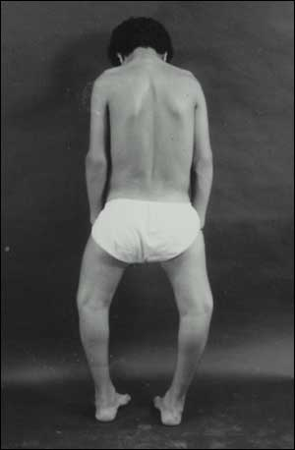
Clinical features
abnormalities of the lower extremities and poor growth are the dominant features
Some have hypophosphatemia and short stature without clinically evident bone disease

Slide 31
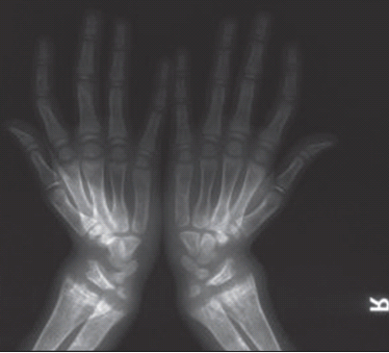
Radiographic findings
cupping
widening of the epiphyseal plate
fraying of the metaphysis

Slide 32
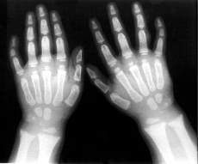
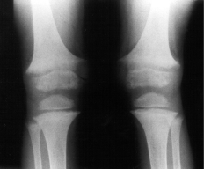
radiographs of a child with hypophosphatemic rickets,
Metaphyseal widening in wrists And knees bone rarefaction

Slide 33
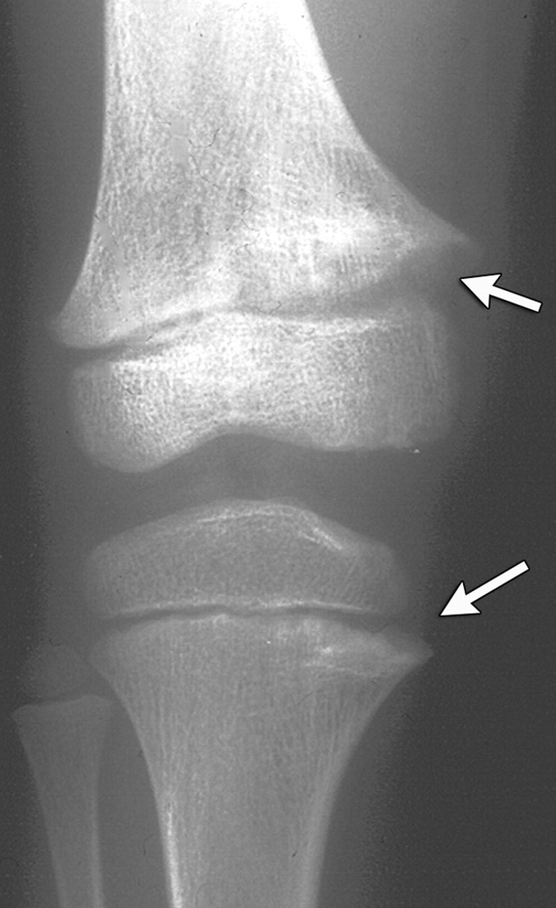
Anteroposterior radiograph of the knee in a 5-year-old girl with XLHR
partial fraying
irregularity of the distal femoral proximal tibial growth plates (upper and lower arrows, respectively)

Slide 34
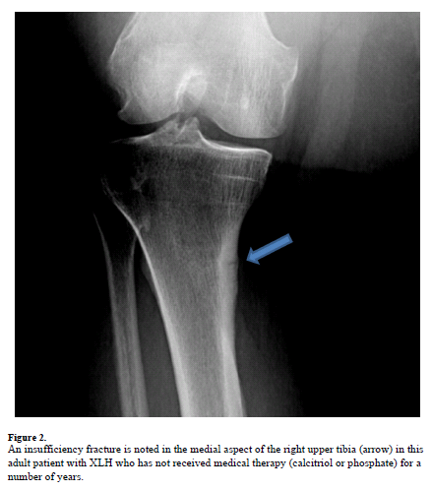
Looser zone (pseudofracture)

Slide 35
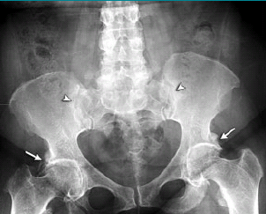
Anteroposterior pelvic show enthesopathy (arrows) in a 48-year-old woman with X-linked hypophosphatemic
osteomalacia. Note sacroiliac joint sclerosis
(arrowheads )

Slide 36
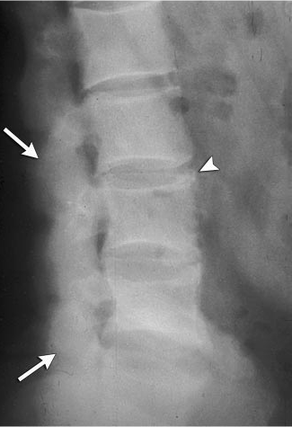
Radiographs in a 62-year-old man
with hypophosphatemic osteomalacia. Lateral lumbar spine image
shows apophyseal joint fusion (arrows) and enthesopathy (arrowhead) of the anterior vertebral bodies

Slide 37
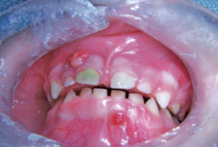
Three-year-old boy with x-linked hypophosphatemic rickets abscess on tooth .

Slide 38
Lab finding
The two main characteristic of XLH are:
- Low phosphate
- Reduced tubular resorption of phosphate for GFR(TmP/GFR)
calcium and 25-(OH) vitD are normal
PTH is normal to slightly elevated
Alk ph elevated
Absence of glycosuria, bicarbonaturia, proteinuria, or amino aciduria
  Inappropriately normal serum calcitriol in the presence of hypophosphatemia

Slide 39

evaluate urinary phosphate wasting
tubular maximum for phosphate corrected for GFR(TmP/GFR)
tubular reabsorption of phosphate (%TRP) can be calculated at any time using the following formula:

Slide 40
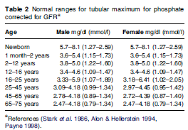

Slide 41
TREATMENT

Slide 42
Children
Treatment more than 30 years consists oral phosphate and calcitriol
phosphate transiently increases the plasma phosphate concentration, lowers the plasma ionized calcium , reduces the plasma calcitriol concentration (by removing the hypophosphatemic stimulus to its synthesis).
This causes secondary hyperparathyroidism because of hypocalcemia and removal of the normal inhibitory effect of calcitriol on PTH synthesis

Slide 43
The elevated PTH levels can aggravate the bone disease and increase urinary phosphate excretion, thereby defeating the aim of oral therapy.
The administration of calcitriol is necessary to increase the intestinal absorption of calcium, and to a lesser degree phosphate, to prevent secondary hyperparathyroidism;
calcitriol also suppresses PTH release directly

Slide 44
Children
In children, treatment generally begins at the time of diagnosis
continues until long bone growth is complete(usually up to the age of 15 to 17 years)
Calcitriol
10-20 ng/kg/dose in 2 doses per day
Phosphate
four to five times. a nighttime dose is important to achieve satisfactory results.
the starting dose is 40 mg of elemental phosphorus
/kg per day.
catch-up growth should be noticeable within the first year.If not, thdose should be increased in steps of 250 mg to 500 mg up to a maximum of 3500 mg/day.

Slide 45
Children
If diarrhea is a problem the dose of phosphorus should be decreased and then gradually re-increased in steps of 125 mg
Slow growth and persistently elevated alk-ph indicate: inadequate dose of phosphorus
compliance with therapy

Slide 46
Adult
Contraversy for treatment in adults
Most have few if any skeletal complaint
employ empiric criteria for pharmacologic therapy:
1. Non union fractures
2. orthopaedic procedures
treatment reduces recovery time
Therapy should start 3-6 months before surgery
3. Elevated alk ph
4. skeletal pain and muscle weakness

Slide 47
Adult
Calcitriol in two doses per day (10 to 20 ng/kg per dose)
Phosphate 1 to 4 g/day in three to four divided doses
goal of therapy is to manage generalized bone pain and enhance limited mobility, and to cure any non-union fractures

Slide 48
Complications
There are two important complications of the treatment of XLH:
Nephrocalcinosis
Hyperparathyroidism

Slide 49
Nephrocalcinosis
on renal ultrasonography in up to 80 percent of patients
are composed calcium phosphate
long-term effect of nephrocalcinosis on renal function is not known
Isolated cases of renal insufficiency have been reported
The development of nephrocalcinosis linked to intermittent episodes of hypercalcemia and hypercalciuria
These can result from an excessive calcitriol dose or from noncompliance with oral phosphate
Hereditary hypophosphatemic rickets and tumor-induced osteomalacia uptodate21.2

Slide 50
Nephrocalcinosis
serial measurements of renal function ,serum and urine calcium is necessary
dose of calcitriol should be reduced
use of phosphorus supplementation emphasized
thiazide diuretics with or without amiloride may arrest the progression of nephrocalcinosis

Slide 51
Hyperparathyroidism
occurs after years of treatment, may be present early
increases phosphate lowers ionized calcium ,Results in PTH release and secondary hyperparathyroidism
if secondary hyperparathyroidism is not adequately controlled, autonomous (tertiary) hyperparathyroidism can occur, necessitating surgical intervention
There is preliminary evidence that addition of a calcimimetic (cinacalcet) to the regimen may prevent secondary hyperparathyroidism

Slide 52
Adjuvant therapy
hydrochlorothiazide and amiloride, decreases urinary calcium excretion and prevents progression of nephrocalcinosis

Slide 53
Adjuvant therapy
Growth Hormone
GH can improve short-term growth in children with XLH
it is possible that aggravates the preexistent
disproportionate stature
a three-year study in rhGH-treated children showed improvement in predicted adult height, but failure to normalize the body disproportion
Available data do not support the recommendation of growth hormone therapy

Slide 54
Surgical care
indicated for severe bowing or tibial torsion unlikely to improve with medical management alone
osteotomies are not usually performed in children under 6 years of age
usually deferred until growth has nearly ceased

Slide 55
dental care
Some children are prone to dental abscesses
one abscess predicts future abscesses
Rigorous dental hygiene is recommended
brushing 2-3 times daily
regular dental hygienist visits

Slide 56
Autosomal dominant hypophosphatemic rickets

Slide 57
Pathogenesis
ADHR results from missense mutations in FGF23 that prevent its proteolytic cleavage and thereby increase circulating FGF23 levels
serum FGF23 concentrations are not consistently elevated
renal phosphate wasting may wax and wane;

Slide 58
Hypophosphatemic flares often coincide with the onset of menses and following pregnancy, when iron deficiency is common.
In addition, high FGF23 concentrations and low serum phosphate in patients with ADHR are associated with low levels of serum iron and ferritin.
So iron deficiency is an environmental trigger that stimulates expression of bone FGF23 mRNA and protein in both normal subjects and in patients with ADHR

Slide 59
Clinical findings
clinical, biochemical, radiographic and treatment similar to X-linked
age of onset varies : early-onset disease
may lose the phosphate-wasting defect after puberty
Patients who present after growth plate closure have bone pain, weakness, and fractures, but no lower extremity deformities

Slide 60
Autosomal Recessive Hypophosphatemic Rickets

Slide 61
extremely rare
Bone abnormalities generally include rickets and osteomalacia, some develop osteosclerosis and bone overgrowth
The features of ARHR may be variable and mutation-specific or age–dependent,
include nerve deafness, facial and dental abnormalities, learning disabilities, joint pain, contractures and immobilization of the spine, and short and deformed long bones

Slide 62
The disorder has been divided into three subtypes:
ARHR1 is caused by inactivating mutations in the DMP1 gene, which encodes Dentin matrix protein 1;
ARHR2 is caused by an inactivating mutation in the ENPP1 gene, which encodes ectonucleotide pyrophosphatase/
phosphodiesterase 1
AHRH3 is associated with mutations in the FAM20C gene encoding a protein kinase .
mutations result in increased FGF23 protein production and defective osteocyte maturation.

Slide 63
Hypophosphatemic rickets with hypercalciuria

Slide 64
Pathogenesis
mutations of the renal type 2 c sodium-phosphate cotransporter
Clinical features
In most patients, disease onset in childhood, feature of rickets and/ or osteomalacia
hypophosphatemia, short stature, and secondary absorptive hypercalciuria.

Slide 65
differs from XLH and ADHR in that the impairment is restricted to phosphate transport, and plasma calcitriol normal or appropriately elevated
Hypercalciuria because of high calcitriol levels and increased intestinal calcium absorption.

Slide 66
Treatment
phosphorus supplementation alone, the same dosing as XLH
Endogenous calcitriol levels are elevated and the addition of exogenous calcitriol may be harmful
Monitor and follow up similar to XLH

Slide 67
TUMOR-INDUCED OSTEOMALACIA

Slide 68
TUMOR-INDUCED OSTEOMALACIA
an acquired disorder in association with a tumor
The tumors, typically benign, often are small and of mesenchymal origin
primarily described in adults, but can occur in children and adolescents
Severe hypophosphatemia with osteomalacia and, if growth plates are still open, rickets
Longstanding bone pain and weakness

Slide 69
Pathogenesis
Extracts of the tumor inhibit phosphate transport in renal epithelial cells
produce both hypophosphatemia and reduced calcitriol production
The phosphaturic hormone implicated in tumor-induced osteomalacia is FGF23

Slide 70
TUMOR-INDUCED OSTEOMALACIA
Diagnosis
Associated with renal phosphate wasting (but no other proximal tubular defects)
inappropriately low calcitriol
family history is negative
Finding the tumors
can be a major diagnostic challenge
total body MRI or scintigraphy using octreotide labeled with indium-111

Slide 71
TUMOR-INDUCED OSTEOMALACIA
Treatment
Limited experience is available in the treatment
similar to those of X-linked disease regimens are used
Therapy is continued until the causative tumor can be removed
Removal of the tumor leads to healing of the bone disease
In some patients, hypophosphatemia were corrected with octreotide therapy

Slide 72
FGF23 and Hypophosphatemic Diseases
Fibroblast growth factor 23 (FGF23) was cloned as a responsible gene for autosomal dominant hypophosphatemic rickets (ADHR) in 2000.
Almost simultaneously, FGF23 was also identified as a responsible humoral factor for tumor-induced osteomalacia (TIO).
hypophosphatemia usually enhances serum 1,25(OH)2D level, but 1,25(OH)2D remains to be low to low normal in ADHR and TIO

Slide 73
FGF23 and Hypophosphatemic Diseases
Similar biochemical changes are seen in patients with X-linked hypophosphatemic rickets (XLH), the most prevalent cause of vitamin D-resistant rickets
circulatory FGF23 levels were shown to be high in patients with XLH, TIO, and ADHR
FGF23-related hypophosphatemic diseases can be diagnosed by high FGF23 levels in the presence of hypophosphatemia
because FGF23 levels are low in hypophosphatemic patients from other causes such as vitamin D deficiency, Fanconi syndrome, and so on

Slide 74
FGF23
Fibroblast growth factor 23 (FGF23) is a phosphaturic hormone
produced by bone, mainly by osteocytes,
works by binding to Klotho–FGF receptor complex. Klotho is a co-receptor for FGF23

Slide 75
excessive and deficient actions of FGF23 cause hypophosphatemic and hyperphosphatemic diseases, respectively
FGF23 is involved in the pathogenesis of chronic kidney disease–mineral and bone disorder (CKD–MBD)

Slide 76
These findings suggest that FGF23-FGF receptor/Klotho pathway can be a new drug target for disorders of mineral and bone metabolism
several preclinical studies indicated that the inhibition of FGF23 activities may be useful for hypophosphatemic diseases caused by excessive actions of FGF23

Slide 77
Actions of FGF23
FGF23 is a peptide with 251 amino acids.
FGF23 inhibits proximal tubular phosphate reabsorption by reducing the expression levels of type 2a and 2c sodium-phosphate cotransporters.

Slide 78
Actions of FGF23
FGF23 reduces serum 1,25(OH)2D by suppressing the expression of CYP27B1 and enhancing the CYP24A1 expression .
CYP27B1 encodes an enzyme that converts 25-OH D to 1,25(OH)2D, and CYP24A1 gene product inactivates 1,25(OH)2D into more hydrophilic metabolite.
1,25(OH)2D enhances intestinal phosphate absorption,
so FGF23 reduces serum phosphate by inhibiting both proximal tubular phosphate reabsorption and intestinal phosphate absorption.

Slide 79
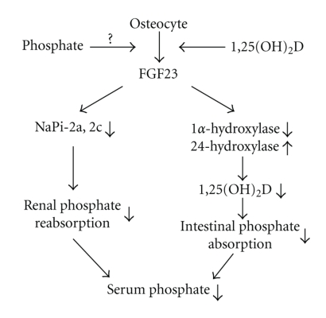

Slide 80
FGF23 and Hyperphosphatemic Diseases
hyperphosphatemic familial tumoral calcinosis (HFTC) is caused by impaired actions of FGF23
Patients with this disease show hyperphosphatemia associated with enhanced proximal tubular phosphate reabsorption and high 1,25(OH)2D,
Three responsible genes for HFTC have been identified, FGF23, GALNT3, and Klotho

Slide 81
FGF23 and CKD–MBD
FGF23 was shown to increase before the development of secondary Hyperparathyroidism in CKD indicated that this increased FGF23 prevents the development of hyperphosphatemia by enhancing urinary phosphate excretion
At the same time, high FGF23 in early CKD decreases 1,25(OH)2D and contributes to the development of secondary hyperparathyroidism

Slide 82
FGF23 and CKD–MBD
It is also reported that FGF23 inhibits the production and secretion of PTH.
Therefore, the precise role of FGF23 in the development of secondary hyperparathyroidism is complex.
unknown what triggers the increase of FGF23 in early CKD
with severely reduced nephron mass, hyperphosphatemia eventually develops even with extremely high FGF23 levels in patients with end-stage renal disease

Slide 83
FGF23 and CKD–MBD
FGF23 levels have been shown to be associated with various adverse events such as cardiovascular events, fractures, progression of CKD, and higher mortality especially in patients with CKD .
FGF23 was also shown to induce left ventricular hypertrophy in a Klotho independent way

Slide 84
FGF23 is a humoral mediator that decreases renal tubular reabsorption of phosphate and decreases the activity of renal 1α-hydroxylase

Slide 86
FGF23-FGF Receptor/Klotho Pathway as a Drug
Target for Hypophosphatemic Diseases
excessive actions of FGF23 cause several kinds of hypophosphatemic diseases,
Most of these diseases are treated with phosphate supplementation and calcitriol
These medications are associated with several adverse events such as gastrointestinal symptoms, secondary– tertiary hyperparathyroidism, hypercalcemia, hypercalciuria and nephrocalcinosis

Slide 87
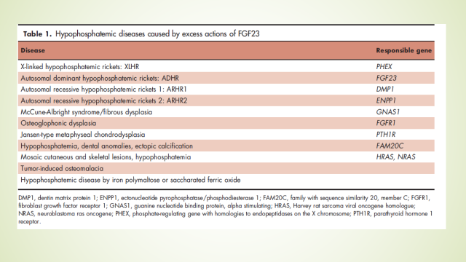

Slide 89
it is presumed that the inhibition of FGF23 actions corrects hypophosphatemia in these diseases
FGF23 works by binding to FGF receptor/Klotho complex.

Slide 90
How FGF23 exerts its bioactivities?

Slide 91
FGF23-FGF Receptor/Klotho Pathway as a Drug
Target for Hypophosphatemic Diseases
Isolated C-terminal fragment of FGF23 competes with full-length FGF23 for binding to FGF receptor/Klotho complex .
This C-terminal fragment inhibited signaling by FGF23 in in vitro experiments .
In addition, injection of isolated C-terminal fragment of FGF23 inhibited urinary phosphate excretion and increased serum phosphate levels both in wild-type and Hyp mice.

Slide 92
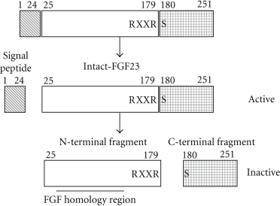

Slide 93
several reports indicate that FGF23 production is stimulated by signaling from FGF receptor .
Therefore, the suppression of FGF receptor was expected to inhibit both the production and actions of FGF23
Another way to inhibit FGF23 actions is to suppress the downstream signals from FGF receptor/Klotho complex

Slide 94
These antibodies were shown to inhibit FGF23 actions in in vitro experiments
The antibodies also synergistically enhanced serum phosphate and 1,25(OH)2D levels
In addition, single injection of these antibodies increased serum phosphate, 1,25(OH)2D, and renal tubular phosphate reabsorption in Hyp mice.
Once weekly injections of the antibodies into young Hyp mice for five times resulted in enhanced bone growth and mineralization, increased bone mineral density, and correction of disorganized growth plates

Slide 95
These results suggested that the inhibition of FGF23 activities by anti- FGF23 antibodies can correct biochemical, morphological, histological, and clinical features of Hyp mice.
Based on these backgrounds, the clinical trial of humanized anti- FGF23 was conducted.

Slide 96
In the phase I trial, single intravenous or subcutaneous administration of various amounts of anti-FGF23 antibody was tested in 38 adult patients with XLH .
The antibody increased tubular maximum transport of phosphate per glomerular filtration rate (TmP/GFR) and serum phosphate in a dose-dependent manner both by intravenous and subcutaneous administration.

Slide 97
The peak serum phosphate was observed on days 4–5 after intravenous administration.
peak phosphate occurred between days 8 and 15 after subcutaneous injection.
Serum phosphate returned toward baseline within 29 and 50 days in intravenous and subcutaneous groups, respectively.
The antibody also transiently increased serum 1,25(OH)2D.
There were no serious adverse events.

Slide 98
From these results, repeated subcutaneous injections of FGF23 were conducted
Twenty-two adult patients with XLH were treated with up to 16 doses of subcutaneous injections of anti-FGF23 antibody every 28 days .

Slide 99
Maximum serum phosphate levels were observed 7–14 days after each dose.
While serum phosphate was\2.5 mg/dl at baseline, serum phosphate was between 2.5 and 3.5 mg/dl in more than 70 % of subjects on day 7.
This antibody also increased TmP/GFR and 1,25(OH)2D by each injection.
there were no serious adverse events.

Slide 100
In April 2018, the FDA approved burosumab, for X-linked hypophosphatemia (XLH).
Burosumab is a monoclonal IgG1 antibody that binds excess fibroblast growth factor 23 (FGF23).
This action normalizes phosphorus levels, improves bone mineralization, improves rickets in children, and helps to heal fractures in adults.

Slide 101
In a placebo-controlled trial, 94% of adults receiving burosumab once a month achieved normal phosphorus levels compared with 8% of those receiving placebo.
In children, 94% to 100% of patients treated with burosumab every 2 weeks achieved normal phosphorus levels.
In both children and adults, radiograph findings associated with XLH improved with burosumab treatment

Slide 102
Pharmacokinetics and pharmacodynamics of a human monoclonal anti‐FGF23 antibody (KRN23) in the first multiple ascending‐dose trial treating adults with X‐linked hypophosphatemia

Slide 103
a phase 1 randomized, placebo‐controlled, double‐blind trial of KRN23 in adults with XLH demonstrated that a single intravenous or subcutaneous dose of KRN23 resulted in prolonged inhibition of FGF23 activity.
Serum Pi, TmP per glomerular filtrate rate (TmP/GFR), and serum 1,25(OH)₂D increased in a dose‐dependent manner, and the half‐life of KRN23 given subcutaneously was 13 to 19 days.

Slide 104
The greater than 4‐week duration of the Pi effect suggested that subcutaneous injection of KRN23 every 4 weeks might be an effective treatment to increase serum Pi in XLH patients.
Subsequently a phase 1/2 dose‐escalation study of repeated subcutaneous doses of KRN23 at 28‐day intervals in adults with XLH was undertaken to assess the efficacy and safety of KRN23

Slide 105
Approval in adults with XLH (n=134) was supported by a randomized, double-blind, placebo-controlled study.
Compared with patients on placebo, a higher proportion of burosumab-treated adults attained serum phosphorus levels above the lower limit of normal.
In addition, the rate of complete healing for active fractures and pseudofractures for burosumab treatment outpaced that of placebo therapy.

Slide 106
A 48-week, open-label, single-arm bone biopsy study in 14 adults also bolstered the adult indication, with osteomalacia healing revealed by decreases in osteoid volume/bone volume, osteoid thickness, and mineralization lag time

Slide 107
Approval for children followed a 64-week, randomized, open-label study in 52 patients aged 5 to 12 years,
burosumab therapy was associated with an improvement in rickets, a rise in serum phosphorus levels,
a reduction in serum alkaline phosphatase activity,
and an increase in growth.
Forty-week data from an open-label study in 13 patients aged 1 to 4 years also back up the indication, with burosomab showing similar benefits to the 64-week study

Slide 108
Effects of KRN23, an Anti-FGF23 Antibody in Patients With Tumor-Induced Osteomalacia and Epidermal Nevus Syndrome: Results from an Ongoing Phase 2 Study
Summary and ConclusionsIn:
patients with TIO or ENS, KRN23 improved mean serum phosphorus, 1,25(OH) 2D, and TmP/GFR over 24 weeks of treatment
KRN23 improved bone mineralization as demonstrated by the first bone biopsy results
The increases in BMD and bone turnover markers over 24 weeks provide additional clinical evidence of an improvement in skeletal health
Treatment-related adverse events were mild in severity
These data suggest KRN23 has the potential to reverse hypophosphatemia and provide clinical benefit to patients with TIO and ENS

Slide 109
Protein convertase

Slide 110
However, several questions need to be answered before the clinical use of anti-FGF23 antibody.
First, it has not been established in human whether the antibody improves growth and prevents the development of bone deformities in child patients with FGF23-related hypophosphatemic rickets.
Second, it is not known either whether the inhibition of FGF23 activity ameliorates the symptoms of adult patients with FGF23-related hypophosphatemic osteomalacia.
Third, long-term safety clearly needs to be evaluated in more studies.

Slide 111
FGF 23 Antibody
BUROSOMAB
https://www.accessdata.fda.gov/drugsatfda_docs/label/2018/761068s000lbl.pdf

Slide 112
INDICATIONS AND USAGE
CRYSVITA is a fibroblast growth factor 23 (FGF23) blocking antibody
indicated for the treatment of X-linked hypophosphatemia (XLH) in adult and pediatric patients 1 year of age and older.

Slide 113
CONTRAINDICATIONS
Do not use CRYSVITA with oral phosphate and active vitamin D analogs.
Do not initiate CRYSVITA if serum phosphorus is within or above the normal range for age.
CRYSVITA is contraindicated in patients with severe renal impairment or end stage renal disease, because these conditions are associated with abnormal mineral metabolism

Slide 114
ADVERSE REACTIONS
Most common adverse reactions (≥25%) in pediatric XLH patients are: headache, injection site reaction, vomiting, pyrexia, pain in extremity, vitamin D decreased.
Other adverse reactions: Rash, Toothache, Myalgia,Tooth abscess, Dizziness
Most common adverse reactions (≥5% and in at least 2 patients more than placebo) in adult XLH patients are: back pain, headache, tooth infection, restless leg syndrome, vitamin D decreased, dizziness, constipation, blood phosphorus increased.

Slide 115
ADVERSE REACTIONS
Spinal Stenosis: Spinal stenosis is prevalent in adults with XLH and spinal cord compression has been reported. In the CRYSVITA phase 2 and phase 3 studies of adults with XLH (total N=176), a total of 6 patients underwent spinal surgery.
Most of these cases appeared to involve progression of a pre-existing spinal stenosis.
It is unknown if CRYSVITA therapy exacerbates spinal stenosis or spinal cord compression.

Slide 116
WARNINGS AND PRECAUTIONS
Hypersensitivity: Hypersensitivity reactions (e.g. rash, urticaria) have been reported in patients with CRYSVITA.
Hyperphosphatemia and Risk of Nephrocalcinosis: Increases in serum phosphorus to above the upper limit of normal may be associated with an increased risk of nephrocalcinosis. For patients already taking CRYSVITA, dose interruption and/or dose reduction may be required based on a patient’s serum phosphorus levels.
Injection Site Reactions: Administration of CRYSVITA may result in local injection site reactions. Discontinue CRYSVITA if severe injection site reactions occur and administer appropriate medical treatment.

Slide 117
Pediatric Patients with XLH(1 to less than 18 years of age)
The recommended starting dose regimen is 0.8 mg/kg of body weight, rounded to the nearest 10 mg, administered every two weeks.
The minimum starting dose is 10 mg up to a maximum dose of 90 mg.
After initiation of treatment with CRYSVITA, measure fasting serum phosphorus every 4 weeks for the first 3 months of treatment, and thereafter as appropriate.
If serum phosphorus is above the lower limit of the reference range for age and below 5 mg/dL, continue treatment with the same dose.
Follow dose adjustment schedule to maintain serum phosphorus within the reference range for age.

Slide 118
CLINICAL STUDIES
Pediatric X-linked Hypophosphatemia

Slide 119
CRYSVITA has been evaluated in 65 pediatric patients with XLH.
Study 1 is a randomized, open-label study in 52 prepubescent XLH patients,5 to 12 years old, which compared treatment with CRYSVITA administered every 2 weeks versus every 4 weeks.
Following an initial 16-week dose titration phase, patients completed 48-weeks of treatment with CRYSVITA every 2 weeks.
All 52 patients completed at least 64 weeks on study; no patient discontinued.
Burosumab-twza dose was adjusted to target a fasting serum phosphorus concentration of 3.5 to 5.0 mg/dL based on the fasting phosphorus level the day of dosing.

Slide 120
Twenty-six of 52 patients received CRYSVITA every two weeks up to a maximum dose of 2 mg/kg.
The average dose was 0.73 mg/kg (range: 0.3, 1.5) at week 16, 0.98 mg/kg (range: 0.4, 2.0) at week 40 and 1.04 mg/kg (range: 0.4, 2.0) at week 60.
The remaining 26 patients received CRYSVITA every four weeks.
At study entry, the mean age of patients was 8.5 years and 46% were male. Ninety-six percent had received oral phosphate and active vitamin D analogs for a mean (SD) duration of 7 (2.4) years.
Oral phosphate and active vitamin D analogs were discontinued prior to study enrollment.
Ninety-four percent of patients had radiographic evidence of rickets at baseline.

Slide 121
Study 2 is a 64-week open-label study in 13 pediatric XLH patients, 1 to 4 years old.
Patients received CRYSVITA at a dose of 0.8 mg/kg every two weeks with titration up to 1.2 mg/kg based on serum phosphorus measurements.
All patients completed at least 40 weeks on study; no patients discontinued.
At study entry, the mean age of patients was 2.9 years and 69% were male.
All patients had radiographic evidence of rickets at baseline and had received oral phosphate and active vitamin D analogs for a mean (SD) duration of 16.9 (13.9) months.
Oral phosphate and active vitamin D analogs were discontinued prior to study enrollment.

Slide 122
Serum Phosphorus
In Study 1, CRYSVITA increased mean (SD) serum phosphorus levels from 2.4 (0.40) at baseline to 3.3 (0.40) and 3.4 (0.45) mg/dL at week 40 and week 64 in the patients who received CRYSVITA every 2 weeks.
The ratio of renal tubular maximum reabsorption rate of phosphate to glomerular filtration rate (TmP/GFR) increased in these patients from mean (SD) of 2.2 (0.49) at baseline to 3.3 (0.60) and 3.4 (0.53) mg/dL at week 40 and week 64.
In Study 2, CRYSVITA increased mean (SD) serum phosphorus levels from 2.5 (0.28) mg/dL at baseline to 3.5 (0.49) mg/dL at week 40.

Slide 123
Radiographic Evaluation of Rickets
Radiographs from 52 CRYSVITA-treated XLH patients in Study 1 and 13 patients in Study 2 were examined to assess XLH-related rickets using the 10-point Thacher Rickets Severity Score (RSS) and the 7-point Radiographic Global Impression of Change (RGI-C). The RSS score is assigned based on images of the wrist and knee from a single timepoint, with higher scores indicating greater rickets severity. The RGI-C score is assigned based on side-by-side comparisons of wrist and knee radiographs from two timepoints, with higher scores indicating greater improvement in radiographic evidence of rickets. A RGI-C score of +2.0 was defined as radiographic evidence of substantial healing.
In Study 1, baseline mean (SD) RSS total score was 1.9 (1.17) in patients receiving CRYSVITA every two weeks. After 40 weeks of treatment with CRYSVITA, mean total RSS decreased from 1.9 to 0.8 (see Table 6). After 40 weeks of treatment with CRYSVITA, the mean RGI-C Global score was +1.7 in patients receiving CRYSVITA every two weeks. Eighteen out of 26 patients achieved an RGI-C score of ≥ +2.0. These findings were maintained at week 64 as shown in Table 6.

Slide 124
In Study 2, baseline mean (SD) total RSS was 2.9 (1.37) in 13 patients. After 40 weeks of treatment
with CRYSVITA, mean total RSS decreased from 2.9 to 1.2 and the mean (SE) RGI-C Global score
was +2.3 (0.08). All 13 patients achieved a RGI-C global score ≥ +2.0. The mean (SE) lower limb
deformity as assessed by RGI-C, using standing long leg radiographs, was +1.3 (0.14)

Slide 125
Serum Alkaline Phosphatase Activity
For Study 1, mean (SD) serum total alkaline phosphatase activity was 462 (110) U/L at baseline and
decreased to 354 (73) U/L at Week 64 (-23%, p < 0.0001) in the patients who received CRYSVITA
every 2 weeks.
For Study 2, mean (SD) serum total alkaline phosphatase activity was 549 (194) U/L at baseline and
decreased to 335 (88) U/L at Week 40 (mean change: -36%).
Growth
In Study 1, CRYSVITA treatment for 64 weeks increased standing mean (SD) height Z score from
-1.72 (1.03) at baseline to -1.54 (1.13) in the patients who received CRYSVITA every two
weeks (LS mean change of +0.19 (95% CI: 0.09 to 0.29).

Slide 126
Adult X-linked Hypophosphatemia

Slide 127
Study 3 (NCT 02526160) is a randomized, double-blind, placebo-controlled study in 134 adult XLH
patients. The study comprises a 24-week placebo-controlled treatment phase. CRYSVITA was
administered at a dose of 1 mg/kg every 4 weeks. At study entry, the mean age of patients was
40 years (range 19 to 66 years) and 35% were male. All patients had skeletal pain associated with
XLH/osteomalacia at baseline. The baseline mean (SD) serum phosphorus concentration was below
the lower limit of normal at 1.98 (0.31) mg/dL. Oral phosphate and active vitamin D analogs were not
allowed during the study. One patient in the CRYSVITA group discontinued treatment.

Slide 128
Study 4 (NCT 02537431) is a 48-week, open-label, single-arm study in 14 adult XLH patients to
assess the effects of CRYSVITA on improvement of osteomalacia as determined by histologic and
histomorphometric evaluation of iliac crest bone biopsies. Patients received 1 mg/kg CRYSVITA
every four weeks. At study entry, the mean age of patients was 40 years (range 25 to 52 years) and
43% were male. Oral phosphate and active vitamin D analogs were not allowed during the study.

Slide 129
In Study 3 at baseline, mean (SD) serum phosphorus was 1.9 (0.32) and 2.0 (0.30) mg/dL in the
placebo and CRYSVITA groups respectively. During the initial 24 weeks of treatment, mean (SD)
serum phosphorus across the midpoints of dose intervals (2 weeks post dose) was 2.1 (0.30) and 3.2
(0.53) mg/dL in the placebo and CRYSVITA groups, and mean (SD) serum phosphorus across the
ends of dose intervals was 2.0 (0.30) and 2.7 (0.45) mg/dL in the placebo and CRYSVITA groups.
A total of 94% of patients treated with CRYSVITA achieved a serum phosphorus level above the
lower limit of normal (LLN) compared to 8% in the placebo group through week 24 (Table 7).

Slide 130
At baseline, the mean (SD) ratio of renal tubular maximum reabsorption rate of phosphate to
glomerular filtration rate (TmP/GFR) was 1.60 (0.37) and 1.68 (0.40) mg/dL in the placebo and
CRYSVITA groups respectively. At week 22 (midpoint of a dose interval), mean (SD) TmP/GFR was
1.69 (0.37) and 2.73 (0.75) mg/dL in the placebo and CRYSVITA groups. At week 24 (end of a dose
interval), mean (SD) TmP/GFR was 1.73 (0.42) and 2.21 (0.48) mg/dL in the placebo and CRYSVITA
groups.

Slide 131
Radiographic Evaluation of Osteomalacia
In Study 3, a skeletal survey was conducted at baseline to identify osteomalacia-related fractures and
pseudofractures. Osteomalacia-related fractures are defined as atraumatic lucencies extending
across both bone cortices and pseudofractures are defined as atraumatic lucencies extending across
one cortex. There were 52% of patients who had either active (unhealed) fractures (12%) or active
pseudofractures (47%) at baseline. The active fractures and pseudofractures were predominantly
located in the femurs, tibia/fibula, and metatarsals of the feet. Assessment of these active
fracture/pseudofracture sites at week 24 demonstrated a higher rate of complete healing in the
CRYSVITA group compared to placebo as shown in Table 8. During treatment through week 24, a
total of 6 new fractures or pseudofractures appeared in 68 patients receiving CRYSVITA, compared
to 8 new abnormalities in 66 patients receiving placebo

Slide 132
Bone Histomorphometry
In Study 4, after 48 weeks of treatment, healing of osteomalacia was observed in ten patients as
demonstrated by decreases in Osteoid volume/Bone volume (OV/BV) from a mean (SD) score of
26% (12.4) at baseline to 11% (6.5), a change of -57%. Osteoid thickness (O.Th) declined in eleven
patients from a mean (SD) of 17 (4.1) micrometers to 12 (3.1) micrometers, a change of -33%.
Mineralization lag time (MLt) declined in 6 patients from a mean (SD) of 594 (675) days to 156 (77)
days, a change of -74%.

Slide 133
THANKS

