Slide 1
به نام خداوند جان و خرد

Slide 2
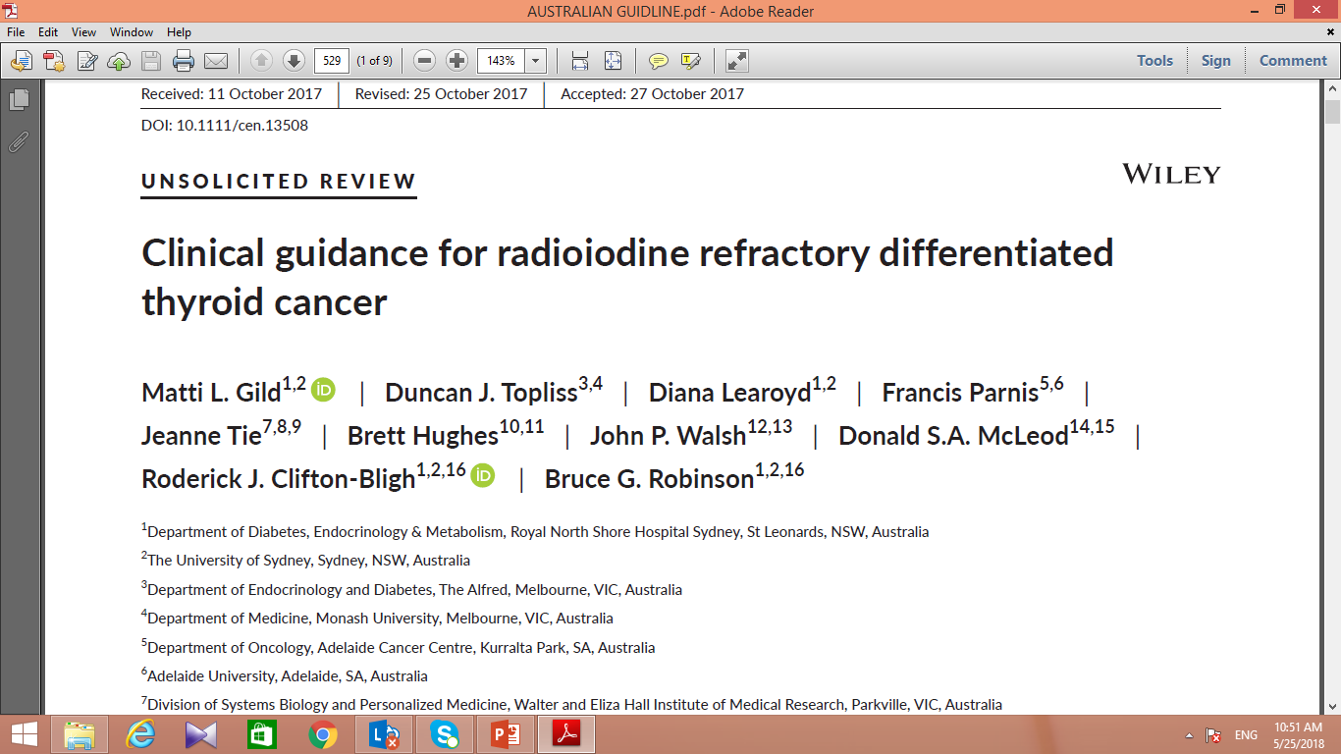

Slide 3
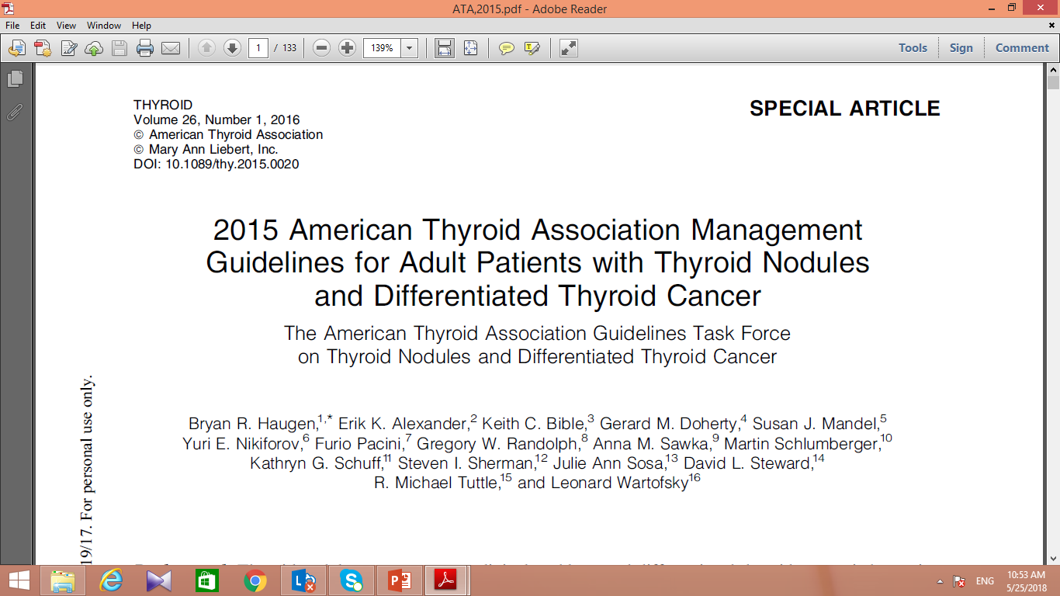

Slide 4
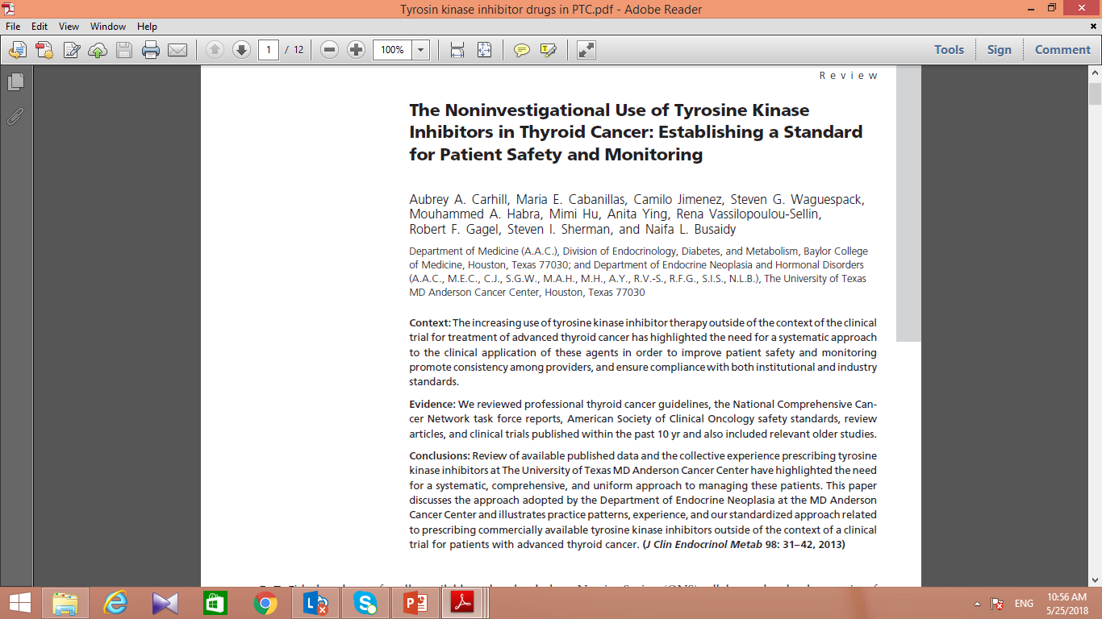

Slide 5
Differentiated thyroid cancer subtypes and prognosis

Slide 6
Treatment of radio avid thyroid cacer

Slide 7
RAI remnant ablation after total thyroidectomy :
Remnant ablation :
destroying remnant thyroid tissue (facilitate detection of recurrent disease by Tg or whole-body RAI scans),
only in low risk disease,
Not routinely recommended for unifocal or multifocal papillary microcarcinoma, in absence of other high risk features.
ATA GUIDLINE,2015
(Weak recommendation, Low-quality evidence) ATA GUIDLINE,2015

Slide 8
RAI adjuvant therapy after total thyroidectomy:
Adjuvant therapy :
Destroying suspected residual disease,
should be considered, in ATA intermediate-risk patients. (Weak recommendation, Low-quality evidence)
Routinely recommended, for ATA high risk patients. (Strong recommendation, Moderate-quality evidence)
ATA GUIDLINE,2015

Slide 9
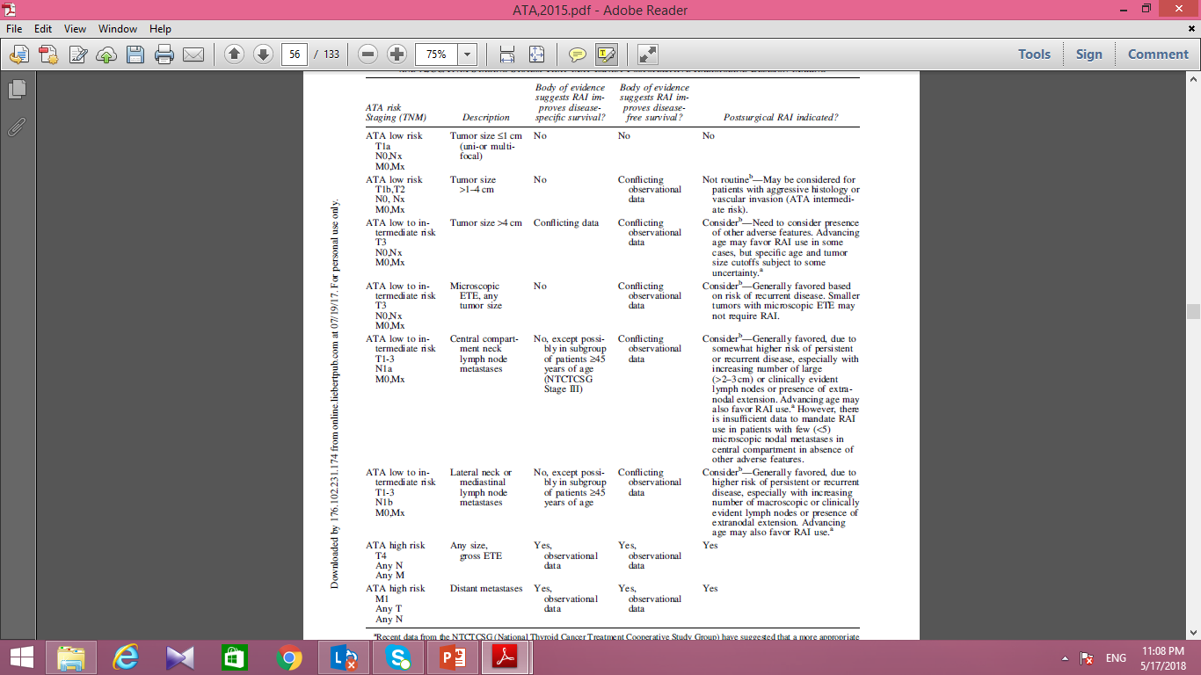
ATA GUIDLINE,2015

Slide 10
What activity of 131I used for remnant ablation or adjuvant therapy?

Slide 11
What activity of 131I used… ?
Approximately of 30 mCi used after total thyroidectomy for :
ATA low-risk thyroid cancer ,
or intermediate-risk disease with low volume central neck nodal metastases with no gross residual disease or any other adverse features.
(Strong recommendation, High-quality evidence) ATA GUIDLINE 2015

Slide 12
What activity of 131I used …?
up to 150mCi may be considered :
for patients receiving less than near-total thyroidectomy in which, a larger remnant is suspected,
As adjuvant therapy(to treat suspected microscopic residual disease) .
(Weak recommendation, Low-quality evidence) ATA GUIDLINE 2015

Slide 13
A posttherapy WBS (with or without SPECT/CT)?
recommended after RAI remnant ablation or treatment to inform :
disease staging and the RAI avidity of any structural disease.
In high risk DTC patients with serum Tg >10 ng/mL and negative RAI imaging :
18FDG-PET scanning or CT imaging of the chest should be considered.
(Strong recommendation, Moderate-quality evidence), ATA GUIDLINE 2015

Slide 14
RAI treatment in radio avid metastatic Differentiated thyroid cancer?

Slide 15
Pulmonary micrometastases :
RAI therapy should be repeated every 6–12 months as long as disease continues to concentrate RAI and respond clinically,
Response to RAI treatment : reduction in serum Tg and in the size of metastases,
In contrast,
a reduction in serum Tg and in RAI uptake with no concomitant decrease or with an increase in tumor size suggests refractoriness to RAI therapy.
ATA GUIDLINE 2015

Slide 16
Macronodular pulmonary metastases
may be treated with RAI if iodine avid.
How many doses of RAI to give and how often to give RAI, individualized based on the disease response to treatment,
age of the patient,
and the presence or absence of other metastatic lesions.
ATA GUIDLINE 2015

Slide 17
Empiric (100–200 mCi) RAI therapy in patients with :
stimulated Tg ≥10 ng/mL with thyroid hormone withdrawal or ≥ 5 ng/mL with rhTSH , Or rapidly rising Tg or ant-Tg antibody levels:
in whom neck/chest imaging and/or 18FDG-PET/CT failed to reveal a tumor source.
If empiric RAI therapy given and the posttherapy scan is negative, the patient is RAI-refractory and no further RAI administered.
ATA GUIDLINE 2015

Slide 18
Radio refractory differentiated thyroid cancer disease

Slide 19
RAI refractory disease and survival?
The prognosis is poor,
Metastatic RAI avid DTC have a 10-year survival of 60%,
whereas survival falls to 10% when RAI avidity are lost.
Clinical guidance for radioiodine refractory differentiated thyroid cancer, Australia,2017

Slide 20
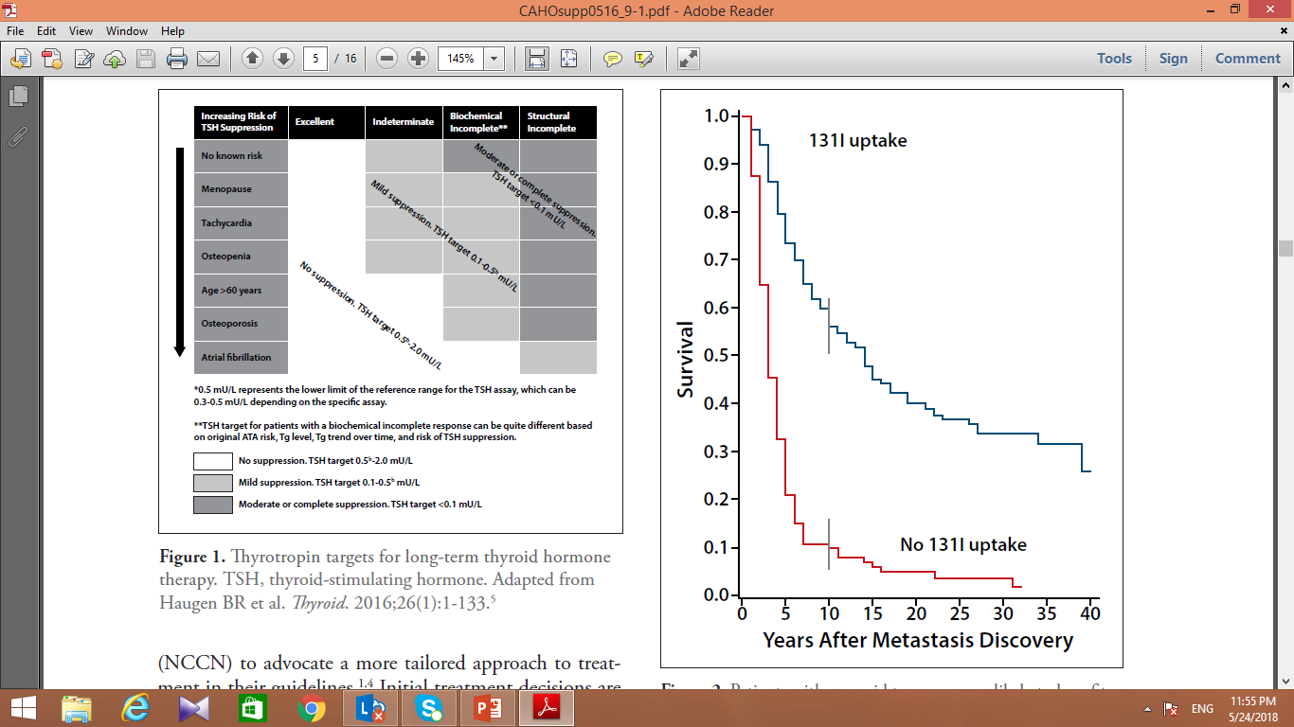
nonavid tumors, unlikely to benefit from radioactive iodine.
J Clin Endocrinol Metab. 2006;91(8):2892-2899.6

Slide 21
Predictive factors for response to RAI treatment:
the presence of 131I uptake by tumor,
and among those patients with RAI uptake :
younger age,
Differentiated histology (PTC or FTC),
small metastases,
and low 18FDG uptake.
ATA GUIDLINE 2015

Slide 22
RAI refractory disease
Radioiodine refractory disease is more common :
in older patients,
those with large tumor burden,
those with FDG-PET positive disease (Poorly differentiated foci with loss of iodine avidity),
and those with poorly differentiated subtypes (tumors with Hurthle cell histology).
Clinical guidance for radioiodine refractory differentiated thyroid cancer, Australia,2017

Slide 23
How is RAI-refractory structurally evident DTC ?
structurally evident DTC : Detects by a post therapy 131I WBS, combined with CT scan, MRI, or PET/CT.

Slide 24
How is RAI-refractory structurally evident DTC :
1)The metastatic tissue not concentrate 131I, outside the thyroid bed at the first therapeutic WBS (further treatment with RAI has no benefit in these patients).
2) The tumor loses the ability to concentrate 131I after previous uptake (This occurs in large and multiple metastases, due to the eradication by 131I of differentiated cells able to concentrate RAI but not of poorly differentiated cells, that not concentrate 131I and generally will progress).
ATA GUIDLINE 2015

Slide 25
How is RAI-refractory structurally evident DTC :
3) 131I retained in some lesions but not in others (in patients with multiple large metastases and by comparing results of FDG-PET scan with 131I WBS. progression occurs in metastases without uptake, in particular when 18FDG uptake is present)
4) Metastatic disease progresses despite significant uptake of 131I (new lesions or progressive growth of lesions, continual rise in Tg within months of RAI therapy).
ATA GUIDLINE 2015

Slide 26
How is RAI-refractory structurally evident DTC :
RAI refractory disease established when (with appropriate TSH stimulation):
the iodine has never concentrated in the metastatic tissue,
The tumor lost the ability to take up iodine despite previously RAI avid,
iodine can be concentrated in some metastases but not others;
metastatic disease progresses despite significant uptake of RAI.
When a patient with DTC is classified as refractory to RAI, there is no indication for further RAI treatment.
Clinical guidance for radioiodine refractory differentiated thyroid cancer, Australia,2017

Slide 27
RAI refractory disease treatment :
Early recognition of RAI refractory disease is important to avoid further unnecessary RAI treatment, and to prompt consideration, if local or systemic therapy is appropriate.
local or systemic therapy of RAI refractory disease influenced by:
the extent of metastatic disease by CT, 18FDG PET/CT, or MRI,
the rate of progression of disease,
the current or potential symptoms;
and the comorbidities.
Clinical guidance for radioiodine refractory differentiated thyroid cancer, Australia,2017

Slide 28
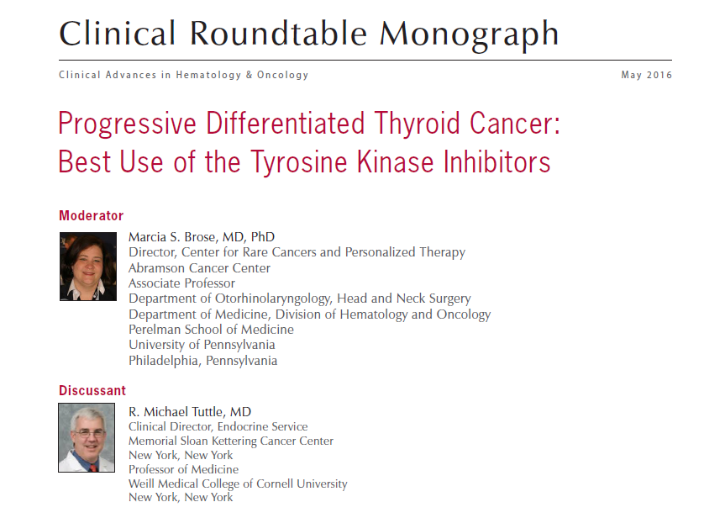

Slide 29
RAI refractory DTC patients : (The Indolant nature)
Generally progresses very slowly,
show only a millimeter of growth every 1 to 2 years (RAI-refractory pulmonary metastases),
Such patients can be observed for several years before more aggressive therapy.
Clinical Advances in Hematology & Oncology Volume 14, Issue 5, Supplement 9 May 2016

Slide 30
RAI refractory DTC patients : (The aggressive nature)
The aggressive tumors :
larger than 1 cm and positive on 18F-FDG-PET scans,
a rapid serum thyroglobulin doubling time (<1-2 years).
likely to cause significant morbidity or mortality,
And therefore should be considered for systemic therapy.
should undergo cross-sectional imaging studies every 6 months.
Clinical Advances in Hematology & Oncology Volume 14, Issue 5, Supplement 9 May 2016

Slide 31
I-refractory metastatic DTC : Active survilance?
Asymptomatic, stable, or minimally progressive patients,
can be monitored on TSH-suppressive therapy with serial radiographic imaging every 3–12 months.
ATA GUILINE,2015

Slide 32
I-refractory metastatic DTC : local or systemic therapy ?
should be considered in patients with:
metastatic, rapidly progressive disease,
or symptomatic disease,
or imminently threatening disease.
ATA GUIDLINE,2015

Slide 33
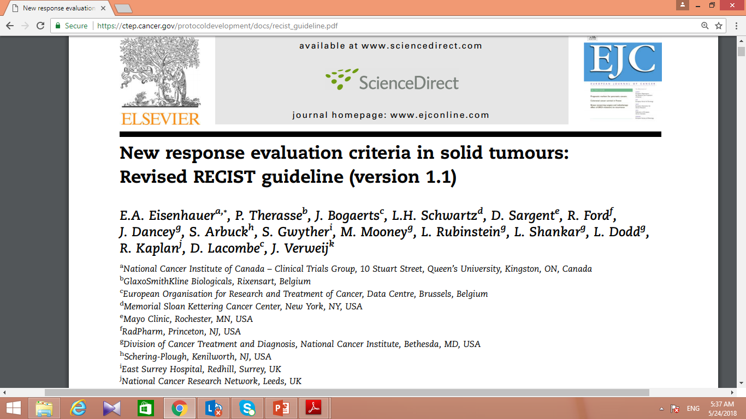
Response Evaluation Criteria in Solid Tumours

Slide 34
Stable or minimally progressive disease ?
RECIST CRITERIA: if the sum of the longest diameters of target lesions (soft tissue metastatic lesions >1 cm) increases < 20% in the absence of new metastatic foci on sequential imaging over 12 months of follow-up.
An appropriate frequency for repeat imaging : within 3–12 months based on the disease burden and locations of lesions.
ATA GUIDLINE,2015

Slide 35
Rapidly progressive and/or symptomatic disease?
RECIST CRITERIA: At least 20% increase in sum of longest diameters of target lesions,
Or the appearance of significant new metastatic lesions,
Development of disease-related symptoms,
should consider : systemic therapies or local therapy, Beyond TSH-suppressive therapy.
ATA GUIDLINE,2015

Slide 36
Rapidly progressive and/or symptomatic disease
Rising Tg :
Not be identified as having progressive disease and requiring more aggressive therapy;
But,
consider more frequent and comprehensive imaging to identify previously occult structural disease.
ATA GUIDLINE,2015

Slide 37
I-refractory metastatic DTC : local therapy ?
surgery, external beam radiotherapy, radiofrequency ablation, cryoablation and chemo-embolization: when the localized disease causing symptoms or posing risk to critical structures.
Nodal metastases greater than 8 mm in the central compartment or 10 mm in the lateral neck: surgically removed (radiofrequency ablation and ethanol injection also safe and effective) ,
Radiotherapy: for bone metastasis with pain, increased fracture risk and potential spinal cord compression.
Clinical guidance for radioiodine refractory differentiated thyroid cancer, Australia,2017

Slide 38
RAI refractory disease: Bone metastases
Bisphosphonate or denosumab be considered with :
diffuse and/or symptomatic bone metastases from RAI-refractory DTC, either alone or concomitantly with other therapies.
Adequate renal function,
calcium level,
and dental evaluation should be documented prior to each dose.
ATA GUIDLINE,2015

Slide 39
Tyrosine kinase inhibitors

Slide 40
Tyrosine kinases :
stimulating tumor proliferation, angiogenesis, invasion, metastasis,
TKIs : since the discovery of the oncogenic roles of mutations in serine kinase BRAF and tyrosine kinases RET and RAS (and of their normal ability to inhibit growth factor receptors such as vascular endothelial growth factor (VEGF) receptor),
Despite inhibition of oncogenic kinases by TKIs , the primary role of TKIs may be inhibition of angiogenesis.
J Clin Endocrinol Metab, January 2013, 98(1):31–42

Slide 41
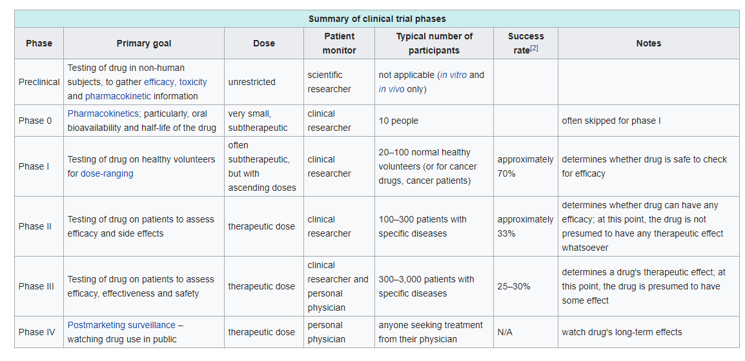
Phases of clinical research (Wikipedia)

Slide 42
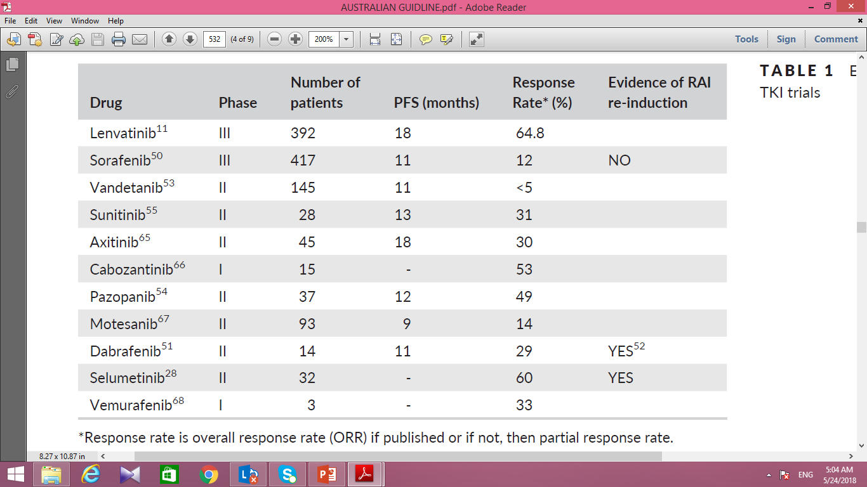
Examples of RAI refractory TKI trials
Clinical guidance for radioiodine refractory differentiated thyroid cancer, Australia,2017

Slide 43
Progression-free survival (Wikipedia)
The length of time during and after the treatment of a cancer, that a patient lives with the disease but it does not get worse.
The advantage of PFS over overall survival(OS): PFS appears sooner than deaths.
when new drugs tested, there is a pressure (that in some cases acceptable while in other cases hide economical interests) to approve new drugs on the basis of PFS data rather than waiting for OS data.
as a clinical endpoint in randomized controlled trials for cancer therapy, instead of OS.
FDA required studies of OS rather than PFS to demonstrate that a drug is effective against cancer, but recently accepted PFS.

Slide 44
Sorafenib and lenvatinib therapy
Neither of these drugs, yet demonstrated a significant overall survival benefit, due to a large proportion of the patients in the placebo arm who crossed over to receive active treatment after disease progression.
Kaplan-Meier curves suggests some improvement in OS with both sorafenib and lenvatinib therapy.
Financial toxicity is a non-negligible consideration.
prior use, not a contraindication to commencement of lenvatinib.
Clinical guidance for radioiodine refractory differentiated thyroid cancer, Australia,2017

Slide 45
Initiation of TKIs for RAI refractory DTC
As these medications cause life-threatening adverse effects, only physicians who have experience in the prescribing of these agents should initiate management.
Not initiate TKI in patients:
at high risk for adverse events (extremely uncontrolled hypertension, high risk for fistula or bleeding),
with poor performance status,
or a history of nonadherence to prescribed medications.
J Clin Endocrinol Metab, January 2013, 98(1):31–42

Slide 46
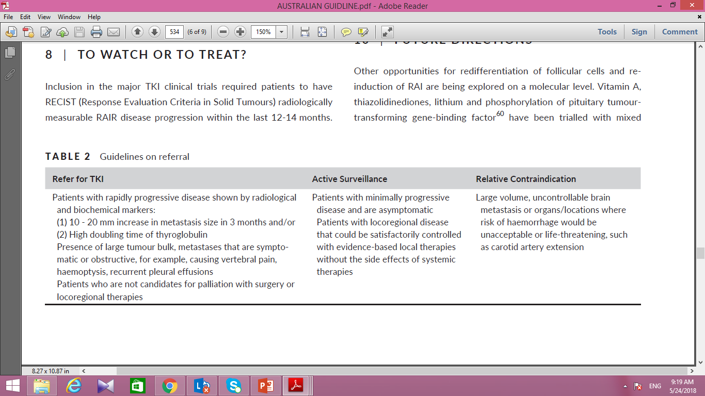
TO WATCH OR TO TREAT WITH TKI?
Clinical guidance for radioiodine refractory differentiated thyroid cancer, Australia,2017

Slide 47
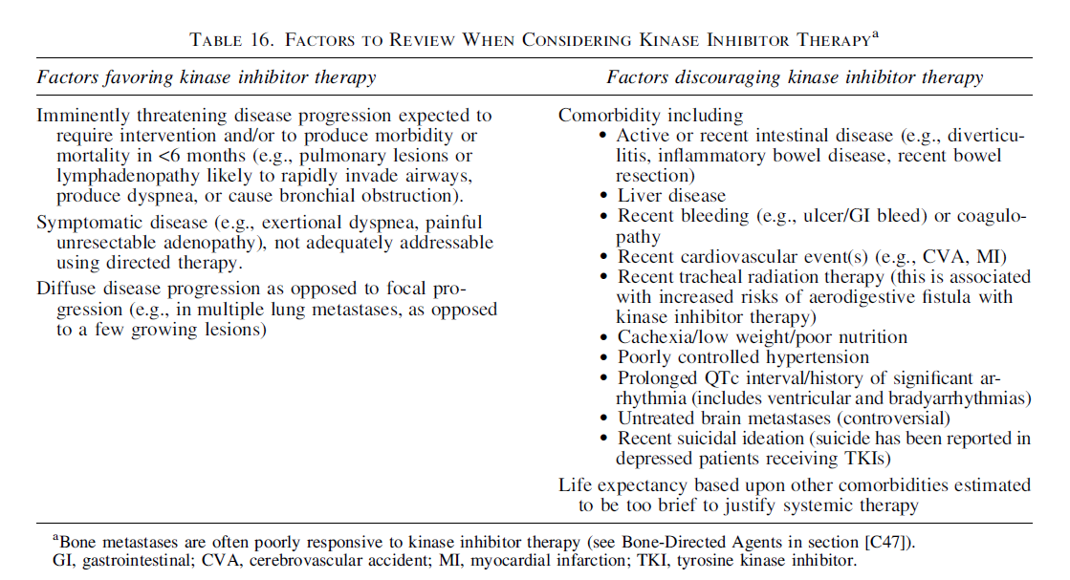
ADA GUIDLINE,2015

Slide 48
Initiation of TKIs for RAI refractory DTC
Initial evaluation include :
assessment of the patient’s performance status using (ECOG) or Karnofsky Performance Status (KPS) scales (as a good estimate of whether or not the patient can tolerate chemotherapy),
Evaluation of cardiovascular, hepatic, and renal systems.
J Clin Endocrinol Metab, January 2013, 98(1):31–42

Slide 49
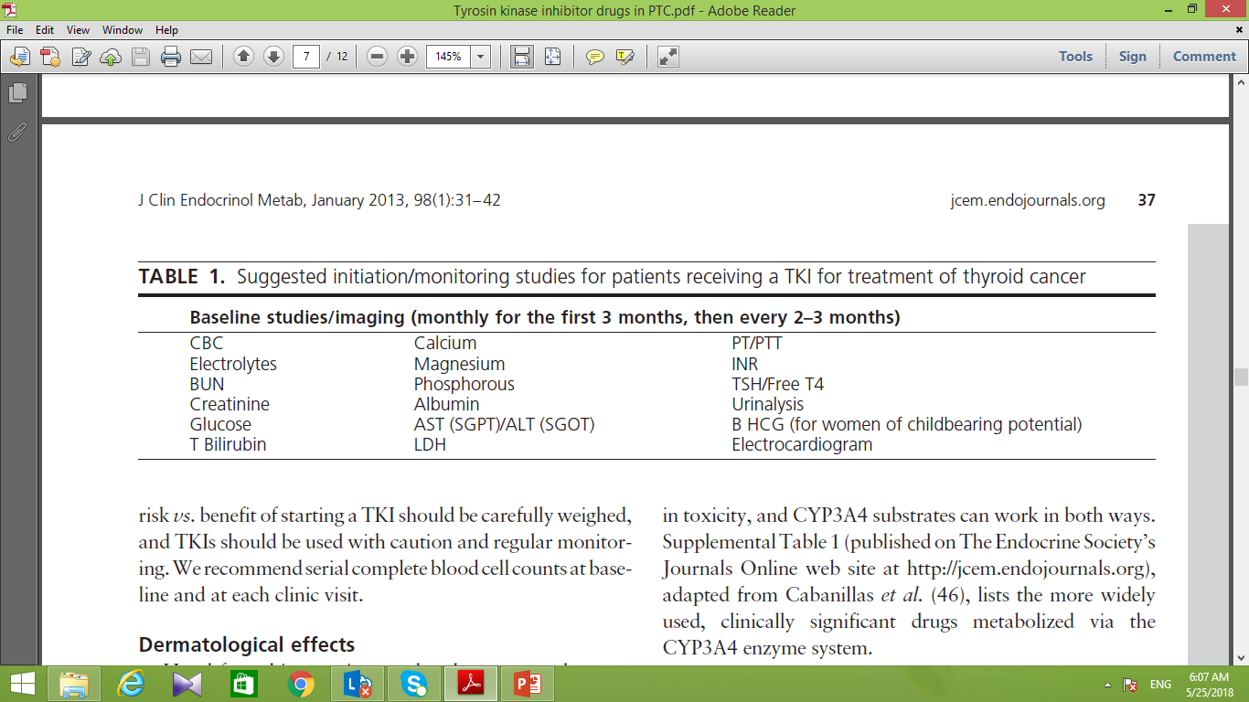
Initiation of TKIs for RAI refractory DTC
J Clin Endocrinol Metab, January 2013, 98(1):31–42

Slide 50
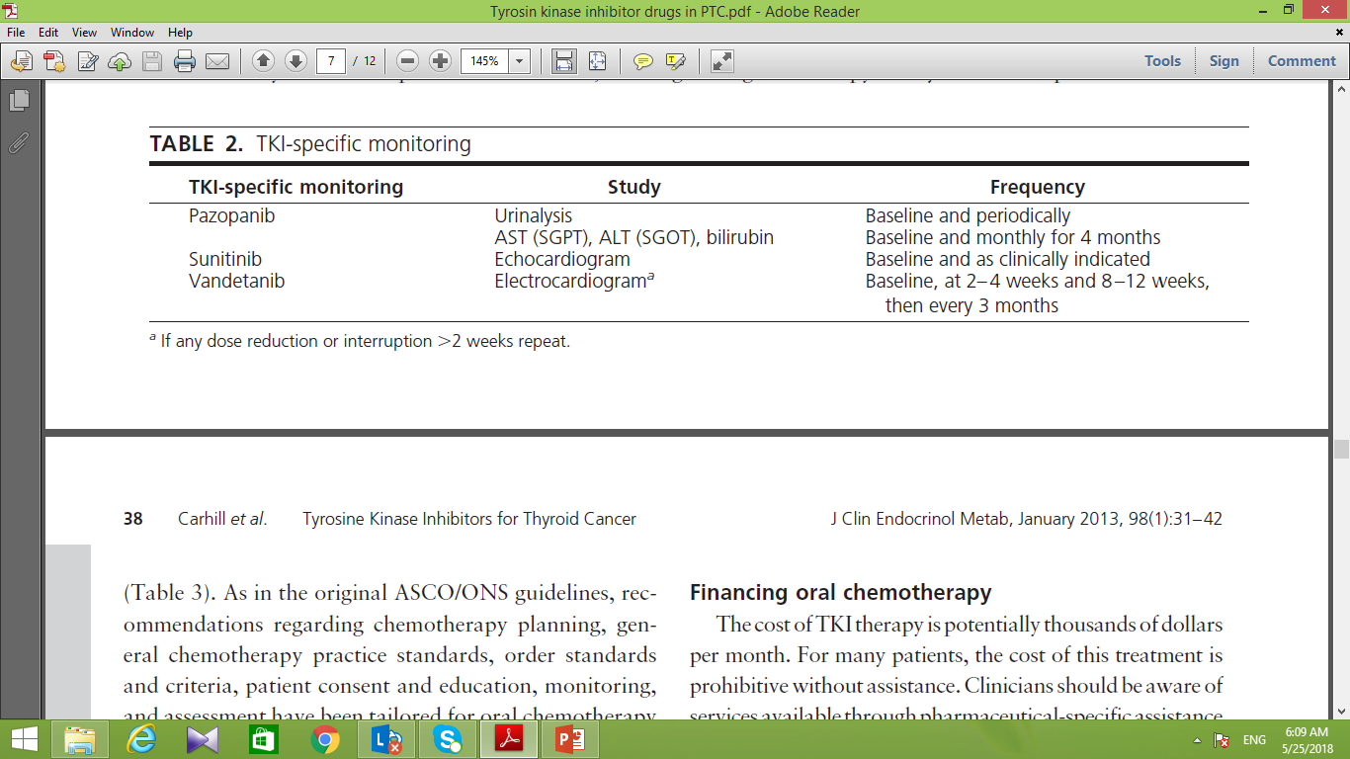
Initiation of TKIs for RAI refractory DTC
J Clin Endocrinol Metab, January 2013, 98(1):31–42

Slide 51
WHEN TO STOP TKI?
Patients must have stable or responding disease according to the RECIST criteria.
we recommend abrupt cessation of TKI, if there is radiological progression, especially in the setting of minimal toxicity.
Clinical guidance for radioiodine refractory differentiated thyroid cancer, Australia,2017

Slide 52
CONCLUSION
For stable radio-refractory metastatic disease (tumors <1 to 2 cm and growing less than 20 percent/year) : Not using systemic chemotherapy and perform imaging every six months to monitor for disease progression.
For progressive radio-refractory metastatic disease (tumors >1 to 2 cm and growing by at least 20 percent/year) or symptomatic metastatic disease : suggest lenvatinib and sorafenib (as next preferred option).

