Slide 1
GOD
NAME OF
IN THE

Slide 2
Editor Terry F. Davies, MD, FRCP Baumritter Professor of
Medicine, Division of Endocrinology, Diabetes, and Bone Diseases
Icahn School of Medicine at Mount Sinai New York , NY , USA
ISBN 978-1-4939-2058-7 ISBN 978-1-4939-2059-4 (eBook)
DOI 10.1007/978-1-4939-2059-4 Springer New York Heidelberg
Dordrecht London
Library of Congress Control Number: 2015930737
© Springer Science+Business Media New York 2015

Slide 3
Incidence of Bone Metastases in Differentiated Thyroid Cancer
Bone metastases are uncommon in thyroid cancer.
While follicular thyroid cancer accounts for less than 15 % of
all differentiated thyroid cancers, bone metastases occur in
up to 7–20 % of these patients.

Slide 4
Bone metastases are less common in papillary thyroid cancer,
but still may be seen in up to 1–7 % of cases. In absolute terms
however, the number of patients with bone metastases due to
papillary thyroid cancer is higher since papillary thyroid cancer
is more common.
Overall, the incidence of bone metastases in well-differentiated
thyroid cancer is 2–13 %.

Slide 5
Skeletal metastases often are clinically silent but can present
with pain, pathologic fracture, painful radiculopathy, bladder
and bowel incontinence, and weakness of one more extremities
from spinal cord compression.
Spine is the most common site of bone metastases and 25 %
of patients may have isolated bone metastases, with 15 % having
both lung and bone metastases. It is important to be vigilant for
metastatic disease since the presence of metastases lowers the
10-year survival rates for differentiated thyroid cancer from
about 90 % to 40 %.

Slide 6
How to Diagnose Bone Metastases
It can be difﬁcult to detect bone metastases from thyroid cancer.
Diagnostic I-131 scans are insensitive, while post-therapy scans
perform better.
X-rays and bone scintigraphy can be used in the evaluation of
osseous metastases, but these imaging modalities are often
limited by their poor speciﬁcity and their ability to detect disease
only when more than half of an involved bone has been
destroyed.

Slide 7
Tc-99 bone scintigraphy can detect skeletal metastases earlier
than plain radiographs when there is a predominant osteoblastic
component to the lesion. But because thyroid cancer metastases
are predominantly osteolytic, bone scintigraphy is of limited
value in thyroid cancer with high false positive and false negative
rates.
MRI of the whole body or of speciﬁc bones is an excellent
modality to visualize the medullary component of bones and
detailing the extra-skeletal extent of disease.

Slide 8
Whole body MRI has higher sensitivity than PET/CT for
diagnosis of osseous metastases (85–95 % vs. 62–91 %).
CT alone is valuable in imaging cortical bone. In a prospective
study of 80 patients comparing FDG PET/CT, I-131 SPECT/CT, and
99m Tc-MDP bone scans. FDG PET/CT and I-131 SPECT/CT were
signiﬁcantly superior to bone scans in detecting osseous
metastases. PET scans have a role in predicting prognosis as well;
a positive PET/CT increases the risk of death from thyroid cancer
by fourfold.

Slide 9
Two future modalities for detecting bone metastases are
18F-ﬂuoride PET/CT and Iodine-124. 18F-ﬂuoride is a bone
seeking, positron emitting molecule with excellent sensitivity
and speciﬁcity for detecting bone lesions, especially osteolytic
metastases.
When combined with PET/CT, 18F-ﬂuoride can provide exquisite
spatial resolution of osseous metastases with some studies
suggesting better performance than PET/CT and Tc-99 bone
scintigraphy.

Slide 10
I-124 emits a positron that can be detected by PET scan.
One study has demonstrated the superiority of I-124 PET/CT
compared to I-131, I-124, and CT scans alone in detecting bone
metastases.
We recommend that when extra cervical spread is suspected,
one should obtain an FDG-PET/CT. If bone metastases are
discovered, then a directed MRI or CT should be employed to
speciﬁcally deﬁne the lesion(s) of interest and as an aid in
planning any surgical approaches or use of other modalities in
the treatment of destructive osseous lesions.

Slide 11
Role of Biopsy in Evaluating Bone Lesions
In most situations where the histology of primary malignancy
has been established, it is usually unnecessary to biopsy new
lesions that present at distant sites. However, if a bone lesion
represents the ﬁrst manifestation of recurrent thyroid cancer,
biopsy is recommended. Bone biopsy is not necessary if the bone
lesions take up radioactive iodine on diagnostic or post-therapy
I-131 scans or if a patient with widespread disease has
undergone bone biopsy before conﬁrming metastases of thyroid
origin.

Slide 12
A needle biopsy is recommended for newly detected spine and
pelvis bone lesions that do not take up radioiodine. Sections of
biopsy should be carefully examined for histological subtype
(papillary, follicular, Hürthle cell, and poorly differentiated
carcinomas). Special stains for thyroid transcription factor (TTF),
Tg, cytokeratin, and calcitonin should be employed and the need
for supplemental stains like prostate-speciﬁc antigen should be
individualized

Slide 13
Another simple technique that can be used in evaluating distant
metastases is detection of thyroglobulin in the washout of ﬁne needle
aspirates of nonthyroidal masses.
Once a bone biopsy has conﬁrmed the origin of the tumor, I do not
recommend biopsies of subsequent skeletal lesions except in rare
circumstances.

Slide 14
Therapy with I-131 for Bone Metastases
There is no prospective study evaluating the effect of I-131
therapy on survival in patients with metastatic differentiated
thyroid cancer. A retrospective study of 444 patients by Durante
et al. showed that only 7 % of patients with bone metastases
achieved remission with I-131 therapy and even 43 % of patients
who had iodine avid lesions still did not achieve remission with
radioactive iodine therapy.

Slide 15
The factors that predicted response to I-131 therapy were age <40
years, solitary lesion and well-differentiated cancer. 10-year survival
rates for complete responders, partial responders, and non
responders were 92%, 29%, and 10%, respectively.
The efﬁcacy of I-131 treatment may be improved by using dosimetry
protocols.

Slide 16
Several studies have demonstrated that skeletal metastases
treated under a dosimetry protocol achieved greater reduction
in tumor volume and Tg levels than a historical control group that
was treated with a ﬁxed dose of radioiodine. Also, dosimetry
may identify lesions that do not concentrate radioiodine to a
degree that would allow the delivery of a therapeutic radiation
dose, thus distinguishing patients who may not beneﬁt from
I-131 therapy.

Slide 17
A retrospective review of 107 patients with an initial skeletal
metastasis demonstrated signiﬁcantly higher rates of total or
partial remissions in patients younger than 45 years old (62.5 %)
compared to patients over 45 years of age (49.5 %).
In younger patients with three or fewer bone lesions, 75 %
achieved complete remission, suggesting that I-131 can be used
with curative intent in speciﬁc situations.

Slide 18
Role of Surgery and Other Local Treatment Modalities
for Bone Metastases
Several studies have reported survival beneﬁt if resection of
metastases is undertaken. There is potential for considerable
bias in this conclusion since in many cases surgical resection is
never contemplated since complete resection is unachievable
given the burden of the disease; these patients may have poor
prognosis to begin with.

Slide 19
Some authors have suggested that resection of basal skull
metastases should not be undertaken. Nevertheless, surgery is
indicated for intractable pain, neurological deﬁcit, and cervical
instability.

Slide 20
Selective arterial embolization therapy is a minimally invasive
procedure that is particularly useful for preparing selected
patients for open surgery of targeted metastatic lesions.
It decreases the blood ﬂow to the lesion thus signiﬁcantly
lowering the intraoperative blood loss. Embolization has been
associated with decreasing serum Tg levels.

Slide 21
However, embolization therapy alone does not appear to confer
a survival beneﬁt though it helps achieve improvement in pain
and neurological symptoms.
Percutaneous spinal tumor ablation can be accomplished by
various techniques which include radiofrequency ablation (RFA),
cryotherapy, and ethanol ablation.

Slide 22
In a study of 43 patients at Mayo clinic, radiofrequency ablation
was able to control pain in 95 % of cases. Complications occurred
in three patients and included a second- degree burn at the
grounding pad site, fracture at the site of ablation, and transient
bowel and bladder incontinence after treating a sacral lesion.
RFA can be considered for pain palliation or as an adjunct to
surgery.
Cryotherapy has also been used for palliation of symptoms from
metastatic bone disease.

Slide 23
Adjunctive Therapy with Bisphosphonates and
Denosumab
Regardless of the form of deﬁnitive treatment chosen, one
should consider the use of bisphosphonates or denosumab to
prevent the secondary complications of bone metastases and
also to reduce pain.
Bisphosphonates inhibit osteoclast activity, so it has been
proposed that these agents slow or prevent the skeletal
complications of bone metastases.

Slide 24
There is a paucity of data on treatment of bone metastases
from thyroid cancer with these agents but they are being used in
management of bone metastases from other solid malignancies.
In a study by Vitale et al., pamidronate 90 mg was administered
intravenously to 10 thyroid cancer patients with bone metastases
every month for 12 months.

Slide 25
The patients had a signiﬁcant decrease in bone pain and partial
radiographic response was observed in 2/10 patients while 5/10
patients had stabilization of their bone lesions. In a retrospective
study by Orita et al. in thyroid cancer patients with metastatic
bone disease, zoledronic acid 4 mg intravenously every month
for average of 16 months signiﬁcantly delayed the onset of
skeletal-related events (SRE) compared to patients who did not
get zoledronic acid.

Slide 26
The SREs included pathological fracture, need for orthopedic
surgery or radiation, and spinal cord compression.
The SRE free 3-year survival rate was 86 % in the treated group
compared to 50 % in the untreated group. Intravenous and oral
ibandronate have also been studied in other cancers and have
demonstrated effectiveness in reducing bone pain and time to
SRE. Side effects associated with intravenous bisphosphonates
are fever, myalgias, nausea, and bone pain.

Slide 27
They are usually mild and can be managed with antipyretics and
they tend to become uncommon on subsequent infusions.
Renal toxicity is the main concern with intravenous
bisphosphonates and is directly related to dose and infusion time.
It is advisable to monitor renal function and creatinine clearance
with every cycle of IV bisphosphonate.

Slide 28
Adequate supplementation with calcium and vitamin D can
prevent most cases of hypocalcemia. For those who measure
25-hydroxyvitamin D levels, the target range should be
approximately >30 ng/ml to reduce the risk of hypocalcemia.
Denosumab is a fully human monoclonal antibody of IgG2
subtype. It acts by neutralizing RANKL, preventing its binding to
RANK on osteoclasts and their precursor cells, thereby inhibiting
osteoclast proliferation and function and reducing bone
resorption.

Slide 29
In a phase-3 trial comparing subcutaneous denosumab 120 mg
every 4 weeks to intravenous zoledronic acid 4 mg every 4 weeks
for 1 year in patients with bone metastases from solid tumors,
denosumab delayed the onset of a SRE event by 27.66 months
and this was signiﬁcantly higher than zoledronic acid which
delayed the onset of a skeletal related event by 19.45 months.
There were no differences between denosumab and zoledronic
acid groups in terms of overall disease progression.

Slide 30
The common side effects associated with administration of
denosumab are fever, fatigue, nausea, and anorexia.
Hypocalcemia is more common with denosumab than with
zoledronic acid with an incidence as high as 9.6 %. As with
bisphosphonates, adequate supplementation with calcium and
vitamin D can prevent most cases of hypocalcemia.

Slide 31
Osteonecrosis of the jaw (ONJ) has been associated with IV
bisphosphonates and subcutaneous denosumab. The risk of ONJ
in cancer patients treated with monthly doses of these agents
may be as high as 1–10/100 patients.
Risk factors for ONJ include head and neck radiotherapy,
periodontal disease, dental procedures involving bone surgery,
edentulous regions, and trauma from poorly ﬁtting dentures.

Slide 32
Malignancy, chemotherapy, corticosteroids, and systemic infections
are additional risk factors. Atypical fractures of the femoral diaphysis
have been reported in patients on long-term (3–8 years)
bisphosphonates and those on denosumab.
Although these fractures have been reported mostly in patients
who have been treated with bisphosphonates (especially those
on glucocorticoids), atypical femoral fractures have occurred in
patients with no history of bisphosphonate use.

Slide 33
Given the lack of comprehensive clinical trial data on the efﬁcacy
of bisphosphonates and denosumab for patients with bone
metastases from thyroid cancer, the optimal treatment regimen
and duration of therapy is unknown. For those who suffer an
acute pathologic fracture or have extensive, symptomatic bone
metastases, or short life expectancy, we think it is reasonable to
follow the prescribing information for both agents and give full
doses (zoledronic acid 4 mg intravenously or denosumab 120 mg
subcutaneously) every 4 weeks.

Slide 34
Based on trial data for other malignancies, we are prepared to
treat severely affected patients with metastatic disease to bone
monthly for 2–4 years. For patients who have a solitary bone
metastasis or stable bone metastases, particularly if
asymptomatic, and with a life expectancy more than 5 years, we
think a prudent course would be to administer zoledronic acid 4
mg twice yearly and denosumab 120 mg twice yearly.

Slide 35
For those who develop new bone metastases or progression of
older metastases, we recommend treating with zoledronic acid
4 mg every 1–3 months or denosumab 120 mg every 1–3
months. If patients go on to develop stable disease, then it seems
reasonable to reduce the dosing frequency of these drugs to
twice yearly, especially if life expectancy is prolonged.
If patients deteriorate and develop progressive or symptomatic
disease from bone metastases, then it makes sense to ratchet up
the dosing frequency to every 1–3 months depending on the
clinical severity.

Slide 36
While these recommendations differ somewhat from those with
bone metastases from other solid tumors, since patients with thyroid
cancer may live many years even with osseous metastases, it seems a
reasonable compromise between the potential advantages
bisphosphonates and denosumab may offer and the potential adverse
effects that could be linked to their long-term use, speciﬁcally atypical
femoral shaft fractures and osteonecrosis of the jaw.

Slide 37
Palliative Treatment
Surgery and percutaneous ablation may be used for palliative
treatment in selected patients. In a retrospective review at a single
institution, 41 patients underwent surgery for thyroid carcinoma bone
metastasis from 1988 to 2011. Overall patient survival probability was
72 % at 1 year, 29 % at 5 years, and 20 % at 8 years.
Disease progression at the surgery site occurred more frequently with
a histological diagnosis of follicular carcinoma compared with other
subtypes ( p = 0.023).

Slide 38
Patients who had their tumor excised ( p = 0.001) or presented with
solitary bone involvement had a lower risk of death following surgery
adjusting for age and gender.
External beam radiotherapy (EBRT) is used to palliate pain in some
individuals. EBRT should be used only when there is signiﬁcant pain,
risk of fracture, and risk of spinal cord compression.

Slide 39
It is more useful in radioiodine refractory disease. When used with
debulking surgery, it is more successful in achieving the goals of pain
improvement and reducing risk of neurological sequelae than either
therapeutic option alone.

Slide 40
New Directions: Tyrosine Kinase Inhibitors
Tyrosine kinase is involved in the activation of cell growth and
proliferation through a number of pathways which include RET and
MAP kinases. Tyrosine kinase inhibitors are competitive inhibitors of
tyrosine kinase receptors. They also act on VEGF receptors to inhibit
vascular proliferation. Since the tyrosine kinase receptors and VEGF
receptors are widely distributed, tyrosine kinase inhibitors target
multiple tissues.

Slide 41
Sorafenib has been approved by the Food and Drug Administration
for the treatment of progressive, metastatic well-differentiated
thyroid carcinoma refractory to radioactive iodine (RAI) treatment.
A phase-3 trial of sorafenib in metastatic differentiated thyroid cancer
not responsive to RAI treatment increased the progression free
survival to 10.8 months compared with 5.8 months in patients
receiving placebo.

Slide 42
Phase-2 trials of sorafenib in iodine refractory metastatic well-
differentiated thyroid cancer have shown partial response rates in
15–23 % of patients and stable disease in 53–56 %. While the general
response of patients to these compounds has been encouraging with
signiﬁcant increases in progression free survival, the speciﬁc value of
these agents for bone metastases has not yet been elucidated.

Slide 43
In one study, 62 patients with various subtypes of thyroid
cancer were treated with sorafenib (62 %), sunitinib (22 %), and
vandetanib (16 %) outside of clinical trials. Most were treated
with a single TKI, but a few were exposed to several lines of TKI
therapy. Of those treated with sorafenib and sunitinib, the partial
response (PR) rate was 15 % and 8 %, respectively.

Slide 44
However, bone and pleural lesions were the most refractory sites to
treatment, suggesting TKIs might not be an optimal therapy for those
with osseous metastases as the only site of distant disease.
Patients taking tyrosine kinase inhibitors need to be
monitored for development of hypertension, prolongation of QTc
interval, elevation of liver enzymes, bone marrow suppression, and
heart failure.

Slide 45
The most common skin reaction associated with use of these agents
is hand–foot skin disease, a blistering skin toxicity.
Contraindications to their use include healing surgical wounds,
QTc interval >450 ms, recent radiotherapy treatment, and history of
cerebral or gastrointestinal bleeding within the 6 months prior to
use of TKI therapy.

Slide 46
Monitoring and Follow-Up
Thyroglobulin is a sensitive and speciﬁc marker for follow-up of
thyroid cancer patients especially after total thyroidectomy and
radioactive iodine ablation. It is usually <0.2 ng/ml after total
thyroidectomy and RAI ablation. one must rule out the presence of
anti-Tg antibodies in the serum.

Slide 47
A value of more than 2 ng/ml should prompt further investigation
with diagnostic radioiodine whole body scan and neck sonogram.
If these are negative, PET/CT scan, CT chest and bone imaging should
be considered. Suppressive levothyroxine therapy should be used in
all intermediate to high-risk thyroid cancer patients with a goal
TSH <0.1 μU/ml.

Slide 48
2015 American Thyroid Association Management Guidelines for Adult Patients with Thyroid Nodules and Differentiated Thyroid Cancer
A) RAI therapy of iodine-avid bone metastases has been
associated with improved survival and should be employed,
although RAI is rarely curative.
(Strong recommendation, Moderate-quality evidence)

Slide 49
B) The RAI activity administered can be given empirically
(100–200 mCi) or determined by dosimetry.
(Weak recommendation, Low-quality evidence)
RAI therapy for patients with bone metastases is rarely curative,
but some patients with RAI-avid bone metastases may beneﬁt from
this therapy. A dosimetrically determined administered dose of RAI
may be beneﬁcial for patients with bone metastases, although this is
not proven in controlled studies.

Slide 50
Kinase inhibitors
RECOMMENDATION
(A) Kinase inhibitor therapy should be considered in RAI refractory DTC
patients with metastatic, rapidly progressive, symptomatic, and/or
imminently threatening disease not otherwise amenable to local control
using other approaches Kinase inhibitors that are FDA approved for
differentiated thyroid carcinoma or other available kinase inhibitors
(preferably within the context of therapeutic clinical trials) can be
considered since the impact of these agents on overall survival and quality
of life remains to be deﬁned.
(Weak recommendation, Moderate-quality evidence)

Slide 51
RECOMMENDATION
(B) Patients who are candidates for kinase inhibitor therapy should be
thoroughly counseled on the potential risks and beneﬁts of this
therapy as well as alternative therapeutic approaches including best
supportive care. Appropriate informed consent should be obtained
and documented in the medical record prior to initiation of any
therapy, regardless of whether the patient is being treated in the
context of a clinical trial.
(Strong recommendation, Low-quality evidence)

Slide 52
Bone-directed agents
RECOMMENDATION
Bisphosphonate or denosumab therapy should be considered in
patients with diffuse and/or symptomatic bone metastases from
RAI-refractory DTC, either alone or concomitantly with other systemic
therapies. Adequate renal function (bisphosphonates) and calcium
level (bisphosphonates and denosumab) should be documented prior
to each dose, and dental evaluation should take place before initial
use. (Strong recommendation, Moderate-quality evidence)

Slide 53
Patients with a small number of threatening and/or symptomatic
bone lesions are generally best treated with focal approaches
such as radiation therapy and/ or surgery and/or thermoablation.
focal therapy to symptomatic lesions or lesions at high risk of
complications may be beneﬁcial and should be performed before
initiation of systemic treatment.

Slide 54
Bisphosphonates (especially zoledronic acid) and the RANK
ligand–directed agent denosumab have been shown to delay
time to occurrence of subsequent skeletal-related adverse
events (fracture, pain, neurologic complications)and to improve
symptoms, and these agents may provide beneﬁts for patients
with diffuse bone metastases

Slide 55
Expert consensus is that bone-directed therapy should be strongly
considered in patients with multiple progressing and/or
symptomatic bone metastases, likely best beginning with
bisphosphonate/zoledronic acid (assuming calcium and renal
function permit).
Zoledronic acid therapy every 3 months

Slide 56
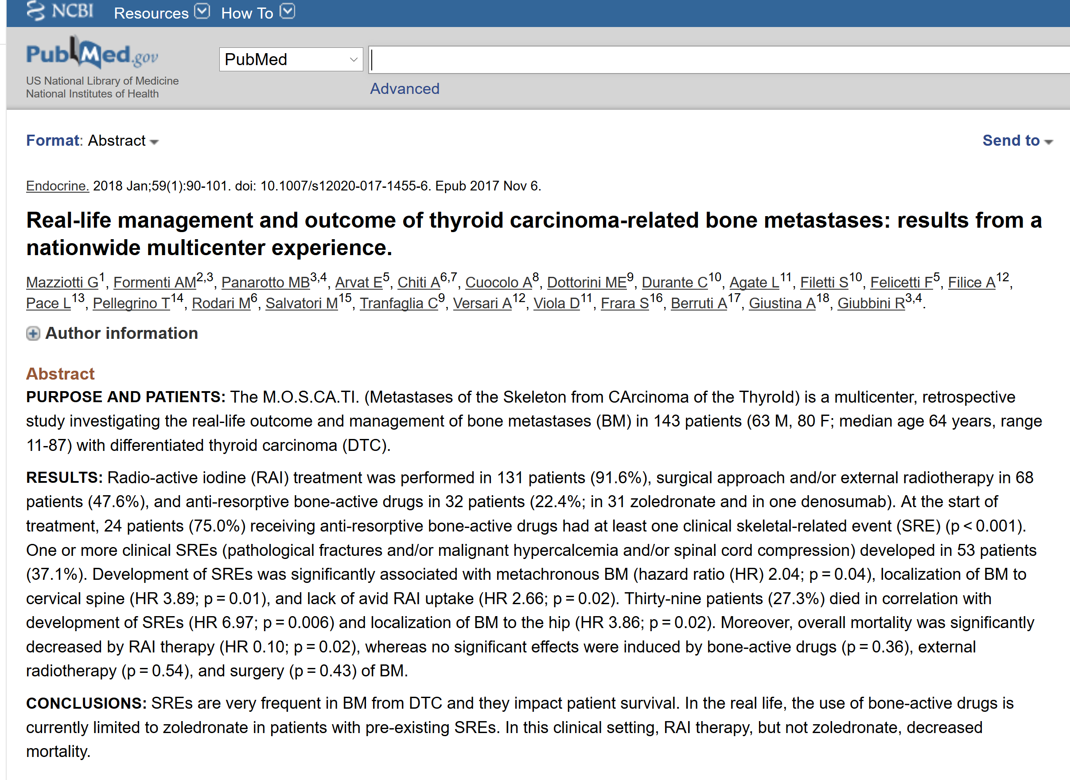

Slide 57
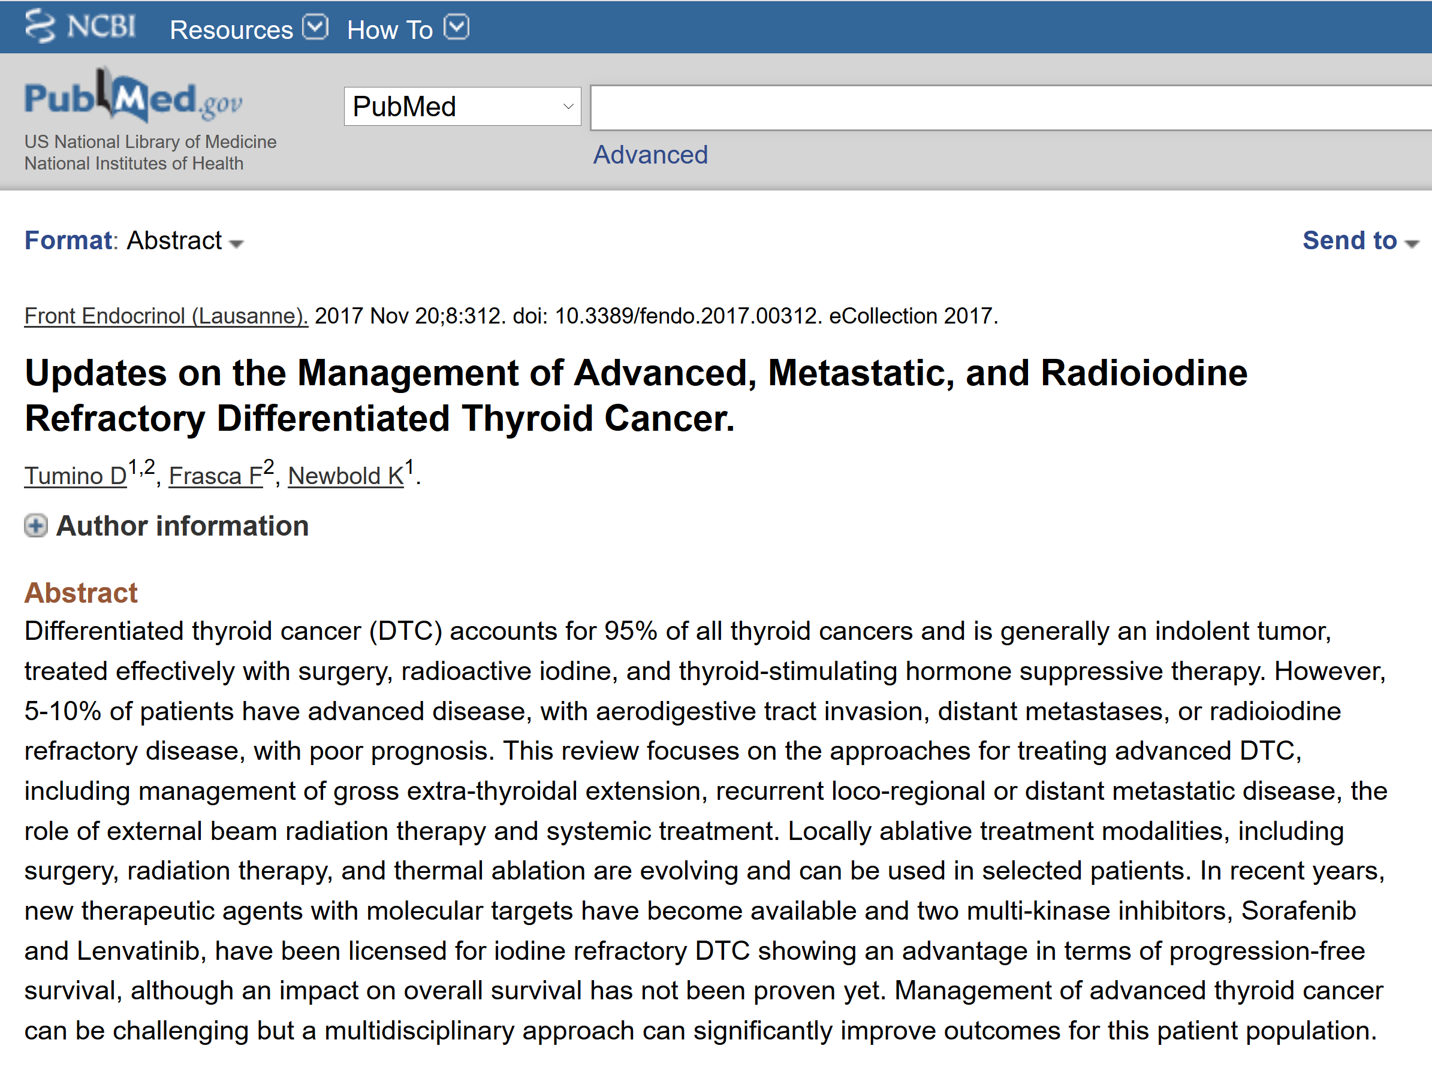

Slide 58
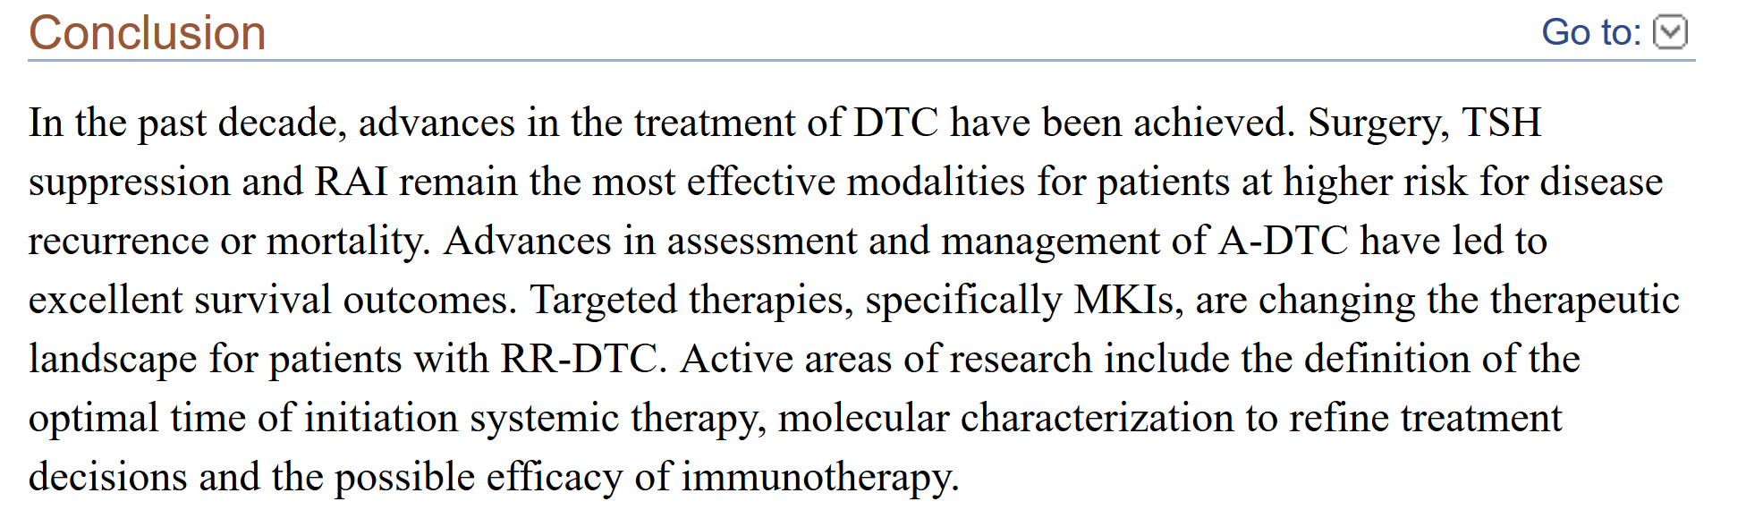

Slide 59
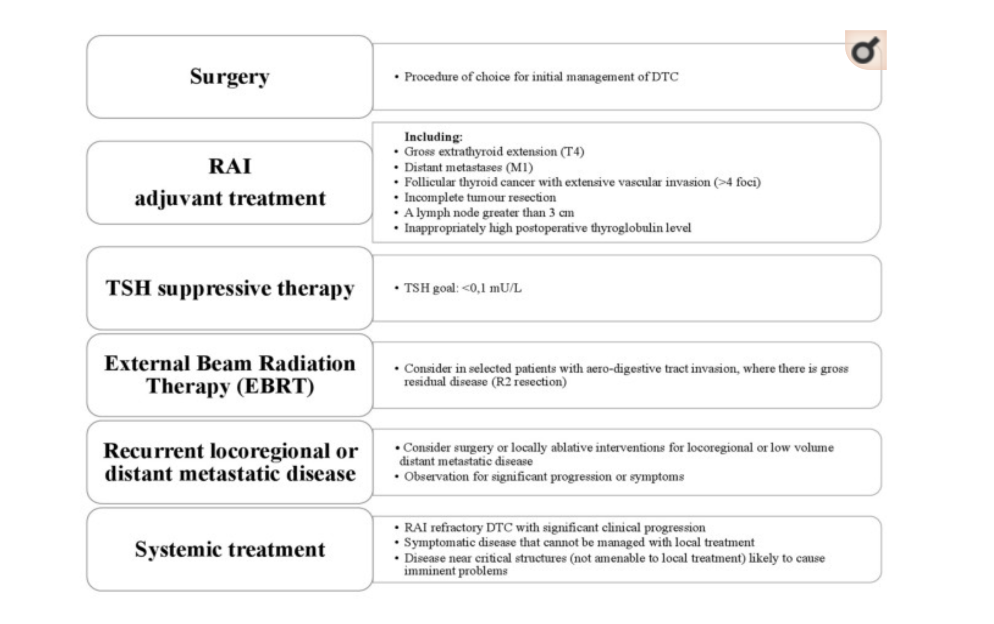

Slide 60
THANKS
FOR YOUR
ATTENTION

