Slide 1
Testosterone Therapy in Men With Hypogonadism
An Endocrine Society Clinical Practice Guideline
Presented by :
Dr. G.Taghipour, MD
Sh. Bhasin, et al., J Clin Endocrinol Metab, May 2018, 103(5):1–30
Notes:
To use this title animation slide with a new image simply 1) move the top semi-transparent shape to the side, 2) delete placeholder image, 3) click on the picture icon to add a new picture, 4) Move semi-transparent shape back to original position, 5) Update text on slide.

Slide 2
Table of Contents
Treatment of Hypogonadism With Testosterone
Efficacy
Adverse events associated with testosterone therapy
Older men with age-related decline in testosterone concentration
Patients with chronic illness and low testosterone concentrations
HIV-infected men with weight loss
Men with type 2 diabetes mellitus
Diagnosis of Hypogonadism in Men
Diagnosis of men with suspected hypogonadism
Screening and case detection for hypogonadism
Distinguishing between primary or secondary hypogonadism
Evaluation for determining the etiology of hypogonadism
Monitoring of Testosterone Replacement Therapy
Other syndromes associated with hypogonadism in men
Hypogonadism associated with chronic opioid use

Slide 3
Hypogonadism is a clinical syndrome that results from failure of the testis to produce physiological concentrations of testosterone (T) (T deficiency) and/or a normal number of spermatozoa due to pathology at one or more concentrations of the hypothalamic–pituitary–testicular axis.
Hypogonadism
Abnormalities at the testicular level cause primary hypogonadism, whereas defects of the hypothalamus or the pituitary cause secondary hypogonadism.
Hypogonadism also can result from defects that affect both the testis and the hypothalamus–pituitary unit. (combined hypogonadism)

Slide 4
Primary hypogonadism results in low T concentrations, impairment of spermatogenesis, and elevated gonadotropin levels.
Causes of primary hypogonadism include:
Klinefelter syndrome (KS),
Cryptorchidism,
Some types of cancer chemotherapy,
Radiation to the testes,
Trauma,
Torsion,
Infectious orchitis,
HIV infection, anorchia syndrome, and
Myotonic dystrophy.

Slide 5
Secondary hypogonadism results in low T concentrations, impairment of spermatogenesis, and low or inappropriately normal gonadotropin levels.
Causes of secondary hypogonadism include
Hyperprolactinemia;
Severe obesity;
Iron overload syndromes;
The use of opioids, glucocorticoids, or androgen-deprivation therapy with gonadotropin-releasing hormone agonists; and
Rogenic–anabolic steroid (AAS) withdrawal syndrome;
Idiopathic hypogonadotropic hypogonadism;
Hypothalamic or pituitary tumors or infiltrative disease;
Head trauma; and
Pituitary surgery or radiation.

Slide 6
The classification of hypogonadism as primary or secondary has therapeutic implications. Spermatogenesis can be stimulated and fertility can be restored with appropriate gonadotropin therapy in patients with secondary hypogonadism but not in patients with primary hypogonadism. Fertility options for men with primary testicular failure are limited to the use of donor sperm, adoption, or (in some patients) assisted reproductive technologies, such as intracytoplasmic sperm injection using sperm in the ejaculate or following testicular sperm extraction.
FACT

Slide 7
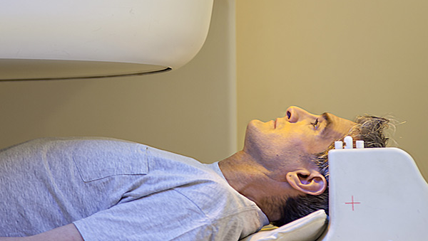
Diagnosis of
Hypogonadism
in Men
Notes:
To use this title animation slide with a new image simply 1) move the top semi-transparent shape to the side, 2) delete placeholder image, 3) click on the picture icon to add a new picture, 4) Move semi-transparent shape back to original position, 5) Update text on slide.

Slide 8
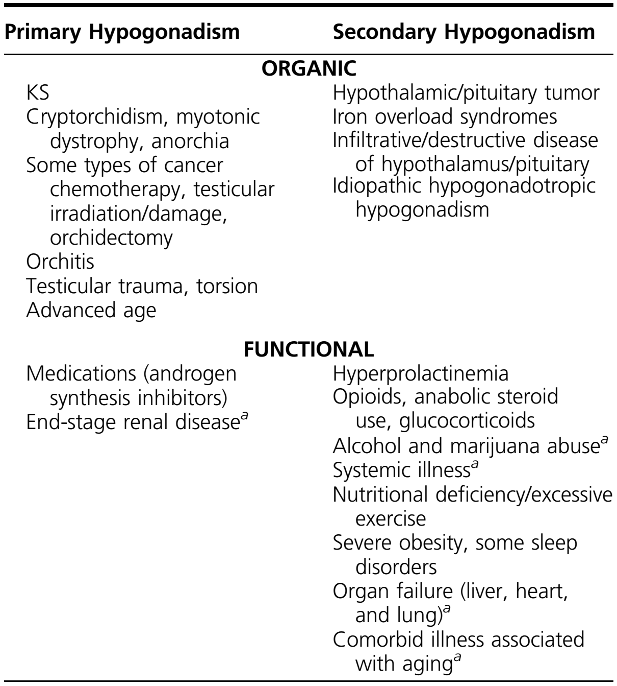
Causes of Hypogonadism
Organic hypogonadism (also referred to as “classical” hypogonadism) is caused by a congenital, structural, or destructive disorder that results in permanent hypothalamic, pituitary, or testicular dysfunction (primary or secondary hypogonadism).
Functional hypogonadism is caused by conditions that suppress gonadotropin and T concentrations but that are potentially reversible with treatment of the underlying etiology.

Slide 9
HINT
!
The process of evaluating secondary hypogonadism may uncover a deficiency/excess of other pituitary hormones or a hypothalamic or pituitary tumor that may require management in addition to treating hypogonadism.
Secondary hypogonadism can result from functional causes (e.g., obesity, opioids, or systemic illness) that might be reversible by treating the underlying condition or discontinuing the offending medication.
Managing the underlying conditions, such as obesity, may have additional health benefits.

Slide 10
1
Diagnosis of men with suspected hypogonadism
We recommend diagnosing hypogonadism in men with symptoms and signs of testosterone deficiency and unequivocally and consistently low serum total testosterone and/or free testosterone concentrations (when indicated).
Notes:
Tip:
When using complex image as full-bleed background add a transparency (70%-90%) fill layer to give contrast to text.

Slide 11
Testosterone concentration measurement
Testosterone concentrations exhibit significant diurnal and day-to-day variations and may be suppressed by food intake or glucose.
Therefore, clinicians should measure total testosterone concentrations on two separate mornings when the patient is fasting.
Clinicians should use an accurate and reliable method, optimally, an assay that has been certified by an accuracy-based standardization or quality control program

Slide 12
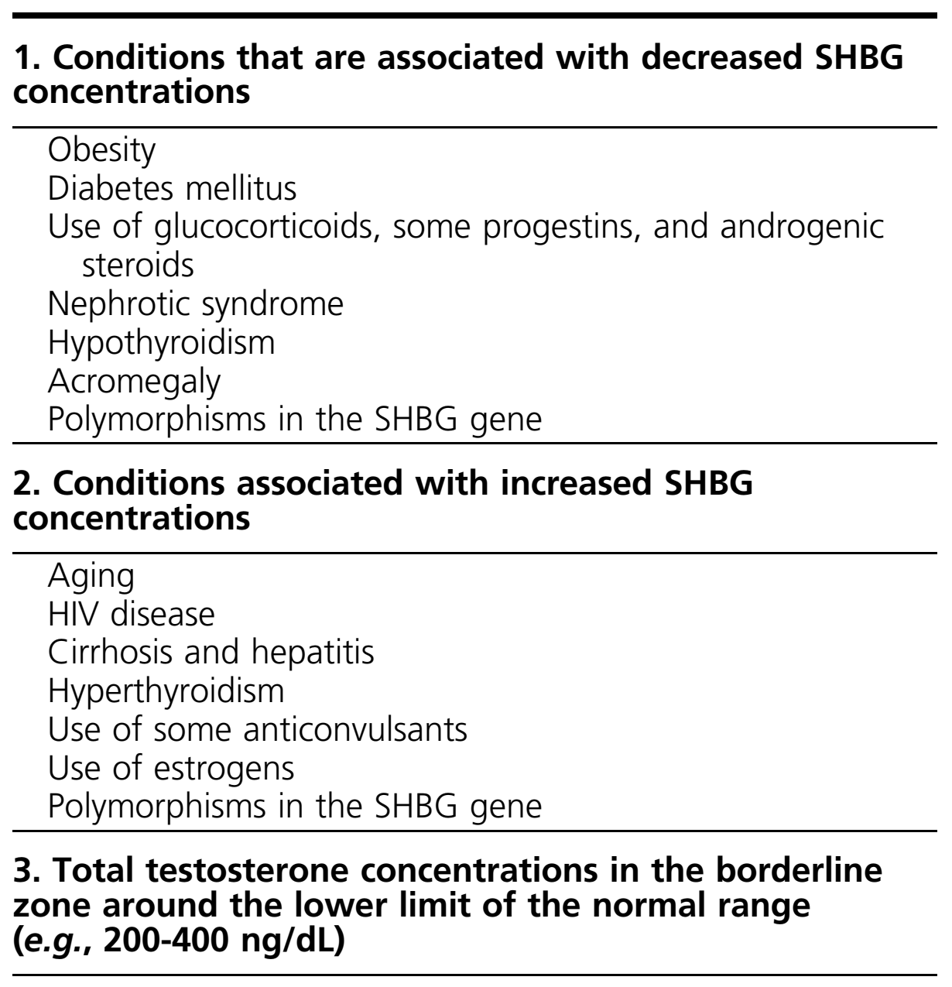
FT concentration
Measurement
Conditions in Which Measurement of FT Concentration Is Recommended

Slide 13
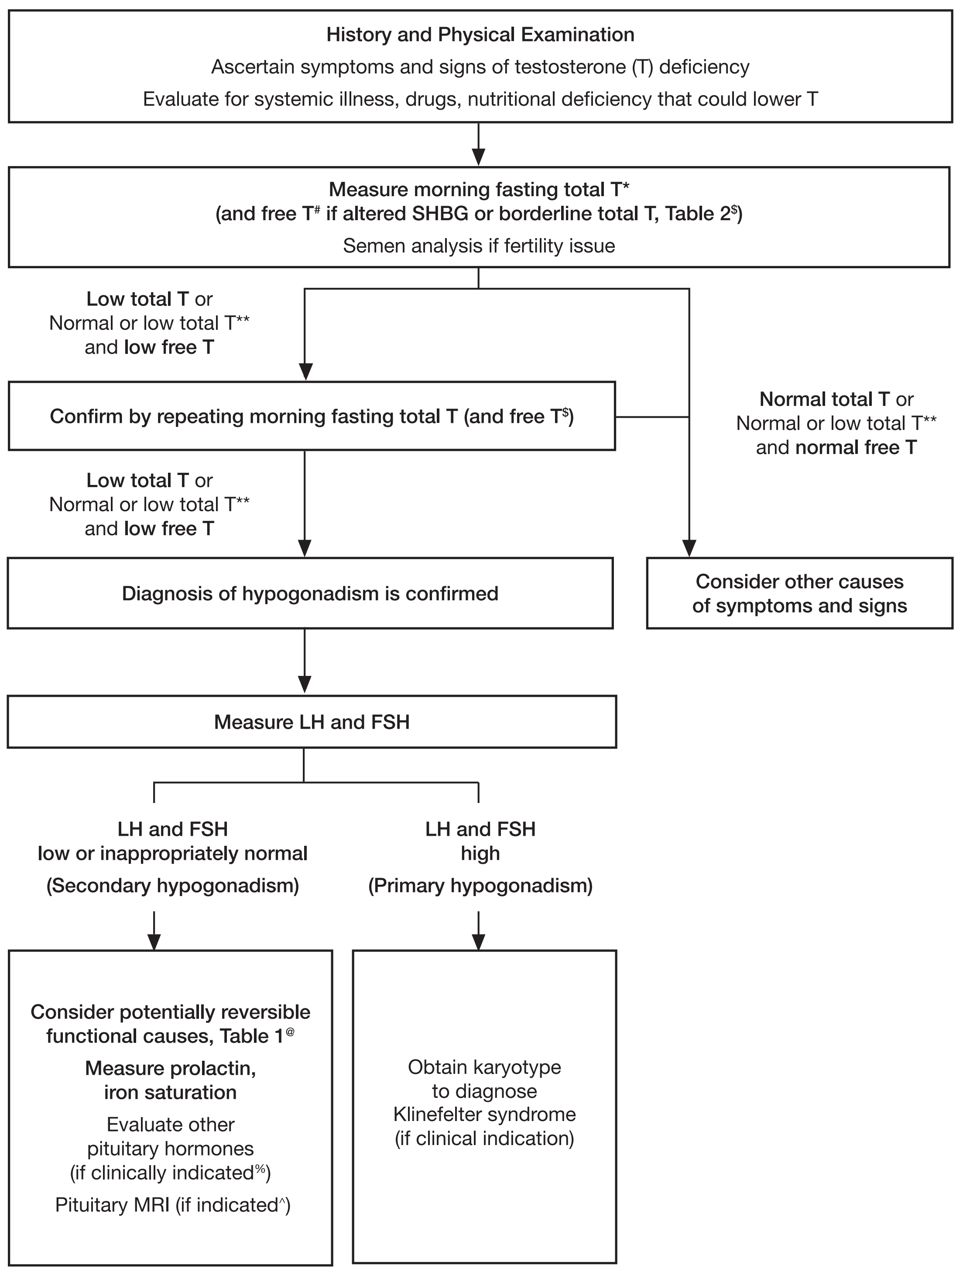
T Deficiency
An approach for the diagnostic evaluation of adult men suspected of having T deficiency.
The lower limit of the normal total testosterone (TT) harmonized to the CDC standard in healthy nonobese young men is 264 ng/dL (9.2 nmol/L)

Slide 14
T concentration
In men who have conditions that
Alter sex hormone–binding globulin (SHBG)
Initial total testosterone concentrations are at or near the lower limit of the normal range,
Clinicians should determine free testosterone concentrations either directly from equilibrium dialysis assays or by calculations that use total testosterone, SHBG, and albumin concentrations.
Clinicians should not test men for testosterone deficiency who have or are recovering from an acute illness or are engaged in short-term use of medications (e.g., opioids) that suppress testosterone concentrations.

Slide 15
HINT
!
The diagnosis of hypogonadism in men poses several challenges:
The clinical presentation of hypogonadism in men depends on the age of onset of T deficiency. Men who have prepubertal onset of hypogonadism that is not adequately treated will exhibit eunuchoidal proportions, lack of development of secondary sex characteristics, and high-pitched voice (eunuchodism)
The symptoms and signs of T deficiency are nonspecific and modified by age, comorbid illness, severity and duration of T deficiency, variations in androgen sensitivity, and previous T therapy.

Slide 16
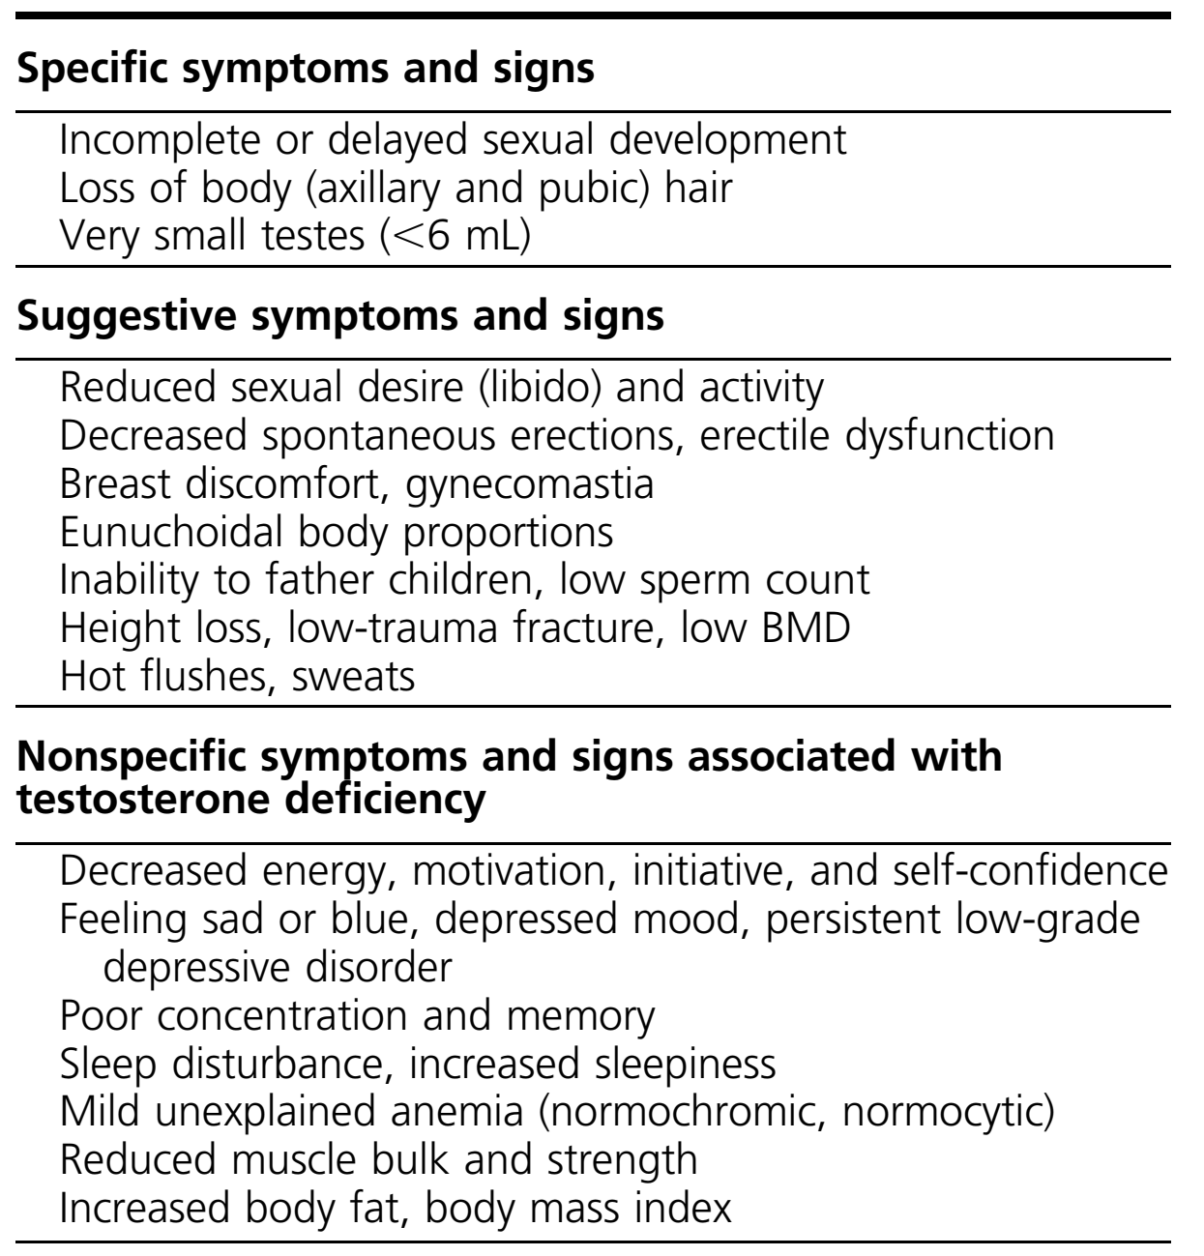
T Deficiency
Symptoms and Signs Suggestive of T
Deficiency in Men

Slide 17
Diagnosis Challenges
!
In middle-aged and older men: low libido, erectile dysfunction, and less specific symptoms (such as fatigue, irritability, depressed mood, poor concentration, reduced physical performance, and sleep disturbance) are associated with low T concentrations.
T alone is required to maintain lean mass and muscle size and strength; estradiol is required to prevent increases in fat mass and vasomotor symptoms, and both T and estradiol are required to maintain sexual function and bone mineral density (BMD).

Slide 18
Diagnosis Challenges
!
T concentrations may be affected by acute illness, nutritional deficiency, and by certain medications (e.g., opioids and glucocorticoids). T concentrations also are affected by age, obesity, diabetes, sleep disorders including obstructive sleep apnea (OSA), and health status.
Therefore, assessing men for T deficiency should include a general health evaluation to exclude systemic illness, eating disorders, excessive exercise, sleep disorders, and use of recreational drugs and certain medications (e.g., opioids or high-dose glucocorticoid therapy) that affect T production or metabolism.
Heritability can explain a substantial fraction of population-level variations in T concentrations among men.

Slide 19
Diagnosis Challenges
!
Serum T concentrations vary significantly as a result of diurnal, circadian, and circannual rhythms, episodic secretion, and assay variations. Serum T concentrations exhibit a diurnal variation with peak values in the morning; aging reduces the magnitude of this diurnal variation. Glucose and food intake suppress T concentrations. Therefore, clinicians should measure T concentrations in the morning after an overnight fast.
At least two T measurements were needed to diagnose T deficiency with confidence

Slide 20
Diagnosis Challenges
!
Clinicians should measure FT in men who have conditions that alter SHBG levels. Conditions that lower SHBG [e.g., obesity, type 2 diabetes mellitus (T2DM), or androgen use] can lower TT concentrations to below the normal range, although FT concentrations might remain within the normal range.
Conditions that increase SHBG (e.g., advanced age, some anticonvulsants, or HIV infection) can raise TT concentrations to well above 400 ng/dL and sometimes into the high normal range or even above the normal range, even though FT concentrations might be low.

Slide 21
Diagnosis Challenges
!
Clinicians should also measure FT in men whose serum TT concentration is modestly above or below the lower limit of normal (e.g., 200 to 400 ng/dL).
In men whose TT concentrations are far below the lower limit of the normal range (e.g.,150 ng/dL), the probability of FT concentration being within the normal range is low.
So, in such circumstance, measuring FT is generally not necessary. Local laboratories usually do not have accurate and reliable assays for FT measurement. Therefore, clinicians should use a reliable reference laboratory for these tests.

Slide 22
T concentration
Clinicians should measure FT using the equilibrium dialysis method performed under standardized conditions.
If equilibrium dialysis is not available for measuring FT, clinicians should estimate FT concentrations using a formula that accurately calculates FT concentrations using TT, SHBG, and albumin concentrations.

Slide 23
2
Screening and case detection for hypogonadism
We recommend against routine screening of men in the general population for hypogonadism.
Notes:
Tip:
When using complex image as full-bleed background add a transparency (70%-90%) fill layer to give contrast to text.

Slide 24
Screening
Low T concentrations occur frequently without symptoms or signs of testosterone deficiency, and these low levels (alone) do not establish a diagnosis of hypogonadism.
Because of the lack of consensus on the extent to which hypogonadism is an important public health problem, we do not recommend population screening.
we suggest that clinicians not use the available case-finding questionnaires for detecting T deficiency in men receiving health care for unrelated reasons.

Slide 25
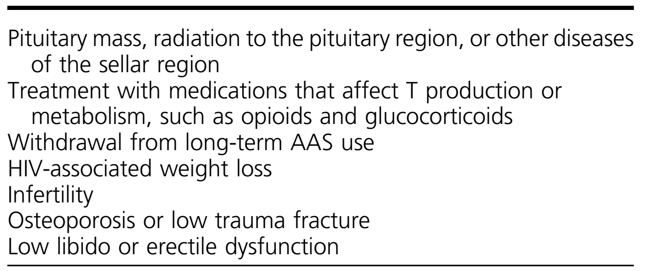
Screening
Candidate groups that have a high prevalence of low T concentrations and for whom we suggest measuring T concentrations
We suggest that clinicians consider using TT concentration measurements for case detection in men with certain clinical disorders in whom the prevalence of hypogonadism is high and T treatment might be indicated.

Slide 26
3
Distinguishing between primary or secondary hypogonadism
In men who have hypogonadism, we recommend distinguishing between primary (testicular) and secondary (pituitary-hypothalamic) hypogonadism by measuring serum luteinizing hormone (LH) and follicle-stimulating hormone (FSH)
concentrations
Notes:
Tip:
When using complex image as full-bleed background add a transparency (70%-90%) fill layer to give contrast to text.

Slide 27
Distinguishing
Measuring LH and FSH concentrations can help distinguish between primary and secondary hypogonadism.
Most clinical laboratories measure LH and FSH levels using immunometric assays.
LH and FSH assays are susceptible to biotin interference that can cause falsely high or low values;
Accordingly, clinicians should stop biotin supplements for at least 72 hours before testing.

Slide 28
4
Evaluation for determining the etiology of hypogonadism
In men with hypogonadism, we suggest further evaluation to identify the etiology of hypothalamic, pituitary, and/or testicular dysfunction. concentrations
Notes:
Tip:
When using complex image as full-bleed background add a transparency (70%-90%) fill layer to give contrast to text.

Slide 29
Etiology
In men with secondary hypogonadism, clinicians should perform serum prolactin and iron saturation measurements, and in certain cases, pituitary function testing and magnetic resonance imaging of the sella turcica to determine the cause of gonadotropin deficiency.
In men with primary hypogonadism of unknown etiology, especially in those with testicular volume <6 mL, clinicians should obtain a karyotype to diagnose KS.

Slide 30
Etiology
Clinicians can make a diagnosis of congenital (also referred to as idiopathic) hypogonadotropic hypogonadism after excluding other causes of secondary hypogonadism in men with prepubertal or less commonly adult onset T deficiency.
In patients with hypogonadotropic hypogonadism, phenotypic features—such as hyperphagia or extreme obesity (e.g., Prader–Willi syndrome), polydactyly, syndactyly, synkinesia, anosmia, kidney abnormalities (e.g., Kallmann syndrome), or short stature (e.g., contiguous gene deletions of chromosome X)—can help clinicians identify specific syndromes via pattern recognition.

Slide 31
Etiology
Many men with secondary hypogonadism have potentially reversible or treatable causes of gonadotropin suppression and low T concentrations or functional secondary hypogonadism [e.g., due to obesity, opioid use, or comorbid illness] that may be managed without need for testosterone treatment.
T directly stimulates bone formation and inhibits bone resorption through multiple mechanisms that involve estrogen receptor– and androgen receptor–mediated processes.

Slide 32
Etiology
Additionally, T may increase skeletal muscle mass and strength, which may indirectly increase BMD and potentially reduce fall propensity and fracture risk;
If fertility is a concern to a patient and his partner, clinicians should perform at least two semen analyses separated by an interval of several weeks on semen samples collected within 1 hour of ejaculation after at least 48 hours of abstinence.

Slide 33
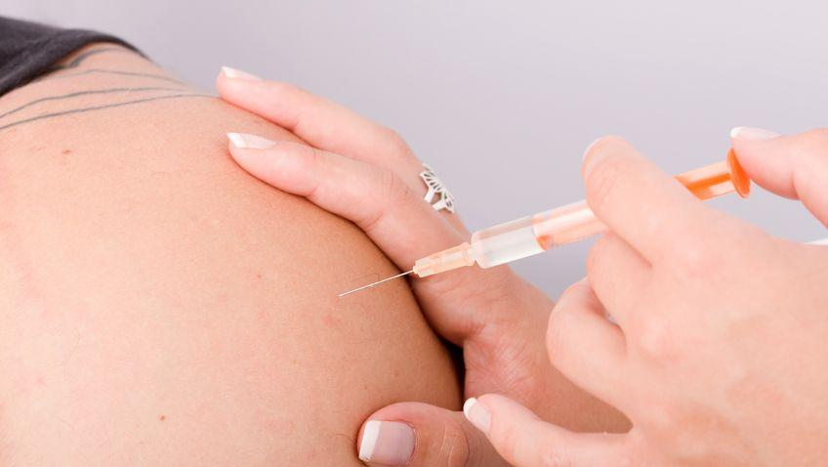
Treatment of
Hypogonadism
with Testosterone
Notes:
To use this title animation slide with a new image simply 1) move the top semi-transparent shape to the side, 2) delete placeholder image, 3) click on the picture icon to add a new picture, 4) Move semi-transparent shape back to original position, 5) Update text on slide.

Slide 34
testosterone therapy
We recommend testosterone therapy in hypogonadal men to induce and maintain secondary sex characteristics and correct symptoms of testosterone deficiency.
Clinicians can initiate testosterone therapy with any of the therapeutic regimens described in Tables 5 and 6, based on the patient’s preference, consideration of pharmacokinetics, treatment burden, and cost.
Clomiphene citrate has been used empirically in men with hypogonadotropic hypogonadism;

Slide 35
testosterone therapy
We recommend against testosterone therapy in men planning fertility in the near term or in men with breast or prostate cancer, a palpable prostate nodule or induration, a prostate-specific antigen (PSA) level >4 ng/mL, a PSA level >3 ng/mL combined with a high risk of prostate cancer (without further urological evaluation), elevated hematocrit, untreated severe OSA, severe lower urinary tract symptoms, uncontrolled heart failure, myocardial infarction or stroke within the last 6 months, or thrombophilia (Table 7).

Slide 36
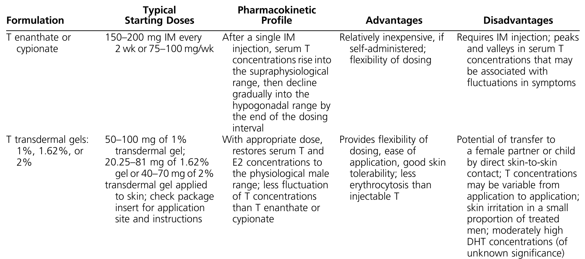
Clinical Pharmacology
Clinical Pharmacology of T Formulations Approved in the United States and Europe
Table 5:

Slide 37
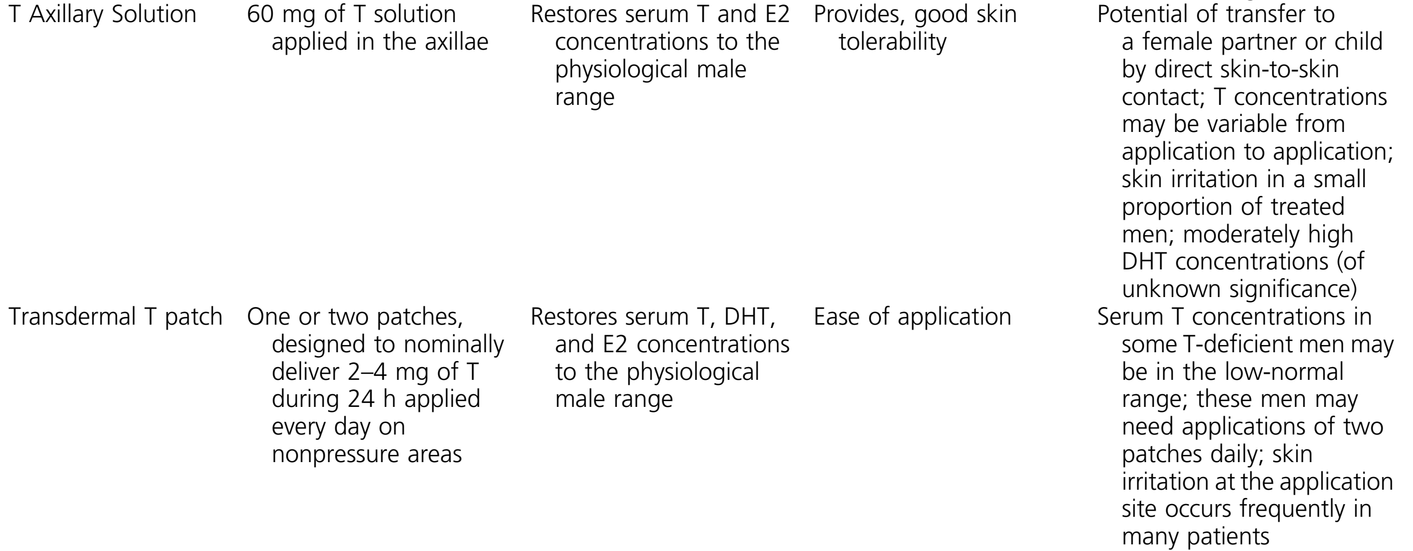
Clinical Pharmacology
Clinical Pharmacology of T Formulations Approved in the United States and Europe
Table 5:

Slide 38
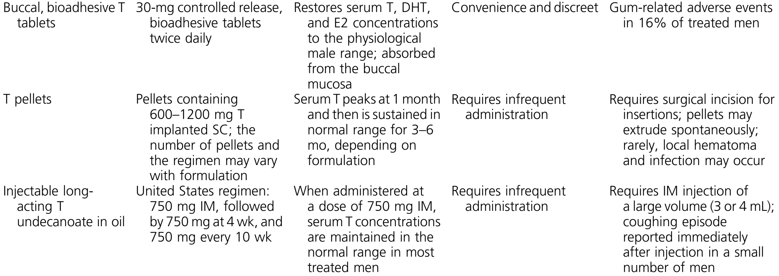
Clinical Pharmacology
Clinical Pharmacology of T Formulations Approved in the United States and Europe
Table 5:

Slide 39
Clinical Pharmacology
Clinical Pharmacology of T Formulations Approved in the United States and Europe
Table 5:

Slide 40
Testosterone Formulations
Testosterone Formulations Available Outside the United States, but Not Approved by the FDA
Table 6:

Slide 41
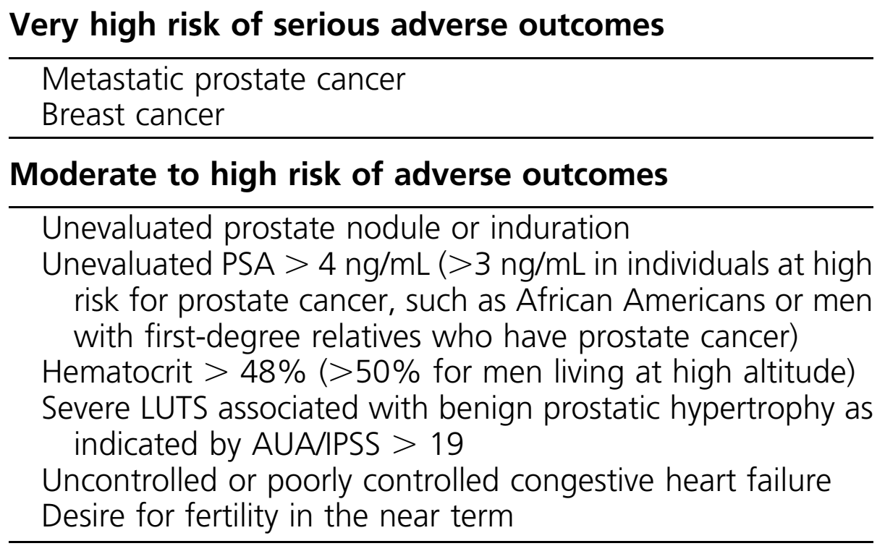
T Administration
Conditions in Which T Administration Is Associated With a High Risk of Adverse Outcomes and for Which We Recommend Against Using T
Table 7:

Slide 42
testosterone therapy
Men who have a prostate nodule or induration require a urological evaluation. Clinicians should not administer testosterone therapy to men with baseline hematocrit above the upper limit of normal for the laboratory without discussing the potential for an increased risk of erythrocytosis and the need to monitor hematocrit assiduously.
In hypogonadal men 55 to 69 years old, who are being considered for testosterone therapy and have a life expectancy >10 years, we suggest discussing the potential benefits and risks of evaluating prostate cancer risk and prostate monitoring and engaging the patient in shared decision making regarding prostate cancer monitoring.

Slide 43
testosterone therapy
For patients who choose monitoring, clinicians should assess prostate cancer risk before starting testosterone treatment and 3 to 12 months after starting testosterone.
In hypogonadal men being considered for testosterone therapy who are 40 to 69 years old and at increased risk of prostate cancer (e.g., African Americans and men with a first-degree relative with diagnosed prostate cancer), we suggest discussing prostate cancer risk with the patient and offering monitoring options.

Slide 44
testosterone therapy
In patients who agree to prostate cancer monitoring, clinicians should evaluate PSA levels and perform a digital prostate examination at baseline and at 3 to 12 months after starting testosterone treatment. After 1 year of testosterone-replacement therapy, we suggest clinicians follow the guidelines for prostate cancer screening based on the age and race of the patient.

Slide 45
testosterone therapy
When the goal of treatment is to replace T: treating men with prepubertal onset of hypogonadism is similar to treating men with postpubertal onset hypogonadism, although some practitioners and patients may elect to start T treatment at a lower dosage initially and gradually increase the dose over many months to avoid sexually disturbing thoughts.
When the goal of treatment is to induce or restore fertility: men with prepubertal onset hypogonadism are more likely to require both FSH and LH (human chorionic gonadotropin or recombinant LH) replacement, whereas men with postpubertal onset hypogonadism are more likely to require LH replacement only.

Slide 46
1
Efficacy
Notes:
Tip:
When using complex image as full-bleed background add a transparency (70%-90%) fill layer to give contrast to text.

Slide 47
Secondary sexual characteristics
Efficacy
In men who have not undergone complete pubertal development, T therapy induces the development of secondary sex characteristics, including facial and body hair growth, deepening of the voice, muscle and bone accretion, penile enlargement, and pigmentation of the scrotum
Sexual function
T treatment in hypogonadal men with low libido is associated with significantly greater improvement in libido, erectile function, and sexual activity vs placebo. T does not significantly improve sexual function and activity in men who do not have low T concentrations in the hypogonadal range.
Phosphodiesterase 5 inhibitors can improve erectile function in eugonadal and hypogonadal men.

Slide 48
Efficacy
Well-being and depressive symptoms
T therapy improves the positive and reduces the negative aspects of mood, but the magnitude of the effect of T on mood in older men is small. T therapy does not improve depressive symptoms in men with clinical depression.
Epidemiological studies have reported an association between lower T concentrations and late-onset, low grade, persistent depressive disorder (previously referred to as dysthymia).

Slide 49
Efficacy
Bone mineral density
T is not an approved treatment for osteoporosis or for reducing fracture risk. Clinicians should not prescribe T for treating osteoporosis in men who have normal T concentrations or as monotherapy to prevent bone fracture in men who are at high risk of bone fracture, regardless of T concentrations (clinicians can assess fracture risk using a fracture risk assessment instrument, such as FRAX®).

Slide 50
Efficacy
Bone mineral density
In hypogonadal men receiving T replacement, clinicians should treat osteoporosis in patients at high risk of bone fracture with a pharmacologic agent that has been approved for the treatment of osteoporosis.
In hypogonadal men who have osteoporosis, are not at high risk of bone fracture, and are being started on T-replacement therapy, clinicians may consider deferring treatment with approved osteoporosis drugs until they have evaluated the response to T replacement by repeating BMD tests of the lumbar spine, femoral neck, and hip after 1 to 2 years of T therapy.

Slide 51
Efficacy
Body composition, muscle strength, and physical function
T therapy in healthy men with hypogonadism increases fat-free mass and muscle strength. T administration reduces whole body, intraabdominal, and intermuscular fat. The effects of T on muscle/fat mass and muscle strength are related to the administered dose and increase in circulating T concentrations. Estrogen predominantly mediates the effects of T on body fat.
Cognitive function
Two RCTs in community-dwelling older men did not find significant improvements in memory or multiple other domains of cognitive function with T treatment.

Slide 52
2
Adverse events associated with testosterone therapy
Common drug-related adverse events include acne, oiliness of skin, and breast tenderness. Erythrocytosis is the most frequent adverse event reported in RCTs of T.
Notes:
Tip:
When using complex image as full-bleed background add a transparency (70%-90%) fill layer to give contrast to text.

Slide 53
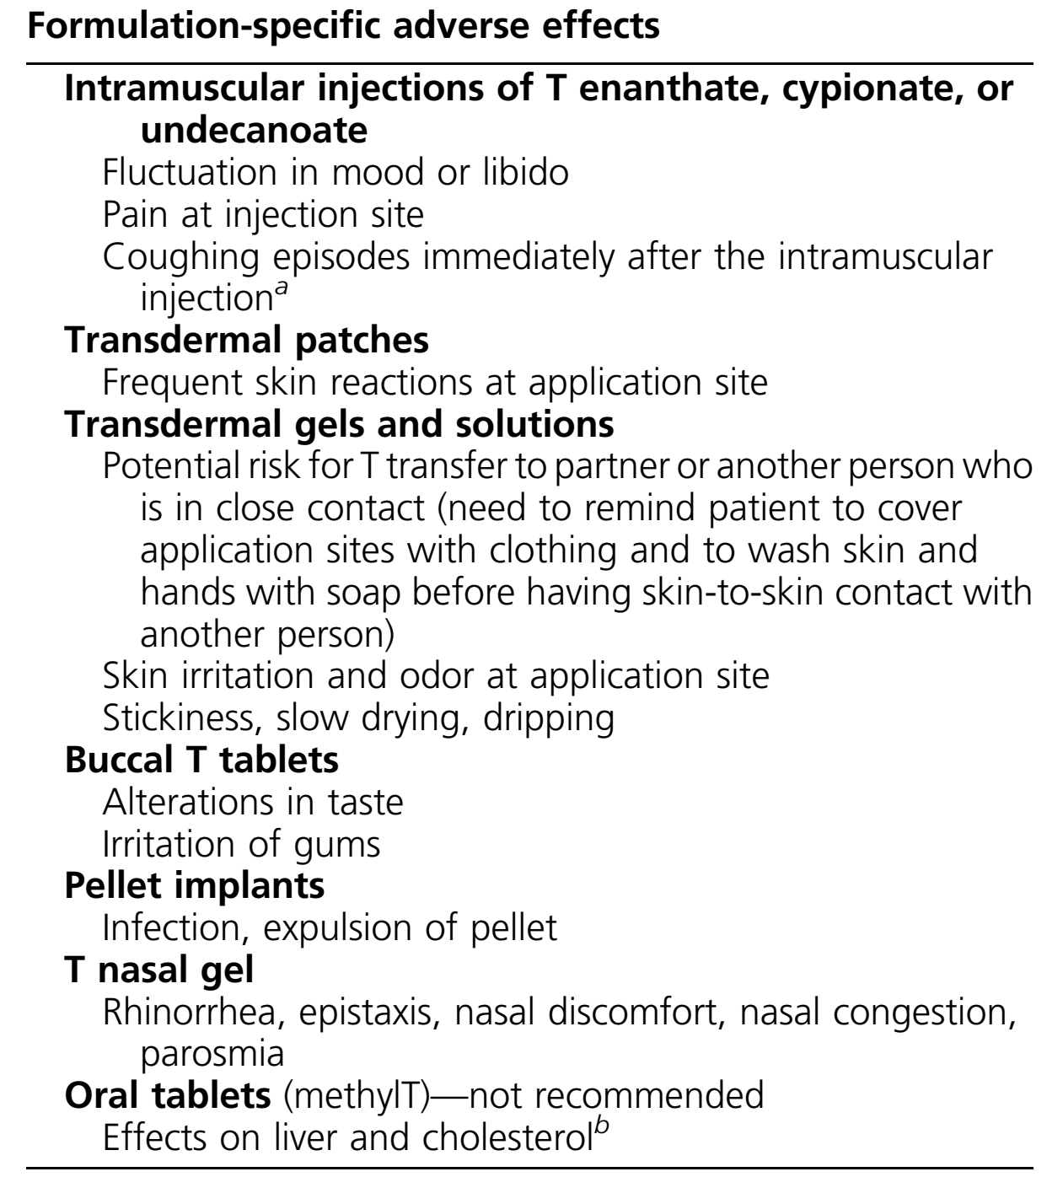
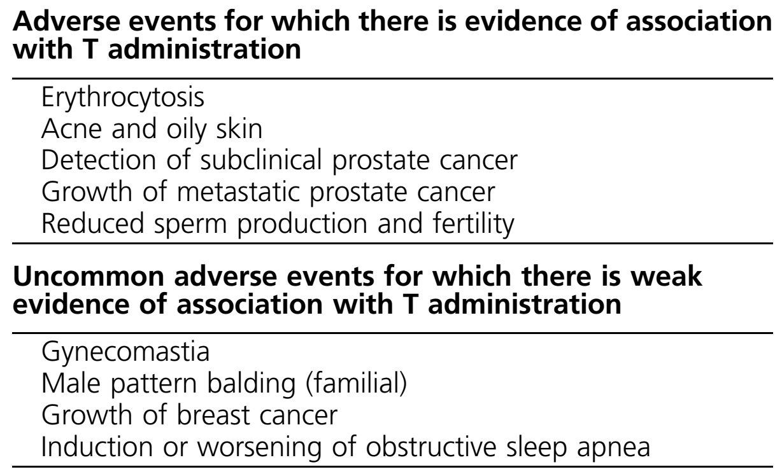
Potential Adverse Effects of
T Replacement

Slide 54
Erythrocytosis
T administration increases hemoglobin and hematocrit; these effects are related to T doses and circulating concentrations. In some men with hypogonadism, T therapy can cause erythrocytosis (hematocrit >54%). The increase in hematocrit during T administration and the frequency of erythrocytosis is higher in older men than in young men.
Clinicians should evaluate men who develop erythrocytosis during T-replacement therapy and withhold T therapy until hematocrit has returned to the normal range and then resume T therapy at a lower dose. Using therapeutic phlebotomy to lower hematocrit is also effective in managing T treatment–induced erythrocytosis.

Slide 55
Cardiovascular
There have been no RCTs that were large enough or long enough to determine the effects of T-replacement therapy on major adverse cardiovascular events (MACE). Additionally, there is no conclusive evidence that T supplementation is associated with increased cardiovascular risk in hypogonadal men.
There are insufficient data to establish a causal link between T therapy and cardiovascular events.

Slide 56
Venous thromboembolism
Case-control and pharmacoepidemiologic studies have not shown a consistent increase in the risk of venous thromboembolism (VTE) with T treatment.
Some case reports have suggested that the risk for VTE may be increased in the presence of thrombophilia even without a raised hematocrit, especially within the first 6 months after starting T therapy.
The FDA has required manufacturers to include a warning about the risk of VTE for T products.

Slide 57
Prostate
We recommend against T supplementation in men with prostate cancer and suggest assessing prostate cancer risk prior to treatment initiation
T therapy increases the risk of detecting subclinical prostate cancer because of increased surveillance and T-induced increase in PSA levels, which may lead to increased risk of prostate biopsy.
Metastatic prostate cancer and breast cancer are hormone-dependent cancers that T treatment may stimulate to grow; T should not be administered to men with these cancers.

Slide 58
Prostate
Clinicians should consider screening and monitoring for all men with hypogonadism who are 55 to 69 years of age, being considered for T-replacement therapy, and in excellent health, and who have a life expectancy >10 years.
This should start at age 40 in men who are at increased risk for high-grade Cancers.

Slide 59
Prostate
Men <40 years do not need prostate monitoring because the risk of prostate cancer is very low. The risk of death due to prostate cancer in men diagnosed when they are >70 years of age is not considered high enough to warrant monitoring.
The predictive value of a suspicious DRE was greater in men who had a PSA level > 3.0 ng/mL.
A prostate nodule or induration or a PSA > 4.0 ng/mL may indicate a previously unrecognized prostate cancer. A confirmed PSA > 4.0 ng/mL is a widely accepted indication for urological evaluation for prostate cancer

Slide 60
Efficacy
Lower urinary tract symptoms
T therapy does not worsen lower urinary tract symptoms (LUTS) in men who do not have severe LUTS prior to treatment.
Fertility
T therapy suppresses spermatogenesis and is not appropriate in men with hypogonadotropic hypogonadism who desire fertility in the next 6 to 12 months.
Miscellaneous
T therapy can cause fluid retention and edema and potentially worsen edema associated with heart failure or other edematous states. Although OSA and sleep disorders are associated with increased risk of low T concentrations, the frequency of OSA in randomized T trials has been very low.

Slide 61
3
Older men with age-related decline in testosterone concentration
Notes:
Tip:
When using complex image as full-bleed background add a transparency (70%-90%) fill layer to give contrast to text.

Slide 62
Older men
We suggest against routinely prescribing testosterone therapy to all men 65 years of age or older with low testosterone concentrations.
In men > 65 years who have symptoms or conditions suggestive of testosterone deficiency (such as low libido or unexplained anemia) and consistently and unequivocally low morning testosterone concentrations, we suggest that clinicians offer testosterone therapy on an individualized basis after explicit discussion of the potential risks and benefits.
TT and FT concentrations fall with increasing age in men. Because SHBG levels increase with advancing age, the decline in FT concentrations with age is greater than that in TT.

Slide 63
Older men
T administration was associated with significantly greater increments in hemoglobin and PSA levels vs placebo.
T administration significantly increased volumetric and areal BMD and the estimated strength of trabecular and peripheral bone in the spine as well as hip.
The increases were greater in trabecular bone than peripheral bone and greater in the spine than the hip.
The rate of subclinical atherosclerosis progression, assessed using common carotid artery intima–media thickness and multidetector computerized tomography, did not differ between T- and placebo-treated men.

Slide 64
4
Patients with chronic illness and low testosterone concentrations
Notes:
Tip:
When using complex image as full-bleed background add a transparency (70%-90%) fill layer to give contrast to text.

Slide 65
chronic illness and low T
Many chronic disorders are associated with an increased risk of low T concentrations, sexual symptoms, weight loss, muscle atrophy, anemia, and/or osteoporosis.
Clinicians must individualize the decision to treat or not to treat these men with T based on careful consideration of the severity of symptoms, the degree of T deficiency, confounding influence of the comorbid illness, patient preferences, and the uncertainty of the risks and benefits of T therapy.

Slide 66
5
HIV-infected men with weight loss
We suggest that clinicians consider short-term testosterone therapy in HIV-infected men with low testosterone concentrations and weight loss (when other causes of weight loss have been excluded) to induce and maintain body weight and
lean mass gain.
Notes:
Tip:
When using complex image as full-bleed background add a transparency (70%-90%) fill layer to give contrast to text.

Slide 67
HIV-infected
There is a high prevalence of low T concentrations in HIV-infected men. Twenty to 25% of HIV-infected men on highly active antiretroviral therapy have low TT or FT concentrations.
Low T concentrations in HIV-infected men are associated with multimorbidity, HIV-associated non-AIDS conditions, progression to AIDS, frailty, weight loss, wasting, depression, and loss of muscle mass and exercise capacity.
Overall, short-term (3 to 6 months) T use in HIVinfected men with low T concentrations and weight loss can lead to small gains in body weight, LBM, and mood, with minimal change in quality of life.

Slide 68
6
Men with type 2 diabetes mellitus
In men with type 2 diabetes mellitus who have low testosterone concentrations, we recommend against testosterone therapy as a means of improving glycemic control.lean mass gain.
Notes:
Tip:
When using complex image as full-bleed background add a transparency (70%-90%) fill layer to give contrast to text.

Slide 69
Type 2 diabetes mellitus
Testosterone therapy in hypogonadal men who have T2DM should follow the same treatment and monitoring plan as hypogonadal men without T2DM.
T2DM is associated with a high prevalence of low T concentrations. In cross-sectional studies of men with T2DM, about one-third have low T concentrations, and TT concentrations were, on average, 86 ng/dL lower in men with T2DM vs controls.
In epidemiological studies, TT concentrations are negatively associated with the risk of T2DM.
The association of SHBG and TT with the risk of T2DM is stronger than for FT concentrations.

Slide 70
Monitoring of
Testosterone
Replacement
Therapy
Notes:
To use this title animation slide with a new image simply 1) move the top semi-transparent shape to the side, 2) delete placeholder image, 3) click on the picture icon to add a new picture, 4) Move semi-transparent shape back to original position, 5) Update text on slide.

Slide 71
Monitoring
In hypogonadal men who have started testosterone therapy, we recommend evaluating the patient after treatment initiation to assess whether the patient has responded to treatment, is suffering any adverse effects, and is complying with the treatment regimen.
Clinicians should maintain serum testosterone concentrations during treatment in the mid-normal range for healthy young men.
Clinicians should evaluate symptoms and signs of testosterone deficiency and formulation-specific adverse events at each visit.

Slide 72
Monitoring
Monitoring includes measuring testosterone and hematocrit at 3 to 6 months (depending upon the formulation) and measuring testosterone and hematocrit at 12 months and annually after initiating testosterone therapy.
For those who choose prostate monitoring, monitoring should include PSA and DRE 3 to 12 months after treatment initiation. After 1 year, prostate monitoring should conform to guidelines for prostate cancer screening, depending on the race and age of the patient.

Slide 73
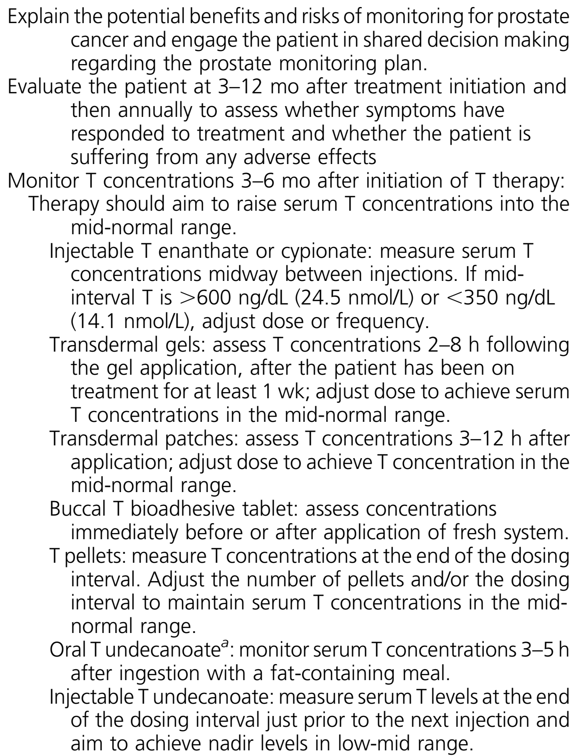
Monitoring
Table 9:
Monitoring Men Receiving T Therapy

Slide 74
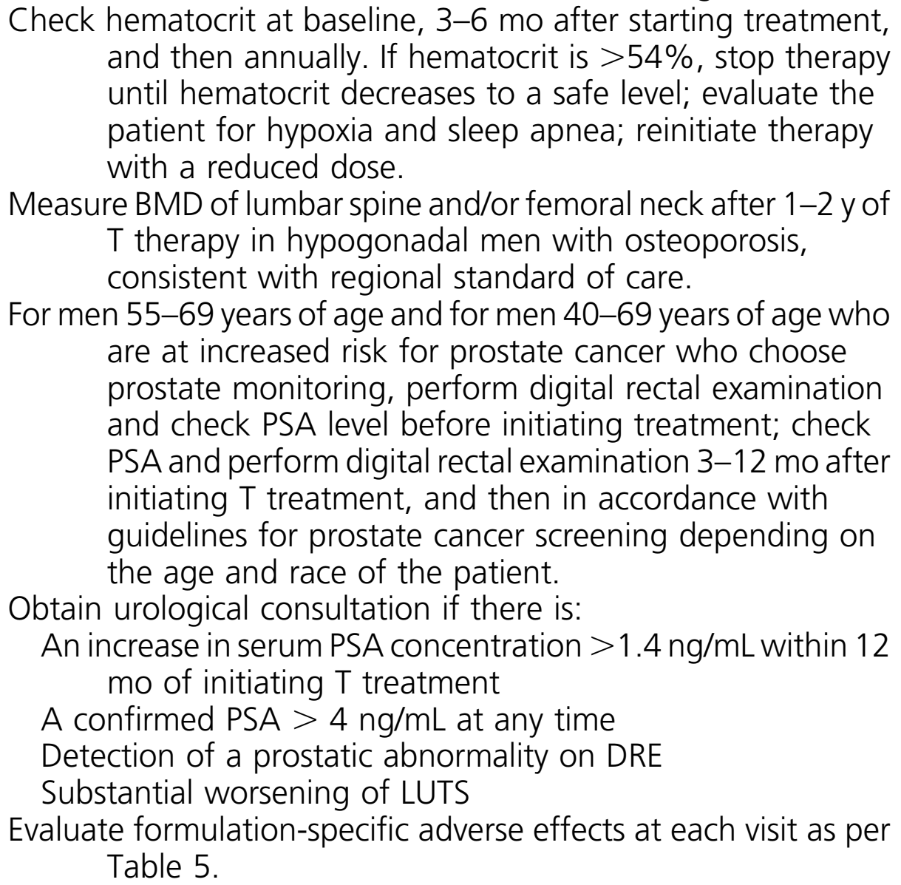
Monitoring
Table 9:
Monitoring Men Receiving T Therapy

Slide 75
Monitoring
The pharmacokinetics of the T formulation should guide the timing of therapeutic level monitoring.
Multiple dose titrations are usually necessary to maintain T concentrations in the therapeutic range in hypogonadal men who are receiving T therapy.
Baseline hematocrit >48% and >50% for men living at higher altitudes is a relative contraindication to T therapy because these men are more likely to develop a hematocrit >54% when treated with T.
Men with elevated hematocrit should undergo further evaluation before considering T therapy. Clinicians should measure hematocrit at baseline, 3 to 6 months, and then annually after a patient begins T therapy.

Slide 76
Monitoring
Some hypogonadal men with baseline PSA between 2.6 and 4.0 ng/mL will develop PSA concentrations >4.0 ng/mL after initiating T treatment. Therefore, in hypogonadal men treated with T whose baseline PSA was between 2.6 and 4 ng/mL, we suggest clinicians consider both a confirmed increase of >1.4 ng/mL in PSA concentration above baseline and the absolute PSA level when deciding to refer the patient for further urological evaluation.
Clinicians should confirm PSA elevations by repeating the test.

Slide 77
Monitoring
The detection of a prostate nodule or an induration may indicate an unrecognized cancer. Based on these considerations, we recommend that clinicians obtain a urological consultation if a prostatic abnormality is detected on DRE.
In men with osteoporosis who are not considered to be at high risk for fracture, clinicians should repeat BMD measurements 1 to 2 years after initiating T therapy to determine the response to T and to ascertain whether the patient needs additional therapy with an approved osteoporosis drug.

Slide 78
1
Other syndromes associated with hypogonadism in men
Notes:
Tip:
When using complex image as full-bleed background add a transparency (70%-90%) fill layer to give contrast to text.

Slide 79
AAS withdrawal hypogonadism
AAS use suppresses the hypothalamic–pituitary–testicular axis in men.
AAS withdrawal after an extended period of high-dose AAS use is associated with marked suppression of endogenous T concentrations and severe symptoms of AAS withdrawal hypogonadism, including sexual dysfunction, fatigue, depressed mood, and sometimes clinical depression and even suicidality.
The recovery of endogenous T may vary depending on the dose and duration of AAS use. After prolonged use of highly supraphysiologic doses of AAS, the recovery of the hypothalamic–pituitary–testicular axis may take months and even years and may be incomplete. A small minority of these men may never recover normal endogenous T production and require T-replacement therapy.

Slide 80
Hypogonadism associated with chronic opioid use
Hypogonadotropic hypogonadism is common in men receiving chronic enteral, parenteral, or intrathecal opioid medications for pain management. Nearly all opioids in doses equivalent to 30 mg of methadone suppress endogenous T production, although longer acting opioids induce greater and more sustained suppression of T concentrations.
Men receiving methadone maintenance therapy are at high risk of developing opioidinduced hypogonadism, whereas the prevalence of opioid-induced hypogonadism is substantially lower with buprenorphine.

Slide 81
Hypogonadism associated with chronic opioid use
Although long-term health consequences of chronic opioid use are not completely understood, opioid-induced suppression of the endogenous hypothalamic–pituitary–testicular axis is associated with sexual dysfunction, low mood, osteoporosis, and increased risk of fracture. Chronic opioid use has emerged as a common antecedent of T prescription use in some health care systems.
Clinicians should consider T-replacement therapy in men with opioid-induced hypogonadism who are experiencing sexual symptoms and in whom discontinuation of opioid medication seems unlikely

Slide 82
Change is the end result of all true learning
THANK YOU

