Slide 1
Evaluating Causality of Gut Microbiota in Obesity and Diabetes in Humans
Endocrine Reviews, April 2018, 39(2):133–153
Presented by
Elham Faghihimani
Endocrinologist

Slide 2
The global rise in prevalence of obesity presents a challenge to public health. Obesity has been associated with a plethora of metabolic disturbances including dyslipidemia and insulin resistance; both are considered major risk factors for development of
cardiovascular disease (CVD), nonalcoholic fatty liver disease, and several forms of cancer.

Slide 3
Factors that strongly contribute to the obesity include decreased physical activity and increased (high-caloric) food intake. However, if the pathogenesis of obesity would have been this simple, Hippocrates’ prescription for treatment of obesity: “eat only once a day and take no baths and sleep on a hard bed and walk as long as possible” would have been a successful prescription

Slide 4
treatment (and prevention) of obesity and obesity-related complications have been proven to be more complex. Despite extensive efforts in the field, successful strategies are still limited. The rise in prevalence of obesity coincides with the prevalence of (T2DM), which is a leading cause of CVD in almost all high-income Countries

Slide 5
In 2009, DeFronzo introduced a new paradigm in diabetes research: the ominous octet. This paradigm describes that in addition to muscle, liver, and b-cells,
adipocytes, the gastrointestinal tract, a-cells, kidney, and brain all play important roles in the development of T2DM.

Slide 6
Additionally, determinants other than those described in the “ominous octet” might play a role in the development of T2DM. In the past decade, the gut microbiome has been identified as a novel, potentially driving, factor in the pathophysiology of T2DM.

Slide 7
In addition to T2DM, the incidence of T1DM is rapidly increasing. Genetic predisposition cannot simply explain this phenomenon The increase in T1DM incidence has therefore largely been attributed to environmental influences such as early enterovirus infection The gut microbiome is therefore a driving force in pathogenesis of T1DM.

Slide 8
identification of the role of the gut microbiome in modulation of host metabolism has grown exponentially since the introduction of affordable, high-throughput sequencing technologies. These technologies allowed for compositional as well as functional analysis of intestinal microbiota in humans and mouse models.

Slide 9
In this review, we aim to provide insight in (the quality of) evidence that is supportive of a causal role for the gut microbiome in obesity and diabetes development in humans

Slide 10
Factors Shaping the Gut Microbiota
The human gut microbiota is a complex ecosystem consisting of an estimated 10 14bacteria . This number equals the number of human cells . The combined genetic material of the gut microbiota, collectively called the gut microbiome, exceeds the human genome ~100 times.
The gut microbial community is dominated by five bacterial phyla: Actinobacteria,Bacteroidetes, Firmicutes, Proteobacteria, and Verrucomicrobia.

Slide 11
Variable pH (pH increases from proximal to distal intestine) and oxygen concentration (decreases from proximal to distal intestine) affect abundance of bacteria across the GI tract. The proximal GI tract is enriched in bacteria belonging to the phyla Firmicutes and Proteobacteria and the genus Lactobacilli, the distal GI tract mainly comprises bacteria belonging to the phyla Bacteroidetes, Firmicutes, and the Akkermansia muciniphila species

Slide 12
Although a definition of what a healthy gut microbiome comprises still has to be defined, it is clear that in healthy individuals, the composition of the intestinal microbiota is highly diverse Interestingly, together with increased industrialization, an overall decline in gut microbiota diversity can been observed

Slide 13
gut microbial composition is highly variable between individuals and is continuously modified by both endogenous and exogenous factors. This inter individual variability already starts at birth and is mainly determined by the microbiota composition of the Mother the intestine of a newborn is not sterile.

Slide 14
One of the most important modulators of the gut
microbiota is diet.
the response of the gut microbiota to (major) changes in dietary composition is very fast. Several studies have shown an acute shift in gut
microbial composition and functionality as soon as 2 days after the start of a dietary intervention
despite rapid changes , long-term dietary habits are required to induce major changes in gut microbiota composition.

Slide 15
there is high inter individual variability in response of microbiome composition to changes in dietary composition . The fact that dietary interventions to treat obesity have variable effects could therefore potentially be due to differences in microbiota composition at the start of the diet

Slide 16
Medication also significantly influences the gut microbial composition. Antibiotics treatment in particular, is well-known for influencing the gut microbiota. Moreover, antibiotics use early in life has been associated with weight gain later in life

Slide 17
A single-blinded randomized controlled trial in 20 male obese subjects who received either vancomycin or amoxicillin for 7 days showed that vancomycin-treated subjects had significantly decreased peripheral insulin sensitivity compared with amoxicillin-treated subjects.
Vancomycin treatment, which specifically eradicates gram-positive bacteria, shifts the gut microbia to a community dominated by gram negative bacteria, which might negatively affect host metabolism, including insulin sensitivity

Slide 18
Metformin is currently the most prescribed oral antidiabetic medication and known to affect intestinal microbiota composition . In a recent double blind, placebo-controlled trial in patients with T2DM, it was indeed shown that metformin-treated subjects had significantly altered gut microbiome composition compared with patients receiving placebo

Slide 19
Mother
Diet
Medications
The role of human genetics in shaping the
composition of the gut microbiota remains largely Associative

Slide 20
Gut Microbiome Composition and T2DM Development in Humans: Why It Is Challenging to Determine Causality in Humans

Slide 21
Scarcity of biopsies or material from proximal parts of the intestine
Causal evidence that link the intestinal microbiota to host health and development of metabolic disease mostly originates from rodent studies

Slide 22
gut microbiota composition has been mainly linked to observational (retrospective) studies.
it cannot be concluded if gut microbiota composition was affected prior to disease development (causal) or whether the Microbiota is a reflection of the disease itself. This chicken–egg situation can in part be clarified in large, prospective studies such as the Dutch Life Lines

Slide 23
Studies in GF mice, which lack microbiota, provided first important evidence that the gut microbiota potentially plays a causal role in development of obesity and related diseases. It was demonstrated that, despite a higher food intake, GF mice are leaner compared with conventionally raised mice .In addition, GF mice are fairly resistant to HFD-induced
Obesity

Slide 24
A follow-up study, in which fecal microbiota was transplanted from conventionally raised obese mice to GF mice:
Interestingly, GF recipient mice that received
a transplant from an obese donor gained more weight on the same diet compared with recipients that received a transplant from a lean donor

Slide 25
Despite convincing evidence from studies in mice, data implicating a causal role for the gut microbiota in obesity development in this model system cannot be projected on humans

Slide 26
Gut Microbiome Composition and Function in Cardio-metabolic Disease Development: Evidence From Human Studies

Slide 27
In line with studies in rodents, an increased ratio of Firmicutes/Bacteroidetes, which reduces with weight loss , has been associated with obesity in humans. Increased abundance of Firmicutes was suggested to
extract more energy from food.In contrast, other research groups were not able to find differences in the ratio between Firmicutes/Bacteroidetes in obese vs lean subjects

Slide 28
in three (independent) metagenomic
Studies , obesity was associated with a reduced bacterial gene richness. Subjects with a less diverse gut microbiota composition were shown to have higher body mass index (BMI), increased fat mass, reduced insulin sensitivity, dyslipidemia, and increased markers of inflammation

Slide 29
in a 10-year follow-up in which subjects with low bacterial richness had gained more weight compared with subjects with higher bacterial richness. As is the case for reported associations between improved ratio of Firmicutes/Bacteroidetes following weight loss, it remains to be determined if increased bacterial richness is a mere reflection of a healthy and varied diet, or that it directly contributes to the protection from obesity.

Slide 31
Bacterial metabolites and bacteria-derived components as modifiers of human metabolism
Changes in gut microbial output (metabolite production) or host exposure to bacterial-derived components (e.g., endotoxin) have been suggested to play a larger role in metabolic disease development than microbial composition on the genome level per se

Slide 32
A chronic, low-grade inflammatory state is often found in patients with obesity, insulin resistance, and T2DM . This increased inflammatory state has been proposed to be a driving factor in development of insulin resistance. In particular, by reducing insulin
sensitivity in muscle and adipose tissue and by impairing pancreatic islet function

Slide 33
studies in mouse models indicate that the gut microbiota is a causal factor in increasing inflammatory tone in obesity. These findings
lead to the hypothesis of metabolic endotoxemia in obesity and T2DM; a low-grade inflammatory state resulting from translocation of toxic, bacteria-derived components of mainly gram-negative bacteria

Slide 34
The gut microbiota produces numerous organic compounds such as nitric oxide, ammonia, carbon oxide, indole, and hydrogen sulfide that possess pro and anti-inflammatory properties and might be able to alter gut permeability However, the role of these organic compounds in cardiometabolic
disease is still under debate

Slide 35
The bacterial metabolite trimethylamine (TMA) is an example of one of many gut-derived metabolites that has been associated with CVD. TMA is converted to trimethylamineoxide (TMAO) in the liver. High concentrations of TMAO were shown to accelerate atherosclerosis development in mice, and high concentrations of TMAO are correlated with a higher incidence of CVD in humans

Slide 36
The first mechanistic link between TMAO
and cardiovascular risk was provided in a study that showed that TMAO mediates blood platelet hyper responsiveness and subsequent thrombosis

Slide 37
SCFAs are produced by bacterial fermentation of Non digestible dietary fibers in the large intestine
SCFA improve intestinal barrier function by a SCFA mediated increase in transcription of mucin genes Improved gut barrier function prevents overt exposure to the innate immune system of the host, potentially reducing inflammatory tone

Slide 38
Bile acid signaling in host metabolism
Bile acids play a pivotal role in human health and metabolic disease, mainly by their role as signaling molecules that can activate receptors in the gut, liver, and adipose tissue In addition to bile acid synthesis and modification, bile acid uptake in the gut has been suggested to be regulated by the
microbiota.

Slide 39
Gut Microbiome Alterations After Bariatric Surgery
RYGB has significant effects on gut microbial,the abundance of Firmicutes, which is generally high in obesity, decreases and Proteobacteria increases following RYGB . These effects differ strongly from effects of diet-mediated weight loss (large prospective studies are needed to validate whether the gut microbiome contributes to the beneficial metabolic effects of bariatric surgery.

Slide 40
The Gut Microbiome and T1DM
enhanced systemic inflammation and autoimmunity can be detected years before disease onset. changes in gut microbiota composition and output (e.g., LPS, SCFA), are determinants of disease progression and can have predictive value for those at risk to develop T1DM. It has been suggested that shifts in gut microbial communities indeed precede disease development

Slide 41
most children are diagnosed in autumn and winter , and being born in spring is associated with a higher chance of developing T1DM. This suggests that the pathogenesis of T1DM is heterogeneous and environmental. environmental factors such as vitamin D deficiency ,infant nutrition, and early enterovirus infection all have been postulated to contribute to the development of T1DM

Slide 42
In infants who later developed T1DM, detectability of anti-islet autoantibodies coincided with reduced abundance of bacterial genes associated with SCFA production and with gut integrity .
This indicates that changes in early autoantibody production is related to changes in microbiome functional output.

Slide 43
A possible mechanistic explanation for the
contribution of the gut microbiome in the development of T1DM comes from a recent prospective study in Finland, Estonia, and Russia . Finland and, Estonia have higher autoimmune disease prevalence, including T1DM, compared with neighboring Russia.

Slide 44
Gut microbiome development was followed from birth until the age of three in 222 infants.
There was a marked reduction in Bacteroides species in Russian infants compared with infants from Finland and Estonia, based on the relation between celiac disease and T1DM, the intestine and its inhabitants might be a shared risk Factor

Slide 45
An intriguing interplay between genetics, altered gut microbiome/metabolites, and
immunity might play a role in the development of T1DM.

Slide 46
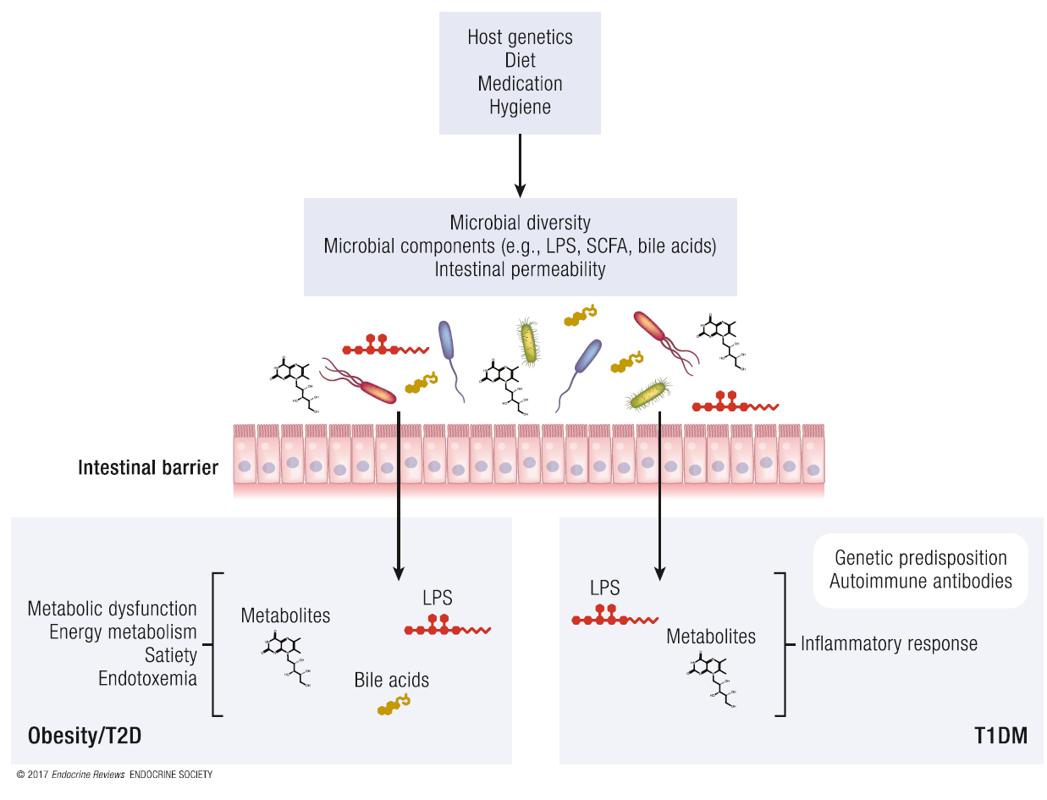

Slide 47
Interventions in Humans: Diet, Pro and Prebiotics, and FMT
Because the gut microbiota is easily accessible and responds rapidly to changes in nutrient composition, dietary reinforcements have been put forward as an attractive therapeutic target
for obesity in addition to low overall adherence to diets, high inter individual differences in response to diet makes this a challenging endeavor

Slide 48
Using novel, personalized prebiotics or probiotics to modify the gut microbiota composition of people predicted to have low response rate to diet induced weight loss regimens into a more responsive composition might optimize the effectiveness of dietary strategies.

Slide 49
Probiotics are living microorganisms that either have potential to improve host metabolism directly (e.g., by improving gut barrier function) or have the capacity to re-establish a more favorable intestinal balance by modulating pH, antibacterial compound production, and competing with pathogens

Slide 50
In humans, administration of Lactobacillus reuteri was associated with increased insulin secretion in obese, insulin resistant subjects. Furthermore, a double– blinded, randomized, placebo-controlled intervention trial in overweight subjects showed beneficial effects of Lactobacillus gasseri on weight loss

Slide 51
Prebiotics are nonmicrobial entities (usually dietary fibers) that elicit a favorable impact on microbial composition and function. Prebiotics might therefore be a feasible tool to modulate gut microbiota. Supplementation of prebiotics has been associated with improved plasma lipid levels and improved glycemic control in both humans and mices.

Slide 52
In humans with T2DM, oligofructose proved to be a useful prebiotic: supplementation for 3 months increased weight loss and improved glucose control compared with patients receiving placebo
Despite focus of (food) industry on development of prebiotics and probiotics to modulate microbiota , only minimal beneficial effects of gut microbiota modulation on metabolism have been obtained

Slide 53
Fecal microbiota transplantation
FMT has a long medical history in treatment of several GI illnesses. As long as1700 years ago, FMT was used to treat patients with food poisoning and diarrhea in China.
The real breakthrough of FMT as treatment modality was after publication of an open-label, randomized, controlled trial, which demonstrated that the resolution of C.difficile infection was 94% after FMT compared with 31% efficacy of vancomycin treatment

Slide 54
Peripheral insulin sensitivity of obese, insulin resistant subjects was significantly improved 6 weeks after receiving a transplant from a lean, insulin sensitive donor (allogenic transplant).
In a second, larger cohort of obese, metabolic syndrome subjects, we were able to reproduce these findings.

Slide 55
Based on baseline microbiota composition of the recipient, the metabolic response to FMT could be predicted.
Variation in experimental protocols, preparation of fecal samples, and diurnal oscillations of the gut microbiota are additional explanations for variable efficacy of FMT.

Slide 56
Modulation of the gut microbial composition and functionality by FMT only partly affects the intrinsic and complex pathophysiology of obesity and T2DM.
Gut microbiome composition and function is influenced by many factors and therefore, it is unlikely that a single FMT can cure obesity or T2DM.

Slide 57
Conclusions
Studies: associations between composition of the gut microbiota, the development of obesity and diabetes.
a few studies have provided causal evidence of the role of the gut microbiota in development of metabolic diseases in humans. The complex interplay between ethnicity, host genetics, dietary habits, and medication use all play an important role in shaping the microbial community and therefore makes it an intriguing yet challenging research field.

Slide 58
Large prospective studies will be of critical importance to answer whether gut microbial composition is a reflection of the disease itself or the microbial composition was affected prior to disease development and hence was a driving factor. Although studies using antibiotic therapy or FMT are suggestive of causal linkage between the gut microbiota and metabolic disease development, effect size and evidence for causality are still marginal.

Slide 60
Figure 2. The role of the gut microbiome in the pathogenesis of cardiometabolic disease. The human gut microbial community is shaped by a complex interplay between host genetics, diet, and (history of) medication use. Alterations in gut microbiota composition (e.g., reduced diversity) or microbial output (e.g., LPS subtypes, SCFA production, or bile acid conversion) have been implicated in development of metabolic diseases such as obesity and T2DM in humans. Although mechanistic evidence for a causal role of the gut microbiota in the pathophysiology of these diseases in humans is scarce, currently available data suggest that an altered microbiota composition affects gut barrier function and induces (low-grade) inflammatory events, either locally in the intestine or systemically. Furthermore, bacterial metabolites including SCFAs and secondary bile acids, which serve important regulatory roles in energy homeostasis and regulation of peripheral glucose and lipid metabolism, have been hypothesized to be drivers of T2DM development. T1DM is generally considered to be driven by autoimmune antibodies that specifically destroy insulin-producing b cells in the pancreas. It has been hypothesized that autoimmune antibody generation is in part consequential to removal of particular microbes, with a crucial role for maturation of the immune system, from our living environment (hygiene hypothesis). In addition, some studies have observed increased autoimmune antibodies prior to T1DM diagnosis and have suggested that altered microbiota composition or microbial output and subsequent initiation of inflammatory events accelerates onset of T1DM

Slide 61
THANK YOU FOR YOUR ATTENTION

