Slide 1
Kathryn A. Martin, et al. J Clin Endocrinol Metab 103: 1–25, 2018
Presented by G. Taghipour, MD
Evaluation and Treatment of Hirsutism in
Premenopausal Women: An Endocrine Society
Clinical Practice Guideline

Slide 2
Definition, Pathogenesis, and Etiology of Hirsutism
1
2
Diagnosis of Hirsutism
CONTENTS
Treatment of Hirsutism in
Premenopausal Women
3
4
Pharmacological Treatments
5
Direct Hair Removal Methods
6
Androgen Testing Remarks

Slide 3
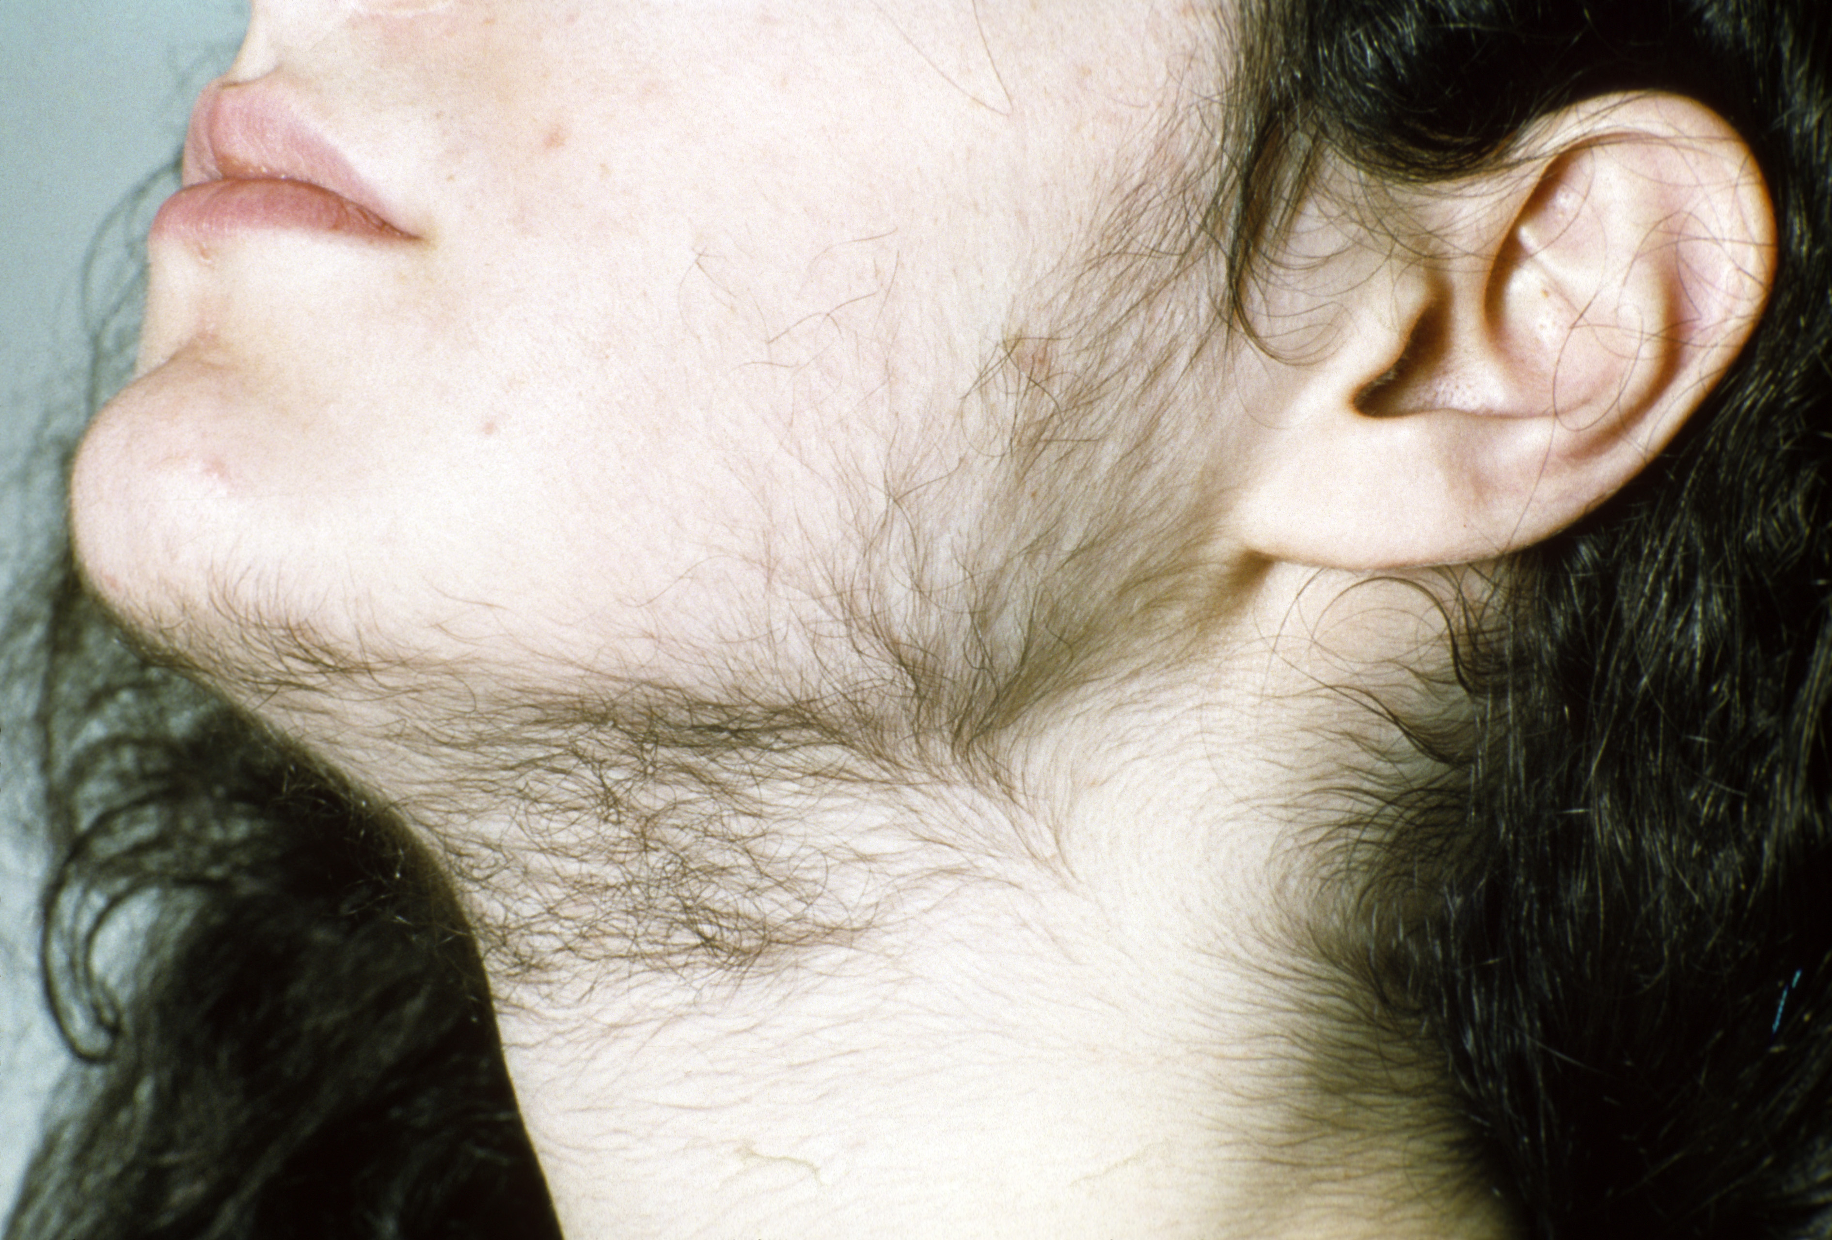
1
Definition, Pathogenesis, and Etiology of Hirsutism

Slide 4
Definition of hirsutism
Hirsutism is excessive terminal hair that appears in a male pattern (excessive hair in androgen-dependent areas; i.e., sexual hair) in women.
Local hair growth: This is unwanted localized hair growth in the absence of an abnormal hirsutism score.
Patient-important hirsutism: Unwanted sexual hair growth of any degree that causes sufficient distress for women to seek additional treatment.
Hyperandrogenism: is defined as clinical features that result from increased androgen production and/or action.
Idiopathic hirsutism: This is hirsutism without hyperandrogenemia or other signs or symptoms indicative of a hyperandrogenic endocrine disorder.

Slide 5
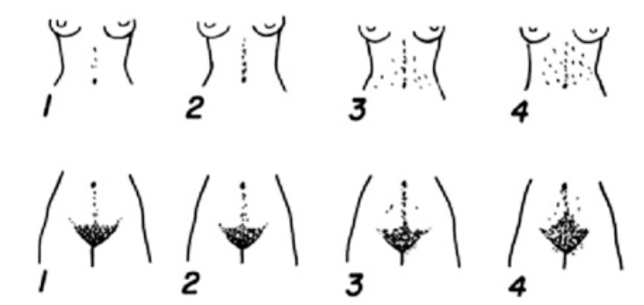
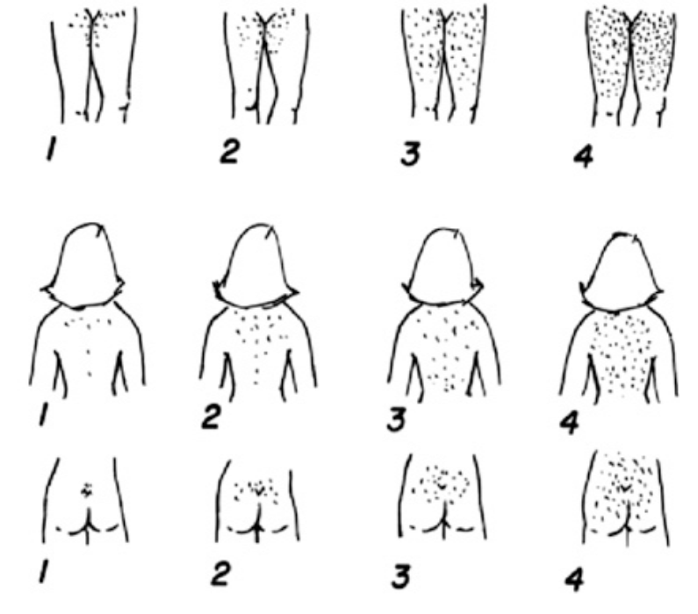
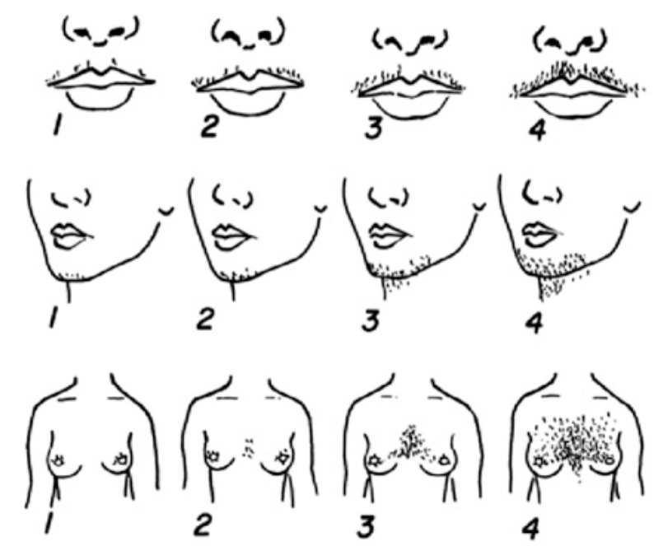
Ferriman–Gallwey score
The modified Ferriman–Gallwey score is the gold standard for evaluating hirsutism. Nine body areas most sensitive to androgen are assigned a score from 0 (no hair) to 4 (frankly virile), and these separate scores are summed to provide a hormonal hirsutism score

Slide 6
Ferriman–Gallwey score
Clinicians commonly diagnose hirsutism as a Ferriman–Gallwey score above the 95th percentile for the population.
Ferriman–Gallwey total scores that define hirsutism in women of reproductive age are as follows:
United States and United Kingdom black or white women, ≥8
Mediterranean, Hispanic, and Middle Eastern women, ≥ 9 to 10
South American women, ≥ 6
Asian women, a range of ≥ 2 for Han Chinese women to ≥ 7 for Southern Chinese women

Slide 7
Ferriman–Gallwey score
This scoring system has its limitations:
Subjective nature,
The failure to account for a locally high score that does not raise the total score to an abnormal extent,
The lack of consideration of such androgensensitive areas such as the sides of the face from the hairline to below the ear (sideburns) and the buttocks.
Lower Ferriman–Gallwey scores can be clinically important.
Even minimal degrees of unwanted hair are often associated with hyperandrogenemia when menstrual irregularity is present.

Slide 8
Pathogenesis of hirsutism
The growth of sexual hair is entirely dependent on the presence of androgen.
Androgens appear to induce vellus follicles in sexspecific areas to develop into terminal hairs, which are larger and more heavily pigmented.
Hairs grow innonsynchronous cycles, and the growth (anagen) phase (which varies with body area) is ~4 months for facial hair.
Due to the long hair growth cycle, it takes ~6 months to detect the effects of hormonal therapy and ~9 months for these effects to become maximal.

Slide 9
Pathogenesis of hirsutism
Hirsutism results from an interaction between the plasma androgens and the apparent sensitivity of the hair follicle to androgen.
The sensitivity of the hair follicle is determined in part by the local metabolism of androgens, particularly by conversion of testosterone to dihydrotestosterone by the enzyme 5a-reductase and subsequent binding of these molecules to the androgen receptor.
The hirsutism score does not correlate well with the androgen level, apparently because the androgen-dependent pilosebaceous follicle response to androgen varies considerably.

Slide 10
Etiology of hirsutism
The majority of hirsutism is due to androgen excess (≥80%), and the majority of women with hirsutism (70% to 80%) have PCOS.
Many women have hirsutism without hyperandrogenemia. We term this “idiopathic hirsutism” in eumenorrheic women who have no other clinical evidence suggesting PCOS or other hyperandrogenic endocrine disorder. Idiopathic hirsutism constitutes 5% to 20% of hirsute women.

Slide 11
Etiology of hirsutism
Among eumenorrheic women with mild hirsutism (a Ferriman–Gallwey hirsutism score of 8 to 15 in the United States), approximately half have idiopathic hirsutism.
It is unclear whether idiopathic hirsutism is due to altered androgen mechanism of action within the hair follicle (referred to as cutaneous hyperandrogenism) or to other alterations in hair biology.
Hirsutism cannot currently be considered synonymous with “clinical evidence of hyperandrogenism” if serum total and free testosterone are normal. The possibility exists that previously unsuspected circulating androgens contribute to idiopathic hirsutism

Slide 12
Etiology of hirsutism
As noted, among women with mild hirsutism, approximately half have idiopathic hirsutism. Plasma total and/or free testosterone levels are elevated in the remainder of cases of mild hirsutism and in most cases of more severe hirsutism.
Most women with a twofold or greater elevation of serum androgen levels have some degree of hirsutism or an alternative pilosebaceous response, such as excessive acne vulgaris, seborrhea, or female- or malepattern alopecia.
NCCAH, the most common of these disorders, is present in 4.2% of hyperandrogenic women worldwide.

Slide 13
Etiology of hirsutism
Androgen-secreting tumors are present in ~0.2% of hyperandrogenic women; over half are malignant.
Clinicians must consider Cushing syndrome, acromegaly, hypothyroidism, and (rarely) hyperprolactinemia in the differential diagnosis of hirsutism, but patients typically will present with the features specific to these disorders.
Clinicians must consider topical androgen use by a partner, exogenous androgens or anabolic steroids, or valproic acid when evaluating patients with hirsutism.

Slide 14
2
Diagnosis of Hirsutism

Slide 15
Diagnosis of Hirsutism
Hirsutism is a clinical diagnosis.
The management of hirsutism is to a considerable extent independent of the etiology.
Hirsutism is a potential indication of an underlying hyperandrogenic disorder that may require specific treatment and may have distinct implications for fertility, medical risks, and genetic counseling.
The goal in assessing hirsutism is to attempt to determine the specific etiology and to provide a baseline in case it becomes necessary to reassess the patient.

Slide 16
Diagnosis of Hirsutism
Initial evaluation of complaint of hirsutism
Drug or medication use
Discontinue of possible
Local hair growth, isolated
Abnormal hirsutism score or local sexual hair growth with clinical evidence of hyperandrogenic endocrine disorder

Slide 17
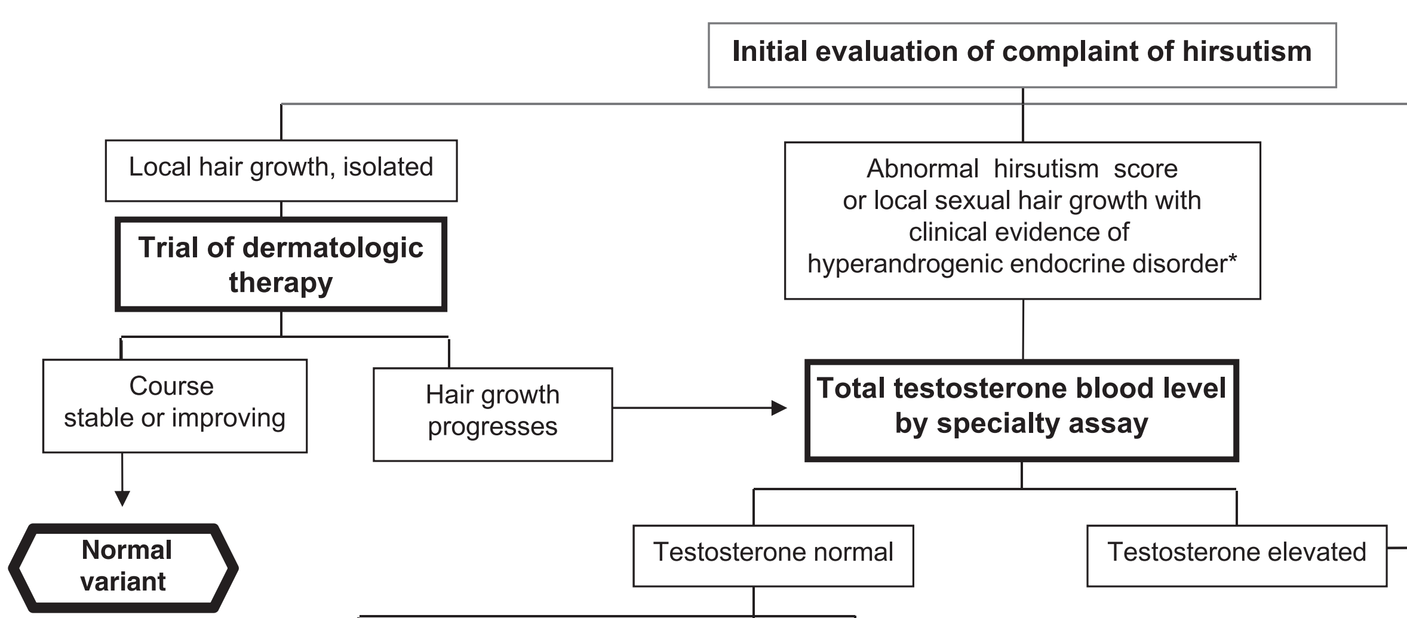
Diagnosis of Hirsutism

Slide 18
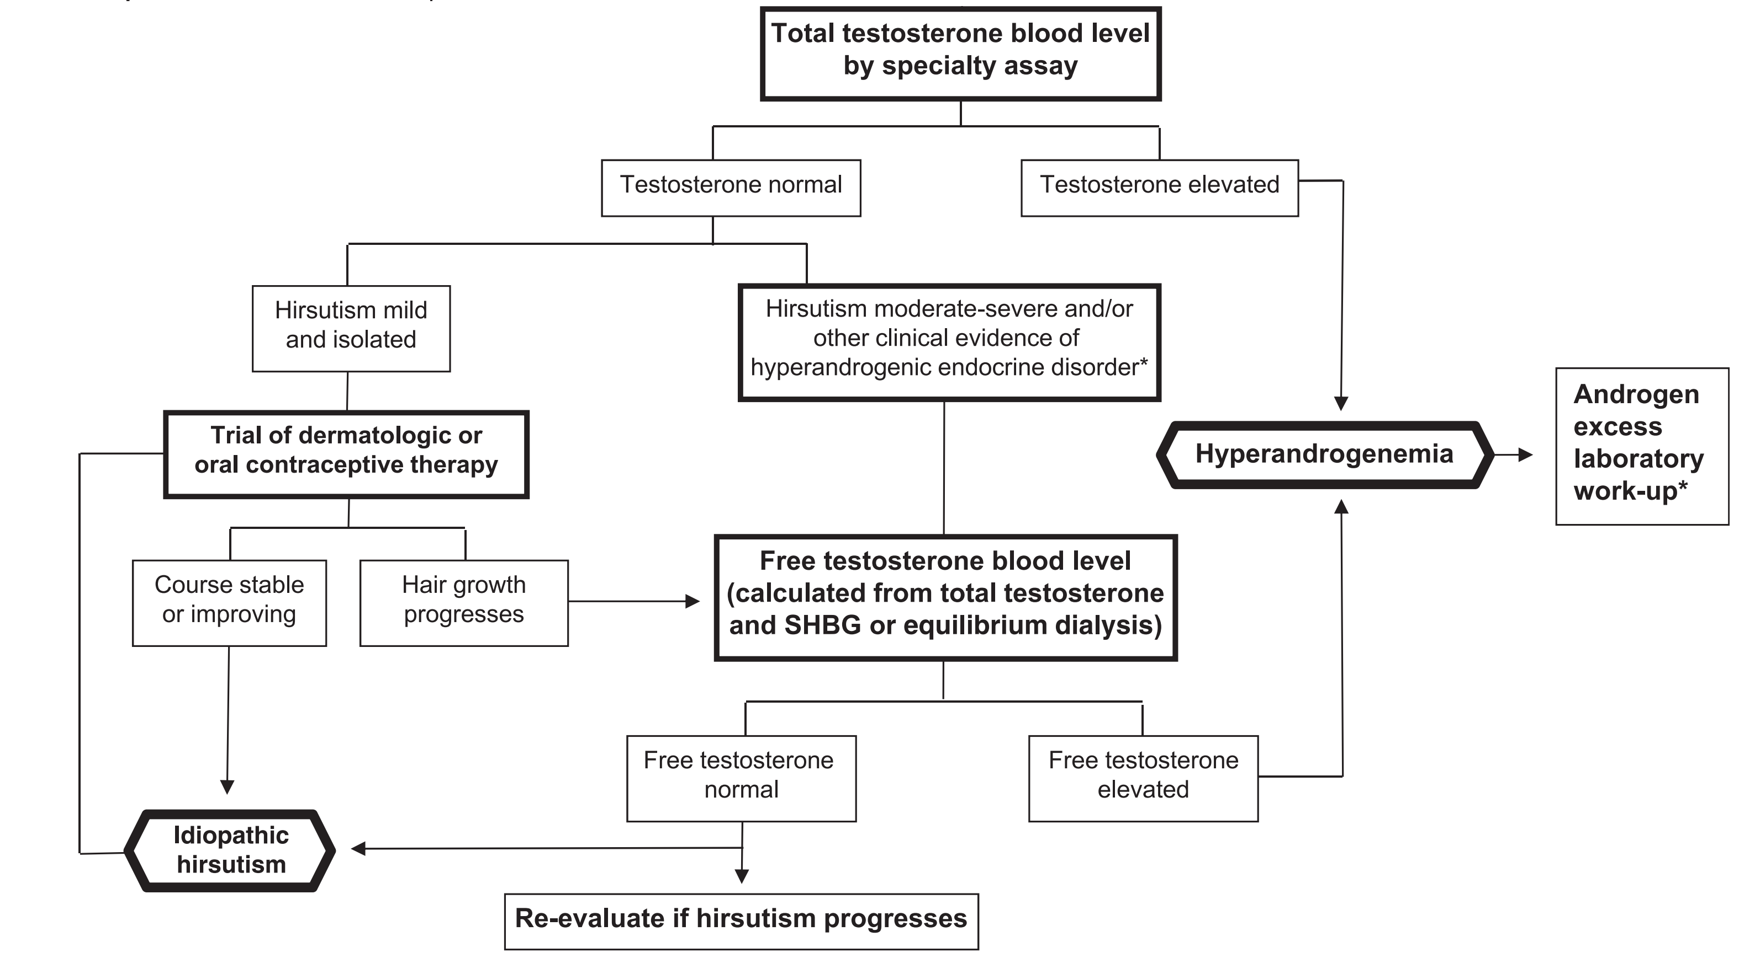
Diagnosis of Hirsutism

Slide 19
Diagnosis of Hirsutism
We suggest testing for elevated androgen levels in all women with an abnormal hirsutism score.
In those cases where serum total testosterone levels are normal, if sexual hair growth is moderate/severe or sexual hair growth is mild but there is clinical evidence of a hyperandrogenic endocrine disorder (such as menstrual disturbance or progression in spite of therapy).
we suggest measuring an early morning serum total and free testosterone by a reliable specialty assay.

Slide 20
Diagnosis of Hirsutism
We suggest against testing for elevated androgen levels in eumenorrheic women with unwanted local hair growth (i.e., in the absence of an abnormal hirsutism score) because of the low likelihood of identifying a medical disorder that would change management or outcome.
Because standard assays fail to detect androgenic drugs, clinicians should be diligent in their effort to obtain a history of anabolic or androgenic steroid use, particularly among athletes and patients who have endometriosis, sexual dysfunction, or partners who may use testosterone gel. Valproic acid is the only anticonvulsant medication that raises plasma testosterone levels.

Slide 21
Diagnosis of Hirsutism
Because of the high frequency of PCOS, clinicians should check all hirsute women for evidence of anovulation (menstrual irregularity) or more subtle ovarian dysfunction that may present as infertility, central obesity, abnormal carbohydrate and lipid metabolism, acanthosis nigricans, or a family history of type 2 diabetes mellitus.
Clinicians can make a diagnosis of ovulatory PCOS in eumenorrheic women with hirsutism, polycystic ovary morphology, and normal levels of testosterone.

Slide 22
Diagnosis of Hirsutism
The most common of nonclassic congenital adrenal hyperplasia due to 21-hydroxylase deficiency.
We suggest screening hyperandrogenemic women for NCCAH due to 21-hydroxylase deficiency by measuring early morning 17-hydroxyprogesterone levels in the follicular phase or on a random day for those with amenorrhea or infrequent menses.
In hirsute patients with a high risk of congenital adrenal hyperplasia (positive family history, member of a high-risk ethnic group), we suggest this screening even if serum total and free testosterone are normal.

Slide 23
Diagnosis of Hirsutism
The evaluation of hyperandrogenemic women may include the following:
Pregnancy tests in patients with amenorrhea;
Measuring dehydroepiandrosterone (DHEA) sulfate (DHEAS) to screen for adrenal hyperandrogenism;
Assessing for Cushing syndrome, thyroid dysfunction, acromegaly, and hyperprolactinemia if features of these conditions are present;
Pelvic ultrasonography (preferably transvaginal) to detect an ovarian neoplasm in women with severe or progressive hyperandrogenism.

Slide 24
Diagnosis of Hirsutism
Further workup to identify the origin of androgen excess may be clinically indicated because of atypical clinical or laboratory findings and may include the following:
measuring serum androstenedione or other steroid intermediates;
assessing the response to cosyntropin of 17-hydroxyprogesterone, DHEA, 17-hydroxypregnenolone, and 11-deoxycortisol, and/or genotyping to exclude rare forms of congenital adrenal hyperplasia;
assessing urinary corticoid metabolites by mass spectrometry to exclude apparent cortisone reductase deficiency ;

Slide 25
Diagnosis of Hirsutism
dexamethasone suppression testing to suppress androgens arising from a functional adrenal source;
adrenal computed tomography, ovarian ultrasound, or more specialized imaging studies if there is reason to suspect an androgen-secreting tumor;
assessing the suppressive response to combined OC or gonadotropin-releasing hormone (GnRH) agonist. transvaginal ultrasound is also helpful if ovarian hyperthecosis is suspected; absence of follicles and or the polycystic ovarian morphology supports the diagnosis of hyperthecosis.

Slide 26
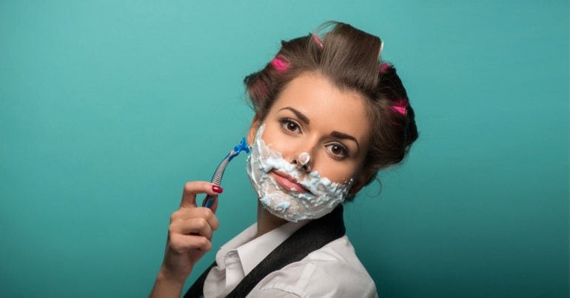
3
Treatment of Hirsutism in
Premenopausal Women

Slide 27
Diagnosis of Hirsutism
There are two main approaches to the management of hirsutism that may be used either individually or in combination:
Pharmacologic therapies that target androgen production and action,
Direct hair removal methods (electrolysis and photoepilation).
Most women also use cosmetic measures (shaving, plucking, waxing) before their first medical consultation and continue to use them during pharmacotherapy.

Slide 28
Treatment of Hirsutism
For most women with patient-important hirsutism despite cosmetic measures, we suggest starting with pharmacological therapy.
For women who then desire additional cosmetic benefit, we suggest adding direct hair removal methods.
However, for women with mild hirsutism and no evidence of an endocrine disorder, we suggest either approach.
For hirsute women with obesity, including those with PCOS, we also recommend lifestyle changes.

Slide 29
Treatment of Hirsutism
Although experts have often made treatment recommendations based on the severity of hirsutism using Ferriman–Gallwey scores, this approach has several limitations:
Many clinicians are unfamiliar with calculating Ferriman–Gallwey scores;
Most women use cosmetic measures before seeking consultation, making it impossible to accurately determine a Ferriman–Gallwey score;
Treatment decisions need to be proportionate to the extent that excessive hair affects patient well-being

Slide 30
Treatment of Hirsutism
Cosmetic measures to manage hirsutism include methods that remove hair shafts from the skin surface (depilation)
Shaving and Chemical depilatory
and those that extract hairs to above the bulb (epilation).
such as plucking or waxing,
In addition to cosmetic and/or pharmacologic therapy, lifestyle changes for obese women with PCOS may improve their hirsutism.

Slide 31
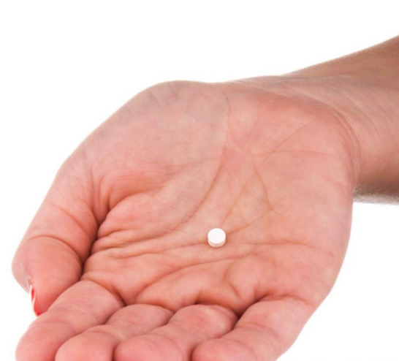
4
Pharmacological Treatments

Slide 32
Pharmacological Treatments
In this guideline, OCs refers only to combined oral estrogen–progestin contraceptives containing EE and not to newer OCs that contain 17-b-estradiol or estradiol valerate combined with highly potent progestins, as the doses of estrogen in these pills are unlikely to suppress ovarian androgens.
Most progestins are derived from 19-nortestosterone and exhibit varying degrees of androgenicity:
Low androgenicity: norgestimate, desogestrel, and gestodene
Medium androgenicity: norethindrone;
Relatively high androgenicity: norgestrel and levonorgestrel.

Slide 33
Pharmacological Treatments
OC therapy reduces hyperandrogenism via a number of mechanisms, including the following:
Suppression of luteinizing hormone secretion (and therefore ovarian androgen secretion),
stimulation of hepatic production of sex hormone–binding globulin (SHBG) (thereby increasing androgen binding in serum and reducing serum free androgen concentrations),
and a slight reduction in both adrenal androgen secretion and binding of androgens to their receptor.
Consequently, there is a reduction of testosterone production

Slide 34
Pharmacological Treatments
For the majority of women with hirsutism who are not seeking fertility, we suggest OCs as initial therapy for treating patient-important hirsutism.
For most women with hirsutism, we suggest against antiandrogen monotherapy as initial therapy (because of the teratogenic potential of these medications) unless these women use adequate contraception.
For women who are not sexually active, have undergone permanent sterilization, or who are using long-acting reversible contraception, we suggest using either OCs or antiandrogens as initial therapy.
The choice between these options depends on patient preferences regarding efficacy, side effects, and cost.

Slide 35
Pharmacological Treatments
Combination OCs carry about a threefold increased risk of VTE in first-time users.
VTE risk is significantly but weakly related to estrogen dose and may wane with duration of estrogen use.
The use of OCs containing some of the recent-generation low-androgenicity progestins (desogestrel, gestodene), and androgen receptor antagonists (CPA, DSP) may confer a 50% to 100% increased risk of VTE compared with OCs containing the secondgeneration progestin levonorgestrel, according to reviews of large-scale comparative analyses.

Slide 36
Pharmacological Treatments
Increased age and obesity are additional factors associated with an increased risk of VTE.
The risk in women over age 39 years taking OCs is approximately fourfold higher than in younger women (100 vs 25 per 100,000 women years).
The risk in obese women taking OCs has been estimated to be 2- to 10-fold higher than nonobese women taking OCs.

Slide 37
Pharmacological Treatments
OCs and Associated VTE Risks

Slide 38
Pharmacological Treatments
For most women, we do not suggest one OC over another as initial therapy, as all OCs appear to be equally effective for hirsutism, and the risk of side effects is low.
For women with hirsutism at higher risk for VTE (e.g., those who are obese or over age 39 years), we suggest initial therapy with an OC containing the lowest effective dose of ethinyl estradiol (EE) (usually 20 mcg) and a low-risk progestin.

Slide 39
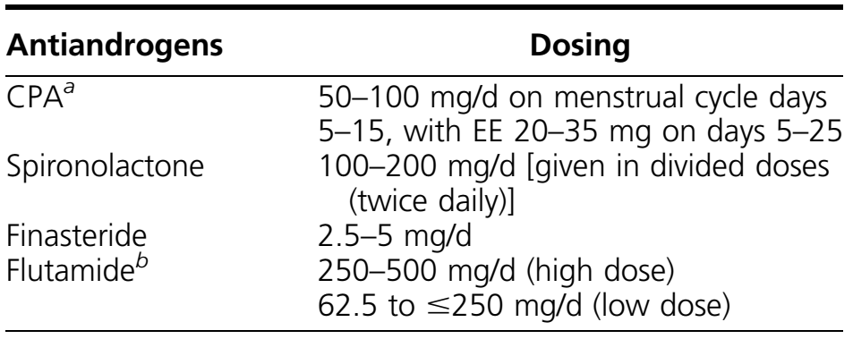
Pharmacological Treatments
Antiandrogens Used for the Treatment of Hirsutism
In analyses of individual antiandrogens compared with placebo, spironolactone 100 mg/d, finasteride 2.5 to 5 mg/d, and flutamide 500 mg/d, each showed a significant reduction in hirsutism scores.

Slide 40
Pharmacological Treatments
CPA is a progestogenic compound with antiandrogen activity by virtue of its effects in inhibiting the androgen receptor and to a lesser degree in inhibiting 5a-reductase activity.
It also suppresses serum gonadotropin and androgen levels.
Finasteride inhibits type 2 5α-reductase activity. Because enhanced 5 α -reductase activity in hirsutism probably involves both type 1 and 2 5 α -reductase enzymes, only a partial inhibitory effect may be expected with finasteride.
Some data suggest that 7.5 mg is more effective than 5 mg, and that doses of 2.5 and 5 mg appear to be equally effective

Slide 41
Pharmacological Treatments
Spironolactone, an aldosterone antagonist, exhibits dose-dependent competitive inhibition of the androgen receptor as well as inhibition of 5α-reductase activity.
Spironolactone use may rarely result in hyperkalemia, and it may cause increased diuresis and occasionally postural hypotension and dizziness early in treatment.
OCs containing DSP have a mild mineralocorticoid effect and should not be used with a potassium-sparing diuretic.
If a patient inadvertently uses spironolactone during early pregnancy, there is a danger that a male fetus could be feminized

Slide 42
Pharmacological Treatments
Flutamide is a “pure” antiandrogen with a dose response inhibition of the androgen receptor.
Whereas the most frequently used dose in RCTs is 500 mg/d, some experts have suggested equal efficacy with 250 and 500 mg/d.
Flutamide doses of 62.5 to 250 mg may be effective for hirsutism.
The major concern with flutamide is its propensity for hepatic toxicity.

Slide 43
Pharmacological Treatments
If patient-important hirsutism remains despite 6 months of monotherapy with an OC, we suggest adding an antiandrogen.
We do not suggest one antiandrogen over another.
We recommend against the use of flutamide because of its potential hepatotoxicity.
For all pharmacologic therapies for hirsutism, we suggest a trial of at least 6 months before making changes in dose, switching to a new medication, or adding medication.

Slide 44
Pharmacological Treatments
In patients with severe hirsutism causing emotional distress and/or in those women who have used OCs in the past and have not experienced sufficient improvement, we suggest initiating combination therapy with an OC and antiandrogen.
we suggest against combination therapy as a standard first-line approach.

Slide 45
Pharmacological Treatments
Clinicians administer glucocorticoids long-term to suppress adrenal androgens in women with classic congenital adrenal hyperplasia due to 21-hydroxylase deficiency.
In these patients, glucocorticoids help prevent or manage hirsutism, and they are effective for maintaining normal ovulatory cycles.
In women with the nonclassic form of 21-hydroxylase deficiency, glucocorticoids are effective for ovulation induction, but their role in the management of hirsutism is less clear.
In patients with pure adrenal hyperandrogenism, suppressing adrenal androgens results in only minor improvements in hirsutism.

Slide 46
Pharmacological Treatments
Our approach to treating hirsutism in women with NCCAH, we suggest starting with an OC and adding an antiandrogen after 6 months if necessary.
We only suggest glucocorticoids for the management of hirsutism in women who have a suboptimal response to OCs and/or antiandrogens, or cannot tolerate them.
For hirsutism, we use prednisone 4 to 6 mg daily or dexamethasone 0.25 mg/d.
For ovulation induction, we suggest glucocorticoid therapy. We typically start with prednisone 5 mg daily. If ovulation has not occurred, the dose can be increased to 7.5 mg.
Clomiphene citrate is then added if ovulation does not occur with prednisone alone.

Slide 47
Pharmacological Treatments
We do not suggest dexamethasone because it is not inactivated by placental 11-β-hydroxysteroid dehydrogenase type 2.
In women with adrenal hyperandrogenism, although glucocorticoids may improve hirsutism, both OCs and antiandrogens may be more effective.
Slight overdosing in glucocorticoid therapy may be associated with side effects, such as adrenal atrophy, increased blood pressure, weight gain, Cushingoid striae (particularly with dexamethasone), and decreased bone mineral density.
DHEAS levels indicate the degree of adrenal suppression; the target level is~70 mcg/dL

Slide 48
Pharmacological Treatments
We suggest against using insulin-lowering drugs for the sole indication of treating hirsutism.
We suggest against using GnRH agonists except in women with severe forms of hyperandrogenemia (such as ovarian hyperthecosis) who have a suboptimal response to OCs and antiandrogens.
We suggest against the use of topical antiandrogen therapy for hirsutism.

Slide 49
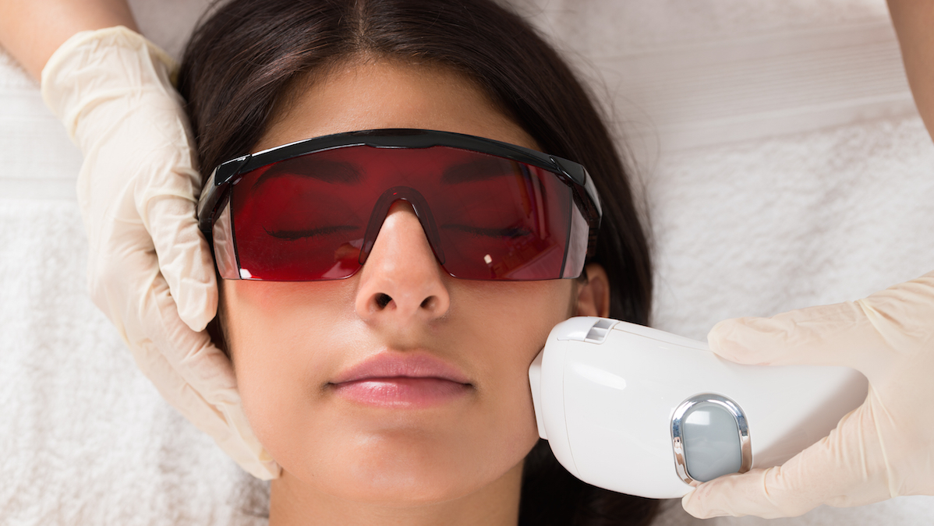
5
Direct Hair Removal Methods

Slide 50
Direct Hair Removal Methods
FDA define permanent hair reduction as attaining at least a 30% reduction of terminal hairs and sustaining this reduction for a period longer than the complete growth cycle of hair follicles (4 to 12 months, depending on body site).
Photoepilation: is a method capable of rapidly treating large areas; it requires the presence of pigmented, terminal hair.
Electrolysis: is generally limited to small treatment areas, and it does not depend on hair pigmentation.

Slide 51
Direct Hair Removal Methods
Photoepilation:
Photoepilation uses pulses of light absorbed by melanin in the hair shaft and follicle to cause selective photothermolysis of pigmented terminal hair follicles.
It selectively injures pigmented tissues based upon wavelength, pulse duration, and fluence (energy applied per area of skin surface).
Some photoepilation devices are able to rapidly treat very large areas (e.g., the lower face, neck, chest, and both axillae) within 20 minutes.
The FDA has cleared less powerful, home-use versions of diode laser IPLs for over-the-counter sale.

Slide 52
Direct Hair Removal Methods
Electrolysis:
The galvanic electrolysis technique uses direct current, causing electrochemical reactions that locally release toxic products within the hair follicle.
The thermolysis technique uses a higher level of alternating current to produce heat in the hair follicle immediately surrounding the wire electrode.
Electrolysis is generally regarded as effective for permanent hair reduction.
The thermolysis and blend techniques are painful.

Slide 53
Direct Hair Removal Methods
Photoepilation vs Electrolysis:
The advantages of electrolysis over photoepilation are its ability to permanently reduce hair of any color in any skin type and the lack of reported PH (the rare occurrence of paradoxical hair growth instead of hair removal after laser epilation).
The disadvantage of electrolysis is longer treatment time.
Both electrolysis and photoepilation are somewhat painful, and both treatments often include a topical anesthetic.
The mean hair reduction was similar for lasers and IPL: 27% to 40% for IPL; 34% for diode laser; and 46% for alexandrite laser

Slide 54
Direct Hair Removal Methods
Side effects:
Patients with tanned or darkly pigmented skin are at higher risk for unintended thermal injury to the epidermis during photoepilation, resulting in inflammation, burns, blistering, hyperpigmentation, hypopigmentation, and/or scarring (rarely).
In fair skin the risk of side effects, other than temporary perifollicular inflammation, is low.
Mild to moderate pain during treatment and transient perifollicular erythema and/or edema are side effects directly related to thermal destruction of hair follicles.

Slide 55
Direct Hair Removal Methods
Side effects:
Side effects related to unintentional epidermal injury are more likely to occur with darker skin pigmentation, higher treatment fluence, and/or inadequate skin-cooling techniques.
These side effects include strong pain, blisters, erosions, crusting, transient or prolonged pigmentary changes (in up to ~10% of patients), and scarring (very rare).
The risk of side effects appears to be greater after IPL and ruby laser (694 nm) treatments. Nd:YAG (1064 nm) lasers (which have the same cost of efficacy) are effective for photoepilation in darkly pigmented skin because of the lower risk of epidermal injury and pigmentary side effects

Slide 56
Direct Hair Removal Methods
For women who choose hair removal therapy, we suggest photoepilation for those whose unwanted hair is auburn, brown, or black, and we suggest electrolysis for those with white or blonde hair.
For women of color who choose photoepilation treatment, we suggest using a long-wavelength, long pulse-duration light source such as Nd:YAG or diode laser delivered with appropriate skin cooling.

Slide 57
Direct Hair Removal Methods
Eflornithine reduces the rate of hair growth by irreversibly inhibiting ornithine decarboxylase, which catalyzes the rate-limiting step for follicular polyamine synthesis.
A topical preparation, eflornithine hydrochloride cream 13.9%, is FDA approved for the treatment of unwanted facial hair in women.
With clinical use, side effects include itching and dry skin.
Clinicians should warn Mediterranean and Middle Eastern women with facial hirsutism about the increased risk of developing PH with photoepilation therapy. We often suggest topical treatment or electrolysis over photoepilation with these patients.

Slide 58
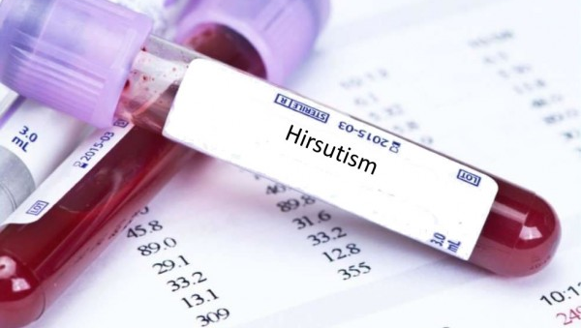
6
Androgen Testing Remarks

Slide 59
Testosterone
Testosterone is the key androgen to measure because it is the major circulating androgen.
It is produced as a by-product of ovarian or adrenal function, either by secretion or by the metabolism of secreted prohormones (mainly androstenedione) in peripheral tissues, such as fat and skin
Testosterone levels vary episodically and diurnally (they are highest in the early morning and vary by ;25% around the mean); in ovulatory women, levels reach a midcycle zenith .
The free hormone hypothesis, i.e., that the bioactive portion of serum testosterone is the free testosterone (protein unbound)

Slide 60
Testosterone and SHBG
The serum free (or bioavailable) testosterone level is more often elevated in hirsute women than the total testosterone level and is more sensitive than total testosterone in detecting excess androgen production.
The reason for this greater diagnostic sensitivity is that hirsute women commonly have a relatively low level of SHBG.
SHBG is the main determinant of the fraction of plasma testosterone that is free or bound to other plasma proteins, principally albumin.
SHBG levels are raised by estrogen and suppressed by androgen, insulin-resistant obesity, and hypothyroidism.

Slide 61
Testosterone and SHBG
The serum free (or bioavailable) testosterone level is more often elevated in hirsute women than the total testosterone level and is more sensitive than total testosterone in detecting excess androgen production.
The reason for this greater diagnostic sensitivity is that hirsute women commonly have a relatively low level of SHBG.
SHBG is the main determinant of the fraction of plasma testosterone that is free or bound to other plasma proteins, principally albumin.
SHBG levels are raised by estrogen and suppressed by androgen, insulin-resistant obesity, and hypothyroidism.

Slide 62
Androgen Testing Remarks
The diagnostic utility of serum testosterone depends on use of an accurate, specific assay.
The automated immunometric assays that are available in most hospital laboratories are generally not suitable to accurately measure testosterone in women.
Some direct radioimmuno assays and chemiluminescence assays available in specialty laboratories provide results comparable to the new generation of liquid chromatography/mass spectrometry methods.
Salivary testosterone correlates with serum-free testosterone, but methodologic differences have led to widely divergent values between laboratories, so we recommend against this methodology.

Slide 63
Androgen Testing Remarks
We also do not recommend measurements of urinary testosterone (testosterone glucuronide), as it is not a unique metabolite of serum testosterone and therefore does not accurately reflect circulating testosterone.
There is no uniform laboratory standard for free or bioavailable testosterone levels, and so assay-specific results differ widely. Direct assay of serum-free testosterone is unreliable.
The most reliable methods compute the free testosterone concentration from total testosterone and SHBG concentrations or as the product of the total testosterone concentration and the fraction of testosterone that is free by equilibrium dialysis or not bound to SHBG.

Slide 64
Androgen Testing Remarks
The routine assay of other known serum androgenic steroids or precursors (e.g., the intermediate 17-hydroxyprogesterone, the prohormones androstenedione and DHEA, and the androgens dihydrotestosterone and androstenediol) has been of little further diagnostic utility in most, but not all, populations.
DHEAS is increased in ≤17% of hirsute women who have normal total and free testosterone levels.
The magnitude of the androgen level is of poor predictive value for tumors, although a very high testosterone (adultmale range) or DHEAS level (>700 mg/dL) is suggestive.
DHEAS levels are of limited sensitivity in screening for NCCAH.

Slide 65
Androgen Testing Remarks
In hirsute patients with a high risk of congenital adrenal hyperplasia (positive family history, member of a high-risk ethnic group), we suggest screening by measuring early morning 17-hydroxyprogesterone levels in the follicular phase or on a random day for those with amenorrhea or infrequent menses, even if serum total and free testosterone are normal.
A 17-hydroxyprogesterone value >170 to 200 ng/dL (5.15 to 6.0 nmol/L) is approximately 95% sensitive and 90% specific for NCCAH.
Definitive diagnosis requires demonstrating a 17-hydroxyprogesterone value ≥1000 to 1500 ng/dL (30 to 45 nmol/L) either basally or in response to cosyntropin stimulation testing, with those in the 1000 to 1500 range being subject to confirmation by molecular genetic analysis of the CYP21A2 gene

Slide 66
Thank you

