Slide 1


Slide 2
Some points & recommendations for diagnosis growth hormone deficiency in Children and Adolescents

Slide 3
Outline
Criteria to Initiate Evaluation for GHD
How to suspect growth hormone deficiency in a child & neonates ?
Utility of serum IGFBP3& IGF1 in the diagnosis of growth hormone deficiency
Interpretation of results of IGFBP3& IGF1
Utility of random GH estimation in the diagnosis of GHD
Neonatal GH deficiency
Different GH dynamic tests

Slide 4
Outline
Children & neonates do not need to do GH provocative test
Limitations of GH dynamic tests in childhood GHD
How to define GH deficiency after GH dynamic tests ?
Cut-offs for GHD diagnosis during during Transitional period
How to diagnose GH insensitivity syndrome
GH neurosecretory dysfunction
Diagnosis of GH deficiency in an adult

Slide 5
Almost always
Mothers are worry about the height's children
In spite of , they are not short

Slide 6

Growth Hormone Deficiency
The incidence of GHD is about 1:4000 to 1:10000
A false positive diagnosis will lead to many years of daily subcutaneous injections, significant wasted expenditure (∼£7500 per year) and unnecessary exposure to potential adverse effects
Arch Dis Child 2016
Up to date 2017

Slide 7
Calculation of height standard deviation score
Example calculation:
A 9-year-old boy is 116 cm
Boy’s age (years) | Mean | Standard deviation
8.0–8.49 | 128.62 | 5.76
8.5–8.99 | 131.58 | 5.93
9.0–9.49 | 134.71 | 6.22
9.5–9.99 | 136.91 | 6.51
10.0–10.49 | 139.59 | 7.67
Kuczmarski et al. CDC growth charts. Vital Health Stat 2002;11(246).
Notes:
.

Slide 8
Z - score
HT 50th – HT5th
SDS =
SD
SD= HT 50th – HT5th
2
8

Slide 9
Ht50th = 134.7
HT 5 th =122.2
SD 134.7-122.2=12.5
SD 12.5÷2=6.22
SDS=134.7-116=18
SDS=18÷6= -3
As the boy’s height SDS is –3 SDS (i.e. below –2 SD), he has severe short stature

Slide 10
Consensus Statement Criteria to Initiate Evaluation for GHD
“Severe” short stature height < - 3 SD below mean
Height <−2SD with a height velocity <−1SD over a period of 1-2 years
Williams 2016
Clinical Rounds in Endocrinology 2016
Up to date 2017
Arch Dis Child 2016

Slide 11
Consensus Statement Criteria to Initiate Evaluation for GHD
Height velocity
SDS >−1.5SD over a period of 2 years
SDS −2SD over a period of one years
Williams 2016
Clinical Rounds in Endocrinology 2016
Up to date 2017
Arch Dis Child 2016

Slide 12
Consensus Statement Criteria to Initiate Evaluation for GHD
Predicted adult height >1.5SD below the target height
Decrease in height SD of more than 0.5 SD over past year in children over 2 years of age
Height-for-age curve has deviated downwards across two major height percentile curves
Clinical Rounds in Endocrinology 2016
Up to date 2017

Slide 13
Consensus Statement Criteria to Initiate Evaluation for GHD
Signs of an intracranial lesion
Signs of multiple pituitary hormone deficiency
Neonatal signs and symptoms of GHD
Curr Opin Endocrinol Diabetes Obes. 2013

Slide 14
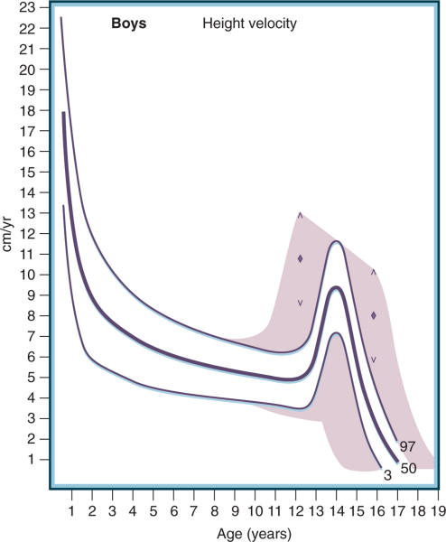
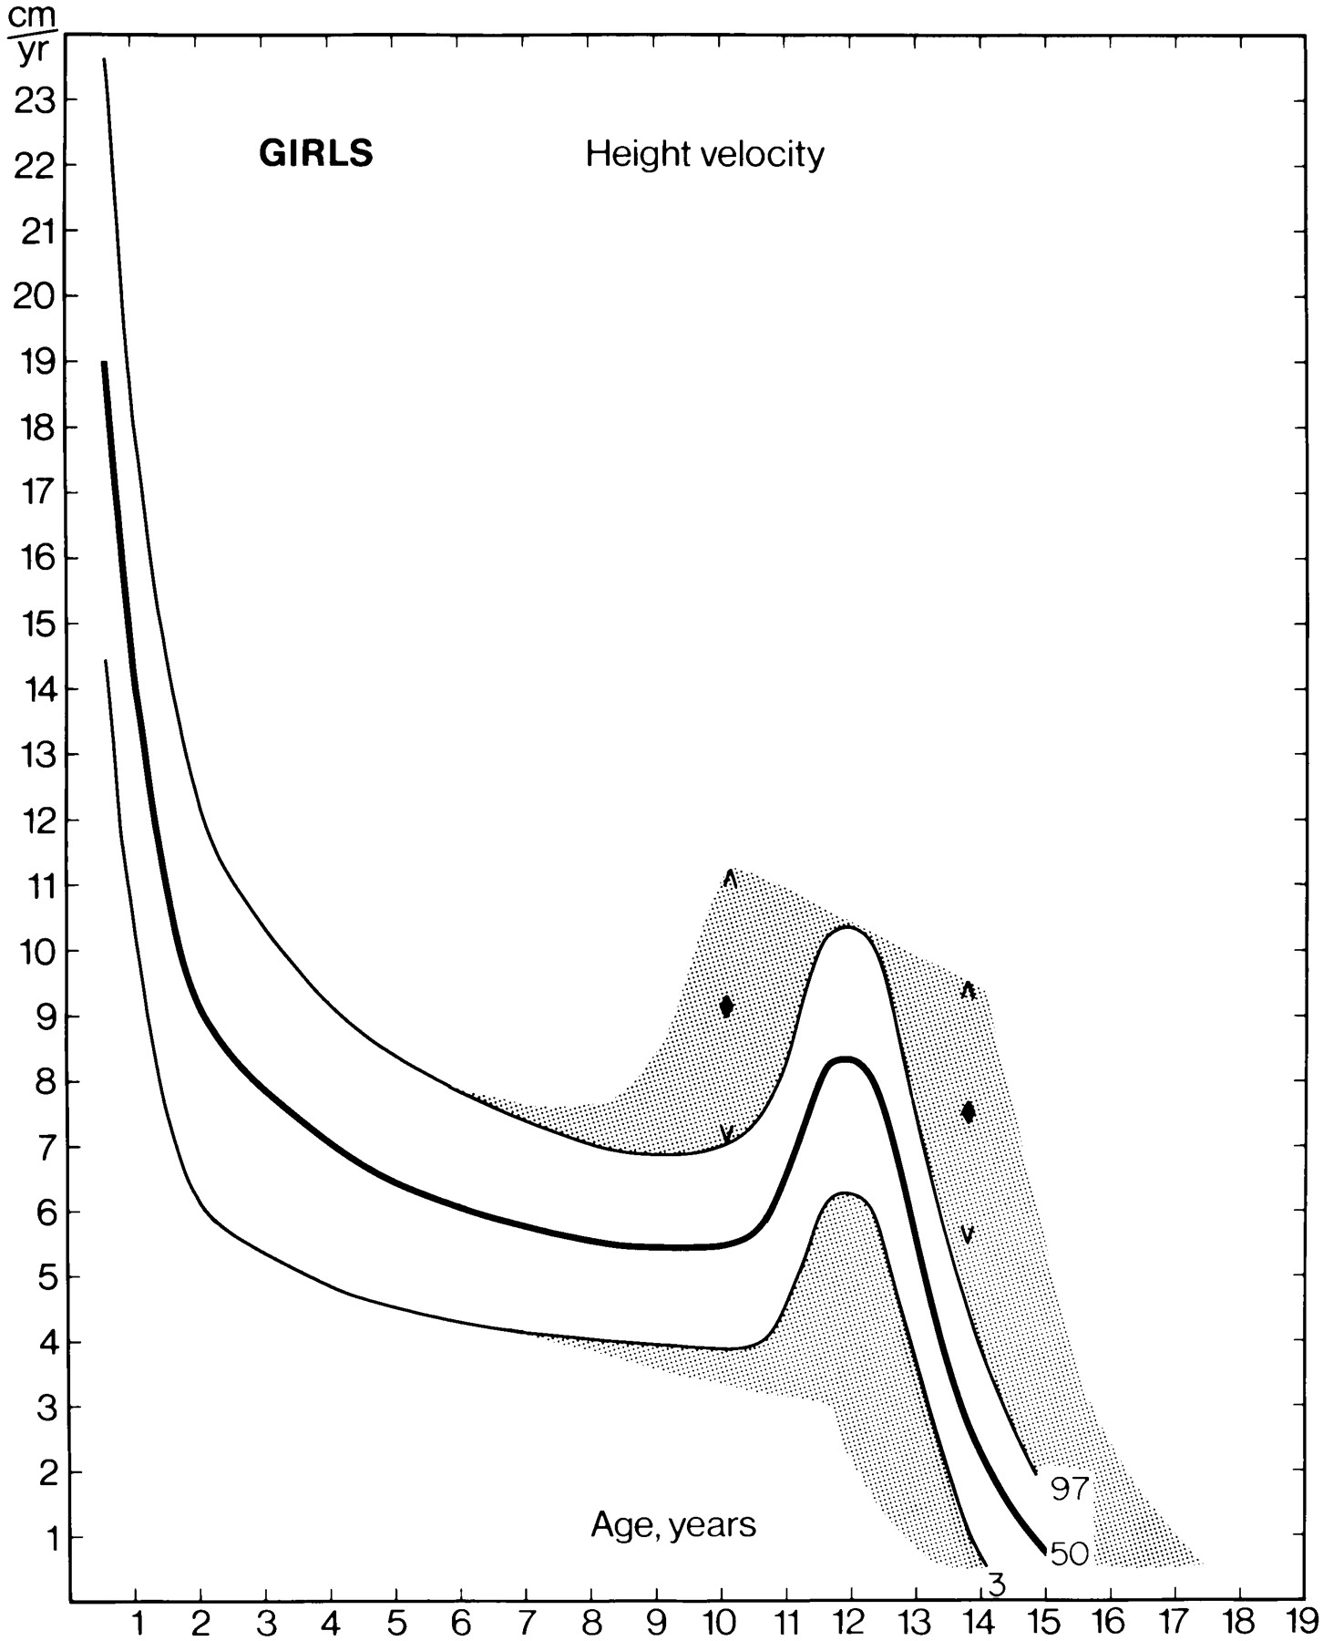
GROWTH
Height Velocity: Boys and Girls

Slide 15
Who needs to be evaluated for short stature
Age two to four years: HV less than 5.5 cm/year
Age four to six years: HV less than 5 cm/year
Age six years to puberty
HV less than 4 cm/year for boys
HV less than 4.5 cm/year for girls
Up to date 2017

Slide 16
Height of neonates with growth hormone deficiency
The birth length is usually normal or slightly reduced
Growth failure can occur during the first months of life may not be obvious until 6 to 24 months of age
Sometimes length -0.5 to -1.5 below the mean
Williams 2016
Up to date2017
Clinical Rounds in Endocrinology 2016

Slide 17
How to suspect growth hormone deficiency in neonate?
Congenital GHD
Midline defects
Micropenis, cryptorchidism, scrotal hypoplasia
Unexplained Neonatal hypoglycemia
Cholestasis
prolonged physiological jaundice
Hepatitis
Breech presentation
Clinical Rounds in Endocrinology 2016
Up to date 2017

Slide 18
How to suspect growth hormone deficiency in a child?
The phenotypic features which suggest GHD
prominent forehead, depressed nasal bridge, midfacial hypoplasia, frontal bossing
Facial immaturity, chubby face, delayed dentition, tardy nail growth,
Nystagmus. blindness ,optic atrophy
History of breech presentation
overweight for height
Clinical Rounds in Endocrinology 2016

Slide 19
How to suspect growth hormone deficiency in a child?
History of Cleft lip, cleft palate, or single central incisor, Bifid uvula
Doll-like," or "angel-like
Infantile voice
Sparse and thin hair growth
Delay puberty
Up to date 2017

Slide 20
How to suspect growth hormone deficiency in a child?
sellar–suprasellar pathology irrespective of auxological criteria
Other anterior pituitary hormone deficienciey
History of irradiation
Consanguinity
Clinical Rounds in Endocrinology 2016

Slide 21
Diagnostic approach

Slide 22
What are the investigations required for evaluation of a short child
History and physical examination
Complete blood count
Creatinine
urine analysis
Bicarbonate
Calcium, phosphorous, alkaline phosphatase
Clinical Rounds in Endocrinology 2016

Slide 23
What are the investigations required for evaluation of a short child
SGOT, SGPT, albumin
TSH, T 4
Celiac serology
Karyotype
Hand X ray (Bone age for PAH), rickets, dysplasia
Clinical Rounds in Endocrinology 2016

Slide 24
Diagnostic approach
Insulin-like growth factor I (IGF-I)
Insulin-like growth factor binding protein 3 (IGFBP-3)
Abnormal results of IGF-I and/or IGFBP-3 levels should be confirmed by provocative GH testing

Slide 25
What are the merits and demerits of serum IGF1 in the diagnosis of growth hormone deficiency ?
is a measure of integrated GH secretion
Half-lives of 12 to 16 hours
Minimal diurnal variation
is a useful tool for the assessment of GH–IGF1 axis
Clinical Rounds in Endocrinology 2016
Up to date 2017

Slide 26
What are the merits and demerits of serum IGF1 in the diagnosis of growth hormone deficiency ?
sensitivity and specify of 70 % in older children
sensitivity is lesser (50 %) in younger children <6 years
A good screening test for the diagnosis of GHD in older children.
influenced by age ,nutritional status, insulin,thyroid hormones, and gonadal steroids. renal failure, vitamin D.
Good reproducibility
Clinical Rounds in Endocrinology 2016

Slide 27
What is the utility of serum IGFBP3 in the diagnosis of growth hormone deficiency ?
is a measure of integrated GH secretion
No diurnal variation
Not influenced by age, nutritional status, or other endocrine factors
is useful measure for the assessment of GH–IGF1 axis
A great degree of overlap between the levels found in normal children and those with GHD
Clinical Rounds in Endocrinology 2016
Up to date 2017

Slide 28
What is the utility of serum IGFBP3 in the diagnosis of growth hormone deficiency ?
Sensitivity &specificity of 50- 60 % and 80–90 %, for the diagnosis of GHD.
Prefer in the diagnosis of GHD in younger children (<6 years)
If the peak level of GH was less than 5 ug/dl , sensitivity is better
Limited data is available regarding the use of combination of IGF1 and IGFBP3 for the diagnosis of GHD in children
Clinical Rounds in Endocrinology 2016
Up to date 2017

Slide 29
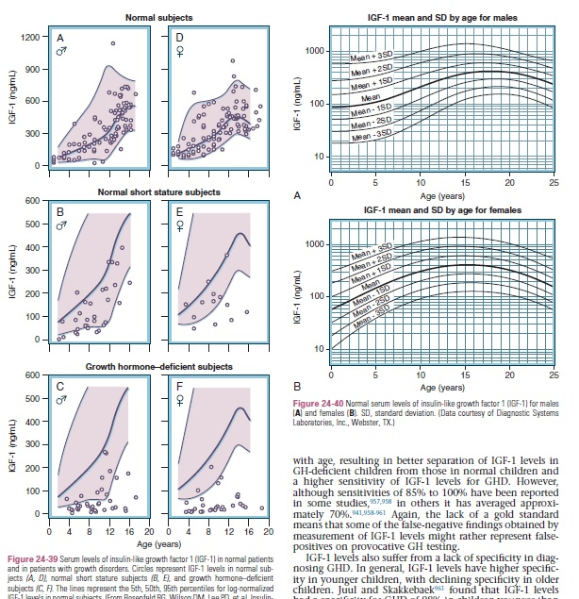

Slide 30
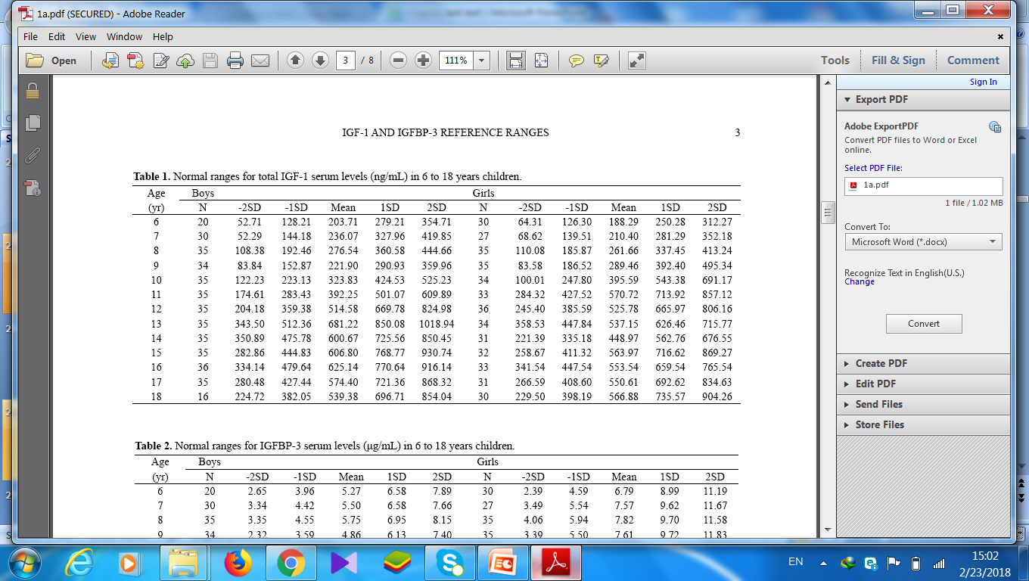

Slide 31
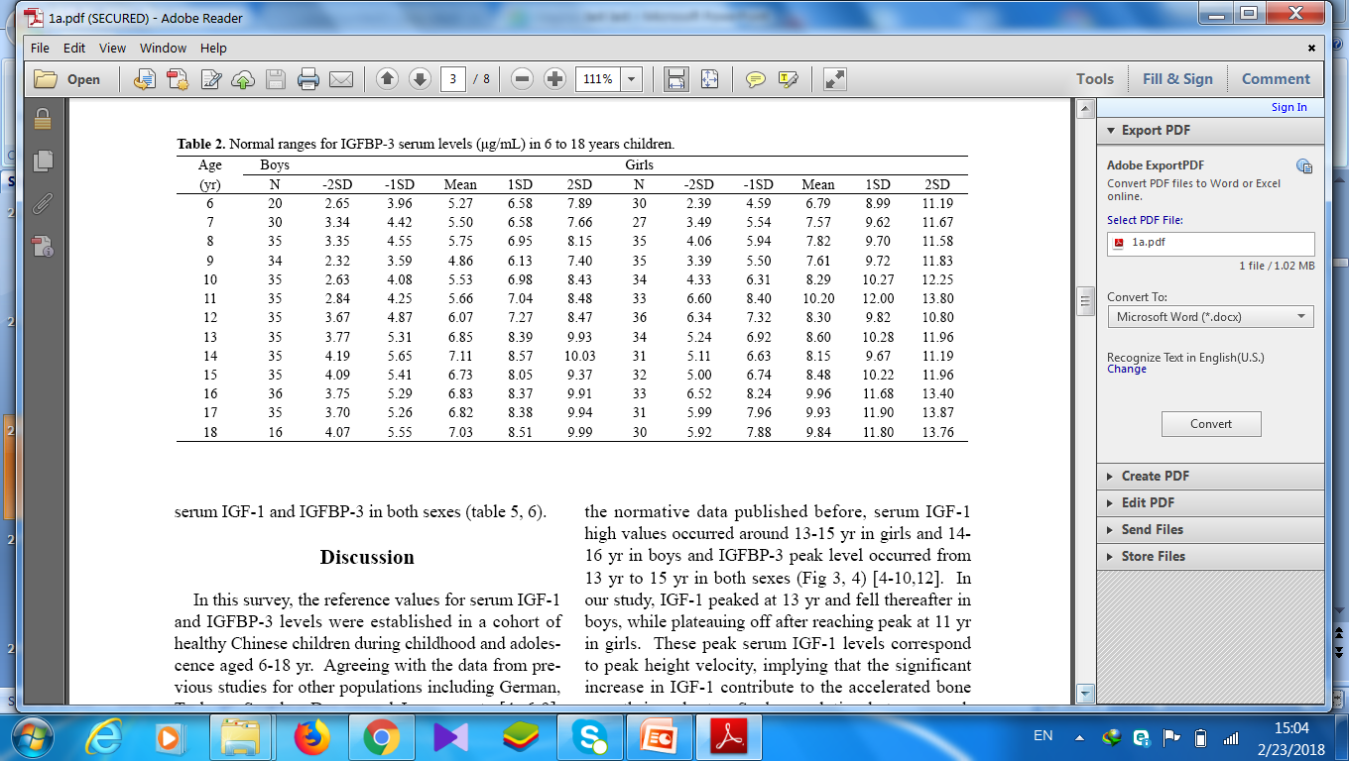

Slide 32
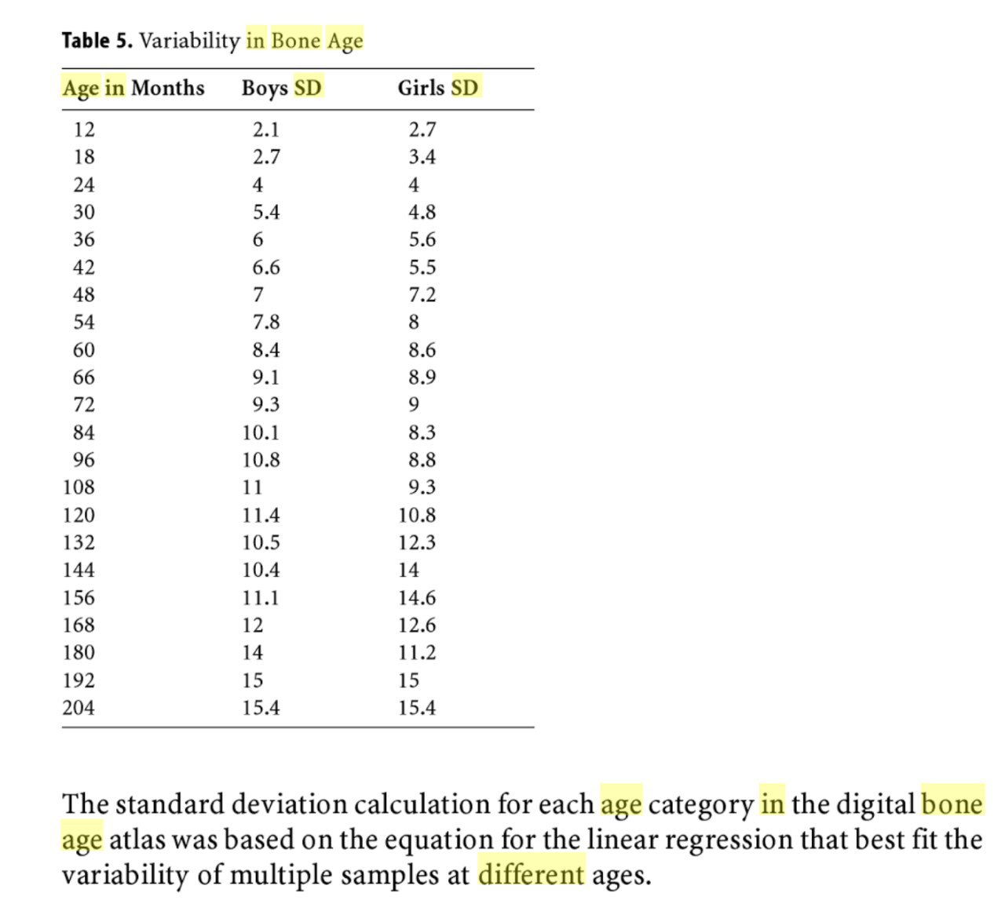

Slide 33
Interpretation of results
For patients with
Growth velocity or severe short stature
Delayed bone age
IGF-I and IGFBP-3 <-1.3 SD
provocative GH test is necessary
Up to date 2017

Slide 34
Interpretation of results
If the growth failure is severe
Delayed bone age
IGF-I and IGFBP-3 <-2 SD
No needs GH stimulation testing especially with
Hypothalamic-pituitary disease
Brain surgery
Radiation
Up to date 2017

Slide 35
Interpretation of results
If the growth failure is severe
Delayed bone age
IGF-I and IGFBP-3 <-2 SD
GH level is normal or elevated
GH insensitivity should be considered
Up to date 2017

Slide 36
Interpretation of results
If IGF-1 and IGFBP-3 0 to -1.3 SD
The decision about provocative GH testing depends on
Severity of growth failure
Degree of bone age delay
Unexplained low IGF1
Up to date 2017

Slide 37
Interpretation of results
If IGF-1 and IGFBP-3 SD ≥0 upper half of the normal range
GHD is extremely unlikely
No further testing is required
Up to date 2017

Slide 38
Interpretation of results
If the results of IGF-1 and IGFBP-3 are discordant
IGF-1 takes precedence , except for infants and young children, in whom
IGFBP-3 is better
Recommended to interpreted by stage of sexual development& BA
Up to date 2017

Slide 39
What is the utility of random GH estimation in the diagnosis of GHD ?
Neonatal GHD
GH insensitivity
.
Horm Res Paediatr 2016
Clinical Rounds in Endocrinology 2016

Slide 40
Neonatal GH deficiency
A random GH <5-7 ng/ml in the first week of life with
Clinical signs or symptoms
Deficiency of other pituitary hormones
suggest the diagnosis of neonatal GHD.
GH in cord blood 20-66 ug/dl
GH 7-55 days of age 16-20 ug/dl
Horm Res Paediatr 2016
Clinical Rounds in Endocrinology 2016
Williams 2016

Slide 41
How can we assess pituitary GH production ?
It is difficult , because GH secretion is pulsatile.
Random GH <0.1 ng/ml during the nadir to >30 ng/ml during the peak.
GH dynamic tests are employed.
Up-to-date 2017

Slide 42
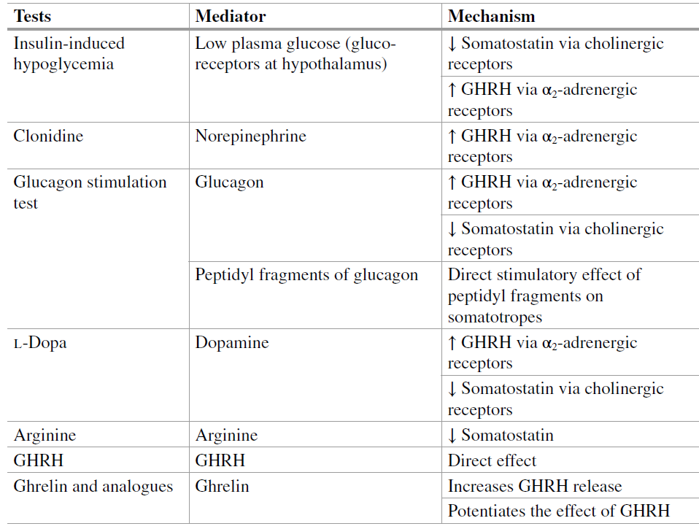
GH provocative test

Slide 43
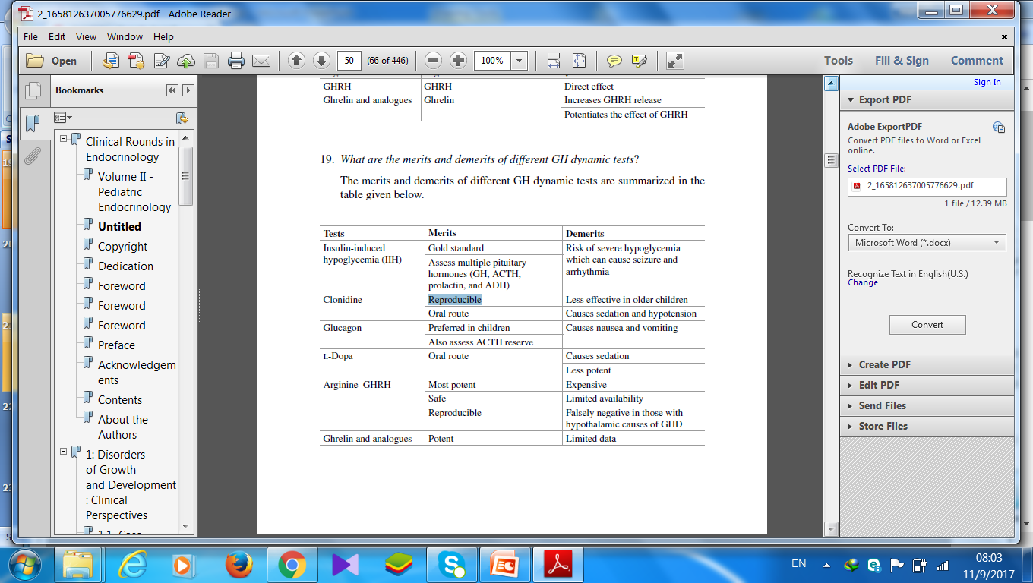
What are the merits and demerits of different GH dynamic tests

Slide 44
Which children do not need to do GH provocative test ?
patients with all of the following three conditions:
Abnormal auxological criteria
Hypothalamic- pituitary defect
Deficiency of at least one additional pituitary hormone
Up to -date 2017
Horm Res Paediatr 2016

Slide 45
Auxological criteria
“Severe” short stature (height < −3 SD below mean
Height <−2SD with a height velocity <−1SD over a period of 1-2 years
Height velocity
SDS >−1.5SD over a period of 2 years
SDS −2SD over a period of one years
Williams 2016
Clinical Rounds in Endocrinology 2016
Up to date 2017
Arch Dis Child 2016

Slide 46
Auxological criteria
Height velocity
SDS >−1.5SD over a period of 2 years
SDS −2SD over a period of one years
Williams 2016
Clinical Rounds in Endocrinology 2016
Up to date 2017
Arch Dis Child 2016

Slide 47
Hypothalamic- pituitary defect
Ectopic posterior pituitary & pituitary hypoplasia & with abnormal stalk
Tumor
Irradiation
Congenital anomaly

Slide 48
Who does not need to do GH provocative test ?
infant or young child with
Extreme short stature -3 SDS
IGF-I &IGFBP-3 <-2 SD
Delay bone age.
Most experts agree that provocative testing is not required to make the diagnosis.
Up to date2017
Horm Res Paediatr 2016

Slide 49
Who does not need to do GH provocative test ?
Short children with
Normal bone age
Normal Height velocity
Normal levels of IGF-1 and IGFBP-3
Up to date 2017

Slide 50
Which neonates do not need to do GH provocative test ?
Newborn with hypoglycemia who does not attain a serum GH above 5 μg/L
and
Has deficiency of at least one additional pituitary hormone
And/or
The classical imaging triad (ectopic posterior pituitary and pituitary hypoplasia with abnormal stalk)
Horm Res Paediatr 2016
Up to date 2017

Slide 51
GH deficiency during hypoglycemia
Beyond the neonatal period, a low GH concentration at the time of hypoglycemia is alone insufficient to diagnose GHD due to low specificity
Horm Res Paediatr 2016

Slide 52
What are the limitations of GH dynamic tests in childhood GHD ?

Slide 53
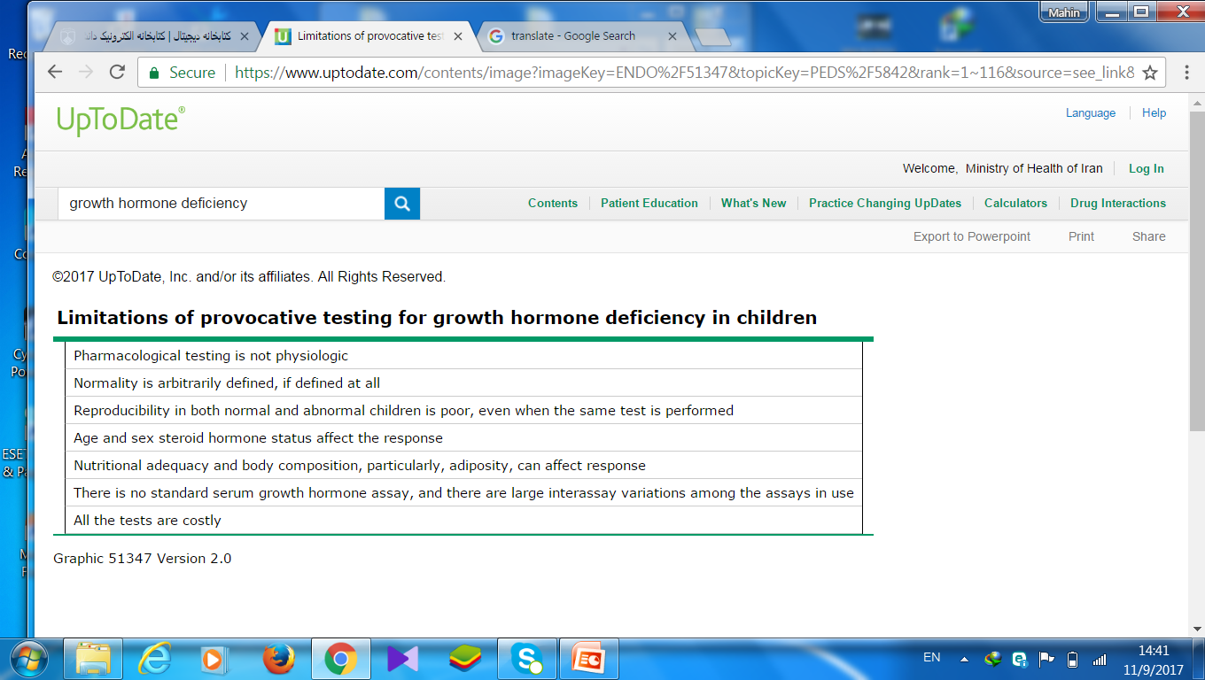

Slide 54
What are the limitations of GH dynamic tests in childhood GHD ?
Assess pituitary GH reserve
Not provide information regarding pulsatility of GH secretion and bioactivity.
Hence, a normal peak GH response to a dynamic test may not necessarily translate into optimal linear growth.
The cutoffs for the diagnosis of GHD are arbitrary
Clinical Rounds in Endocrinology 2016

Slide 55
What are the limitations of GH dynamic tests in childhood GHD ?
Have poor specificity ( 2 tests )
Controversy regarding priming with sex steroids
Risks associated like hypoglycemia, seizure, and hypotension
Can not diagnosis GH neurosecretory dysfunction
Up to date2017
Horm Res Paediatr 2016
Clinical Rounds in Endocrinology 2016

Slide 56
What are the limitations of GH dynamic tests in childhood GHD ?
Not take into account the effect of age and BMI on GH dynamics
peak values decrease with increasing BMI
GH responses are blunted in obese or overweight individuals
Obesity-dependent modifications to diagnostic criteria in children are undetermined
Horm Res Paediatr 2016
Clinical Rounds in Endocrinology 2016
Up to date 2017

Slide 57
What are the limitations of GH dynamic tests in childhood GHD ?
Molecular heterogeneity
GH circulates in several isoforms, a 22 kD molecule and 20 kD molecule, as well as hetero- and homodimers and multimers, and assay results vary considerably depending on reactivity with various isoforms
Curr Opin Endocrinol Diabetes Obes. 2013

Slide 58
What are the limitations of GH dynamic tests in childhood GHD ?
Normal values were established using polyclonal radioimmunoassays and purified pituitary standards
Currently used immunometric assays with monoclonal antibodies and recombinant standards have higher specificity

Slide 59
Is “ GH provocative test “ reliable ?
Not discriminate between normal short children and partial GHD
Do not reliance on GH provocative test results as the sole diagnostic criterion of GHD.
is no real "gold standard" for the diagnosis of GHD
Horm Res Paediatr 2016
Up to date 2017

Slide 60
Is “ GH provocative test “ reliable ?
.
The threshold test result that distinguishes normal from partial GHD that responds to treatment has not been well established
Horm Res Paediatr 2016

Slide 61
What are the prerequisites for GH dynamic testing ?
GH secretion is regulated by various factors diet, sleep, exercise, thyroid hormones, cortisol, and gonadal steroids.
Amino acids stimulate GH secretion.
Glucose and FFA inhibit GH secretion.
GH dynamic tests are recommended to be performed in fasting state.
Clinical Rounds in Endocrinology 2016

Slide 62
What are not the prerequisites for GH dynamic testing ?
Routine cardiac testing
Dual X-ray absorptiometry scanning
Lipid profiles
Horm Res Paediatr 2016

Slide 63
What are the prerequisites for GH dynamic testing ?
Thyroxine has a permissive role in GH–IGF1 secretion.
Euthyroidism should be ensured prior to GH dynamic tests.
Clinical Rounds in Endocrinology 2016

Slide 64
What are the prerequisites for GH dynamic testing ?
GH dynamic tests should not be performed in children receiving >15 mg/m 2 /day of hydrocortisone or its equivalents.
This may lead to more false-positive results
Antipsychotic medications , and ondansetron
Clinical Rounds in Endocrinology 2016
Arch Dis Child 2016

Slide 65
What are the prerequisites for GH dynamic testing ?
Gonadal steroids influence GH–IGF1 secretion.
Priming with estrogen/testosterone should be considered in some children
Controversies regarding the need for priming, the age at which
priming should be done and which agent should be used for priming
Up to date 2017
Clinical Rounds in Endocrinology 2016
Uptodate 2017
clinic

Slide 66
Who dose need “ priming ” prior to GH dynamic testing ?
Children above 8 years of age having Tanner stage ≤2.
Aged >8 years for girls or >9 years for boys
This can be based either on chronological age or bone age
prepubertal at 13–14 years in boys and 11–12 years in girls
Arch Dis Child 2016
Clinical Rounds in Endocrinology 2016

Slide 67

Who dose need “ priming ” prior to GH dynamic testing ?
Prepubertal boys older than 11 years
Prepubertal girls older than 10 years
with PAH prognosis within –2 SD of the reference population mean
Horm Res Paediatr 2016
Up to date 2017

Slide 68
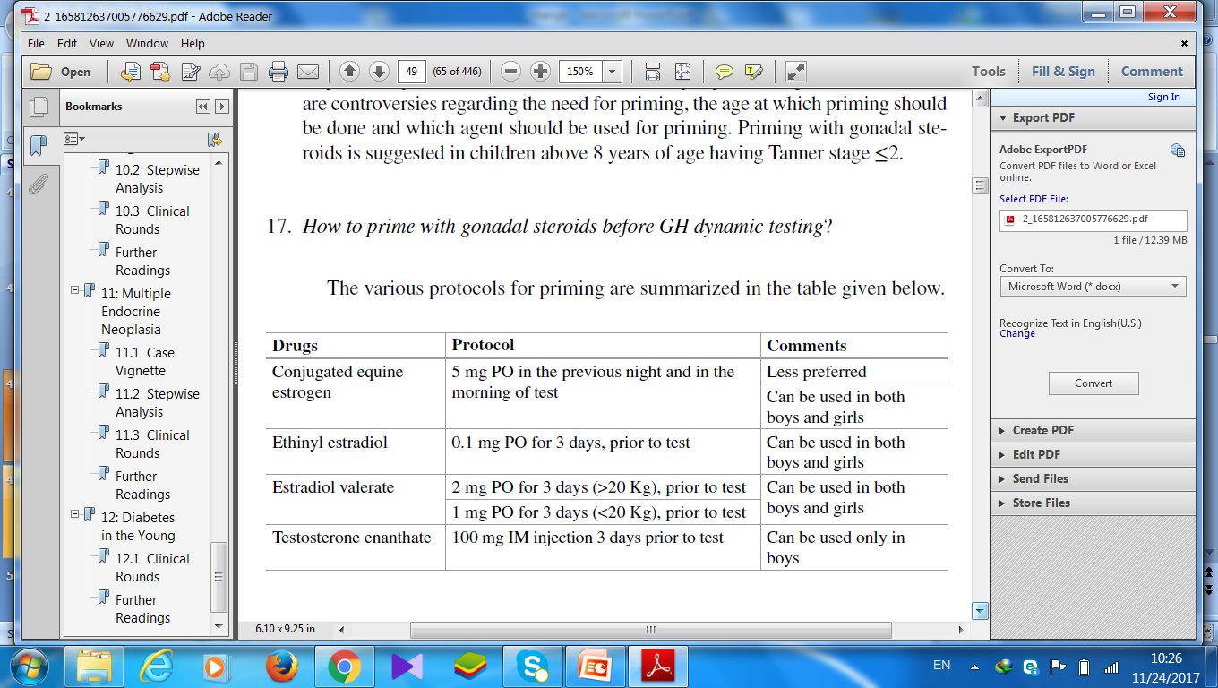
How to prime with gonadal steroids before GH dynamic testing ?

Slide 69
what's the benefit “ priming ” prior to GH dynamic testing ?
priming in prepubertal children of pubertal age improves specificity without compromising the sensitivity
Horm Res Paediatr 2016

Slide 70
Not recommended sex steroid to patients that were already on GH treatment
Horm Res Paediatr 2016

Slide 71
Which is the preferred GH dynamic test ?
Insulin-induced hypoglycemia is gold standard for the diagnosis of GHD.
Colonidine and glucagon stimulation tests are commonly performed in clinical practice.
Clinical Rounds in Endocrinology 2016

Slide 72
Why two dynamic tests is needed in the diagnosis of GHD ?
Because of low specificity of these tests
Two tests should be abnormal.
There is no evidence against performing both tests sequentially on the same day
Horm Res Paediatr 2016
Clinical Rounds in Endocrinology 2016
Up to date 2017

Slide 73
Who needs one provocative test?
A single dynamic test is sufficient to diagnose GHD in those with
structural pituitary defects
Multiple pituitary hormone deficiencies(other pituitary hormone defects)
Genetic defect
History of irradiation
Arch Dis Child 2016
Up to date 2017

Slide 74
Provocative test
Pharmacologic stimuli include
L-dopa ,clonidine,
Glucagon , arginine, insulin-induced hypoglycemia.
The last three tests have the highest specificity
Are still subject to false-positive results
Up to date 2017

Slide 75
Provocative test
Arginine
An intravenous infusion of 0.5 g/kg body weight (to a maximum of30- 40 g) is given over 30 minutes
GH is measured at 0, 30, 60, 90, and 120 minutes
The maximum GH peak is expected at about 60 minutes. by adding a dose of L-Dopa orally just prior to the administration of arginine
L-Dopa is a relatively weak stimulant of GH release
Up to date 2017

Slide 76
Provocative test
Colonidine
stimulation of GHRH via alpha-adrenergic pathways
5 mcg/kg (0.1-015 mg/m2 ) maximum 250 mcg
GH is measured at 0, 30, 60 and 90 minutes
peak GH secretion typically occurs about one hour after the stimulus is given
Up to date 2017
CLINICAL SCIENCE 2016

Slide 77
Provocative test
Glucagon
is a good choice for infants and young children
Glucagon is administered subcutaneously at a dose of 0.03 mg/kg (maximum 1 mg),
serum samples are drawn at intervals between one and three hours after the stimulus.
Peak GH secretion occurs between two and three hours
Up to date 2017

Slide 78
Provocative test
levo-dopa
150–175 mg/m², maximum 250 mg
Propranolol 0.75 mg/kg, maximum 40 mg,
sampling at 30, 45, 60, 90, 120, 180 min
peak response is 90 minutes
Clin Endocrinol Metab. 2009

Slide 79
Provocative test
insulin-induced hypoglycemia
potent stimulant of GH release
Most specific tests for GHD
Up to date 2017

Slide 80
Provocative test
Combination of GHRH and arginine to better evaluate patients with multiple pituitary hormone deficiencies
it is not useful in making a diagnosis of GHD in children with isolated idiopathic GHD
Because these children have a defect in hypothalamic regulation of pituitary GH secretion and are expected to respond normally to GHRH
Up to date 2017

Slide 81
Provocative test in neonatal period
Glucagon test
GH cut off value is 25ng/ml
GH value under 20ng/ml is suspicious
First choice test is IGFBP3
Sperling 2014

Slide 82
How to define GH deficiency after GH dynamic tests ?
GH level 5- 10 ng/ml partial GHD
Cutoff <3 ng<5ng /ml severe GHD
UK centres use a cut-off of 7 µg/L
whose 5th percentile lies below 5 μg/L for most tests
GHRH–arginine ≤19 ng/ml is suggested because of its high potency
Arch Dis Child 2016
Clinical Rounds in Endocrinology 2016
Horm Res Paediatr 2016

Slide 83
False positive rates based on cut off level
Cut-off of 7 µg/L 8.9% -23.7%,
Cut-off of 10µg/L 4.9–49%
Arch Dis Child 2016

Slide 84
What is the relationship between BMI & GH provocative testing?
Cut off for GH deficiency for BMI :
25 - 30 Kg/m2 = 8 ng/ml
> 30 kg / m2 = 4.2 ng/ml
J Clin Endocrinol Metab 2016

Slide 85
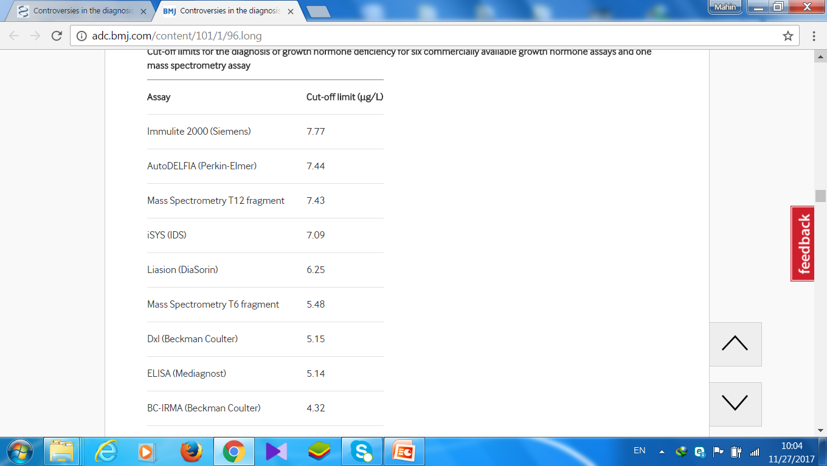
Cut-off limits for the diagnosis of growth hormone deficiency for six commercially available growth hormone assays and one mass spectrometry assay
Arch Dis Child 2016

Slide 86
MRI abnormalities associated with
severe short stature
Greater catch-up growth in response to GH treatment
predict development of additional hormonal deficiencies
Severe GHD peak GH <3mcg/L
Abnormalized GH secretion in adulthood
Curr Opin Endocrinol Diabetes Obes. 2013

Slide 87
Genetic Testing
iGHD Autosomal recessive, autosomal dominant, and X-linked recessive
Severe iGHD and a family history of GHD testing for Mutation in GH1 and GHRH receptor, GHSR1A
Mutations in PROP1, POU1F1, HESX1 associated with MPHD
HMGA2 mutation had severe short stature, low IGF-I, abnormal response to provocative GH testing, and abnormal MRI, and responded well to growth hormone therapy
Curr Opin Endocrinol Diabetes Obes. 2013

Slide 88
When and how should testing be performed to determine whether an individual has persistent GHD?

Slide 89
Transitional period
Mid-to-late teens until six to seven years after reaching near-adult height
The transition period is the time from late puberty to establishment of adult muscle and bone composition, and encompasses attainment of AH
Horm Res Paediatr 2016
Up to date 2017

Slide 90
Transitional period
50 % of children with isolated idiopathic GHD do not have persistent
disease on retesting during adulthood
96 % of children with MPHD have persistent GHD.
It may be possibly due to recovery from transient disruption of neuroendocrine alteration in GH–IGF1 axis.
Clinical Rounds in Endocrinology 2016

Slide 91
When should retesting be done?
Retesting as near-adult height ,growth rate <2.0 to 2.5 cm/year
Retesting in mid-puberty would reduce the length of GH treatment by three years or more
Retesting at the end of the transition phase (age in mid-20s). not optimal
Up to date 2017

Slide 92
When should retesting be done?
Retesting for high risk patients (genetic, structural, or organic GHD) should be later
For patients who have a history of cranial radiation therapy, the results of retesting should not be considered definitive because radiation tends to cause progressive damage to the hypothalamus and pituitary.
They should be retested for GHD for five to ten years after completion of radiation therapy
Up to date 2017

Slide 93
How we reassessment during transition to adulthood ?
Testing can be performed after a trial of at least 1 month off GH treatment in late adolescent
Horm Res Paediatr 2016

Slide 94
Interpretation of IGF1 test after GH off
A normal IGF-I result (>0 SD) suggests that permanent GHD is unlikely, and GH therapy can be stopped
iGF1< -2 SD for age and gender suggests the possibility of permanent GHD. Should perform GH stimulation test to confirm the diagnosis
A significant number of patients with MPHD can have normal IGF-I Thus, the results of IGF-I must be interpreted carefully
Up to date 2017
Horm Res Paediatr 2016

Slide 95
Diagnosis in Transitional period
One stimulation test is generally considered sufficient
Up to date 2017

Slide 96
Who should not be tested for adult - onset GHD ?
Persistent GHD :
Multiple ( ≥ 3) pituitary hormone deficiencies
Genetic mutation
structural defect
Ectopic posterior pituitary gland associated with pituitary stalk agenesis, Hypoplastic absent anterior pituitary,
optic nerve hypoplasia/septo-optic dysplasia
Organic causes (Radiation doses >40 Gy, brain surgery )
Up to date 2017
Horm Res Paediatr 2016

Slide 97
Who should not be tested for adult - onset GHD ?
Patients who have very low GH peaks during stimulation tests done as children (GH <3 ng/mL) are more likely to have permanent GHD as compared with those with higher peak stimulated levels
Up to date 2017

Slide 98
Retesting of patients during transitional period
Deficiency of only one additional pituitary hormone
Idiopathic IGHD with or without Small pituitary or ectopic posterior pituitary
After irradiation (dose and time dependent )
IGF-I result < -2 SD
Up to date 2017
Horm Res Paediatr 2016

Slide 99
What are the GH dynamic tests recommended for the diagnosis of GHD in transitional phase ?
insulin-induced hypoglycemia test has approximately 95 percent specificity and sensitivity for detecting GHD
Glucagon test(1 mg ) sensitivity of 97 to 100 percent and a specificity of 88 to 100 percent
14 percent of the patients by Glucagon would have been misclassified by the glucagon stimulation test compared with the ITT
Up to date 2017

Slide 100
cut-offs for GHD diagnosis during transition
American guidelines 3 µg/L
European Society for Paediatric Endocrinology guidelines 5 µg/L
GH Research Society guidelines 6 µg/L
Arch Dis Child 2016

Slide 101
What are the cut off level recommended for the diagnosis of GHD?
Tests | GH peak (ng/ml )
IIH | < 5.1
Glucagon | < 3
GHRH–arginine | BMI<25 kg/m² <11.5 BMI25-30 kg/m² <8 BMI>30 kg/m2 <4.2
Arginine-L-DOPA (weak) | <1.5 ng/mL

Slide 102
How to diagnose GH insensitivity syndrome ?
Height SDS <−3
Basal GH >5 ng/ml
Serum IGF1 <50 ng/ml with peak GH>15 ng/ml during GH dynamic Test
GH binding with GHBP <10 % -2SDS
IUGR and postnatal growth delay
Clinical Rounds in Endocrinology 2016
Horm Res Paediatr 2016

Slide 103
How to diagnose GH insensitivity syndrome
rhGH is administered daily for four consecutive days at a dose of 0.033 mg/Kg/d SC at 2000h
IGF1 is estimated at baseline and on day 5 at 0800h.
An increment in iGF1 of <15 ng/ml is considered subnormal.
low serum basal IGFBP3
increment in IGFBP3 <0.4 mg/L after IGF1 generation test also supports the diagnosis
Three out of these five criteria are required to make a diagnosis of GHIS
Horm Res Paediatr 2016
Clinical Rounds in Endocrinology 2016

Slide 104
GH neurosecretory dysfunction
Abnormal 24-h GH secretory profile
low IGF-I
Abnormal auxologic parameter
Delayed bone age at least 2 years
Normal GH stimulation test
Abnormal MRI
Arch Dis Child 2016

Slide 105
Conclusion
Clinical presentation and auxological parameters are the most important factors in the diagnosis of GHD
. Although there is considerable overlap between IGF-I and IGFBP-3 values in children with GHD compared to normal children, these measures have reasonable specificity and are useful in conjunction with other diagnostic criteria
Curr Opin Endocrinol Diabetes Obes. 2013

Slide 106
Conclusion
Abnormal findings on pituitary MRI indicate a relatively high likelihood that GHD will persist into adulthood and may suggest that subsequent pituitary deficiencies may develop
Children with iGHD and family history of GHD should have screening for GH1 and GHRHR mutation
provocative GH testing are poorly reproducible
Curr Opin Endocrinol Diabetes Obes. 2013

Slide 107
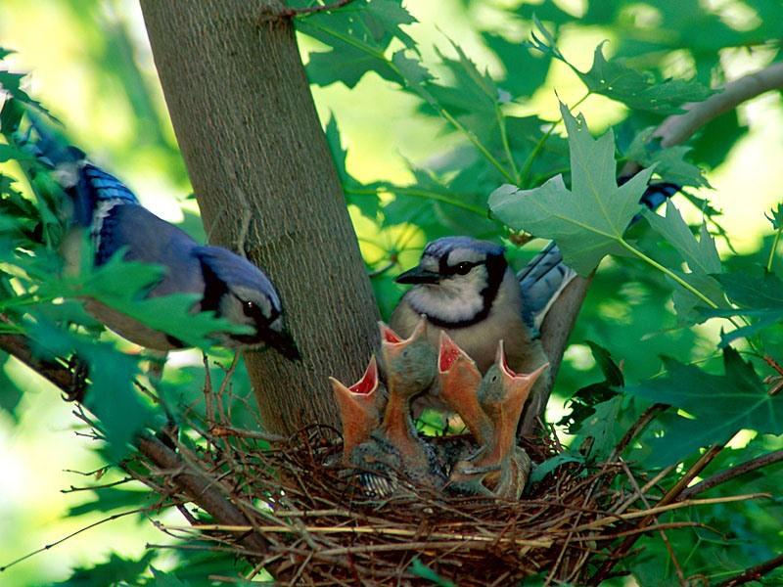

Slide 108
Diagnosis of GH deficiency in an adult

Slide 109
Adult GH deficiency
Body composition
Bone mineral density and fractures
Quality of life
Cardiovascular risk factors (dyslipidemia ,increased inflammatory markers , endothelial dysfunction )
Mortality

Slide 110
DIAGNOSIS
Subnormal IGF-1
Subnormal serum GH response to a potent stimulus

Slide 111
Who should be tested for adult - onset GHD ?
Hypothalamic or pituitary disease
History of GH deficiency in childhood due to an organic disease
Mid-line craniofacial anomalies such as optic nerve hypoplasia/septo-optic dysplasia
Sheehan syndrome
Up to date 2017

Slide 112
Who should be tested for adult - onset GHD ?
Traumatic brain injury
subarachnoid hemorrhage
History of cranial irradiation
History of surgery in hypothalamic– pituitary region
Congenital anomalies, agenesis of the hypothalamic-pituitary stalk
Clinical Rounds in Endocrinology 2016

Slide 113
Who should be tested for adult - onset GHD ?
Those with organic disease and having MPHD <3, low serum IGF1
A single GH dynamic test should be done to establish a diagnosis of GHD
Up to date 2017

Slide 114
Who should not be tested for adult - onset GHD
Adults with organic disease and having MPHD ≥3 , a low IGF1 is highly suggestive of GHD and GH dynamic tests may not be necessary
Clinical Rounds in Endocrinology 2016
Up to date 2017

Slide 115
Who should not be tested for adult - onset GHD ?
Patients who have very low GH peaks during stimulation tests done as children (GH <3 ng/mL) are more likely to have permanent GHD as compared with those with higher peak stimulated levels
Up to date 2017
Horm Res Paediatr 2016

Slide 116
Provocative tests
insulin-induced hypoglycemia Cutoff value <5.1 mcg/L
Argininne and GHRH Cutoff value <4.1 mcg/L
Argininne and levodopa Cutoff value 1.5 mcg/L
Glucagon stimulation test Cutoff value <3 mcg/L
Macimorelin stimulation test Cutoff value 2.8 mcg/L

Slide 117
1 mg of glucagon or 1.5 mg for weigh >90 kg iM
Measuring GH every 30 minutes for four hours
Cutoff of 1 ng/mL for obese patients

Slide 118
Why are cutoffs for the diagnosis of GHD lower in adults?
progressive decline in function of somatotropes after puberty.
lower levels of GH are required for metabolic effects as compared to children for linear growth
Clinical Rounds in Endocrinology 2016

Slide 119
Do all adults need to GH therapy ?
Mild GHD may not have clinically important effects during adulthood
Because the metabolic effects of GH are seen at low doses
whereas the same individual needs high concentrations of GH for stimulate growth
.
Continued GH treatment in adulthood is not necessary for patients who remain asymptomatic when GH is withdrawn without underlying genetic, organic, or structural causes , particularly if the results of GH testing during the transition period are equivocal
Up to date 2017

Slide 120


Slide 121

References:
Up to date 2017
Clinical Rounds in Endocrinology 2016
Horm Res Paediatr 2016
J Clin Endocrinol Metab 2016

Slide 122


Slide 123
What is the “ ternary complex ” in GH - IGF axis ?
The “ternary complex” comprises of IGF1, IGFBP3, and acid labile subunit (ALS)
in equimolar ratio. Serum IGF1 and ALS are synthesized in hepatocytes, while
IGFBP3 in the Kupffer cells of the liver. All the components of ternary complex
including IGF1, IGFBP3, and ALS are GH-dependent. The ternary complex prolongs
the half-life of IGF1 (from 10 min to 12–15 h) and regulates the bioavailability
of IGF1 to target sites. Therefore, patients with mutation of ALS gene have
reduced serum levels of IGF1 and IGFBP3. However, growth impairment in these
children is modest due to preserved local IGF1 generation at the growth plate
Clinical round

Slide 124
What is septo-optic dysplasia ?
Septo-optic dysplasia (SOD) includes midline defects of brain (absence of septum
pellucidum, corpus callosum agenesis), optic nerve dysplasia, and pituitary
hypoplasia. Two out of these three abnormalities are required for the diagnosis
of SOD. Familial forms of SOD are caused by HESX1 transcription factor
defect and are associated with multiple pituitary hormone defi ciency including
vasopressin

Slide 125
As many as 3 to 30 percent of children with GHD have an affected parent, sibling, or child
POU1F1autosomal recessive
PROP1 mutations
LHX3 GHRH receptor gene defects
LHX4 OTX2
TBX19 (TPIT), SOX2, SOX3 [21-23], and GLI2
Deletions and mutations of GH1causes of familial GH
Up to date

Slide 126
When does GH therapy stop
small for gestational age,
chronic kidney disease
, Turner syndrome,
Prader-Willi syndrome??
When achieved to normal height

Slide 127
Provocative tests
If IGF-1 is equivocal, a subnormal GH response to a provocative test will confirm the diagnosis. Either insulin-induced hypoglycemia or the combination of arginine and GH-releasing hormone (GHRH) response of 4.1 ng/mL
(or levodopa [L-DOPA]) is a potent stimulus of GH release. A subnormal increase in the serum GH concentration in a patient who has organic pituitary disease confirms the diagnosis of GH deficiency in those whose serum IGF-1 was equivocal
ther stimuli, such as arginine alone, clonidine, L-DOPA, and the combination of arginine and L-DOPA are much weaker and therefore more likely to give false-positive results. All tests of GH secretion are more likely to give false-positive results in obesity. All are performed in the morning after an overnight fast.

Slide 128
Serum GH concentrations are currently measured using
a variety of methods against a variety of standards.
Normal values were established using polyclonal radioimmunoassays
and purified pituitary standards. Currently
used immunometric assays with monoclonal antibodies
and recombinant standards have higher specificity,
but the use of different standards and antibodies withspecificities for different GH isoforms has resulted in
large discrepancies between assays
Hormon rsech

Slide 129
Who should be tested for adult - onset GHD
Pituitary/hypothalamic structural defect
Mid-line craniofacial anomalies such as optic nerve hypoplasia/septo-optic dysplasia
Congenital anomalies, agenesis of the hypothalamic-pituitary stalk
Brain surgery
Radiation doses >40 Gy)
Up to date 2017

Slide 130
Who should not be tested for adult - onset GHD
MPHD (≥3 hormone Deficiency
Those With a low IGF1 is highly suggestive of GHD , dynamic tests may not be necessary

Slide 131
Which individuals with childhood GHD will remain deficient as adults?
100% fail rate on GH provocative testing
Hence, an IGF-I measurement off GH is not necessary.
An IGF-I level may be obtained off GH to confirm the diagnosis for the patient
A significant number of persons with MPHD can have normal IGF-I Thus, the results of IGF-I must be interpreted carefully
کلا حذف کنم

Slide 132
progressive decline in function of somatotropes after puberty
low levels of GH are required in adults

Slide 133
Who should be tested for adult - onset GHD ?
These structural defects in a short child is highly predictive MPHD
The presence of these abnormalities is also suggestive of irreversible GHD
Clinical Rounds in Endocrinology 2016
Up to date 2017

Slide 134
Who should be tested for adult - onset GHD ?
Those with organic brain disease and having <3 hormone deficiency
serum IGF1 and a single GH dynamic test should be done to establish a diagnosis of GHD.

Slide 135
Adult GH deficiency
Body composition
Bone mineral density and fractures
Quality of life
Cardiovascular risk factors
Mortality

Slide 136
What is MRI “ tetrad ” associated with GHD / MPHD ?
The MRI tetrad includes
small sella
Hypoplastic/absent anterior pituitary
Redundant/absent pituitary stalk
Ectopic/absent posterior pituitary bright spot
only a single GH dynamic
test is required to establish the diagnosis of GHD in these patients. The presence
of these abnormalities is also suggestive of irreversible GHD; therefore,
GH dynamic tests may not be required during transition to adulthood in these
patients
Clinical Rounds in Endocrinology 2016
Up to date 201

Slide 137
What is the “ ternary complex ” in GH - IGF axis
IGF1, IGFBP3, and acid labile subunit (ALS)
The ternary complex prolongs
the half-life of IGF1 (from 10 min to 12–15 h) and regulates the bioavailability
of IGF1 to target sites

Slide 138
How to prime with gonadal steroids before GH dynamic testing ?
Drugs | Protocol | Comment
Ethinyl estradiol β-estradiolEstradiol valerate | 0.05 - 0.1 mg , for 3 days, prior to test 2 mg (1 mg for BW <20 kg) , for 2 days , prior to test | Can be used in both boys and girls
Testosterone enanthate | 50-100 mg IM injection 3 -7 days prior to test | Can be used only in boys
Horm Res Paediatr 2016
Clinical Rounds in Endocrinology 2016

Slide 139
Growth hormone secretion during neonatal period
Normal neonates have random GH levels higher than older children and adults in the first 5–7 days of life

Slide 140
ورزش

Slide 141
he reproducibility of 24-h GH profiles is superior to that of GH stimulation tests but it differentiates poorly between GH deficient and normal short children and has a lower sensitivity, failing to identify 57% of children classified as GHD via stimulation testing

Slide 142
Measurement of GH by mass spectrometry (MS) has the potential to circumvent many of the problems associated with immunoassays as it allows recognition by analyte mass rather than epitope. MS measurement of GH has been demonstrated to be completely independent of the serum concentration of GHBP¹⁵ and, unlike immunoassays, has the potential to establish a reproducible and sustainable cut-off concentration.

Slide 143
Common protocols for priming include intramuscular injection of testosterone (100 mg intramuscular, 7–10 days) before testing for boys and the administration of oral oestrogen (eg, 10–20 µg ethinyloestradiol) for 48–72 h prior to testing in girls. In order to avoid the need for an injection (potentially with an additional hospital visit) some paediatric endocrinologists will prime boys with oestrogen preparations such as stilboestrol or ethinyloestradiol.

Slide 144
d that obesity is linked to reduced spontaneous GH secretion,²⁰ reduced peak GH concentrations to stimulation testing
sex steroids that augments the pulse amplitude of GH secretion, and increases IGF-I concentrations and anterior pituitary siz
hildren receiving medications that may affect endogenous GH secretion, including oral or inhaled corticosteroids (23,24), antipsychotic medications (25,26), and ondansetron (27), were also excluded

Slide 145
hortened half-life of GH or decreased GH production and secretion (16). The possible causes of decreased GH production and secretion are dysregulation of the GHRH, somatostatin, and ghrelin pathways (17, 18), hyperinsulinemia (19), or increased free fatty acid (FFA) level

Slide 146
Who does need an urgent evaluation for GHD?
Severe short stature (height <−3SD)
Height <−2SD with height velocity <−1SD over 1 year
Height velocity <−2SD over 1 year
Child with sellar–suprasellar mass irrespective of auxological criteria
short Child with signs and symptoms of an intracranial lesion
Neonate with symptoms and signs of GHD/MPHD
Clinical Rounds in Endocrinology 2016

Slide 147
Interpretation of results
For the patient with
Severe GHD, IGF-I and IGFBP-3 are reduced
Milder GHD, IGF-system provide a meaningful measure of functional GH secretion and more effectively than does provocative GH testing,
The fact that IGF-I and IGFBP-3 do not correlate with results of provocative GH testing
Up to date 2017

Slide 148
The fact that IGF-I and IGFBP-3 do not invariably correlate with results of provocative GH testing speaks more directly to the inadequacies of our direct assessment of GH secretion than to limitations of IGF system assays????????????????????????????

Slide 149
What is the utility of random GH estimation in the diagnosis of GHD ?
Beyond the neonatal period
A low GH at the time of hypoglycemia is alone insufficient to diagnose GHD due to low specificity
Random GH >5 ng/ml in the presence of low IGF1 is diagnostic of GH insensitivity
Horm Res Paediatr 2016

Slide 150
What is the need for GH dynamic tests in the evaluation of GHD ?
Auxologic assessment is the best index
IGF1 but influenced by many factors other than GH
Because of these limitations, GH dynamic tests are employed for the evaluation of GHD.
Clinical Rounds in Endocrinology 2016

Slide 151
Why is there a need for two dynamic tests in the diagnosis of GHD ?
is possible that combining tests might yield different results from tests performed on separate days باز نگری
Horm Res Paediatr 2016

Slide 153
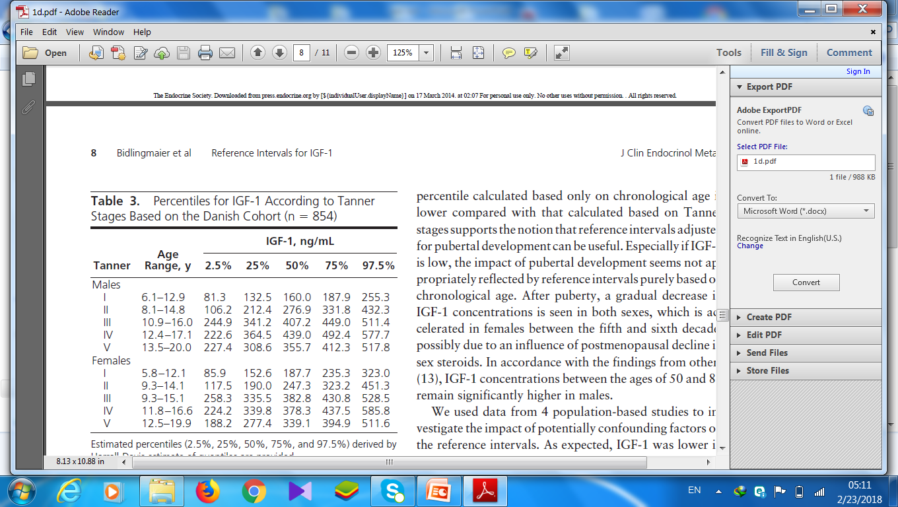

Slide 154
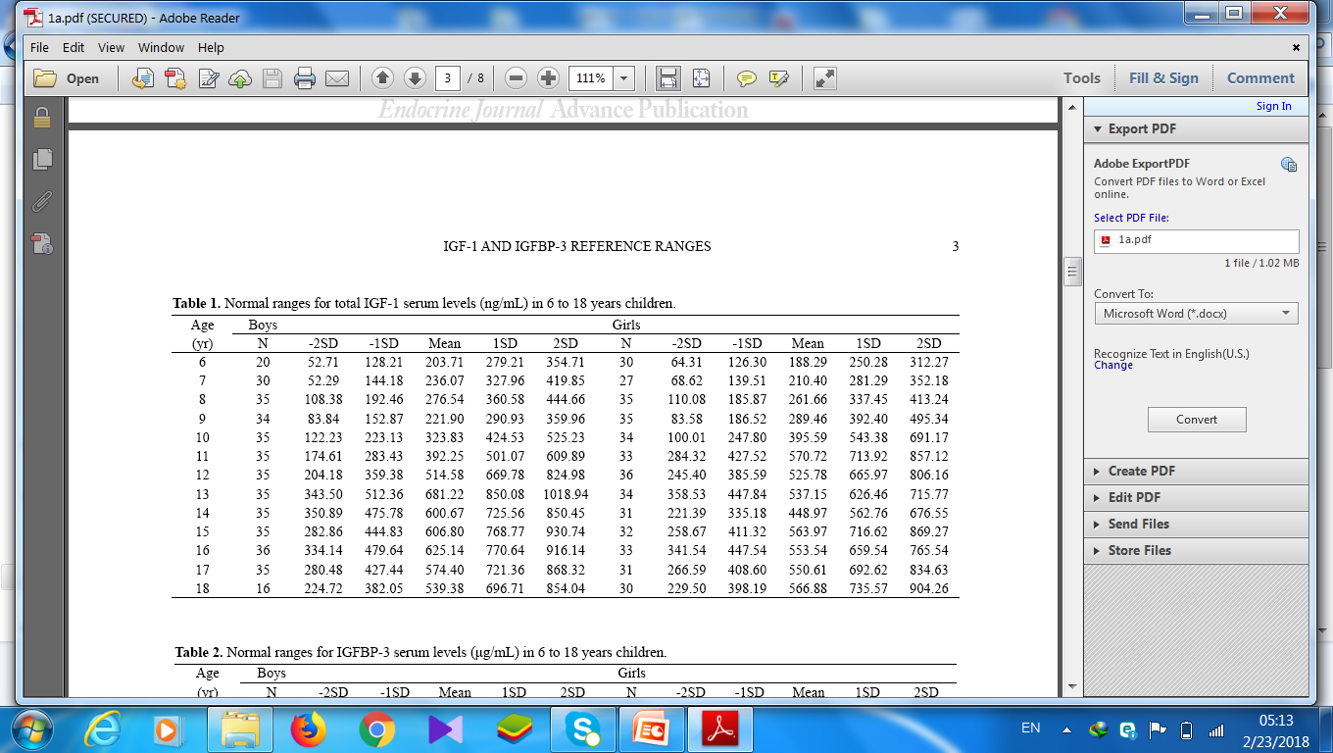

Slide 155
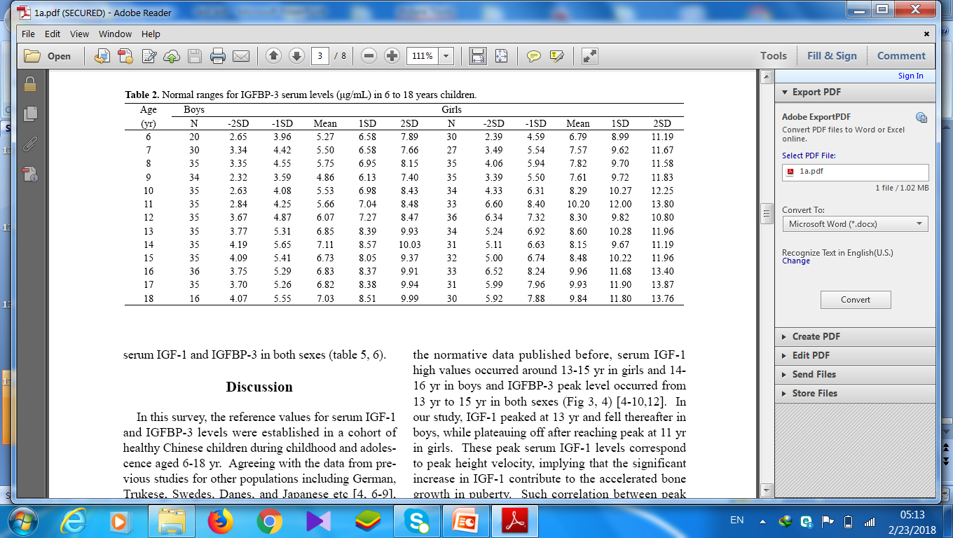

Slide 156
obesity is linked to reduced spontaneous GH
secretion,20 reduced peak GH concentrations to stimulation
Testing2
glucagon is a potent insulin secretagogue. suggests that a glucagon dose of 15 pug/kg isconsistent cortisol levels are obtained after intramuscular administration than after the subcutaneous
arginine,while having a direct action on the hypothalamus, are also insulin secretagogues.
L dopa effect of nausea limits its use, although
concomitant administration of propranolol
minimises this

Slide 157
clonidine, an a-agonist drug that promotes
the release of GH-releasing hormone (GHRH) (6), and
insulin-induced hypoglycemia
بتا بلوکر رسپتور بتا را بلوکه می کند در نتیجه الفا باعث ترشح هورمون رشد می شود

Slide 158
even when there is a relevant clinical context (4,5).
As soon as the immunoradiometric, immunofluorometric
(IFMA) and ICMA methods were developed, experience
working with them demonstrated that a cut-off value of
10 ng/mL for the GH response to provocative tests was too
high for both the clonidine test and the ITT, leading to several
false-positive diagnoses (12-15). In a pilot study (22) involving
78 patients, a cut-off value more appropriate for the ICMA
methodwas adopted by our service (5 ng/mL), thus providing
a foundation for the current studyBased on the data obtained in the current study, we
conclude that the clonidine-stimulated GH concentrations
X3.0 ng/mL that were assayed by ICMA, within an
appropriate clinical and laboratorial context

