Slide 1
In the name of god

Slide 2
Definition of pheochromocytoma and paraganglioma (PPGL)
A pheochromocytoma is a tumor arising from
adrenomedullary chromaffin cells that commonly produces
one or more catecholamines: epinephrine, norepinephrine,
and dopamine. Rarely, these tumors are biochemically silent.

Slide 3
A paraganglioma is a tumor derived from extra-adrenal
chromaffin cells of the sympathetic paravertebral ganglia
of thorax, abdomen, and pelvis. Paragangliomas also arise
from parasympathetic ganglia located along the
glossopharyngeal and vagal nerves in the neck and at the
base of the skull, these do not produce catecholamines.
About 80 to 85% of chromaffin-cell tumors are
pheochromocytomas, whereas 15 to 20% are
paragangliomas. Together they will be referred to here as
PPGL.

Slide 4
The prevalence of PPGL in patients with hypertension in
general out patient clinics varies between 0.2 and 0.6%.
The prevalence of PPGL in individuals carrying a germline
mutation in PPGL susceptibility genes may be around 50%.
Patients with hereditary PPGLs typically present with
multifocal disease and at a younger age than those with
sporadic neoplasms.

Slide 6
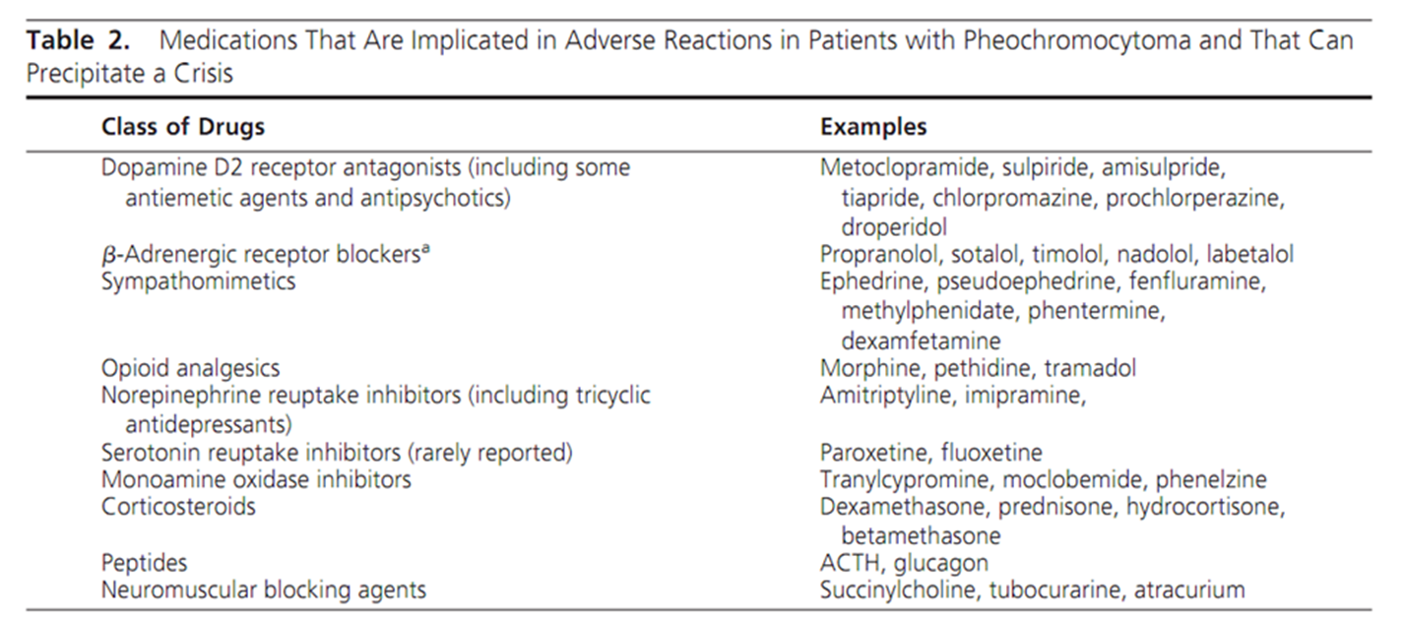
a Although most case reports on ß-adrenergic receptor blockers pertain to nonselective blockers, selective ß1-blockers may also precipitate a crisis because at higher doses they may lose ß1-selectivity.

Slide 8
Biochemical Testing for Diagnosis of Pheochromocytoma and Paraganglioma
Recommendation (1)
We recommend that initial biochemical testing for PPGLs
should include measurements of plasma free metanephrines
or urinary fractionated metanephrines. {1(++++)}

Slide 9
Evidence
Initial evidence that measurements of plasma free
metanephrines provide advantages for diagnosis of PPGLs
over other tests was first outlined by Lenders et al.
Diagnostic specificity was equivalent to other tests, but
diagnostic sensitivity was superior.
The high diagnostic accuracy of measurements of plasma free
metanephrines has now been confirmed by15 independent
studies.

Slide 10
Five of the 15 studies involved comparisons of plasma free with
urine fractionated metanephrines. The results suggest higher
specificity of the plasma than the urine test. however, all five
studies had limitations, and none involved head-to-head
comparisons of mass spectrometric-based measurements.
As shown by Perry et al, measurements of urine fractionated
metanephrines by mass spectrometry provide excellent
sensitivity (97%) and specificity (91%) for diagnosis of PPGLs.

Slide 11
Thus, until there are data available directly comparing plasma
and urinary measurements by “gold standard” mass
Spectrometric methods, there can be no recommendation
that one test is superior to the other.
This includes measurements of urinary free fractionated
metanephrines as an alternative test. Thus, all measurements of
fractionated metanephrines remain recommended as initial
screening tests.

Slide 12
Recommendation (2)
For measurements of plasma metanephrines, we suggest
drawing blood with the patient in the supine position and
use of reference intervals established in the same position.
{2 (++OO)}

Slide 13
Evidence
Recognizing the problem of seated sampling, Lenders et al
took blood samples from 60 patients with primary hypertension
in the seated position and after 30 minutes of supine rest, at
which stage consistent decreases in plasma normetanephrine
were noted. Using data from a further 872 patients tested for
PPGLs, it was calculated that drawing blood in the seated
position would result in a 2.8-fold increase in false-positive
results.

Slide 14
Higher concentrations of plasma metanephrines in upright
positions of blood sampling than in supine positions have
been confirmed in other studies.
When blood taken in the seated position yields a positive result,
the test should be repeated in the supine position.

Slide 15
Recommendation (3)
We recommend that all patients with positive test results
should receive appropriate follow-up according to the
extent of increased values and clinical presentation. {1(++OO)}

Slide 16
Evidence
Although the high diagnostic sensitivity of plasma free or
urine fractionated metanephrines means that almost all
cases of symptomatic catecholamine-producing tumors can
be detected by positive results, this does not imply that all
positive results indicate the presence of a tumor.

Slide 17
Elevations of both normetanephrine and metanephrine are rare
as false-positives but occur in at least half of all patients with
adrenal pheochromocytomas.
Such findings should therefore be treated with a high level of
suspicion. Similarly, findings of solitary increases in either
normetanephrine or metanephrine elevated 3-fold or more
above upper cutoffs are also rare as false positives and should
be followed up in most cases by imaging to locate the tumors.

Slide 18
The larger problem for interpreting positive test results
concerns those that are borderline, which involves a quarter
of all patients with PPGLs, hidden among a much larger
proportion of patients without tumors and similarly elevated
test results. In most situations this is due to inappropriate
sampling and is easily dealt with by repeat sampling in the
supine position.

Slide 19
If results remain elevated, the clonidine suppression test with
measurements of plasma normetanephrine provides one
method to distinguish true-positive from false-positive borderline
elevations of that metabolite.
This test has a purported diagnostic specificity of 100% with a
sensitivity of 97%, but as yet it has not been validated in any
prospective study

Slide 21
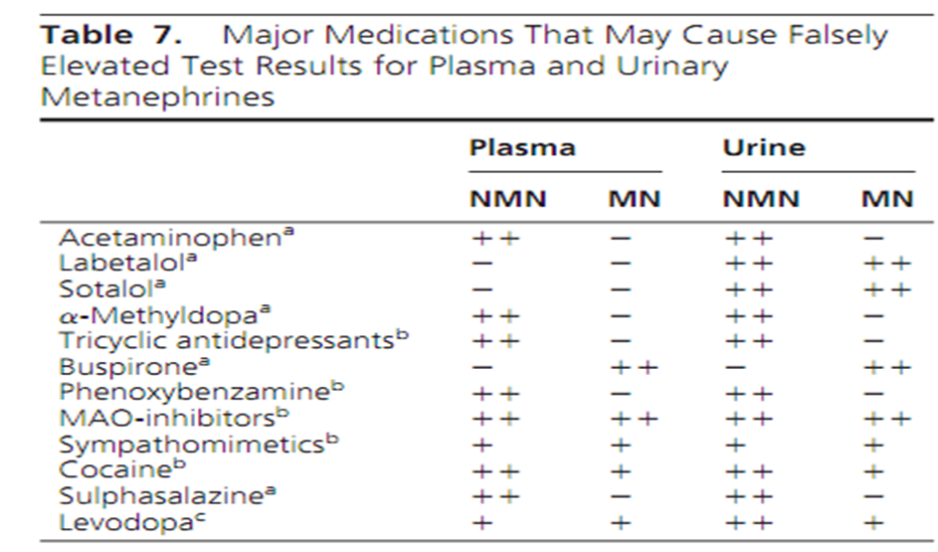

Slide 22
Imaging Studies
Recommendation (4)
We recommend that imaging studies to locate PPGLs should be
initiated once there is clear biochemical evidence of a PPGL.
{1(++OO)}

Slide 23
Where PPGL can be biochemically negative, even when collections of specimens and biochemical measurements are correctly employed?
1) skull base and neck paragangliomas, often biochemically
silent and for which imaging represents the principal means
for diagnosis
2) paragangliomas in patients with SDHx mutations.

Slide 24
For a cost-effective approach and to avoid unnecessary
radiation, there is a need for biochemical proof of PPGL
before imaging studies are performed.
There is insufficient evidence to formulate guidelines about
when and how to perform imaging studies in patients at risk
for biochemically silent PPGL.

Slide 25
Recommendation (5)
We suggest CT rather than MRI as the first-choice imaging
modality because of its excellent spatial resolution for
thorax, abdomen, and pelvis. {2 (+++O)}

Slide 26
Evidence
CT with contrast provides an excellent initial method
for the localization of PPGLs, with sensitivity between 88 and
100% .
CT has excellent tomographical resolution but, as with MRI,
lacks specificity. On CT, PPGLs may be homogeneous or
heterogeneous, necrotic with some calcifications, solid, or
cystic.

Slide 27
Although between 87 and 100% of PPGLs exhibit a mean
attenuation of more than 10 Hounsfield units on unenhanced
CT, PPGLs can occasionally have more than 60% washout of
contrast agents on 15-minute delayed scanning.
The use of nonionic contrast is safe, and therefore, contrast
CT can be performed in patients without adrenergic receptor
blockade. Modern CT scans can detect tumors 5 mm or
larger. MRI should not be performed in patients who have
intracranial aneurysm clips.

Slide 28
Because most PPGLs are located in the abdomen, a CT scan of
the abdomen and pelvis should be the first option.
Some studies showed that sensitivity of CT for extra-adrenal,
residual, recurrent, or metastatic tumors can be as low as 57%
and inferior to MRI.
CT is preferred to MRI for detection of lung metastatic lesions.
For skull base and neck paraganglioma, the sensitivity of MRI is
between 90 and 95%. Use of ultrasound is usually not
recommended due to its suboptimal sensitivity.

Slide 29
Recommendation (6)
We recommend MRI in patients with metastatic PPGLs, for
detection of skull base and neck paragangliomas, in patients
with surgical clips causing artifacts when using CT, in patients
with an allergy to CT contrast, and in patients in whom radiation
exposure should be limited (children, pregnant women, patients
with known germline mutations, and those with recent excessive
radiation exposure). {1(+++O)}

Slide 30
Recommendation (7)
We suggest the use of 123 I-metaiodobenzylguanidine (MIBG)
scintigraphy as a functional imaging modality in patients with
metastatic PPGLs detected by other imaging modalities when
radiotherapy using 131 I-MIBG is planned and occasionally in
some patients with an increased risk for metastatic disease due
to large size of the primary tumor or to extra-adrenal, multifocal
(except skull base and neck PPGLs), or recurrent disease.
{2 (+OOO)}

Slide 31
Evidence
Because 123 I-MIBG has better sensitivity than 131 I-MIBG for
detection of PPGLs, only the former agent is recommended for
imaging. Another advantage of 123 I- over 131 I-labeled MIBG is
its utility for imaging by SPECT.
Because up to 50 % of normal adrenal glands demonstrate
physiological uptake of 123 I-MIBG, false positive results can be
a problem. Asymmetric uptake in normal adrenal glands can
further lead to misinterpretation.

Slide 32
Sensitivity of 123 I-MIBG ranges between 85 and 88% for
pheochromocytomas and between 56 and 75% for
paragangliomas, whereas specificity ranges from 70– 100% and
84–100%, respectively. Sensitivity for metastatic PPGLs is
between 56 and 83%, whereas for recurrent PPGLs it is
approximately 75%.

Slide 33
Accumulation of 123 I-MIBG can be decreased by several drugs:
sympathomimetics;
2) agents that block catecholamine transport via the
norepinephrine transporter, such as cocaine and tricyclic anti
depressants; and
3)agents such as calcium channel blockers and some
combined - and ß-adrenergic receptor blockers such as
labetalol.

Slide 34
Therefore, most of these drugs should be withheld for about
2 weeks before 123 I-MIBG scintigraphy. Accumulation of
123 I-MIBG is also profoundly decreased in necrotic tumors.
Use of 123 I-MIBG scintigraphy is contraindicated in
pregnant women.
The committee recommends that 123 I-MIBG scintigraphy be
performed by and results be assessed by experienced
nuclear medicine physicians.

Slide 35
Recommendation (8)
We suggest the use of 18F-FDG PET/CT scanning in patients
with metastatic disease.
18F-FDG PET/CT is the preferred imaging modality over
123 I-MIBG scintigraphy in patients with known metastatic
PPGLs. {2 (+++O)}

Slide 36
The sensitivity of 18F-FDG PET was shown to be between 74 and
100%, with the highest performance for metastatic, particularly
SDHB-related, PPGLs.
The use of PET imaging modalities is contraindicated in pregnant
women. There are also several drugs that may profoundly
decrease the uptake of PET radiopharmaceuticals by PPGL, but
the data are limited, and further studies are needed.

Slide 37
Recommendation (9)
We recommend that all patients with PPGLs should be
engaged in shared decision making for genetic testing.
{1(+++O)}

Slide 38
There are several reasons to consider genetic testing in
all patients who present with PPGLs:
1)at least one-third of all patients with PPGLs have
disease-causing germline mutations;
2) mutations of SDHB lead to metastatic disease in 40% or
more of affected patients and
3) establishing a hereditary syndrome in the proband may result
in earlier diagnosis and treatment of PPGLs and other syndromic
manifestations in relatives.

Slide 39
The committee’s recommendation that genetic testing
should be considered in each patient does not imply that
genetic testing should be done in each patient.
In particular, in view of the financial costs, genetic testing has
limited incremental value in patients with unilateral
pheochromocytoma and no syndromic or malignant features
and no positive family history. The importance of the diagnosis
of an inherited disease for at-risk families must be balanced
against any negative impacts and financial costs of genetic
testing.

Slide 40
Recommendation (10)
We recommend the use of a clinical feature-driven
diagnostic algorithm to establish the priorities for specific
genetic testing in PPGL patients with suspected germline
mutations. {1(+++O)}

Slide 41
Figure 1. Decisional algorithm for genetic testing in patients with a proven PPGL. Dopaminergic, noradrenergic, and adrenergic phenotypes are defined as significant productions of respective 3-methoxytyramine, normetanephrine, and metanephrine relative to combined production of all three metabolites.

Slide 42
Recommendation (11)
We suggest that patients with paraganglioma undergo
testing of SDH mutations and that patients with metastatic
disease undergo testing for SDHB mutations. {2 (+++O)}

Slide 43
Recommendation (12)
We recommend that genetic testing for PPGL be delivered
within the framework of health care.
Specifically, pretest and post-test counseling should be
available.
All tests for PPGL genetic testing should be performed by
accredited laboratories. (Ungraded recommendation).

Slide 44
Perioperative Medical Management
Recommendation (13)
We recommend that all patients with a hormonally functional PPGL
should undergo preoperative blockade to prevent perioperative
cardiovascular complications.{1( ++OO)}
We suggest -drenergic receptor blockers as the first choice.
{2 (++OO)

Slide 45
Evidence
Evidence from randomized controlled clinical studies
regarding the comparable effectiveness of nonselective -
vs 1-selective adrenergic receptor blockers is unavailable.
However, retrospective studies support the use of  -adrenergic
receptor blockers as the first-choice drug class to minimize
perioperative complications.

Slide 46
Calcium channel blockers are the most often used add-on
drug class to further improve blood pressure control in
patients already treated with -adrenergic receptor
blockers. However, some studies have suggested that this
drug class can be used as the first choice.
Monotherapy with calcium channel blockers is not
recommended unless patients have very mild preoperative
hypertension or have severe orthostatic hypotension with
-adrenergic receptor blockers.

Slide 47
Preoperative coadministration of ß-adrenergic receptor
blockers is indicated to control tachycardia only after
administration of -adrenergic receptor blockers.
Use of ß-adrenergic receptor blockers in the absence of an
-adrenoceptor blocker is not recommended because of
the potential for hypertensive crisis due to unopposed
stimulation of -adrenergic receptors.

Slide 48
There is no evidence to support the preference of
ß1-selective adrenergic receptor blockers over nonselective
ß-adrenergic receptor blockers.
Labetalol with its fixed but more potent ß than -antagonistic
activities ( :ß of 1:5 ) should not be used as the initial therapy
because it can result in paradoxical hypertension or even
hypertensive crisis.

Slide 49
-Methyl-paratyrosine (metyrosine) inhibits catecholamine
synthesis and may be used in combination with -adrenergic
receptor blockers for a short period before surgery to further
stabilize blood pressure to reduce blood loss and volume
depletion during surgery.

Slide 50
There has been one report that preoperative 1-adrenergic
receptor blockade offers no benefit in maintaining intra
operative hemodynamics of normotensive PPGL patients.
Nevertheless, it is the view of the committee that for such
patients -adrenergic receptor blockers and/or calcium
channel blockers remain recommended to prevent
unpredictable increases in blood pressure during surgery.

Slide 52
Recommendation (14)
We recommend preoperative medical treatment for 7 to 14
days to allow adequate time to normalize blood pressure
and heart rate. Treatment should also include a high-sodium
diet and fluid intake to reverse catecholamine-induced
blood volume contraction preoperatively to prevent severe
hypotension after tumor removal. {1(++OO)}

Slide 53
Recommendation (15)
We recommend monitoring blood pressure, heart rate, and
blood glucose levels with adjustment of associated
therapies in the immediate postoperative period. {1(++OO)}

Slide 54
Because of potential adrenal insufficiency, particular
attention needs to be paid to patients who undergo:
bilateral adrenalectomy; 2) bilateral cortical-sparing
adrenalectomy; or 3) unilateral cortical-sparing
adrenalectomy of a sole remaining adrenal gland.
There are numerous case reports of post surgical
hypoglycemia but no studies documenting its exact
prevalence.

Slide 55
Recommendation (16)
We suggest measuring plasma or urine levels of
metanephrines on follow-up to diagnose persistent disease.
We suggest lifelong annual biochemical testing to assess for
recurrent or metastatic disease. { 2 (++OO)}

Slide 56
Evidence
Evidence from randomized, controlled studies is unavailable.
These recommendations depend on personal and
institutional experiences. Several studies reported
high rates of recurrence or metastatic disease after surgical
resection.
To document successful tumor removal, biochemical testing
should be performed upon recovery of the patient from
surgery (eg, 2–4 wk after surgery).

Slide 57
Recommendation (17)
We recommend minimally invasive adrenalectomy
(eg,laparoscopic)for most adrenal pheochromocytomas.
{1(++OO)}
We recommend open resection for large (eg, 6 cm) or
invasive pheochromocytomas to ensure complete tumor
resection, prevent tumor rupture, and avoid local recurrence.
{1(+OOO)}

Slide 58
Recommendation (18)
We suggest open resection for paragangliomas, but
laparoscopic resection can be performed for small,
noninvasive paragangliomas in surgically favorable
locations. {2 (+OOO)}

Slide 59
There are no prospective randomized studies comparing
laparoscopic with open adrenalectomy for
pheochromocytomas.
Because pheochromocytomas are rare, a prospective
randomized study comparing open with laparoscopic
resection is unlikely.

Slide 60
Recommendation (19)
We suggest partial adrenalectomy for selected patients,
such as those with hereditary pheochromocytoma, with
small tumors who have already undergone a contralateral
complete adrenalectomy to spare adrenal cortex to
prevent permanent hypocortisolism. {2 (+OOO)}

Slide 61
Recommendation (20)
In recognition of the distinct genotype-phenotype
presentations of hereditary PPGLs, we recommend a
personalized approach to patient management
(ie, biochemical testing, imaging, surgery, and follow-up).
(Ungraded recommendation).

Slide 62
Recommendation (21)
We recommend that patients with PPGLs should be evaluated and
treated by multidisciplinary teams at centers with appropriate expertise to
ensure a favorable outcome. In particular, patients should be referred to
such centers should there be pregnancy, metastatic disease, or issues
concerning the complexity or difficulty in biochemical diagnosis;
localization; performance, and interpretation of genetic testing;
preoperative preparation; surgical treatment; and follow-up.
(Ungraded recommendation)

Slide 63
Figure 2. Decisional algorithm for functional imaging in patients with proven PPGL. *, When treatment with radiolabeled somatostatin analogs is considered. †, When treatment with 131IMIBG is considered

Slide 64
THANKS FOR
YOUR
ATTENTION

