Slide 1
IN THE NAME OF GOD
clinically nonfunctioning pituitary adenomas

Slide 3
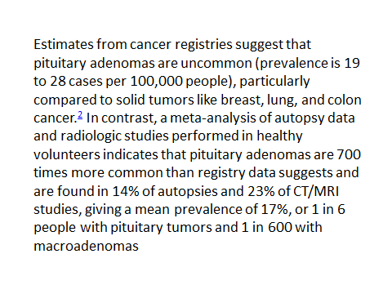

Slide 4
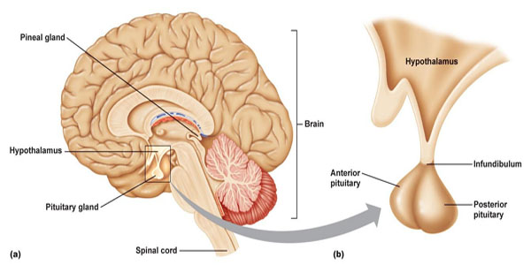

Slide 5
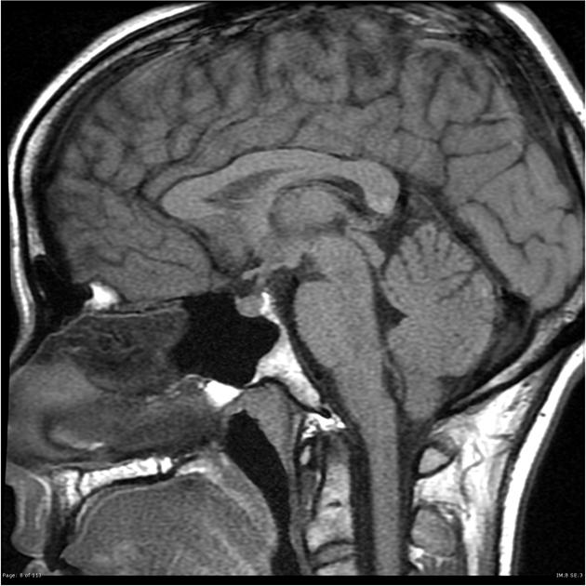

Slide 6
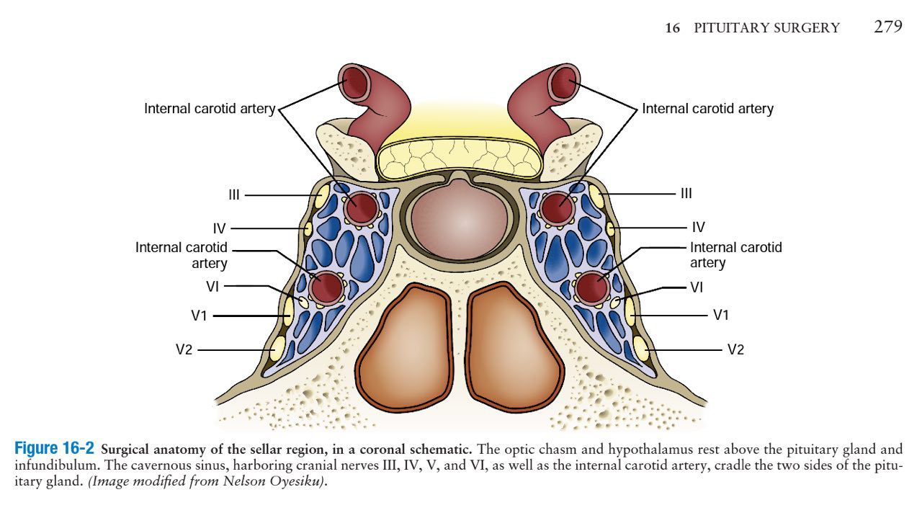

Slide 8
Pituitary adenomas are classified by their cell of origin (lactotroph, gonadotroph, somatotroph, corticotroph, and thyrotroph) and their size (microadenomas <1 cm, macroadenomas ≥1 cm). Most adenomas (65 to 70 percent) secrete an excess amount of hormone including prolactin, growth hormone (GH), corticotropin (ACTH), or thyroid-stimulating hormone (TSH).

Slide 9
The remainder of pituitary adenomas (30 to 35 percent) are clinically nonfunctioning or "silent." Of these, 80 to 90 percent are gonadotroph adenomas. There are also clinically nonfunctioning somatotroph ,lactotroph, and corticotroph adenomas, although these are less common.

Slide 10
One of the most challenging aspects in preoperative assessment of NFPAs involves differentiation from the other lesions that occur in this region. Such discrimination affords neurosurgeons an opportunity to tailor the surgical approach for resection or use specific pharmacotherapy.

Slide 11
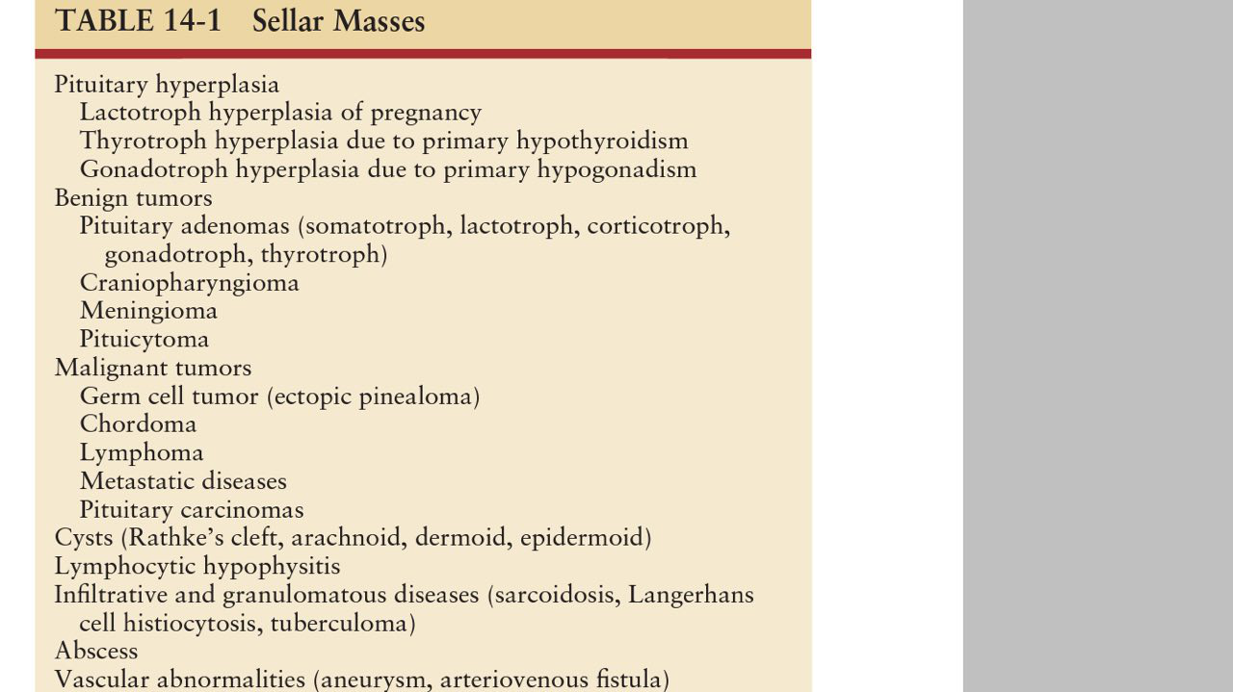

Slide 12
MR spectroscopy may be helpful in this regard. For instance, both hypothalamic hamartomas and gliomas exhibit decreased N-acetyl asparate (NAA). However, hypothalamic hamartomas are characterized by increased myoinositol while hypothalamic gliomas show increased choline accumulation. Class III data found that pituitary adenomas, on the other hand, often show a choline peak . Craniopharyngiomas and germinomas both show dominant lipid peaks. One study with Class III data demonstrated that the integration of spectroscopy data with conventional MRI sequences better enables preoperative assessment of sellar/suprasellar lesions.

Slide 13
Gonadotroph adenomas are the most common pituitary macroadenomas, comprising approximately 80 percent of clinically nonfunctioning adenomas. These adenomas are difficult to identify because their secretory products usually do not cause a recognizable clinical syndrome and because they often secrete so inefficiently that serum concentrations of intact gonadotropins and their subunits are often only minimally abnormal or not abnormal at all. Consequently, they are typically not detected until they become sufficiently large to cause neurologic symptoms, most often impaired vision due to pressure on the optic chiasm.

Slide 14
The majority of gonadotroph adenomas are clinically "silent" and difficult to identify because they are poorly differentiated and produce and secrete hormones inefficiently. The gonadotropins, luteinizing hormone (LH) and follicle-stimulating hormone (FSH), consist of a common alpha subunit, and a unique beta subunit. The hormones secreted by gonadotroph adenomas in order of decreasing frequency include: FSH, FSH-beta, alpha subunit, LH, and LH-beta .

Slide 15
clinicaly noun functional pituitary adenoma macroadenomas (96.5%) and the main presenting symptoms are visual defects (67.8%) and headache (41.4%), and the most frequent pituitary deficit was hypogonadism (43.3%).

Slide 16
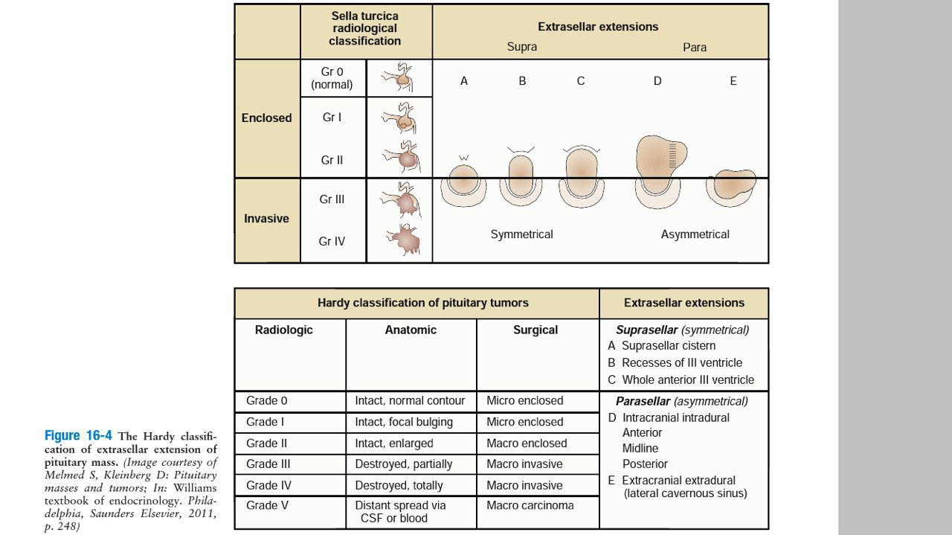

Slide 17
PATHOGENESIS
— Gonadotroph adenomas, like other pituitary adenomas, appear to be true clonal neoplasms , but the mutations that cause them are not known. Genes that have been found to be overexpressed include the pituitary tumor transforming gene, Ki-67, and FGF-R.

Slide 18
CLINICAL PRESENTATIONS
Neurologic symptoms, most commonly visual symptoms; less commonly headache.
A pituitary mass that is discovered as an incidental finding when an imaging procedure is done for reasons other than pituitary symptoms or disease.
Pituitary hypofunction due to compression of normal pituitary tissue by the adenoma.

Slide 19
Less commonly, patients with gonadotroph adenomas may present with clinical syndromes due to hypersecretion of follicle-stimulating hormone (FSH) or, less commonly, luteinizing hormone (LH) (ovarian hyperstimulation or precocious puberty).

Slide 20
Although gonadotroph adenomas are considered to be "nonfunctioning", most do produce intact gonadotropins or their subunits. However, these adenomas are typically poorly differentiated and inefficient producers/secretors and do not raise serum gonadotropin concentrations. Thus, they are usually clinically "silent" and cannot be distinguished from other clinically nonfunctioning adenomas until immunohistochemistry is performed after pituitary surgery.

Slide 22
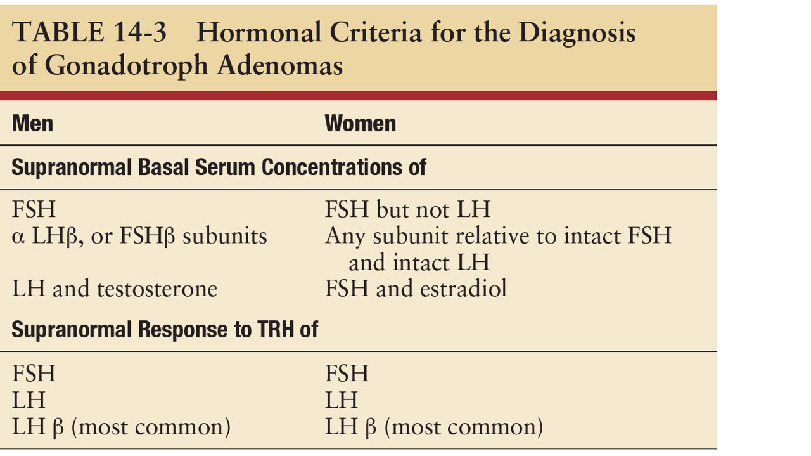

Slide 23
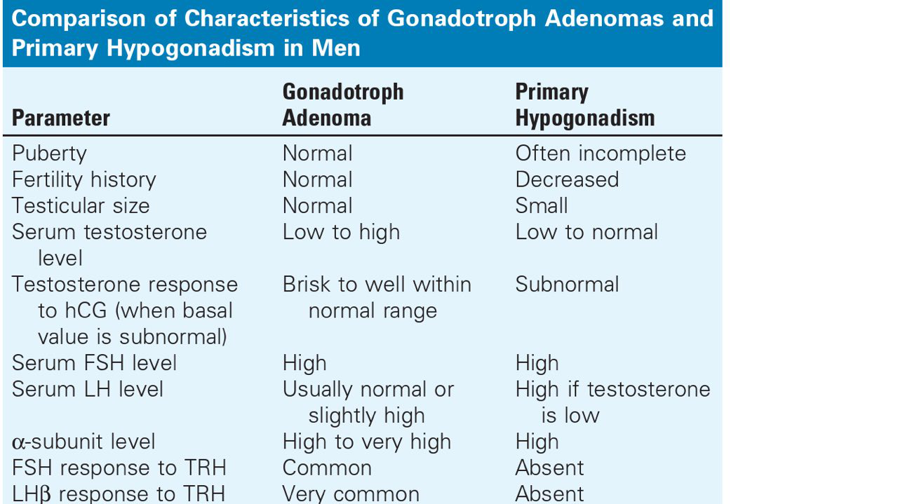

Slide 25
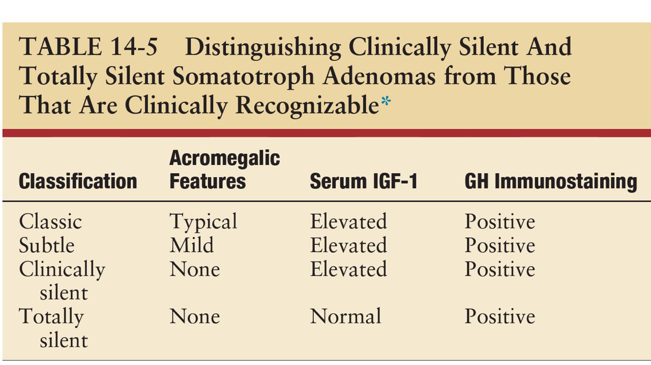

Slide 27
Neurosurgery is the treatment of choice of these tumours). However, because of frequent
supra- or parasellar extension, surgery is infrequently curative, leaving tumour remnants that regrow during long-term follow-up in a significant proportion of cases The use of post-operative radiotherapy is still controversial.

Slide 28
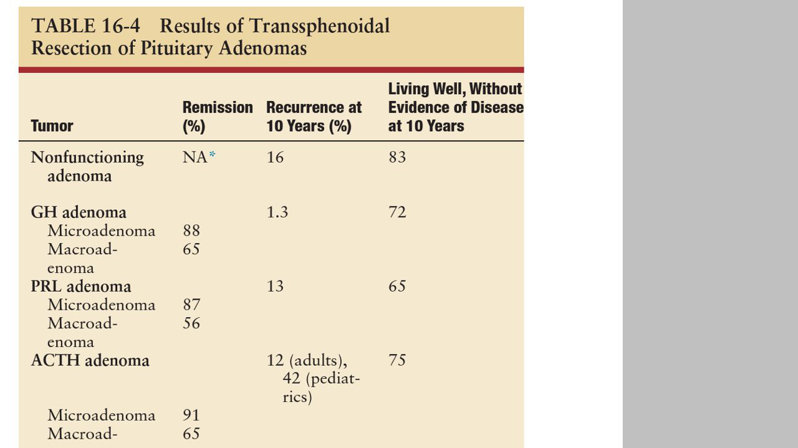

Slide 29
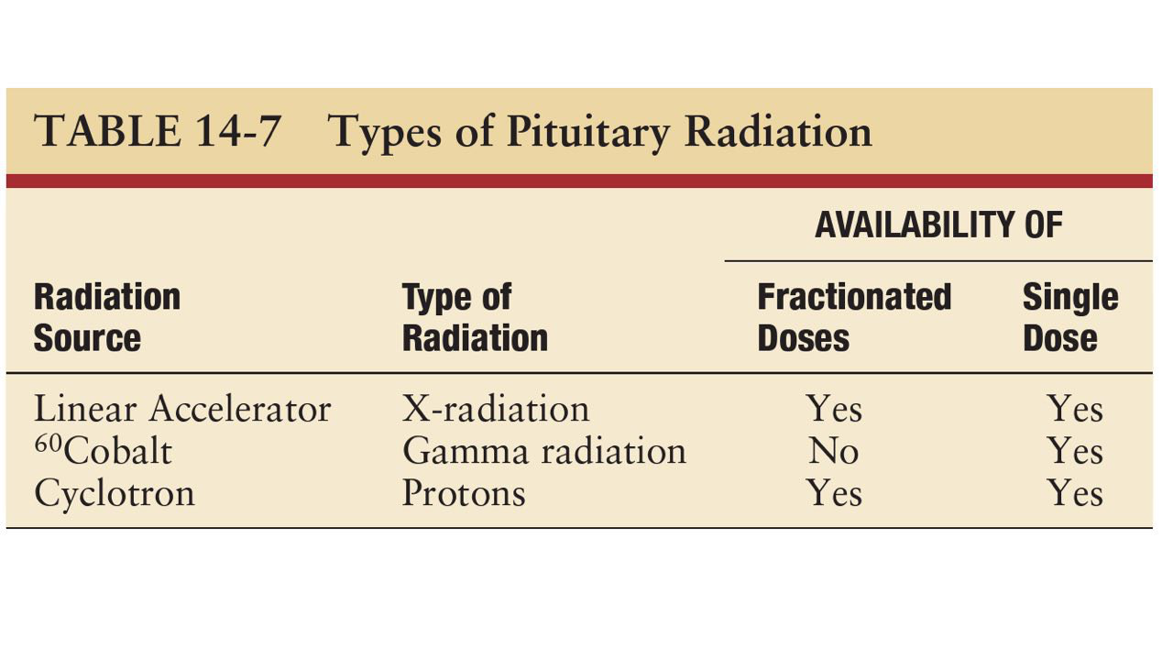

Slide 30
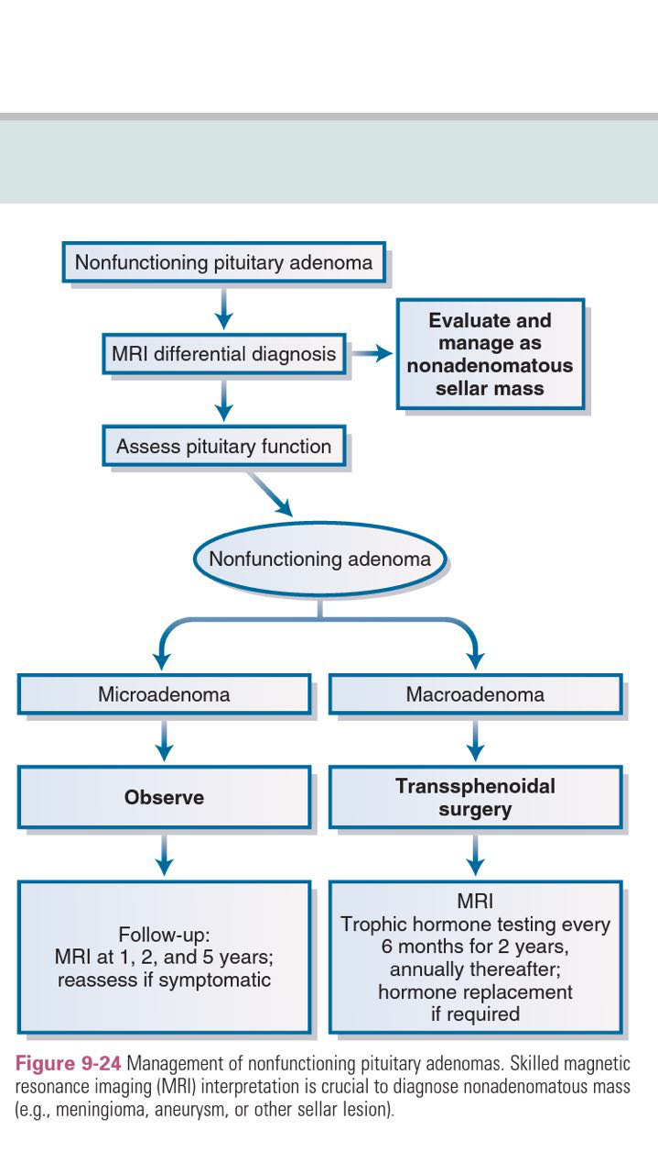

Slide 31
Goals of treatment — The goals of treatment in patients with gonadotroph or nonfunctioning adenomas include:
●Relief of visual impairment or other neurologic symptoms
●Removal of pituitary macroadenoma as completely as possible to avoid recurrence
●Management of hormonal deficiencies due to compression of nonadenomatous pituitary cells by the macroadenoma

Slide 32
PITUITARY SURGERY

Slide 33
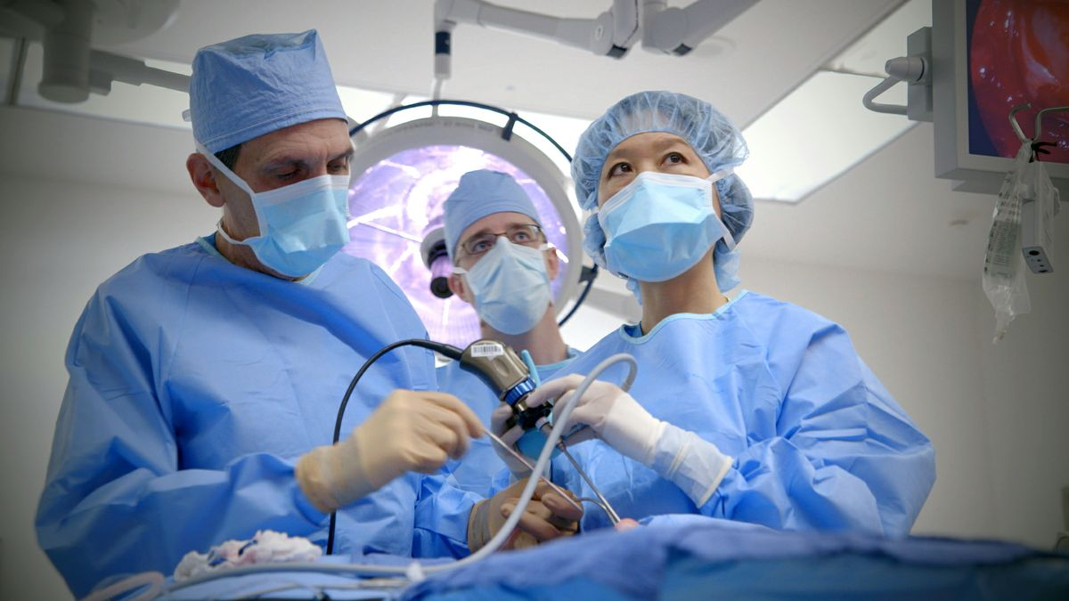

Slide 34
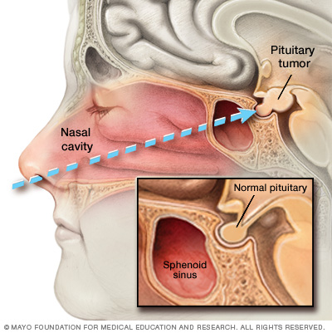

Slide 35
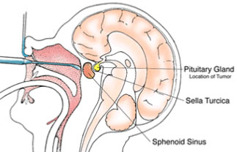

Slide 36
— Transsphenoidal surgery is the treatment of choice for initial therapy as it is currently the only treatment that can provide rapid relief of neurologic symptoms in patients with a gonadotroph or other nonfunctioning adenoma .Transsphenoidal surgery reduces the size of the adenoma and its hormonal hypersecretion in more than 90 percent of cases; it improves vision in approximately 80 percent.

Slide 38
Preoperative preparation
1)Confirming the sellar lesion is a gonadotroph or other nonfunctioning adenoma, which must be distinguished from a nonpituitary lesion in or near the sella, which might best be approached differently. Abnormalities that strongly suggest a gonadotroph adenoma are elevated basal serum concentrations of intact follicle-stimulating hormone (FSH) and of alpha subunit and a response of either to exogenous thyrotropin-releasing hormone (TRH).

Slide 39
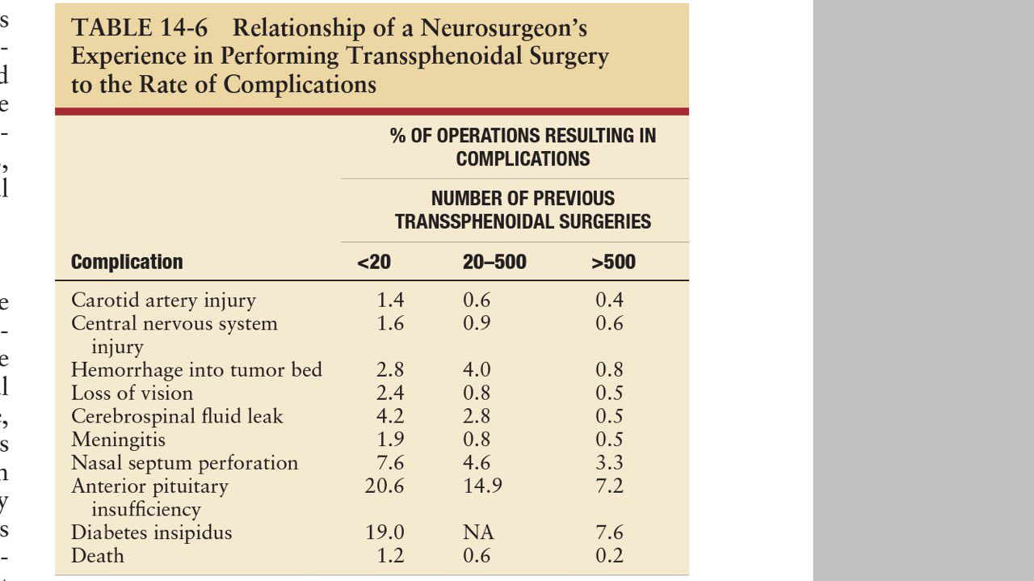

Slide 40
3) Identifying any pituitary hormone deficiencies that need to be treated preoperatively, including hypothyroidism due to thyroid-stimulating hormone (TSH) deficiency, and hypocortisolism due to corticotropin (ACTH) deficiency. Hypothyroidism, which increases the risk of respiratory insufficiency following postoperative administration of opiates or barbiturates, should be corrected preoperatively or pain medication should be used in lower than usual doses. Hypocortisolism should be replaced physiologically.

Slide 42
Perioperative management — MRI on postoperative day 1 gives an initial view of how much of the adenoma has been removed, even though a more accurate view is provided when the artefacts of surgery have regressed three to six months later. Perioperative hormonal management should be directed toward abnormalities of cortisol and vasopressin.

Slide 43
Hypocortisolism — Because of the possibility that nonadenomatous pituitary tissue could be removed inadvertently when attempting to remove the large volume of adenoma, patients should be treated with 100 mg of hydrocortisone beginning at the induction of anesthesia. The dose should be gradually decreased during the next few days. a replacement dose (eg, 15 to 25 mg/day) following discharge until the initial postoperative evaluation four to six weeks after discharge recommended.

Slide 44
Diabetes insipidus and SIADH — Both can occur shortly after transsphenoidal surgery.
The possibility of these abnormalities in vasopressin secretion dictate that any patient who has transsphenoidal surgery be assessed daily postoperatively by inquiring about thirst and measuring fluid intake and output, serum sodium, and urine osmolality.

Slide 45
Diabetes insipidus that occurs in the first day after surgery, when absorption through the nasal mucosa is variable, should be treated with desmopressin intravenously in doses from 0.25 to 1.0 mcg every 12 to 24 hours, titrated to keep urine volume and serum sodium normal. If diabetes insipidus has not remitted by the time of discharge, the desmopressin can be given as a nasal spray or orally.
SIADH is treated by fluid restriction until it remits, usually by postoperative day 10.

Slide 46
Four to six weeks after discharge from the hospital, the patient should be evaluated
Amount of residual adenoma. A crude estimation of the amount of residual adenoma can be determined by MRI, but artifacts of surgery may obscure the actual amount of residual adenoma tissue for several months. A more accurate estimate of the amount of residual adenoma at this time can be attained by monitoring the serum concentration of any pituitary adenoma product that had been elevated before surgery, such as FSH and alpha subunit for gonadotroph adenomas, insulin-like growth factor-1 (IGF-1) for clinically silent somatotroph adenomas, or ACTH for clinically silent corticotroph adenoma.

Slide 47
•Early morning serum cortisol 24 hours after the previous dose of hydrocortisone. If the serum cortisol value is ≤3 mcg/dL (83 nmol/L), the patient has secondary adrenal insufficiency (ACTH deficiency); if it is ≥18 mcg/dL , the patient has normal adrenal function; if it is between 4 and 17 mcg/dL on three occasions, a test of ACTH reserve, such as a metyrapone test, should be performed. Measurement of serum cortisol one hour after the administration of 250 mcg of cosyntropin should not be used in these patients, because it may give a falsely normal result .

Slide 48
Visual function — Transsphenoidal surgery improves visual function in approximately 80 percent of patients improvement can be seen in the first few days after surgery If visual function was abnormal before surgery, it should be reevaluated a month or two afterward and less often until no further change occurs.

