Slide 2

Standards of Medical Care in Diabetes - 2018
Notes:
This purpose of this talk is to overview the 2018 American Diabetes Association Standards of Medical Care in Diabetes. These Standards comprise all of the current and key clinical practice recommendations of the American Diabetes Association.
[SLIDE]
2
Reference
American Diabetes Association. Standards of medical care in diabetes—2014. Diabetes Care 2014;37(suppl 1):S1

Slide 3
Standards of Care
Funded out of the ADA’s general revenues and does not use industry support.
Slides correspond with sections within the Standards of Medical Care in Diabetes - 2018.
Reviewed and approved by the Association’s Board of Directors.
Notes:
A few notes on the Standards of Care:
The Association funds development of the Standards of Care and all Association position statements out of its general revenues and does not use industry support for these purposes [CLICK]
The slides are organized to correspond with sections within the 2018 Standards of Care. As we go through I’ll make note of where we are within the document. [CLICK]
Though not every section in the document is represented, these slides do incorporate the most salient points from the Standards of Care
As with all Association position statements, the Standards of Care are reviewed and approved by the Association’s Board of Directors, which includes health care professionals, scientists, and lay people.
[SLIDE]
3

Slide 4
Process
ADA’s Professional Practice Committee (PPC) conducts annual review & revision.
Searched Medline for human studies related to each subsection and published since January 1, 2017.
Recommendations revised per new evidence, for clarity, or to better match text to strength of evidence.
Professional.diabetes.org/SOC
Notes:
These Standards of Care are revised annually by the ADA’s multidisciplinary Professional Practice Committee (PPC) [CLICK]
For the 2018 revision, PPC members systematically searched Medline for human studies related to each subsection and published since 1 January 2017. [CLICK]
Recommendations were revised based on new evidence or, in some cases, to clarify the prior recommendations or match the strength of the word to the strength of the evidence [CLICK]
The Association and the Professional Practice Committee welcome feedback from the larger clinical community, which you can also submit at this URL.
[SLIDE]
4

Slide 5
General Process Changes
Standards will be ADA’s sole source of Clinical Practice Recommendations
The PPC will continue to update the Standards annually, but has the option to update more frequently online should the PPC determine that new evidence or regulatory changes merit immediate incorporation
ADA will begin taking proposals from the community for statements, consensus reports, scientific reviews, and clinical/research conferences
Professional.diabetes.org/SOC
Notes:
These Standards of Care will now be ADA’s sole source of clinical practice recommendations, as position statements containing such recommendations are being phased out. The Standards supersedes all previous ADA statements. [CLICK]
The PPC updates the Standards of Care annually, or more frequently online should the PPC determine that new evidence or regulatory
changes (e.g., drug approvals, label changes) merit immediate incorporation. [CLICK]
The Association and the Professional Practice Committee welcome proposals rom the larger clinical community for meetings and official ADA documents, which you can also submit at this URL.
[SLIDE]
5

Slide 6
Professional Practice Committee
Members of the PPC
Rita R. Kalyani, MD, MHS, FACP (Chair)
Christopher P. Cannon, MD
Andrea L. Cherrington, MD, MPH
Donald R. Coustan, MD
Ian H. de Boer, MD, MS
Hope Feldman, CRNP, FNP-BC
Judith Fradkin, MD
David Maahs, MD, PhD
Melinda Maryniuk, MEd, RD, CDE
Medha N. Munshi, MD
Joshua J. Neumiller, PharmD, CDE, FASCP
Guillermo E. Umpierrez, MD, CDE, FACE, FACP
ADA Staff
Erika Gebel Berg, PhD
Tamara Darsow, PhD
Matthew P. Petersen
Sacha Uelmen, RDN, CDE
William T. Cefalu, MD
Notes:
The Professional Practice Committee (PPC) of the American Diabetes Association (ADA) is responsible for the
“Standards of Medical Care in Diabetes” position statement, referred to as the “Standards of Care.” The PPC is a multidisciplinary expert committee comprised of physicians, diabetes educators, registered dietitians, and others who have expertise in a range of areas, including adult and pediatric endocrinology, epidemiology, public health, lipid research, hypertension, preconception planning, and pregnancy care. Appointment to the PPC is based on excellence in clinical practice and research.

Slide 7
Evidence Grading System
A | Clear evidence from well-conducted, generalizable RCTs, that are adequately powered, including: Evidence from a well-conducted multicenter trial or meta-analysis that incorporated quality ratings in the analysis; Compelling nonexperimental evidence; Supportive evidence from well-conducted RCTs that are adequately powered
B | Supportive evidence from a well-conducted cohort studies
 | Supportive evidence from a well-conducted case-control study
C | Supportive evidence from poorly controlled or uncontrolled studies
 | Conflicting evidence with the weight of evidence supporting the recommendation
E | Expert consensus or clinical experience
Notes:
Here is the Association’s evidence grading system in use for these clinical practice recommendations, used to clarify and codify the evidence that forms the basis for each of the recommendations in the 2018 Standards of Medical Care in Diabetes.
The level of evidence that supports each recommendation is listed after each recommendation using the letters A, B, C, or E. As we proceed through this presentation you’ll see these grades next to each of the recommendations listed. I won’t call them out each time, but they’re there for your reference.
[SLIDE]

Slide 8
1. Improving Care and Promoting Health in Populations
Notes:
Section 1, Improving Care and Promoting Health in Populations.
[SLIDE]
8

Slide 9
Diabetes and Population Health: Recommendations
Ensure treatment decisions are timely, rely on evidence-based guidelines, and are made collaboratively with patients based on individual preferences, prognoses, and comorbidities. B
Align approaches to diabetes management with the Chronic Care Model, emphasizing productive interactions between a prepared proactive care team and an informed activated patient. A
Improving Care and Promoting Health in Population:
Standards of Medical Care in Diabetes - 2018. Diabetes Care 2018; 41 (Suppl. 1): S7-S12
Notes:
A few key recommendations are intended to cover all sections of the Standards of Care. The following recommendations fall within this category and related to diabetes and population health:
Ensure treatment decisions are timely, rely on evidence-based guidelines, and are made collaboratively with patients based on individual preferences, prognoses, and comorbidities. B
Align approaches to diabetes management with the Chronic Care Model, emphasizing productive interactions between a prepared proactive care team and an informed activated patient. A
[SLIDE]
9

Slide 10
Diabetes and Population Health: Recommendations (2)
Care systems should facilitate team-based care, patient registries, decision support tools, and community involvement to meet patient needs. B
Efforts to assess the quality of diabetes care and create quality improvement strategies should incorporate reliable data metrics, to promote improved processes of care and health outcomes, with simultaneous emphasis on costs. E
Improving Care and Promoting Health in Population:
Standards of Medical Care in Diabetes - 2018. Diabetes Care 2018; 41 (Suppl. 1): S7-S12
Notes:
Care systems should facilitate team-based care, patient registries, decision support tools, and community involvement to meet patient needs. B
Efforts to assess the quality of diabetes care and create quality improvement strategies should incorporate reliable data metrics, to promote improved processes of care and health outcomes, with simultaneous emphasis on costs. E
[SLIDE]
10

Slide 11
Care Delivery Systems
33-49% of patients still do not meet targets for A1C, blood pressure, or lipids.
Only14% of patients meet targets for all A1C, BP, lipids, and nonsmoking status.
Progress in CVD risk factor control is slowing.
Substantial system-level improvements are needed.
Delivery system is fragmented, lacks clinical information capabilities, duplicates services & is poorly designed.
Improving Care and Promoting Health in Population:
Standards of Medical Care in Diabetes - 2018. Diabetes Care 2018; 41 (Suppl. 1): S7-S12
Notes:
Over the last ten years we’ve seen steady improvement in the proportion of patients with diabetes who are treated with statins and achieving recommended levels for A1C, blood pressure, and LDL, but nevertheless, 33-49% of patients still do not meet targets for glycemic, blood pressure, or cholesterol control, and [CLICK] only 14% meet targets for all three measures plus nonsmoking status. [CLICK]
Evidence also suggests that our progress in control of cardiovascular disease is slowing. [CLICK]
Even after adjusting for patient factors, the persistent variation in quality of diabetes care across providers and practice settings indicates that there is potential for substantial system-level improvements. [CLICK]
A major barrier to optimal care is a delivery system that is often fragmented, lacks clinical information capabilities, duplicates services, and is poorly designed for the coordinated delivery of chronic care.
[SLIDE]
11

Slide 12
Chronic Care Model (CCM)
The CCM includes Six Core Elements to optimize the care of patients with chronic disease:
Delivery system design
Self-management support
Decision support
Clinical information systems
Community resources & policies
Health systems
Improving Care and Promoting Health in Population:
Standards of Medical Care in Diabetes - 2018. Diabetes Care 2018; 41 (Suppl. 1): S7-S12
Notes:
But we know that the chronic care model has been shown to be an effective framework for improving the quality of diabetes care.
The CCM includes six core elements for the provision of optimal care of patients with chronic disease:
Delivery system design, or moving from a reactive to a proactive care delivery system where planned visits are coordinated through a team-based approach),
Self-management support,
Decision support (basing care on evidence-based, effective care guidelines),
Clinical information systems, including using registries that can provide patient-specific and population-based support to the care team
Community resources and policies, such as identifying or developing resources to support healthy lifestyles), and
Health systems that create a quality-oriented culture
[SLIDE]
12

Slide 13
Strategies for System-Level Improvement
The National Diabetes Education Program (NDEP) maintains an online resource to help health care professionals design and implement more effective health care delivery systems for those with diabetes:
www.BetterDiabetesCare.nih.gov
Improving Care and Promoting Health in Population:
Standards of Medical Care in Diabetes - 2018. Diabetes Care 2018; 41 (Suppl. 1): S7-S12
Notes:
Efforts to improve population health will require a combination of patient-level and system-level approaches. [CLICK]
The National Diabetes Education Program (NDEP) maintains an online resource (www.betterdiabetescare.nih.gov) to help health care professionals design and implement more effective health care delivery systems for those with diabetes at a systems level.
[SLIDE]
13

Slide 14
Strategies for System-Level Improvement (2)
The care team should prioritize timely and appropriate intensification of lifestyle and/or pharmacologic therapy for patients who have not achieved metabolic targets.
Strategies for intensification include:
  Explicit and collaborative goal setting with patients
  Identifying and addressing language, numeracy, and/or cultural barriers to care
  Integrating evidence-based guidelines and clinical information tools into the process of care
  Soliciting performance feedback, setting reminders, and providing structured care
  Incorporating care management teams
Improving Care and Promoting Health in Population:
Standards of Medical Care in Diabetes - 2018. Diabetes Care 2018; 41 (Suppl. 1): S7-S12
Notes:
The care team should prioritize timely and appropriate intensification of lifestyle and/or pharmacologic therapy for patients who have not achieved metabolic targets.
As outlined on this slide, the following [CLICK] strategies each have been shown to optimize provider and team behavior and thereby catalyze reductions in A1C, blood pressure, and LDL cholesterol:
Explicit and collaborative goal setting with patients
Identifying and addressing language, numeracy, and/or cultural barriers to care
Integrating evidence-based guidelines and clinical information tools into the process of care
Soliciting performance feedback, setting reminders, and providing structured care
Incorporating care management teams
[SLIDE]
14
References
Davidson MB. How our current medical care system fails people with diabetes: lack of timely, appropriate clinical decisions. Diabetes Care 2009;32:370–372
American Diabetes Association. Standards of medical care in diabetes—2014. Diabetes Care 2014;37(suppl 1):S61

Slide 15
Support Patient Self-Management
Implement a systematic approach to support patient behavior change efforts, including:
  High-quality diabetes self-management education and support (DSMES)
    Clinical content & skills
    Behavioral strategies (goal setting, problem solving, etc.)
    Engagement with psychosocial concerns
  Addressing barriers to medication taking
Improving Care and Promoting Health in Population:
Standards of Medical Care in Diabetes - 2018. Diabetes Care 2018; 41 (Suppl. 1): S7-S12
Notes:
Health care professionals can design and implement more effective health care delivery systems for our patients with diabetes by supporting patient self-management and behavior change efforts, through:
Use of high-quality diabetes self-management education and support (DSMES) that addresses:
Clinical content & skills
Behavioral strategies (goal setting, problem solving, etc.)
Engagement with psychosocial concerns
And addressing barriers to medication taking, which may include both patient-level factors (remembering to take medications, fear, depression or health beliefs), and system-level factors (inadequate follow-up or support).
[SLIDE]
15
References
American Diabetes Association. Standards of medical care in diabetes—2014. Diabetes Care 2014;37(suppl 1):S62
Duncan I, Birkmeyer C, Coughlin S, Li QE, Sherr D, Boren S. Assessing the value of diabetes education. Diabetes Educ 2009;35:752–760
Berikai P, Meyer PM, Kazlauskaite R, Savoy B, Kozik K, Fogelfeld L. Gain in patients’ knowledge of diabetes management targets is associated with better glycemic control. Diabetes Care 2007;30:1587–1589
Funnell MM, Brown TL, Childs BP, et al. National Standards for Diabetes Self-Management Education. Diabetes Care 2007;30:1630–1637
Klein S, Sheard NF, Pi-Sunyer X, et al.; American Diabetes Association; North American Association for the Study of Obesity; American Society for Clinical Nutrition. Weight management through lifestyle modification for the prevention and management of type 2 diabetes: rationale and strategies: a statement of the American Diabetes Association, the North American Association for the Study of Obesity, and the American Society for Clinical Nutrition. Diabetes Care 2004;27:2067–2073
Norris SL, Zhang X, Avenell A, et al. Efficacy of pharmacotherapy for weight loss in adults with type 2 diabetes mellitus: a meta-analysis. Arch Intern Med 2004;164:1395–1404

Slide 16
Tailoring Treatment for Social Context
Key Recommendations:
Providers should assess social context, including potential food insecurity, housing stability, and financial barriers, and apply that information to treatment decisions. A
Refer patients to local community resources when available. B
Provide patients with self-management support from lay health coaches, navigators, or community health workers when available. A
Improving Care and Promoting Health in Population:
Standards of Medical Care in Diabetes - 2018. Diabetes Care 2018; 41 (Suppl. 1): S7-S12
Notes:
Within the first section of the 2018 Standards of Care, a section is included to discuss tailoring treatment for patients with diabetes based on their social context.
Key recommendations for this section of the standards include:
Providers should assess social context, including potential food insecurity, housing stability, and financial barriers, and apply that information to treatment decisions. A [CLICK]
Refer patients to local community resources when available. B [CLICK]
Provide patients with self-management support from lay health coaches, navigators, or community health workers when available. A
[SLIDE]
16

Slide 17
Health Inequities
Health inequities related to diabetes and its complications are well documented and are heavily influenced by social determinants of health
Social determinants of health are defined as:
  The economic, environmental, political, and social conditions in which people live
  Responsible for a major part of health inequality worldwide
Improving Care and Promoting Health in Population:
Standards of Medical Care in Diabetes - 2018. Diabetes Care 2018; 41 (Suppl. 1): S7-S12
Notes:
Health inequities related to diabetes and its complications are well documented and are heavily influenced by social determinants of health. [CLICK]
Social determinants of health are defined as the economic, environmental, political, and social conditions in which people live and are responsible for a major part of health inequality worldwide.
[SLIDE]
17

Slide 18
Health Inequities (2)
Social determinants of health are not always recognized and often go undiscussed in the clinical encounter
Creating systems-level mechanisms to screen for social determinants of health may help overcome structural barriers and communication gaps between patients and providers.
Validated screening tools for some social determinants of health exist for clinical use
Improving Care and Promoting Health in Population:
Standards of Medical Care in Diabetes - 2018. Diabetes Care 2018; 41 (Suppl. 1): S7-S12
Notes:
Social determinants of health are not always recognized and often go undiscussed in the clinical encounter [CLICK]
Creating systems-level mechanisms to screen for social determinants of health may help overcome structural barriers and communication gaps between patients and providers. [CLICK]
Validated screening tools for some social determinants of health exist for clinical use[CLICK]
[SLIDE]
18

Slide 19
Health Inequities (3)
Food Insecurity
Homelessness
Language Barriers
  Non-English speaking/low literacy
Improving Care and Promoting Health in Population:
Standards of Medical Care in Diabetes - 2018. Diabetes Care 2018; 41 (Suppl. 1): S7-S12
Notes:
The 2018 Standards highlight several key health inequities that threaten the health of people with diabetes, including: [CLICK]
Food Insecurity [CLICK]
Homelessness [CLICK]
Language barriers, such as those who are non-English speaking and have associated low literacy levels.
For additional detailed discussion on these key health inequities, please refer to the full 2018 Standards of Care for more information.
[SLIDE]
19

Slide 20
2. Classification and
Diagnosis of Diabetes
Notes:
Moving on to section two, Classification and Diagnosis of Diabetes….
[SLIDE]
20

Slide 21
Classification & Diagnosis of Diabetes
Classification
Diagnostic Tests for Diabetes
Categories of Increased Risk for Diabetes (Prediabetes)
Type 1 Diabetes
Type 2 Diabetes
Gestational Diabetes
Monogenic Diabetes Syndromes
Cystic Fibrosis-Related Diabetes
Posttransplantation Diabetes Mellitus
Classification and Diagnosis of Diabetes:
Standards of Medical Care in Diabetes - 2018. Diabetes Care 2018; 41 (Suppl. 1): S13-S27
Notes:
The section on classification and diagnosis of diabetes includes several key subsections, such as classification of and diagnostic tests for diabetes, prediabetes, type 1 and type 2 diabetes, GDM, MODY, CFRD (or Cystic Fibrosis-Related Diabetes), and lastly a new section discussing posttransplantation diabetes.
[SLIDE]
21

Slide 22
Classification of Diabetes
Type 1 diabetes
  β-cell destruction
Type 2 diabetes
  Progressive insulin secretory defect
Gestational Diabetes Mellitus (GDM)
Other specific types of diabetes due to other causes:
  Monogenic diabetes syndromes
  Diseases of the exocrine pancreas, e.g., cystic fibrosis
  Drug- or chemical-induced diabetes
Classification and Diagnosis of Diabetes:
Standards of Medical Care in Diabetes - 2018. Diabetes Care 2018; 41 (Suppl. 1): S13-S27
Notes:
The 2018 Standards of Care classifies diabetes into four general clinical categories:
Type 1 diabetes, due to β-cell destruction, usually leading to absolute insulin deficiency; [CLICK]
Type 2 diabetes, due to a progressive insulin secretory defect frequently on the background of insulin resistance; [CLICK]
Gestational diabetes mellitus, which is diabetes diagnosed in the second or third trimester pregnancy that is not clearly overt diabetes existing prior to gestation [CLICK]
And other specific types of diabetes due to other causes, such as monogenic diabetes syndromes, diseases of the exocrine pancreas (such as cystic fibrosis and pancreatitis), and drug- or chemical-induced diabetes (such as diabetes resulting from glucocorticoid use, treatment of HIV/AIDS, or medications used after organ transplantation)
[SLIDE]
22
Reference
American Diabetes Association. Standards of medical care in diabetes—2014. Diabetes Care 2014;37(suppl 1):S14

Slide 23
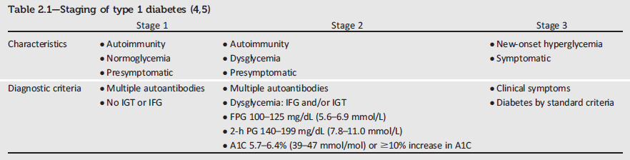
Staging of Type 1 Diabetes
Classification and Diagnosis of Diabetes:
Standards of Medical Care in Diabetes - 2018. Diabetes Care 2018; 41 (Suppl. 1): S13-S27
Notes:
Characterization of the underlying pathophysiology of diabetes is much more developed in type 1 diabetes than in type 2 diabetes. Three distinct stages of type 1 diabetes can be identified and serve as a framework for future research and regulatory decision making. The rate of progression is dependent on the age at first detection of antibody, number of antibodies, antibody specificity, and antibody titer. Glucose and A1C levels rise well before the clinical onset of diabetes, making diagnosis feasible well before the onset of DKA.
[SLIDE]
23
Reference
American Diabetes Association. Standards of medical care in diabetes—2014. Diabetes Care 2014;37(suppl 1):S14

Slide 24
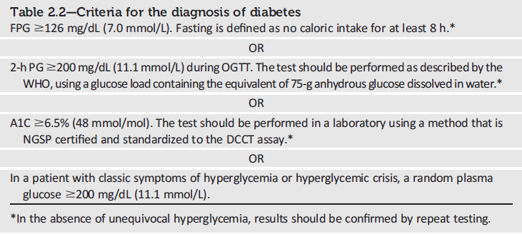
Criteria for the Diagnosis of Diabetes
Classification and Diagnosis of Diabetes:
Standards of Medical Care in Diabetes - 2018. Diabetes Care 2018; 41 (Suppl. 1): S13-S27
Notes:
Fasting plasma glucose, the 2 hour plasma glucose after a 75-g oral glucose tolerance test, and A1C are equally appropriate diagnostic tests for diabetes.
These diagnostic criteria are:
Fasting plasma glucose (FPG) ≥126 mg/dL
OR
2-hour plasma glucose ≥200 mg/dL during an OGTT
OR
A1C ≥6.5%
OR
In a patient with classic symptoms of hyperglycemia a random plasma glucose ≥ 200 can also be used.
In the absence of unequivocal hyperglycemia, the result should be confirmed by repeat testing.
[SLIDE]
24
Reference
American Diabetes Association. Standards of medical care in diabetes—2014. Diabetes Care 2014;37(suppl 1):S15; Table 2

Slide 25
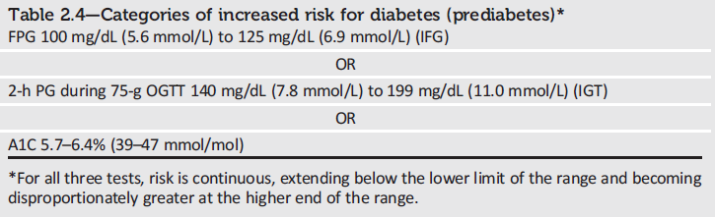
Categories of Increased Risk for Diabetes (Prediabetes)
Classification and Diagnosis of Diabetes:
Standards of Medical Care in Diabetes - 2018. Diabetes Care 2018; 41 (Suppl. 1): S13-S27
Notes:
The 2018 Standards of Care additionally provide definitions for prediabetes.
An increased risk for diabetes/prediabetes is defined as:
Fasting plasma glucose (FPG) of 100-125 mg/dL
OR
2-hour plasma glucose of 140-199 mg/dL during an OGTT
OR
A1C between 5.7-6.4%
For all three tests, risk is continuous, extending below the lower limit of the range and becoming disproportionately greater at the higher end of the range.
[SLIDE]
25
Reference
American Diabetes Association. Standards of medical care in diabetes—2014. Diabetes Care 2014;37(suppl 1):S15; Table 2

Slide 26
A1C: New Recommendations
To avoid misdiagnosis or missed diagnosis, the A1C test should be performed using a method that is certified by the NGSP and standardized to the Diabetes Control and Complications Trial (DCCT) assay. B
Marked discordance between measured A1C and plasma glucose levels should raise the possibility of A1C assay interference due to hemoglobin variants (i.e., hemoglobinopathies) and consideration of using an assay without interference or plasma blood glucose criteria to diagnose diabetes. B
In conditions associated with increased red blood cell turnover, such as sickle cell disease, pregnancy (second and third trimesters), hemodialysis, recent blood loss or transfusion, or erythropoietin therapy, only plasma blood glucose criteria should be used to diagnose diabetes. B
Classification and Diagnosis of Diabetes:
Standards of Medical Care in Diabetes - 2018. Diabetes Care 2018; 41 (Suppl. 1): S13-S27
Notes:
As a result of recent evidence describing potential limitations in A1C measurements due to hemoglobin variants, assay
interference, and conditions associated with red blood cell turnover, additional recommendations were added to clarify
the appropriate use of the A1C test generally and in the diagnosis of diabetes in these special cases
[SLIDE]
26
Reference
American Diabetes Association. Standards of medical care in diabetes—2014. Diabetes Care 2014;37(suppl 1):S14

Slide 27
Prediabetes: Recommendations
Screening for prediabetes and risk for future diabetes with an informal assessment of risk factors or validated tools should be considered in asymptomatic adults. B
Testing for prediabetes and risk for future diabetes in asymptomatic people should be considered in adults of any age who are overweight or obese (BMI ≥25 kg/m² or ≥23 kg/m² in Asian Americans) and who have one or more risk factors for diabetes (Table 2.3). B
For all people, testing should begin at age 45 years. B
Classification and Diagnosis of Diabetes:
Standards of Medical Care in Diabetes - 2018. Diabetes Care 2018; 41 (Suppl. 1): S13-S27
Notes:
With that, let’s direct our attention to recommendations provided in section 2 relating to categories of increased risk for diabetes (prediabetes):
Screening for prediabetes and risk for future diabetes with an informal assessment of risk factors or validated tools should be considered in asymptomatic adults. [CLICK]
Testing for prediabetes and risk for future diabetes in asymptomatic people should be considered in adults of any age who are overweight or obese (BMI ≥25 kg/m² or ≥23 kg/m² in Asian Americans) and who have one or more risk factors for diabetes (Table 2.3). [CLICK]
For all people, testing should begin at age 45 years. [CLICK]
[SLIDE]
27

Slide 28
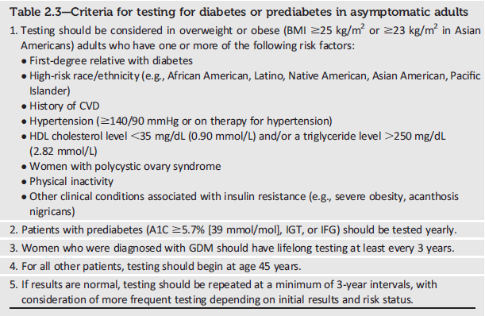
Testing for Diabetes or Prediabetes in Asymptomatic Adults
Classification and Diagnosis of Diabetes:
Standards of Medical Care in Diabetes - 2018. Diabetes Care 2018; 41 (Suppl. 1): S13-S27
Notes:
Because Table 2.3 was called out in the recommendation highlighted in the previous slide, lets take a quick look at the criteria for testing for diabetes or prediabetes in asymptomatic adults. As shown here, the criteria are as follows:
1. Testing should be considered in overweight or obese (BMI ≥25 kg/m2 or ≥23 kg/m2 in Asian Americans) adults who have one or more of the following risk factors:
First-degree relative with diabetes
High-risk race/ethnicity (e.g., African American, Latino, Native American, Asian American, Pacific Islander)
History of CVD
Hypertension (≥140/90 mmHg or on therapy for hypertension)
HDL cholesterol level <35 mg/dL (0.90 mmol/L) and/or a triglyceride level >250 mg/dL (2.82 mmol/L)
Women with polycystic ovary syndrome
Physical inactivity
Other clinical conditions associated with insulin resistance (e.g., severe obesity, acanthosis nigricans)
2. Patients with prediabetes (A1C ≥5.7% [39 mmol/mol], IGT, or IFG) should be tested yearly.
3. Women who were diagnosed with GDM should have lifelong testing at least every 3 years.
4. For all other patients, testing should begin at age 45 years.
5. If results are normal, testing should be repeated at a minimum of 3-year intervals, with consideration of more frequent testing depending on initial results and risk status.
[SLIDE]
28
Reference
American Diabetes Association. Standards of medical care in diabetes—2014. Diabetes Care 2014;37(suppl 1):S15; Table 2

Slide 29
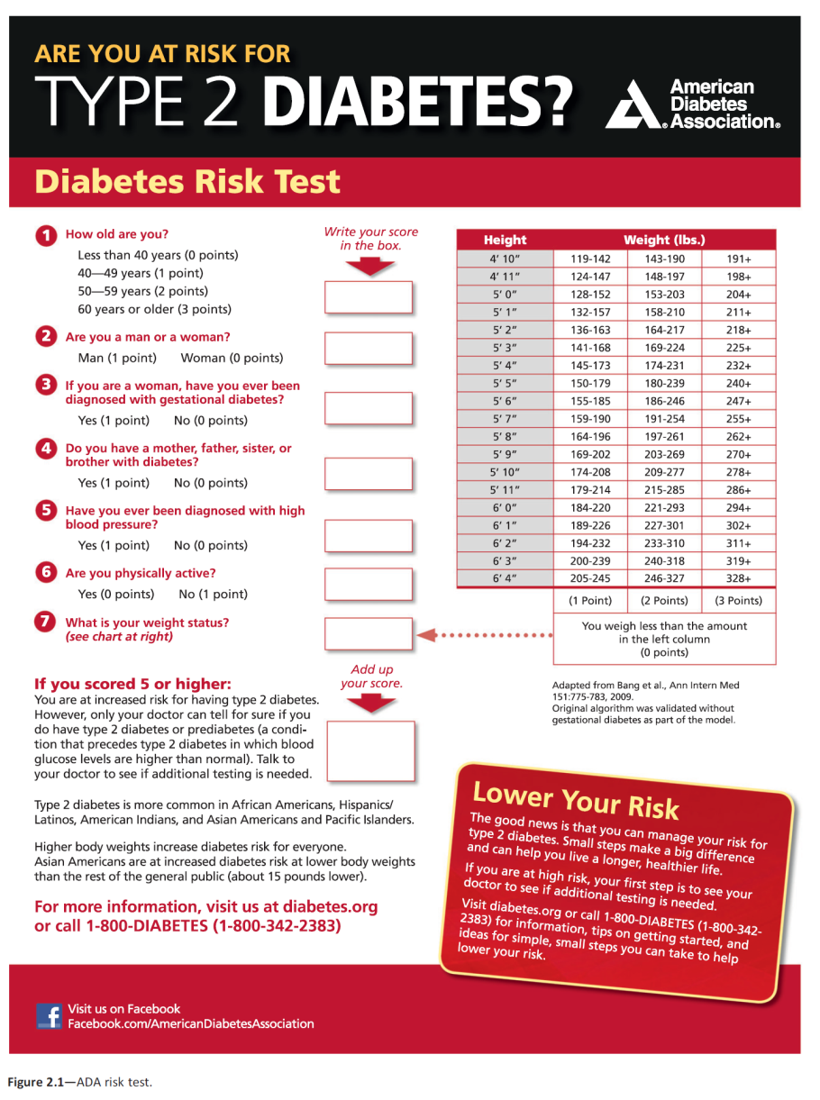
Notes:
An additional option for screening is provided in the ADA Diabetes Risk Test, which can be accessed online at diabetes dot org backslash soc risk test (diabetes.org/socrisktest)
[SLIDE]

Slide 30
community
screening may be considered in
specific situations where an adequate
referral system for positive tests is
established.

Slide 31
Prediabetes: Recommendations (2)
If tests are normal, repeat testing carried out at a minimum of 3-year intervals is reasonable. C
To test for prediabetes, fasting plasma glucose, 2-h plasma glucose during 75-g oral glucose tolerance test, and A1C are equally appropriate. B
In patients with prediabetes, identify and, if appropriate, treat other cardiovascular disease risk factors. B
Classification and Diagnosis of Diabetes:
Standards of Medical Care in Diabetes - 2018. Diabetes Care 2018; 41 (Suppl. 1): S13-S27
Notes:
Returning to the recommendations in section 2 that relate to prediabetes, the following are additional recommendations are provided:
If tests are normal, repeat testing carried out at a minimum of 3-year intervals is reasonable. . [CLICK]
To test for prediabetes, fasting plasma glucose, 2-h plasma glucose during 75-g oral glucose tolerance test, and A1C are equally appropriate. [CLICK]
In patients with prediabetes, identify and, if appropriate, treat other cardiovascular disease risk factors.
[SLIDE]
31

Slide 32
Prediabetes: Recommendations (3)
Testing for prediabetes should be considered in children and adolescents who are overweight or obese (BMI >85th percentile for age and sex, weight for height >85th percentile, or weight >120% of ideal for height) and who have additional risk factors for diabetes (Table 2.5). E
Classification and Diagnosis of Diabetes:
Standards of Medical Care in Diabetes - 2018. Diabetes Care 2018; 41 (Suppl. 1): S13-S27
Notes:
And lastly:
Testing for prediabetes should be considered in children and adolescents who are overweight or obese (BMI >85th percentile for age and sex, weight for height >85th percentile, or weight >120% of ideal for height) and who have additional risk factors for diabetes (Table 2.5).
Let’s now take a look at Table 2.5.
[SLIDE]
32

Slide 33
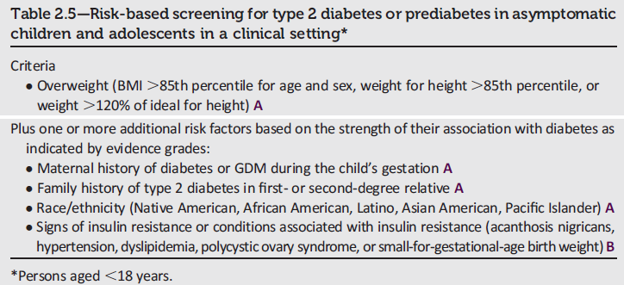
Risk-Based Screening in Asymptomatic Children and Adolescents
Classification and Diagnosis of Diabetes:
Standards of Medical Care in Diabetes - 2018. Diabetes Care 2018; 41 (Suppl. 1): S13-S27
Notes:
Table 2.5 provides information for risk-based screening for type 2 diabetes or prediabetes in asymptomatic children and adolescents, defined as persons under the age of 18 years. The criteria are as follows:
Criteria:
Overweight (BMI >85th percentile for age and sex, weight for height >85th percentile, or weight >120% of ideal for height) A
Plus one or more additional risk factors based on the strength of their association with diabetes as indicated by evidence grades:
Maternal history of diabetes or GDM during the child’s gestation A
Family history of type 2 diabetes in first- or second-degree relative A
Race/ethnicity (Native American, African American, Latino, Asian American, Pacific Islander) A
Signs of insulin resistance or conditions associated with insulin resistance (acanthosis nigricans, hypertension, dyslipidemia, polycystic ovary syndrome, or small-for-gestational-age birth weight) B
[SLIDE]
33

Slide 34
Type 1 Diabetes: Recommendations
Plasma blood glucose rather than A1C should be used to diagnose type 1 diabetes in individuals with symptoms of hyperglycemia. E
Screening for type 1 diabetes with a panel of autoantibodies is currently recommended only in the setting of a research trial study or in first-degree family members of a proband with type 1 diabetes. B
Persistence of two or more autoantibodies predicts clinical diabetes and may serve as an indication for intervention in the setting of a clinical trial. B
www.DiabetesTrialNet.org
Classification and Diagnosis of Diabetes:
Standards of Medical Care in Diabetes - 2018. Diabetes Care 2018; 41 (Suppl. 1): S13-S27
Notes:
Moving on to type 1 diabetes diagnosis and screening recommendations, these patients often present with acute symptoms of diabetes and markedly elevated blood glucose levels, and some cases are diagnosed with life-threatening ketoacidosis.
In these cases, knowing the blood glucose level is critical because, in addition to confirming that symptoms are due to diabetes mellitus, this will inform management decisions. Some providers may also want to know the A1C to determine how long a patient has had hyperglycemia. Therefore the Association recommends that blood glucose rather than A1c should be used to diagnose acute onset type 1 diabetes in those with symptoms of hyperglycemia. [CLICK]
While there is currently a lack of accepted screening programs, consider referring relatives of those with type 1 diabetes for antibody testing for risk assessment in the setting of a clinical research study, which can be identified at diabetestrialnet.org. [CLICK]
Persistence of two or more autoantibodies predicts clinical diabetes and may serve as an indication for intervention in the setting of a clinical trial.
[SLIDE]
34
References
American Diabetes Association. Standards of medical care in diabetes—2014. Diabetes Care 2014;37(suppl 1):S18
Imperatore G, Boyle JP, Thompson TJ, et al.; SEARCH for Diabetes in Youth Study Group. Projections of type 1 and type 2 diabetes burden in the U.S. population aged <20 years through 2050: dynamic modeling of incidence, mortality, and population growth. Diabetes Care 2012;35:2515–2520
Lipman TH, Levitt Katz LE, Ratcliffe SJ, et al. Increasing incidence of type 1 diabetes in youth: twenty years of the Philadelphia Pediatric Diabetes Registry. Diabetes Care 2013;36:1597–1603
Pettitt DJ, Talton J, Dabelea D, et al. Prevalence of diabetes mellitus in U.S. youth in 2009: the SEARCH for Diabetes in Youth Study. Diabetes Care. 16 September 2013 [Epub ahead of print]

Slide 35
Type 2 Diabetes: Recommendations
Screening for type 2 diabetes with an informal assessment of risk factors or validated tools should be considered in asymptomatic adults. B
Testing for type 2 diabetes in asymptomatic people should be considered in adults of any age who are overweight or obese (BMI ≥25 kg/m² or ≥23 kg/m² in Asian Americans) and who have 1 or more additional risk factors for diabetes (Table 2.3). B
For all patients, testing should begin at age 45 years. B
If tests are normal, repeat testing carried out at a minimum of 3-year intervals is reasonable. C
Classification and Diagnosis of Diabetes:
Standards of Medical Care in Diabetes - 2018. Diabetes Care 2018; 41 (Suppl. 1): S13-S27
Notes:
Type 2 diabetes, previously referred to as “non-insulin-dependent diabetes” or “adult-onset diabetes,” accounts for 90–95% of all diabetes. This form encompasses individuals who have insulin resistance and usually relative (rather than absolute) insulin deficiency. At least initially, and often throughout their lifetime, patients with type 2 diabetes may not need insulin treatment to survive.
These recommendations are similar to those previously presented for prediabetes, and include:
Screening for type 2 diabetes with an informal assessment of risk factors or validated tools should be considered in asymptomatic adults. B
Testing for type 2 diabetes in asymptomatic people should be considered in adults of any age who are overweight or obese (BMI ≥25 kg/m² or ≥23 kg/m² in Asian Americans) and who have 1 or more additional risk factors for diabetes (Table 2.3). B
For all patients, testing should begin at age 45 years. B
If tests are normal, repeat testing carried out at a minimum of 3-year intervals is reasonable. C
[SLIDE]
35

Slide 36
Type 2 Diabetes: Recommendations (2)
To test for type 2 diabetes, FPG, 2-h plasma glucose during a 75-g OGTT, and the A1C are equally appropriate. B
In patients with diabetes, identify and treat other cardiovascular disease risk factors. B
Testing for type 2 diabetes should be considered in children and adolescents who are overweight or obese (BMI >85th percentile for age and sex, weight for height >85th percentile, or weight >120% of ideal for height) and who have additional risk factors for diabetes (Table 2.5). E
Classification and Diagnosis of Diabetes:
Standards of Medical Care in Diabetes - 2018. Diabetes Care 2018; 41 (Suppl. 1): S13-S27
Notes:
And slide two of the screening recommendations for type 2 diabetes are again just like those previously presented for prediabetes, and include:
To test for type 2 diabetes, FPG, 2-h plasma glucose during a 75-g OGTT, and the A1C are equally appropriate. B
In patients with diabetes, identify and treat other cardiovascular disease risk factors. B
Testing for type 2 diabetes should be considered in children and adolescents who are overweight or obese (BMI >85th percentile for age and sex, weight for height >85th percentile, or weight >120% of ideal for height) and who have additional risk factors for diabetes (Table 2.5). E
[SLIDE]
36

Slide 37
Gestational Diabetes Mellitus (GDM): Recommendations
Test for undiagnosed diabetes at the 1st prenatal visit in those with risk factors, using standard diagnostic criteria. B
Test for GDM at 24–28 weeks of gestation in pregnant women not previously known to have diabetes. A
Test women with GDM for persistent diabetes at 4–12 weeks postpartum, using the OGTT and clinically appropriate nonpregnancy diagnostic criteria. E
Classification and Diagnosis of Diabetes:
Standards of Medical Care in Diabetes - 2018. Diabetes Care 2018; 41 (Suppl. 1): S13-S27
Notes:
Recommendations for the detection and diagnosis of gestational diabetes mellitus (GDM) are summarized on two slides;
First, because of the number of pregnant women with undiagnosed type 2 diabetes, it is reasonable to test women with risk factors for type 2 at the first prenatal visit, using standard diagnostic criteria. B [CLICK]
Test for GDM at 24–28 weeks of gestation in pregnant women not previously known to have diabetes. A [CLICK]
Test women with GDM for persistent diabetes at 4–12 weeks postpartum, using the OGTT and clinically appropriate nonpregnancy diagnostic criteria. E
[SLIDE]
37
References
Lawrence JM, Contreras R, Chen W, Sacks DA. Trends in the prevalence of preexisting diabetes and gestational diabetes mellitus among a racially/ethnically diverse population of pregnant women, 1999-2005. Diabetes Care 2008;31:899–904
American Diabetes Association. Standards of medical care in diabetes—2014. Diabetes Care 2014;37(suppl 1):S18

Slide 38
Gestational Diabetes Mellitus (GDM): Recommendations (2)
Women with a history of GDM should have lifelong screening for the development of diabetes or prediabetes at least every 3 years. B
Women with a history of GDM found to have prediabetes should receive intensive lifestyle interventions or metformin to prevent diabetes. A
Classification and Diagnosis of Diabetes:
Standards of Medical Care in Diabetes - 2018. Diabetes Care 2018; 41 (Suppl. 1): S13-S27
Notes:
And finally,
Women with a history of GDM should have lifelong screening for the development of diabetes or prediabetes at least every 3 years. [CLICK]
Women with a history of GDM found to have prediabetes should receive intensive lifestyle interventions or metformin to prevent diabetes.
[SLIDE]
38
References
Lawrence JM, Contreras R, Chen W, Sacks DA. Trends in the prevalence of preexisting diabetes and gestational diabetes mellitus among a racially/ethnically diverse population of pregnant women, 1999–2005. Diabetes Care 2008;31:899–904
American Diabetes Association. Standards of medical care in diabetes—2014. Diabetes Care 2014;37(suppl 1):S15–S16

Slide 39
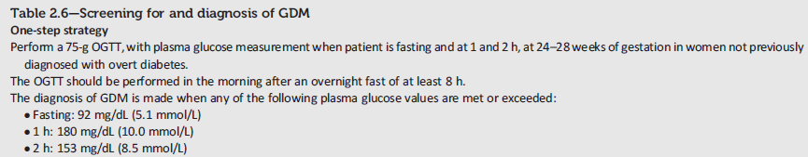
Screening and Diagnosis of GDM: One-Step Strategy
Classification and Diagnosis of Diabetes:
Standards of Medical Care in Diabetes - 2018. Diabetes Care 2018; 41 (Suppl. 1): S13-S27
Notes:
A diagnosis of gestational diabetes can be accomplished with either of two strategies, which we’ll walk through now.
First, the one-step strategy, which consists of a 75g OGTT:
In women between 24 and 28 weeks gestation not previously diagnosed with overt diabetes, perform a 75-g OGTT in the morning after an overnight fast of at least 8 hours.
Measure plasma glucose measurement fasting and at 1 and 2 hours.
Gestational diabetes is diagnosed if the fasting glucose is higher than 92 mg per dL, if the 1 hour glucose is higher than 180, or if the 2 hour is over 153.
[SLIDE]
39
References
American Diabetes Association. Standards of medical care in diabetes—2014. Diabetes Care 2014;37(suppl 1):S19; Table 6
Metzger BE, Lowe LP, Dyer AR, et al, for the HAPO Study Cooperative Research Group. Hyperglycemia and adverse pregnancy outcomes. N Engl J Med 2008;358:1991–2002
Metzger BE, Gabbe SG, Persson B, et al, for the International Association of Diabetes and Pregnancy Study Groups Consensus Panel. International Association of Diabetes and Pregnancy Study Groups recommendations on the diagnosis and classification of hyperglycemia in pregnancy. Diabetes Care 2010;33:676–682

Slide 40
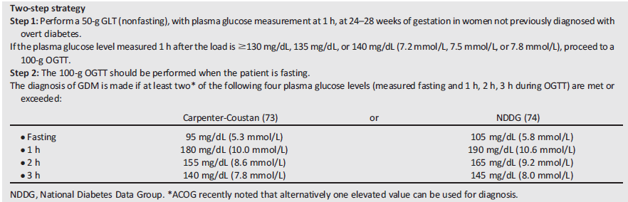
Screening and Diagnosis of GDM: Two-Step Strategy
Classification and Diagnosis of Diabetes:
Standards of Medical Care in Diabetes - 2018. Diabetes Care 2018; 41 (Suppl. 1): S13-S27
Notes:
And here’s the 2-step strategy recommended by NIH.
Step 1:
First, perform a 50-g GLT (nonfasting), with plasma glucose measurement at 1 h, at 24–28 weeks of gestation in women not previously diagnosed with overt diabetes
If the plasma glucose level measured 1 h after the load is ≥140 mg/dL, proceed to Step 2, the 100-g OGTT
Step 2:
If the non-fasted 1-hour glucose is 140 or above, then perform the 100-g OGTT. This one is fasting, and GDM is diagnosed if at least two of the four plasma glucose criteria (measured fasting and 1h, 2h, 3h during OGTT) are met or exceeded, as illustrated in the table within this slide.
[SLIDE]
40
References
American Diabetes Association. Standards of medical care in diabetes—2014. Diabetes Care 2014;37(suppl 1):S19; Table 6
Vandorsten JP, Dodson WC, Espeland MA, et al. NIH consensus development conference: diagnosing gestational diabetes mellitus. NIH Consens State Sci Statements 2013;29:1–31

Slide 41
Monogenic Diabetes Syndromes: Recommendations
All children diagnosed with diabetes in the first 6 months of life should have immediate genetic testing for neonatal diabetes. A
Children and adults, diagnosed in early adulthood, who have diabetes not characteristic of T1DM or T2DM that occurs in successive generations (suggestive of an autosomal dominant pattern of inheritance) should have genetic testing for MODY. A
In both instances, consultation with a center specializing in diabetes genetics is recommended to understand the significance of these mutations and how best to approach further evaluation, treatment, and genetic counseling. E
Classification and Diagnosis of Diabetes:
Standards of Medical Care in Diabetes - 2018. Diabetes Care 2018; 41 (Suppl. 1): S13-S27
Notes:
The Association has expanded guidance, recommendations, and text on monogenic diabetes syndromes for 2018. the 2018 recommendations consist of the following:
All children diagnosed with diabetes in the first 6 months of life should have immediate genetic testing for neonatal diabetes. A
Children and adults, diagnosed in early adulthood, who have diabetes not characteristic of T1DM or T2DM that occurs in successive generations (suggestive of an autosomal dominant pattern of inheritance) should have genetic testing for MODY. A
In both instances, consultation with a center specializing in diabetes genetics is recommended to understand the significance of these mutations and how best to approach further evaluation, treatment, and genetic counseling. E
[SLIDE]
41

Slide 42
Cystic Fibrosis–Related Diabetes (CFRD): Recommendations
Annual screening for CFRD with OGTT should begin by age 10 years in all patients with cystic fibrosis not previously diagnosed with CFRD. B
A1C is not recommended as a screening test for CFRD. B
Patients with CFRD should be treated with insulin to attain individualized glycemic goals. A
Beginning 5 years after the diagnosis of CFRD, annual monitoring for complications of diabetes is recommended. E
Classification and Diagnosis of Diabetes:
Standards of Medical Care in Diabetes - 2018. Diabetes Care 2018; 41 (Suppl. 1): S13-S27
Notes:
Cystic Fibrosis-Related Diabetes is the most common comorbidity in people with cystic fibrosis, occurring in about 20% of adolescents and 40-50% of adults. Diabetes in this population, compared to individuals with type 1 or type 2 diabetes, is associated with worse nutritional status, more severe inflammatory lung disease, and greater mortality.
Recommendations for the care of patients with cystic-fibrosis-related diabetes (CFRD) are summarized here.
First, annual screening for CFRD with OGTT should begin by age 10 years in all patients with cystic fibrosis not previously diagnosed with CFRD. B
A1C is not recommended as a screening test for CFRD. B
Patients with CFRD should be treated with insulin to attain individualized glycemic goals. A
Beginning 5 years after the diagnosis of CFRD, annual monitoring for complications of diabetes is recommended. E
[SLIDE]
42
References
American Diabetes Association. Standards of medical care in diabetes—2014. Diabetes Care 2014;37(suppl 1):S56
Kern AS, Prestridge AL. Improving screening for cystic fibrosis-related diabetes at a pediatric cystic fibrosis program. Pediatrics 2013;132:e512–e518
Waugh N, Royle P, Craigie I, et al. Screening for cystic fibrosis-related diabetes: a systematic review. Health Technol Assess 2012;16:iii–iv, 1–179
Moran A, Dunitz J, Nathan B, Saeed A, Holme B, Thomas W. Cystic fibrosis-related diabetes: current trends in prevalence, incidence, and mortality. Diabetes Care 2009;32:1626–1631

Slide 43
Posttransplantation Diabetes Mellitus (PTDM): Recommendations
Patients should be screened after organ transplantation for hyperglycemia, with a formal diagnosis of PTDM being best made once a patient is stable on an immunosuppressive regimen and in the absence of an acute infection. E
The OGTT is the preferred test to make a diagnosis of PTDM. B
Immunosuppresive regimens shown to provide the best outcomes for patient and graft survival should be used, irrespective of PTDM risk. E
Classification and Diagnosis of Diabetes:
Standards of Medical Care in Diabetes - 2018. Diabetes Care 2018; 41 (Suppl. 1): S13-S27
Notes:
Hyperglycemia is very common during the early posttransplant period, with ~90% of kidney allograft recipients exhibiting hyperglycemia in the first few weeks following transplant, as an example. Risk factors for PTDM include both general diabetes risk as well as transplant-specific factors, such as use of immunosuppressant agents.
The following recommendations are provided in the 2018 Standards as related to PTDM:
Patients should be screened after organ transplantation for hyperglycemia, with a formal diagnosis of PTDM being best made once a patient is stable on an immunosuppressive regimen and in the absence of an acute infection. E
The OGTT is the preferred test to make a diagnosis of PTDM. B
Immunosuppresive regimens shown to provide the best outcomes for patient and graft survival should be used, irrespective of PTDM risk. E
[SLIDE]
43
References
American Diabetes Association. Standards of medical care in diabetes—2014. Diabetes Care 2014;37(suppl 1):S56
Onady GM, Stolfi A. Insulin and oral agents for managing cystic fibrosis-related diabetes. Cochrane Database Syst Rev 2013;(7):CD004730
Moran A, Brunzell C, Cohen RC, et al. CFRD Guidelines Committee. Clinical care guidelines for cystic fibrosis-related diabetes: a position statement of the American Diabetes Association and a clinical practice guideline of the Cystic Fibrosis Foundation, endorsed by the Pediatric Endocrine Society. Diabetes Care 2010;33:2697–2708

Slide 44
3. Comprehensive Medical Evaluation and Assessment of Comorbidities
Notes:
This new section highlights the importance of assessing comorbidities in the context of a patient-centered comprehensive medical evaluation.
[SLIDE]
44

Slide 45
Patient-Centered Collaborative Care
A patient-centered communication style that uses person-centered and strength-based language, active listening, elicits patient preferences and beliefs, and assesses literacy, numeracy, and potential barriers to care should be used to optimize patient health outcomes and health-related quality of life. B
Comprehensive Medical Evaluation and Assessment of Comorbidities:
Standards of Medical Care in Diabetes - 2018. Diabetes Care 2018; 41 (Suppl. 1): S28-S37
Notes:
This section starts by highlighting the importance of patient-centered collaborative care as well as provider communications in the context of the comprehensive medical evaluation.
Provider communications with patients and their families should acknowledge that multiple factors impact glycemic management, but also emphasize that collaboratively developed treatment plans and a healthy lifestyle can significantly improve disease outcomes and well-being. The goal of provider-patient communication is to establish a collaborative relationship and to assess and address self-management barriers without blaming patients for “noncompliance” or “nonadherence” when the outcomes of self-management are not optimal.
[SLIDE]
45

Slide 46
Comprehensive Medical Evaluation
A complete medical evaluation should be performed at the initial visit to:
Confirm the diagnosis and classify diabetes. B
Evaluate for diabetes complications and potential comorbid conditions. E
Review previous treatment & risk factor control in patients with established diabetes. E
Begin patient engagement in the formulation of a care management plan. B
Develop a plan for continuing care. B
Comprehensive Medical Evaluation and Assessment of Comorbidities:
Standards of Medical Care in Diabetes - 2018. Diabetes Care 2018; 41 (Suppl. 1): S28-S37
Notes:
Moving on to the medical evaluation, a comprehensive medical evaluation should be performed at the initial visit in order to accomplish several things:
First, to confirm the diagnosis and classify diabetes; [CLICK]
To evaluate for diabetes complications and potential comorbid conditions; [CLICK]
To review previous treatment & risk factor control in patients with established diabetes; [CLICK]
To Begin patient engagement in the formulation of a care management plan, and finally, [CLICK]
To develop a plan for continuing care.
[SLIDE[
46

Slide 47
Comprehensive Medical Evaluation (2)
A follow-up visit should include most components of the initial comprehensive medical evaluation including: interval medical history; assessment of medication-taking behavior and intolerance/side effects; physical examination; laboratory evaluation as appropriate to assess attainment of A1C and metabolic targets; and assessment of risk for complications, diabetes self-management behaviors, nutrition, psychosocial health, and the need for referrals, immunizations, or other routine health maintenance screening. B
Comprehensive Medical Evaluation and Assessment of Comorbidities:
Standards of Medical Care in Diabetes - 2018. Diabetes Care 2018; 41 (Suppl. 1): S28-S37
Notes:
Following the initial visit, a follow-up visit should be conducted
that includes most components of the initial comprehensive medical evaluation including: interval medical history; assessment of medication-taking behavior and intolerance/side effects; physical examination; laboratory evaluation as appropriate to assess attainment of A1C and metabolic targets; and assessment of risk for complications, diabetes self-management behaviors, nutrition, psychosocial health, and the need for referrals, immunizations, or other routine health maintenance screening. B
[SLIDE[
47

Slide 48
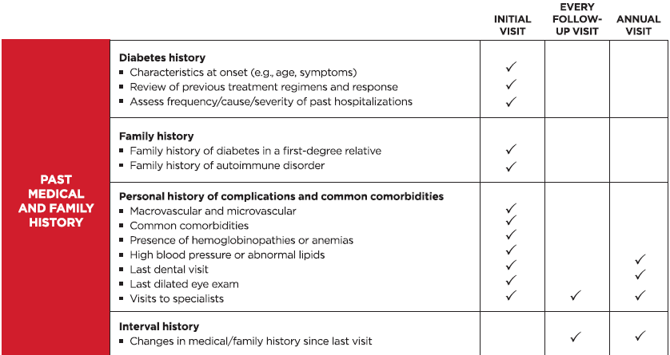
Components of the Comprehensive Diabetes Evaluation
Comprehensive Medical Evaluation and Assessment of Comorbidities:
Standards of Medical Care in Diabetes - 2018. Diabetes Care 2018; 41 (Suppl. 1): S28-S37
Notes:
The table describing the components of a comprehensive medical evaluation (Table
3.1) was substantially redesigned and reorganized for 2018, incorporating information about the recommended frequency of the components of care at both initial and follow-up visits.
Here is a section of the new table, regarding past medical and family history. The table also includes sections on:
[SLIDE]
48
Reference
American Diabetes Association. Standards of medical care in diabetes—2014. Diabetes Care 2014;37(suppl 1):S21; Table 7

Slide 49
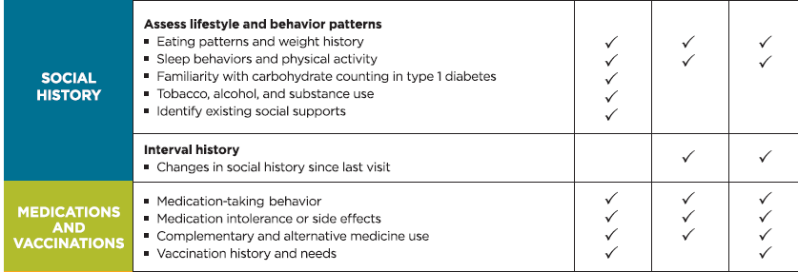
Components of the Comprehensive Diabetes Evaluation
Comprehensive Medical Evaluation and Assessment of Comorbidities:
Standards of Medical Care in Diabetes - 2018. Diabetes Care 2018; 41 (Suppl. 1): S28-S37
Notes:
--Social history
--Medications and Vaccinations
[SLIDE]
49
Reference
American Diabetes Association. Standards of medical care in diabetes—2014. Diabetes Care 2014;37(suppl 1):S21; Table 7

Slide 50
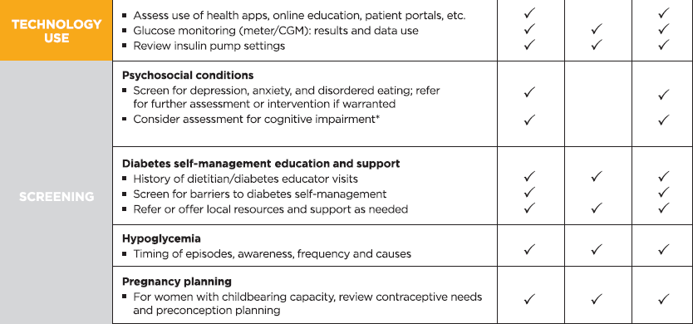
Components of the Comprehensive Diabetes Evaluation
* ≥65 years
Comprehensive Medical Evaluation and Assessment of Comorbidities:
Standards of Medical Care in Diabetes - 2018. Diabetes Care 2018; 41 (Suppl. 1): S28-S37
Notes:
--Technology Use
--Screening
[SLIDE]
50
Reference
American Diabetes Association. Standards of medical care in diabetes—2014. Diabetes Care 2014;37(suppl 1):S21; Table 7

Slide 51
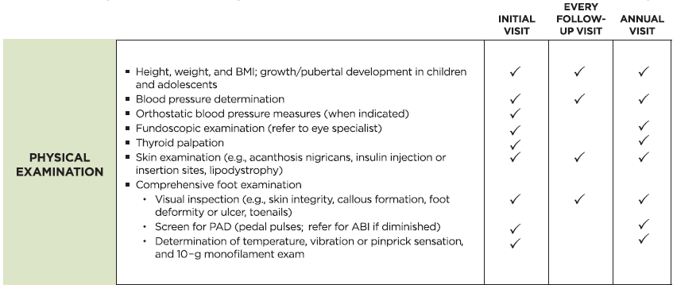
Components of the Comprehensive Diabetes Evaluation
Comprehensive Medical Evaluation and Assessment of Comorbidities:
Standards of Medical Care in Diabetes - 2018. Diabetes Care 2018; 41 (Suppl. 1): S28-S37
Notes:
--Physical Examination
[SLIDE]
51
Reference
American Diabetes Association. Standards of medical care in diabetes—2014. Diabetes Care 2014;37(suppl 1):S21; Table 7

Slide 52
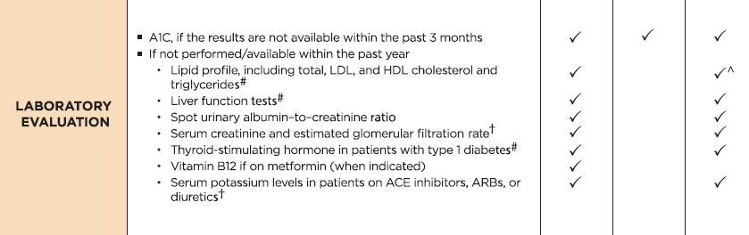
Components of the Comprehensive Diabetes Evaluation
† May be needed more frequently in patients with known chronic kidney disease or with changes in medications that affect kidney function and serum potassium.
# May also need to be checked after initiation or dose changes of medications that affect these laboratory values (i.e., diabetes medications, blood pressure medications, cholesterol medications, or thyroid medications),.
˄ In people without dyslipidemia and not on cholesterol-lowering therapy, testing may be less frequent.
Comprehensive Medical Evaluation and Assessment of Comorbidities:
Standards of Medical Care in Diabetes - 2018. Diabetes Care 2018; 41 (Suppl. 1): S28-S37
Notes:
--Laboratory Evaluation
[SLIDE]
52
Reference
American Diabetes Association. Standards of medical care in diabetes—2014. Diabetes Care 2014;37(suppl 1):S21; Table 7

Slide 53
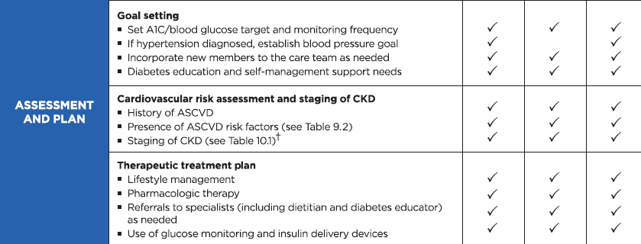
Components of the Comprehensive Diabetes Evaluation
† May be needed more frequently in patients with known chronic kidney disease or with changes in medications that affect kidney function and serum potassium.
Comprehensive Medical Evaluation and Assessment of Comorbidities:
Standards of Medical Care in Diabetes - 2018. Diabetes Care 2018; 41 (Suppl. 1): S28-S37
Notes:
--And assessment and Planning
[SLIDE]
53
Reference
American Diabetes Association. Standards of medical care in diabetes—2014. Diabetes Care 2014;37(suppl 1):S21; Table 7

Slide 54
Referrals for Initial Care Management
Eye care professional for annual dilated eye exam
Family planning for women of reproductive age
Registered dietitian for MNT
DSMES
Dentist for comprehensive dental and periodontal examination
Mental health professional, if indicated
Comprehensive Medical Evaluation and Assessment of Comorbidities:
Standards of Medical Care in Diabetes - 2018. Diabetes Care 2018; 41 (Suppl. 1): S28-S37
Notes:
In addition to the components of the comprehensive diabetes medical evaluation at initial and follow-up visits just covered, the 2018 Standards provides recommendations for additional referrals, as indicated, for people with diabetes. Such referrals may include:
Eye care professional for annual dilated eye exam
Family planning for women of reproductive age
Registered dietitian for MNT
DSMES
Dentist for comprehensive dental and periodontal examination
Mental health professional, if indicated
[SLIDE]
54
Reference
American Diabetes Association. Standards of medical care in diabetes—2014. Diabetes Care 2014;37(suppl 1):S21; Table 7

Slide 55
Immunization: Recommendations
Provide routinely recommended vaccinations for children and adults with diabetes by age. C
Annual vaccination against influenza is recommended for all people ≥6 months of age, including those with diabetes. C
Administer 3-dose series of hepatitis B vaccine to unvaccinated adults with diabetes aged 19-59 years. C
Consider administering 3-dose hepatitis B vaccine to unvaccinated adults with diabetes ages ≥ 60 years. C
Comprehensive Medical Evaluation and Assessment of Comorbidities:
Standards of Medical Care in Diabetes - 2018. Diabetes Care 2018; 41 (Suppl. 1): S28-S37
Notes:
As far as immunizations, the Association recommends that, as for the general population, all children and adults with diabetes should receive routine vaccinations according to age-specific CDC recommendations. In addition, the following recommendations are provided: [CLICK]
Annual vaccination against influenza is recommended for all people ≥6 months of age, including those with diabetes. C [CLICK]
Administer 3-dose series of hepatitis B vaccine to unvaccinated adults with diabetes aged 19-59 years. C [CLICK]
Consider administering 3-dose hepatitis B vaccine to unvaccinated adults with diabetes ages ≥ 60 years. C
[SLIDE]
55

Slide 56
Immunization: Recommendations (2)
Vaccination against pneumococcal disease, including pneumococcal pneumonia, with 13-valent pneumococcal conjugate vaccine (PCV13) is recommended for children before age 2 years. People with diabetes ages 2-64 years should also receive 23-valent pneumococcal polysaccharide vaccine (PPSV23). Ag age ≥65 years, regardless of vaccination history, additional PPSV23 vaccination is necessary. C
Comprehensive Medical Evaluation and Assessment of Comorbidities:
Standards of Medical Care in Diabetes - 2018. Diabetes Care 2018; 41 (Suppl. 1): S28-S37
Notes:
Lastly, pneumococcal vaccine is recommended based on age per the recommendation noted here.
[SLIDE]
56

Slide 57
Immunization Resources
The CDC child and adolescent vaccination schedule can be found at:
www.cdc.gov/vaccines/schedules/hcp/imz/child-adolescent.html
The CDC adult vaccination schedule can be found at:
www.cdc.gov/vaccines/schedules/hcp/imz/adult.html
Comprehensive Medical Evaluation and Assessment of Comorbidities:
Standards of Medical Care in Diabetes - 2018. Diabetes Care 2018; 41 (Suppl. 1): S28-S37
Notes:
The CDC websites provided here can be easily accessed for current vaccination schedule recommendations.
[SLIDE]
57

Slide 58
Common Comorbidities
Autoimmune Diseases (T1D)
Cancer
Cognitive Impairment/ Dementia
Fatty Liver Disease
Pancreatitis
Fractures
Hearing Impairment
HIV
Low Testosterone (Men)
Obstructive Sleep Apnea
Periodontal Disease
Psychosocial/Emotional Disorders
Comprehensive Medical Evaluation and Assessment of Comorbidities:
Standards of Medical Care in Diabetes - 2018. Diabetes Care 2018; 41 (Suppl. 1): S28-S37
Notes:
Moving on now to a discussion of the common comorbidities of diabetes, listed on this slide. We’ll highlight 2018 ADA recommendations relating to some of these comorbidities. For a detailed discussion of these common comorbidities, please refer to the chapter in its entirety.
[SLIDE]
58

Slide 59
Autoimmune Diseases: Recommendation
Consider screening patients with type 1 diabetes for autoimmune thyroid disease and celiac disease soon after diagnosis. B
Comprehensive Medical Evaluation and Assessment of Comorbidities:
Standards of Medical Care in Diabetes - 2018. Diabetes Care 2018; 41 (Suppl. 1): S28-S37
Notes:
People with type 1 diabetes are at increased risk for other autoimmune diseases including thyroid disease, primary adrenal insufficiency, celiac disease, autoimmune gastritis, autoimmune hepatitis, dermatomyositis, and myasthenia gravis. Per the recommendation noted here, it is recommended that patients with type 1 diabetes be considered for screening to identify potential autoimmune thyroid disease and celiac disease soon after diagnosis.
[SLIDE]
59

Slide 60
Cognitive Impairment/Dementia: Recommendation
In people with a history of cognitive impairment/dementia, intensive glucose control cannot be expected to remediate deficits. Treatment should be tailored to avoid significant hypoglycemia. B
Comprehensive Medical Evaluation and Assessment of Comorbidities:
Standards of Medical Care in Diabetes - 2018. Diabetes Care 2018; 41 (Suppl. 1): S28-S37
Notes:
Specific to your patients with cognitive dysfunction, the most common form of which is dementia, including Alzheimer’s.
[SLIDE[
60

Slide 61
Pancreatitis: New Recommendation
Islet autotransplantation should be considered for patients requiring total pancreatectomy for medically refractory chronic pancreatitis to prevent postsurgical diabetes. C
Comprehensive Medical Evaluation and Assessment of Comorbidities:
Standards of Medical Care in Diabetes - 2018. Diabetes Care 2018; 41 (Suppl. 1): S28-S37
Notes:
Diabetes is linked to diseases of the exocrine pancreas such as pancreatitis, which may disrupt the global architecture or physiology of the pancreas, often resulting in both exocrine and endocrine dysfunction. Up to half of patients with diabetes may have impaired exocrine pancreas function.
Islet autotransplantation should be considered for patients requiring total pancreatectomy for medically refractory chronic pancreatitis to prevent postsurgical diabetes. Approximately one-third of patients undergoing total pancreatectomy with islet autotransplantation are insulin free one year postoperatively, and observational studies from different centers have demonstrated islet graft function up to a decade after the surgery in some patients. Both patient and disease factors should be carefully considered when deciding the indications and timing of this surgery. Surgeries should be performed in skilled facilities that have demonstrated expertise in islet autotransplantation.
[SLIDE]
61

Slide 62
Human Immunodeficiency Virus (HIV): Recommendation
Patients with HIV should be screened for diabetes and prediabetes with a fasting glucose level every 6–12 months before starting antiretroviral therapy and 3 months after starting or changing antiretroviral therapy. If initial screening results are normal, checking fasting glucose every year is advised. E
Comprehensive Medical Evaluation and Assessment of Comorbidities:
Standards of Medical Care in Diabetes - 2018. Diabetes Care 2018; 41 (Suppl. 1): S28-S37
Notes:
Also included in the section are recommendations for patients with HIV, who are at higher risk for developing prediabetes and type 2 diabetes due to side effects of some antiretroviral medications. Specifically, the Association recommends that patients with HIV be screened for diabetes and prediabetes with a fasting glucose level before starting antiretroviral therapy, and again 3 months after starting or changing it.
If initial screening results are normal, checking fasting glucose each year is advised. E
[SLIDE]
62

Slide 63
Low Testosterone in Men: Recommendation
In men with diabetes who have symptoms or signs of hypogonadism such as decreased sexual desire (libido) or activity, or erectile dysfunction, consider screening with a morning serum testosterone level. B
Comprehensive Medical Evaluation and Assessment of Comorbidities:
Standards of Medical Care in Diabetes - 2018. Diabetes Care 2018; 41 (Suppl. 1): S28-S37
Notes:
Mean levels of testosterone are lower in men with diabetes compared with age matched men without diabetes, but obesity is a major confounder. Treatment in asymptomatic men is controversial.
Testosterone replacement in men with symptomatic hypogonadism may have benefits including improved sexual function, well being, muscle mass and strength, and bone density.
In men with diabetes who have symptoms or signs of low testosterone (hypogonadism), a morning total testosterone should be measured using an accurate and reliable assay.
[SLIDE]
63

Slide 64
Anxiety Disorders: Recommendations
Consider screening for anxiety in people exhibiting anxiety or worries regarding diabetes complications, insulin injections or infusion, taking medications, and/or hypoglycemia that interfere with self-management behaviors and those who express fear, dread, or irrational thoughts and/or show anxiety symptoms such as avoidance behaviors, excessive repetitive behaviors, or social withdrawal. Refer for treatment if anxiety is present. B
People with hypoglycemic unawareness, which can co-occur with fear of hypoglycemia, should be treated using blood glucose awareness training (or other evidence-based intervention) to help reestablish awareness of hypoglycemia and reduce fear of hypoglycemia. A
Comprehensive Medical Evaluation and Assessment of Comorbidities:
Standards of Medical Care in Diabetes - 2018. Diabetes Care 2018; 41 (Suppl. 1): S28-S37
Notes:
In 2017, the Standards added a series of recommendations related to comorbid psychosocial and emotional disorders, including anxiety, depression, disordered eating behavior, and serious mental illness. These have been modified slightly for the 2018 Standards update. Here we provide recommendations related to anxiety:
Consider screening for anxiety in people exhibiting anxiety or worries regarding diabetes complications, insulin injections or infusion, taking medications, and/or hypoglycemia that interfere with self-management behaviors and those who express fear, dread, or irrational thoughts and/or show anxiety symptoms such as avoidance behaviors, excessive repetitive behaviors, or social withdrawal. Refer for treatment if anxiety is present. B
People with hypoglycemic unawareness, which can co-occur with fear of hypoglycemia, should be treated using blood glucose awareness training (or other evidence-based intervention) to help reestablish awareness of hypoglycemia and reduce fear of hypoglycemia. A
[SLIDE]
64

Slide 65
Depression: Recommendations
Providers should consider annual screening of all patients with diabetes, especially those with a self-reported history of depression, for depressive symptoms with age-appropriate depression screening measures, recognizing that further evaluation will be necessary for individuals who have a positive screen. B
Beginning at diagnosis of complications or when there are significant changes in medical status, consider assessment for depression. B
Comprehensive Medical Evaluation and Assessment of Comorbidities:
Standards of Medical Care in Diabetes - 2018. Diabetes Care 2018; 41 (Suppl. 1): S28-S37
Notes:
Moving on to depression, now, which affects one in four patients with type 1 or type 2 diabetes. Recommendations related to depression will be presented here and in the next slide:
Providers should consider annual screening of all patients with diabetes, especially those with a self-reported history of depression, for depressive symptoms with age-appropriate depression screening measures, recognizing that further evaluation will be necessary for individuals who have a positive screen. B
Beginning at diagnosis of complications or when there are significant changes in medical status, consider assessment for depression. B
[SLIDE]
65

Slide 66
Depression: Recommendations
Referrals for treatment of depression should be made to mental health providers with experience using cognitive behavioral therapy, interpersonal therapy, or other evidence-based treatment approaches in conjunction with collaborative care with the patient’s diabetes treatment team. A
Comprehensive Medical Evaluation and Assessment of Comorbidities:
Standards of Medical Care in Diabetes - 2018. Diabetes Care 2018; 41 (Suppl. 1): S28-S37
Notes:
And lastly,
Referrals for treatment of depression should be made to mental health providers with experience using cognitive behavioral therapy, interpersonal therapy, or other evidence-based treatment approaches in conjunction with collaborative care with the patient’s diabetes treatment team. A
[SLIDE]
66

Slide 67
Disordered Eating Behavior: Recommendations
Providers should consider reevaluating the treatment regimen of people with diabetes who present with symptoms of disordered eating behavior, an eating disorder, or disrupted patterns of eating. B
Consider screening for disordered or disrupted eating using validated screening measures when hyperglycemia and weight loss are unexplained based on self-reported behaviors related to medication dosing, meal plan, and physical activity. In addition, a review of the medical regimen is recommended to identify potential treatment-related effects on hunger/caloric intake. B
Comprehensive Medical Evaluation and Assessment of Comorbidities:
Standards of Medical Care in Diabetes - 2018. Diabetes Care 2018; 41 (Suppl. 1): S28-S37
Notes:
The prevalence of eating disorders in people with diabetes is unknown, but in type 1 diabetes, insulin omission in order to lose weight is the most commonly reported disordered eating behavior, while in type 2, binge-eating is most commonly reported.
The following recommendations are presented in the 2018 SOC for disordered eating behavior:
Providers should consider reevaluating the treatment regimen of people with diabetes who present with symptoms of disordered eating behavior, an eating disorder, or disrupted patterns of eating. B
Consider screening for disordered or disrupted eating using validated screening measures when hyperglycemia and weight loss are unexplained based on self-reported behaviors related to medication dosing, meal plan, and physical activity. In addition, a review of the medical regimen is recommended to identify potential treatment-related effects on hunger/caloric intake. B
[SLIDE]
67

Slide 68
Serious Mental Illness
Annually screen people who are prescribed atypical antipsychotic medications for prediabetes or diabetes. B
If a second-generation antipsychotic medication is prescribed for adolescents or adults with diabetes, changes in weight, glycemic control, and cholesterol levels should be carefully monitored and the treatment regimen should be reassessed. C
Incorporate monitoring of diabetes self-care activities into treatment goals in people with diabetes and serious mental illness. B
Comprehensive Medical Evaluation and Assessment of Comorbidities:
Standards of Medical Care in Diabetes - 2018. Diabetes Care 2018; 41 (Suppl. 1): S28-S37
Notes:
And finally, people with serious mental illness, particularly schizophrenia, are at increased risk of developing type 2 diabetes, as are those taking atypical antipsychotics. Recommendations are provided here for monitoring and regimen evaluation based on metabolic response to antipsychotic therapy.
[SLIDE]
68

Slide 69
4. Lifestyle Management
Notes:
Lifestyle management is a fundamental aspect of diabetes care and includes diabetes self-management education and support (DSMES), medical nutrition therapy (MNT), physical activity, smoking cessation counseling, and psychosocial care.
Patients and care providers should focus together on how to optimize lifestyle from the time of the initial comprehensive medical evaluation, throughout all subsequent evaluations and follow-up, and during the assessment of complications and management of comorbid conditions in order to enhance diabetes care.
[SLIDE]
69

Slide 70
Diabetes Self-Management Education & Support (DSMES): Recommendations
In accordance with the national standards for DSMES, all people with diabetes should participate in DSME to facilitate the knowledge, skills, and ability necessary for diabetes self-care and in DSMS to assist with implementing and sustaining skills and behaviors needed for ongoing self-management. B
There are four critical times to evaluate the need for DSMES: at diagnosis, annually, when complicating factors arise, and when transitions in care occur. E
Facilitating appropriate diabetes self-management and improving clinical outcomes, health status, and quality of life are key goals of DSMES to be measured and monitored as part of routine care. C
Lifestyle Management:
Standards of Medical Care in Diabetes - 2018. Diabetes Care 2018; 41 (Suppl. 1): S38-S50
Notes:
Here are the recommendations on diabetes self management education and support:
In accordance with the national standards for DSMES, all people with diabetes should participate in DSME to facilitate the knowledge, skills, and ability necessary for diabetes self-care and in DSMS to assist with implementing and sustaining skills and behaviors needed for ongoing self-management. B
There are four critical times to evaluate the need for DSME/S: at diagnosis, annually, when complicating factors arise, and when transitions in care occur. E
Facilitating appropriate diabetes self-management and improving clinical outcomes, health status, and quality of life are key goals of DSME/S to be measured and monitored as part of routine care. C
[SLIDE]
70

Slide 71
Diabetes Self-Management Education & Support: Recommendations (2)
Effective DSMES should be patient centered, may be given in group or individualized settings or using technology, and should help guide clinical decisions. A
Because DSMES can improve outcomes and reduce costs B, adequate reimbursement by third-party payers is recommended. E
Lifestyle Management:
Standards of Medical Care in Diabetes - 2018. Diabetes Care 2018; 41 (Suppl. 1): S38-S50
Notes:
Effective DSMES should be patient centered, may be given in group or individualized settings or using technology, and should help guide clinical decisions. A
Because DSMES can improve outcomes and reduce costs B, adequate reimbursement by third-party payers is recommended. E
[SLIDE]
71

Slide 72
DSMES Delivery
Four critical time points for DSMES delivery:
At diagnosis
Annually for assessment of education, nutrition, and emotional needs
When new complicating factors (health conditions, physical limitations, emotional factors, or basic living needs) arise that influence self-management; and
When transitions in care occur
Lifestyle Management:
Standards of Medical Care in Diabetes - 2018. Diabetes Care 2018; 41 (Suppl. 1): S38-S50
Notes:
The DSMES algorithm defines four critical time points for DSMES delivery. These include:
1) at diagnosis;
2) annually for assessment of education, nutrition, and emotional needs;
3) When new complicating factors (health conditions, physical limitations, emotional factors, or basic living needs) arise that influence self-management; and
4) when transitions in care occur
[SLIDE]
72

Slide 73
Goals of Nutrition Therapy
To promote and support healthful eating patterns, emphasizing a variety of nutrient-dense foods in appropriate portion sizes, to improve overall health and to:
  Achieve and maintain body weight goals
  Attain individualized glycemic, blood pressure, and lipid goals
  Delay or prevent the complications of diabetes
To address individual nutrition needs based on personal & cultural preferences, health literacy & numeracy, access to healthful foods, willingness and ability to make behavioral changes, & barriers to change
Lifestyle Management:
Standards of Medical Care in Diabetes - 2018. Diabetes Care 2018; 41 (Suppl. 1): S38-S50
Notes:
Figuring out what to eat can be the most challenging part of daily self-management for people with diabetes. The Association has long held that there is no “one size fits all” approach to nutrition therapy, and lays out four goals for nutrition therapy for adults with diabetes. The following series of slides outlines the goals of nutrition therapy for adults with diabetes.
1. We want to promote and support healthful eating patterns, emphasizing a variety of nutrient-dense foods in appropriate portion sizes, in order to improve overall health and specifically to:
Achieve and maintain body weight goals
Attain individualized glycemic, blood pressure, and lipid goals
Delay or prevent complications of diabetes [CLICK]
2. To address individual nutrition needs based on personal and cultural preferences, health literacy and numeracy, access to healthful foods, willingness and ability to make behavioral changes, and barriers to change.
[SLIDE]
73

Slide 74
Goals of Nutrition Therapy (2)
To maintain the pleasure of eating by providing non-judgmental messages about food choices
To provide an individual with diabetes the practical tools for developing healthful eating patterns rather than focusing on individual macronutrients, micronutrients, or single foods
Lifestyle Management:
Standards of Medical Care in Diabetes - 2018. Diabetes Care 2018; 41 (Suppl. 1): S38-S50
Notes:
3. We want to help our patients maintain the pleasure of eating by providing non-judgmental messages about food choices, and finally, [CLICK]
4. We want to provide the individual with diabetes with practical tools for developing healthful eating patterns rather than focusing on individual macronutrients, micro-nutrients, or single foods.
[SLIDE}
74

Slide 75
Goals of Nutrition Therapy
There is no universal ideal macronutrient
distribution and that eating plans should be
individualized.

Slide 76
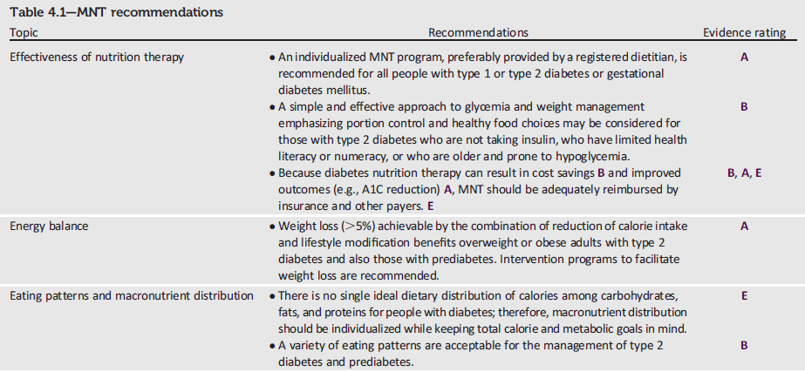
Nutrition: Recommendations
Lifestyle Management:
Standards of Medical Care in Diabetes - 2018. Diabetes Care 2018; 41 (Suppl. 1): S38-S50
Notes:
[SLIDE]
76

Slide 77
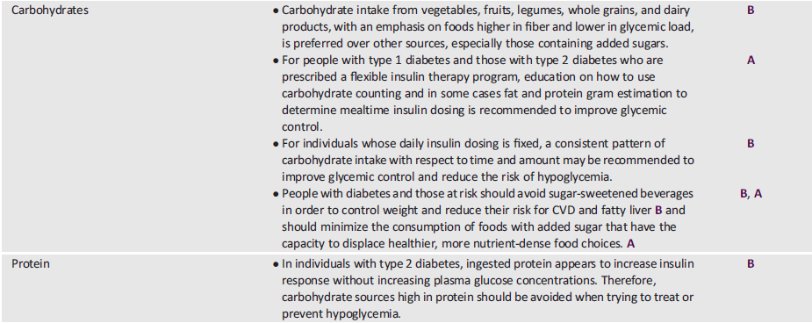
Nutrition: Recommendations (2)
Lifestyle Management:
Standards of Medical Care in Diabetes - 2018. Diabetes Care 2018; 41 (Suppl. 1): S38-S50
Notes:
[SLIDE]
77

Slide 78
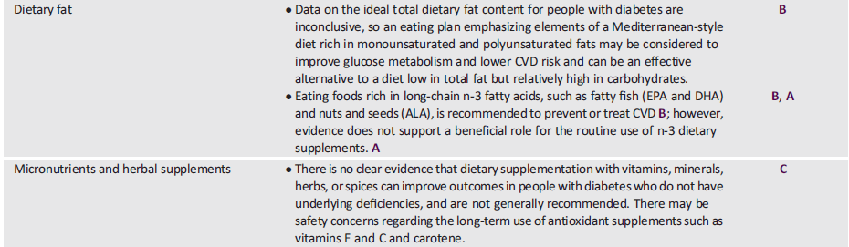
Nutrition: Recommendations (3)
Lifestyle Management:
Standards of Medical Care in Diabetes - 2018. Diabetes Care 2018; 41 (Suppl. 1): S38-S50
Notes:
[SLIDE]
78

Slide 79
Nutrition: Recommendations (3)
Lifestyle Management:
Standards of Medical Care in Diabetes - 2018. Diabetes Care 2018; 41 (Suppl. 1): S38-S50
Notes:
[SLIDE]
79

Slide 80
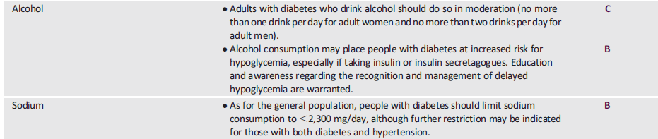

Nutrition: Recommendations (4)
Lifestyle Management:
Standards of Medical Care in Diabetes - 2018. Diabetes Care 2018; 41 (Suppl. 1): S38-S50
Notes:
[SLIDE]
80

Slide 81
Physical Activity: Recommendations
Children and adolescents with diabetes or prediabetes should engage in 60 min/day or more of moderate- or vigorous-intensity aerobic activity, with vigorous muscle-strengthening and bone-strengthening activities at least 3 days/week. C
Most adults with type 1 C and type 2 B diabetes should engage in 150 min or more of moderate-to-vigorous intensity aerobic activity per week, spread over at least 3 days/week, with no more than 2 consecutive days without activity. Shorter durations (minimum 75 min/week) of vigorous-intensity or interval training may be sufficient for younger and more physically fit individuals.
Lifestyle Management:
Standards of Medical Care in Diabetes - 2018. Diabetes Care 2018; 41 (Suppl. 1): S38-S50
Notes:
Recommendations for physical activity for people with diabetes are summarized on this slide and the next:
• Children and adolescents with diabetes or prediabetes should engage in 60 min/day or more of moderate- or vigorous-intensity aerobic activity, with vigorous muscle-strengthening and bone-strengthening activities at least 3
days/week. C [Click]
Most adults with type 1 C and type 2 B diabetes should engage in 150 min or more of moderate-to-vigorous intensity aerobic activity per week, spread over at least 3 days/week, with no more than 2 consecutive days without activity. Shorter durations (minimum 75 min/week) of vigorous-intensity or interval training may be sufficient for younger and more physically fit individuals.
[SLIDE]
81
References
American Diabetes Association. Standards of medical care in diabetes—2014. Diabetes Care 2014;37(suppl 1):S31
Knowler WC, Barrett-Connor E, Fowler SE, et al, for the Diabetes Prevention Program Research Group. Reduction in the incidence of type 2 diabetes with lifestyle intervention or metformin. N Engl J Med 2002;346:393–403
Tuomilehto J, Lindström J, Eriksson JG, et al.; Finnish Diabetes Prevention Study Group. Prevention of type 2 diabetes mellitus by changes in lifestyle among subjects with impaired glucose tolerance. N Engl J Med 2001;344:1343–1350
Pan XR, Li GW, Hu YH, et al. Effects of diet and exercise in preventing NIDDM in people with impaired glucose tolerance. The Da Qing IGT and Diabetes Study. Diabetes Care 1997;20:537–544
Colberg SR, Sigal RJ, Fernhall B, et al. Exercise and type 2 diabetes. The American Collegoe of Sports Medicine and the American Diabetes Association: joint position statement. Diabetes Care 2010;33:2692–2696

Slide 82
Recommendations: Physical Activity (2)
Adults with type 1 C and type 2 B diabetes should engage in 2-3 sessions/week of resistance exercise on nonconsecutive days.
All adults, and particularly those with type 2 diabetes, should decrease the amount of time spent in daily sedentary behavior. B Prolonged sitting should be interrupted every 30 min for blood glucose benefits, particularly in adults with type 2 diabetes. C
Flexibility training and balance training are recommended 2–3 times/week for older adults with diabetes. Yoga and tai chi may be included based on individual preferences to increase flexibility, muscular strength, and balance. C
Lifestyle Management:
Standards of Medical Care in Diabetes - 2018. Diabetes Care 2018; 41 (Suppl. 1): S38-S50
Notes:
• Adults with type 1 C and type 2 B diabetes should engage in 2-3 sessions/week of resistance exercise on nonconsecutive days. [Click]
All adults, and particularly those with type 2 diabetes, should decrease the amount of time spent in daily sedentary behavior. B Prolonged sitting should be interrupted every 30 min for blood glucose benefits, particularly in adults with type 2 diabetes. C
Flexibility training and balance training are recommended 2–3 times/week for older adults with diabetes. Yoga and tai chi may be included based on individual preferences to increase flexibility, muscular strength, and balance. C
[SLIDE]
82
References
American Diabetes Association. Standards of medical care in diabetes—2014. Diabetes Care 2014;37(suppl 1):S31
Knowler WC, Barrett-Connor E, Fowler SE, et al, for the Diabetes Prevention Program Research Group. Reduction in the incidence of type 2 diabetes with lifestyle intervention or metformin. N Engl J Med 2002;346:393–403
Tuomilehto J, Lindström J, Eriksson JG, et al.; Finnish Diabetes Prevention Study Group. Prevention of type 2 diabetes mellitus by changes in lifestyle among subjects with impaired glucose tolerance. N Engl J Med 2001;344:1343–1350
Pan XR, Li GW, Hu YH, et al. Effects of diet and exercise in preventing NIDDM in people with impaired glucose tolerance. The Da Qing IGT and Diabetes Study. Diabetes Care 1997;20:537–544
Colberg SR, Sigal RJ, Fernhall B, et al. Exercise and type 2 diabetes. The American Collegoe of Sports Medicine and the American Diabetes Association: joint position statement. Diabetes Care 2010;33:2692–2696

Slide 83
Recommendations: Smoking Cessation
Advise all patients not to use cigarettes and other tobacco products A or e-cigarettes. E
Include smoking cessation counseling and other forms of treatment as a routine component of diabetes care. B
Lifestyle Management:
Standards of Medical Care in Diabetes - 2018. Diabetes Care 2018; 41 (Suppl. 1): S38-S50
Notes:
The Association offers two key recommendations in the areas of tobacco and e-cigarettes. First, do advise all patients not to use cigarettes, other tobacco products, or e-cigarettes. This last one – e-cigarettes– is hard, but there just are no rigorous studies demonstrating that e-cigarettes are a healthier alternative to smoking or that e-cigarettes can facilitate smoking cessation. More extensive research of their short- and long-term effects is needed to determine their safety and their cardiopulmonary effects in comparison with smoking and standard approaches to smoking cessation so the Association recommends against their use.
And secondly, do include smoking cessation counseling and other forms of treatment as a routine component of diabetes care.
[SLIDE]
83

Slide 84
Psychosocial Issues: Recommendations
Psychosocial care should be integrated with a collaborative, patient-centered approach and provided to all people with diabetes, with the goals of optimizing health outcomes and health-related quality of life (QOL). A
Psychosocial screening and follow-up may include, but are not limited to, attitudes about diabetes, expectations for medical management and outcomes, affect or mood, general and diabetes-related QOL, available resources (financial, social, and emotional), and psychiatric history. E
Lifestyle Management:
Standards of Medical Care in Diabetes - 2018. Diabetes Care 2018; 41 (Suppl. 1): S38-S50
Notes:
Emotional well-being is an important part of diabetes care and self-management. Psychological and social problems can impair the individual’s or family’s ability to carry out diabetes care tasks and therefore compromise health status. The Association offers several recommendations for addressing psychosocial issues, comprised on the next two slides:
Psychosocial care should be integrated with a collaborative, patient-centered approach and provided to all people with diabetes, with the goals of optimizing health outcomes and health-related quality of life (QOL). A
Psychosocial screening and follow-up may include, but are not limited to, attitudes about diabetes, expectations for medical management and outcomes, affect or mood, general and diabetes-related QOL, available resources (financial, social, and emotional), and psychiatric history. E
[SLIDE]
84

Slide 85
Psychosocial Issues: Recommendations (2)
Providers should consider assessment for symptoms of diabetes distress, depression, anxiety, disordered eating, and cognitive capacities using patient-appropriate standardized and validated tools at the initial visit, at periodic intervals, and when there is a change in disease, treatment, or life circumstance. Including caregivers and family members in this assessment is recommended. B
Consider screening older adults (aged ≥65 years) with diabetes for cognitive impairment and depression. B
Lifestyle Management:
Standards of Medical Care in Diabetes - 2018. Diabetes Care 2018; 41 (Suppl. 1): S38-S50
Notes:
Providers should consider assessment for symptoms of diabetes distress, depression, anxiety, disordered eating, and cognitive capacities using patient-appropriate standardized and validated tools at the initial visit, at periodic intervals, and when there is a change in disease, treatment, or life circumstance. Including caregivers and family members in this assessment is recommended. B
Consider screening older adults (aged ≥65 years) with diabetes for cognitive impairment and depression. B
[SLIDE]
85

Slide 86
Diabetes Distress
Diabetes distress
  Very common and distinct from other psychological disorders
  Negative psychological reactions related to emotional burdens of managing a demanding chronic disease
Recommendation:
  Routinely monitor people with diabetes for diabetes distress, particularly when treatment targets are not met and/or at the onset of diabetes complications. B
Lifestyle Management:
Standards of Medical Care in Diabetes - 2018. Diabetes Care 2018; 41 (Suppl. 1): S38-S50
Notes:
And now on to diabetes distress, which is very common and, importantly, distinct from other psychological disorders. Diabetes distress is defined as significant negative psychological reactions related to emotional burdens and worries specific to an individual’s experience in having to manage a severe, complicated, and demanding chronic disease such as diabetes.
The ADA recommends routinely monitoring people with diabetes for diabetes distress, particularly when treatment targets are not met and/or at the onset
of diabetes complications. B
If diabetes distress is identified, the person should be referred for specific diabetes education to address areas of diabetes self-care that are most relevant to the patient.
[SLIDE]
86

Slide 87
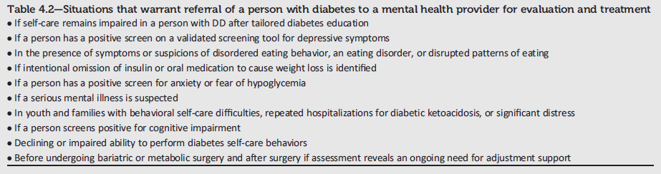
Referral for Psychosocial Care
Lifestyle Management:
Standards of Medical Care in Diabetes - 2018. Diabetes Care 2018; 41 (Suppl. 1): S38-S50
Notes:
And finally, here is a list of some specific situations that would warrant referral of a person with diabetes to a mental health provider for evaluation and treatment.
[SLIDE]
87

Slide 88
5. Prevention or Delay
of Type 2 Diabetes
Notes:
Now we are going to move on to section five, on the prevention or delay of type 2 diabetes.
[SLIDE]
88

Slide 89
Prevention or Delay of T2DM: Recommendations
At least annual monitoring for the development of diabetes in those with prediabetes is suggested. E
Patients with prediabetes should be referred to an intensive behavioral lifestyle intervention program modeled on the Diabetes Prevention Program to achieve and maintain 7% loss of initial body weight and increase moderate-intensity physical activity (such as brisk walking) to at least 150 min/week. A
Prevention or Delay of Type 2 Diabetes:
Standards of Medical Care in Diabetes - 2018. Diabetes Care 2018; 41 (Suppl. 1): S51-S54
Notes:
Guidelines related to screening for increased risk for type 2 diabetes (prediabetes) was previously discussed when reviewing recommendations from Section 2 “Classification and Diagnosis of Diabetes.” Section 5 provides some additional recommendations to consider for the prevention or delay of type 2 diabetes. Recommendations from this section are provided in this and the following series of slides.
At least annual monitoring for the development of diabetes in those with prediabetes is suggested. E
Patients with prediabetes should be referred to an intensive behavioral lifestyle intervention program modeled on the Diabetes Prevention Program to achieve and maintain 7% loss of initial body weight and increase moderate-intensity physical activity (such as brisk walking) to at least 150 min/week. A
[SLIDE]
89
References
American Diabetes Association. Standards of medical care in diabetes—2014. Diabetes Care 2014;37(suppl 1):S20
Knowler WC, Barrett-Connor E, Fowler SE,et al. Diabetes Prevention Program Research Group. Reduction in the incidence of type 2 diabetes with lifestyle intervention or metformin. N Engl J Med 2002;346:393–403
Tuomilehto J, Lindström J, Eriksson JG, et al. Finnish Diabetes Prevention Study Group. Prevention of type 2 diabetes mellitus by changes in lifestyle among subjects with impaired glucose tolerance. N Engl J Med 2001;344:1343–1350
Pan XR, Li GW, Hu YH, et al. Effects of diet and exercise in preventing NIDDM in people with impaired glucose tolerance. The Da Qing IGT and Diabetes Study. Diabetes Care 1997;20:537–544
Buchanan TA, Xiang AH, Peters RK, et al. Preservation of pancreatic beta-cell function and prevention of type 2 diabetes by pharmacological treatment of insulin resistance in high-risk Hispanic women. Diabetes 2002;51:2796–2803
Chiasson JL, Josse RG, Gomis R, Hanefeld M, Karasik A, Laakso M; STOP-NIDDM Trial Research Group. Acarbose for prevention of type 2 diabetes mellitus: the STOP-NIDDM randomised trial. Lancet 2002; 359:2072–2077
Gerstein HC, Yusuf S, Bosch J, et al.; DREAM (Diabetes REduction Assessment with ramipril and rosiglitazone Medication) Trial Investigators. Effect of rosiglitazone on the frequency of diabetes in patients with impaired glucose tolerance or impaired fasting glucose: a randomised controlled trial. Lancet 2006;368:1096–1105
Ramachandran A, Snehalatha C, Mary S, Mukesh B, Bhaskar AD, Vijay V; Indian Diabetes Prevention Programme (IDPP) The Indian Diabetes Prevention Programme shows that lifestyle modification and metformin prevent type 2 diabetes in Asian Indian subjects with impaired glucose tolerance (IDPP-1). Diabetologia 2006;49:289–297

Slide 90
Prevention or Delay of T2DM: Recommendations (2)
Technology-assisted tools including Internet-based social networks, distance learning, and mobile applications that incorporate bidirectional communication may be useful elements of effective lifestyle modification to prevent diabetes. B
Given the cost-effectiveness of diabetes prevention, such intervention programs should be covered by third-party payers. B
Prevention or Delay of Type 2 Diabetes:
Standards of Medical Care in Diabetes - 2018. Diabetes Care 2018; 41 (Suppl. 1): S51-S54
Notes:
Technology-assisted tools including Internet-based social networks, distance learning, and mobile applications that incorporate bidirectional communication may be useful elements of effective lifestyle modification to prevent diabetes. B
Given the cost-effectiveness of diabetes prevention, such intervention programs should be covered by third-party payers. B
[SLIDE]
90
References
American Diabetes Association. Standards of medical care in diabetes—2014. Diabetes Care 2014;37(suppl 1):S20
Knowler WC, Barrett-Connor E, Fowler SE,et al. Diabetes Prevention Program Research Group. Reduction in the incidence of type 2 diabetes with lifestyle intervention or metformin. N Engl J Med 2002;346:393–403
Tuomilehto J, Lindström J, Eriksson JG, et al. Finnish Diabetes Prevention Study Group. Prevention of type 2 diabetes mellitus by changes in lifestyle among subjects with impaired glucose tolerance. N Engl J Med 2001;344:1343–1350
Pan XR, Li GW, Hu YH, et al. Effects of diet and exercise in preventing NIDDM in people with impaired glucose tolerance. The Da Qing IGT and Diabetes Study. Diabetes Care 1997;20:537–544
Buchanan TA, Xiang AH, Peters RK, et al. Preservation of pancreatic beta-cell function and prevention of type 2 diabetes by pharmacological treatment of insulin resistance in high-risk Hispanic women. Diabetes 2002;51:2796–2803
Chiasson JL, Josse RG, Gomis R, Hanefeld M, Karasik A, Laakso M; STOP-NIDDM Trial Research Group. Acarbose for prevention of type 2 diabetes mellitus: the STOP-NIDDM randomised trial. Lancet 2002; 359:2072–2077
Gerstein HC, Yusuf S, Bosch J, et al.; DREAM (Diabetes REduction Assessment with ramipril and rosiglitazone Medication) Trial Investigators. Effect of rosiglitazone on the frequency of diabetes in patients with impaired glucose tolerance or impaired fasting glucose: a randomised controlled trial. Lancet 2006;368:1096–1105
Ramachandran A, Snehalatha C, Mary S, Mukesh B, Bhaskar AD, Vijay V; Indian Diabetes Prevention Programme (IDPP) The Indian Diabetes Prevention Programme shows that lifestyle modification and metformin prevent type 2 diabetes in Asian Indian subjects with impaired glucose tolerance (IDPP-1). Diabetologia 2006;49:289–297

Slide 91
Pharmacologic Interventions for Prevention: Recommendations
Metformin therapy for prevention of type 2 diabetes should be considered in those with prediabetes, especially for those with BMI ≥35 kg/m², those aged <60 years, and women with prior GDM. A
Long-term use of metformin may be associated with biochemical vitamin B12 deficiency, and periodic measurement of vitamin B12 levels should be considered in metformin-treated patients, especially in those with anemia or peripheral neuropathy. B
Prevention or Delay of Type 2 Diabetes:
Standards of Medical Care in Diabetes - 2018. Diabetes Care 2018; 41 (Suppl. 1): S51-S54
Notes:
The following recommendations are presented in the 2018 Standards as related to use of metformin for the prevention of diabetes:
Metformin therapy for prevention of type 2 diabetes should be considered in those with prediabetes, especially for those with BMI ≥35 kg/m², those aged <60 years, and women with prior GDM. A
Long-term use of metformin may be associated with biochemical vitamin B12 deficiency, and periodic measurement of vitamin B12 levels should be considered in metformin-treated patients, especially in those with anemia or peripheral neuropathy. B
[SLIDE]
91
References
American Diabetes Association. Standards of medical care in diabetes—2014. Diabetes Care 2014;37(suppl 1):S20
Knowler WC, Barrett-Connor E, Fowler SE,et al. Diabetes Prevention Program Research Group. Reduction in the incidence of type 2 diabetes with lifestyle intervention or metformin. N Engl J Med 2002;346:393–403
Tuomilehto J, Lindström J, Eriksson JG, et al. Finnish Diabetes Prevention Study Group. Prevention of type 2 diabetes mellitus by changes in lifestyle among subjects with impaired glucose tolerance. N Engl J Med 2001;344:1343–1350
Pan XR, Li GW, Hu YH, et al. Effects of diet and exercise in preventing NIDDM in people with impaired glucose tolerance. The Da Qing IGT and Diabetes Study. Diabetes Care 1997;20:537–544
Buchanan TA, Xiang AH, Peters RK, et al. Preservation of pancreatic beta-cell function and prevention of type 2 diabetes by pharmacological treatment of insulin resistance in high-risk Hispanic women. Diabetes 2002;51:2796–2803
Chiasson JL, Josse RG, Gomis R, Hanefeld M, Karasik A, Laakso M; STOP-NIDDM Trial Research Group. Acarbose for prevention of type 2 diabetes mellitus: the STOP-NIDDM randomised trial. Lancet 2002; 359:2072–2077
Gerstein HC, Yusuf S, Bosch J, et al.; DREAM (Diabetes REduction Assessment with ramipril and rosiglitazone Medication) Trial Investigators. Effect of rosiglitazone on the frequency of diabetes in patients with impaired glucose tolerance or impaired fasting glucose: a randomised controlled trial. Lancet 2006;368:1096–1105
Ramachandran A, Snehalatha C, Mary S, Mukesh B, Bhaskar AD, Vijay V; Indian Diabetes Prevention Programme (IDPP) The Indian Diabetes Prevention Programme shows that lifestyle modification and metformin prevent type 2 diabetes in Asian Indian subjects with impaired glucose tolerance (IDPP-1). Diabetologia 2006;49:289–297

Slide 92
Prevention of CVD in Prediabetes: Recommendation
Screening for and treatment of modifiable risk factors for cardiovascular disease is suggested for those with prediabetes. B
Prevention or Delay of Type 2 Diabetes:
Standards of Medical Care in Diabetes - 2018. Diabetes Care 2018; 41 (Suppl. 1): S51-S54
Notes:
People with prediabetes often have other cardiovascular risk factors, including hypertension and dyslipidemia, and are at increased risk for cardiovascular disease. Although treatment goals for people with prediabetes are the same as for the
general population, increased vigilance is warranted to identify and treat these and other cardiovascular risk factors (e.g., smoking).
[SLIDE]
92
References
American Diabetes Association. Standards of medical care in diabetes—2014. Diabetes Care 2014;37(suppl 1):S20
Knowler WC, Barrett-Connor E, Fowler SE,et al. Diabetes Prevention Program Research Group. Reduction in the incidence of type 2 diabetes with lifestyle intervention or metformin. N Engl J Med 2002;346:393–403
Tuomilehto J, Lindström J, Eriksson JG, et al. Finnish Diabetes Prevention Study Group. Prevention of type 2 diabetes mellitus by changes in lifestyle among subjects with impaired glucose tolerance. N Engl J Med 2001;344:1343–1350
Pan XR, Li GW, Hu YH, et al. Effects of diet and exercise in preventing NIDDM in people with impaired glucose tolerance. The Da Qing IGT and Diabetes Study. Diabetes Care 1997;20:537–544
Buchanan TA, Xiang AH, Peters RK, et al. Preservation of pancreatic beta-cell function and prevention of type 2 diabetes by pharmacological treatment of insulin resistance in high-risk Hispanic women. Diabetes 2002;51:2796–2803
Chiasson JL, Josse RG, Gomis R, Hanefeld M, Karasik A, Laakso M; STOP-NIDDM Trial Research Group. Acarbose for prevention of type 2 diabetes mellitus: the STOP-NIDDM randomised trial. Lancet 2002; 359:2072–2077
Gerstein HC, Yusuf S, Bosch J, et al.; DREAM (Diabetes REduction Assessment with ramipril and rosiglitazone Medication) Trial Investigators. Effect of rosiglitazone on the frequency of diabetes in patients with impaired glucose tolerance or impaired fasting glucose: a randomised controlled trial. Lancet 2006;368:1096–1105
Ramachandran A, Snehalatha C, Mary S, Mukesh B, Bhaskar AD, Vijay V; Indian Diabetes Prevention Programme (IDPP) The Indian Diabetes Prevention Programme shows that lifestyle modification and metformin prevent type 2 diabetes in Asian Indian subjects with impaired glucose tolerance (IDPP-1). Diabetologia 2006;49:289–297

Slide 93
DSMES in People with Prediabetes: Recommendations
DSMES programs may be appropriate venues for people with prediabetes to receive education and support to develop and maintain behaviors that can prevent or delay the development of type 2 diabetes. B
Prevention or Delay of Type 2 Diabetes:
Standards of Medical Care in Diabetes - 2018. Diabetes Care 2018; 41 (Suppl. 1): S51-S54
Notes:
Finally, both diabetes self-management education and support programs may be appropriate venues for people with prediabetes to receive education and support to develop and maintain behaviors that can prevent or delay the development of type 2 diabetes. B
[SLIDE]
93
References
American Diabetes Association. Standards of medical care in diabetes—2014. Diabetes Care 2014;37(suppl 1):S20
Knowler WC, Barrett-Connor E, Fowler SE,et al. Diabetes Prevention Program Research Group. Reduction in the incidence of type 2 diabetes with lifestyle intervention or metformin. N Engl J Med 2002;346:393–403
Tuomilehto J, Lindström J, Eriksson JG, et al. Finnish Diabetes Prevention Study Group. Prevention of type 2 diabetes mellitus by changes in lifestyle among subjects with impaired glucose tolerance. N Engl J Med 2001;344:1343–1350
Pan XR, Li GW, Hu YH, et al. Effects of diet and exercise in preventing NIDDM in people with impaired glucose tolerance. The Da Qing IGT and Diabetes Study. Diabetes Care 1997;20:537–544
Buchanan TA, Xiang AH, Peters RK, et al. Preservation of pancreatic beta-cell function and prevention of type 2 diabetes by pharmacological treatment of insulin resistance in high-risk Hispanic women. Diabetes 2002;51:2796–2803
Chiasson JL, Josse RG, Gomis R, Hanefeld M, Karasik A, Laakso M; STOP-NIDDM Trial Research Group. Acarbose for prevention of type 2 diabetes mellitus: the STOP-NIDDM randomised trial. Lancet 2002; 359:2072–2077
Gerstein HC, Yusuf S, Bosch J, et al.; DREAM (Diabetes REduction Assessment with ramipril and rosiglitazone Medication) Trial Investigators. Effect of rosiglitazone on the frequency of diabetes in patients with impaired glucose tolerance or impaired fasting glucose: a randomised controlled trial. Lancet 2006;368:1096–1105
Ramachandran A, Snehalatha C, Mary S, Mukesh B, Bhaskar AD, Vijay V; Indian Diabetes Prevention Programme (IDPP) The Indian Diabetes Prevention Programme shows that lifestyle modification and metformin prevent type 2 diabetes in Asian Indian subjects with impaired glucose tolerance (IDPP-1). Diabetologia 2006;49:289–297

Slide 94
6. Glycemic Targets
Notes:
We will now shift our discussion to Section 6: Glycemic Targets.
[SLIDE]
94

Slide 95
Assessment of Glycemic Control
Two primary techniques are available for health providers and patients to assess the effectiveness of a management plan on glycemic control:
  Patient self-monitoring of blood glucose (SMBG)
  A1C
Continuous glucose monitoring (CGM) also has an important role in assessing the efficacy and safety of treatment in subgroups of patients with T1DM and in selected patients with T2DM.
  Data indicate similar A1C and safety with the use of CGM compared with SMBG.
Glycemic Targets:
Standards of Medical Care in Diabetes - 2018. Diabetes Care 2018; 41 (Suppl. 1): S55-S64
Notes:
In addition to an initial evaluation and management, diabetes care requires an assessment of glycemic control.
Two primary techniques are available for health providers and patients to assess the effectiveness of a management plan on glycemic control:
Patient self-monitoring of blood glucose (SMBG)
A1C
Continuous glucose monitoring (CGM) also has an important role in assessing the efficacy and safety of treatment in subgroups of patients with T1DM and in selected patients with T2DM.
Data indicate similar A1C and safety with the use of CGM compared with SMBG.
Recommendations for glucose monitoring, A1C testing, correlation of A1C with average glucose, glycemic goals in adults, intensive glycemic control and cardiovascular outcomes, and recommended glycemic goals for many nonpregnant adults with diabetes as well as glycemic goals in pregnant women are summarized in the following slides.
[SLIDE]
95
Reference
American Diabetes Association. Standards of medical care in diabetes—2014. Diabetes Care 2014;37(suppl 1):S21

Slide 96
Flash CGM
New
intermittent or “flash” CGM device that
was recently approved for adult use.

Slide 97
Glucose Monitoring: Recommendations
Most patients using intensive insulin regimens (multiple-dose insulin or insulin pump therapy) should perform SMBG: B
  Prior to meals and snacks
  At bedtime
  Occasionally postprandially
  Prior to exercise
  When they suspect low blood glucose
  After treating low blood glucose until they are normoglycemic
  Prior to critical tasks such as driving
Glycemic Targets:
Standards of Medical Care in Diabetes - 2018. Diabetes Care 2018; 41 (Suppl. 1): S55-S64
Notes:
The 2018 Standards of Care provide several recommendations related to assessment of glycemic control. These recommendations include the following:
Patients on multiple-dose insulin (MDI) or insulin pump therapy should do SMBG prior to meals and snacks, at bedtime, occasionally postprandially, prior to exercise, when they suspect low blood glucose, after treating low blood glucose until they are normoglycemic, and prior to critical tasks such as driving This may mean testing 6-10 times per day, though individual needs vary. But at least in studies of children with type 1 diabetes, increased daily frequency of SMBG was significantly associated with lower A1C.
SMBG frequency and timing should be dictated by the patient’s specific needs and goals
SMBG is especially important for patients treated with insulin to monitor for and prevent asymptomatic hypoglycemia and hyperglycemia
[SLIDE]
97
Reference
American Diabetes Association. Standards of medical care in diabetes—2014. Diabetes Care 2014;37(suppl 1):S21

Slide 98
Glucose Monitoring: Recommendations (2)
When prescribed as part of a broad educational program, SMBG may help to guide treatment decisions and/or self-management for patients taking less frequent insulin injections B or noninsulin therapies. E
When prescribing SMBG, ensure that patients receive ongoing instruction and regular evaluation of SMBG technique, SMBG results, and their ability to use SMBG data to adjust therapy. E
Glycemic Targets:
Standards of Medical Care in Diabetes - 2018. Diabetes Care 2018; 41 (Suppl. 1): S55-S64
Notes:
When prescribed as part of a broad educational program, SMBG may help to guide treatment decisions and/or self-management for patients taking less frequent insulin injections B or noninsulin therapies. E
When prescribing SMBG, ensure that patients receive ongoing instruction and regular evaluation of SMBG technique, SMBG results, and their ability to use SMBG data to adjust therapy. E
[SLIDE]
98
Reference
American Diabetes Association. Standards of medical care in diabetes—2014. Diabetes Care 2014;37(suppl 1):S21–S22

Slide 99
Glucose Monitoring: Recommendations (3)
When used properly, CGM in conjunction with intensive insulin regimens is a useful tool to lower A1C in adults with type 1 diabetes who are not meeting glycemic targets. A
CGM may be a useful tool in those with hypoglycemia unawareness and/or frequent hypoglycemic episodes. C
Given the variable adherence to CGM, assess individual readiness for continuing CGM use prior to prescribing. E
Glycemic Targets:
Standards of Medical Care in Diabetes - 2018. Diabetes Care 2018; 41 (Suppl. 1): S55-S64
Notes:
When used properly, CGM in conjunction with intensive insulin regimens is a useful tool to lower A1C in adults with type 1 diabetes who are not meeting glycemic targets. A
CGM may be a useful tool in those with hypoglycemia unawareness and/or frequent hypoglycemic episodes. C
Given the variable adherence to CGM, assess individual readiness for continuing CGM use prior to prescribing. E
[SLIDE]
99
References
American Diabetes Association. Standards of medical care in diabetes—2014. Diabetes Care 2014;37(suppl 1):S21–S22
Tamborlane WV, Beck RW, Bode BW, et al for the Juvenile Diabetes Research Foundation Continuous Glucose Monitoring Study Group. Continuous glucose monitoring and intensive treatment of type 1 diabetes. N Engl J Med 2008;359:1464–1476
Yeh HC, Brown TT, Maruthur N, et al. Comparative effectiveness and safety of methods of insulin delivery and glucose monitoring for diabetes mellitus: a systematic review and meta-analysis. Ann Intern Med 2012;157:336–347

Slide 100
Glucose Monitoring: Recommendations (4)
When prescribing CGM, robust diabetes education, training, and support are required for optimal CGM implementation and ongoing use. E
People who have been successfully using CGM should have continued access after they turn 65 years of age. E
Glycemic Targets:
Standards of Medical Care in Diabetes - 2018. Diabetes Care 2018; 41 (Suppl. 1): S55-S64
Notes:
When prescribing CGM, robust diabetes education, training, and support are required for optimal CGM implementation and ongoing use. E
People who have been successfully using CGM should have continued access after they turn 65 years of age. E
[SLIDE]
100
References
American Diabetes Association. Standards of medical care in diabetes—2014. Diabetes Care 2014;37(suppl 1):S21–S22
Tamborlane WV, Beck RW, Bode BW, et al for the Juvenile Diabetes Research Foundation Continuous Glucose Monitoring Study Group. Continuous glucose monitoring and intensive treatment of type 1 diabetes. N Engl J Med 2008;359:1464–1476
Yeh HC, Brown TT, Maruthur N, et al. Comparative effectiveness and safety of methods of insulin delivery and glucose monitoring for diabetes mellitus: a systematic review and meta-analysis. Ann Intern Med 2012;157:336–347

Slide 101
A1C Testing: Recommendations
Perform the A1C test at least two times a year in patients who are meeting treatment goals (and who have stable glycemic control). E
Perform the A1C test quarterly in patients whose therapy has changed or who are not meeting glycemic goals. E
Point-of-care testing for A1C provides the opportunity for more timely treatment changes. E
Glycemic Targets:
Standards of Medical Care in Diabetes - 2018. Diabetes Care 2018; 41 (Suppl. 1): S55-S64
Notes:
A1C reflects average glycemia over several months and has strong predictive value for diabetes complications. Thus, A1C testing should be performed routinely in all patients with diabetes—at initial assessment and as part of continuing care. Measurement about every 3 months determines whether patients’ glycemic targets have been reached and maintained, though the frequency of A1C testing should depend on the clinical situation, the treatment regimen, and the clinician’s judgment.
For your patients meeting treatment goals and with stable control, check the A1C at least twice a year, and for your patients whose therapy has changed or who aren’t meeting glycemic goals, test quarterly. You may also have patients who are unstable or highly intensively managed, such as pregnant women with type 1, whom you may wish to test more frequently than every 3 months.
Point of care A1C testing can help accommodate more timely decisions, for example on when to change therapy.
The A1C test is subject to certain limitations: conditions that affect erythrocyte turnover (e.g., hemolysis, blood loss) and hemoglobin variants must be considered, particularly when the A1C result does not correlate with the patient’s clinical situation; in addition, A1C does not provide a measure of glycemic variability or hypoglycemia. For patients prone to glycemic variability (especially type 1 diabetic patients, or type 2 diabetic patients with severe insulin deficiency), glycemic control is best judged by the combination of result of self-monitoring of blood glucose (SMBG) testing and A1C.
The A1C may also confirm the accuracy of a patient’s meter (or the patient’s reported SMBG results) and the adequacy of the SMBG testing schedule
[SLIDE]
101
References
American Diabetes Association. Standards of medical care in diabetes—2014. Diabetes Care 2014;37(suppl 1):S22–S23
Sacks DB, Arnold M, Bakris GL, et al. National Academy of Clinical Biochemistry. Position statement executive summary: guidelines and recommendations for laboratory analysis in the diagnosis and management of diabetes mellitus. Diabetes Care 2011;34:1419–1423

Slide 102
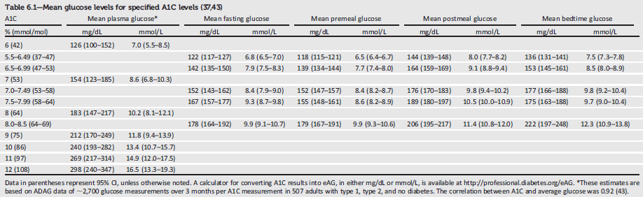
Mean Glucose Levels for Specified A1C Levels
professional.diabetes.org/eAG
Glycemic Targets:
Standards of Medical Care in Diabetes - 2018. Diabetes Care 2018; 41 (Suppl. 1): S55-S64
Notes:
This slide shows the correlation between A1C and mean plasma glucose levels based on data from the international A1C-Derived Average Glucose (ADAG) trial. The trial used frequent SMBG and continuous glucose monitoring in 507 adults with type 1, type 2, and no diabetes.
The Association and the American Association for Clinical Chemistry have determined that the correlation (r = 0.92) is strong enough to justify reporting both an A1C result and an estimated average glucose (eAG) results when a clinician orders the A1C test
For patients in whom A1C/eAG and measured blood glucose appear discrepant, clinicians should consider the possibilities of hemoglobinopathy or altered red cell turnover, and the options of more frequent and/or different timing of SMBG or use of CGM
Other measures of chronic glycemia such as fructosamine are available, but their linkage to average glucose and their prognostic significance are not as clear as is the case for A1C
[CLICK]
You can access a calculator for converting A1C results into eAG, in either mg/dL or mmol/L, at professional.diabetes.org/eAG
[SLIDE]
102
References
Nathan DM, Kuenen J, Borg R, et al for the A1C-Derived Average Glucose Study Group. Translating the A1C assay into estimated average glucose values. Diabetes Care 2008;31:1473–1478
American Diabetes Association. Standards of medical care in diabetes—2014. Diabetes Care 2014;37(suppl 1):S23; Table 8

Slide 103
A1C Goals in Adults: Recommendations
A reasonable A1C goal for many nonpregnant adults is <7% (53 mmol/mol). A
Providers might reasonably suggest more stringent A1C goals (such as <6.5%) for select individual patients if this can be achieved without significant hypoglycemia or other adverse effects of treatment (i.e., polypharmacy). Appropriate patients might include those with short duration of diabetes, type 2 diabetes treated with lifestyle or metformin only, long life expectancy, or no significant cardiovascular disease. C
Glycemic Targets:
Standards of Medical Care in Diabetes - 2018. Diabetes Care 2018; 41 (Suppl. 1): S55-S64
Notes:
We’ll discuss glycemic goals in children and adolescents and in pregnant women in the sections specific to care of those populations. These slides are specific to nonpregnant adults.
Hyperglycemia defines diabetes, and glycemic control is fundamental to diabetes management. The concerning mortality findings from the ACCORD trial and the relatively intense efforts required to achieve near-euglycemia should also be considered when setting glycemic targets.
The following recommendations are set forth in the 2018 ADA Standards of Care as related to A1C goal setting in adults:
A reasonable A1C goal for many nonpregnant adults is <7% (53 mmol/mol). A
Providers might reasonably suggest more stringent A1C goals (such as <6.5%) for select individual patients if this can be achieved without significant hypoglycemia or other adverse effects of treatment (i.e., polypharmacy). Appropriate patients might include those with short duration of diabetes, type 2 diabetes treated with lifestyle or metformin only, long life expectancy, or no significant cardiovascular disease. C
[SLIDE]
103
References
American Diabetes Association. Standards of medical care in diabetes—2014. Diabetes Care 2014;37(suppl 1):S23
The Diabetes Control and Complications Trial Research Group. The effect of intensive treatment of diabetes on the development and progression of long-term complications in insulin-dependent diabetes mellitus. N Engl J Med 1993;329:977–986
The Diabetes Control and Complications Trial/Epidemiology of Diabetes Interventions and Complications Research Group. Retinopathy and nephropathy in patients with type 1 diabetes four years after a trial of intensive therapy. N Engl JMed 2000;342:381–389
Martin CL, Albers J, Herman WH, et al for the DCCT/EDIC Research Group. Neuropathy among the diabetes control and complications trial cohort 8 years after trial completion. Diabetes Care 2006;29:340–344

Slide 104
A1C Goals in Adults: Recommendations (2)
Less stringent goals (such as <8% [64 mmol/mol]) may be appropriate for patients with a history of severe hypoglycemia, limited life expectancy, advanced microvascular or macrovascular complications, or long-standing diabetes in whom the goal is difficult to achieve despite diabetes self-management education, appropriate glucose monitoring, and effective doses of multiple glucose-lowering agents including insulin. B
Glycemic Targets:
Standards of Medical Care in Diabetes - 2018. Diabetes Care 2018; 41 (Suppl. 1): S55-S64
Notes:
Less stringent goals (such as <8% [64 mmol/mol]) may be appropriate for patients with a history of severe hypoglycemia, limited life expectancy, advanced microvascular or macrovascular complications, or long-standing diabetes in whom the goal is difficult to achieve despite diabetes self-management education, appropriate glucose monitoring, and effective doses of multiple glucose-lowering agents including insulin. B
[SLIDE]
104
References
American Diabetes Association. Standards of medical care in diabetes—2014. Diabetes Care 2014;37(suppl 1):S23
The Diabetes Control and Complications Trial Research Group. The effect of intensive treatment of diabetes on the development and progression of long-term complications in insulin-dependent diabetes mellitus. N Engl J Med 1993;329:977–986
The Diabetes Control and Complications Trial/Epidemiology of Diabetes Interventions and Complications Research Group. Retinopathy and nephropathy in patients with type 1 diabetes four years after a trial of intensive therapy. N Engl JMed 2000;342:381–389
Martin CL, Albers J, Herman WH, et al for the DCCT/EDIC Research Group. Neuropathy among the diabetes control and complications trial cohort 8 years after trial completion. Diabetes Care 2006;29:340–344

Slide 105
A1C and CVD Outcomes
DCCT: Trend toward lower risk of CVD events with intensive control (T1DM)
EDIC: 57% reduction in risk of nonfatal MI, stroke, or CVD death (T1DM)
UKPDS: Nonsignificant reduction in CVD events (T2DM).
ACCORD, ADVANCE, VADT suggested no significant reduction in CVD outcomes with intensive glycemic control. (T2DM)
Care.DiabetesJournals.org
Glycemic Targets:
Standards of Medical Care in Diabetes - 2018. Diabetes Care 2018; 41 (Suppl. 1): S55-S64
Notes:
There is evidence for a cardiovascular benefit of intensive glycemic control after long-term follow-up of study cohorts treated early in the course of both type 1 and type 2 diabetes.
Type 1 Diabetes
For example in the Diabetes Control & Complications Trial (DCCT) there was a trend toward lower risk of CVD events with intensive control. In the 9-year post-DCCT follow-up of the Epidemiology of Diabetes Interventions and Complications (EDIC) cohort, participants previously randomized to the intensive arm had a significant 57% reduction in the risk of nonfatal myocardial infarction (MI), stroke, or CVD death compared with those previously in the standard arm.
The benefit of intensive glycemic control in this type 1 diabetic cohort has been shown to persist for several decades and to be associated with a modest reduction in all-cause mortality.
Type 2 Diabetes
During the UKPDS, there was a 16% reduction in CVD events (combined fatal or nonfatal MI and sudden death) in the intensive glycemic control arm that did not reach statistical significance, and there was no suggestion of benefit on other CVD outcomes (e.g., stroke).
The ACCORD, ADVANCE, and VADT suggested no significant reduction in CVD outcomes with intensive glycemic control in participants followed for 3.5−5.6 years who had more advanced type 2 diabetes than UKPDS participants.
Details of these studies are reviewed extensively in the Association’s position statement on intensive glycemic control and the prevention of cardiovascular events, which you can download for free from care.diabetesjournals.org.
[SLIDE]
105

Slide 106









Approach to the Management of Hyperglycemia
Patient/Disease Features
more stringent
A1C
7%
less stringent
Risk of hypoglycemia/drug adverse effects
low
high
Disease Duration
newly diagnosed
long-standing
Life expectancy
long
short
Important comorbidities
absent
Few/mild
severe
Established vascular complications
absent
Few/mild
severe
Patient attitude & expected
treatment efforts
highly motivated, adherent, excellent self-care capabilities
less motivated, nonadherent, poor self-care capabilities
Resources & support system
readily available
limited
Glycemic Targets:
Standards of Medical Care in Diabetes - 2018. Diabetes Care 2018; 41 (Suppl. 1): S55-S64
Notes:
This slide, “Approach to Management of Hyperglycemia,” depicts the elements of decision making used to determine appropriate A1C targets.
You may have seen this before, but in case you haven’t, we’ll walk through it briefly. Going down the left side you see a series of patient or disease characteristics with a corresponding target A1C impact scale on the right. The small end of the triangle aligns with more stringent A1C targets and the fatter end aligns with less stringent A1C targets. So taking the first one as an example, the red triangle: for patients at low risk of hypoglycemia or other adverse drug effects, a more stringent A1C target may be considered, while for those at higher risk, a less stringent A1C target is likely more appropriate.
The patient and disease features are grouped into two categories, the top set consists of factors that are usually not modifiable and the bottom set may be potentially modifiable.
Where possible, decisions about A1C goals should be made in conjunction with the patient, reflecting his or her preferences, needs, and values
[SLIDE]
106
References
American Diabetes Association. Standards of medical care in diabetes—2014. Diabetes Care 2014;37(suppl 1):S25; Figure 1
Ismail-Beigi F, Moghissi E, Tiktin M, Hirsch IB, Inzucchi SE, Genuth S. Individualizing glycemic targets in type 2 diabetes mellitus: implications of recent clinical trials. Ann Intern Med 2011;154:554–559

Slide 107
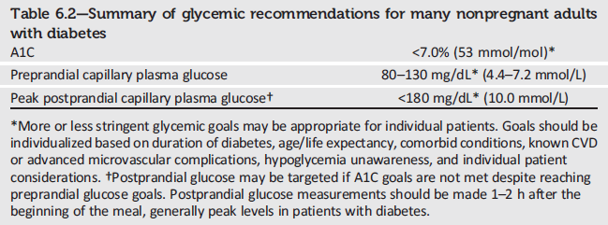
Summary of Glycemic Recommendations
Glycemic Targets:
Standards of Medical Care in Diabetes - 2018. Diabetes Care 2018; 41 (Suppl. 1): S55-S64
Notes:
Shown here are the Association’s recommended glycemic goals for many nonpregnant adults with diabetes.
These recommendations are based on those for A1C values, with listed blood glucose levels that appear to correlate with achievement of an A1C of <7.0%.
[SLIDE]
107
References
American Diabetes Association. Standards of medical care in diabetes—2014. Diabetes Care 2014;37(suppl 1):S25–S26; Table 9
American Diabetes Association. Postprandial blood glucose. Diabetes Care 2001;24:775–778
Ceriello A, Taboga C, Tonutti L, et al. Evidence for an independent and cumulative effect of postprandial hypertriglyceridemia and hyperglycemia on endothelial dysfunction and oxidative stress generation: effects of short- and long-term simvastatin treatment. Circulation 2002;106:1211–1218

Slide 108
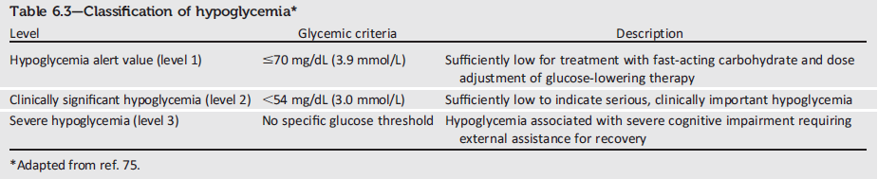
Classification of Hypoglycemia
Glycemic Targets:
Standards of Medical Care in Diabetes - 2018. Diabetes Care 2018; 41 (Suppl. 1): S55-S64
Notes:
Here is the ADA’s new classification scheme for hypoglycemia, based on recommendations from the International Hypoglycaemia Study Group. Of note, this classification scheme considers a blood glucose less than 54 mg/dL (3.0 mmol/L) detected by SMBG, CGM (for at least 20 min), or laboratory measurement of plasma glucose as sufficiently low to indicate serious, clinically significant hypoglycemia that should be included in reports of clinical trials of glucose-lowering drugs for the treatment of diabetes.
However, a glucose alert value of less than or equal to 70 mg/dL (3.9 mmol/L) can be important for therapeutic dose adjustment of glucose-lowering drugs in clinical care and is often related to symptomatic hypoglycemia.
Severe hypoglycemia is defined as severe cognitive impairment requiring assistance from another person for recovery.
[SLIDE]
108
References
Cryer PE. Hypoglycaemia: the limiting factor in the glycaemic management of Type I and Type II diabetes. Diabetologia 2002;45:937–948
American Diabetes Association. Standards of medical care in diabetes—2014. Diabetes Care 2014;37(suppl 1):S33–S34

Slide 109
Hypoglycemia: Recommendations
Individuals at risk for hypoglycemia should be asked about symptomatic and asymptomatic hypoglycemia at each encounter. C
Glucose (15–20 g) is the preferred treatment for the conscious individual with blood glucose <70 mg/dL, although any form of carbohydrate that contains glucose may be used. Fifteen minutes after treatment, if SMBG shows continued hypoglycemia, the treatment should be repeated. Once SMBG returns to normal, the individual should consume a meal or snack to prevent recurrence of hypoglycemia. E
Glycemic Targets:
Standards of Medical Care in Diabetes - 2018. Diabetes Care 2018; 41 (Suppl. 1): S55-S64
Notes:
Moving on to hypoglycemia recommendations, hypoglycemia is the leading limiting factor in the glycemic management of patients with type 1 and insulin-treated type 2 diabetes.
Individuals at risk for hypoglycemia should be asked about symptomatic and asymptomatic hypoglycemia at each encounter. C [CLICK]
Glucose (15–20 g) is the preferred treatment for the conscious individual with blood glucose <70 mg/dL, although any form of carbohydrate that contains glucose may be used. Fifteen minutes after treatment, if SMBG shows continued hypoglycemia, the treatment should be repeated. Once SMBG returns to normal, the individual should consume a meal or snack to prevent recurrence of hypoglycemia. E
[SLIDE]
109
References
Cryer PE. Hypoglycaemia: the limiting factor in the glycaemic management of Type I and Type II diabetes. Diabetologia 2002;45:937–948
American Diabetes Association. Standards of medical care in diabetes—2014. Diabetes Care 2014;37(suppl 1):S33–S34

Slide 110
Hypoglycemia: Recommendations (2)
Glucagon should be prescribed for all individuals at increased risk of clinically significant hypoglycemia, defined as blood glucose < 54 mg/dL, so it is available if needed. Caregivers, school personnel, or family members of these individuals should know where it is and when and how to administer it. Glucagon administration is not limited to health care professionals. E
Hypoglycemia unawareness or one or more episodes of severe hypoglycemia should trigger reevaluation of the treatment regimen. E
Glycemic Targets:
Standards of Medical Care in Diabetes - 2018. Diabetes Care 2018; 41 (Suppl. 1): S55-S64
Notes:
Glucagon should be prescribed for all individuals at increased risk of clinically significant hypoglycemia, defined as blood glucose < 54 mg/dL, so it is available if needed. Caregivers, school personnel, or family members of these individuals should know where it is and when and how to administer it. Glucagon administration is not limited to health care professionals. E
A glucagon kit does require a prescription; some patients may want more than one kit, for example, one to keep at school or work and another for home. Care should be taken to ensure that glucagon kits are not expired; its worth reminding patients to check expiration dates upon receipt and perhaps jotting the date down on a calendar. [CLICK]
Hypoglycemia unawareness or one or more episodes of severe hypoglycemia should trigger reevaluation of the treatment regimen. E
[SLIDE]
110
References
Cryer PE. Hypoglycaemia: the limiting factor in the glycaemic management of Type I and Type II diabetes. Diabetologia 2002;45:937–948
American Diabetes Association. Standards of medical care in diabetes—2014. Diabetes Care 2014;37(suppl 1):S33–S34

Slide 111
Hypoglycemia: Recommendations (3)
Insulin-treated patients with hypoglycemia unawareness or an episode of clinically significant hypoglycemia should be advised to raise their glycemic targets to strictly avoid hypoglycemia for at least several weeks in order to partially reverse hypoglycemia unawareness and reduce risk of future episodes. A
Ongoing assessment of cognitive function is suggested with increased vigilance for hypoglycemia by the clinician, patient, and caregivers if low cognition or declining cognition is found. B
Glycemic Targets:
Standards of Medical Care in Diabetes - 2018. Diabetes Care 2018; 41 (Suppl. 1): S55-S64
Notes:
Insulin-treated patients with hypoglycemia unawareness or an episode of clinically significant hypoglycemia should be advised to raise their glycemic targets to strictly avoid hypoglycemia for at least several weeks in order to partially reverse hypoglycemia unawareness and reduce risk of future episodes. A [CLICK]
And finally, do conduct ongoing assessments of cognitive function, and if low or declining cognition is found, exercise increased vigilance for hypoglycemia.
A large cohort study suggested that among older adults with type 2 diabetes, a history of severe hypoglycemia was associated with greater risk of dementia
Conversely, in a substudy of the ACCORD trial, cognitive impairment at baseline or decline in cognitive function during the trial was significantly associated with subsequent episodes of severe hypoglycemia.
Mild hypoglycemia may be inconvenient or frightening to patients with diabetes. Severe hypoglycemia can cause acute harm to the person with diabetes or others, especially if it causes falls, motor vehicle accidents, or other injury.
[SLIDE]
111
Reference
American Diabetes Association. Standards of medical care in diabetes—2014. Diabetes Care 2014;37(suppl 1):S33–S34

Slide 112
7. Obesity Management for the
Treatment of Type 2 Diabetes
Notes:
Section 7 is dedicated to the discussion of Obesity Management for the Treatment of Type 2 Diabetes.
[SLIDE]
112

Slide 113
Benefits of Weight Loss
Delay progression from prediabetes to type 2 diabetes
Positive impact on glycemia in type 2 diabetes
  Most likely to occur early in disease development
Obesity Management for the Treatment of Type 2 Diabetes:
Standards of Medical Care in Diabetes - 2018. Diabetes Care 2018; 41 (Suppl. 1): S65-S72
Notes:
There is strong and consistent evidence that obesity management can delay progression from prediabetes to type 2 diabetes, and benefits type 2 diabetes treatment. [CLICK]
Weight loss induced improvements in glycemia are most likely to occur early in the natural history of type 2 diabetes when obesity-associated insulin resistance has caused reversible β-cell dysfunction, but insulin secretory capacity remains relatively preserved
And just a reminder that this entire section pertains to the treatment of type 2 diabetes specifically.
[SLIDE]
113

Slide 114
Recommendations: Assessment
At each patient encounter, BMI should be calculated and documented in the medical record. B
  BMI should be:
    Classified to determine the presence of overweight or obesity
    Discussed with the patient
    Documented in the patient record
  Remember that BMI cutpoints for Asian Americans are lower than in other populations
Obesity Management for the Treatment of Type 2 Diabetes:
Standards of Medical Care in Diabetes - 2018. Diabetes Care 2018; 41 (Suppl. 1): S65-S72
Notes:
As far as assessment is concerned, just one recommendation, and that is to calculate and document BMI in the medical record at each patient encounter. B [CLICK]
The calculated BMI should be classified to determine the presence of overweight or obesity, discussed with the patient, and documented in the patient’s medical record. [CLICK]
Remember that BMI cutpoints for Asian Americans are lower than in other populations, as will be noted in the following slide when discussing treatment options for overweight and obesity in type 2 diabetes patients.
[SLIDE]
114

Slide 115
Overweight/Obesity Treatment Options in T2DM
 | Body Mass Index (BMI) Category (kg/m²)
Treatment | 25.0-26.9 (or 23.0-26.9*) | 27.0-29.9 | 30.0-34.9 (or 27.5-32.4*) | 35.0-39.9 (or 32.5-37.4*) | ≥40 (or ≥37.5*)
Diet, physical activity & behavioral therapy | ┼ | ┼ | ┼ | ┼ | ┼
Pharmacotherapy |  | ┼ | ┼ | ┼ | ┼
Metabolic surgery |  |  | ┼ | ┼ | ┼
* Cutoff points for Asian-American individuals.
┼ Treatment may be indicated for selected, motivated patients.
Obesity Management for the Treatment of Type 2 Diabetes:
Standards of Medical Care in Diabetes - 2018. Diabetes Care 2018; 41 (Suppl. 1): S65-S72
Notes:
This chart is a quick summary of recommended treatment course for patients across various BMI categories. This is to be consistent with other ADA position
statements and to reinforce the role of surgery in the treatment of type 2 diabetes.
[SLIDE]
115

Slide 116
Diet, Physical Activity & Behavioral Therapy: Recommendations
Diet, physical activity and behavioral therapy designed to achieve >5% weight loss should be prescribed for overweight and obese patients with T2DM ready to achieve weight loss. A
Such interventions should be high-intensity (≥16 sessions in 6 months) and focus on diet, physical activity and behavioral strategies to achieve a 500 - 750 kcal/day energy deficit. A
Obesity Management for the Treatment of Type 2 Diabetes:
Standards of Medical Care in Diabetes - 2018. Diabetes Care 2018; 41 (Suppl. 1): S65-S72
Notes:
Recommendations in the area of diet, physical activity, and behavioral therapy are on the next three slides.
First, for your overweight and obese patients with type 2 diabetes who are ready to achieve weight loss, prescribe diet, physical activity, and behavioral therapy designed to achieve 5% weight loss.
[CLICK]
These interventions should be high-intensity, which is defined as at least 16 sessions in 6 months, and should focus on diet, physical activity and behavioral strategies to achieve a daily calorie deficit of 500-750 kcals.
[SLIDE]
116

Slide 117
Recommendations: Diet, physical activity & behavioral therapy (2)
Diets should be individualized, as those that provide the same caloric restriction but differ in protein, carbohydrate, and fat content are equally effective in achieving weight loss. A
For patients who achieve short-term weight loss goals, long-term (≥1 year) comprehensive weight maintenance programs should be prescribed. Such programs should provide at least monthly contact and encourage ongoing monitoring of body weight (weekly or more frequently), continued consumption of a reduced-calorie diet, and participation in high levels of physical activity (200-300 min/week). A
Obesity Management for the Treatment of Type 2 Diabetes:
Standards of Medical Care in Diabetes - 2018. Diabetes Care 2018; 41 (Suppl. 1): S65-S72
Notes:
Third, diets that provide the same caloric restriction but differ in protein, carbohydrate, and fat content are equally effective in achieving weight loss. [CLICK]
Overweight and obese patients with type 2 diabetes who have lost weight during the six-month intensive behavioral lifestyle intervention should be enrolled in long-term (≥1 year), comprehensive, weight loss maintenance programs that provide at least monthly contact with a trained interventionist and focus on ongoing monitoring of body weight (weekly or more frequently), continued consumption of a reduced-calorie diet, and participation in high levels of physical activity (200 to 300 minutes per week). Some commercial and proprietary weight-loss programs have shown promising weight loss results (20).
[SLIDE]
117

Slide 118
Recommendations: Diet, physical activity & behavioral therapy (3)
To achieve weight loss of >5%, short-term (3-month) interventions that use very-low-calorie diets (<800 kcal/day) and total meal replacements may be prescribed for carefully selected patients by trained practitioners in medical care settings with close medical monitoring. To maintain weight loss, such programs must incorporate long-term comprehensive weight maintenance counseling. B
Obesity Management for the Treatment of Type 2 Diabetes:
Standards of Medical Care in Diabetes - 2018. Diabetes Care 2018; 41 (Suppl. 1): S65-S72
Notes:
And finally, to achieve weight loss of >5%, short-term (3-month) interventions that use very-low-calorie diets (<800 kcal/day) and total meal replacements may be prescribed for carefully selected patients by trained practitioners in medical care settings with close medical monitoring. To maintain weight loss, such programs must incorporate long-term comprehensive weight maintenance counseling. B
[SLIDE]
118

Slide 119
Pharmacotherapy: Recommendations
When choosing glucose-lowering medications for overweight or obese patients with T2DM, consider their effect on weight. E
Whenever possible, minimize the medications for comorbid conditions that are associated with weight gain. E
Obesity Management for the Treatment of Type 2 Diabetes:
Standards of Medical Care in Diabetes - 2018. Diabetes Care 2018; 41 (Suppl. 1): S65-S72
Notes:
Four recommendations in the area of pharmacotherapy:
First, consider the potential impact on weight when choosing glucose-lowering medications for your overweight or obese patients with type 2 diabetes. The full Standards of Care document includes a handy table on medications approved by the FDA for the long-term treatment of obesity that is handy when trying to select aa treatment option.
[CLICK]
And whenever possible, minimize the medications for comorbid conditions that are associated with weight gain.
[SLIDE]
119

Slide 120
Pharmacotherapy: Recommendations (2)
Weight loss meds may be effective as adjuncts to diet, physical activity & behavioral counseling for selected patients with T2DM and BMI ≥27 kg/m². Potential benefits must be weighed against the potential risks of the medications. A
If patient’s response to weight loss medications is <5% weight loss after 3 months or if there are any safety or tolerability issues at any time, the medication should be discontinued and alternative medications or treatment approaches should be considered. A
Obesity Management for the Treatment of Type 2 Diabetes:
Standards of Medical Care in Diabetes - 2018. Diabetes Care 2018; 41 (Suppl. 1): S65-S72
Notes:
Remember that weight loss medications may be effective adjuncts to lifestyle intervention for select type 2 patients with a BMI ≥27 kg/m2. Potential benefits must be weighed against the potential risks of the medications. [CLICK]
And finally under pharmacotheraphy, if a patient’s response to medications is less than 5% weight loss after 3 months, or if there are safety or tolerability issues at any time, discontinue the medication and consider alternative medications or treatment approaches.
[SLIDE]
120

Slide 121
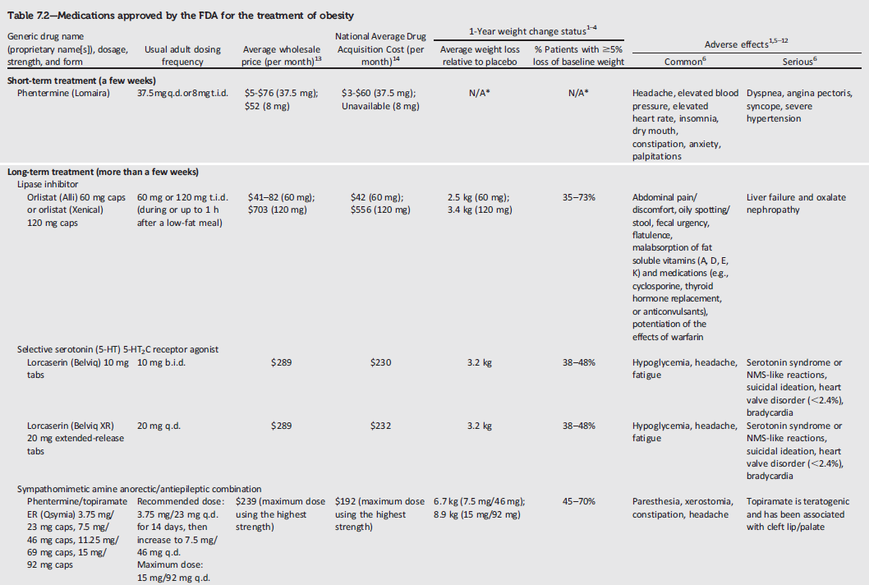
Medications Approved by the FDA for the Treatment of Obesity
Obesity Management for the Treatment of Type 2 Diabetes:
Standards of Medical Care in Diabetes - 2018. Diabetes Care 2018; 41 (Suppl. 1): S65-S72
Notes:
This slide and the next provide simplified table information for medications approved by the FDA for the treatment of obesity. Current FDA-approved treatments include phentermine for short-term treatment, and 5 additional treatments for long-term (more than a few weeks) of thereapy: orlistat, lorcaserin, a combination of phentermine/topiramate, a combination of naltrexone and bupropion, and liraglutide.
[SLIDE]

Slide 122
Medications Approved by the FDA for the Treatment of Obesity (2)
Obesity Management for the Treatment of Type 2 Diabetes:
Standards of Medical Care in Diabetes - 2018. Diabetes Care 2018; 41 (Suppl. 1): S65-S72
Notes:
And here are the remaining medications approved for the treatment of obesity.
[SLIDE]

Slide 123
Metabolic Surgery
Evidence supports gastrointestinal (GI) operations as effective treatments for overweight T2DM patients.
Randomized controlled trials with postoperative follow-up ranging from 1 to 5 years have documented sustained diabetes remission in 30–63% of patients, though erosion of remission occurs in 35-50% or more.
With or without diabetes relapse, the majority of patients who undergo surgery maintain substantial improvement of glycemic control for at least 5 to 15 years.
Obesity Management for the Treatment of Type 2 Diabetes:
Standards of Medical Care in Diabetes - 2018. Diabetes Care 2018; 41 (Suppl. 1): S65-S72
Notes:
To reflect the results of an international workgroup report endorsed by the ADA and many other organizations, recommendations regarding metabolic surgery
have been substantially changed, including those related to BMI thresholds for surgical candidacy, mental health assessment, and appropriate
surgical venues.
Either gastric banding or procedures that involve resecting, bypassing, or transposing sections of the stomach and small intestine, can be effective weight-loss treatments for severe obesity when performed as part of a comprehensive weight-management program with lifelong lifestyle support and medical monitoring.
[SLIDE]
123

Slide 124
Metabolic Surgery: Recommendations
Metabolic surgery should be recommended as an option to treat T2DM in appropriate surgical candidates with BMI >40 kg/m² (37.5*), regardless of the level of glycemic control or complexity of glucose-lowering regimens, and in adults with BMIs 35.0-39.9 kg/m² (32.5-37.4*) when hyperglycemia is inadequately controlled despite lifestyle and optimal medical therapy. A
Metabolic surgery should be considered as an option for adults with T2DM and BMI 30-34.9 kg/m² (27.5-32.4*) if hyperglycemia is inadequately controlled despite optimal medical control by either oral or injectable medications (including insulin). B
Metabolic surgery should be performed in high-volume centers with multidisciplinary teams that understand and are experienced in the management of diabetes and gastrointestinal surgery. C
Obesity Management for the Treatment of Type 2 Diabetes:
Standards of Medical Care in Diabetes - 2018. Diabetes Care 2018; 41 (Suppl. 1): S65-S72
Notes:
And here are the metabolic surgery recommendations, which are based on both the BMI and glycemic management of the patient, as well as other factors related to surgical candidacy.
Metabolic surgery should be recommended as an option to treat type 2 diabetes for all appropriate surgical candidates with BMIs > 40 (Again, the asterisks denotes cutpoints for Asian Americans, which is 37.5). This recommendation also applies to those with BMIs 35.0-39.9 (32.5-37.4 in Asian Americans) when hyperglycemia is inadequately controlled despite lifestyle & optimal medical therapy. [CLICK]
Metabolic surgery should be considered, note the change in the strength of the recommendation, for the treatment of type 2 diabetes in adults with BMIs 30-34.9 (27.5-32.4 in Asian Americans) when hyperglycemia is inadequately controlled despite optimal medical control by either oral or injectable medications (including insulin). [CLICK]
Another recommendation aimed at improving metabolic surgery outcomes is that metabolic surgery should be performed in high-volume centers with multidisciplinary teams that understand and are experienced in the management of diabetes and gastrointestinal surgery.
[SLIDE]
124

Slide 125
Metabolic Surgery: Recommendations (2)
Long-term lifestyle support and routine monitoring of micronutrient and nutritional status must be provided after surgery, according to guidelines for postoperative management of metabolic surgery by national and international professional societies. C
People presenting for metabolic surgery should receive a comprehensive mental health assessment. B Surgery should be postponed in patients with histories of alcohol or substance abuse, significant depression, suicidal ideation, or other mental health conditions until these conditions have been fully addressed. E
People who undergo metabolic surgery should be evaluated to assess the need for ongoing mental health services to help them adjust to medical and psychosocial changes after surgery. C
Obesity Management for the Treatment of Type 2 Diabetes:
Standards of Medical Care in Diabetes - 2018. Diabetes Care 2018; 41 (Suppl. 1): S65-S72
Notes:
Here are three more recommendations for metabolic surgery. The first is related to the importance of long-term care after a surgical procedure. The next two highlight the importance of mental health assessments, both before surgery to help determine surgical candidacy and after surgery to assess the need for ongoing psychosocial care.
[SLIDE]
125

Slide 126
Metabolic Surgery: Adverse Effects
Costly
Some associated risks
Outcomes vary
Patients undergoing metabolic surgery
may be at higher risk for depression, substance abuse, and other psychosocial issues
Obesity Management for the Treatment of Type 2 Diabetes:
Standards of Medical Care in Diabetes - 2018. Diabetes Care 2018; 41 (Suppl. 1): S65-S72
Notes:
There are several disadvantages to keep in mind when considering bariatric surgery for your patients with type 2 diabetes. First, it’s costly. And there still are associated risks. Mortality rates are typically 0.1-0.5%, similar to cholecystectomy or hysterectomy.
Finally, some recent studies suggest that patients who undergo bariatric surgery may be at higher risk for substance use including drug and alcohol use and cigarette smoking.
Understanding the long-term benefits and risks of bariatric surgery in patients with type 2 diabetes, especially those who are not severely obese, will require well-designed clinical trials, with optimal medical therapy as the comparator. Unfortunately, such studies may not be feasible.
[SLIDE]
126

Slide 127
8. Pharmacologic Approaches to
Glycemic Treatment
Notes:
Section 8: Pharmacologic Approaches to Glycemic Treatment
127

Slide 128
Pharmacologic Therapy For Type 1 Diabetes: Recommendations
Most people with T1DM should be treated with multiple daily injections of prandial insulin and basal insulin or continuous subcutaneous insulin infusion (CSII). A
Most individuals with T1DM should use rapid-acting insulin analogs to reduce hypoglycemia risk. A
Pharmacologic Approaches to Glycemic Treatment:
Standards of Medical Care in Diabetes - 2018. Diabetes Care 2018; 41 (Suppl. 1): S73-S85
Notes:
Starting off with type 1 diabetes, there are plenty of other resources out there on initiating and managing insulin therapy, so we won’t go into that here.
Most of your patients with type 1 diabetes should be treated with multiple dose injections or insulin pump therapy. There are minimal differences between the two as far as hypoglycemia is concerned. Whichever one a patient chooses, intensive management and active patient or family participation should be strongly encouraged. [CLICK]
Most patients with type 1 diabetes should likewise use rapid-acting insulin analogs to cover prandial needs to reduce the risk of hypoglycemia
[SLIDE]
128
References
American Diabetes Association. Standards of medical care in diabetes—2014. Diabetes Care 2014;37(suppl 1):S26
The Diabetes Control and Complications Trial Research Group. The effect of intensive treatment of diabetes on the development and progression of long-term complications in insulin-dependent diabetes mellitus. N Engl J Med 1993;329:977–986
Nathan DM, Cleary PA, Backlund JY, et al for the Diabetes Control and Complications Trial/Epidemiology of Diabetes Interventions and Complications (DCCT/EDIC) Study Research Group. Intensive diabetes treatment and cardiovascular disease in patients with type 1 diabetes. N Engl J Med 2005;353:2643–2653

Slide 129
Pharmacologic Therapy For Type 1 Diabetes: Recommendations (2)
Consider educating individuals with T1DM on matching prandial insulin doses to carbohydrate intake, premeal blood glucose levels, and anticipated physical activity. E
Individuals with T1DM who have been successfully using CSII should have continued access to this therapy after they turn 65 years of age. E
Pharmacologic Approaches to Glycemic Treatment:
Standards of Medical Care in Diabetes - 2018. Diabetes Care 2018; 41 (Suppl. 1): S73-S85
Notes:
Consider educating your patients with type 1 diabetes on matching prandial insulin doses to carbohydrate intake, premeal blood glucose, and anticipated activity. [CLICK]
And finally, individuals with T1DM who have been successfully using CSII should have continued access to this therapy after they turn 65 years of age.
[SLIDE]
129

Slide 130
T1DM: Pramlintide
FDA approved for T1DM
Amylin analog
Delays gastric emptying, blunts pancreatic glucose secretion, enhances satiety
Induces weight loss, lowers insulin dose
Requires reduction in prandial insulin to reduce risk of severe hypos
Pharmacologic Approaches to Glycemic Treatment:
Standards of Medical Care in Diabetes - 2018. Diabetes Care 2018; 41 (Suppl. 1): S73-S85
Notes:
Pramlintide is an FDA approved amylin analog that delays gastric emptying, blunts pancreatic glucose secretion, and enhances satiety.
It can induce weight loss and lower the insulin dose, but does require the concurrent reduction of prandial insulin to lower the risk of severe hypoglycemia.
[SLIDE]
130

Slide 131
T1DM: Investigational Agents
Metformin
Incretin-Based Therapies
  Glucagon-Like Peptide 1 (GLP-1) Receptor Agonists
  Dipeptidyl Peptidase 4 (DPP-4) Inhibitors
Sodium-Glucose Cotransporter 2 (SGLT2) Inhibitors
Pharmacologic Approaches to Glycemic Treatment:
Standards of Medical Care in Diabetes - 2018. Diabetes Care 2018; 41 (Suppl. 1): S73-S85
Notes:
The 2018 Standards of Care additionally provide some information on investigational use of a variety of other antihyperglycemic agents in patients with type 1 diabetes, inclusive of metformin, incretin-based therapies, and sodium-glucose contransporter 2 inhibitors. Use of these agents is off-label in the context of type 1 diabetes. For additional information please refer to the full standards document.
[SLIDE]
131

Slide 132
T1DM: Pancreas and Islet Transplantation
Can normalize glucose but require lifelong immunosuppression.
Reserve pancreas transplantation for T1D patients:
  Undergoing simultaneous renal transplantation
  Following renal transplant
  With recurrent ketoacidosis or severe hypoglycemia
Pharmacologic Approaches to Glycemic Treatment:
Standards of Medical Care in Diabetes - 2018. Diabetes Care 2018; 41 (Suppl. 1): S73-S85
Notes:
A few words on transplantation.
Pancreatic or islet cell transplantation can normalize glucose levels but require lifelong immunosuppression to prevent graft rejection and recurrence of islet destruction. Therefore, pancreas transplantation should be reserved for type 1 patients undergoing simultaneous renal transplantation, following renal transplantation, or for those with recurrent ketoacidosis or severe hypoglycemia despite aggressive glycemic management.
[SLIDE]
132

Slide 133
Pharmacologic Therapy For T2DM: Recommendations
Metformin, if not contraindicated and
if tolerated, is the preferred initial pharmacologic agent for the treatment of T2DM. A
Long-term use of metformin may be associated with biochemical vitamin B12 deficiency, and periodic measurement of vitamin B12 levels should be considered in metformin-treated patients, especially in those with anemia or peripheral neuropathy. B
Pharmacologic Approaches to Glycemic Treatment:
Standards of Medical Care in Diabetes - 2018. Diabetes Care 2018; 41 (Suppl. 1): S73-S85
Notes:
Recommended pharmacological therapy for hyperglycemia in type 2 diabetes is summarized on the next several slides.
First, metformin, if not contraindicated and if tolerated, is the preferred initial pharmacological agent for type 2 diabetes. Metformin has a long-standing evidence base for efficacy and safety, is inexpensive, and may reduce risk of cardiovascular events. [CLICK]
To reflect new evidence showing an association between B12 deficiency and long term metformin use, a recommendation was added in 2017 to consider periodic measurement of B12 levels and supplementation as needed.
[SLIDE]
133
References
American Diabetes Association. Standards of medical care in diabetes—2014. Diabetes Care 2014;37(suppl 1):S27
Inzucchi SE, Bergenstal RM, Buse JB, et al.; American Diabetes Association (ADA); European Association for the Study of Diabetes (EASD). Management of hyperglycemia in type 2 diabetes: a patient-centered approach. Position Statement of the American Diabetes Association (ADA) and the European Association for the Study of Diabetes (EASD). Diabetes Care 2012;35:1364–1379

Slide 134
Pharmacologic Therapy For T2DM: Recommendations (2)
Consider initiating insulin therapy (with or without additional agents) in patients with newly diagnosed T2DM who are symptomatic and/or have A1C >10% and/or blood glucose levels ≥300 mg/dL. E
Consider initiating dual therapy in patients with newly diagnosed T2DM who have A1C >9%. E
Pharmacologic Approaches to Glycemic Treatment:
Standards of Medical Care in Diabetes - 2018. Diabetes Care 2018; 41 (Suppl. 1): S73-S85
Notes:
Consider initiating insulin therapy (with or without additional agents) in patients with newly diagnosed T2DM who are symptomatic and/or have A1C >10% and/or blood glucose levels ≥300 mg/dL. E
Consider initiating dual therapy in patients with newly diagnosed T2DM who have A1C >9%. E
134
References
American Diabetes Association. Standards of medical care in diabetes—2014. Diabetes Care 2014;37(suppl 1):S27
Inzucchi SE, Bergenstal RM, Buse JB, et al.; American Diabetes Association (ADA); European Association for the Study of Diabetes (EASD). Management of hyperglycemia in type 2 diabetes: a patient-centered approach. Position Statement of the American Diabetes Association (ADA) and the European Association for the Study of Diabetes (EASD). Diabetes Care 2012;35:1364–1379

Slide 135
Pharmacologic Therapy For T2DM: Recommendations (3)
In patients without atherosclerotic cardiovascular disease (ASCVD), if monotherapy or dual therapy does not achieve or maintain the A1C goal over 3 months, add an additional antihyperglycemic agent based on drug-specific and patient factors (Table 8.1). A
A patient-centered approach should be used to guide the choice of pharmacologic agents. Considerations include efficacy, hypoglycemia risk, history of ASCVD, impact on weight, potential side effects, renal effects, delivery method, cost, and patient preferences. E
Pharmacologic Approaches to Glycemic Treatment:
Standards of Medical Care in Diabetes - 2018. Diabetes Care 2018; 41 (Suppl. 1): S73-S85
Notes:
Multiple changes have been made to recommendations pertaining to the treatment of patients with T2DM in 2018. Here we begin to see some of the substantive recommendation changes:
In patients without atherosclerotic cardiovascular disease (ASCVD), if monotherapy or dual therapy does not achieve or maintain the A1C goal over 3 months, add an additional antihyperglycemic agent based on drug-specific and patient factors (Table 8.1). A
A patient-centered approach should be used to guide the choice of pharmacologic agents. Considerations include efficacy, hypoglycemia risk, history of ASCVD, impact on weight, potential side effects, renal effects, delivery method, cost, and patient preferences. E
[SLIDE]
135
References
American Diabetes Association. Standards of medical care in diabetes—2014. Diabetes Care 2014;37(suppl 1):S27
Inzucchi SE, Bergenstal RM, Buse JB, et al.; American Diabetes Association (ADA); European Association for the Study of Diabetes (EASD). Management of hyperglycemia in type 2 diabetes: a patient-centered approach. Position Statement of the American Diabetes Association (ADA) and the European Association for the Study of Diabetes (EASD). Diabetes Care 2012;35:1364–1379

Slide 136
Pharmacologic Therapy For T2DM: Recommendations (4)
In patients with T2DM and established ASCVD, antihyperglycemic therapy should begin with lifestyle management and metformin and subsequently incorporate an agent proven to reduce major adverse CV events and CV mortality (currently empagliflozin and liraglutide), after considering drug-specific and patient factors (Table 8.1). A
In patients with T2DM and established ASCVD, after lifestyle management and metformin, the antihyperglycemic agent canagliflozin may be considered to reduce major adverse CV events, based on drug-specific and patient factors (Table 8.1). C
Pharmacologic Approaches to Glycemic Treatment:
Standards of Medical Care in Diabetes - 2018. Diabetes Care 2018; 41 (Suppl. 1): S73-S85
Notes:
In patients with T2DM and established ASCVD, antihyperglycemic therapy should begin with lifestyle management and metformin and subsequently incorporate an agent proven to reduce major adverse CV events and CV mortality (currently empagliflozin and liraglutide), after considering drug-specific and patient factors (Table 8.1). A
In patients with T2DM and established ASCVD, after lifestyle management and metformin, the antihyperglycemic agent canagliflozin may be considered to reduce major adverse CV events, based on drug-specific and patient factors (Table 8.1). C
[SLIDE]
136
References
American Diabetes Association. Standards of medical care in diabetes—2014. Diabetes Care 2014;37(suppl 1):S27
Inzucchi SE, Bergenstal RM, Buse JB, et al.; American Diabetes Association (ADA); European Association for the Study of Diabetes (EASD). Management of hyperglycemia in type 2 diabetes: a patient-centered approach. Position Statement of the American Diabetes Association (ADA) and the European Association for the Study of Diabetes (EASD). Diabetes Care 2012;35:1364–1379

Slide 137
Pharmacologic Therapy For T2DM: Recommendations (5)
Continuous reevaluation of the medication regimen and adjustment as needed to incorporate patient factors (Table 8.1) and regimen complexity is recommended. E
For patients with T2DM who are not achieving glycemic goals, drug intensification, including consideration of insulin therapy, should not be delayed. B
Metformin should be continued when used in combination with other agents, including insulin, if not contraindicated and if tolerated. A
Pharmacologic Approaches to Glycemic Treatment:
Standards of Medical Care in Diabetes - 2018. Diabetes Care 2018; 41 (Suppl. 1): S73-S85
Notes:
Continuous reevaluation of the medication regimen and adjustment as needed to incorporate patient factors (Table 8.1) and regimen complexity is recommended. E
For patients with T2DM who are not achieving glycemic goals, drug intensification, including consideration of insulin therapy, should not be delayed. B
Metformin should be continued when used in combination with other agents, including insulin, if not contraindicated and if tolerated. A
[SLIDE]
137
References
American Diabetes Association. Standards of medical care in diabetes—2014. Diabetes Care 2014;37(suppl 1):S27
Inzucchi SE, Bergenstal RM, Buse JB, et al.; American Diabetes Association (ADA); European Association for the Study of Diabetes (EASD). Management of hyperglycemia in type 2 diabetes: a patient-centered approach. Position Statement of the American Diabetes Association (ADA) and the European Association for the Study of Diabetes (EASD). Diabetes Care 2012;35:1364–1379

Slide 138
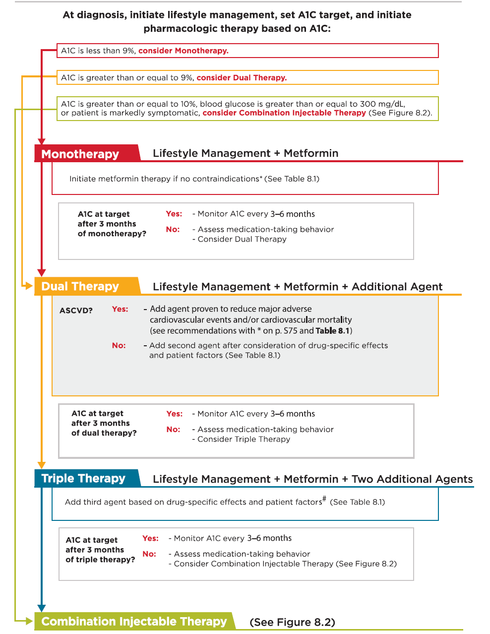
Pharmacologic Approaches to Glycemic Treatment:
Standards of Medical Care in Diabetes - 2018. Diabetes Care 2018; 41 (Suppl. 1): S73-S85
Notes:
Here is an overview of the ADA’s new treatment algorithm for type 2 diabetes, moving from monotherapy, to dual therapy, to triple therapy, and then to combination injectable therapy. Lifestyle management is emphasized throughout the progression of care, and individualization based on efficacy, hypoglycemia risk, weight, side effects, and costs is recommended.
It is important to note that the ADA’s full Standards of Care provides tables on the properties of these agents, as well as the costs associated with them. Please visit professional-dot-diabetes-org-slash-S-O-C for more information.
Let’s take a closer look at the algorithm.
[SLIDE]
138

Slide 139
Pharmacologic Approaches to Glycemic Treatment:
Standards of Medical Care in Diabetes - 2018. Diabetes Care 2018; 41 (Suppl. 1): S73-S85
Notes:
The first step in the management of newly diagnosed type 2 diabetes is highlighted at the top of the algorithm: initiate lifestyle management, set A1C target, and initiate pharmacotherapy based on A1C at diagnosis.
For those with an initial A1C less than 9%, monotherapy may be considered, while those with an A1C greater than 9% should consider dual therapy, and those with A1C greater than 10%, high blood glucose (>300 mg/dl), or symptoms of hyperglycemia may consider combination injectable therapy, which I’ll detail shortly.
The initial preferred agent remain metformin, though other therapies may be considered if metformin is contraindicated or isn’t tolerated.
If A1C target is not achieved or maintained within 3 months, or at any point, lifestyle management should be reinforced and dual therapy considered.
[SLIDE]
139

Slide 140
Antihyperglycemic Therapy in Adults with T2DM
Pharmacologic Approaches to Glycemic Treatment:
Standards of Medical Care in Diabetes - 2018. Diabetes Care 2018; 41 (Suppl. 1): S73-S85
Notes:
Starting with dual therapy, the algorithm has been updated this year to incorporate consideration of ASCVD at the point of dual therapy given results of recently published cardiovascular outcome trials.
As noted in the algorithm, in patients who do not have atherosclerotic cardiovascular disease (ASCVD), consider a combination of metformin and any one of the preferred six treatment options: sulfonylurea, thiazolidinedione, DPP-4 inhibitor, SGLT2 inhibitor, GLP-1 receptor agonist, or basal insulin; the choice of which agent to add is based on drug specific effects and patient factors, as highlighted in Table
8.1 which will be highlighted in the next slide.
For patients with ASCVD, add a second agent with evidence of cardiovascular risk reduction after consideration of drug-specific and patient factors.
If A1C target is still not achieved after 3 months of dual therapy, proceed to a three-drug combination. Again, if A1C target is not achieved after ~3 months of triple therapy, proceed to combination injectable therapy. At each step, lifestyle management should be reinforced and medication-taking behavior assessed.
[SLIDE]
140

Slide 141
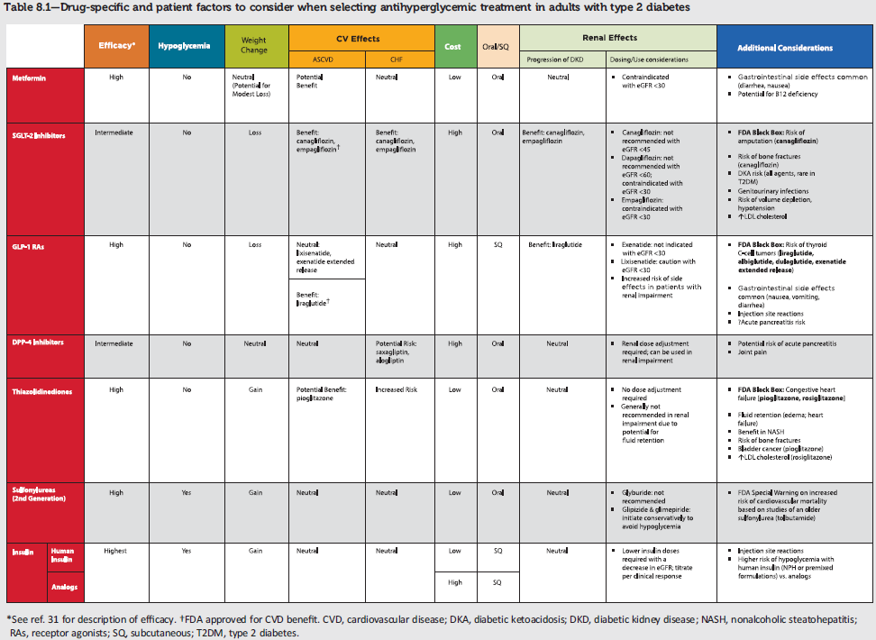
Notes:
As mentioned in the previous slide, Table 8.1 was added this year to highlight patient-specific factors to consider when selecting antihyperglycemic treatments for adults with T2DM.This is difficult to read, but I just wanted to highlight the overall structure of the table and describe its contents. Considerations noted in the table include: efficacy, hypoglycemia risk, effects on weight, cardiovascular effects, treatment cost, route of administration, renal effects, and additional drug-specific considerations, such as notable black box warnings and unique drug side effects.
[SLIDE]

Slide 142
Insulin Therapy in T2DM
The progressive nature of T2DM should be regularly and objectively explained to T2DM patients.
Avoid using insulin as a threat, describing it as a failure or punishment.
Give patients a self-titration algorithm.
Pharmacologic Approaches to Glycemic Treatment:
Standards of Medical Care in Diabetes - 2018. Diabetes Care 2018; 41 (Suppl. 1): S73-S85
Notes:
The progressive nature of T2DM should be regularly & objectively explained to T2DM patients.
Along those lines, for your patients who are not achieving glycemic goals, promptly initiate insulin therapy
Avoid using insulin as a threat, describing it as a failure or punishment
And do give patients a self-titration algorithm
[SLIDE]
142

Slide 143
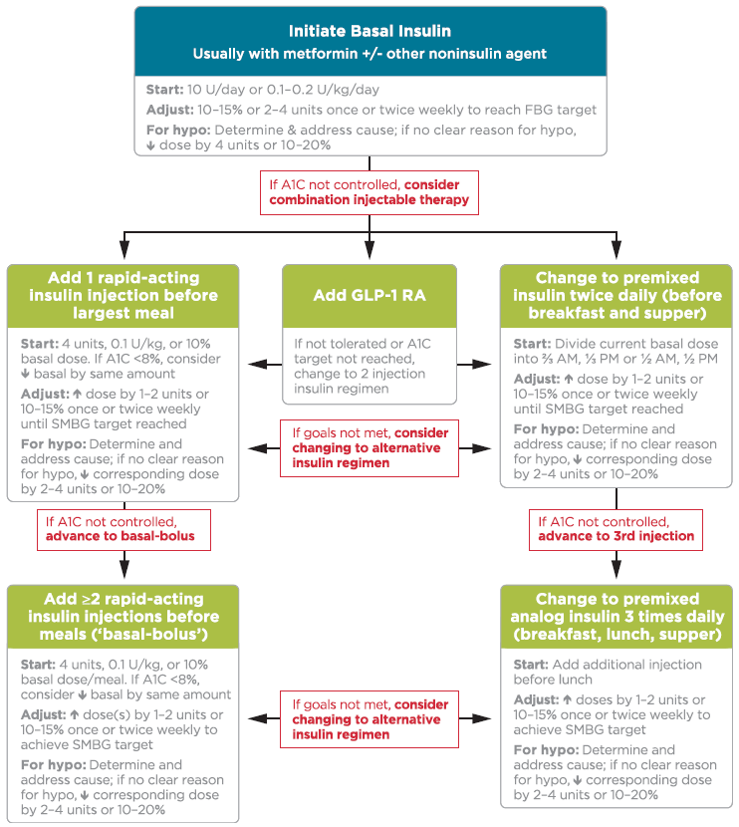
Combination Injectable Therapy in T2DM
Pharmacologic Approaches to Glycemic Treatment:
Standards of Medical Care in Diabetes - 2018. Diabetes Care 2018; 41 (Suppl. 1): S73-S85
Notes:
The algorithm for combination injectable therapy in type 2 diabetes starts with basal insulin, with or without other agents, and offers three equivalent strategies for intensification if goals are not met, with ample room for individualization.
Again, it is important to note that the ADA’s full Standards of Care provides tables on the properties of these agents, as well as the costs associated with them. Please visit professional-dot-diabetes-org-slash-S-O-C for more information.
FBG, fasting blood glucose; GLP-1 RA, GLP-1 receptor agonist; hypo, hypoglycemia.
[SLIDE]
143

Slide 144
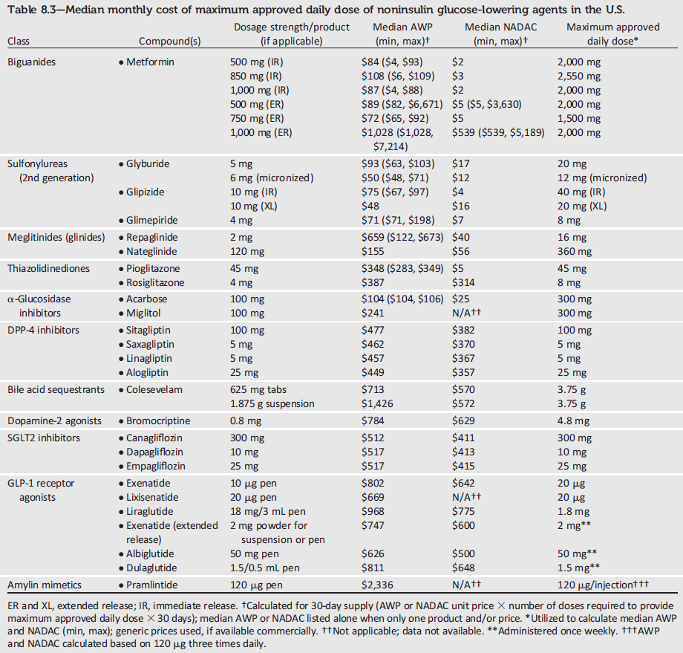
Average wholesale price (AWP) and National Average Drug Acquisition Costs (NADAC) do not account for discounts, rebates, or other price adjustments that may affect the actual cost incurred by the patient, but highlight the importance of cost considerations.
Notes:
This table provides cost information for currently approved noninsulin therapies. Of note, both average wholesale prices (AWP) and National Average Drug Acquisition Costs (NADAC) are provided, but neither measure is perfect and they do not account for discounts, rebates, or other price adjustments often
involved in prescription sales that affect the actual cost incurred by the patient.
While there are alternative means to estimate medication prices, AWP and NADAC were utilized to provide a comparison of list prices with the primary goal of highlighting the importance of cost considerations when prescribing antihyperglycemic treatments.
[SLIDE]

Slide 145
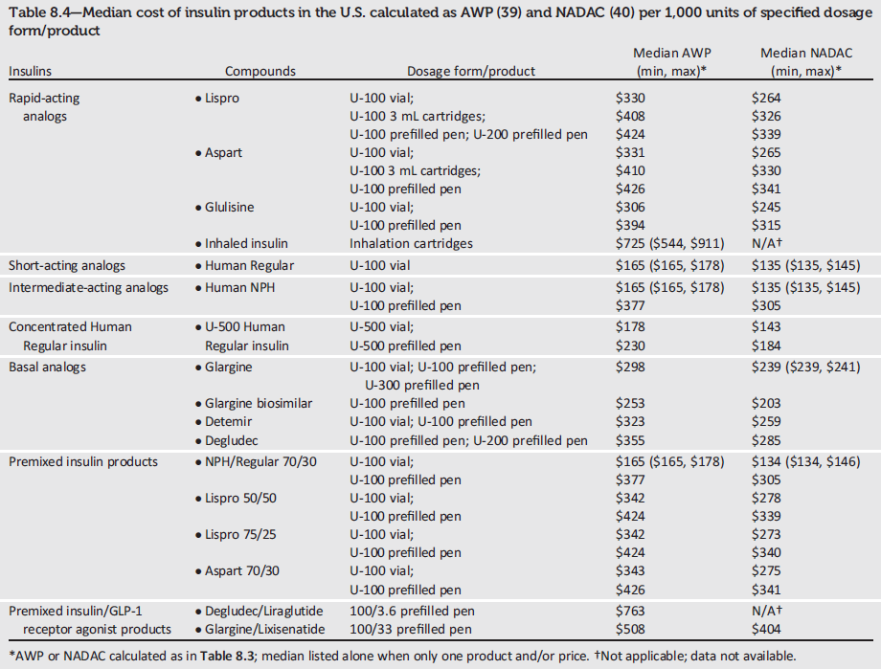
There have been substantial increases in the price of insulin in the past decade, and cost-effectiveness is an important consideration.
Notes:
This table provides AWP and NADAC information (cost per 1,000 units) for currently available insulin
products in the U.S. There have been substantial increases in the price of insulin over the past decade and the cost-effectiveness of different antihyperglycemic agents is an important consideration when selecting therapies.

Slide 146
9. Cardiovascular Disease and Risk Management
Notes:
Moving on to cardiovascular disease and risk management….
[SLIDE]
146

Slide 147
Cardiovascular Disease
ASCVD is the leading cause of morbidity & mortality for those with diabetes.
Largest contributor to direct/indirect costs
Common conditions coexisting with type 2 diabetes (e.g., hypertension, dyslipidemia) are clear risk factors for ASCVD.
Diabetes itself confers independent risk
Control individual cardiovascular risk factors to prevent/slow CVD in people with diabetes.
Systematically assess all patients with diabetes for cardiovascular risk factors.
Cardiovascular Disease and Risk Management:
Standards of Medical Care in Diabetes - 2018. Diabetes Care 2018; 41 (Suppl. 1): S86-S104
Notes:
Atherosclerotic cardiovascular disease is the major cause of morbidity and mortality for individuals with diabetes, and the largest contributor to the direct and indirect costs of diabetes [CLICK]
The common conditions coexisting with type 2 diabetes, such as hypertension and dyslipidemia, are clear risk factors for atherosclerotic cardiovascular disease, [CLICK] and diabetes itself confers independent risk [CLICK]
Numerous studies have shown the efficacy of controlling individual cardiovascular risk factors in preventing of slowing CVD in people with diabetes. Large benefits are seen when multiple risk factors are addressed globally. [CLICK]
Finally, the Association recommends systematic assessment at least annually of all people with diabetes for cardiovascular risk factors, including dyslipidemia, hypertension, smoking, family history of premature coronary disease, and the presence of albuminuria. Abnormal risk factors should be treated.
[SLIDE]
147
References
American Diabetes Association. Standards of medical care in diabetes—2014. Diabetes Care 2014;37(suppl 1):S36
Buse JB, Ginsberg HN, Bakris GL, et al., for the American Heart Association, American Diabetes Association. Primary prevention of cardiovascular diseases in people with diabetes mellitus: a scientific statement from the American Heart Association and the American Diabetes Association. Diabetes Care 2007;30:162–172
Gaede P, Lund-Andersen H, Parving HH, Pedersen O. Effect of a multifactorial intervention on mortality in type 2 diabetes. N Engl J Med 2008;358:580–591
Ali MK, Bullard KM, Saaddine JB, Cowie CC, Imperatore G, Gregg EW. Achievement of goals in U.S. diabetes care, 1999–2010. N Engl J Med 2013;368:1613–1624

Slide 148
Hypertension
Common DM comorbidity
Major risk factor for ASCVD & microvascular complications
Antihypertensive therapy reduces ASCVD events, heart failure, and microvascular complications.
Cardiovascular Disease and Risk Management:
Standards of Medical Care in Diabetes - 2018. Diabetes Care 2018; 41 (Suppl. 1): S86-S104
Notes:
Hypertension is a common diabetes comorbidity that affects many patients. Hypertension is a major risk factor for both ASCVD and microvascular complications. Moreover, numerous studies have shown that antihypertensive therapy reduces ASCVD events, heart failure, and microvascular complications.
[SLIDE]
148

Slide 149
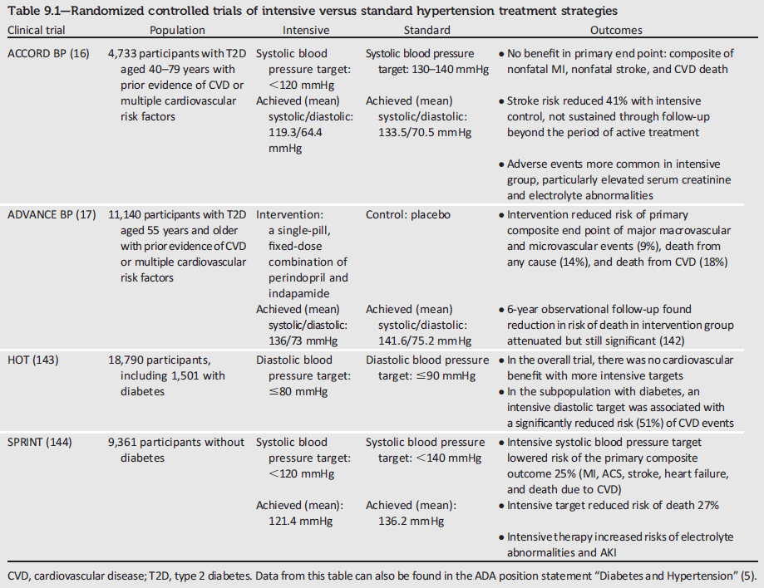
Notes:
Table 9.1 from the 2018 Standards of Care provides a summary of findings from randomized controlled trials of intensive versus standard hypertension treatment strategies in patients with T2DM.
Given the epidemiological relationship between lower blood pressure and better long-term clinical outcomes, two landmark trials, Action to Control Cardiovascular Risk in Diabetes, or ACCORD trial, and Action in Diabetes and Vascular Disease: Preterax and Diamicron MR Controlled Evaluation–Blood Pressure (ADVANCE-BP), examined the benefit of tighter blood pressure control in patients with type 2 diabetes.
The ACCORD trial examined whether a lower SBP of <120 mm Hg, in type 2 diabetes patients at high risk for ASCVD, provided greater cardiovascular protection than an SBP level of 130–140 mm Hg and the study did not find a benefit in primary endpoints of nonfatal MI, nonfatal stroke and cardiovascular death.
The ADVANCE-BP intervention arm consisted of a single pill, fixed dose combination of perindopril and indapamide and showed a significant reduction in the risk of the primary composite end point (major macrovascular or microvascular event) and significant reductions in the risk of death from any cause and of death from cardiovascular causes.
Findings from the HOT and SPRINT trials are also noted here.
[SLIDE]
149

Slide 150
Hypertension/BP Control: Recommendations
Screening and Diagnosis:
Blood pressure (BP) should be measured at every routine clinical visit. Patients found to have elevated BP(≥140/90) should have BP confirmed using multiple readings, including measurements on a separate day, to diagnose hypertension. B
All hypertensive patients with diabetes should monitor their BP at home. B
Cardiovascular Disease and Risk Management:
Standards of Medical Care in Diabetes - 2018. Diabetes Care 2018; 41 (Suppl. 1): S86-S104
Notes:
Moving along to recommendations, the following recommendations are provided for the screening and diagnosis of hypertension:
Blood pressure (BP) should be measured at every routine clinical visit. Patients found to have elevated BP(≥140/90) should have BP confirmed using multiple readings, including measurements on a separate day, to diagnose hypertension. B
All hypertensive patients with diabetes should monitor their BP at home. B
[SLIDE]
150
Reference
American Diabetes Association. Standards of medical care in diabetes—2014. Diabetes Care 2014;37(suppl 1):S36

Slide 151
Hypertension/BP Control: Recommendations (2)
Treatment Goals
Most people with diabetes and hypertension should be treated to a systolic BP goal of <140 mmHg and a diastolic BP goal of <90 mmHg. A
Lower systolic and diastolic BP targets, such as 130/80 mmHg, may be appropriate for individuals at high risk of CVD, if they can be achieved without undue treatment burden. C
In pregnant patients with diabetes and preexisting hypertension who are treated with antihypertensive therapy, BP targets of 120-160/80-105 mmHg are suggested in the interest of optimizing long-term maternal health and minimizing impaired fetal growth. E
Cardiovascular Disease and Risk Management:
Standards of Medical Care in Diabetes - 2018. Diabetes Care 2018; 41 (Suppl. 1): S86-S104
Notes:
The following recommendations pertain to hypertension treatment goals:
Most people with diabetes and hypertension should be treated to a systolic BP goal of <140 mmHg and a diastolic BP goal of <90 mmHg. A [CLICK]
Lower systolic and diastolic BP targets, such as 130/80 mmHg, may be appropriate for individuals at high risk of CVD, if they can be achieved without undue treatment burden. C [CLICK]
In pregnant patients with diabetes and preexisting hypertension who are treated with antihypertensive therapy, BP targets of 120-160/80-105 mmHg are suggested in the interest of optimizing long-term maternal health and minimizing impaired fetal growth. E [CLICK]
[SLIDE]
151
Reference
American Diabetes Association. Standards of medical care in diabetes—2014. Diabetes Care 2014;37(suppl 1):S36

Slide 152
Hypertension/BP Control: Recommendations (3)
Lifestyle Intervention
For patients with BP >120/80, lifestyle intervention consists of weight loss if overweight or obese; a Dietary Approaches to Stop Hypertension-style dietary pattern including reducing sodium and increasing potassium intake; moderation of alcohol intake; and increased physical activity. B
Cardiovascular Disease and Risk Management:
Standards of Medical Care in Diabetes - 2018. Diabetes Care 2018; 41 (Suppl. 1): S86-S104
Notes:
Recommendations in the area of lifestyle interventions to manage high blood pressure:
For patients with BP >120/80, lifestyle intervention consists of weight loss if overweight or obese; a Dietary Approaches to Stop Hypertension-style dietary pattern including reducing sodium and increasing potassium intake; moderation of alcohol intake; and increased physical activity. B
[SLIDE]
152
Reference
American Diabetes Association. Standards of medical care in diabetes—2014. Diabetes Care 2014;37(suppl 1):S36

Slide 153
Hypertension/BP Control: Recommendations (4)
Pharmacologic Interventions
Patients with confirmed office-based blood pressure ≥140/90 mmHg should, in addition to lifestyle therapy, have prompt initiation and timely titration of pharmacologic therapy to achieve BP goals. A
Patients with confirmed office-based blood pressure ≥160/100 mmHg should, in addition to lifestyle therapy, have prompt initiation and timely titration of two drugs or a single-pill combination of drugs demonstrated to reduce CV events in patients with diabetes. A
Cardiovascular Disease and Risk Management:
Standards of Medical Care in Diabetes - 2018. Diabetes Care 2018; 41 (Suppl. 1): S86-S104
Notes:
The next three slides will be dedicated to recommendations on pharmacological interventions for the treatment of hypertension. The 2018 recommendations are as follows:
Patients with confirmed office-based blood pressure ≥140/90 mmHg should, in addition to lifestyle therapy, have prompt initiation and timely titration of pharmacologic therapy to achieve BP goals. A
Patients with confirmed office-based blood pressure ≥160/100 mmHg should, in addition to lifestyle therapy, have prompt initiation and timely titration of two drugs or a single-pill combination of drugs demonstrated to reduce CV events in patients with diabetes. A
[SLIDE]
153
Reference
American Diabetes Association. Standards of medical care in diabetes—2014. Diabetes Care 2014;37(suppl 1):S36

Slide 154
Hypertension/BP Control: Recommendations (5)
Pharmacologic Interventions
Treatment for hypertension should include drug classes demonstrated to reduce CV events in patients with diabetes: A
  ACE Inhibitors
  Angiotensin receptor blockers (ARBs)
  Thiazide-like diuretics
  Dihydropyridine calcium channel blockers
Cardiovascular Disease and Risk Management:
Standards of Medical Care in Diabetes - 2018. Diabetes Care 2018; 41 (Suppl. 1): S86-S104
Notes:
Treatment for hypertension should include drug classes demonstrated to reduce CV events in patients with diabetes: A
ACE Inhibitors
Angiotensin receptor blockers (ARBs)
Thiazide-like diuretics
Dihydropyridine calcium channel blockers
[SLIDE]
154
Reference
American Diabetes Association. Standards of medical care in diabetes—2014. Diabetes Care 2014;37(suppl 1):S36

Slide 155
Hypertension/BP Control: Recommendations (6)
Pharmacologic Interventions
Multiple-drug therapy is generally required to achieve BP targets. However, combinations of ACE inhibitors and ARBs and combinations of ACE inhibitors or ARBs with direct renin inhibitors should not be used. A
Cardiovascular Disease and Risk Management:
Standards of Medical Care in Diabetes - 2018. Diabetes Care 2018; 41 (Suppl. 1): S86-S104
Notes:
Multiple-drug therapy is generally required to achieve BP targets. However, combinations of ACE inhibitors and angiotensin receptor blockers and combinations of ACE inhibitors or angiotensin receptor blockers with direct renin inhibitors should not be used. A
[SLIDE]
155
Reference
American Diabetes Association. Standards of medical care in diabetes—2014. Diabetes Care 2014;37(suppl 1):S36

Slide 156
Hypertension/BP Control: Recommendations (7)
Pharmacologic Interventions
An ACE inhibitor or ARB, at the maximumly tolerated dose indicated for BP treatment, is the recommended first-line treatment for hypertension in patients with diabetes and urinary albumin-to-creatinine ratio ≥300 mg/g creatinine A or 30-299 mg/g creatinine B. If one class is not tolerated, the other should be substituted. B
For patients treated with an ACE inhibitor, ARB, or diuretic, serum creatinine/estimated glomerular filtrated rate and serum potassium levels should be monitored at least annually. B
Cardiovascular Disease and Risk Management:
Standards of Medical Care in Diabetes - 2018. Diabetes Care 2018; 41 (Suppl. 1): S86-S104
Notes:
An ACE inhibitor or ARB, at the maximumly tolerated dose indicated for BP treatment, is the recommended first-line treatment for hypertension in patients with diabetes and urinary albumin-to-creatinine ratio ≥300 mg/g creatinine A or 30-299 mg/g creatinine. B If one class is not tolerated, the other should be substituted. B
For patients treated with an ACE inhibitor, ARB, or diuretic, serum creatinine/estimated glomerular filtrated rate and serum potassium levels should be monitored at least annually. B
[SLIDE]
156
Reference
American Diabetes Association. Standards of medical care in diabetes—2014. Diabetes Care 2014;37(suppl 1):S36

Slide 157
Hypertension/BP Control: Recommendations (8)
Resistant Hypertension
Patients with hypertension who are not meeting BP targets on three classes of antihypertensive medications (including a diuretic) should be considered for mineralocorticoid receptor antagonist therapy. A
Cardiovascular Disease and Risk Management:
Standards of Medical Care in Diabetes - 2018. Diabetes Care 2018; 41 (Suppl. 1): S86-S104
Notes:
And finally, for patients with resistant hypertension who are not meeting blood pressure targets despite use of three classes of antihypertensive medications, inclusive of a diuretic, the use of a mineralocorticoid receptor antagonist should be considered.
[SLIDE]
157
Reference
American Diabetes Association. Standards of medical care in diabetes—2014. Diabetes Care 2014;37(suppl 1):S36

Slide 158
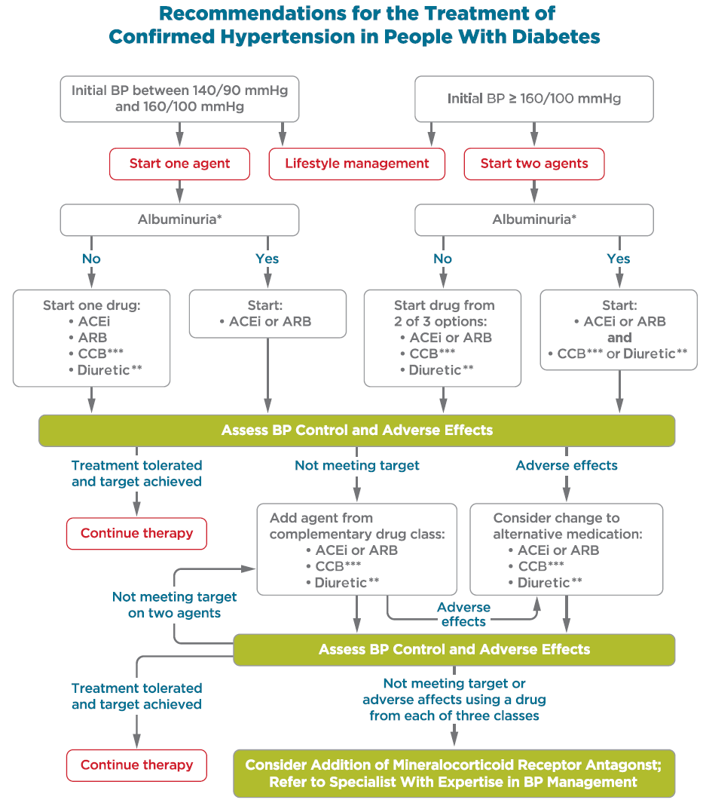
Notes:
New to the standards in 2018, an algorithm summarizing recommendations for the treatment of confirmed hypertension in people with diabetes has been added to Section 9.
A few key points about this algorithm is that it has different pathways depending on blood pressure at hypertension diagnosis as well as the presence or absence of albuminuria. It also emphasizes that ACE inhibitors and ARBs should not be combined.
[SLIDE]
158

Slide 159
Lipid Management: Recommendations
Lifestyle Intervention
Lifestyle modification focusing on weight loss (if indicated); the reduction of saturated fat, trans fat, and cholesterol intake; increase of dietary n-3 fatty acids, viscous fiber, and plant stanols/sterols intake; and increased physical activity should be recommended to improve the lipid profile in patients with diabetes. A
Intensify lifestyle therapy and optimize glycemic control for patients with elevated triglyceride levels (≥150 mg/dL) and/or low HDL cholesterol (<40 mg/dL for men, <50 for women). C
Cardiovascular Disease and Risk Management:
Standards of Medical Care in Diabetes - 2018. Diabetes Care 2018; 41 (Suppl. 1): S86-S104
Notes:
Moving on to recommendations for lipid management. The following two recommendations are provided in regard to lifestyle interventions.
Lifestyle modification focusing on weight loss (if indicated); the reduction of saturated fat, trans fat, and cholesterol intake; increase of dietary n-3 fatty acids, viscous fiber, and plant stanols/sterols intake; and increased physical activity should be recommended to improve the lipid profile in patients with diabetes. A
Intensify lifestyle therapy and optimize glycemic control for patients with elevated triglyceride levels (≥150 mg/dL) and/or low HDL cholesterol (<40 mg/dL for men, <50 for women). C
[SLIDE]
159
Reference
American Diabetes Association. Standards of medical care in diabetes—2014. Diabetes Care 2014;37(suppl 1):S36

Slide 160
Lipid Management: Recommendations (2)
Ongoing Therapy and Monitoring with Lipid Panel
In adults not taking statins or other lipid-lowering therapy, it is reasonable to obtain a lipid profile at the time of diabetes diagnosis, at an initial medical evaluation, and every 5 years thereafter if under the age of 40 years, or more frequently if indicated. E
Obtain a lipid profile at initiation of statins or other lipid-lowering therapy, 4-12 weeks after initiation or a change in dose, and annually thereafter as it may help to monitor the response to therapy and inform adherence. E
Cardiovascular Disease and Risk Management:
Standards of Medical Care in Diabetes - 2018. Diabetes Care 2018; 41 (Suppl. 1): S86-S104
Notes:
In adults not taking statins or other lipid-lowering therapy, it is reasonable to obtain a lipid profile at the time of diabetes diagnosis, at an initial medical evaluation, and every 5 years thereafter if under the age of 40 years, or more frequently if indicated. E
Obtain a lipid profile at initiation of statins or other lipid-lowering therapy, 4-12 weeks after initiation or a change in dose, and annually thereafter as it may help to monitor the response to therapy and inform adherence. E
[SLIDE]
160
Reference
American Diabetes Association. Standards of medical care in diabetes—2014. Diabetes Care 2014;37(suppl 1):S36

Slide 161
Lipid Management: Recommendations (3)
Statin Treatment
For patients of all ages with diabetes and ASCVD, high-intensity statin therapy should be added to lifestyle therapy. A
For patients with diabetes aged <40 years with additional ASCVD risk factors, the patient and provider should consider using moderate-intensity statin in addition to lifestyle therapy. C
Cardiovascular Disease and Risk Management:
Standards of Medical Care in Diabetes - 2018. Diabetes Care 2018; 41 (Suppl. 1): S86-S104
Notes:
The 2018 Standards provide 6 individual recommendations related specifically to statin treatment. They are as follows:
For patients of all ages with diabetes and ASCVD, high-intensity statin therapy should be added to lifestyle therapy. A
For patients with diabetes aged <40 years with additional ASCVD risk factors, the patient and provider should consider using moderate-intensity statin in addition to lifestyle therapy. C
[SLIDE]
161
Reference
American Diabetes Association. Standards of medical care in diabetes—2014. Diabetes Care 2014;37(suppl 1):S36

Slide 162
Lipid Management: Recommendations (4)
Statin Treatment
For patients with diabetes aged 40-75 years A and >75 years B without ASCVD, use moderate-intensity statin in addition to lifestyle therapy.
In clinical practice, providers may need to adjust the intensity of statin therapy based on individual patient response to medication (e.g., side effects, tolerability, LDL levels, or percent LDL reduction on statin therapy). For patients who do not tolerate the intended intensity of statin, the maximally tolerated statin dose should be used. E
Cardiovascular Disease and Risk Management:
Standards of Medical Care in Diabetes - 2018. Diabetes Care 2018; 41 (Suppl. 1): S86-S104
Notes:
For patients with diabetes aged 40-75 years A and >75 years B without ASCVD, use moderate-intensity statin in addition to lifestyle therapy.
In clinical practice, providers may need to adjust the intensity of statin therapy based on individual patient response to medication (e.g., side effects, tolerability, LDL levels, or percent LDL reduction on statin therapy). For patients who do not tolerate the intended intensity of statin, the maximally tolerated statin dose should be used. E
[SLIDE]
162
Reference
American Diabetes Association. Standards of medical care in diabetes—2014. Diabetes Care 2014;37(suppl 1):S36

Slide 163
Lipid Management: Recommendations (5)
Statin Treatment:
For patients with diabetes and ASCVD, if LDL cholesterol is ≥70 md/dL on maximally tolerated statin dose, consider adding additional LDL-lowering therapy (such as ezetimibe or PCSK9 inhibitor) after evaluating the potential for further ASCVD risk reduction, drug-specific adverse effects, and patient preferences. Ezetimibe may be preferred due to lower cost. A
Statin therapy is contraindicated in pregnancy. B
Cardiovascular Disease and Risk Management:
Standards of Medical Care in Diabetes - 2018. Diabetes Care 2018; 41 (Suppl. 1): S86-S104
Notes:
For patients with diabetes and ASCVD, if LDL cholesterol is ≥70 md/dL on maximally tolerated statin dose, consider adding additional LDL-lowering therapy (such as ezetimibe or PCSK9 inhibitor) after evaluating the potential for further ASCVD risk reduction, drug-specific adverse effects, and patient preferences. Ezetimibe may be preferred due to lower cost. A
Statin therapy is contraindicated in pregnancy. B
[SLIDE]
163
Reference
American Diabetes Association. Standards of medical care in diabetes—2014. Diabetes Care 2014;37(suppl 1):S36

Slide 164
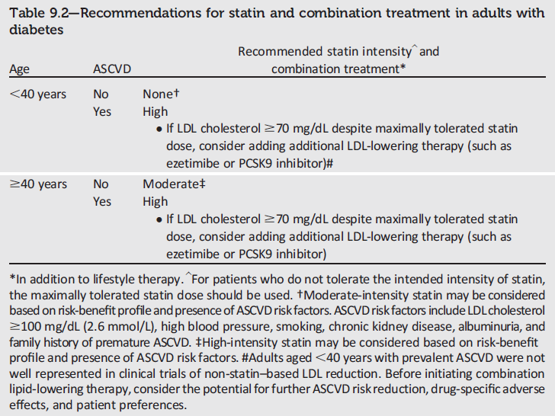
Notes:
The recommendations in Table 9.2 regarding statin and combination treatment in adults with diabetes have been revised for 2018 to stratify risk based on whether a patient is older or younger than 40 years of age and on whether a patient has ASCVD. For example, patients of any age with ASCVD should be placed on a high-intensity statin.
[SLIDE]

Slide 165
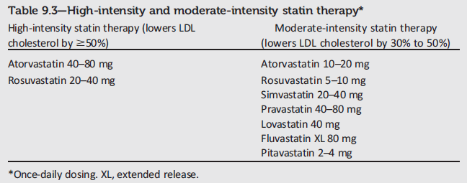
High- and Moderate-Intensity Statin Therapy
Cardiovascular Disease and Risk Management:
Standards of Medical Care in Diabetes - 2018. Diabetes Care 2018; 41 (Suppl. 1): S86-S104
Notes:
Here’s a quick summary of recommended statin dosing for high and moderate intensity therapy. Note that these are all based on once-daily dosing.
[SLIDE]
165

Slide 166
Lipid Management: Recommendations (6)
Treatment of Other Lipoprotein Fractions or Targets
For patients with fasting triglyceride levels ≥500 md/dL, evaluate for secondary causes of hypertriglyceridemia and consider medical therapy to reduce the risk of pancreatitis. C
Cardiovascular Disease and Risk Management:
Standards of Medical Care in Diabetes - 2018. Diabetes Care 2018; 41 (Suppl. 1): S86-S104
Notes:
For patients with fasting triglyceride levels ≥500 md/dL, evaluate for secondary causes of hypertriglyceridemia and consider medical therapy to reduce the risk of pancreatitis.
[SLIDE]
166
Reference
American Diabetes Association. Standards of medical care in diabetes—2014. Diabetes Care 2014;37(suppl 1):S36

Slide 167
Lipid Management: Recommendations (7)
Other Combination Therapy
Combination therapy (statin/fibrate) has not been shown to improve ASCVD outcomes and is generally not recommended. A
Combination therapy (statin/niacin) has not been shown to provide additional CV benefit above statin therapy alone, may increase the risk of stroke with additional side effects, and is generally not recommended. A
Cardiovascular Disease and Risk Management:
Standards of Medical Care in Diabetes - 2018. Diabetes Care 2018; 41 (Suppl. 1): S86-S104
Notes:
In regard to other treatment combinations for the management of hyperlipidemia,
Combination therapy (statin/fibrate) has not been shown to improve ASCVD outcomes and is generally not recommended. A
Combination therapy (statin/niacin) has not been shown to provide additional CV benefit above statin therapy alone, may increase the risk of stroke with additional side effects, and is generally not recommended. A
[SLIDE]
167
Reference
American Diabetes Association. Standards of medical care in diabetes—2014. Diabetes Care 2014;37(suppl 1):S36

Slide 168
Antiplatelet Agents: Recommendations
Use aspirin therapy (75-162 mg/day) as a secondary prevention strategy in those with diabetes and a history of ASCVD. A
For patients with ASCVD and documented aspirin allergy, clopidogrel (75 mg/day) should be used. B
Dual antiplatelet therapy (with low-dose aspirin and a P2Y12 inhibitor) is reasonable for a year after an acute coronary syndrome A and may have benefits beyond this period. B
Cardiovascular Disease and Risk Management:
Standards of Medical Care in Diabetes - 2018. Diabetes Care 2018; 41 (Suppl. 1): S86-S104
Notes:
Aspirin has been shown to be effective in reducing cardiovascular morbidity and mortality in high-risk patients with previous MI or stroke (secondary prevention). Its net benefit in primary prevention among patients with no previous cardiovascular events is more controversial, both for patients with and without diabetes.
Multiple recent well-conducted studies and meta-analyses reported a risk of heart disease and stroke that is equivalent if not higher in women compared to men with diabetes, including among non-elderly adults. Thus, the recommendations for using aspirin as primary prevention are now revised to include both men and women aged 50 years or older with diabetes and one or more major risk factors, to reflect these more recent findings.
Recommendations for the use of antiplatelet agents are summarized in two slides. The 2018 recommendations are as follows:
Use aspirin therapy (75-162 mg/day) as a secondary prevention strategy in those with diabetes and a history of ASCVD. A
For patients with ASCVD and documented aspirin allergy, clopidogrel (75 mg/day) should be used. B
Dual antiplatelet therapy (with low-dose aspirin and a P2Y12 inhibitor) is reasonable for a year after an acute coronary syndrome A and may have benefits beyond this period. B
[SLIDE}
168
References
American Diabetes Association. Standards of medical care in diabetes—2014. Diabetes Care 2014;37(suppl 1):S40–S41
Pignone M, Alberts MJ, Colwell JA, et al.; American Diabetes Association; American Heart Association; American College of Cardiology Foundation. Aspirin for primary prevention of cardiovascular events in people with diabetes: a position statement of the American Diabetes Association, a scientific statement of the American Heart Association, and an expert consensus document of the American College of Cardiology Foundation. Diabetes Care 2010;33:1395–1402

Slide 169
Antiplatelet Agents: Recommendations (2)
Aspirin therapy (75-162 mg/day) may be considered as a primary prevention strategy in those with type 1 or type 2 diabetes who are at increased CV risk. This includes most men and women with diabetes aged ≥50 years who have at least one additional major risk factor (family history of premature ASCVD, hypertension, dyslipidemia, smoking, or albuminuria) and are not at increased risk of bleeding. A
Cardiovascular Disease and Risk Management:
Standards of Medical Care in Diabetes - 2018. Diabetes Care 2018; 41 (Suppl. 1): S86-S104
Notes:
Aspirin therapy (75-162 mg/day) may be considered as a primary prevention strategy in those with type 1 or type 2 diabetes who are at increased CV risk. This includes most men and women with diabetes aged ≥50 years who have at least one additional major risk factor (family history of premature ASCVD, hypertension, dyslipidemia, smoking, or albuminuria) and are not at increased risk of bleeding. A
[SLIDE]
169
References
American Diabetes Association. Standards of medical care in diabetes—2014. Diabetes Care 2014;37(suppl 1):S40–S41
Pignone M, Alberts MJ, Colwell JA, et al.; American Diabetes Association; American Heart Association; American College of Cardiology Foundation. Aspirin for primary prevention of cardiovascular events in people with diabetes: a position statement of the American Diabetes Association, a scientific statement of the American Heart Association, and an expert consensus document of the American College of Cardiology Foundation. Diabetes Care 2010;33:1395–1402

Slide 170
Coronary Heart Disease: Recommendations
Screening
In asymptomatic patients, routine screening for CAD is not recommended as it does not improve outcomes as long as ASCVD risk factors are treated. A
Consider investigations for CAD in the presence of:
  Atypical cardiac symptoms (e.g. unexplained dyspnea, chest discomfort)
  Signs or symptoms of associated vascular disease including carotid bruits, transient ischemic attack, stroke, claudication or PAD
  EKG abnormalities (e.g. Q waves). E
Cardiovascular Disease and Risk Management:
Standards of Medical Care in Diabetes - 2018. Diabetes Care 2018; 41 (Suppl. 1): S86-S104
Notes:
Recommendations for screening for coronary heart disease are summarized on this slide:
The screening of asymptomatic patients with high ASCVD risk is not recommended, in part because these high-risk patients should already be receiving intensive medical therapy, an approach that provides similar benefit as invasive revascularization. There is also some evidence that silent MI may reverse over time, adding to the controversy concerning aggressive screening strategies
But do consider investigations for coronary artery disease in the presence of any of the following:
Atypical cardiac symptoms (e.g. unexplained dyspnea, chest discomfort)
Signs or symptoms of associated vascular disease including carotid bruits, transient ischemic attack, stroke, claudication or peripheral arterial disease
EKG abnormalities (e.g. Q waves)
[SLIDE]
170
Reference
American Diabetes Association. Standards of medical care in diabetes—2014. Diabetes Care 2014;37(suppl 1):S42

Slide 171
Coronary Heart Disease: Recommendations (2)
Treatment
In patients with known ASCVD, consider ACE inhibitor or ARB therapy to reduce the risk of CV events. A
In patients with prior myocardial infarction, β-blockers should be continued for at least 2 years after the event. B
In patients with T2DM with stable congestive heart failure, metformin may be used if estimated glomerular filtration rate remains >30 mL/min but should be avoided in unstable or hospitalized patients with congestive heart failure. B
Cardiovascular Disease and Risk Management:
Standards of Medical Care in Diabetes - 2018. Diabetes Care 2018; 41 (Suppl. 1): S86-S104
Notes:
Recommendations for treatment of coronary heart disease are summarized on this and the next slide:
[SLIDE]
171
Reference
American Diabetes Association. Standards of medical care in diabetes—2014. Diabetes Care 2014;37(suppl 1):S42

Slide 172
Coronary Heart Disease: Recommendations (3)
Treatment
In patients with T2DM and established ASCVD, antihyperglycemic therapy should begin with lifestyle management and metformin and subsequently incorporate an agent proven to reduce major adverse CV events and CV mortality (currently empagliflozin and liraglutide), after considering drug-specific and patient factors. A
In patients with T2DM and established ASCVD, after lifestyle management and metformin, the antihyperglycemic agent canagliflozin may be considered to reduce major adverse CV events, based on drug-specific and patient factors. C
Cardiovascular Disease and Risk Management:
Standards of Medical Care in Diabetes - 2018. Diabetes Care 2018; 41 (Suppl. 1): S86-S104
Notes:
In patients with T2DM and established ASCVD, antihyperglycemic therapy should begin with lifestyle management and metformin and subsequently incorporate an agent proven to reduce major adverse CV events and CV mortality (currently empagliflozin and liraglutide), after considering drug-specific and patient factors. A
In patients with T2DM and established ASCVD, after lifestyle management and metformin, the antihyperglycemic agent canagliflozin may be considered to reduce major adverse CV events, based on drug-specific and patient factors. C
[SLIDE]
172
Reference
American Diabetes Association. Standards of medical care in diabetes—2014. Diabetes Care 2014;37(suppl 1):S42

Slide 173
10. Microvascular Complications and Foot Care
Notes:
Moving onto section 10, Microvascular Complications and Foot Care.
[SLIDE]
173

Slide 174
Diabetic Kidney Disease (DKD): Recommendations
Screening
At least once a year, assess urinary albumin (e.g., spot urinary albumin-to-creatinine ratio) and estimated glomerular filtration rate (eGFR):
  In patients with type 1 diabetes with duration of ≥5 years B
  In all patients with type 2 diabetes B
  In all patients with comorbid hypertension B
Microvascular Complications and Foot Care:
Standards of Medical Care in Diabetes - 2018. Diabetes Care 2018; 41 (Suppl. 1): S105-S118
Notes:
Recommendations for screening patients with diabetic kidney disease are highlighted on this slide. Diabetic kidney disease, or chronic kidney disease attributed to diabetes, occurs in 20–40% of patients with diabetes and is the leading cause of end-stage renal disease (ESRD). Kidney disease not attributable to diabetes, and due to other etiologies, is referred to as chronic kidney disease (CKD).
Screening is recommended to occur at least once a year, assess urinary albumin (e.g., spot urine albumin-to-creatinine ratio [UACR]) and estimated glomerular filtration rate (eGFR) in patients with type 1 diabetes with duration of ≥5 years, in all patients with type 2 diabetes, and in all patients with comorbid hypertension.
174
Reference
American Diabetes Association. Standards of medical care in diabetes—2014. Diabetes Care 2014;37(suppl 1):S42

Slide 175
Diabetic Kidney Disease (DKD): Recommendations (2)
Treatment
Optimize glucose control to reduce the risk or slow progression of DKD. A
Optimize blood pressure control to reduce the risk or slow progression of DKD. A
For people with nondialysis-dependent DKD, dietary protein intake should be ~0.8 g/kg body weight per day (the recommended daily allowance). For patients on dialysis, higher levels of dietary protein intake should be considered. B
Microvascular Complications and Foot Care:
Standards of Medical Care in Diabetes - 2018. Diabetes Care 2018; 41 (Suppl. 1): S105-S118
Notes:
The following series of slides will outline 2018 recommendations related to the treatment of DKD. The recommendations are as follows:
Optimize glucose control to reduce the risk or slow progression of DKD. A
Optimize blood pressure control to reduce the risk or slow progression of DKD. A
For people with nondialysis-dependent DKD, dietary protein intake should be ~0.8 g/kg body weight per day (the recommended daily allowance). For patients on dialysis, higher levels of dietary protein intake should be considered. B
[SLIDE]
175
References
American Diabetes Association. Standards of medical care in diabetes—2014. Diabetes Care 2014;37(suppl 1):S42–S43
The Diabetes Control and Complications (DCCT) Research Group. Effect of intensive therapy on the development and progression of diabetic nephropathy in the Diabetes Control and Complications Trial. Kidney Int 1995;47:1703–1720
UK Prospective Diabetes Study (UKPDS) Group. Effect of intensive blood-glucose control with metformin on complications in overweight patients with type 2 diabetes (UKPDS 34). Lancet 1998;352:854–865
UK Prospective Diabetes Study Group. Tight blood pressure control and risk of macrovascular and microvascular complications in type 2 diabetes: UKPDS 38. BMJ 1998;317:703–713

Slide 176
Diabetic Kidney Disease (DKD): Recommendations (3)
Treatment
In nonpregnant patients with diabetes and hypertension, either an ACE inhibitor or ARB is recommended for those with modestly elevated urinary albumin-to-creatinine ratio (UACR) (30–299 mg/g creatinine) B and is strongly recommended for those with UACR ≥300 mg/g creatinine and/or eGFR <60 mL/min/1.73m². A
Microvascular Complications and Foot Care:
Standards of Medical Care in Diabetes - 2018. Diabetes Care 2018; 41 (Suppl. 1): S105-S118
Notes:
In nonpregnant patients with diabetes and hypertension, either an ACE inhibitor or ARB is recommended for those with modestly elevated urinary albumin-to-creatinine ratio (30–299 mg/g creatinine) B and is strongly recommended for those with urinary albumin-to-creatinine ratio ≥300 mg/g creatinine and/or eGFR <60 mL/min/1.73m². A
[SLIDE]
176
References
American Diabetes Association. Standards of medical care in diabetes—2014. Diabetes Care 2014;37(suppl 1):S42–S43
The Diabetes Control and Complications (DCCT) Research Group. Effect of intensive therapy on the development and progression of diabetic nephropathy in the Diabetes Control and Complications Trial. Kidney Int 1995;47:1703–1720
UK Prospective Diabetes Study (UKPDS) Group. Effect of intensive blood-glucose control with metformin on complications in overweight patients with type 2 diabetes (UKPDS 34). Lancet 1998;352:854–865
UK Prospective Diabetes Study Group. Tight blood pressure control and risk of macrovascular and microvascular complications in type 2 diabetes: UKPDS 38. BMJ 1998;317:703–713

Slide 177
Diabetic Kidney Disease (DKD): Recommendations (4)
Treatment
Periodically monitor serum creatinine and potassium levels for the development of increased creatinine or changes in potassium when ACE inhibitors, ARBs, or diuretics are used. B
Continued monitoring of UACR in patients with albuminuria treated with an ACE inhibitor or ARB is reasonable to assess the response to treatment and progression of DKD. E
Microvascular Complications and Foot Care:
Standards of Medical Care in Diabetes - 2018. Diabetes Care 2018; 41 (Suppl. 1): S105-S118
Notes:
Periodically monitor serum creatinine and potassium levels for the development of increased creatinine or changes in potassium when ACE inhibitors, ARBs, or diuretics are used. B
Continued monitoring of UACR in patients with albuminuria treated with an ACE inhibitor or ARB is reasonable to assess the response to treatment and progression of DKD. E
[SLIDE]
177
References
American Diabetes Association. Standards of medical care in diabetes—2014. Diabetes Care 2014;37(suppl 1):S42–S43
The Diabetes Control and Complications (DCCT) Research Group. Effect of intensive therapy on the development and progression of diabetic nephropathy in the Diabetes Control and Complications Trial. Kidney Int 1995;47:1703–1720
UK Prospective Diabetes Study (UKPDS) Group. Effect of intensive blood-glucose control with metformin on complications in overweight patients with type 2 diabetes (UKPDS 34). Lancet 1998;352:854–865
UK Prospective Diabetes Study Group. Tight blood pressure control and risk of macrovascular and microvascular complications in type 2 diabetes: UKPDS 38. BMJ 1998;317:703–713

Slide 178
Diabetic Kidney Disease (DKD): Recommendations (5)
Treatment
An ACE inhibitor or an ARB is not recommended for the primary prevention of DKD in patients with diabetes who have normal blood pressure, normal UACR (<30 mg/g creatinine), and normal eGFR. B
When eGFR rate is <60 mL/min/1.73m², evaluate and manage potential complications of DKD. E
Microvascular Complications and Foot Care:
Standards of Medical Care in Diabetes - 2018. Diabetes Care 2018; 41 (Suppl. 1): S105-S118
Notes:
An ACE inhibitor or an ARB is not recommended for the primary prevention of DKD in patients with diabetes who have normal blood pressure, normal UACR (<30 mg/g creatinine), and normal eGFR. B
When eGFR rate is <60 mL/min/1.73m², evaluate and manage potential complications of DKD. E
[SLIDE]
178
References
American Diabetes Association. Standards of medical care in diabetes—2014. Diabetes Care 2014;37(suppl 1):S42–S43
The Diabetes Control and Complications (DCCT) Research Group. Effect of intensive therapy on the development and progression of diabetic nephropathy in the Diabetes Control and Complications Trial. Kidney Int 1995;47:1703–1720
UK Prospective Diabetes Study (UKPDS) Group. Effect of intensive blood-glucose control with metformin on complications in overweight patients with type 2 diabetes (UKPDS 34). Lancet 1998;352:854–865
UK Prospective Diabetes Study Group. Tight blood pressure control and risk of macrovascular and microvascular complications in type 2 diabetes: UKPDS 38. BMJ 1998;317:703–713

Slide 179
Diabetic Kidney Disease (DKD): Recommendations (6)
Treatment
Patients should be referred for evaluation for renal replacement treatment if they have an eGFR <30 mL/min/1.73m². A
Promptly refer to a physician experienced in the care of kidney disease for uncertainty about the etiology of kidney disease, difficult management issues, and rapidly progressing kidney disease. B
Microvascular Complications and Foot Care:
Standards of Medical Care in Diabetes - 2018. Diabetes Care 2018; 41 (Suppl. 1): S105-S118
Notes:
Patients should be referred for evaluation for renal replacement treatment if they have an eGFR <30 mL/min/1.73m². A
Promptly refer to a physician experienced in the care of kidney disease for uncertainty about the etiology of kidney disease, difficult management issues, and rapidly progressing kidney disease. B
[SLIDE]
179
References
American Diabetes Association. Standards of medical care in diabetes—2014. Diabetes Care 2014;37(suppl 1):S42–S43
The Diabetes Control and Complications (DCCT) Research Group. Effect of intensive therapy on the development and progression of diabetic nephropathy in the Diabetes Control and Complications Trial. Kidney Int 1995;47:1703–1720
UK Prospective Diabetes Study (UKPDS) Group. Effect of intensive blood-glucose control with metformin on complications in overweight patients with type 2 diabetes (UKPDS 34). Lancet 1998;352:854–865
UK Prospective Diabetes Study Group. Tight blood pressure control and risk of macrovascular and microvascular complications in type 2 diabetes: UKPDS 38. BMJ 1998;317:703–713

Slide 180
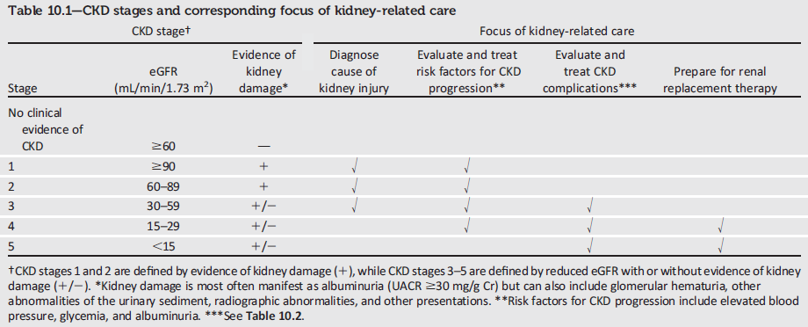
CKD Stages and Corresponding Focus of Kidney-Related Care
Microvascular Complications and Foot Care:
Standards of Medical Care in Diabetes - 2018. Diabetes Care 2018; 41 (Suppl. 1): S105-S118
Notes:
This table from the 2018 Standards of Care summarizes the stages of CKD and the corresponding recommended foci of kidney-related care, as summarized in the DKD recommendations just reviewed.
[SLIDE]
180

Slide 181
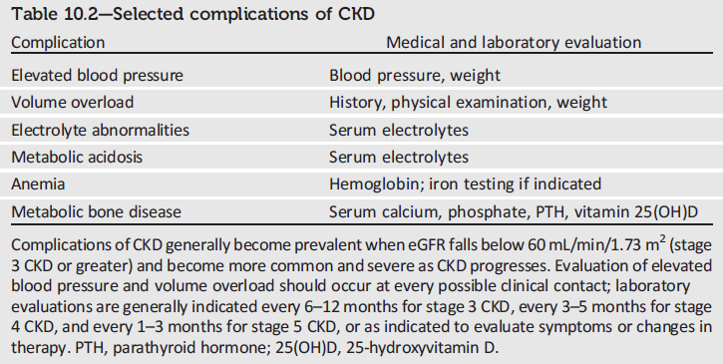
Selected Complications of CKD
Microvascular Complications and Foot Care:
Standards of Medical Care in Diabetes - 2018. Diabetes Care 2018; 41 (Suppl. 1): S105-S118
Notes:
The prevalence of CKD complications correlates with eGFR. When eGFR is <60 mL/min/1.73m2, screening for complications of CKD is indicated (Table 10.2).
[SLIDE]
181

Slide 182
Diabetic Retinopathy: Recommendations
To reduce the risk or slow the progression of diabetic retinopathy:
  Optimize glycemic control. A
  Optimize blood pressure and serum lipid control. A
Microvascular Complications and Foot Care:
Standards of Medical Care in Diabetes - 2018. Diabetes Care 2018; 41 (Suppl. 1): S105-S118
Notes:
Diabetic retinopathy is a highly specific vascular complication of both type 1 and type 2 diabetes, with prevalence strongly related to duration of diabetes. It’s the most frequent cause of new cases of blindness among adults aged 20–74 years
Glaucoma, cataracts, and other disorders of the eye occur earlier and more frequently in people with diabetes
In addition to duration of diabetes, other factors that increase the risk of, or are associated with, retinopathy include chronic hyperglycemia, the presence of nephropathy, and hypertension.
The first line of defense against diabetic retinopathy, to reduce the risk or slow its progression, is to optimize glycemic control, blood pressure, and serum lipid control.
[SLIDE]
182
References
American Diabetes Association. Standards of medical care in diabetes—2014. Diabetes Care 2014;37(suppl 1):S44–S45
Klein R. Hyperglycemia and microvascular and macrovascular disease in diabetes. Diabetes Care 1995;18:258–268
Estacio RO, McFarling E, Biggerstaff S, Jeffers BW, Johnson D, Schrier RW. Overt albuminuria predicts diabetic retinopathy in Hispanics with NIDDM. Am J Kidney Dis 1998;31:947–953
Leske MC, Wu SY, Hennis A, et al., for the Barbados Eye Study Group. Hyperglycemia, blood pressure, and the 9-year incidence of diabetic retinopathy: the Barbados Eye Studies. Ophthalmology 2005;112:799–805

Slide 183
Diabetic Retinopathy: Recommendations (2)
Screening:
Initial dilated and comprehensive eye
examination by an ophthalmologist or optometrist:
  Adults with type 1 diabetes, within 5 years of diabetes onset. B
  Patients with type 2 diabetes at the time of diabetes diagnosis. B
Microvascular Complications and Foot Care:
Standards of Medical Care in Diabetes - 2018. Diabetes Care 2018; 41 (Suppl. 1): S105-S118
Notes:
As far as screening for diabetic retinopathy, your patients with diabetes should have a dilated and comprehensive eye exam by an ophthalmologist or optometrist.
Because retinopathy is estimated to take at least 5 years to develop after the onset of hyperglycemia, patients with type 1 diabetes should have an initial dilated and comprehensive eye examination within 5 years after the diagnosis of diabetes
Patients with type 2 diabetes who may have had years of undiagnosed diabetes and have a significant risk of prevalent diabetic retinopathy at the time of diagnosis should have an initial dilated and comprehensive eye examination at the time of diagnosis.
Results of eye examinations should be documented and transmitted to the referring health care professional.
[SLIDE]
183
Reference
American Diabetes Association. Standards of medical care in diabetes—2014. Diabetes Care 2014;37(suppl 1):S44

Slide 184
Diabetic Retinopathy: Recommendations (3)
Screening:
If there is no evidence of retinopathy for one or more annual eye exams and glycemia is well controlled, then exams every 1-2 years may be considered. If any level of diabetic retinopathy is present, subsequent dilated retinal examinations should be repeated at least annually by an ophthalmologist or optometrist. If retinopathy is progressing or sight-threatening, then examinations will be required more frequently. B
Microvascular Complications and Foot Care:
Standards of Medical Care in Diabetes - 2018. Diabetes Care 2018; 41 (Suppl. 1): S105-S118
Notes:
If there is no evidence of retinopathy for one or more annual eye exams and glycemia is well controlled, then exams every 1-2 years may be considered. If any level of diabetic retinopathy is present, subsequent dilated retinal examinations should be repeated at least annually by an ophthalmologist or optometrist. If retinopathy is progressing or sight-threatening, then examinations will be required more frequently. B
[SLIDE]
184
References
American Diabetes Association. Standards of medical care in diabetes—2014. Diabetes Care 2014;37(suppl 1):S44–S45
Agardh E, Tababat-Khani P. Adopting 3-year screening intervals for sight threatening retinal vascular lesions in type 2 diabetic subjects without retinopathy. Diabetes Care 2011;34:1318–1319

Slide 185
Diabetic Retinopathy: Recommendations (4)
Screening:
While retinal photography may serve as a screening tool for retinopathy, it is not a substitute for a comprehensive eye exam. E
Women with preexisting type 1 or type 2 diabetes who are planning pregnancy or who are pregnant should be counseled on the risk of development and/or progression of diabetic retinopathy. B
Eye examinations should occur before pregnancy or in the first trimester in patients with preexisting type 1 or type 2 diabetes, and then patients should be monitored every trimester and for 1 year postpartum as indicated by the degree of retinopathy. B
Microvascular Complications and Foot Care:
Standards of Medical Care in Diabetes - 2018. Diabetes Care 2018; 41 (Suppl. 1): S105-S118
Notes:
While retinal photography may serve as a screening tool for retinopathy, it is not a substitute for a comprehensive eye exam. E
Women with preexisting type 1 or type 2 diabetes who are planning pregnancy or who are pregnant should be counseled on the risk of development and/or progression of diabetic retinopathy. B
Eye examinations should occur before pregnancy or in the first trimester in patients with preexisting type 1 or type 2 diabetes, and then patients should be monitored every trimester and for 1 year postpartum as indicated by the degree of retinopathy. B
[SLIDE]
185
References
American Diabetes Association. Standards of medical care in diabetes—2014. Diabetes Care 2014;37(suppl 1):S45
Ahmed J, Ward TP, Bursell SE, Aiello LM, Cavallerano JD, Vigersky RA. The sensitivity and specificity of nonmydriatic digital stereoscopic retinal imaging in detecting diabetic retinopathy. Diabetes Care 2006;29:2205–2209

Slide 186
Diabetic Retinopathy: Recommendations (5)
Treatment:
Promptly refer patients with any level of macular edema, severe NPDR, or any PDR to an ophthalmologist who is knowledgeable and experienced in the management of diabetic retinopathy. A
The traditional standard treatment, panretinal laser photocoagulation therapy, is indicated to reduce the risk of vision loss in patients with high-risk PDR and, in some cases, severe NPDR. A
Microvascular Complications and Foot Care:
Standards of Medical Care in Diabetes - 2018. Diabetes Care 2018; 41 (Suppl. 1): S105-S118
Notes:
This slide and the next provides recommendations for the treatment of diabetic retinopathy:
Promptly refer patients with any level of macular edema, severe NPDR, or any PDR to an ophthalmologist who is knowledgeable and experienced in the management of diabetic retinopathy. A
The traditional standard treatment, panretinal laser photocoagulation therapy, is indicated to reduce the risk of vision loss in patients with high-risk PDR and, in some cases, severe NPDR. A
[SLIDE]
186
Reference
American Diabetes Association. Standards of medical care in diabetes—2014. Diabetes Care 2014;37(suppl 1):S45

Slide 187
Diabetic Retinopathy: Recommendations (6)
Treatment:
Intravitreous injections of anti-vascular endothelial growth factor ranibizumab are not inferior to traditional panretinal laser photocoagulation and are also indicated to reduce the risk of vision loss in patients with PDR. A
Intravitreous injections of anti-vascular endothelial growth factor are indicated for central-involved diabetic macular edema, which occurs beneath the foveal center and may threaten reading vision. A
The presence of retinopathy is not a contraindication to aspirin therapy for cardioprotection, as aspirin does not increase the risk of retinal hemorrhage. A
Microvascular Complications and Foot Care:
Standards of Medical Care in Diabetes - 2018. Diabetes Care 2018; 41 (Suppl. 1): S105-S118
Notes:
This recommendation is new for 2018, in recognition of recent data and regulatory changes by the FDA: Intravitreous injections of anti-vascular endothelial growth factor ranibizumab are not inferior to traditional panretinal laser photocoagulation and are also indicated to reduce the risk of vision loss in patients with PDR. A
Intravitreous injections of anti-vascular endothelial growth factor are indicated for central-involved diabetic macular edema, which occurs beneath the foveal center and may threaten reading vision. A
The presence of retinopathy is not a contraindication to aspirin therapy for cardioprotection, as aspirin does not increase the risk of retinal hemorrhage. A
[SLIDE]
187
Reference
American Diabetes Association. Standards of medical care in diabetes—2014. Diabetes Care 2014;37(suppl 1):S45

Slide 188
Neuropathy: Overview
Early recognition and management is important because:
Diabetic neuropathy (DN) is a diagnosis of exclusion.
Numerous treatment options exist.
Up to 50% of diabetic peripheral neuropathy (DPN) may be asymptomatic.
Recognition & treatment may improve symptoms, reduce sequelae, and improve quality of life.
Microvascular Complications and Foot Care:
Standards of Medical Care in Diabetes - 2018. Diabetes Care 2018; 41 (Suppl. 1): S105-S118
Notes:
The early recognition and appropriate management of neuropathy in the patient with diabetes is important because: [CLICK]
Diabetic neuropathy is a diagnosis of exclusion. Nondiabetic neuropathies may be present in patients with diabetes and may be treatable. [CLICK]
Numerous treatment options exist for symptomatic diabetic neuropathy. [CLICK]
Up to 50% of DPN may be asymptomatic. If not recognized and if preventive foot care is not implemented (see below), patients are at risk for injuries to their insensate feet. [CLICK]
Recognition and treatment of autonomic neuropathy may improve symptoms, reduce sequelae, and improve quality-of-life.
[SLIDE]
188
Reference
American Diabetes Association. Standards of medical care in diabetes—2014. Diabetes Care 2014;37(suppl 1):S45

Slide 189
Neuropathy: Recommendations
Screening:
All patients should be assessed for DPN starting at diagnosis for T2DM and 5 years after diagnosis of T1DM and at least annually thereafter. B
Assessment for distal symmetric polyneuropathy should include a careful history and assessment of either temperature or pinprick sensation (small-fiber function) and vibration sensation using a 128-Hz tuning fork (for large-fiber function). All patients should have annual 10-g monofilament testing to identify feet at risk for ulceration and amputation. B
Symptoms and signs of autonomic neuropathy should be assessed in patients with microvascular complications. E
Microvascular Complications and Foot Care:
Standards of Medical Care in Diabetes - 2018. Diabetes Care 2018; 41 (Suppl. 1): S105-S118
Notes:
Specific screening recommendations for neuropathy include:
All patients should be assessed for DPN starting at diagnosis for T2DM and 5 years after diagnosis of T1DM and at least annually thereafter. B [CLICK]
Assessment for distal symmetric polyneuropathy should include a careful history and assessment of either temperature or pinprick sensation (small-fiber function) and vibration sensation using a 128-Hz tuning fork (for large-fiber function). All patients should have annual 10-g monofilament testing to identify feet at risk for ulceration and amputation. B [CLICK]
Symptoms and signs of autonomic neuropathy should be assessed in patients with microvascular complications. E [CLICK]
[SLIDE]
189
Reference
American Diabetes Association. Standards of medical care in diabetes—2014. Diabetes Care 2014;37(suppl 1):S45

Slide 190
Neuropathy: Recommendations (2)
Treatment:
Optimize glucose control to prevent or delay the development of neuropathy in patients with T1DM A and to slow the progression in patients with T2DM. B
Assess and treat patients to reduce pain related to DPN B and symptoms of autonomic neuropathy and to improve quality of life. E
Either pregabalin or duloxetine are recommended as initial pharmacologic treatments for neuropathic pain in diabetes. A
Microvascular Complications and Foot Care:
Standards of Medical Care in Diabetes - 2018. Diabetes Care 2018; 41 (Suppl. 1): S105-S118
Notes:
Near-normal glycemic control, implemented early in the course of diabetes, has been shown to effectively delay or prevent the development of DPN and cardiovascular autonomic diabetes in patients with type 1 diabetes.
While the evidence for the benefit of near-normal glycemic control is not as strong for type 2 diabetes, some studies have demonstrated a modest slowing of progression without reversal of neuronal loss.
Recommendations for treatment of neuropathy in patients with diabetes include:
Optimize glucose control to prevent or delay the development of neuropathy in patients with T1DM A and to slow the progression in patients with T2DM. B [CLICK]
Assess and treat patients to reduce pain related to DPN B and symptoms of autonomic neuropathy and to improve quality of life. E [CLICK]
Either pregabalin or duloxetine are recommended as initial pharmacologic treatments for neuropathic pain in diabetes. A [CLICK]
[SLIDE]
190
References
American Diabetes Association. Standards of medical care in diabetes—2014. Diabetes Care 2014;37(suppl 1):S46
Ismail-Beigi F, Craven T, Banerji MA, et al for the ACCORD Trial Group. Effect of intensive treatment of hyperglycaemia on microvascular outcomes in type 2 diabetes: an analysis of the ACCORD randomised trial. Lancet 2010;376:419–430
Bril V, England J, Franklin GM, et al for the American Academy of Neurology; American Association of Neuromuscular and Electrodiagnostic Medicine; American Academy of Physical Medicine and Rehabilitation. Evidence-based guideline: treatment of painful diabetic neuropathy: report of the American Academy of Neurology, the American Association of Neuromuscular and Electrodiagnostic Medicine, and the American Academy of Physical Medicine and Rehabilitation. Neurology 2011;76:1758–1765

Slide 191
Foot Care
Appropriate foot care practices are important in diabetes care for a number of reasons:
Foot ulcers and amputation are common and represent major causes of morbidity and mortality.
Early recognition and treatment of feet at risk for ulcers and amputation can delay or prevent adverse outcomes.
Microvascular Complications and Foot Care:
Standards of Medical Care in Diabetes - 2018. Diabetes Care 2018; 41 (Suppl. 1): S105-S118
Notes:
Appropriate foot care practices are important in diabetes care for a number of reasons: [CLICK]
Foot ulcers and amputation are common and represent major causes of morbidity and mortality. [CLICK]
Early recognition and treatment of feet at risk for ulcers and amputation can delay or prevent adverse outcomes. [CLICK]
[SLIDE]
191
Reference
American Diabetes Association. Standards of medical care in diabetes—2014. Diabetes Care 2014;37(suppl 1):S45

Slide 192
Foot Care: Risk Of Ulcer and Amputation
Risk of ulcers or amputations is increased in people with the following risk factors:
Poor glycemic control
Peripheral neuropathy with loss of protective sensation (LOPS)
Cigarette smoking
Foot deformities
Preulcerative callus or corn
PAD
History of foot ulcer
Amputation
Visual impairment
DKD (especially patients on dialysis)
Microvascular Complications and Foot Care:
Standards of Medical Care in Diabetes - 2018. Diabetes Care 2018; 41 (Suppl. 1): S105-S118
Notes:
Risk of ulcers or amputations is increased in people with the following risk factors:
Poor glycemic control
Peripheral neuropathy with loss of protective sensation (LOPS)
Cigarette smoking
Foot deformities
Preulcerative callus or corn
PAD
History of foot ulcer
Amputation
Visual impairment
DKD (especially patients on dialysis)
[SLIDE]
192
Reference
American Diabetes Association. Standards of medical care in diabetes—2014. Diabetes Care 2014;37(suppl 1):S45

Slide 193
Foot Care: Recommendations
Perform a comprehensive foot evaluation at least annually to identify risk factors for ulcers and amputations. B
All patients with diabetes should have their feet inspected at every visit. C
Obtain a prior history of ulceration, amputation, Charcot foot, angioplasty or vascular surgery, cigarette smoking, retinopathy, and renal disease and assess current symptoms of neuropathy (pain, burning, numbness) and vascular disease (leg fatigue, claudication). B
Microvascular Complications and Foot Care:
Standards of Medical Care in Diabetes - 2018. Diabetes Care 2018; 41 (Suppl. 1): S105-S118
Notes:
Given the importance of foot care in the prevention of morbidity and mortality, the following recommendations are provided:
For all patients with diabetes, perform a comprehensive foot evaluation each year to identify risk factors for ulcers and amputations, and perform a foot inspection at every visit. [CLICK]
The history should obtain a prior history of ulceration, amputation, Charcot foot, angioplasty or vascular surgery, cigarette smoking, retinopathy and renal disease, and assess current symptoms of neuropathy (pain, burning, numbness) and vascular disease (leg fatigue, claudication).
[SLIDE]
193
Reference
American Diabetes Association. Standards of medical care in diabetes—2014. Diabetes Care 2014;36(suppl 1):S47–S48

Slide 194
Foot Care: Recommendations (2)
The examination should include inspection of the skin, assessment of foot deformities, neurologic assessment (10-g monofilament testing with at least one other assessment: pinprick, temperature, vibration), and vascular assessment including pulses in the legs and feet. B
Patients with symptoms of claudication or decreased or absent pedal pulses should be referred for ABI and for further vascular assessment as appropriate. C
Microvascular Complications and Foot Care:
Standards of Medical Care in Diabetes - 2018. Diabetes Care 2018; 41 (Suppl. 1): S105-S118
Notes:
The examination should include inspection of the skin, assessment of foot deformities, neurologic assessment (10-g monofilament testing with at least one other assessment: pinprick, temperature, vibration), and vascular assessment including pulses in the legs and feet. B
Patients with symptoms of claudication or decreased or absent pedal pulses should be referred for ABI and for further vascular assessment as appropriate. C
[SLIDE]
194
Reference
American Diabetes Association. Standards of medical care in diabetes—2014. Diabetes Care 2014;36(suppl 1):S47–S48

Slide 195
Foot Care: Recommendations (3)
A multidisciplinary approach is recommended for individuals with foot ulcers and high-risk feet (e.g., dialysis patients and those with Charcot foot, prior ulcers, or amputation). B
Refer patients who smoke or who have histories of prior lower-extremity complications, loss of protective sensation, structural abnormalities, or PAD to foot care specialists for ongoing preventive care and life-long surveillance. C
Microvascular Complications and Foot Care:
Standards of Medical Care in Diabetes - 2018. Diabetes Care 2018; 41 (Suppl. 1): S105-S118
Notes:
A multidisciplinary approach is recommended for individuals with foot ulcers and high-risk feet (e.g., dialysis patients and those with Charcot foot, prior ulcers, or amputation). B
Refer patients who smoke or who have histories of prior lower-extremity complications, loss of protective sensation, structural abnormalities, or PAD to foot care specialists for ongoing preventive care and life-long surveillance. C
[SLIDE]
195
Reference
American Diabetes Association. Standards of medical care in diabetes—2014. Diabetes Care 2014;36(suppl 1):S47–S48

Slide 196
Foot Care: Recommendations (4)
Provide general preventive foot self-care education to all patients with diabetes. B
The use of specialized therapeutic footwear is recommended for high-risk patients with diabetes including those with severe neuropathy, foot deformities, or history of amputation. B
Microvascular Complications and Foot Care:
Standards of Medical Care in Diabetes - 2018. Diabetes Care 2018; 41 (Suppl. 1): S105-S118
Notes:
Provide general preventive foot self-care education to all patients with diabetes. B
The use of specialized therapeutic footwear is recommended for high-risk patients with diabetes including those with severe neuropathy, foot deformities, or history of amputation. B
[SLIDE]
196
Reference
American Diabetes Association. Standards of medical care in diabetes—2014. Diabetes Care 2014;36(suppl 1):S47–S48

Slide 197
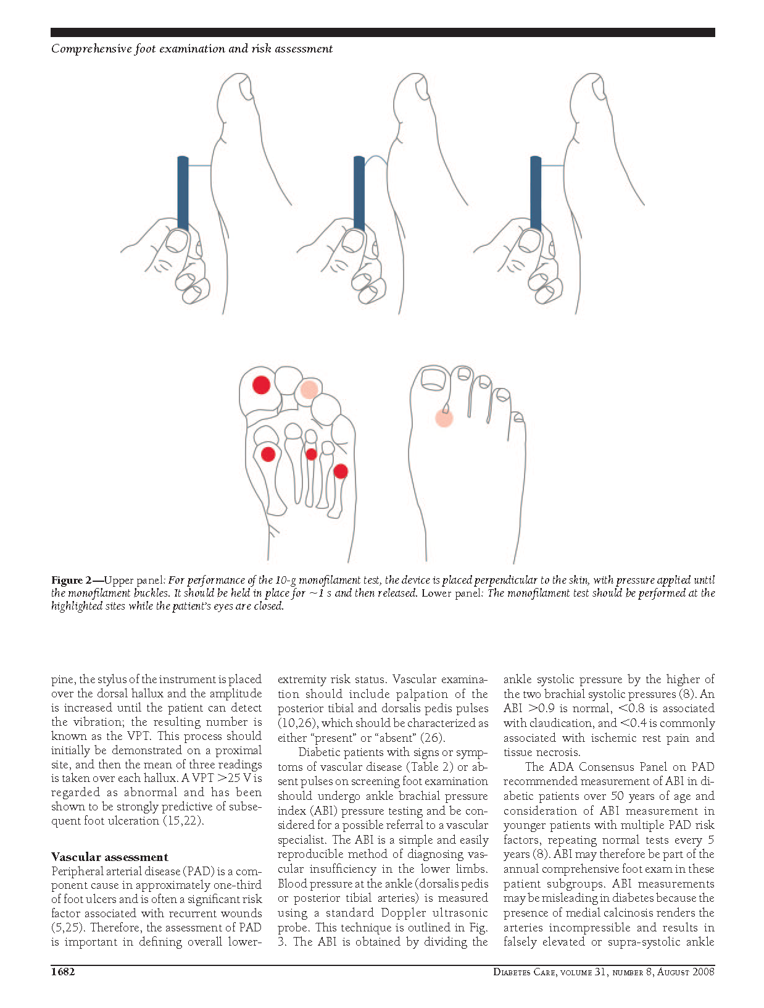
Foot Care: Recommendations (5)
To perform the 10-g monofilament test, place the device perpendicular to the skin; Apply pressure until monofilament buckles.
Hold in place for 1 second & release.
The monofilament test should be performed at the highlighted sites while the patient’s eyes are closed.
Boulton A, Armstrong D, Albert, S et. al. Comprehensive
Foot Examination and Risk Assessment. Diabetes Care. 2008; 31: 1679-1685
Notes:
This slide illustrates how to perform the 10-g monofilament test
Upper panel
To perform the 10-g monofilament test, place the device perpendicular to the skin, with pressure applied until the monofilament buckles
Hold in place for 1 second and then release
Lower panel
The monofilament test should be performed at the highlighted sites while the patient’s eyes are closed
[SLIDE]
197
References
American Diabetes Association. Standards of medical care in diabetes—2014. Diabetes Care 2014;37(suppl 1):S39
Boulton AJ, Armstrong DG, Albert SF, et al., for the American Diabetes Association, American Association of Clinical Endocrinologists. Comprehensive foot examination and risk assessment: a report of the task force of the foot care interest group of the American Diabetes Association, with endorsement by the American Association of Clinical Endocrinologists. Diabetes Care 2008;31:1679–1685

Slide 198
11. Older Adults
Notes:
Section 11, diabetes care in older adults.
[SLIDE]
198

Slide 199
Older Adults
26% of patients >65 years of age have diabetes.
Older adults have higher rates of premature death, functional disability & coexisting illnesses.
At greater risk for polypharmacy, cognitive impairment, urinary incontinence, injurious falls & persistent pain.
Screening for complications should be individualized and periodically revisited.
At higher risk for depression.
Older Adults:
Standards of Medical Care in Diabetes - 2018. Diabetes Care 2018; 41 (Suppl. 1): S119-S125
Notes:
Diabetes is an important health condition for the aging population; approximately 26% of patients over the age of 65 years have diabetes (cdc.gov/diabetes), and this number is expected to grow rapidly in the coming decades.
Older individuals with diabetes have higher rates of premature death, functional disability, and coexisting illnesses, such as hypertension, coronary heart disease, and stroke, than those without diabetes.
Older adults with diabetes are also at a greater risk than other older adults for several common geriatric syndromes, such as polypharmacy, cognitive impairment, urinary incontinence, injurious falls, and persistent pain.
Screening for diabetes complications in older adults also should be individualized and periodically revisited, since the results of screening tests may impact therapeutic approaches and targets.
Older adults are at an increased risk for depression and should therefore be screened and treated accordingly.
Diabetes management may require assessment of medical, functional, mental, and social domains. This may provide a framework to determine targets and therapeutic approaches. Particular attention should be paid to complications that can develop over short periods of time and/or that would significantly impair functional status, such as visual and lower-extremity complications. Please refer to the American Diabetes Association consensus report “Diabetes in Older Adults” for more information.
[SLIDE]
199

Slide 200
Older Adults: Recommendations
Consider the assessment of medical, psychological, functional, and social geriatric domains in older adults to provide a framework to determine targets and therapeutic approaches for diabetes management. C
Screening for geriatric syndromes may be appropriate in older adults experiencing limitations in their basic and instrumental activities of daily living as they may affect diabetes self-management and be related to health-related quality of life. C
Older Adults:
Standards of Medical Care in Diabetes - 2018. Diabetes Care 2018; 41 (Suppl. 1): S119-S125
Notes:
We will now begin covering recommendations from the 2018 Standards of Care for the management of older adults with diabetes:
Consider the assessment of medical, psychological, functional, and social geriatric domains in older adults to provide a framework to determine targets and therapeutic approaches for diabetes management. C
Screening for geriatric syndromes may be appropriate in older adults experiencing limitations in their basic and instrumental activities of daily living as they may affect diabetes self-management and be related to health-related quality of life. C
[SLIDE]
200
References
American Diabetes Association. Standards of medical care in diabetes—2014. Diabetes Care 2014;37(suppl 1):S54-55
Kirkman M, Briscoe VJ, Clark N, et al. Diabetes in older adults. Diabetes Care 2012;35:2650–2664

Slide 201
Older Adults: Recommendations (2)
Neurocognitive Function:
Screening for early detection of mild cognitive impairment of dementia and depression is indicated for adults 65 years of age or older at the initial visit and annually as appropriate. B
Older Adults:
Standards of Medical Care in Diabetes - 2018. Diabetes Care 2018; 41 (Suppl. 1): S119-S125
Notes:
Screening for early detection of mild cognitive impairment of dementia and depression is indicated for adults 65 years of age or older at the initial visit and annually as appropriate. B
[SLIDE]
201
References
American Diabetes Association. Standards of medical care in diabetes—2014. Diabetes Care 2014;37(suppl 1):S54-55
Kirkman M, Briscoe VJ, Clark N, et al. Diabetes in older adults. Diabetes Care 2012;35:2650–2664

Slide 202
Older Adults: Recommendations (3)
Hypoglycemia:
Hypoglycemia should be avoided in older adults with diabetes. It should be assessed and managed by adjusting glycemic targets and pharmacologic interventions. B
Older Adults:
Standards of Medical Care in Diabetes - 2018. Diabetes Care 2018; 41 (Suppl. 1): S119-S125
Notes:
Hypoglycemia should be avoided in older adults with diabetes. It should be assessed and managed by adjusting glycemic targets and pharmacologic interventions. B
[SLIDE]
202
References
American Diabetes Association. Standards of medical care in diabetes—2014. Diabetes Care 2014;37(suppl 1):S54-55
Kirkman M, Briscoe VJ, Clark N, et al. Diabetes in older adults. Diabetes Care 2012;35:2650–2664

Slide 203
Older Adults: Recommendations (4)
Treatment Goals:
Older adults who are otherwise healthy with few coexisting chronic illnesses and intact cognitive function and functional status should have lower glycemic goals (A1C <7.5%), while those with multiple coexisting chronic illnesses, cognitive impairment, or functional dependence should have less stringent glycemic goals (A1C <8.0-8.5%). C
Glycemic goals for some older adults might reasonably be relaxed as part of individualized care, but hyperglycemia leading to symptoms or risk of acute hyperglycemic complications should be avoided in all patients. C
Older Adults:
Standards of Medical Care in Diabetes - 2018. Diabetes Care 2018; 41 (Suppl. 1): S119-S125
Notes:
Recommendations for treatment goals in older adults are provided on three slides:
Older adults who are otherwise healthy with few coexisting chronic illnesses and intact cognitive function and functional status should have lower glycemic goals (A1C <7.5%), while those with multiple coexisting chronic illnesses, cognitive impairment, or functional dependence should have less stringent glycemic goals (A1C <8.0-8.5%). C
Glycemic goals for some older adults might reasonably be relaxed as part of individualized care, but hyperglycemia leading to symptoms or risk of acute hyperglycemic complications should be avoided in all patients. C
[SLIDE]
203
References
American Diabetes Association. Standards of medical care in diabetes—2014. Diabetes Care 2014;37(suppl 1):S54-55
Kirkman M, Briscoe VJ, Clark N, et al. Diabetes in older adults. Diabetes Care 2012;35:2650–2664

Slide 204
Older Adults: Recommendations (5)
Treatment Goals:
Screening for diabetes complications should be individualized in older adults. Particular attention should be paid to complications that would lead to functional impairment. C
Treatment of hypertension to individualized target levels is indicated in most older adults. C
Older Adults:
Standards of Medical Care in Diabetes - 2018. Diabetes Care 2018; 41 (Suppl. 1): S119-S125
Notes:
Screening for diabetes complications should be individualized in older adults. Particular attention should be paid to complications that would lead to functional impairment. C
Treatment of hypertension to individualized target levels is indicated in most older adults. C
[SLIDE]
204
References
American Diabetes Association. Standards of medical care in diabetes—2014. Diabetes Care 2014;37(suppl 1):S54-55
Kirkman M, Briscoe VJ, Clark N, et al. Diabetes in older adults. Diabetes Care 2012;35:2650–2664

Slide 205
Older Adults: Recommendations (6)
Treatment Goals:
Treatment of other CV risk factors should be individualized in older adults considering the time frame of benefit. Lipid-lowering therapy and aspirin therapy may benefit those with life expectancies at least equal to the time frame of primary prevention or secondary intervention trials. E
Older Adults:
Standards of Medical Care in Diabetes - 2018. Diabetes Care 2018; 41 (Suppl. 1): S119-S125
Notes:
Treatment of other CV risk factors should be individualized in older adults considering the time frame of benefit. Lipid-lowering therapy and aspirin therapy may benefit those with life expectancies at least equal to the time frame of primary prevention or secondary intervention trials. E
[SLIDE]
205
References
American Diabetes Association. Standards of medical care in diabetes—2014. Diabetes Care 2014;37(suppl 1):S54-55
Kirkman M, Briscoe VJ, Clark N, et al. Diabetes in older adults. Diabetes Care 2012;35:2650–2664

Slide 206
Older Adults: Recommendations (7)
Pharmacologic Therapy:
In older adults at increased risk of hypoglycemia, medication classes with low risk of hypoglycemia are preferred. B
Overtreatment of diabetes is common in older adults and should be avoided. B
Deintensification (or simplification) of complex regimens is recommended to reduce the risk of hypoglycemia, if it can be achieved within the individualized A1C target. B
Older Adults:
Standards of Medical Care in Diabetes - 2018. Diabetes Care 2018; 41 (Suppl. 1): S119-S125
Notes:
Here are three new recommendations, included to emphasize the individualization of pharmacologic therapies in older adults:
In older adults at increased risk of hypoglycemia, medication classes with low risk of hypoglycemia are preferred. B
Overtreatment of diabetes is common in older adults and should be avoided. B
Deintensification (or simplification) of complex regimens is recommended to reduce the risk of hypoglycemia, if it can be achieved within the individualized A1C target. B
[SLIDE]
206
References
American Diabetes Association. Standards of medical care in diabetes—2014. Diabetes Care 2014;37(suppl 1):S54-55
Kirkman M, Briscoe VJ, Clark N, et al. Diabetes in older adults. Diabetes Care 2012;35:2650–2664

Slide 207
Older Adults: Recommendations (8)
Treatment in Skilled Nursing Facilities and Nursing Homes:
Consider diabetes education for the staff of long-term care facilities to improve the management of older adults with diabetes. E
Patients with diabetes residing in long-term care facilities need careful assessment to establish glycemic goals and to make appropriate choices of glucose-lowering agents based on their clinical and functional status. E
Older Adults:
Standards of Medical Care in Diabetes - 2018. Diabetes Care 2018; 41 (Suppl. 1): S119-S125
Notes:
Consider diabetes education for the staff of long-term care facilities to improve the management of older adults with diabetes. E
Patients with diabetes residing in long-term care facilities need careful assessment to establish glycemic goals and to make appropriate choices of glucose-lowering agents based on their clinical and functional status. E
[SLIDE]
207
References
American Diabetes Association. Standards of medical care in diabetes—2014. Diabetes Care 2014;37(suppl 1):S54-55
Kirkman M, Briscoe VJ, Clark N, et al. Diabetes in older adults. Diabetes Care 2012;35:2650–2664

Slide 208
Older Adults: Recommendations (9)
End-Of-Life Care:
When palliative care is needed in older adults with diabetes, strict blood pressure control may not be necessary, and withdrawal of therapy may be appropriate. Similarly, the intensity of lipid management can be relaxed, and withdrawal of lipid-lowering therapy may be appropriate. E
Overall comfort, prevention of distressing symptoms, and preservation of quality of life and dignity are primary goals for diabetes management at end of life. E
Older Adults:
Standards of Medical Care in Diabetes - 2018. Diabetes Care 2018; 41 (Suppl. 1): S119-S125
Notes:
When palliative care is needed in older adults with diabetes, strict blood pressure control may not be necessary, and withdrawal of therapy may be appropriate. Similarly, the intensity of lipid management can be relaxed, and withdrawal of lipid-lowering therapy may be appropriate. E
Overall comfort, prevention of distressing symptoms, and preservation of quality of life and dignity are primary goals for diabetes management at end of life. E
[SLIDE]
208
References
American Diabetes Association. Standards of medical care in diabetes—2014. Diabetes Care 2014;37(suppl 1):S54-55
Kirkman M, Briscoe VJ, Clark N, et al. Diabetes in older adults. Diabetes Care 2012;35:2650–2664

Slide 209
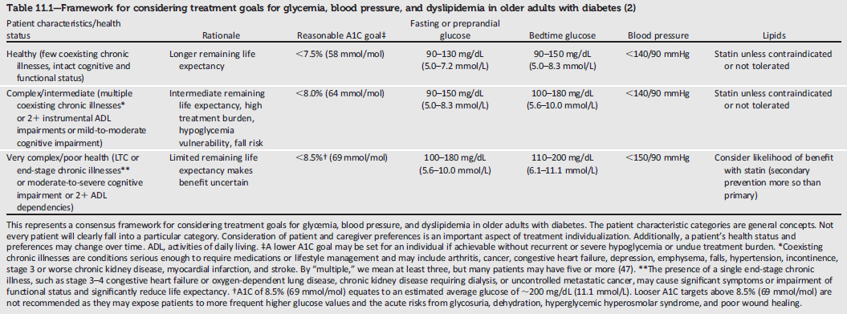
Framework for Considering Treatment Goals in Older Adults with Diabetes
Older Adults:
Standards of Medical Care in Diabetes - 2018. Diabetes Care 2018; 41 (Suppl. 1): S119-S125
Notes:
In summary, the care of older adults with diabetes is complicated by their clinical, cognitive, and functional heterogeneity. Some older individuals may have developed diabetes years earlier and have significant complications, others are newly diagnosed and may have had years of undiagnosed diabetes with resultant complications, and still other older adults may have truly recent-onset disease with few or no complications.
Some older adults with diabetes have other underlying chronic conditions, substantial diabetes-related comorbidity, limited cognitive or physical functioning, or frailty. Other older individuals with diabetes have little comorbidity and are active. Life expectancies are highly variable but are often longer than clinicians realize. Providers caring for older adults with diabetes must take this heterogeneity into consideration when setting and prioritizing treatment goals, as shown here in the table included on this slide.
In addition, older adults with diabetes should be assessed for disease treatment and self-management knowledge, health literacy, and mathematical literacy (numeracy) at the onset of treatment.
[SLIDE]
209

Slide 210
12. Children and Adolescents
Notes:
Section 12, Children and Adolescents.
[SLIDE]
210

Slide 211
Type 1 Diabetes
Three-quarters of all cases of T1DM are diagnosed in patients <18 years of age.
Providers must consider many unique aspects to care and management of children & adolescents with T1DM.
Attention to family dynamics, developmental stages, and physiological differences is essential.
Recommendations less likely to be based on clinical trial evidence.
Children and Adolescents:
Standards of Medical Care in Diabetes - 2018. Diabetes Care 2018; 41 (Suppl. 1): S126-S136
Notes:
Three-quarters of all cases of type 1 diabetes are diagnosed in individuals <18 years of age.
The provider must consider the unique aspects of care and management of children and adolescents with type 1 diabetes, such as changes in insulin sensitivity related to physical growth and sexual maturation, ability to provide self-care, supervision in the child care and school environment, and neurological vulnerability to hypoglycemia and hyperglycemia in young children as well as possible adverse neurocognitive effects of diabetic ketoacidosis.
Attention to family dynamics, developmental stages, and physiological differences related to sexual maturity are all essential in developing and implementing an optimal diabetes regimen.
Due to the paucity of clinical research in children, the recommendations for children and adolescents are less likely to be based on clinical trial evidence.
[SLIDE]
211

Slide 212
Type 1 Diabetes: Recommendations
DSME/S:
Youth with T1DM and parents/caregivers (for patients <18 years) should receive culturally sensitive and developmentally appropriate individualized DSME/S according to national standards at diagnosis and routinely thereafter. B
Children and Adolescents:
Standards of Medical Care in Diabetes - 2018. Diabetes Care 2018; 41 (Suppl. 1): S126-S136
Notes:
Youth with type 1 diabetes and parents/caregivers (for patients aged <18 years) should receive culturally sensitive and developmentally appropriate individualized DSME and DSMS according to national standards at diagnosed and routinely thereafter.
No matter how sound the medical regimen, it can only be effective if the family and/or affected individual are able to implement it. Family involvement is a vital component of optimal diabetes management throughout childhood and adolescence. Health care providers (the diabetes care team) who care for children and adolescents must be capable of evaluating the educational, behavioral, emotional, and psychosocial factors that impact implementation of a treatment plan and must work with the individual and family to overcome barriers or redefine goals as appropriate.
[SLIDE]
212

Slide 213
Type 1 Diabetes: Recommendations (2)
Psychosocial Issues:
At diagnosis and during routine follow-up care, assess psychosocial issues and family stresses that could impact adherence to diabetes management and provide appropriate referrals to trained mental health professionals, preferably experienced in childhood diabetes. E
Children and Adolescents:
Standards of Medical Care in Diabetes - 2018. Diabetes Care 2018; 41 (Suppl. 1): S126-S136
Notes:
Several recommendations are provided in Section 12 related to psychosocial issues in kids with T1DM:
At diagnosis and during routine follow-up care, assess psychosocial issues and family stresses that could impact adherence to diabetes management and provide appropriate referrals to trained mental health professionals, preferably experienced in childhood diabetes. E
[SLIDE]
213

Slide 214
Type 1 Diabetes: Recommendations (3)
Psychosocial Issues:
Mental health professionals should be considered integral members of the pediatric diabetes multidisciplinary team. E
Encourage developmentally appropriate family involvement in diabetes management tasks for children and adolescents, recognizing that premature transfer of diabetes care to the child can result in nonadherence and deterioration in glycemic control. A
Children and Adolescents:
Standards of Medical Care in Diabetes - 2018. Diabetes Care 2018; 41 (Suppl. 1): S126-S136
Notes:
Mental health professionals should be considered integral members of the pediatric diabetes multidisciplinary team. E
Encourage developmentally appropriate family involvement in diabetes management tasks for children and adolescents, recognizing that premature transfer of diabetes care to the child can result in nonadherence and deterioration in glycemic control. A
[SLIDE]
214

Slide 215
Type 1 Diabetes: Recommendations (4)
Psychosocial Issues:
Providers should consider asking youth and their parents about social adjustment (peer relationships) and school performance to determine whether further intervention is needed. B
Assess youth with diabetes for psychosocial and diabetes-related distress, generally starting at 7-8 years of age. B
At diagnosis and during routine follow-up care, consider assessing psychosocial issues and family stresses that could impact diabetes management and provide appropriate referrals to trained mental health professionals, preferably experienced in childhood diabetes. E
Children and Adolescents:
Standards of Medical Care in Diabetes - 2018. Diabetes Care 2018; 41 (Suppl. 1): S126-S136
Notes:
Providers should consider asking youth and their parents about social adjustment (peer relationships) and school performance to determine whether further intervention is needed. B
Assess youth with diabetes for psychosocial and diabetes-related distress, generally starting at 7-8 years of age. B
At diagnosis and during routine follow-up care, consider assessing psychosocial issues and family stresses that could impact diabetes management and provide appropriate referrals to trained mental health professionals, preferably experienced in childhood diabetes. E
[SLIDE]
215

Slide 216
Type 1 Diabetes: Recommendations (5)
Psychosocial Issues:
Offer adolescents time by themselves with their care provider(s) starting at age 12 years, or when developmentally appropriate. E
Starting at puberty, preconception counseling should be incorporated into routine diabetes care for all girls of childbearing potential. A
Children and Adolescents:
Standards of Medical Care in Diabetes - 2018. Diabetes Care 2018; 41 (Suppl. 1): S126-S136
Notes:
Offer adolescents time by themselves with their care provider(s) starting at age 12 years, or when developmentally appropriate. E
Starting at puberty, preconception counseling should be incorporated into routine diabetes care for all girls of childbearing potential. A
[SLIDE]
216

Slide 217
Type 1 Diabetes: Recommendations (6)
Glycemic Control:
The majority of children and adolescents with T1DM should be treated with intensive insulin regimens, either via multiple daily injections or CSII. A
All children and adolescents with T1DM should self-monitor blood glucose levels multiple times daily, including premeal, prebedtime, and as needed for safety in specific clinical situations such as exercise, driving, or for symptoms of hypoglycemia. B
Children and Adolescents:
Standards of Medical Care in Diabetes - 2018. Diabetes Care 2018; 41 (Suppl. 1): S126-S136
Notes:
Treating children and adolescents with T1DM carries with it specific goals and considerations for glycemic control:
The majority of children and adolescents with T1DM should be treated with intensive insulin regimens, either via multiple daily injections or CSII. A
All children and adolescents with T1DM should self-monitor blood glucose levels multiple times daily, including premeal, prebedtime, and as needed for safety in specific clinical situations such as exercise, driving, or for symptoms of hypoglycemia. B
[SLIDE]
217

Slide 218
Type 1 Diabetes: Recommendations (7)
Glycemic Control:
CGM should be considered in children and adolescents with T1DM, whether using injections or CSII, as an additional tool to help improve glycemic control. Benefits of CGM correlate with adherence to ongoing use of the device. B
Automated insulin delivery systems improve glycemic control and reduce hypoglycemia in adolescents and should be considered in adolescents with T1DM. B
An A1C goal of <7.5% is recommended across all pediatric age-groups. E
Children and Adolescents:
Standards of Medical Care in Diabetes - 2018. Diabetes Care 2018; 41 (Suppl. 1): S126-S136
Notes:
CGM should be considered in children and adolescents with T1DM, whether using injections or CSII, as an additional tool to help improve glycemic control. Benefits of CGM correlate with adherence to ongoing use of the device. B
Automated insulin delivery systems improve glycemic control and reduce hypoglycemia in adolescents and should be considered in adolescents with T1DM. B
An A1C goal of <7.5% is recommended across all pediatric age-groups. E
Current standards for diabetes management reflect the need to lower glucose as safely as possible. This should be done with stepwise goals. Special consideration should be given to the risk of hypoglycemia in young children (aged <6 years) who are often unable to recognize, articulate, and/or manage their hypoglycemic symptoms. This “hypoglycemia unawareness” should be considered when establishing individualized glycemic targets.
Although it was previously thought that young children were at risk for cognitive impairment after episodes of severe hypoglycemia, current data have not confirmed this notion. Furthermore, new therapeutic modalities, such as rapid- and long-acting insulin analogs, technological advances (e.g., continuous glucose monitors, low glucose suspend insulin pumps), and education, may mitigate the incidence of severe hypoglycemia.
[SLIDE]
218

Slide 219
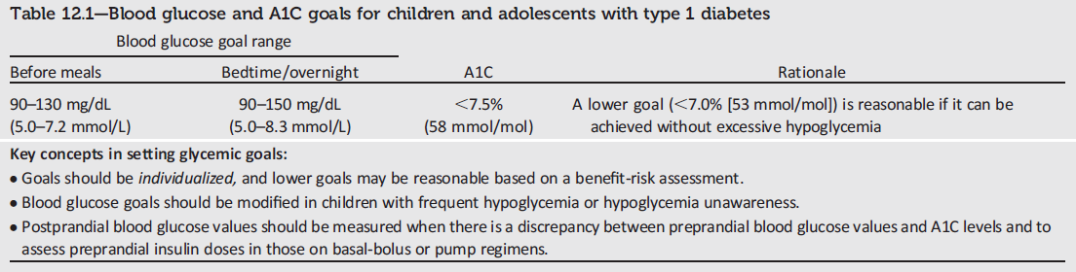
Glucose and A1C Goals for Children and Adolescents with Type 1 Diabetes
Children and Adolescents:
Standards of Medical Care in Diabetes - 2018. Diabetes Care 2018; 41 (Suppl. 1): S126-S136
Notes:
This table from the 2018 Standards of Care provides a summary of blood glucose and A1C goals for children and adolescents with type 1 diabetes.
Key concepts in setting glycemic goals are as follows:
Goals should be individualized, and lower goals may be reasonable based on a benefit-risk assessment.
Blood glucose goals should be modified in children with frequent hypoglycemia or hypoglycemia unawareness.
Postprandial blood glucose values should be measured when there is a discrepancy between preprandial blood glucose values and A1C levels and to assess preprandial insulin doses in those on basal-bolus or pump regimens.
[SLIDE]
219

Slide 220
Type 1 Diabetes: Recommendations (8)
Autoimmune Conditions:
Assess for the presence of autoimmune conditions associated with type 1 diabetes soon after the diagnosis and if symptoms develop. B
Children and Adolescents:
Standards of Medical Care in Diabetes - 2018. Diabetes Care 2018; 41 (Suppl. 1): S126-S136
Notes:
As with adults with type 1 diabetes, consider assessing for autoimmune conditions in youth with type 1 diabetes soon after diagnosis and if symptoms develop.
[SLIDE]
220

Slide 221
Type 1 Diabetes: Recommendations (9)
Thyroid Disease:
Consider testing individuals with T1DM for antithyroid peroxidase and antithyroglobulin antibodies soon after the diagnosis. E
Measure thyroid stimulating hormone concentrations at diagnosis when clinically stable or soon after glycemic control has been established. If normal, consider rechecking every 1-2 years or sooner if the patient develops symptoms suggestive of thyroid dysfunction, thyromegaly, an abnormal growth rate, or an unexplained glycemic variation. A
Children and Adolescents:
Standards of Medical Care in Diabetes - 2018. Diabetes Care 2018; 41 (Suppl. 1): S126-S136
Notes:
Consider testing individuals with T1DM for antithyroid peroxidase and antithyroglobulin antibodies soon after the diagnosis. E
Measure thyroid stimulating hormone concentrations at diagnosis when clinically stable or soon after glycemic control has been established. If normal, consider rechecking every 1-2 years or sooner if the patient develops symptoms suggestive of thyroid dysfunction, thyromegaly, an abnormal growth rate, or an unexplained glycemic variation. A
[SLIDE]
221

Slide 222
Type 1 Diabetes: Recommendations (10)
Celiac Disease:
Screen individuals with T1DM for celiac disease soon after the diagnosis of diabetes by measuring IgA tissue transglutaminase antibodies, with documentation of normal total serum IgA levels or, if IgA deficient, IgG tissue transglutamine and deamidated gliadin antibodies. B
Repeat screening within 2 years of diabetes diagnosis and then again after 5 years and consider more frequent screening in children who have symptoms or a first-degree relative with celiac disease. B
Individuals with biopsy-confirmed celiac disease should be placed on a gluten-free diet and have a consultation with a dietitian experienced in managing both diabetes and celiac disease. B
Children and Adolescents:
Standards of Medical Care in Diabetes - 2018. Diabetes Care 2018; 41 (Suppl. 1): S126-S136
Notes:
Screen individuals with T1DM for celiac disease soon after the diagnosis of diabetes by measuring IgA tissue transglutaminase antibodies, with documentation of normal total serum IgA levels or, if IgA deficient, IgG tissue transglutamine and deamidated gliadin antibodies. B
Repeat screening within 2 years of diabetes diagnosis and then again after 5 years and consider more frequent screening in children who have symptoms or a first-degree relative with celiac disease. B
Individuals with biopsy-confirmed celiac disease should be placed on a gluten-free diet and have a consultation with a dietitian experienced in managing both diabetes and celiac disease. B
[SLIDE]
222

Slide 223
Type 1 Diabetes: Recommendations (11)
Hypertension Screening:
BP should be measured at each routine visit. Children found to have high-normal blood pressure (SBP or DBP ≥90th percentile for age, sex, and height) or hypertension (SBP or DBP ≥95th percentile for age, sex, and height) should have elevated blood pressure confirmed on three separate days. B
Children and Adolescents:
Standards of Medical Care in Diabetes - 2018. Diabetes Care 2018; 41 (Suppl. 1): S126-S136
Notes:
Blood pressure should be measured at each routine visit. Children found to have high-normal blood pressure, which is defined as either systolic blood pressure or diastolic blood pressure ≥90th percentile for age, sex, and height, or hypertension should have blood pressure confirmed on three separate days.
[SLIDE]
223

Slide 224
Type 1 Diabetes: Recommendations (12)
Hypertension Treatment:
Initial treatment of high-normal BP (SBP or DBP consistently ≥90th percentile for age, sex, and height) includes dietary modification and increased exercise, if appropriate, aimed at weight control. If target blood pressure is not reached within 3–6 months of initiating lifestyle intervention, pharmacological treatment should be considered. E
In addition to lifestyle modification, pharmacological treatment of hypertension (SBP or DBP consistently ≥95th percentile for age, sex, and height) should be considered as soon as hypertension is confirmed. E
Children and Adolescents:
Standards of Medical Care in Diabetes - 2018. Diabetes Care 2018; 41 (Suppl. 1): S126-S136
Notes:
Initial treatment of high-normal BP (SBP or DBP consistently ≥90th percentile for age, sex, and height) includes dietary modification and increased exercise, if appropriate, aimed at weight control. If target blood pressure is not reached within 3–6 months of initiating lifestyle intervention, pharmacological treatment should be considered. E
In addition to lifestyle modification, pharmacological treatment of hypertension (SBP or DBP consistently ≥95th percentile for age, sex, and height) should be considered as soon as hypertension is confirmed. E
[SLIDE]
224

Slide 225
Type 1 Diabetes: Recommendations (13)
Hypertension Treatment:
ACE inhibitors or ARBs may be considered for treatment of elevated (>30mg/g) UACR (B) and hypertension (E) in children and adolescents, following reproductive counseling and implementation of effective birth control due to the potential teratogenic effects of both drug classes. E
The goal of treatment is blood pressure consistently <90th percentile for age, sex, and height. E
Children and Adolescents:
Standards of Medical Care in Diabetes - 2018. Diabetes Care 2018; 41 (Suppl. 1): S126-S136
Notes:
ACE inhibitors or ARBs may be considered for treatment of elevated (>30mg/g) UACR (B) and hypertension (E) in children and adolescents, following reproductive counseling and implementation of effective birth control due to the potential teratogenic effects of both drug classes. E
The goal of treatment is blood pressure consistently <90th percentile for age, sex, and height. E
[SLIDE]
225

Slide 226
Type 1 Diabetes: Recommendations (14)
Testing for Dyslipidemia:
Obtain a lipid profile in children ≥10 years of age soon after the diagnosis of diabetes (after glucose control has been established). If abnormal, repeat lipid profile after fasting. E
If lipids are abnormal, annual monitoring is reasonable. If LDL values are within the accepted risk level (<100 mg/dL), a lipid profile repeated every 5 years is reasonable. E
Children and Adolescents:
Standards of Medical Care in Diabetes - 2018. Diabetes Care 2018; 41 (Suppl. 1): S126-S136
Notes:
Obtain a lipid profile in children ≥10 years of age soon after the diagnosis of diabetes (after glucose control has been established). If abnormal, repeat lipid profile after fasting. E
If lipids are abnormal, annual monitoring is reasonable. If LDL values are within the accepted risk level (<100 mg/dL), a lipid profile repeated every 5 years is reasonable. E
[SLIDE]
226
References
American Diabetes Association. Standards of medical care in diabetes—2014. Diabetes Care 2014;37(suppl 1):S51
Hörtenhuber T, Rami-Mehar B, Satler M, et al. Endothelial progenitor cells are related to glycemic control in children with type 1 diabetes over time. Diabetes Care 2013;36:1647–1653
Haller MJ, Samyn M, Nichols WW, et al. Radial artery tonometry demonstrates arterial stiffness in children with type 1 diabetes. Diabetes Care 2004;27:2911–2917
Orchard TJ, Forrest KY, Kuller LH, Becker DJ, for the Pittsburgh Epidemiology of Diabetes Complications Study. Lipid and blood pressure treatment goals for type 1 diabetes: 10-year incidence data from the Pittsburgh Epidemiology of Diabetes Complications Study. Diabetes Care 2001;24:1053–1059

Slide 227
Type 1 Diabetes: Recommendations (15)
Dyslipidemia Treatment:
Initial therapy should consist of optimizing glucose control and MNT using a Step 2 American Heart Association diet to decrease the amount of saturated fat in the diet. B
After the age of 10 years, addition of a statin is suggested in patients who, despite MNT and lifestyle changes, continue to have LDL cholesterol >160 mg/dL or LDL cholesterol >130 mg/dL and one or more CVD risk factors, following reproductive counseling and implementation of effective birth control due to the potential teratogenic effects of statins. B
The goal of therapy is an LDL cholesterol value <100 mg/dL. E
Children and Adolescents:
Standards of Medical Care in Diabetes - 2018. Diabetes Care 2018; 41 (Suppl. 1): S126-S136
Notes:
In terms of dyslipidemia treatment:
Initial therapy should consist of optimizing glucose control and MNT using a Step 2 American Heart Association diet to decrease the amount of saturated fat in the diet. B
After the age of 10 years, addition of a statin is suggested in patients who, despite MNT and lifestyle changes, continue to have LDL cholesterol >160 mg/dL or LDL cholesterol >130 mg/dL and one or more CVD risk factors, following reproductive counseling and implementation of effective birth control due to the potential teratogenic effects of statins. B
The goal of therapy is an LDL cholesterol value <100 mg/dL. E
[SLIDE]
227
References
American Diabetes Association. Standards of medical care in diabetes—2014. Diabetes Care 2014;37(suppl 1):S51
Hörtenhuber T, Rami-Mehar B, Satler M, et al. Endothelial progenitor cells are related to glycemic control in children with type 1 diabetes over time. Diabetes Care 2013;36:1647–1653
Haller MJ, Samyn M, Nichols WW, et al. Radial artery tonometry demonstrates arterial stiffness in children with type 1 diabetes. Diabetes Care 2004;27:2911–2917
Orchard TJ, Forrest KY, Kuller LH, Becker DJ, for the Pittsburgh Epidemiology of Diabetes Complications Study. Lipid and blood pressure treatment goals for type 1 diabetes: 10-year incidence data from the Pittsburgh Epidemiology of Diabetes Complications Study. Diabetes Care 2001;24:1053–1059

Slide 228
Type 1 Diabetes: Recommendations (16)
Smoking:
Elicit a smoking history at initial and follow-up diabetes visits; discourage smoking in youth who do not smoke, and encourage smoking cessation in those who do smoke. B
Children and Adolescents:
Standards of Medical Care in Diabetes - 2018. Diabetes Care 2018; 41 (Suppl. 1): S126-S136
Notes:
As in adults with diabetes and the population as a whole, discourage smoking in youth who do not smoke and encourage smoking cessation in those who do. Elicit a smoking history at initial and follow-up diabetes visits.
The adverse health effects of smoking are well recognized with respect to future cancer and CVD risk. In youth with diabetes, it is important to avoid additional CVD risk factors.
[SLIDE]
228
References
American Diabetes Association. Standards of medical care in diabetes—2014. Diabetes Care 2014;37(suppl 1):S51
Hörtenhuber T, Rami-Mehar B, Satler M, et al. Endothelial progenitor cells are related to glycemic control in children with type 1 diabetes over time. Diabetes Care 2013;36:1647–1653
Haller MJ, Samyn M, Nichols WW, et al. Radial artery tonometry demonstrates arterial stiffness in children with type 1 diabetes. Diabetes Care 2004;27:2911–2917
Orchard TJ, Forrest KY, Kuller LH, Becker DJ, for the Pittsburgh Epidemiology of Diabetes Complications Study. Lipid and blood pressure treatment goals for type 1 diabetes: 10-year incidence data from the Pittsburgh Epidemiology of Diabetes Complications Study. Diabetes Care 2001;24:1053–1059

Slide 229
Type 1 Diabetes: Recommendations (17)
DKD Screening:
Annual screening for albuminuria with a random spot urine sample for UACR, should be performed at puberty or at age ≥10 years, whichever is earlier, once the child has had diabetes for 5 years. B
Children and Adolescents:
Standards of Medical Care in Diabetes - 2018. Diabetes Care 2018; 41 (Suppl. 1): S126-S136
Notes:
Annual screening for albuminuria with a random spot urine sample for UACR, should be performed at puberty or at age ≥10 years, whichever is earlier, once the child has had diabetes for 5 years. B
[SLIDE]
229

Slide 230
Type 1 Diabetes: Recommendations (18)
DKD Treatment:
When persistently elevated UACR (>30 mg/g) is documented with at least two of three urine samples, treatment with an ACE inhibitor or ARB may be considered and the dose titrated to maintain blood pressure within the age-appropriate normal range. The urine samples should be obtained over a 6-month interval following efforts to improve glycemic control and normalize blood pressure. B
Children and Adolescents:
Standards of Medical Care in Diabetes - 2018. Diabetes Care 2018; 41 (Suppl. 1): S126-S136
Notes:
As far as treatment of DKD, when persistently elevated UACR (>30 mg/g) is documented with at least two of three urine samples, treatment with an ACE inhibitor or ARB may be considered and the dose titrated to maintain blood pressure within the age-appropriate normal range. The urine samples should be obtained over a 6-month interval following efforts to improve glycemic control and normalize blood pressure.
[SLIDE]
230

Slide 231
Type 1 Diabetes: Recommendations (19)
Retinopathy:
An initial dilated and comprehensive eye examination is recommended once youth have had T1DM for 3-5 years, provided they are age ≥10 years or puberty has started, whichever is earlier. B
After the initial examination, annual routine follow-up is generally recommended. Less frequent examinations, every 2 years, may be acceptable on the advice of an eye care professional and based on risk factor assessment. E
Children and Adolescents:
Standards of Medical Care in Diabetes - 2018. Diabetes Care 2018; 41 (Suppl. 1): S126-S136
Notes:
An initial dilated and comprehensive eye examination is recommended at age ≥10 years or after puberty has started, whichever is earlier, once the youth has had diabetes for 3–5 years.
After the initial examination, annual routine follow-up is generally recommended. Less frequent examinations, every 2 years, may be acceptable on the advice of an eye care professional.
Although retinopathy (like albuminuria) most commonly occurs after the onset of puberty and after 5–10 years of diabetes duration, it has been reported in prepubertal children and with diabetes duration of only 1–2 years. Referrals should be made to eye care professionals with expertise in diabetic retinopathy and experience in counseling the pediatric patient and family on the importance of early prevention/intervention.
[SLIDE]
231

Slide 232
Type 1 Diabetes: Recommendations (20)
Neuropathy:
Consider an annual comprehensive foot exam at the start of puberty or at age ≥10 years, whichever is earlier, once the youth has had type 1 diabetes for 5 years. B
Children and Adolescents:
Standards of Medical Care in Diabetes - 2018. Diabetes Care 2018; 41 (Suppl. 1): S126-S136
Notes:
Consider an annual comprehensive foot exam for the child at the start of puberty or at age ≥10 years, whichever is earlier, once the youth has had type 1 diabetes for 5 years.
Neuropathy rarely occurs in prepubertal children or after only 1–2 years of diabetes. A comprehensive foot exam, including inspection, palpation of dorsalis pedis and posterior tibial pulses, assessment of the patellar and Achilles reflexes, and determination of proprioception, vibration, and monofilament sensation, should be performed annually along with assessment of symptoms of neuropathic pain.
[SLIDE]
232

Slide 233
Type 2 Diabetes
T2DM in youth has increased over the past 20 years
  ~5,000 new cases per year in the U.S.
T2DM in youth is different from both T1DM in youth and T2DM in adults
Disproportionally impacts youth of ethnic and racial minorities
Additional risk factors include:
  Adiposity, family history of diabetes, female sex, and low socioeconomic status
Children and Adolescents:
Standards of Medical Care in Diabetes - 2018. Diabetes Care 2018; 41 (Suppl. 1): S126-S136
Notes:
We covered information on screening and testing for type 2 diabetes in children & adolescents earlier, so now we’ll focus on treatment.
Type 2 diabetes in youth has increased over the past 20 years, and recent estimates suggest an incidence of ~5,000 new cases per year in the U.S.
Evidence suggests that type 2 diabetes in youth is different not only from type 1 diabetes but also from type 2 diabetes in adults and has unique features, such as a more rapidly progressive decline in β-cell function and accelerated development of diabetes complications.
Type 2 diabetes disproportionately impacts youth of ethnic and racial minorities and can occur in complex psychosocial and cultural environments, which may make it difficult to sustain healthy lifestyle changes and self-management behaviors.
Additional risk factors associated with type 2 diabetes in youth include adiposity, family history of diabetes, female sex, and low socioeconomic status.
[SLIDE]
233

Slide 234
Type 2 Diabetes: Recommendations
Screening and Diagnosis:
Risk-based screening for prediabetes and/or type 2 diabetes should be considered in children and adolescents after the onset of puberty or ≥10 years of age, whichever occurs earlier, who are overweight (BMI >85th %) or obese (BMI >95th %) and who have one or more additional risk factors for diabetes. A
If tests are normal, repeat testing at minimum of 3-year intervals E, or more frequently if BMI is increasing. C
Children and Adolescents:
Standards of Medical Care in Diabetes - 2018. Diabetes Care 2018; 41 (Suppl. 1): S126-S136
Notes:
The following recommendations pertain to screening and diagnosis of type 2 diabetes in children and adolescents:
Risk-based screening for prediabetes and/or type 2 diabetes should be considered in children and adolescents after the onset of puberty or ≥10 years of age, whichever occurs earlier, who are overweight (BMI >85th %) or obese (BMI >95th %) and who have one or more additional risk factors for diabetes. A
If tests are normal, repeat testing at minimum of 3-year intervals E, or more frequently if BMI is increasing. C
[SLIDE]
234

Slide 235
Type 2 Diabetes: Recommendations (2)
Screening and Diagnosis:
Fasting plasma glucose, 2-h plasma glucose during a 75-g OGTT, and A1C can be used to test for prediabetes or diabetes in children and adolescents. B
Children and Adolescents:
Standards of Medical Care in Diabetes - 2018. Diabetes Care 2018; 41 (Suppl. 1): S126-S136
Notes:
Fasting plasma glucose, 2-h plasma glucose during a 75-g OGTT, and A1C can be used to test for prediabetes or diabetes in children and adolescents. B
[SLIDE]
235

Slide 236
Type 2 Diabetes: Recommendations (3)
Lifestyle Management:
Overweight or obese youth with T2DM and their families should be provided with developmentally and culturally appropriate comprehensive lifestyle programs that are integrated with diabetes management to achieve 7-10% decrease in excess weight. C
Given the necessity of long-term weight management for children and adolescents with type 2 diabetes, lifestyle intervention should be based on a chronic care model and offered in the context of diabetes care. E
Children and Adolescents:
Standards of Medical Care in Diabetes - 2018. Diabetes Care 2018; 41 (Suppl. 1): S126-S136
Notes:
Lifestyle Management:
Overweight or obese youth with T2DM and their families should be provided with developmentally and culturally appropriate comprehensive lifestyle programs that are integrated with diabetes management to achieve 7-10% decrease in excess weight. C
Given the necessity of long-term weight management for children and adolescents with type 2 diabetes, lifestyle intervention should be based on a chronic care model and offered in the context of diabetes care. E
[SLIDE]
236

Slide 237
Type 2 Diabetes: Recommendations (4)
Lifestyle Management:
Youth with diabetes, like all children, should be encouraged to participate in at least 60 min of moderate to vigorous physical activity per day (and strength training on at least 3 days/week) B and to decrease sedentary behavior. C
Nutrition for youth with T2DM, like all children, should focus on healthy eating patterns that emphasize consumption of nutrient-dense, high-quality foods and decreased consumption of calorie-dense, nutrient-poor foods, particularly sugar-added beverages. B
Children and Adolescents:
Standards of Medical Care in Diabetes - 2018. Diabetes Care 2018; 41 (Suppl. 1): S126-S136
Notes:
Youth with diabetes, like all children, should be encouraged to participate in at least 60 min of moderate to vigorous physical activity per day (and strength training on at least 3 days/week) B and to decrease sedentary behavior. C
Nutrition for youth with T2DM, like all children, should focus on healthy eating patterns that emphasize consumption of nutrient-dense, high-quality foods and decreased consumption of calorie-dense, nutrient-poor foods, particularly sugar-added beverages. B
[SLIDE]
237

Slide 238
Type 2 Diabetes: Recommendations (5)
Pharmacologic Management:
Initiate pharmacologic therapy, in addition to lifestyle therapy, at diagnosis of T2DM. A
In metabolically stable patients (A1C <8.5% and asymptomatic), metformin is the initial pharmacologic treatment of choice if renal function is >30 ml/min/1.73m². A
Youth with marked hyperglycemia (blood glucose ≥250 mg/dL, A1C ≥) without ketoacidosis at diagnosis who are symptomatic with polyuria, polydipsia, nocturia, and/or weight loss should be treated initially with basal insulin while metformin is initiated and titrated to maximally tolerated dose to achieve A1C goal. E
Children and Adolescents:
Standards of Medical Care in Diabetes - 2018. Diabetes Care 2018; 41 (Suppl. 1): S126-S136
Notes:
And the following recommendations are provided for the pharmacologic management of T2DM in children and adolescents:
Initiate pharmacologic therapy, in addition to lifestyle therapy, at diagnosis of T2DM. A
In metabolically stable patients (A1C <8.5% and asymptomatic), metformin is the initial pharmacologic treatment of choice if renal function is >30 ml/min/1.73m². A
Youth with marked hyperglycemia (blood glucose ≥250 mg/dL, A1C ≥250 mg/dL) without ketoacidosis at diagnosis who are symptomatic with polyuria, polydipsia, nocturia, and/or weight loss should be treated initially with basal insulin while metformin is initiated and titrated to maximally tolerated dose to achieve A1C goal. E
[SLIDE]
238

Slide 239
Type 2 Diabetes: Recommendations (6)
Pharmacologic Management:
When the A1C target is no longer met with metformin monotherapy, or if contraindications or intolerable side effects of metformin develop, basal insulin therapy should be initiated. E
In patients initially treated with basal insulin and metformin who are meeting glucose targets based on home blood glucose monitoring, basal insulin can be tapered over 2-6 weeks by decreasing the insulin dose by 10-30% every few days. A
Children and Adolescents:
Standards of Medical Care in Diabetes - 2018. Diabetes Care 2018; 41 (Suppl. 1): S126-S136
Notes:
When the A1C target is no longer met with metformin monotherapy, or if contraindications or intolerable side effects of metformin develop, basal insulin therapy should be initiated. E
In patients initially treated with basal insulin and metformin who are meeting glucose targets based on home blood glucose monitoring, basal insulin can be tapered over 2-6 weeks by decreasing the insulin dose by 10-30% every few days. A
[SLIDE]
239

Slide 240
Type 2 Diabetes: Recommendations (7)
Pharmacologic Management:
Use of medications not approved by the U.S. FDA for youth with T2DM is not recommended outside of research trials. B
All youth with T2DM and their families should receive comprehensive diabetes self-management education and support that is specific to youth with T2DM and culturally competent. B
Children and Adolescents:
Standards of Medical Care in Diabetes - 2018. Diabetes Care 2018; 41 (Suppl. 1): S126-S136
Notes:
Use of medications not approved by the U.S. FDA for youth with T2DM is not recommended outside of research trials. B
All youth with T2DM and their families should receive comprehensive diabetes self-management education and support that is specific to youth with T2DM and culturally competent. B
[SLIDE]
240

Slide 241
Transitions from Pediatric to Adults Care
Pediatric diabetes providers and families should begin to prepare youth for transition in early adolescence and, at the latest, at least 1 year before the transition to adult health care. E
Both pediatric and adult diabetes care providers should provide support and links to resources for transitioning young adults. B
Children and Adolescents:
Standards of Medical Care in Diabetes - 2018. Diabetes Care 2018; 41 (Suppl. 1): S126-S136
Notes:
These recommendations apply to type 1 and type 2 diabetes. Care and close supervision of diabetes management is increasingly shifted from parents and other older adults throughout childhood and adolescence; however, the shift from pediatric to adult health care providers often occurs very abruptly as the older teen enters the next developmental stage, referred to as emerging adulthood,¹ a critical period for young people who have diabetes
Health care providers and families should begin to prepare youth in early to mid-adolescence and, at the latest, at least 1 year before the transition to adult health care.
Both pediatricians and adult health care providers should assist in providing support and links to resources for the teen and emerging adult.
[SLIDE]
[SLIDE]
241

Slide 242
Transition from Pediatric to Adult Care (2)
Early and ongoing attention should be given to comprehensive, coordinated planning for seamless transition of all youth to adult health care.
Association position statement, “Diabetes Care for Emerging Adults”
NDEP: http://ndep.nih.gov/transitions
Endocrine Society: www.endocrine.org
Children and Adolescents:
Standards of Medical Care in Diabetes - 2018. Diabetes Care 2018; 41 (Suppl. 1): S126-S136
Notes:
Care and close supervision of diabetes management is increasingly shifted from parents and other older adults throughout childhood and adolescence; however, the shift from pediatric to adult health care providers often occurs very abruptly as the older teen enters the next developmental stage, referred to as emerging adulthood,¹ a critical period for young people who have diabetes
Health care providers and families should begin to prepare youth in early to mid-adolescence and, at the latest, at least 1 year before the transition to adult health care.
Both pediatricians and adult health care providers should assist in providing support and links to resources for the teen and emerging adult.
[SLIDE]
[SLIDE]
242

Slide 243
13. Management of Diabetes in Pregnancy
Notes:
Section 13: Management of Diabetes in Pregnancy
This section will cover the management of diabetes in pregnancy; Guidelines related to the diagnosis of GDM were covered earlier, in Classification and Diagnosis of Diabetes.
[SLIDE]
243

Slide 244
Diabetes in Pregnancy: Recommendations
Preconception Counseling:
Starting at puberty, preconception counseling should be incorporated into routine diabetes care for all girls of childbearing potential. A
Family planning should be discussed and effective contraception should be prescribed and used until a woman is prepared and ready to become pregnant. A
Preconception counseling should address the importance of glycemic control as close to normal as is safely possible, ideally <6.5%, to reduce the risk of congenital anomalies. B
Management of Diabetes in Pregnancy:
Standards of Medical Care in Diabetes - 2018. Diabetes Care 2018; 41 (Suppl. 1): S137-S143
Notes:
Recommendations for the preconception care of women with diabetes are summarized here:
Starting at puberty, preconception counseling should be incorporated into routine diabetes care for all girls of childbearing potential. A
Family planning should be discussed and effective contraception should be prescribed and used until a woman is prepared and ready to become pregnant. A
Preconception counseling should address the importance of glycemic control as close to normal as is safely possible, ideally <6.5%, to reduce the risk of congenital anomalies. B
[SLIDE]
244
Reference
American Diabetes Association. Standards of medical care in diabetes—2014. Diabetes Care 2014;37(suppl 1):S53–S54

Slide 245
Diabetes in Pregnancy: Recommendations (2)
Preconception Testing:
Women with preexisting type 1 or type 2 diabetes who are planning pregnancy or who have become pregnant should be counseled on the risk of development and/or progression of diabetic retinopathy. Dilated eye examinations should occur before pregnancy or in the first trimester, and then patients should be monitored every trimester and for 1-year postpartum as indicated by the degree of retinopathy and as recommended by the eye care provider. B
Management of Diabetes in Pregnancy:
Standards of Medical Care in Diabetes - 2018. Diabetes Care 2018; 41 (Suppl. 1): S137-S143
Notes:
Women with preexisting type 1 or type 2 diabetes who are planning pregnancy or who have become pregnant should be counseled on the risk of development and/or progression of diabetic retinopathy. Dilated eye examinations should occur before pregnancy or in the first trimester, and then patients should be monitored every trimester and for 1-year postpartum as indicated by the degree of retinopathy and as recommended by the eye care provider. B
[SLIDE]
245
Reference
American Diabetes Association. Standards of medical care in diabetes—2014. Diabetes Care 2014;37(suppl 1):S53–S54

Slide 246
Diabetes in Pregnancy: Recommendations (3)
Glycemic Targets:
Fasting and postprandial self-monitoring of blood glucose are recommended in both GDM and preexisting diabetes in pregnancy to achieve glycemic control. Some women with preexisting diabetes should also test blood glucose preprandially. B
Due to increased red blood cell turnover, A1C is slightly lower in normal pregnancy than in normal nonpregnant women. The A1C target in pregnancy is 6-6.5%; <6% may be optimal if this can be achieved without significant hypoglycemia, but the target may be relaxed to <7% if necessary to prevent hypoglycemia. B
Management of Diabetes in Pregnancy:
Standards of Medical Care in Diabetes - 2018. Diabetes Care 2018; 41 (Suppl. 1): S137-S143
Notes:
And related to glycemic goal setting in the setting of pregnancy:
Fasting and postprandial self-monitoring of blood glucose are recommended in both GDM and preexisting diabetes in pregnancy to achieve glycemic control. Some women with preexisting diabetes should also test blood glucose preprandially. B
Due to increased red blood cell turnover, A1C is slightly lower in normal pregnancy than in normal nonpregnant women. The A1C target in pregnancy is 6-6.5%; <6% may be optimal if this can be achieved without significant hypoglycemia, but the target may be relaxed to <7% if necessary to prevent hypoglycemia. B
[SLIDE]
246
Reference
American Diabetes Association. Standards of medical care in diabetes—2014. Diabetes Care 2014;37(suppl 1):S53–S54

Slide 247
Diabetes in Pregnancy: Recommendations (4)
Management of GDM:
Lifestyle change is an essential component of management of GDM and may suffice for the treatment of many women. Medications should be added to achieve glycemic targets. A
Insulin is the preferred medication for treating hyperglycemia in GDM as it does not cross the placenta to a measurable extent. Metformin and glyburide may be used, but both cross the placenta to the fetus, with metformin likely crossing to a greater extent than glyburide. All oral agents lack long-term safety data. A
Management of Diabetes in Pregnancy:
Standards of Medical Care in Diabetes - 2018. Diabetes Care 2018; 41 (Suppl. 1): S137-S143
Notes:
Let’s now turn our attention to recommendations related to the management of GDM:
Lifestyle change is an essential component of management of GDM and may suffice for the treatment of many women. Medications should be added to achieve glycemic targets. A
Insulin is the preferred medication for treating hyperglycemia in GDM as it does not cross the placenta to a measurable extent. Metformin and glyburide may be used, but both cross the placenta to the fetus, with metformin likely crossing to a greater extent than glyburide. All oral agents lack long-term safety data. A
[SLIDE]
247
Reference
American Diabetes Association. Standards of medical care in diabetes—2014. Diabetes Care 2014;37(suppl 1):S53–S54

Slide 248
Diabetes in Pregnancy: Recommendations (5)
Management of GDM:
Metformin, when used to treat polycystic ovary syndrome and induce ovulation, need not be continued once pregnancy has been confirmed. A
Management of Diabetes in Pregnancy:
Standards of Medical Care in Diabetes - 2018. Diabetes Care 2018; 41 (Suppl. 1): S137-S143
Notes:
Metformin, when used to treat polycystic ovary syndrome and induce ovulation, need not be continued once pregnancy has been confirmed. A
[SLIDE]
248
Reference
American Diabetes Association. Standards of medical care in diabetes—2014. Diabetes Care 2014;37(suppl 1):S53–S54

Slide 249
Diabetes in Pregnancy: Recommendations (6)
Management of Preexisting T1DM and T2DM in Pregnancy:
Insulin is the preferred agent for management of both T1DM and T2DM in pregnancy because it does not cross the placenta, and because oral agents are generally insufficient to overcome the insulin resistance in T2DM and are ineffective in T1DM. E
Management of Diabetes in Pregnancy:
Standards of Medical Care in Diabetes - 2018. Diabetes Care 2018; 41 (Suppl. 1): S137-S143
Notes:
Management of Preexisting T1DM and T2DM in Pregnancy:
Insulin is the preferred agent for management of both T1DM and T2DM in pregnancy because it does not cross the placenta, and because oral agents are generally insufficient to overcome the insulin resistance in T2DM and are ineffective in T1DM. E
[SLIDE]
249
Reference
American Diabetes Association. Standards of medical care in diabetes—2014. Diabetes Care 2014;37(suppl 1):S53–S54

Slide 250
Diabetes in Pregnancy: Recommendations (7)
Preeclampsia and Aspirin:
Women with T1DM or T2DM should be prescribed low-dose aspirin 60-150 mg/day (usual dose 81 mg/day) from the end of the first trimester until the baby is born in order to lower the risk of preeclampsia. A
Management of Diabetes in Pregnancy:
Standards of Medical Care in Diabetes - 2018. Diabetes Care 2018; 41 (Suppl. 1): S137-S143
Notes:
Here’s a new recommendation on Preeclampsia and Aspirin:
Women with T1DM or T2DM should be prescribed low-dose aspirin 60-150 mg/day (usual dose 81 mg/day) from the end of the first trimester until the baby is born in order to lower the risk of preeclampsia. A
[SLIDE]
250
Reference
American Diabetes Association. Standards of medical care in diabetes—2014. Diabetes Care 2014;37(suppl 1):S53–S54

Slide 251
Diabetes in Pregnancy: Recommendations (8)
Pregnancy and Drug Considerations:
In pregnant patients with diabetes and chronic hypertension, blood pressure targets of 120-160/80-105 mmHg are suggested in the interest of optimizing long-term maternal health and minimizing impaired fetal growth. E
Potentially teratogenic medications (i.e., ACE inhibitors, ARBs, statins) should be avoided in sexually active women of childbearing age who are not using reliable contraception. B
Management of Diabetes in Pregnancy:
Standards of Medical Care in Diabetes - 2018. Diabetes Care 2018; 41 (Suppl. 1): S137-S143
Notes:
And the following recommendations cover drug-specific considerations when management women with diabetes who are, or may become, pregnant:
In pregnant patients with diabetes and chronic hypertension, blood pressure targets of 120-160/80-105 mmHg are suggested in the interest of optimizing long-term maternal health and minimizing impaired fetal growth. E
Potentially teratogenic medications (i.e., ACE inhibitors, ARBs, statins) should be avoided in sexually active women of childbearing age who are not using reliable contraception. B
[SLIDE]
251
Reference
American Diabetes Association. Standards of medical care in diabetes—2014. Diabetes Care 2014;37(suppl 1):S53–S54

Slide 252
14. Diabetes Care
in the Hospital
Notes:
Section 14: Diabetes Care in the Hospital
[SLIDE]
252

Slide 253
Diabetes Care in the Hospital: Recommendations
Perform an A1C on all patients with diabetes or hyperglycemia (blood glucose >140 mg/dL) admitted to the hospital if not performed in the prior 3 months. B
Insulin should be administered using validated written or computerized protocols that allow for predefined adjustments in the insulin dosage based on glycemic fluctuations. E
Diabetes Care in the Hospital:
Standards of Medical Care in Diabetes - 2018. Diabetes Care 2018; 41 (Suppl. 1): S144-S151
Notes:
Recommendations for diabetes care in the hospital include:
Perform an A1C on all patients with diabetes or hyperglycemia (blood glucose >140 mg/dL) admitted to the hospital if not performed in the prior 3 months. B
Insulin should be administered using validated written or computerized protocols that allow for predefined adjustments in the insulin dosage based on glycemic fluctuations. E
[SLIDE]
253
Reference
American Diabetes Association. Standards of medical care in diabetes—2014. Diabetes Care 2014;37(suppl 1):S56–S57

Slide 254
Diabetes Care in the Hospital: Recommendations (2)
Glycemic Targets:
Insulin therapy should be initiated for treatment of persistent hyperglycemia starting at a threshold ≥180 mg/dL. Once insulin therapy is started, a target glucose range of 140-180 mg/dL is recommended for the majority of critically ill patients and noncritically ill patients. A
More stringent goals, such as 110-140 mg/dL, may be appropriate for selected patients, if this can be achieved without significant hypoglycemia. C
Diabetes Care in the Hospital:
Standards of Medical Care in Diabetes - 2018. Diabetes Care 2018; 41 (Suppl. 1): S144-S151
Notes:
The following recommendations are provided regarding glycemic targets in hospitalized patients:
Insulin therapy should be initiated for treatment of persistent hyperglycemia starting at a threshold ≥180 mg/dL. Once insulin therapy is started, a target glucose range of 140-180 mg/dL is recommended for the majority of critically ill patients and noncritically ill patients. A
More stringent goals, such as 110-140 mg/dL, may be appropriate for selected patients, if this can be achieved without significant hypoglycemia. C
[SLIDE]
254
Reference
American Diabetes Association. Standards of medical care in diabetes—2014. Diabetes Care 2014;37(suppl 1):S56–S57

Slide 255
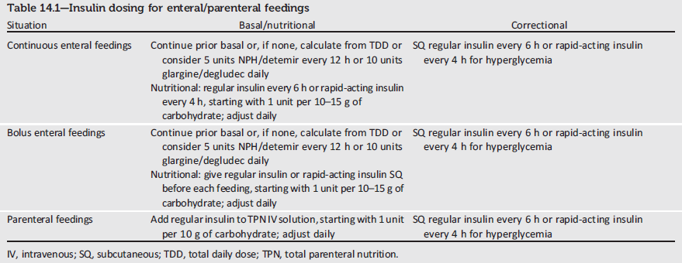
Insulin Dosing for Enteral/Parenteral Feedings
Notes:
The table shown here provides guidance on insulin dosing within the hospital for patients receiving enteral and parenteral feedings.
[SLIDE]

Slide 256
Diabetes Care in the Hospital: Recommendations (3)
Antihyperglycemic Agent Use:
A basal bolus correction insulin regimen, with the addition of nutritional insulin in patients who have good nutritional intake, is the preferred treatment for noncritically ill patients. A
Sole use of sliding scale insulin the inpatient hospital setting is strongly discouraged. A
Diabetes Care in the Hospital:
Standards of Medical Care in Diabetes - 2018. Diabetes Care 2018; 41 (Suppl. 1): S144-S151
Notes:
Antihyperglycemic Agent Use:
A basal bolus correction insulin regimen, with the addition of nutritional insulin in patients who have good nutritional intake, is the preferred treatment for noncritically ill patients. A
Sole use of sliding scale insulin the inpatient hospital setting is strongly discouraged. A
[SLIDE]
256
Reference
American Diabetes Association. Standards of medical care in diabetes—2014. Diabetes Care 2014;37(suppl 1):S56–S57

Slide 257
Diabetes Care in the Hospital: Recommendations (4)
Hypoglycemia:
A hypoglycemia management protocol should be adopted and implemented by each hospital or hospital system. A plan for preventing and treating hypoglycemia should be established for each patient. Episodes of hypoglycemia in the hospital should be documented in the medical record and tracked. E
The treatment regimen should be reviewed and changed as necessary to prevent further hypoglycemia when a blood glucose value is ≤70 mg/dL (3.9 mmol/L). C
Diabetes Care in the Hospital:
Standards of Medical Care in Diabetes - 2018. Diabetes Care 2018; 41 (Suppl. 1): S144-S151
Notes:
Hypoglycemia:
A hypoglycemia management protocol should be adopted and implemented by each hospital or hospital system. A plan for preventing and treating hypoglycemia should be established for each patient. Episodes of hypoglycemia in the hospital should be documented in the medical record and tracked. E
The treatment regimen should be reviewed and changed as necessary to prevent further hypoglycemia when a blood glucose value is ≤70 mg/dL (3.9 mmol/L). C
[SLIDE]
257
Reference
American Diabetes Association. Standards of medical care in diabetes—2014. Diabetes Care 2014;37(suppl 1):S56–S57

Slide 258
Diabetes Care in the Hospital: Recommendations (5)
Transition from the Acute Care Setting:
There should be a structured discharge plan tailored to the individual patient with diabetes. B
Diabetes Care in the Hospital:
Standards of Medical Care in Diabetes - 2018. Diabetes Care 2018; 41 (Suppl. 1): S144-S151
Notes:
And finally, for patients transitioning from the acute care setting, there should be a structured discharge plan developed that is tailored to the individual patient with diabetes.
[SLIDE]
258
Reference
American Diabetes Association. Standards of medical care in diabetes—2014. Diabetes Care 2014;37(suppl 1):S56–S57

Slide 259
15. Diabetes Advocacy
Notes:
Managing the daily health demands of diabetes can be challenging. People living with diabetes should not have to face additional discrimination due to diabetes. By advocating for the rights of those with diabetes at all levels, the American Diabetes Association can help to ensure that they live a healthy and productive life. A strategic goal of the ADA is that more children and adults with diabetes live free from the burden of discrimination.
[SLIDE]
259

Slide 260
Advocacy Position Statements
ADA publishes evidence-based advocacy statements on issues including:
  Diabetes and employment
  Diabetes and driving
  Diabetes management in schools, child care programs, and correctional institutions.
These are important tools in educating:
  Schools
  Employers
  Licensing agencies
  Policy makers
Diabetes Advocacy:
Standards of Medical Care in Diabetes - 2018. Diabetes Care 2018; 41 (Suppl. 1): S152-S153
Notes:
A strategic goal of the ADA is that more children and adults with diabetes live free from the burden of discrimination. One tactic for achieving this goal is to implement the ADA’s Standards of Medical Care through advocacy-oriented position statements. The ADA publishes evidence-based, peer-reviewed statements on topics such as diabetes and employment, diabetes and driving, and diabetes management in certain settings such as schools, child care programs, and correctional institutions.
In addition to ADA’s clinical position statements, these advocacy position statements are important tools in educating schools, employers, licensing agencies, policymakers, and others about the intersection of diabetes medicine and the law.
[SLIDE]
260
References
American Diabetes Association. Standards of medical care in diabetes—2014. Diabetes Care 2014;37(suppl 1):S57
Finfer S, Chittock Dr, Su SY, et al for the NICE-SUGAR Study Investigators. Intensive versus conventional glucose control in critically ill patients. N Engl J Med. 2009;360:1283–1297
Griesdale DE, de Souza RJ, van Dam RM, et al. Intensive insulin therapy and mortality among critically ill patients: a meta-analysis including NICE-SUGAR study data. CMAJ 2009;180:821–827

Slide 261
Helpful Resources
Notes:
261

Slide 262
2018 Standards of Care - Resources
Full version available
Abridged version for PCPs
Free app (February 2018)
Pocket cards with key figures
Free webcast for continuing education credit
Professional.Diabetes.org/SOC

Slide 263

Professional Education
Live programs
Online self-assessment programs
Online webcasts
Professional.Diabetes.org/CE
Notes:
ADA offers several ways to obtain high-quality continuing education credits. You can access several courses online. There are also many live events offered regionally and at national meetings.

Slide 264

Diabetes Self-Management Education
Find a recognized Diabetes Self-Management program
Become a recognized DSME program
Tools and resources for DSME programs
Online education documentation tools
Professional.Diabetes.org/ERP
Notes:
The ADA is the largest and longest standing Medicare National Accrediting Organization and has been recognizing DSME/S programs that meet national standards since 1986. Currently ADA recognizes DSME/S programs at ~3,700 sites with >8,800 educators that see ~860,000 patients annually.
If your clinic doesn’t already have a DSME program, reach out to ADA to learn more.

Slide 265




Professional Membership
Journals
Meeting, book and journal discounts
Career center
Quarterly member newsletter
Professional.Diabetes.org/membership

Slide 266

Thank you

