Slide 1
In the name of Gad
AACE 2017 Guidelines
Title:
AMERICAN ASSOCIATION OF CLINICAL ENDOCRINOLOGISTS AND AMERICAN COLLEGE OF ENDOCRINOLOGY GUIDELINES FOR MANAGEMENT OF DYSLIPIDEMIA AND PREVENTION OF CARDIOVASCULAR DISEASE

Slide 2
In this update, there are 87 Recommendations of which 45 are Grade A (51.7%), 18 are Grade B (20.7%), 15 are Grade C (17.2%), and 9 (10.3%) are Grade D. There is a greater percentage of Recommendations that are Grade A or B (72%) compared with those that are Grade C and Grade D (28%). The evidence base presented here provides relevant information for the recommendations in the Executive Summary.

Slide 3
3Q1. HOW SHOULD INDIVIDUALS BE SCREENED FOR THE DETECTION OF DYSLIPIDEMIA?
3Q1.1. Global Risk Assessment
• R1. Identify risk factors that enable personalized and optimal therapy for dyslipidemia (Table 5) (Grade A; BEL 1).
• R2. Based on epidemiologic studies, individuals with type 2 diabetes (T2DM) should be considered as high, very high, or extreme risk for ASCVD (Table 6) (Grade B; BEL 3; upgraded due to high relevance).

Slide 4
3Q1.1. Global Risk Assessment
• R3. Based on epidemiologic and prospective cohort studies, individuals with type 1 diabetes (T1DM) and duration more than 15 years or with 2 or more major cardiovascular (CV) risk factors (e.g., albuminuria, chronic kidney disease [CKD] stage 3/4, initiation of intensive control >5 years after diagnosis), poorly controlled hemoglobin A1C (A1C) or insulin resistance with metabolic syndrome should be considered to have risk-equivalence to individuals with T2DM (Table 7, see online Appendix/Evidence Base) (Grade B; BEL 2).
• R4. The 10-year risk of a coronary event (high, intermediate, or low) should be determined by detailed assessment using one or more of the following tools (Table 8)(Grade C; BEL 4, upgraded due to cost effectiveness)

Slide 5
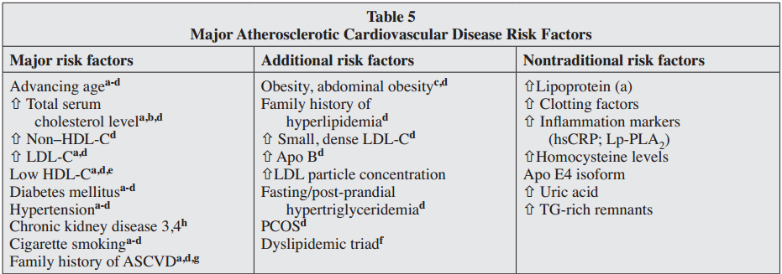
Table 5 Major Atherosclerotic Cardiovascular Disease Risk Factors

Slide 6
R5. Special attention should be given to assessing women for ASCVD risk by determining the 10-year risk (high, intermediate, or low) of a coronary event using the Reynolds Risk Score or the Framingham Risk Assessment Tool (Grade C; BEL 4, upgraded due to cost-effectiveness).
• R6. Dyslipidemia in childhood and adolescence should be diagnosed and managed as early as possible to reduce the levels of LDL-C that may eventually increase risk of CV events in adulthood (Table 9) (Grade A; BEL 1).
• R7. When the HDL-C concentration is >60 mg/dL, 1 risk factor should be subtracted from an individual’s overall risk profile (Grade B; BEL 2).
• R8. A classification of elevated TG should be incorporated into risk assessments to aid in treatment decisions (Table 10) (Grade B; BEL 2).

Slide 7
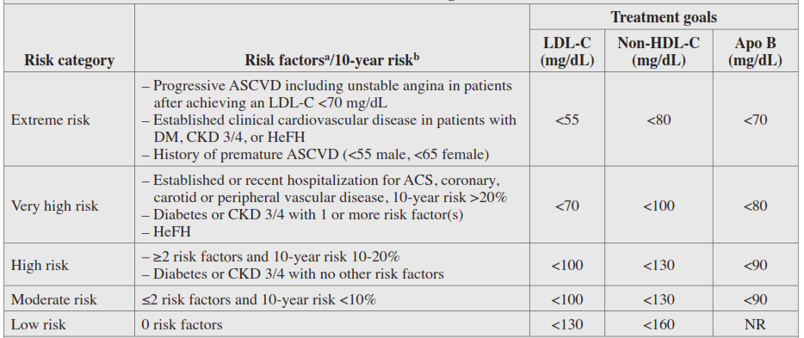
Table 6
Atherosclerotic Cardiovascular Disease Risk Categories and LDL-C Treatment Goals

Slide 8
3Q1.2. Screening Familial Hypercholesterolemia
• R9. Individuals should be screened for familial hypercholesterolemia (FH) when there is a family history of:
• Premature ASCVD (definite MI or sudden death before age 55 years in father or other male first degree relative, or before age 65 years in mother or other female -degree relative) or
• Elevated cholesterol levels (total, non-HDL and/ or LDL) consistent with FH (Grade C; BEL 4, upgraded due to cost-effectiveness).

Slide 9
Adults With Diabetes
•R10. Annually screen all adult individuals with T1DM or T2DM for dyslipidemia (Grade B; BEL 2).
Young Adults (Men Aged 20-45 Years, Women Aged 20-55 Years)
• R11. Evaluate all adults 20 years of age or older for dyslipidemia every 5 years as part of a global risk assessment (Grade C; BEL 4, upgraded due to cost-effectiveness).

Slide 10
Middle-Aged Adults (Men Aged 45-65 Years, Women Aged 55-65 Years) • R12. In the absence of ASCVD risk factors, screen middle-aged individuals for dyslipidemia at least once every 1 to 2 years. More frequent lipid testing is recommended when multiple global ASCVD risk factors are present (Grade A; BEL 1). • R13. The frequency of lipid testing should be based on individual clinical circumstances and the clinician’s best judgment (Grade C; BEL 4, upgraded due to cost-effectiveness).
Older Adults (Older Than 65 Years)
• R14. Annually screen older adults with 0 to 1 ASCVD risk factor for dyslipidemia (Grade A; BEL 1).

Slide 11
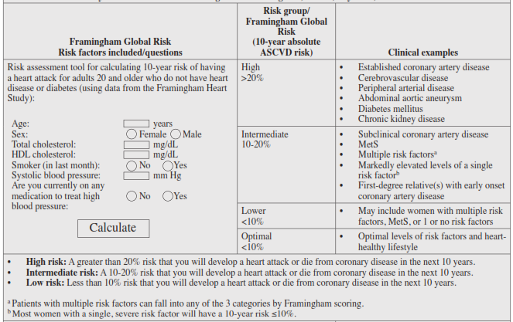
Table 8 Key Cardiovascular Risk Scoring Tools: Framingham, MESA, Reynolds, and UKPDS

Slide 12
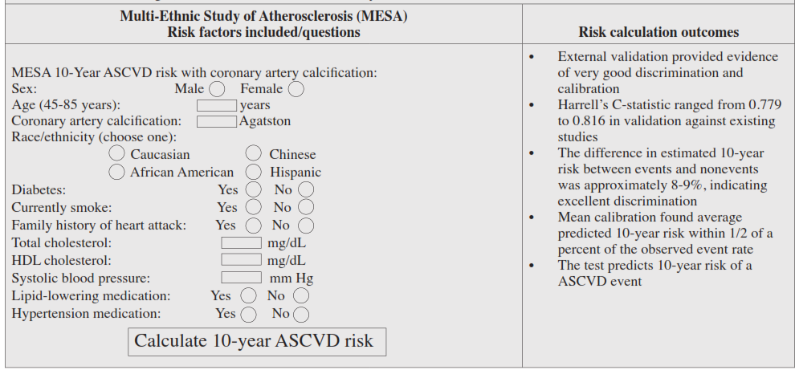
Table 8 Continue

Slide 13
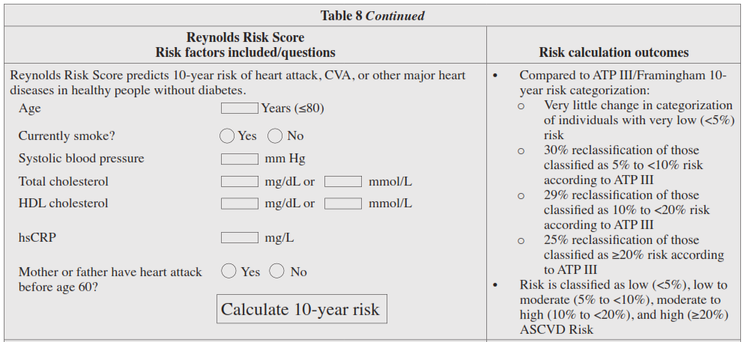

Slide 14
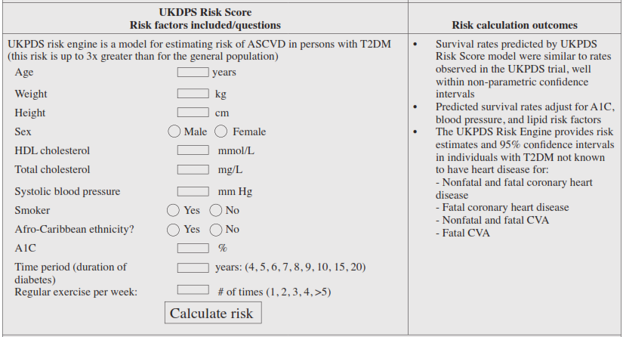
Table 8 Continue

Slide 15
R15. Older adults should undergo lipid assessment if they have multiple ASCVD global risk factors (i.e., other than age) (Grade C; BEL 4, upgraded due to cost-effectiveness). • R16. Screening for this group is based on age and risk, but not sex; therefore, older women should be screened in the same way as older men (Grade A; BEL 1).
Children and Adolescents
• R17. In children at risk for FH (e.g., family history of premature cardiovascular disease or elevated cholesterol), screening should be at 3 years of age, again between ages 9 and 11, and again at age 18 (Grade B; BEL 3, upgraded due to cost-effectiveness).
• R18. Screen adolescents older than 16 years every 5 years or more frequently if they have ASCVD risk factors, have overweight or obesity, have other elements of the insulin resistance syndrome, or have a family history of premature ASCVD (Grade B; BEL 3, upgraded due to cost-effectiveness).

Slide 16
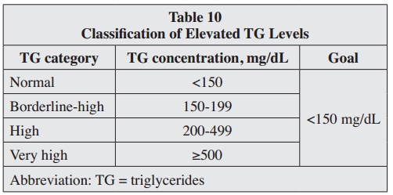
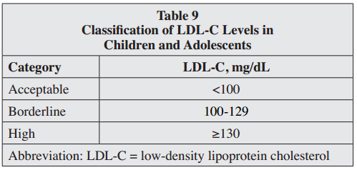
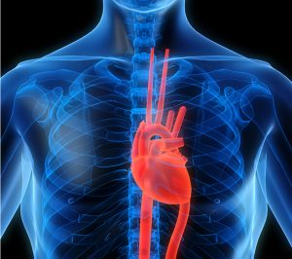

Slide 17
3Q2. WHICH SCREENING TESTS ARE RECOMMENDED FOR THE DETECTION OF CARDIOVASCULAR RISK? 3Q2.1. Fasting Lipid Profile • R19. Use a fasting lipid profile to ensure the most precise lipid assessment; this should include total cholesterol, LDL-C, TG, and non-HDL-C (Grade C; BEL 4, upgraded due to cost-effectiveness).
3Q2.2. LDL-C • R21. LDL-C may be estimated using the Friedewald equation: LDL-C = (total cholesterol – HDL-C) – TG/5; however, this method is valid only for values obtained during the fasting state and becomes increasingly inaccurate and invalid when TG levels are greater than 200 mg/dL and 400 mg/dL, respectively (Grade C; BEL 3).

Slide 18
• R22. LDL-C should be directly measured in certain high-risk individuals such as those with fasting TG levels greater than 250 mg/dL or those with diabetes or known vascular disease (Grade C; BEL 3).
3Q2.3. HDL-C
• R23. Measurement of HDL-C should be included in screening tests for dyslipidemia (Grade B; BEL 2).
3Q2.4. Non-HDL-C
• R24. The non-HDL-C (total cholesterol – HDLC) should be calculated to assist risk stratification in individuals with moderately elevated TG (200 to 500 mg/dL), diabetes, and/or established ASCVD (Grade B; BEL 2). • R25. If insulin resistance is suspected, the non-HDL-C should be evaluated to gain useful information regarding the individual’s total atherogenic lipoprotein burden (Grade D).

Slide 19
3Q2.5. TG • R26. TG levels should be part of routine lipid screening: moderate elevations (≥150 mg/dL) may identify individuals at risk for the insulin resistance syndrome and levels ≥200 mg/dL may identify individuals at substantially increased ASCVD risk (Grade B; BEL 2).
3Q2.6. Apolipoproteins
• R27. Apo B and/or an apo B/apo A1 ratio calculation and evaluation may be useful in at-risk individuals (TG ≥150, HDL-C <40, prior ASCVD event, T2DM, and/or the insulin resistance syndrome [even at target LDL-C levels]) to assess residual risk and guide decision-making (Grade A; BEL 1).

Slide 20
• R28. Apo B measurements (reﬂecting the particle concentration of LDL and all other atherogenic lipoproteins) may be useful to assess the success of LDL-C– lowering therapy (Grade A; BEL 1).
3Q2.7. Secondary Causes of Dyslipidemia • R29. Rule out secondary causes of dyslipidemia (Table 11) (Grade B; BEL 2). 3Q2.8. Additional Tests • R30. Use hsCRP to stratify ASCVD risk in individuals with a standard risk assessment that is borderline, or in those with an intermediate or higher risk with an LDL-C concentration <130 mg/dL (Grade B; BEL 2).

Slide 21
• R31. Measure lipoprotein-associated phospholipase A 2 (Lp-PLA2), which in some studies has demonstrated more specifcity than hsCRP, when it is necessary to further stratify an individual’s ASCVD risk, especially in the presence of hsCRP elevations (Grade A; BEL 1).
• R32. The routine measurement of homocysteine, uric acid, plasminogen activator inhibitor-1, or other inﬂammatory markers is not recommended because the benefit of doing so is not sufficiently proven (Grade D).
• R33. Coronary artery calcification (CAC) measurement has been shown to be of high predictive value and is useful in refining risk stratification to determine the need for more aggressive treatment strategies (Grade B; BEL 2).

Slide 22
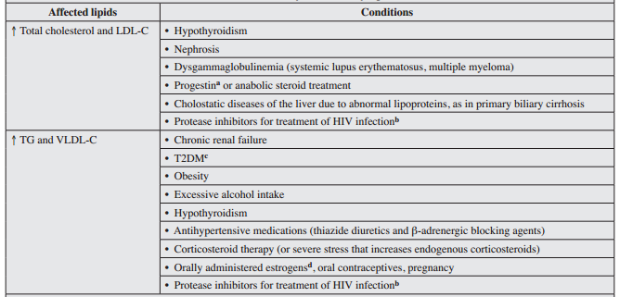
Table 11: Common Secondary Causes of Dyslipidemia

Slide 23
• R34. Carotid intima media thickness (CIMT) may be considered to refine risk stratification to determine the need for more aggressive ASCVD preventive strategies (Grade B; BEL 2).
3Q3. WHAT ARE THE TREATMENT RECOMMENDATIONS IN INDIVIDUALS WITH DYSLIPIDEMIA AND ASCVD RISK?
3Q3.1. Treatment Goals • R35. Treatment goals for dyslipidemia should be personalized according to levels of risk (Tables 6 and 11)
(Grade A; BEL 1).
• 3Q3.1.1. Risk Categories and LDL-C Goals (Table 6)
• R36. For individuals at low risk (i.e., with no risk factors), an LDL-C goal <130 mg/dL is recommended (Grade A; BEL 1).

Slide 24
• R37. For individuals at moderate risk (i.e., with 2 or fewer risk factors and a calculated 10-year risk of less than 10%), an LDL-C goal <100 mg/dL is recommended (Grade A; BEL 1).
• R38. For individuals at high risk (i.e., with an ASCVD equivalent including diabetes or stage 3 or 4 CKD with no other risk factors, or individuals with 2 or more risk factors and a 10-year risk of 10%- 20%), an LDL-C goal <100 mg/dL is recommended (Grade A; BEL 1). • R39. For individuals at very high risk (i.e., with established or recent hospitalization for acute coronary syndrome (ACS); coronary, carotid or peripheral vascular disease; diabetes or stage 3 or 4 CKD with 1 or more risk factors; a calculated 10-year risk greater than 20%; or heterozygous familial hypercholesterolemia [HeFH]), an LDL-C goal <70 mg/dL is recommended (Grade A; BEL 1).

Slide 25
• R40. For individuals at extreme risk (i.e., with progressive ASCVD, including unstable angina that persists after achieving an LDL-C <70 mg/dL, or established clinical ASCVD in individuals with diabetes, stage 3 or 4 CKD, and/or HeFH, or in individuals with a history of premature ASCVD (<55 years of age for males or <65 years of age for females), an LDL-C goal <55 mg/dL is recommended (Grade A; BEL 1).
• R41. An LDL-C goal <100 mg/dL is considered “acceptable” for children and adolescents, with 100 to 129 mg/dL considered “borderline” and 130 mg/dL or greater considered “high” (based on recommendations from the American Academy of Pediatrics) (Table 9) (Grade D).

Slide 26
• 3Q3.1.2. HDL-C • R42. HDL-C should be >40 mg/dL, but also as high as possible, primarily through the use of lifestyle interventions (e.g., weight loss, physical activity, and tobacco cessation), and if risk factors are present (e.g., borderline elevated LDL-C levels, a family history of premature ASCVD, or a personal history of ASCVD), also through the use of pharmacotherapy primarily focused on reducing LDL-C (Grade A; BEL 1).
• 3Q3.1.3. Non-HDL-C
• R43. For most individuals, a non-HDL-C goal (total cholesterol – HDL-C) 30 mg/dL higher than the individual’s specific LDL-C goal is recommended (Table 12) (Grade D). • R44. For individuals at extreme risk, a non-HDLC goal 25 mg/dL higher than the individual-specific LDL-C goal is recommended (Table 12)(Grade A; BEL 1).

Slide 27
• 3Q3.1.4. Apolipoproteins
• R45. For individuals at increased risk of ASCVD, including those with diabetes, an optimal apo B goal is <90 mg/dL, while for individuals with established ASCVD or diabetes plus 1 or more additional risk factor(s), an optimal apo B goal is <80 mg/dL, and for individuals at extreme risk, an optimal apo B goal is <70 mg/dL (Table 12) (Grade A; BEL 1).
• 3Q3.1.5 TG
• R46. TG goals <150 mg/dL are recommended (Table 12) (Grade A; BEL 1). 3Q3.2. Treatment Recommendations • R47. A comprehensive strategy to control lipid levels and address associated metabolic abnormalities and modify able risk factors is recommended primarily using lifestyle changes (Grade A, BEL 1) and patient education with pharmacotherapy as needed to achieve evidence-based targets (Grade A, BEL 1).

Slide 28
• 3Q3.2.1. Physical Activity
• R48. A reasonable and feasible approach to fitness therapy (i.e., exercise programs that include at least 30 minutes of moderate-intensity physical activity [consuming 4-7 kcal/min] 4 to 6 times weekly, with an expenditure of at least 200 kcal/day) is recommended; suggested activities include brisk walking, riding a stationary bike, water aerobics, cleaning/ scrubbing, mowing the lawn, and sporting activities (Grade A; BEL 1). • R49. Daily physical activity goals can be met in a single session or in multiple sessions throughout the course of a day (10 minutes minimum per session); for some individuals, breaking activity up throughout the day may help improve adherence with physical activity programs (Grade A; BEL 1).

Slide 29
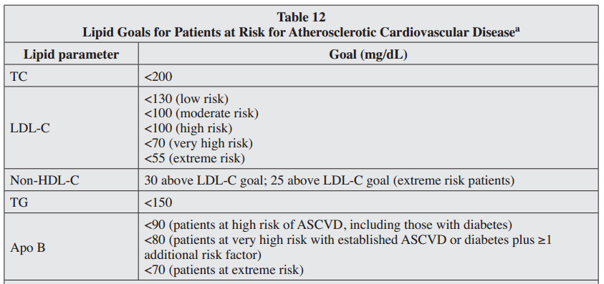
Table 12: Lipid Goals for Patients at Risk for Atherosclerotic Cardiovascular Diseasea

Slide 30
• R50. In addition to aerobic activity, muscle-strengthening activity is recommended at least 2 days a week (Grade A; BEL 1). • 3Q3.2.2. Medical Nutrition Therapy • R51. For adults, a reduced-calorie diet consisting of fruits and vegetables (combined ≥5 servings/day), grains (primarily whole grains), fish, and lean meats is recommended (Grade A; BEL 1). • R52. For adults, the intake of saturated fats, trans-fats, and cholesterol should be limited, while LDLC-lowering macronutrient intake should include plant stanols/sterols (~2 g/day) and soluble fiber (10-25 g/ day) (Grade A; BEL 1). • R53. Primary preventive nutrition consisting of healthy lifestyle habits is recommended in all healthy children (Grade A; BEL 1).

Slide 31
• 3Q3.2.3. Smoking Cessation • R54. Tobacco cessation should be strongly encouraged and facilitated (Grade A; BEL 2; upgraded due to potential benefit).
• 3Q3.2.4. Pharmacologic Therapy • R55. In individuals at risk for ASCVD, aggressive lipid-modifying therapy is recommended to achieve appropriate LDL-C goals (Table 13) (Grade A, BEL 1).
Statins • R56. Statin therapy is recommended as the primary pharmacologic agent to achieve target LDL-C goals on the basis of morbidity and mortality outcome trials (Grade A; BEL 1).

Slide 32
• R57. For clinical decision-making, mild elevations in blood glucose levels and/or an increased risk of new onset T2DM associated with intensive statin therapy do not outweigh the benefits of statin therapy for ASCVD risk reduction (Grade A, BEL 1). • R58. In individuals within high-risk and very high risk categories, further lowering of LDL-C beyond established targets with statins results in additional ASCVD event reduction and may be considered (Grade A, BEL 1).
• R59. Very high-risk individuals with established coronary, carotid, and peripheral vascular disease, or diabetes who also have at least 1 additional risk factor should be treated with statins to target a reduced LDL-C treatment goal of <70 mg/dL (Grade A, BEL 1). • R60. Extreme-risk individuals should be treated with statins to target an even lower LDL-C treatment goal of <55 mg/dL (Table 6) (Grade A, BEL 1).

Slide 33
Fibrates
• R61. Fibrates should be used to treat severe hypertriglyceridemia (TG >500 mg/dL) (Table 13) (Grade A; BEL 1).
• R62. Fibrates may improve ASCVD outcomes in primary and secondary prevention when TG concentrations are ≥200 mg/dL and HDL-C concentrations are <40 mg/dL (Grade A; BEL 1). Omega-3 Fish Oil
• R63. Prescription omega-3 oil, 2 to 4 g daily, should be used to treat severe hypertriglyceridemia (TG >500 mg/dL). Dietary supplements are not FDA-approved for treatment of hypertriglyceridemia and generally are not recommended for this purpose. (Grade A, BEL 1).
Niacin • R64. Niacin therapy is recommended principally as an adjunct for reducing TG (Grade A, BEL 1).

Slide 34
• R65. Niacin therapy should not be used in individuals aggressively treated with statin due to absence of additional benefits with well-controlled LDL-C (Grade A; BEL 1).
Bile Acid Sequestrants
• R66. Bile acid sequestrants may be considered for reducing LDL-C and apo B and modestly increasing HDL-C, but they may increase TG (Grade A; BEL 1).
Cholesterol Absorption Inhibitors • R67. Ezetimibe may be considered as monotherapy in reducing LDL-C and apo B, especially in statin-intolerant individuals (Grade B, BEL 2). • R68. Ezetimibe can be used in combination with statins to further reduce both LDL-C and ASCVD risk (Grade A; BEL 1).

Slide 35
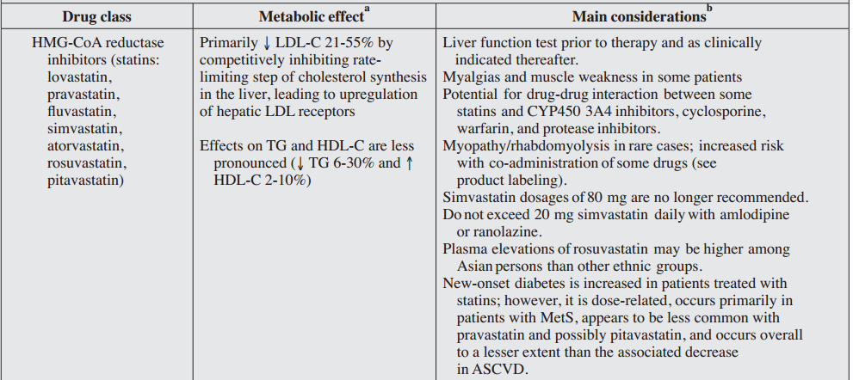
Table 13: Primary Lipid-Lowering Drug Classes

Slide 36
Table 13: Primary Lipid-Lowering Drug Classes continue

Slide 37
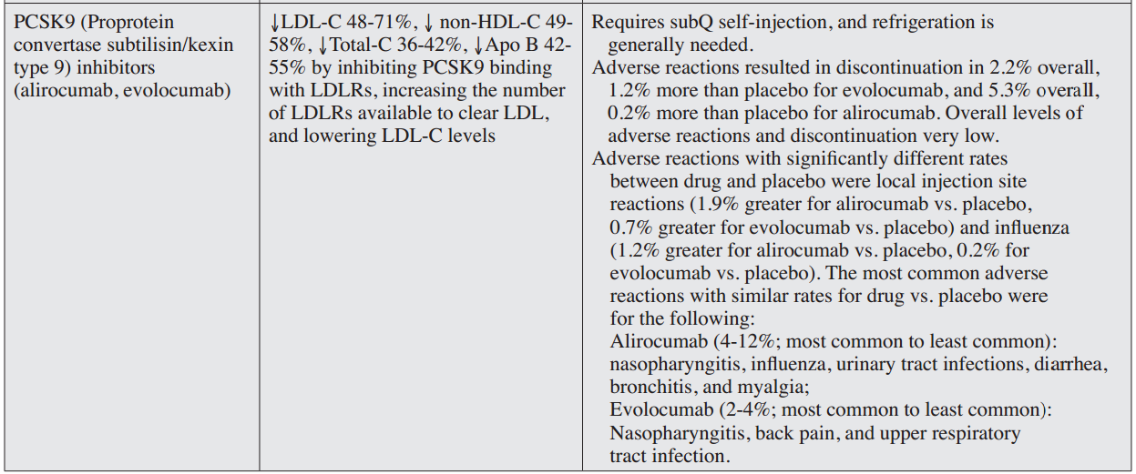
Table 13: Primary Lipid-Lowering Drug Classes continue

Slide 38
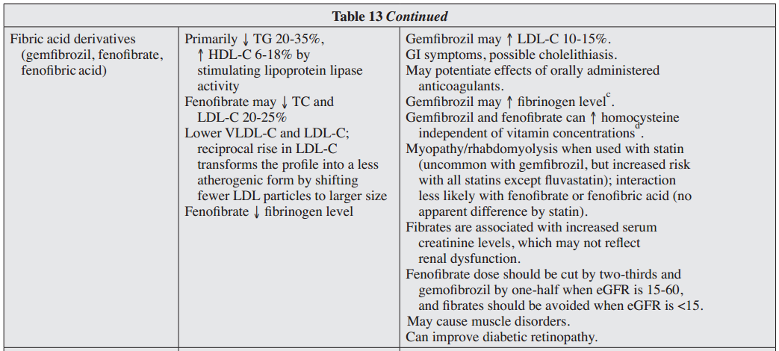

Slide 39
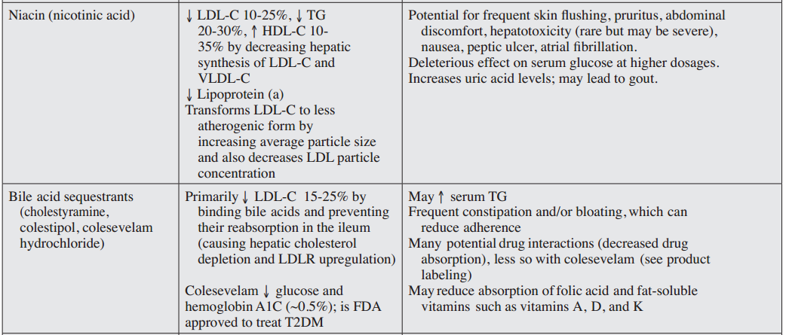
Table 13: Primary Lipid-Lowering Drug Classes continue

Slide 40
Table 13: Primary Lipid-Lowering Drug Classes continue

Slide 42
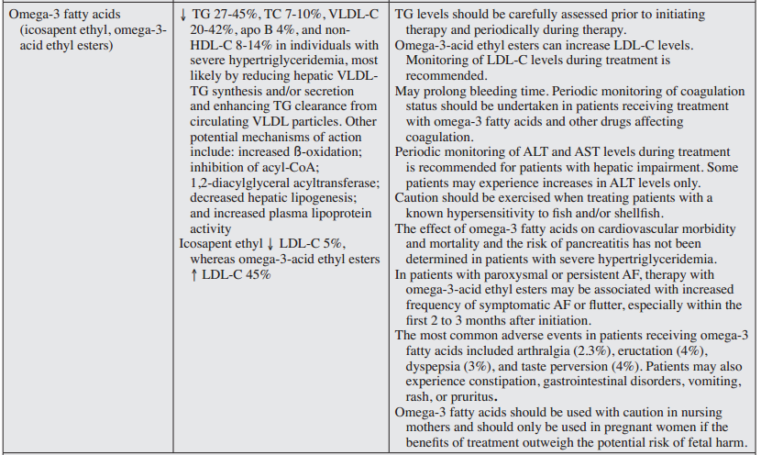

Slide 43
Proprotein convertase subtilisin/kexin type 9 (PCSK9) Inhibitors • R69. PCSK9 inhibitors should be considered for use in combination with statin therapy for LDL-C lowering in individuals with FH (Grade A; BEL 1). • R70. PCSK9 inhibitors should be considered in individuals with clinical cardiovascular disease who are unable to reach LDL-C/non-HDL-C goals with maximally tolerated statin therapy. They should not be used as monotherapy except in statin-intolerant individuals (Grade A; BEL 1). Combination Therapy • R71. Combination therapy of lipid-lowering agents should be considered when the LDL-C/non-HDL-C level is markedly increased and monotherapy (usually with a statin) does not achieve the therapeutic goal (Grade A; BEL 1). Special Considerations: Women • R72. Women should be evaluated for their ASCVD risk and be treated with pharmacotherapy if lifestyle intervention is insuffcient (Grade C; BEL 4; upgraded due to potential beneft).

Slide 44
• R73. Hormone replacement therapy for the treatment of dyslipidemia in postmenopausal women is not recommended (Grade A; BEL 1).
Special Considerations: Children and Adolescents • R74. Pharmacotherapy is recommended for children and adolescents older than 10 years who do not respond suffciently to lifestyle modifcation, particularly for those satisfying the following criteria (Grade D; BEL 4): • LDL-C ≥190 mg/dL • LDL-C ≥160 mg/dL and the presence of 2 or more cardiovascular risk factors, even after vigorous intervention • Family history of premature ASCVD (before 55 years of age), or
• Having overweight, obesity, or other elements of the insulin resistance syndrome 3Q3.3. Follow-up and Monitoring • R75. Re-assess individuals’ lipid status 6 weeks after therapy initiation and again at 6-week intervals until the treatment goal is achieved (Grade D; BEL 4).
• R76. While on stable lipid therapy, individuals should be tested at 6- to 12-month intervals (Grade D; BEL 4).

Slide 45
• R79. Liver transaminase levels should be measured before and 3 months after niacin or fbric acid treatment initiation because most liver abnormalities occur within 3 months of treatment initiation. Liver transaminase levels should be measured periodically thereafter (e.g., semiannually or annually) (Grade C; BEL 4; upgraded due to potential beneft).
• R80. Creatine kinase levels should be assessed and the statin discontinued, at least temporarily, when an individual reports clinically signifcant myalgias or muscle weakness on statin therapy (Grade C; BEL 4; upgraded due to potential beneft).

Slide 46
3Q4. IS TREATMENT OF DYSLIPIDEMIA AND PREVENTION OF ATHEROSCLEROTIC CARDIOVASCULAR DISEASE COST-EFFECTIVE? • R81. Nonpharmacologic interventions such as dietary management (Grade A; BEL 1) and smoking cessation are the most cost-effective options available for ASCVD prevention (Grade A; BEL 2, upgraded due to potential health beneft). • R82. When nonpharmacologic interventions fail, pharmacologic intervention is a recommended cost-effective option for primary and secondary intervention among individuals at moderate to high risk (Grade B; BEL 2). • R83. Among otherwise healthy individuals at lower risk, the cost-effectiveness of primary pharmacologic intervention varies on the basis of age and sex (with this approach being least cost-effective among women at low risk) (Grade C; BEL 3).

Slide 47
• R84. Statins have proven cost-effective in both secondary and primary prevention of ASCVD events in individuals at moderate to high risk or in individuals at low risk whose LDL-C levels are very high (≥190 mg/ dL) (Grade B; BEL 2). • R85. Treatment with fibrates has been found to be cost-effective as both monotherapy and combination therapy for lowering TG and raising HDL-C (Grade D; BEL 4), but not in reducing cardiovascular events, except in individuals with TG concentrations greater than 200 mg/dL and HDL-C concentrations less than 40 mg/dL (Grade D; BEL 4).
• R86. Ezetimibe, co-administered with statin therapy in individuals unable to meet target LDL-C levels, has not been evaluated for cost-effectiveness in the U.S. Based on studies from Canada and the United Kingdom, ezetimibe may be a cost-effective strategy to achieve LDL-C goals, especially with price decreases for generic ezetimibe (Grade A; BEL 1).

Slide 48
• R87. Bile acid sequestrants are generally not cost effective alternatives to statin therapy despite generic availability; this is due to their low LDL-C lowering efficacy compared to statins (Grade B; BEL 2).

Slide 49
• 4Q3.2.2. Medical Nutrition Therapy
Research has shown that diet can have a substantial effect on lipid levels and may be an important determinant of ASCVD risk. Therefore, medical nutrition therapy provides an important tool for the management of dyslipidemia.
Dietary Risk Factors:
Fats Dietary fat includes both unsaturated and saturated fatty acids. The substitution of unsaturated fatty acids (including both polyunsaturated and monounsaturated) for saturated fatty acids leads to decreased LDL-C levels; slightly greater LDL-C reductions are observed with polyunsaturated fatty acids than with monounsaturated fatty acids .While high intake of poly-unsaturated fatty acids may reduce HDL-C and TG levels, the substitution of monounsaturated fatty acids for saturated fatty acids has a minimal effect on HDL-C values and does not raise TG levels. Dietary intake of trans fatty acids is associated with both increased LDL-C and decreased HDL-C levels .Combined with evidence from epidemiologic cohort studies, these effects indicate that diets high in trans fatty acids are associated with an increased risk of ASCVD; evidence indicates that, on a per calorie basis, risk with trans fatty acids is higher than with any other macronutrient.

Slide 50
Dietary Changes: Recommendations and Clinical Effects
Nutritional guidelines for the reduction of cardiovascular risk through lipid management recommend diets rich in fruits and vegetables (combined ≥5 servings/day; ≥1 of these servings/day of dark green or orange vegetables), Additional recommendations, such as those provided in the therapeutic lifestyle changes diet, specify limits for the intake of saturated fat (<7% of total calories), trans fats (<1% of total calories), and cholesterol (<200 mg/day). Guidelines also indicate that polyunsaturated and monounsaturated fatty acids may comprise up to 10% and 20% of caloric intake, respectively, and that total dietary fat should constitute 25 to 35% of calories consumed Further recommendations include a reduction in both salt intake and total calories consumed .

Slide 51
While low-fat diets are generally recommended, it is important to recognize that decreases in dietary fat intake may lead to increased carbohydrate consumption (principally starches and sugars) and subsequent weight gain. Individuals at risk for the insulin resistance syndrome are advised to avoid excessive carbohydrate intake and consume diets that include relatively more unsaturated fats .A diet high in carbohydrates (>60% of total energy) will increase TG, while a diet that replaces saturated fatty acids with monounsaturated fatty acids will not Nutrition therapy effectively reduces cholesterol levels . In the European Prospective Investigation into Cancer and Nutrition (EPIC)-Oxford study, mortality from ischemic heart disease was lower in vegetarians than in nonvegetarians. In other studies, vegetarian diets were associated with reduced total cholesterol, LDL-C, and systolic blood pressure compared with control or meat-eating diets.

Slide 52
Duration and Diagnostic Signifcance of Nutrition Therapy
In primary prevention, nutrition therapy should be applied as the sole therapeutic approach for dyslipidemia management for at least 3 months. Depending on individual progress, nutritional therapy may be extended through 6 months before initiating lipid-lowering drug therapy. For high-risk individuals, it is appropriate to institute nutrition therapy and pharmacotherapy simultaneously.

Slide 53
The End

