Slide 1
PITUITARY APOPLEXY
بنام خداوند جان و خرد
M. Siavash
Professor of endocrinology
Isfahan University of medical sciences
2017

Slide 3
ای از بر سدره شاهراهت وای قبّه ی عرش تكیه گاهت | ای طاق نهم رواق بالا بشكسته ز گوشه ی كلاهت | هم عقل دویده در ركابت هم شرع خزیده در پناهت
ای چرخ كبود ژنده دلقی در گردن پیر خانقاهت | جبریل مقیم آستانت افلاك حریم بارگاهت | چرخ ار چه رفیع، خاك پایت عقل ارچه بزرگ، طفل راهت
ای نام تو دستگیر آدم و ای خلق تو پایمرد عالم | فرّاش درت كلیم عمران چاووش رهت مسیح مریم | در خدمتت انبیا مشرّف وز حرمتت آدمی مكرّم
كونین نواله ای ز جودت افلاك طفیلی وجودت | ای مسند تو ورای افلاك صدر تو و خاك توده حاشاك | طغرای جلال تو لعمرك منشور ولایت تو لولاك
نُه حقّه و هفت مهره پیشت دست تو و دامن تو زان پاك | در عهد نبوّت تو آدم پوشیده هنوز خرقه ی خاك | نقش صفحات رایت تو لولاك لما خلقت الافلاك

Slide 4
Objectives
Definition
Anatomy and Physiology
Pathophysiology
Signs and Symptoms
Differential diagnosis
Treatment
Prognosis and Outcomes

Slide 5
Introduction
The word "apoplexy" comes from the Greek "apoplexia" meaning a seizure, in the sense of being struck down.
→In Greek "plexe" is "a stroke." The ancients believed that someone suffering a stroke had been struck down by the gods
apoplexy :a sudden neurologic impairment, usually due to a vascular process

Slide 6
Introduction
The term “pituitary apoplexy” was coined by Brougham et al. in 1950 in a case series of 5 patients during the pre–magnetic resonance imaging (MRI) era.
Bailey was previously credited with describing the first case of pituitary tumor with hemorrhage in 1898.
Retrospective series of pituitary apoplexy have since been described in the literature, but there is still disagreement about the definition and optimal management

Slide 7
Introduction
Some authors define the term pathologically as hemorrhage or infarction (or both) of the pituitary or sellar tumor.
Others focus on the clinical syndrome, defining “classic” or “acute” pituitary apoplexy as characterized by sudden-onset headache, vomiting, visual problems, and decreased consciousness.

Slide 8
Definition
Clinical syndrome characterized by sudden headache, vomiting, visual impairment and meningismus caused by rapid enlargement of a pituitary adenoma usually due to hemorrhagic infarction of the tumor
Pituitary apoplexy is a clinical definition

Slide 9
Pituitary Apoplexy
A clinical syndrome resulting from acute hemorrhage or infarction of the pituitary gland characterized by the onset of:
Headache
Vomiting
Visual Disturbances
Opthalmoplegia – CN III most common
Meningismus
Fever
Decreased Consciousness
Death

Slide 10
Incidence
0.6 – 9.1% apoplexy in pituitary adenomas treated surgically
0.6 – 25.7% hemorrhage in pituitary adenomas treated surgically
Male: Female: 1.3:1
Mean age: 46.7 years

Slide 11
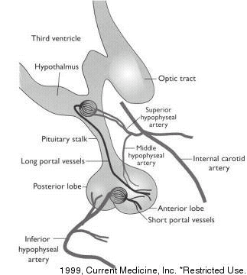
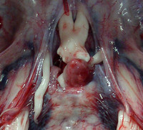
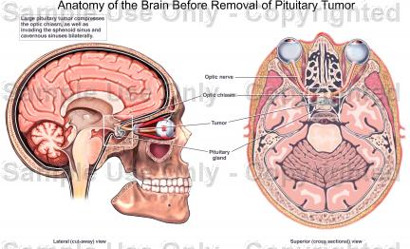
Anatomy and Physiology

Slide 12
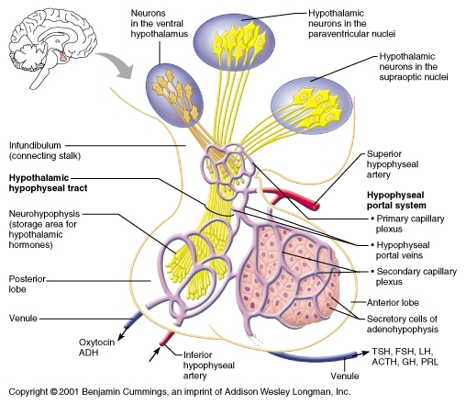
Anatomy and Physiology

Slide 13
Pathophysiology
-- stems from an acute expansion of a pituitary adenoma or, less commonly, in a nonadenomatous gland, from infarction or hemorrhage.
-- Some postulate :
gradual enlarging pituitary tumor →compressing and distorting the hypophyseal stalk and its vascular supply →causing ischemia and subsequent necrosis
-- Another theory :rapid expansion of the tumor outstrips its vascular supply→ resulting in ischemia and necrosis
(doubtful?→ tumors that undergo apoplexy are slow growing)

Slide 14
Pathophysiology
Controversial
Rapid growth of tumor outstrips blood supply, producing ischemic necrosis → hemorrhage
Direct invasion of vessel wall by tumor and consequent vessel rupture
Differences in vasculature of adenoma and normal adenohypophesis

Slide 15
Pathophysiology
Compromised blood flow caused by compression of pituitary stalk
High pressure system through inferior hypophyseal arteries causes hemorrhages in low-pressure adenohypophyseal sinusoids
Increased intrasellar pressure (fragile neovascularization)

Slide 16
Pathophysiology
Null-cell adenomas have highest incidence of apoplexy
Size, apparently, does not matter
Most cases show necrosis, hemorrhage, or both
Pituitary apoplexy as been described in association with a variety of conditions
Most common predisposing factor, however unproven, is arterial hypertension

Slide 17
Predisposing Factors:
Arterial hypertension
Sudden head trauma
Cardiac surgery
Transient elevation of intracranial pressure
Diabetes
Acromegaly
Cushing’s Syndrome
Estrogens
Anticoagulation
Bromocriptine
Dynamic pituitary function tests
GnRH analogues
Radiotherapy

Slide 18
Signs and Symptoms
Headache 100% (often retro-orbital)
Nausea 80%
Reduction in visual field 71%
Ocular paresis 69%
Third nerve palsy 67%
Reduction in visual acuity 66%
Vomiting 57%
Photophobia 49%
Decreased level of consciousness 11%

Slide 19
Frequency: This condition results in an estimated 1.5-27.7% of cases of pituitary adenoma
Sex: Male-to-female predominance is 2:1.
Age: The age range is 37-57 years.

Slide 20
Clinical manifestations
headache in 95% of cases.
The headache is sudden .Frequently, it is retro-orbital in location and may be unilateral at onset, then becomes generalized.
Vomiting occurs in 69% of patients and often accompanies the headache.

Slide 21
Clinical manifestations
The classic visual field defect is a bitemporal superior quadrantic defect.
Ocular paresis (78%) results from compression of the cavernous sinus, which make cranial nerves III, IV, VI vulnerable to compression.
diplopia may be present.
Of the cranial nerves, the oculomotor nerve is involved most commonly→unilateral dilated pupil, ptosis,
Less commonly, cranial nerve IV is involved

Slide 22
Clinical manifestations
Horner syndrome may develop from damage to the sympathetic fibers.
Involvement of the hypothalamus may alter thermal regulation.
Destruction of adenohypophyseal tissue may lead to endocrinologic deficiencies.

Slide 23
Investigations
Biochemical:
Gonadotropin deficiency 79%
Hypocortisolism 76%
Testosterone deficiency 73%
TSH deficiency 50%
Hyponatremia (<135) 44%

Slide 24
Investigations
Radiological:
CT scan revealed tumor in 93% and hemorrhage in 21%
MRI revealed tumor in 100% and hemorrhage in 88%

Slide 26
Enhanced T1-weighted axial and coronal MRI showing a large pituitary tumor that has recently undergone ischemic apoplexy showing a necrotic (hypointense) center and ring of gadolinium enhancement (hyperintense), ie, the "pituitary ring sign." There is a small area of hemorrhagic blush in the center of the necrosis.

Slide 27
Differential Diagnosis
SAH from aneurysmal rupture
Spontaneous hemorrhage from hypertension, amyloid angiopathy
Migraine
Temporal arteritis
Meningitis
Diabetic oculomotor palsy
Optic neuritis
Cavernous sinus thrombosis

Slide 28
Treatment

Slide 29
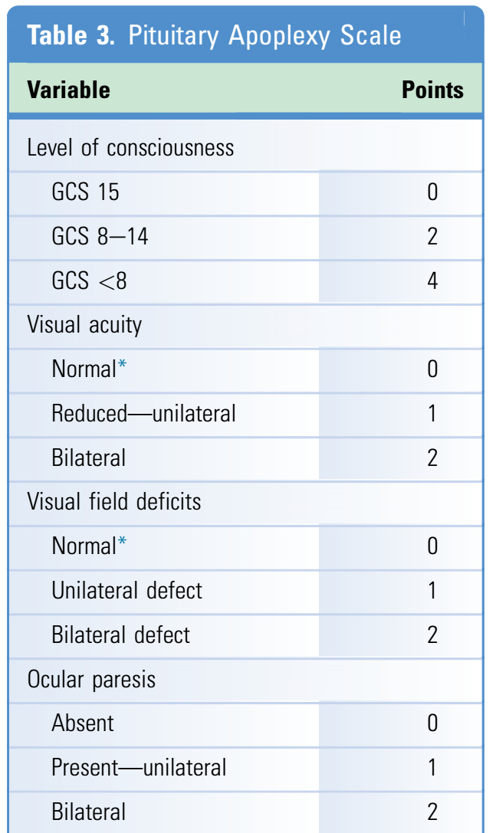
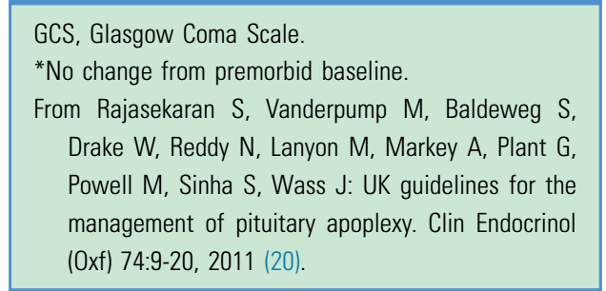

Slide 30
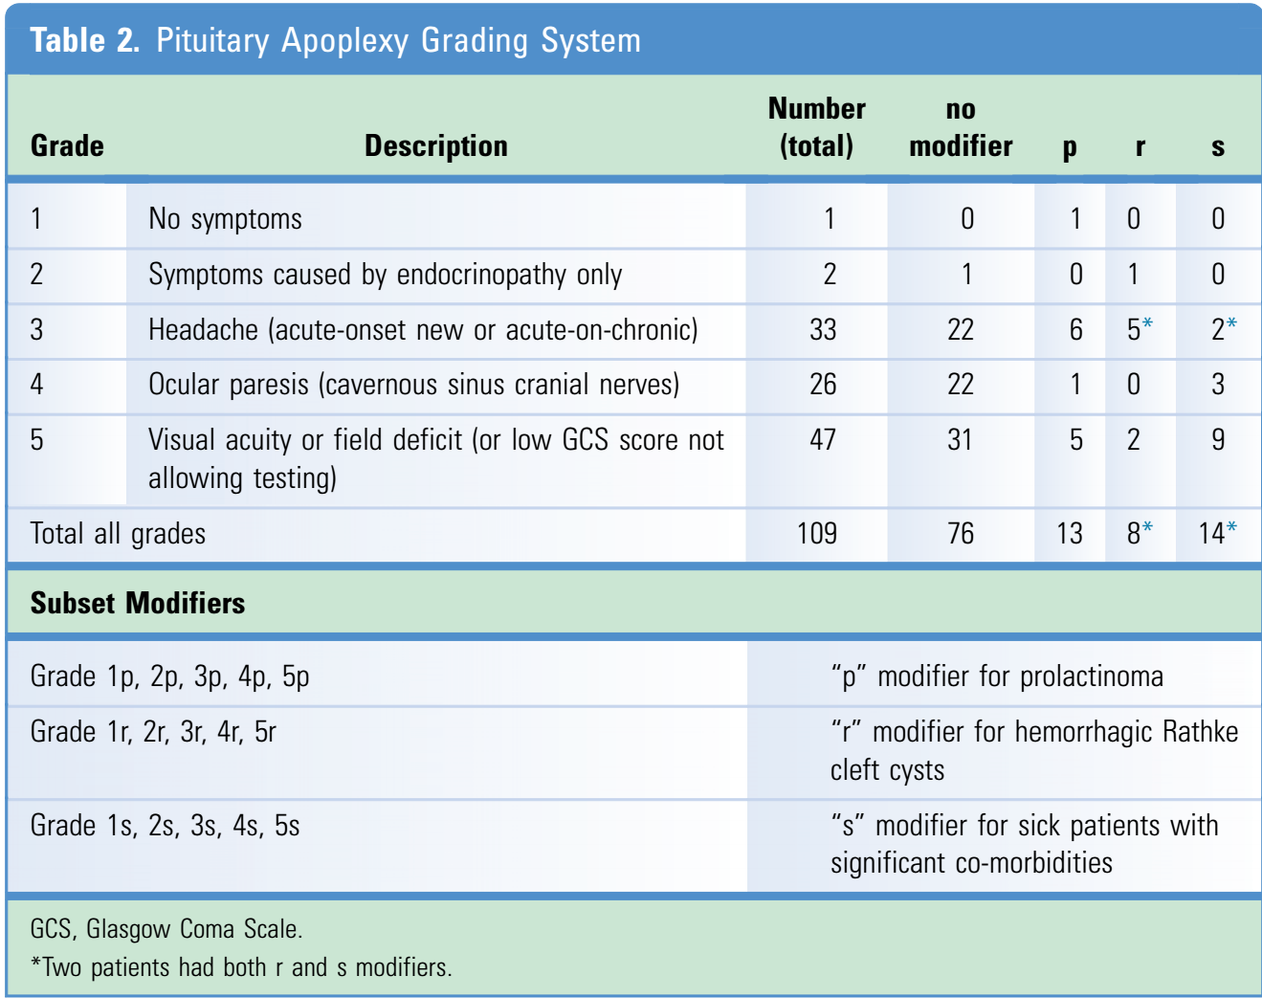

Slide 31
Flow chart illustrating assessment using the Pituitary Apoplexy Grading System
GCS, Glasgow Coma Scale; p modifier, prolactinoma; r modifier, hemorrhagic Rathke cleft cyst; s modifier, significant comorbidities.

Slide 32
Treatment
Management focused on two aspects:
i. Endocrinopathy
ii. Acute neurologic deficits from tumor mass

Slide 33
Treatment
Medical stabilisation
High-dose steroids
Pituitary panel and electrolytes
Imaging
Emergent surgical decompression
Endocrinologic consultation

Slide 34
Treatment
Careful monitoring of fluid and electrolyte balance
Replacement of deficient hormone, especially corticosteriods
Pituitary surgery
Long term monitoring for hypopituitarism and recurrence of pituitary adenomas

Slide 35
Surgical Treatment Indicated with:
Diminished level of consciousness
Hypothalmic disturbances
Visual impairment
Some disagreement in literature about timing of surgery; question of improved outcome (in visual field and visual acuity) if operation occurs within 8 days of onset of symptoms (Randeva et al. 1999); other studies demonstrate satisfactory recovery of vision with late surgery (Ayuck et al. 2004, Sibal et al. 2005).

Slide 36
Conservative Therapy
Favored in patients without or with mild neuro-opthalmic signs.
Retrospective studies have shown spontaneous improvement in neuro-opthalmic symptoms with conservative management (Sibal et al. 2005)

Slide 37
Outcome and Prognosis
Lethal outcome very infrequent
Emergent decompression may recover pituitary function
Visual outcome: early decompression (<8 days) improves visual acuity and visual fields. No influence on ocular paresis (86%, 76%, 91%)

Slide 38
Outcome and Prognosis
Endocrinologic outcome: long-term replacement therapy in 43-58%, transient diabetes insipidus in 16%

Slide 39
The Bottom Line
Rapid, thorough evaluation
Pituitary panel
High-dose steroids
MRI
Unless patient presents with rapidly progressive visual or neurologic deficit, urgent but not emergent intervention is recommended.

Slide 40
Thank you and hope for a good rain

