Slide 1
Non-Classic Congenital Adrenal Hyperplasia: update on the diagnosis and treatment
Presented by G. Taghipour, MD
AZAR 1396

Slide 2
Introduction
Congenital adrenal hyperplasia (CAH) refers to a group of inherited autosomal recessive disorders that arise from defective steroidogenesis and results from a deficiency in one or several of the enzymes of cortisol biosynthesis.
CAH is associated with higher CV risk factors and probably with excess CV and metabolic morbidity.
Fertility rate, i.e. live births per woman, is significantly lower in CAH women than in the general female population

Slide 3
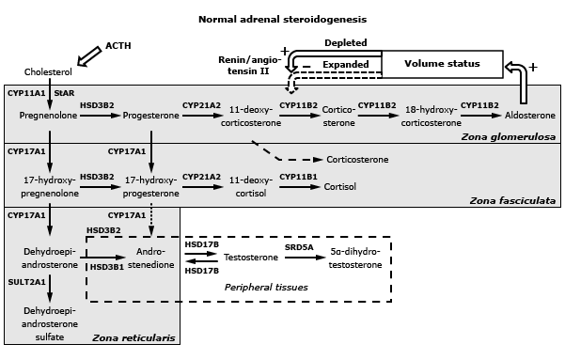
Normal Adrenal Steroidogenesis

Slide 4
Introduction
The other forms of CAH other than CYP21A2, including:
CYP17A1 deficiencies
3-beta-hydroxysteroid dehydrogenase type 2 deficiency
CYP11B1 deficiency
Cytochrome P450-oxidoreductase (POR) deficiency (ORD)
Hexose-6-phosphate-dehydrogenase deficiency
PAPSS2 deficiency
Congenital lipoid adrenal hyperplasia

Slide 5
A: CYP17A1 deficiencies

Slide 6
A: CYP17A1 deficiencies
Clinical presentation CYP17A1:
The classic presentation of severe 17OHD in phenotypic females (who can have 46,XX or 46,XY karyotypes) includes:
Hypertension
Primary amenorrhea
Absence of secondary sexual characteristics
Minimal body hair

Slide 7
A: CYP17A1 deficiencies
The diagnosis of 17OHD:
The diagnosis is established by showing elevated DOC and corticosterone (>4,000 ng/dL, >116 nmol/L) with low cortisol (<5 mcg/dL, <138 nmol/L), androgens, and estrogens. Progesterone is also elevated, while aldosterone and renin are suppressed.
Gonadotropins and corticotropin (ACTH) are elevated even in children.
ILD is the elevated 17-hydroxyprogesterone (17OHP)/ androstenedione ratio (>50), with all downstream (19-carbon) steroids reduced and 17-hydroxysteroids generally normal.

Slide 8
A: CYP17A1 deficiencies
The Treatment:
The goals of treatment in classic 17OHD are to mitigate the effects of mineralocorticoid excess, prevent glucocorticoid deficiency, and restore desired secondary sexual characteristics with attendant benefits such as improved bone mineral density (BMD).
While glucocorticoid administration, similar to treating 21-hydroxylase deficiency (21OHD), is a logical approach to lower ACTH and thus stop the accumulation of mineralocorticoids,
axis suppression and the consequences of glucocorticoid excess are unnecessary.

Slide 9
A: CYP17A1 deficiencies
The Treatment:
Glucocorticoid therapy should be minimized and need not exceed physiologic replacement doses.
Since all patients are clinically female, Spironolactone is the drug of choice to blockade the mineralocorticoid receptor and can be viewed as a glucocorticoid-sparing adjunctive therapy, similar to its use in glucocorticoidremediable aldosteronism

Slide 10
A: CYP17A1 deficiencies
The Treatment:
Medications are titrated based on monitoring blood pressure, DOC, and electrolytes; renin suppression can persist for years, despite adequate therapy, in some cases.
Estrogen replacement is started at the time of expected puberty. Cyclical withdrawal bleeding is only required for 46,XX females with an intact uterus.
Androgen replacement has not been studied in this disorder.

Slide 11
B: 3-beta-hydroxysteroid dehydrogenase type 2 deficiency
A rare form of CAH in which synthesis of all active steroid hormones is impaired.
This very rare disorder, like 17OHD, impairs both adrenal and gonadal steroid production.
Both male and female infants are born with genital ambiguity.

Slide 12
B: 3-beta-hydroxysteroid dehydrogenase type 2 deficiency
Clinical presentation:
Most patients present as neonates or in early infancy with clinical manifestations of both cortisol and aldosterone deficiency, with feeding difficulties, vomiting, volume depletion, hyponatremia, and hyperkalemia.
This disease is not part of neonatal screening programs, and rare patients may have severe deficiency but few symptoms and escape diagnosis until they are evaluated for delayed puberty

Slide 13
B: 3-beta-hydroxysteroid dehydrogenase type 2 deficiency
Clinical presentation:
Newborn males are undervirilized in proportion to the severity of the enzymatic deficiency, but this disease is a rarely found in boys with idiopathic hypospadias.
Newborn females often have mild virilization and clitoromegaly due to peripheral conversion of DHEA sulfate (DHEAS) to testosterone by the type 1 enzyme.
Premature pubarche with exaggerated serum 17-alphahydroxypregnenolone responses to ACTH has been described in three girls with missense mutations of the gene

Slide 14
B: 3-beta-hydroxysteroid dehydrogenase type 2 deficiency
The diagnosis :
stimulated delta-5-17-hydroxypregnenolone values >5000 ng/dL (150 nmol/L) or more should be considered consistent with the diagnosis.

Slide 15
B: 3-beta-hydroxysteroid dehydrogenase type 2 deficiency
The Managment :
Therapy must include replacement of both adrenal and gonadal steroid deficiencies.
In 46,XY children raised as males, replacement doses of glucocorticoid (hydrocortisone) and mineralocorticoid (fludrocortisone acetate) are sufficient, and suppression of ACTH is unnecessary.
In children raised as females, somewhat higher doses may be needed to prevent excess production of androgens derived from adrenal DHEAS.

Slide 16
B: 3-beta-hydroxysteroid dehydrogenase type 2 deficiency
The Managment :
At the time of expected puberty, gender-appropriate replacement of androgens or estrogens with progestins should be started and advanced slowly to adult regimens.
In undervirilized 46,XY males, testosterone therapy may be used during childhood to augment penile size prior to initiation of puberty

Slide 17
C: CYP11B1 deficiency
Affects 1 in 100,000 live births and accounts for up to 5 percent of adrenal steroidogenic defects.
11OHD is generally considered the second most frequent congenital adrenal hyperplasia (CAH) variant other than 21OHD deficiency.
The phenotype of 11OHD is a mix of androgen excess with mineralocorticoid excess as in combined 17OHD.

Slide 18
C: CYP11B1 deficiency
Clinical presentation:
The two characteristic clinical features are hypertension with hypokalemia, as found in any other form of mineralocorticoid excess, and androgen excess.
Hypertension occurs in approximately two-thirds of patients and often occurs early in life.
The hypertension and hypokalemia distinguish 11OHD from 21OHD and 3-beta-hydroxysteroid dehydrogenase deficiency, and the androgen excess distinguishes 11OHD from 17OHD.

Slide 19
C: CYP11B1 deficiency
The diagnosis :
In affected neonates, the diagnosis is most efficiently established by high basal and cosyntropin-stimulated serum 11-deoxycortisol concentrations with low cortisol or by increased urinary excretion of tetrahydro-11-deoxycortisol with low cortisol metabolites.
In adolescents and young adults, basal serum 11-deoxycortisol values may be normal, and cosyntropin stimulation testing is often required to establish the diagnosis.

Slide 20
C: CYP11B1 deficiency
The Treatment:
Children are generally treated with glucocorticoids only, including hydrocortisone, prednisolone, and dexamethasone to lower ACTH secretion.
Mineralocorticoid therapy is rarely necessary, and spironolactone is sometimes added to antagonize bothandrogens and mineralocorticoids, allowing reduce glucocorticoid dosing.
The response to therapy should be monitored both biochemically and clinically. (Serum DHEAS, testosterone, measurable plasma renin activity)

Slide 21
C: CYP11B1 deficiency
The Treatment:
In adult women:
Androgen excess and hypertension remain indications for treatment
Spironolactone, 25 to 200 mg/day,
If pregnancy is not desired, spironolactone and an oral contraception pill can be combined with replacement doses of hydrocortisone only as a glucocorticoid-sparing regimen, as in 17OHD.

Slide 22
C: CYP11B1 deficiency
The Treatment:
In adult males:
At least replacement doses of hydrocortisone should be administered to avoid the development of adrenal rest tumors.
Spironolactone can cause gynecomastia and sexual dysfunction in males, whereas eplerenone and the potassium-sparing diuretics triamterene and amiloride are alternatives.

Slide 23
The most common cause of CAH worldwide is 21-hydroxylase deficiency (21OHD). CAH due to 21-hydroxylase deficiency (21OHD) is the result of deletions or deleterious mutations in the active gene CYP21A2. There are many mutations of the CYP21A2 gene identified so far, which are the causes of varying degrees of impairment of 21-hydroxylase activity. Most patients are compound heterozygotes.
CYP21A2

Slide 24
CYP21A2
1
Classic
Severe: salt-wasting (SW)
Less severe: simple virilizing (SV)
Non-Classic
2
least severe form

Slide 25
CYP21A2 Classic form
Have an early growth spurt, but their final adult height is usually shorter than others in their family.
Have a reduced ability to have biological children (decreased fertility).
Females may also develop excessive body hair growth (hirsutism)
Male pattern baldness, and irregular menstruation.
Females typically have external genitalia that do not look clearly male or female (ambiguous genitalia).
Males usually have normal genitalia, but the testes may be small.

Slide 26
CYP21A2 Classic form
Fertility in women with classic CAH is reduced, especially for the patients with the SW form, as a result of several issues such as biological (poor hormonal balance), mechanical (related to surgeries), psychological and sexual factors.
Menstrual irregularities and anovulation are frequent in CAH women, affecting from 30% to 68% of women with the SW form and 30–75% of those with the SV form.
Male patients with CAH may present impaired gonadic function and infertility.

Slide 27
CYP21A2 Classic form
Management:
Monitoring of the efficacy of glucocorticoid replacement therapy
Monitoring of the efficacy of mineralocorticoid replacement
Periodic measurements and/or monitoring: Weight , BP, ...
Assessment of male/female gonadic function and fertility
Genetic counseling
Pregnancy management
Psychological support

Slide 28
CYP21A2 Classic form
Management:
In the treatment of classic CAH, glucocorticoid is given in doses sufcient to suppress adrenal androgen secretion without total suppression of the hypothalamic-pituitary-adrenal axis.
At physiological doses, hydrocortisone prevents adrenal insufciency but does not suppress corticotrophin and androgen production.
Thus, it is sometimes quite difcult to reduce excess androgen without giving excess glucocorticoid, and patients ofen experience hypercortisolism, androgen excess, or a combination of these states

Slide 29
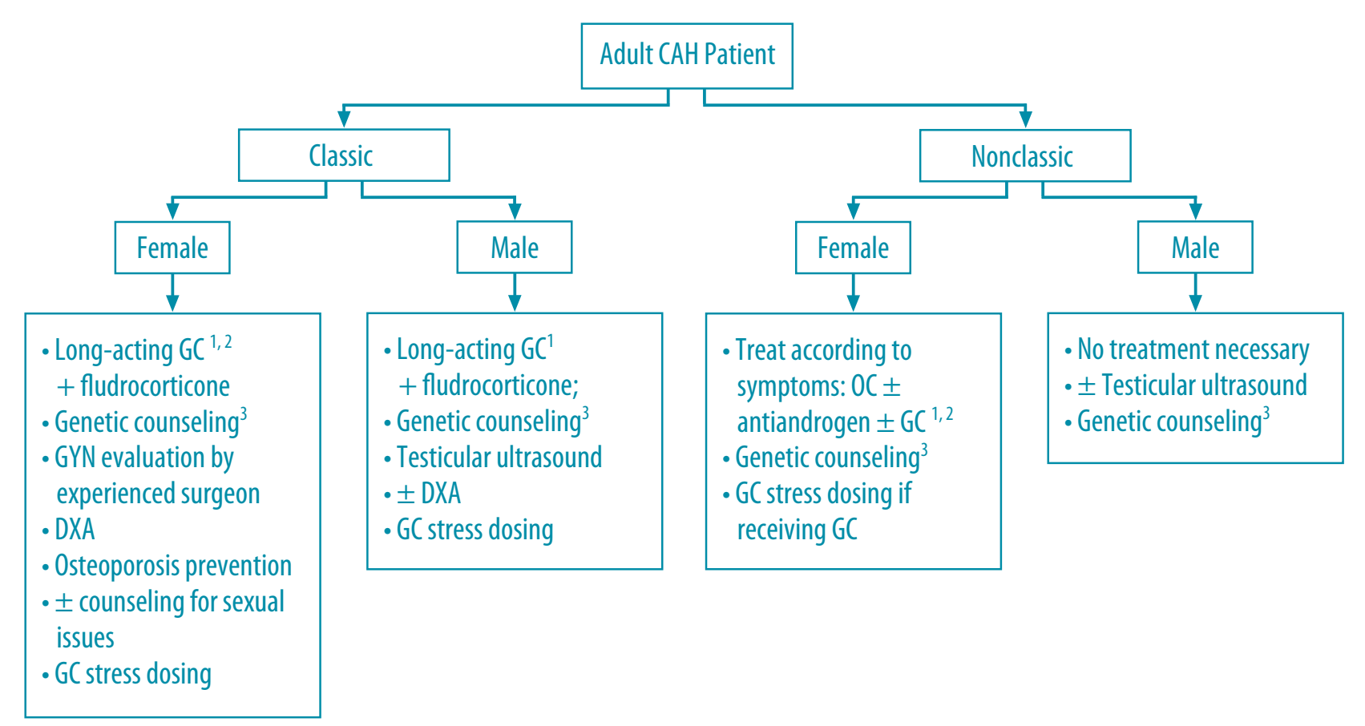
CYP21A2 Classic form
Management:

Slide 30
Non-Classic form
CYP21A2

Slide 31
CYP21A2 Non-Classic form
Genetics of NCAH:
NCAH is an autosomal recessive disorder due to mutations in the 21-hydroxylase (CYP21A2) gene resulting in a 30–50% reduction in the activity of the enzyme.
This gene is mapped to a complex genetic region at chromosome 6p21.3 where it lies in close proximity to a highly homologous pseudogene, CYP21A1P

Slide 32
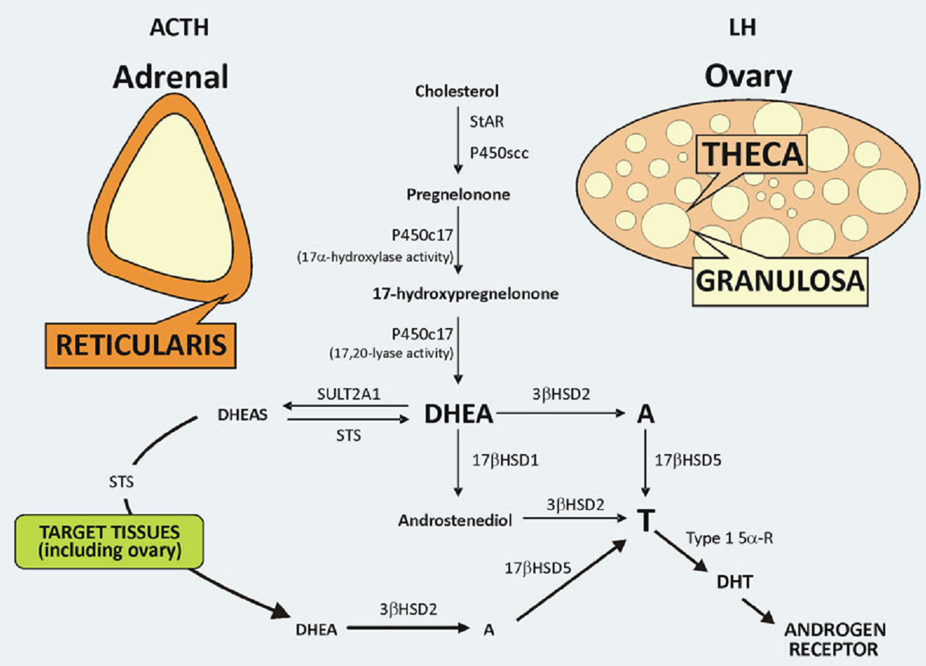
CYP21A2 Non-Classic form
Pathophysiology of
NCAH:
In the majority of the affected subjects with NCAH, ACTH production is normal.
Excessive adrenal androgen secretion mainly results from altered enzyme kinetics due to CYP21A2 missense
mutations

Slide 33
CYP21A2 Non-Classic form
Hyperandrogenism in NCAH:
Adrenal hyperactivity depending on altered enzyme kinetics withoutincreased ACTH circulating levels.
Increased peripheral conversion to androgens of circulating excessive levels of steroid metabolites.
Increased ovarian androgen secretion determined by the appearance of a secondary PCOS-like phenotype in NCAH patients.

Slide 34
CYP21A2 Non-Classic form
Clinical presentation of NCAH in Children:
Most children are asymptomatic in the prepubertal years and exhibit normal external genitalia at birth and throughout early childhood.
Premature pubarche may be the first clinical presentation with onset reported as early as 6 months of age.
The prevalence of NCAH in children with premature adrenarche has been reported to vary from 5% to 20%.
Children with NCAH may demonstrate rapid linear growth, bone age advancement and tall stature.

Slide 35
CYP21A2 Non-Classic form
Clinical presentation of NCAH in adult women:
Principle area:
Hypothalamic–pituitary–ovarian dysfunction
Dermatologic signs of hyperandrogenism
Other clinical symptoms in adulthood may include metabolic dysfunction and anatomic defects of the adrenal cortex.

Slide 36
CYP21A2 Non-Classic form
Clinical presentation of NCAH in adult women:
Hirsutism: 60% to 80%
Acne: one-third of cases
Alopecia: 2–8%
Clitoromegaly: 6–20%
Overt ovulatory and menstrual dysfunction: 30–50%
Polycystic ovarian morphology (PCOM): 24-34%
Adrenal hyperplasia and adenomas: unknown
Mild insulin resistance
Increased risk of metabolic and cardiovascular morbidities

Slide 37
CYP21A2 Non-Classic form
Fertility and reproductive outcome in women with NCAH:
The majority of women with NCAH will conceive spontaneously.
The rate of a singleton live birth was higher in NCAH women .
No differences in the rate of ectopic pregnancy, preterm birth, stillbirths, twins or multiple pregnancies.
Between 10% and 30% of NCAH women of reproductive age complain of infertility.

Slide 38
CYP21A2 Non-Classic form
Fertility and reproductive outcome in women with NCAH:
Anovulation is the main cause of subfertility in NCAH women, which is most evident by the positive outcome in response to ovulation induction.
Persistent elevated progestogen concentrations (due to excess circulating levels of progesterone and 17-OHP of adrenal origin) may also result in an unfavorable cervical mucus and a persistent decidualized or hypo- or atrophic endometrium

Slide 39
CYP21A2 Non-Classic form
Clinical presentation of NCAH in adult males:
NCAH occurs equally in men and women, since it is an autosomal recessive disease.
The great majority of male patients are asymptomatic and most are identified during genetic screening carried out for purposes of genetic counseling.
Testicular adrenal rest tumors (TARTs) are the most important cause of infertility in male patients with CAH. (uncommon)

Slide 40
CYP21A2 Non-Classic form
Other clincal presnentations:
Obesity
Metabolic syndrome
Increased visceral to subcutaneous adipose tissue ratios
Exercise intolerance
Enhanced systolic blood pressure response to exercise

Slide 41
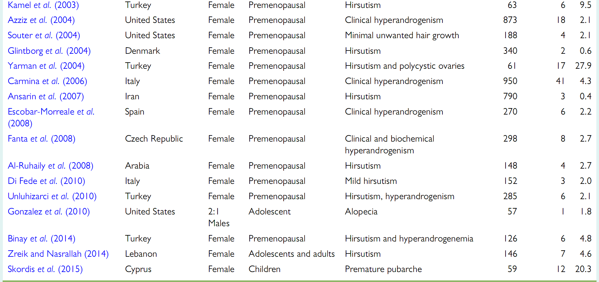
CYP21A2 Non-Classic form
Prevalence of non-classic congenital adrenal hyperplasia

Slide 42
CYP21A2 Non-Classic form
Who should be tested for NCAH:
Children: with premature pubarch or accelerated growth velocity with advanced age.
Women: Oligomenorrhea and Acne or Hirsutism
Males: do not suggest routine screening
Other: Family history CAH, Adrenal incidentaloma or by lateral Adrenal mass with a history consistent with NCAH

Slide 43
CYP21A2 Non-Classic form
Diagnosis of NCAH:
For initial screening, a morning (7:30 to 8 AM) serum sample for 17-hydroxyprogesterone concentration should be obtained during the follicular phase of the menstrual cycle if the woman is cycling regularly.
For women with amenorrhea or infrequent menses, the sample canbe drawn on a random day
SST is required to etablish normal adrenal glucocorticoid reserve.

Slide 44
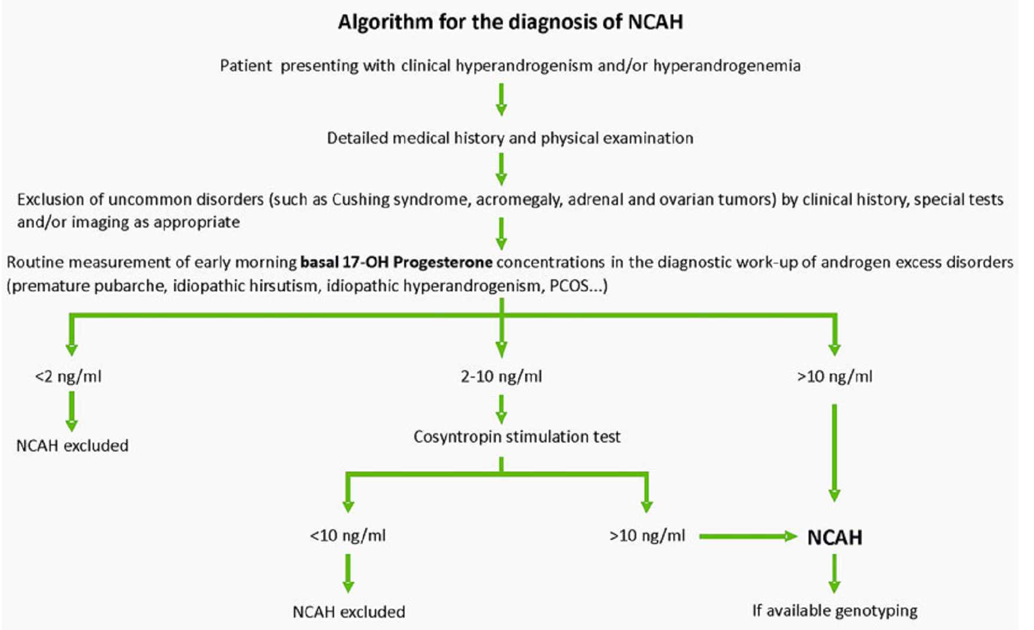
CYP21A2 Non-Classic form
Diagnosis of NCAH:

Slide 45
CYP21A2 Non-Classic form
Differential diagnosis of NCAH:
Children: causes of premature pubarche such as premature adrenarche, precocious puberty, and other forms of CAH.
In adolescents and adult females: the clinical presentation of NCCAH can be indistinguishable from that of polycystic ovary syndrome (PCOS). PCOS is far more common than NCCAH; basal levels of 17-hydroxyprogesterone may overlap, but ACTH stimulation testing works well to distinguish between the two.

Slide 46
CYP21A2 Non-Classic form
Treatment of NCAH: Prepubertal and adolescent patients
Treatment with glucocorticoids for NCAH should be considered only for pre- and peripubertal children who have inappropriately early onset or rapid progression of pubarche or bone age
Routine treatment with GnRH analogs and GH are not recommended and should be considered experimental
In adolescents and young adults with NCAH, treatment is reserved for those who demonstrate important or clinically significant hyperandrogenism.

Slide 47
CYP21A2 Non-Classic form
Treatment of NCAH: Prepubertal and adolescent patients
Recent data suggest that replacement with glucocorticoids should be considered when major surgery or trauma in childhood or even when ‘fatigue’ occurs, particularly in those NCAH patients with a decreased cortisol response to cosyntropin.
A cortisol cut-off value of 18 μg/dl (497 nmol/l), below which glucocorticoid therapy may be considered, has been recommended in children and adolescents

Slide 48
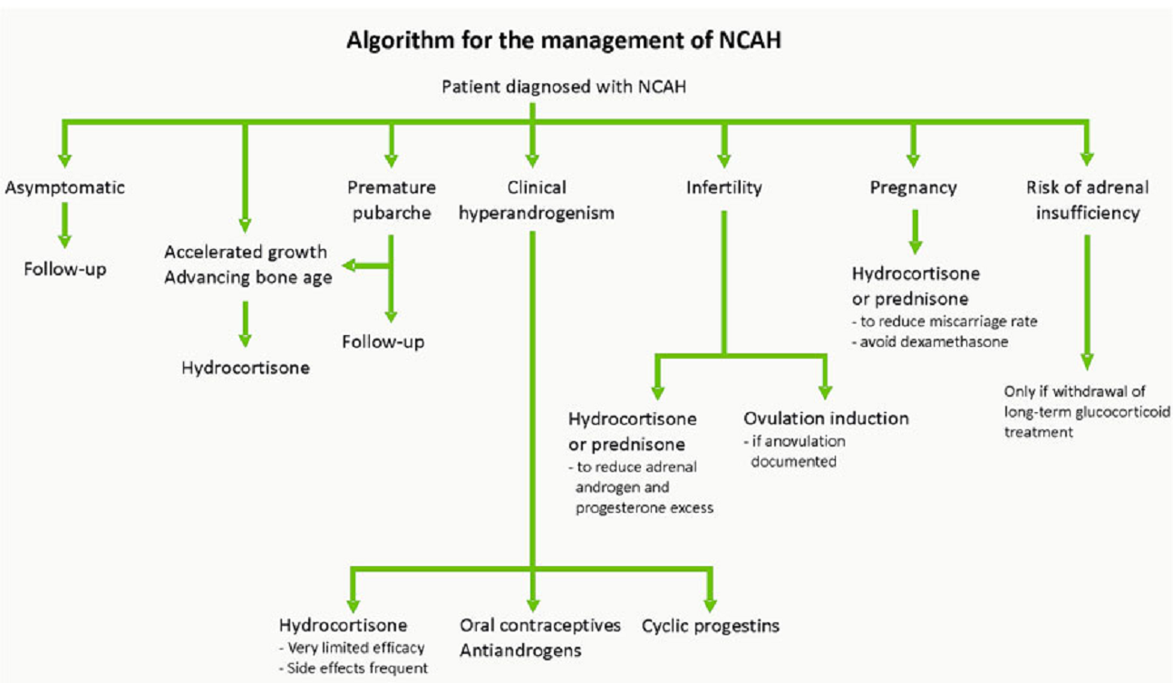
CYP21A2 Non-Classic form
Treatment of NCAH: Adult women

Slide 49
CYP21A2 Non-Classic form
Treatment of NCAH: Adult women
In adult women with NCAH, reduction of circulating androgens may also be obtained by blocking ovarian androgen secretion by the use of estrogen–progestin combination preparations or GnRH agonists
Based on the hirsutism score, CPA was more effective than hydrocortisone (hirsutism improved in 54% and 24% patients, respectively).
CPA associated with ethinylestradiol was found to be superior to dexamethasone (hirsutism improved in 66% and 31% patients, respectively)

Slide 50
CYP21A2 Non-Classic form
Treatment of NCAH: Adult women
In countries where CPA is not available, spironolactone could be used as an alternative androgen blocking drug.
When fertility is not an immediate concern, estrogen–progestin combination preparations represent the most commonly used treatment of adult women with NCAH

Slide 51
CYP21A2 Non-Classic form
Treatment of NCAH: Management of infertility in women
NCAH adult women who have not conceived spontaneously and who demonstrate overt or subclinical ovulatory dysfunction may benefit from glucocorticoids or from ovulation induction.
When hydrocortisone therapy does not lead to normal ovarian function, ovulation induction with clomiphene citrate or exogenous gonadotropins, or assisted reproductive techniques, should be considered following the usual protocol for these treatments

Slide 52
CYP21A2 Non-Classic form
Treatment of NCAH: Management of pregnancy
There are no clear guidelines concerning treatment of NCAH during pregnancy.
Cross-sectional data suggest that early pregnancy losses might be lower when patients are on glucocorticoid therapy and these data support continuing corticosteroids during pregnancy

Slide 53
CYP21A2 Non-Classic form
Treatment of NCAH: Management of pregnancy
Glucocorticoid replacement is usually maintained at a hydrocortisone dose of 20–25 mg/day or a prednisone dose of 2.5–5 mg/day, but no study so far has prospectively addressed the benefits of this practice to prevent early pregnancy loss and/or improve pregnancy outcome in NCAH.
Dexamethasone should be avoided during pregnancy in favor of replacement doses of glucocorticoids such as hydrocortisone and prednisone, which are easily metabolized by placental 11 beta-hydroxysteroid dehydrogenase type 2.

Slide 54
CYP21A2 Non-Classic form
Treatment of NCAH: Adult men
Treatment is not necessary for men unless there is oligospermia (in a man desiring fertility).
For the rare patient requiring treatment, we suggest starting with dexamethasone 0.25 mg given once daily or prednisone or prednisolone 4 to 6 mg per day divided into two doses.
While testicular adrenal rest tumors (TART) and infertility are common in men with classic CAH, they are thought to be very rare in men with NCCAH.

Slide 55
CYP21A2 Non-Classic form
Monitoring treatment:
In both children and women, concentrations of 17-hydroxyprogesterone, androstenedione, and testosterone should be measured in women, with the goal of normalizing androstenedione and testosterone levels.
Adrenal androgen secretion should not be completely suppressed; suppressed levels of 17-hydroxyprogesterone generally indicate overtreatment, and elevation of 17-hydroxyprogesterone to two or three times the upper limit of normal is acceptable.

Slide 56
CYP21A2 Non-Classic form
Monitoring treatment:
In children, one goal of treatment is normalization of height velocity; hence, growth charts should be maintained.
For women with classic CAH trying to conceive, monitoring progesterone is useful, and progesterone <2 nmol/L (<0.6 ng/mL) is associated with improved fertility in women with classic CAH. It is unclear whether this is also true in women with NCCAH.

Slide 57
CYP21A2 Non-Classic form
Risk of adrenal insufficiency:
There is no consensus regarding the recommendation that NCAH patients carry a medical alert identification, available in various forms such as wallet cards, bracelets, necklaces, etc., stating that the patient has NCAH and may be at risk for adrenal insufficiency, and that systematic glucocorticoid treatment should be considered prior to surgery or if acute trauma or acute physical stress occurs. Nevertheless, patients on chronic glucocorticoid therapy may need to carry with them medical alert identification.

Slide 58
References:
www.uptodate.com, visited on 27 Nov 2017.
E. Carmina, et al., “Non-classic congenital adrenal hyperplasia due to 21-hydroxylase deficiency revisited: an update with a special focus on adolescent and adult women”, Human Reproduction Update, pp. 1–20, 2017.
A. Bachelot, “Congenital adrenal hyperplasia due to 21-hydroxylase deficiency: update on the management of adult patients and prenatal treatment”, European Journal of Endocrinology, (2017) 176, R167–R181.
S. Melmed, et al., “WILLIAMS Textbook of Endocrinology”, Elsevier Inc., 13TH Edition, 2016.
P. W. Ladenson, et al. , “A Clinical Approach to Endocrine & Metabolic Diseases”, The Endocrine Society Press, 2010.

Slide 59
THANK YOU

