Slide 2
Type 2 Diabetes and Osteoporosis: A Guide to Optimal Management

Slide 3
The burden of diabetes is increasing as, according to the World Health Organization,~ 422 million people are affected globally .
Type 2 diabetes (T2D) accounts for most people affected and its prevalence increases with age.

Slide 4
Osteoporosis affects ~125 million people in Europe, India, Japan, and the United States; it is estimated that one in three women and one in five men over the age of 50 will experience an osteoporotic fracture at some point in life .

Slide 5
As the prevalence of osteoporosis rises with age, the increasing life expectancy will result in further increases in the global burden of osteoporosis.

Slide 6
Both diseases are affected by aging and by changes in lifestyle and they can coexist, especially in the elderly.

Slide 7
The true prevalence of their coexistence would be hard to determine, as the fracture risk in patients with T2D is increased and is underestimated by conventional diagnostic criteria for osteoporosis.

Slide 8
Interestingly, there is a complex pathophysiological interaction between them: T2D affects bone metabolism and strength in a direct way, certain antidiabetic medications affect bone metabolism, and there is an association between diabetic complications and risk for falls and subsequent fractures.

Slide 9
Although many original papers, clinical statements, and guidelines focus on the management of patients with T2D and osteoporosis as separate diseases, their coexistence poses important pathophysiologic, diagnostic, and therapeutic issues that have not been fully elucidated.

Slide 10
The aim of this article is to present updated information regarding the prevalence of osteoporosis and fracture risk in patients with T2D, to systematically review effects of medications on both entities, and to provide an individualized guide for the optimal management of patients with T2D and concomitant osteoporosis.

Slide 11
Methods Search strategies
To identify publications on T2D and osteoporosis, a systematic literature search for human studies was conducted in three electronic databases (PubMed, Cochrane, and EMBASE) until March 2017 and using combinations of the key terms “type 2 diabetes” or “hyperglycemia” or “anti-diabetic agents (each one separately)” and “osteoporosis” or “fracture” or “bone mineral density” or “anti-osteoporotic agents” (each one separately).

Slide 12
On the top, a manual search of key journals and abstracts from the major annual meetings in the fields of diabetes, osteoporosis, and endocrinology was conducted.
Special attention was paid to papers and guidelines focusing on the management of patients with T2D and osteoporosis.

Slide 13
The main search was completed independently by three investigators (S.A.P., A.D.D., and P.G.A.).
Any discrepancy was solved by consultation of an investigator who was not involved in the initial procedure (D.G.G.).

Slide 14
Grading of recommendations
We adopted the grading system introduced by the American College of Physicians.
Every recommendation is followed by a pair of grading, one grade for the strength of the recommendation and one for the quality of the evidence that supports the specific recommendation.
There are three levels of “strength” (strong, weak, insufficient) and three levels of “quality” (high, moderate, low) .

Slide 15
Results and Discussion Osteoporosis and fracture risk in patients with T2D
Both T2D and osteoporosis are negatively affected by aging and lifestyle changes and quite often coexist.

Slide 16
Most importantly, several studies have demonstrated that fracture risk is increased in patients with T2D, being higher with longer duration of T2D, poor glycemic control, and when diabetic complications are present .

Slide 17
Interestingly, high fasting glucose variability has also been associated with higher risk for hip fracture .
On the contrary, patients with impaired glucose tolerance are not at increased risk for fracture and in fact they may be at lower risk.

Slide 18
It is postulated that this could be the effect of high body mass index (BMI) and insulin resistance, which are often encountered in patients with impaired glucose tolerance .

Slide 19
FRAX is a widely used online tool to calculate 10-year fracture risk probability. Its use to guide treatment decisions is reinforced by international societies .

Slide 20
T2D is not currently included in the FRAX tool and is not considered a secondary cause of osteoporosis, in contrast to type 1 diabetes .

Slide 21
FRAX is known to underestimate fracture risk in patients with T2D , particularly when disease duration is >10 years .
This is probably associated, at least partly, with the fact that in patients with T2D, bone mineral density (BMD) is generally higher than in nondiabetic patients .

Slide 22
However, as in the general population, there is significant negative correlation between dual-energy x-ray absorptiometry–derived T-scores and the risk for fracture, even though patients with T2D tend to fracture at higher T-scores compared to the general population .

Slide 23
The effect of T2D on bone fragility is complex . Patients with T2D, especially those on treatment with hypoglycemic agents and those with complications, such as neuropathy and retinopathy, are at increased risk of falls, which predispose to fractures.

Slide 24
Diabetic nephropathy with concomitant secondary hyperparathyroidism and renal osteodystrophy is also associated with augmented fracture risk .

Slide 25
T2D, through hyperglycemia, oxidative stress, and the formation of advanced glycation end products, has a direct effect on bone metabolism, reducing bone turnover, and disrupting bone formation.

Slide 26
Moreover, many patients with T2D have low serum vitamin D concentrations, probably as the result of obesity, low physical activity, and less sun exposure .

Slide 27
As bone fragility in T2D is associated with high BMD and reduced bone turnover, there have been concerns about the effectiveness of antiosteoporotic medications in patients with T2D.

Slide 28
Data so far have been reassuring, showing that bisphosphonates, raloxifene, and teriparatide are effective in increasing BMD both in patients with and without T2D .

Slide 29
Moreover, teriparatide is equally effective in reducing nonvertebral fractures in patients with T2D and raloxifene in reducing vertebral fractures .
There are currently no data about the effectiveness of other antiosteoporotic agents.

Slide 30
Effect of antidiabetic medications on
bone metabolism

Slide 31
Although lifestyle intervention is the cornerstone of management for patients with T2D, most of those eventually require pharmacologic therapy.

Slide 32
Metformin, sulfonylureas, thiazolidinediones (TZDs), dipeptidyl peptidase 4 inhibitors (DPP-4i), glucagon-like peptide-1 receptor agonists (GLP-1RA), sodium-dependent glucose transporter 2 inhibitors (SGLT-2i), and insulin are the most commonly used medications.

Slide 33
Furthermore, bariatric surgery is now included in the therapeutic armamentarium for T2D.

Slide 34
The results of our literature search for human studies examining the effects of antidiabetic agents on bone health are comprehensively presented in Table 1 .

Slide 35
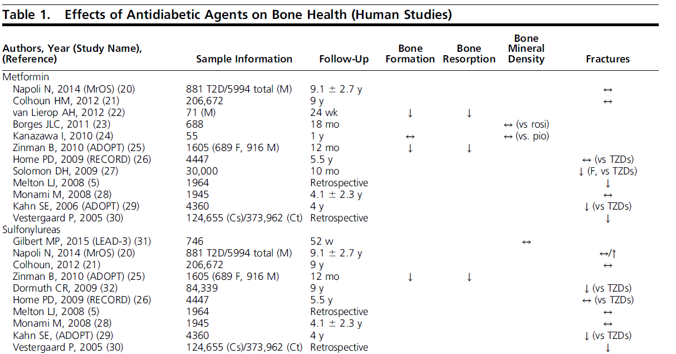

Slide 36
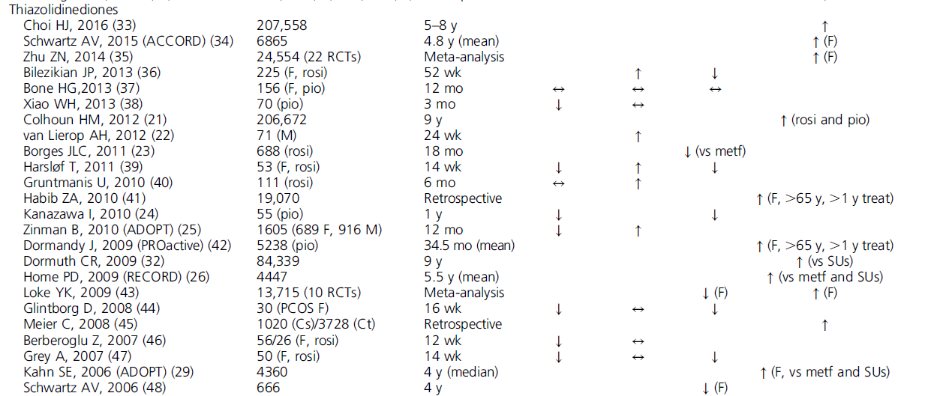

Slide 38
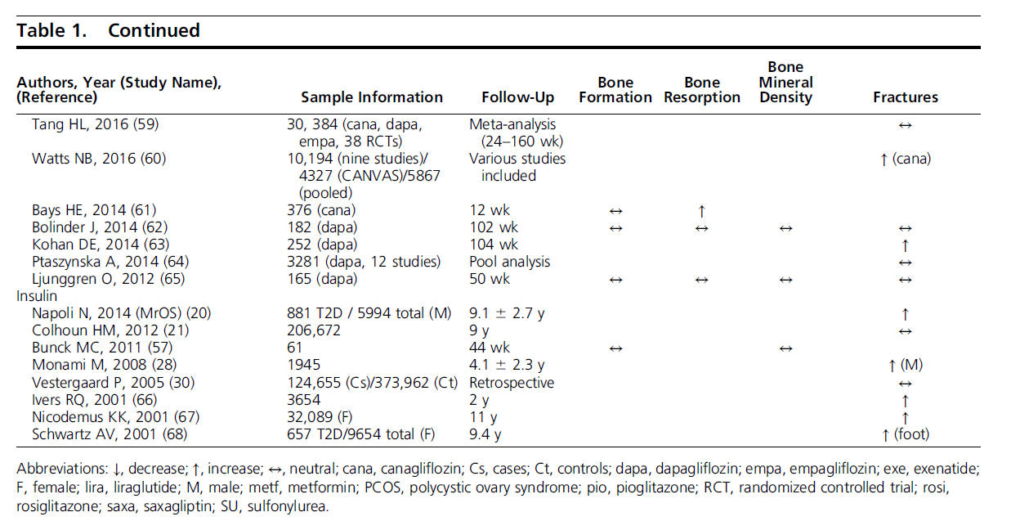

Slide 39
Metformin :
Metformin primarily decreases hepatic glucose production by inhibiting key enzymes for gluconeogenesis and secondarily enhances peripheral insulin sensitivity.

Slide 40
Experimental studies have indicated beneficial effects on bone formation , whereas large clinical studies resulted in neutral or positive effects on BMD and fracture risk, in different and various large patient cohorts .

Slide 41
Evidence from randomized controlled trials is missing.
However, these observational data are strongly suggestive of a protective metformin profile regarding bone health.

Slide 42
Sulfonylureas
Sulfonylureas are sulfonylurea receptor-1 agonists, which initiate inhibition of the adenosine triphosphate– sensitive K+ channel and result in depolarization of cell membrane, leading to increased endogenous insulin secretion.

Slide 43
With the exception of MrOS study, which suggests that sulfonylureas increase fractures risk in old men with T2D , the rest of the studies are indicative of a beneficial or at least neutral effect on fracture risk .

Slide 44
Furthermore, the effect of sulfonylureas on
bone metabolism and BMD seem to be neutral, too .
However, the high risk of hypoglycemic episodes, which can increase the final amount of falls and fractures in these patients, should be taken into consideration .

Slide 45
TZDs
TZDs are peroxisome proliferator–activated receptor γ agonists that modulate gene expression, resulting in improved glucose uptake, improved b-cell function, and increased insulin sensitivity.

Slide 46
Within a few years of TZDs entering routine clinical use in the treatment of T2D, signals emerged suggesting reduced bone density and increased fracture risk with TZDs compared with other antidiabetic medications.

Slide 47
This effect has now been confirmed in randomized studies and meta analyses.
A meta-analysis of close to 25,000 subjects
showed an increased risk of fracture with TZDs in women (odds ratio of 1.94), but not in men .

Slide 48
The risk was similar with pioglitazone and rosiglitazone, did not vary with age, and was associated with reductions in BMD .

Slide 49
Other studies have suggested highest risk in women other the age of 65 , whereas some studies have also suggested an increased risk in men.

Slide 50
A longitudinal follow-up of participants in the ACCORD study using TZDs also showed an increased rate of nonspine fractures in women (but not men) and reductions in risk following discontinuation of the TZD .

Slide 51
A key part of the mechanism of action of TZDs is the activation of adipogenesis, for which peroxisome proliferator–activated receptor γ is required.

Slide 52
Adipocytes and osteoblasts are both derived from mesenchymal stem cells , and activation of adipogenesis is known to be associated with suppression of regulators of bone differentiation.

Slide 53
Thus, it is likely that the effects of TZDs on bone are closely linked to their metabolic effects, and it is clear now that these medications should be avoided in women with increased fracture risk.

Slide 54
DPP-4 i
DPP-4i are oral diabetes medications that inhibit the enzyme DPP-4, which deactivates a variety of bioactive peptides, including glucose-dependent insulinotropic polypeptide and GLP-1; therefore, its inhibition potentially affects glucose regulation through multiple effects.

Slide 55
Data from clinical trials so far suggest a potential favorable effect of these agents on bone metabolism, but real evidence is still lacking.

Slide 56
A recent cohort study from South Korea suggested a protective effect of DPP-4i as well. A post hoc analysis of 20 randomized controlled trials found a slightly higher incidence of fractures with saxagliptin compared with control group.

Slide 57
Results of neutral effect on fracture risk were
recently found in the TECOS trial with sitagliptin.
Thus, to date more indications for a rather neutral effect of these drugs exist.
Further studies are needed to confirm their
possible favorable effect.

Slide 58
GLP-1RA :
GLP-1RA potentiate glucose-induced insulin secretion and inhibit glucagon release. Furthermore, they delay gastric emptying and reduce appetite, inducing clinically significant weight loss.

Slide 59
They have been demonstrated to successfully control glucose levels and promote weight loss without increasing the risk of fractures.

Slide 60
A recent randomized study including obese nondiabetic women showed that after 52 weeks of treatment with a long-acting GLP-1RA, for weight maintenance after 12% loss through a low-calorie diet, increased bone formation by 16% and prevented bone loss .

Slide 61
A randomized, placebo-controlled, double-blinded, crossover trial with liraglutide in patients with T2D did not find any effect of treatment either on bone mineral density or bone markers.
The treatment period in this study was shorter than in the previously described study .

Slide 62
The initial results of GLP-1RA effects on bone metabolism sound promising, but they should be interpreted with caution and in the context of the trials that were not designed for studying bone outcomes.

Slide 63
SGLT-2i
Glucose is physiologically reabsorpted in the proximal tubule of the kidney from glomerular filtrate via sodium-glucose cotransporters. SGLT-2i inhibit these cotransporters, resulting in loss of glucose calories in urine and reduction of glucose concentrations .

Slide 64
Several agents are available with common (“class effect”) and different characteristics.
Regarding bone health, it has been shown that canagliflozin might exert negative effects on bone density, bone resorption, and fracture risk at the hip .

Slide 65
This resulted in revision of the label of this drug and addition of a new warning by the US Food and Drug Administration in September 2015.

Slide 66
With the exception of one study with dapagliflozin , empagliflozin and dapagliflozin have not been shown to exert significant changes in BMD, bone markers, or fracture risk, and therefore they seem to present a rather neutral effect on bone metabolism .

Slide 67
However, the concerns raised from studies with canagliflozin inevitably affect the whole class. Further studies are needed to elucidate the mechanisms of bone loss and the real safety profile among these newly used medications.

Slide 68
Insulin
No specific randomized controlled trial has been designed so far to investigate the effect of insulin treatment on bone health.
However, it has been almost consistently shown that patients who are treated with insulin present in general an increased prevalence of fractures .

Slide 69
The long term of the disease, the presence of more diabetes complications, and the increased risk of falls both because of the above but also of the hypoglycemic events due to insulin therapy may altogether contribute to the increase of fractures.

Slide 70
In the Blue Mountain Eye Study, longer duration of diabetes, the presence of diabetic retinopathy, and cataract were associated with increased fracture risk .

Slide 71
The question of whether insulin itself impairs bone quality needs further investigation, even if the higher incidence of fractures with insulin was maintained after adjusting for a broad number of other parameters in a large study .

Slide 72
Bariatric surgery :
Bariatric surgery is now a well-established therapeutic option for adults with T2D and BMI > 35 kg/m2.

Slide 73
In fact, this is the most effective treatment of substantial weight loss with durable results and significant reduction in abdominal obesity, as well as better glycemic control requiring less medication.

Slide 74
However, after surgery, life-long lifestyle support and medical monitoring is necessary, as nutritional deficiencies, hyperinsulinemic hypoglycemia, osteoporosis, and bone fractures need to be carefully balanced with the metabolic benefits .

Slide 75
Indeed, recently published studies revealed that patients undergoing bariatric surgery are more likely to have fractures than are obese or nonobese controls, and this risk remains higher after surgery .

Slide 76
Fracture risk seems to be increased 1 to 2 years after surgery and is more clearly associated with biliopancreatic diversion than with Roux-en-Y gastric bypass or sleeve gastrectomy.

Slide 77
Effects of antiosteoporotic
medications on the incidence of
T2D and glucose metabolism

Slide 78
Bisphosphonates, denosumab, teriparatide, strontium ranelate, and selective estrogen receptor modulators (SERMs) (raloxifene and bazedoxifene) are currently the only agents approved for the treatment of osteoporosis.

Slide 79
There are only scarce data about their effects on glycemia in patients with T2D and few data about their effect on glucose metabolism in individuals without T2D.

Slide 80
The results of our literature search for human studies examining the effects of antiosteoporotic medications on the incidence of T2D and glucose metabolism are comprehensively presented in Table 2 (80–108).

Slide 81
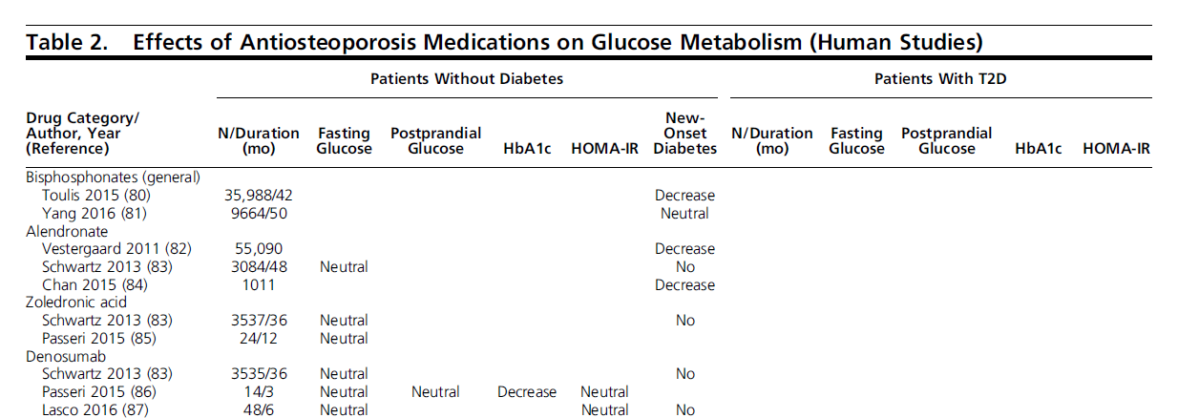

Slide 82
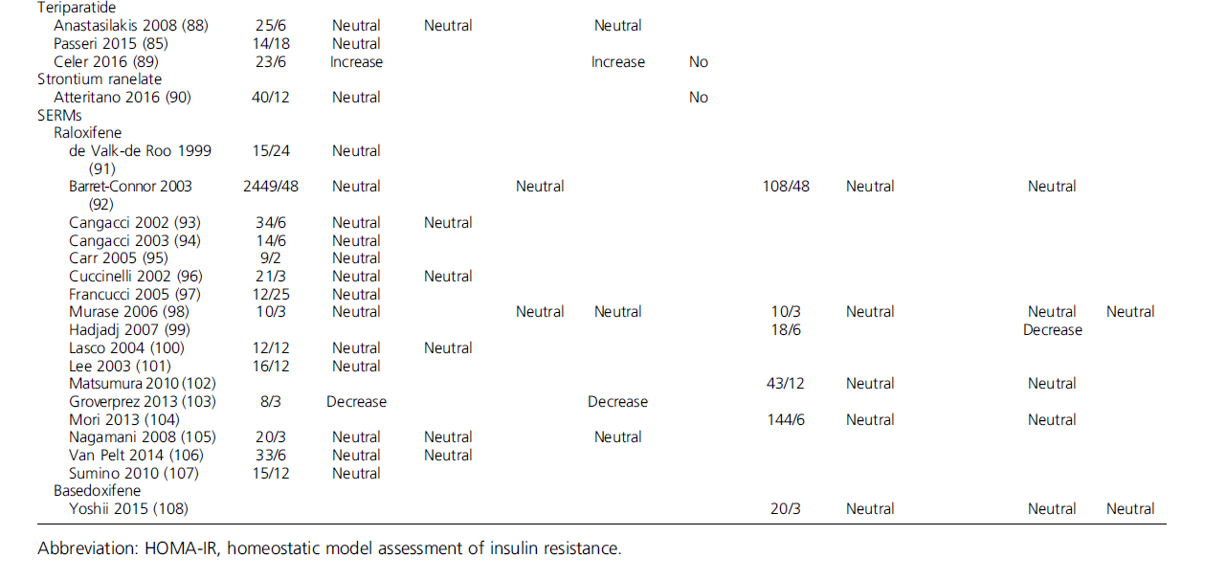

Slide 83
Studies conducted in patients with glucocorticoid-induced osteoporosis were not included.

Slide 84
Bisphosphonates
Two studies fulfilled eligibility criteria .
A large (n = 35,998) retrospective open cohort study with data from primary care from the United Kingdom showed a reduced risk of developing T2D in individuals exposed to bisphosphonates (median follow-up time, 42 months), compared with age-, sex-, and BMI-matched controls, and interestingly this was independent of sex and [adjusted incidence rate ratio (aIRR) 0.52; 95% confidence interval (CI), 0.48 to 0.56; P , 0.0001].

Slide 85
This reduction was independent of sex, BMI, and the specific agent used.
It must be emphasized that there was a negative association between the incidence of T2D and the duration of exposure to bisphosphonates.

Slide 86
Alendronate
Three studies (one randomized placebo controlled study and two case-control studies) fulfilled eligibility criteria.
The largest (n = 6151) study was the Fracture Intervention Trial, a randomized placebo controlled study, in which postmenopausal women were assigned to alendronate at 5 mg/d for 2 years and 10 mg/d thereafter (n = 3084) or placebo (n = 3067).

Slide 87
No difference in fasting glucose concentrations or in the incidence of diabetes was observed between the two groups after 4 years of follow-up .

Slide 88
In a large retrospective case-control study, patients exposed to alendronate for three or more times (n = 1011) showed a reduced incidence of T2D, compared with no treatment (the relative risk for developing T2D in nonexposed group was 1.21; 95% CI, 1.03 to 1.41).

Slide 89
However, the significance of this association was diminished in patients older than 65 years or with hypertension or dyslipidemia.

Slide 90
In a nationwide cohort study in Denmark, alendronate use was associated with a reduced risk of developing T2D (hazard ratio, 0.71; 95% CI, 0.59 to 0.85).

Slide 91
Risedronate. No study fulfilled eligibility criteria.
Ibandronate. No study fulfilled eligibility criteria.

Slide 92
Zoledronic acid.
Two studies fulfilled eligibility criteria.
The largest (n = 6151) study was the Health Outcomes and Reduced Incidence with Zoledronic Acid Once Yearly Pivotal Fracture Trial, a randomized placebo controlled trial in which postmenopausal women with osteoporosis were assigned to zoledronic acid 5 mg/y for 3 years (n = 3537) or placebo (n = 3576).

Slide 93
No difference in fasting glucose concentrations or in the incidence of diabetes was observed between the two groups after 4 years of follow-up .
The other was a prospective study (n = 24) in which zoledronic acid (5 mg/y) did not affect glucose metabolism after 12 months .

Slide 94
Denosumab
Three prospective studies fulfilled eligibility criteria.
The largest (n = 7076) study was the Fracture Reduction Evaluation of Denosumab in Osteoporosis Every 6 Months trial, a randomized placebo-controlled study in which postmenopausal women were assigned to denosumab 60 mg every 6 months (n = 3535) or placebo (n = 3541).

Slide 95
No difference in fasting glucose concentrations or in the incidence of diabetes was observed between the two groups after 3 years of follow-up .

Slide 96
In 48 women with postmenopausal osteoporosis, administration of 60 mg of denosumab did not affect fasting plasma glucose concentrations and homoeostatic model assessment of insulin resistance (HOMA-IR) after 24 weeks .

Slide 97
Another small prospective study (n = 14), in which an oral glucose tolerance test was performed at 4 and 12 weeks after injection of 60 mg of denosumab, did not show any effect on fasting, postprandial glucose concentrations, or HOMA-IR, despite a slight reduction in hemoglobin A1c (HbA1c) .

Slide 98
Teriparatide
Three prospective studies in postmenopausal women with osteoporosis fulfilled eligibility criteria.
One study showed that teriparatide treatment (20 mg/d) increased fasting glucose and HOMA-IR index in 23 postmenopausal women after 6 months of treatment .

Slide 99
In another small study (n = 14), neither teriparatide nor zoledronic acid affected glucose metabolism after 18 and 12 months, respectively , as another small study (n = 25) showed in which teriparatide did not affect glucose metabolism (fasting and postprandial glucose, as well as HOMA-IR levels) after 6 months of treatment ,

Slide 100
Strontium ranelate
One study fulfilled eligibility criteria, which did not show any effect of strontium ranelate in 40 postmenopausal women with osteoporosis with respect to fasting plasma glucose concentrations, after 12 months of treatment.
It also did not affect hemostasis factors or lipid profile.

Slide 101
SERMs
Raloxifene.
Seventeen studies, 12 randomized-controlled and 5 observational prospective studies, fulfilled eligibility criteria.

Slide 102
Twelve studies were conducted in postmenopausal women without diabetes , three were conducted in those with T2D , and two were conducted in both diabetic and nondiabetic postmenopausal women .

Slide 103
Only one study in T2D showed a decrease in HbA1c levels , and two studies in patients without diabetes showed an increase in insulin sensitivity and a decrease in fasting glucose concentrations (only in patients with high insulin resistance) .

Slide 104
In 14 studies no significant effect of raloxifene on glucose metabolism was noticed .

Slide 105
Bazedoxifene.
Regarding the effect of bazedoxifene, one prospective study fulfilled eligibility criteria, according to which, in 20 postmenopausal women with T2D, bazedoxifene (20 mg/d) did not affect fasting plasma glucose concentrations, HbA1c, or HOMA-IR after 12 weeks of treatment (except for a slight and transient decrease in HOMA-IR at 4 weeks).

Slide 106
In conclusion, data so far indicate that antiosteoporotic medications have minimal, if any, effects on glucose metabolism, whereas the finding of a reduction in the risk of developing diabetes with bisphosphonates users warrants further investigation in well-designed studies.

Slide 107
Practical guide for the optimal management of T2D
in patients with concomitant osteoporosis

Slide 108
Targets
Glycemic control is usually assessed by measuring HbA1c, which correlates with the average blood glucose concentrations during the past 2 to 3 months.

Slide 109
The American Diabetes Association and European Association for the Study of Diabetes consensus guidelines recommend a general HbA1c target of < 7% .

Slide 110
However, this therapeutic target should be personalized and should be modified from time to time even for the same patient.
Therapeutic targets are determined by the patient’s and disease’s features .

Slide 111
In patients with T2D and osteoporosis, longer duration of T2D, presence of clinical cardiovascular disease, recurrent severe hypoglycemia episodes, or hypoglycemia unawareness should indicate a higher HbA1c target (≤ 7.5% to 8%) to avoid hypoglycemia and falls, which will further increase the risk of fracture .
(Strong Recommendation, Low-Quality Evidence)

Slide 112
Additionally, most patients with T2D present hypertension and are treated with several antihypertensive agents.
Proper control of blood pressure with careful consideration of avoiding hypotension is of great importance in order again for falls to be avoided.

Slide 113
Furthermore, proper vision of these patients with at least annual tests by fundoscopy and referral to ophthalmologists if needed, as well as at least annual neuropathy assessment, should be taken into careful consideration.
(Strong Recommendation, Low-Quality Evidence)

Slide 114
Therapeutic algorithm

Slide 115
Lifestyle intervention with medical nutrition therapy and exercise forms the cornerstone of therapy of T2D and coexistent osteoporosis.

Slide 116
Modest weight loss, a Mediterranean-style diet rich in monounsaturated fats and long-chain omega-3 fatty acids, as well as nuts and seeds, appropriate intake of calcium and vitamin D with careful consumption of fatty milk products, and limited intake of alcohol and sodium are an ideal medical nutrition therapy for both entities.

Slide 117
Regarding exercise, intense walking at least 150 minutes per week could combine the moderate-intensity aerobic type of exercise indicated for T2D with the weight-bearing exercise indicated for osteoporosis.

Slide 118
Of course, cessation of smoking is very important for these patients and such counseling should be a routine component of diabetes and osteoporosis care.
(Strong Recommendations, High-Quality
Evidence) .

Slide 119
Eventually, most patients require pharmacologic therapy.
Metformin should be the first-line pharmacologic therapy, sometimes even initiated at diagnosis concurrently with lifestyle intervention .

Slide 120
If HbA1c remains over target (usually ≥ 7%) after 3 months, then a second agent should be added.
Of the following six treatment options, that is, sulfonylureas, TZDs, DPP-4i, SGLT-2i, GLP-1RA, or basal insulin, that represent the current general second-line treatment on patients with T2D (presenting also as options for monotherapy
.

Slide 121
if metformin is contraindicated or not well
tolerated) , sulfonylureas, DPP-4i, or GLP-1RA
should be rather preferred in patients
with osteoporosis.
(Weak Recommendation, Moderate-Quality Evidence)

Slide 122
Insulin should be used with caution and with careful measures to avoid hypoglycemia .
(Weak Recommendation, Moderate-Quality Evidence)

Slide 123
TZDs and canagliflozin should be avoided, whereas other SGLT-2i are less well-validated options .
(Strong Recommendation, High-Quality Evidence).

Slide 124
The effect of antiosteoporotic medications on the incidence of T2D and on glucose metabolism should be taken into consideration as well.

Slide 125
The existing data show no real effect, whereas the finding of reduction in the risk of developing diabetes with bisphosphonates users warrants further investigation in well-designed studies (Table 2).

Slide 126
In general, both the treatment and the monitoring of osteoporosis should be continued as indicated by international guidelines without important amendments because of the presence of T2D .
(Strong Recommendation, High-Quality Evidence)

Slide 127
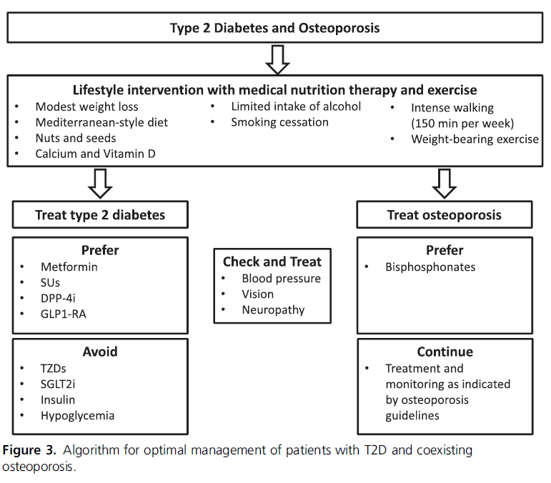

Slide 128
Management of hospitalized patients with fracture

Slide 129
Insulin therapy is the preferred method for achieving glycemic control in hospitalized patients with T2D and fracture, as it is for all hospitalized patients with hyperglycemia .

Slide 130
Oral or injectable hypoglycemic agents other than insulin should be discontinued at the time of hospital admission and insulin therapy should be initiated.
Sliding scale insulin therapy has been broadly used in the past, but it should be avoided .

Slide 131
The treatment option of choice is a scheduled subcutaneous insulin regimen including basal insulin, in combination with short-acting insulin administered before meals.

Slide 132
During surgery for fracture, continuous insulin infusion (also known as variable rate insulin infusions) may be required, but subcutaneous basal insulin along with subcutaneous bolus insulin to prevent hyperglycemia during the perioperative period could be an alternative choice.

Slide 133
In the postsurgical setting, basal insulin with or without bolus (depending on eating) should be initiated after continuous insulin infusion .
(Strong Recommendation, Moderate-Quality
Evidence).

Slide 134
Conclusion

Slide 135
Both T2D and osteoporosis are affected by aging and changes in lifestyle.
These two clinical entities quite often coexist and the medications used for each one affects the course of the other.

Slide 136
Healthy diet and physical exercise are very important for the prevention and treatment of both.
Metformin, sulfonylureas, DPP-4i, and GLP-1RA should be preferred for the treatment of T2D in patients with osteoporosis, whereas strict targets should be avoided for the fear of hypoglycemia, falls, and fractures.

Slide 137
Insulin should be used with caution and with careful measures to avoid hypoglycemia.
TZDs and canagliflozin should be avoided, whereas other SGLT-2i are less well-validated options.

Slide 138
Because no evidence currently exists for any detrimental effect of antiosteoporosis medications on glucose metabolism and taking also into consideration a possible beneficial effect of bisphosphonates, the treatment and the monitoring of osteoporosis should not be modified because of the presence of T2D.

Slide 139
