Slide 2
The Management of Primary Aldosteronism: Case Detection, Diagnosis, and Treatment: An Endocrine Society Clinical Practice Guideline J Clin Endocrinol Metab, May 2016 &
Screening for Endocrine Hypertension: An Endocrine Society Scientific Statement
Endocrine Reviews, April 2017

Slide 3
Definition and clinical significance of primary aldosteronism
What is primary aldosteronism?
PA is a group of disorders in which aldosterone production is inappropriately high for sodium status, relatively autonomous of the major regulators of secretion (angiotensin II, plasma potassium concentration), and nonsuppressible by sodium loading.
Such inappropriate production of aldosterone causes hypertension, cardiovascular damage, sodium retention, suppression of plasma renin, and increased potassium excretion that(if prolonged and severe) may lead to hypokalemia.

Slide 4
How common is primary aldosteronism?
Most experts previously described PA in 1% of patients with mild-to-moderate essential hypertension and had assumed that hypokalemia was a sine qua non for diagnosis .
Accumulating evidence has over turned these assumptions. Cross-sectional and prospective studies report PA in 5% and possibly 10% of hypertensive patients.

Slide 5
A. Prevalence
Once thought to be a rare condition and not worth investigating in patients with hypertension unless hypokalemic, PA is now considered the most common, specifically treatable, and potentially curable form of hypertension, accounting for at least 5% to 10% of hypertensive patients, with most patients normokalemic
In resistant hypertensive cohorts, the prevalence of PA is approximately 20%.
Most patients with PA are diagnosed during their third to sixth decades.

Slide 6
How frequent is hypokalemia in primary aldosteronism?
Only a minority of patients with PA (9 to 37%) has hypokalemia.
Thus, normokalemic hypertension constitutes the most common presentation of the disease, with hypokalemi a probably present in only the more severe cases.

Slide 7
Why is primary aldosteronism important?
This condition is important not only because of its prevalence, but also because patients with PA have higher cardiovascular morbidity and mortality than age-and sex matched patients with essential hypertension and the same degree of BP elevation .

Slide 8
1.0 Case detection
We recommend case detection of PA in patients with sustained BP above 150/100mm Hg on each of three measurements obtained on different days,
with hypertension(BP140/90mmHg)resistant to three conventional antihypertensive drugs (including a diuretic),
or controlled BP (140/90 mm Hg) on four or more antihypertensive drugs;
hypertension and spontaneous or diuretic-induced hypokalemia;
hypertension and adrenal incidentaloma;
hypertension and sleep apnea;
hypertension and a family history of early on set hypertension or cerebrovascular accident at a young age (40 years)
and all hypertensive first-degree relatives of patients with PA.

Slide 10
Values
Our recommendation to detect cases of PA places a high value on avoiding the risks associated with missing a PA diagnosis.
and it places a lower value on avoiding the risk of falsely classifying a hypertensive patient as having PA and exposing him or her to additional diagnostic testing.
1.2 We recommend using the plasma ARR to detect possible cases of PA in these patient groups.

Slide 11
Evidence
The ARR is currently the most reliable means available for screening for PA.
Although valid estimates of test characteristics of the ARR are lacking,numerous studies have demonstrated the ARR to be superior in measuring potassium or aldosterone (both of which have lower sensitivity)or renin(which is less specific)in isolation .

Slide 13
B. Clinical presentation
During pregnancy, hypertension and symptoms may improve or become worse.
Improvement appears to be due to the anti mineralocorticoid effects of high circulating levels of placental progesterone, which antagonize aldosterone action at the mineralocorticoid receptor .
Studies have reported increased luteinizing hormone choriogonadotropin-receptor expression in aldosterone producing adenomas harboring b-catenin mutations in some pregnant women, and the increased pregnancy related blood levels of human chorionic gonadotropin, in turn, increased the degree of hyperaldosteronism .

Slide 14
The aldosterone/renin ratio
Treating with antidepressants of the selective serotonin reuptake inhibitor class lowers the ARR, but whether they can cause false-negative findings in patients with PA remains uncertain.
In cases where clinicians cannot withdraw a potentially interfering medication, they should take into account the medication’s known effects when interpreting ratios. For example, an elevated ratio in patients receiving a diuretic, ACE inhibitor, angiotensin receptor blocker, or dihydropyridine calcium blocker would make PA very likely.
whereas a normal ratio in the presence of b-adrenergic blocker treatment would make the diagnosis unlikely.

Slide 15
Although reference ranges and cutoffs differ depending on the laboratory, plasma aldosterone concentrations >10 ng/dL in concert with plasma renin activity<1ng/mL/h should trigger confirmatory testing.

Slide 19
2.0 Case confirmation
2.1 Instead of proceeding directly to subtype classification, we recommend that patients with a positive ARR undergo one or more confirmatory tests to definitively confirm or exclude the diagnosis.
However, in the setting of spontaneous hypokalemia, plasma renin below detection levels, plus PAC >20 ng/dL (550 pmol/L), we suggest that there may be no need for further confirmatory testing.

Slide 20
Evidence
The current literature does not identify a “gold standard” confirmatory test for PA.
the choice of confirmatory test is commonly determined by considering cost, patient compliance, laboratory routine, and local expertise (Table 7).

Slide 21
Values
Confirmatory testing places a high value on sparing patients with false-positive ARR tests from undergoing costly and intrusive lateralization procedures.

Slide 22
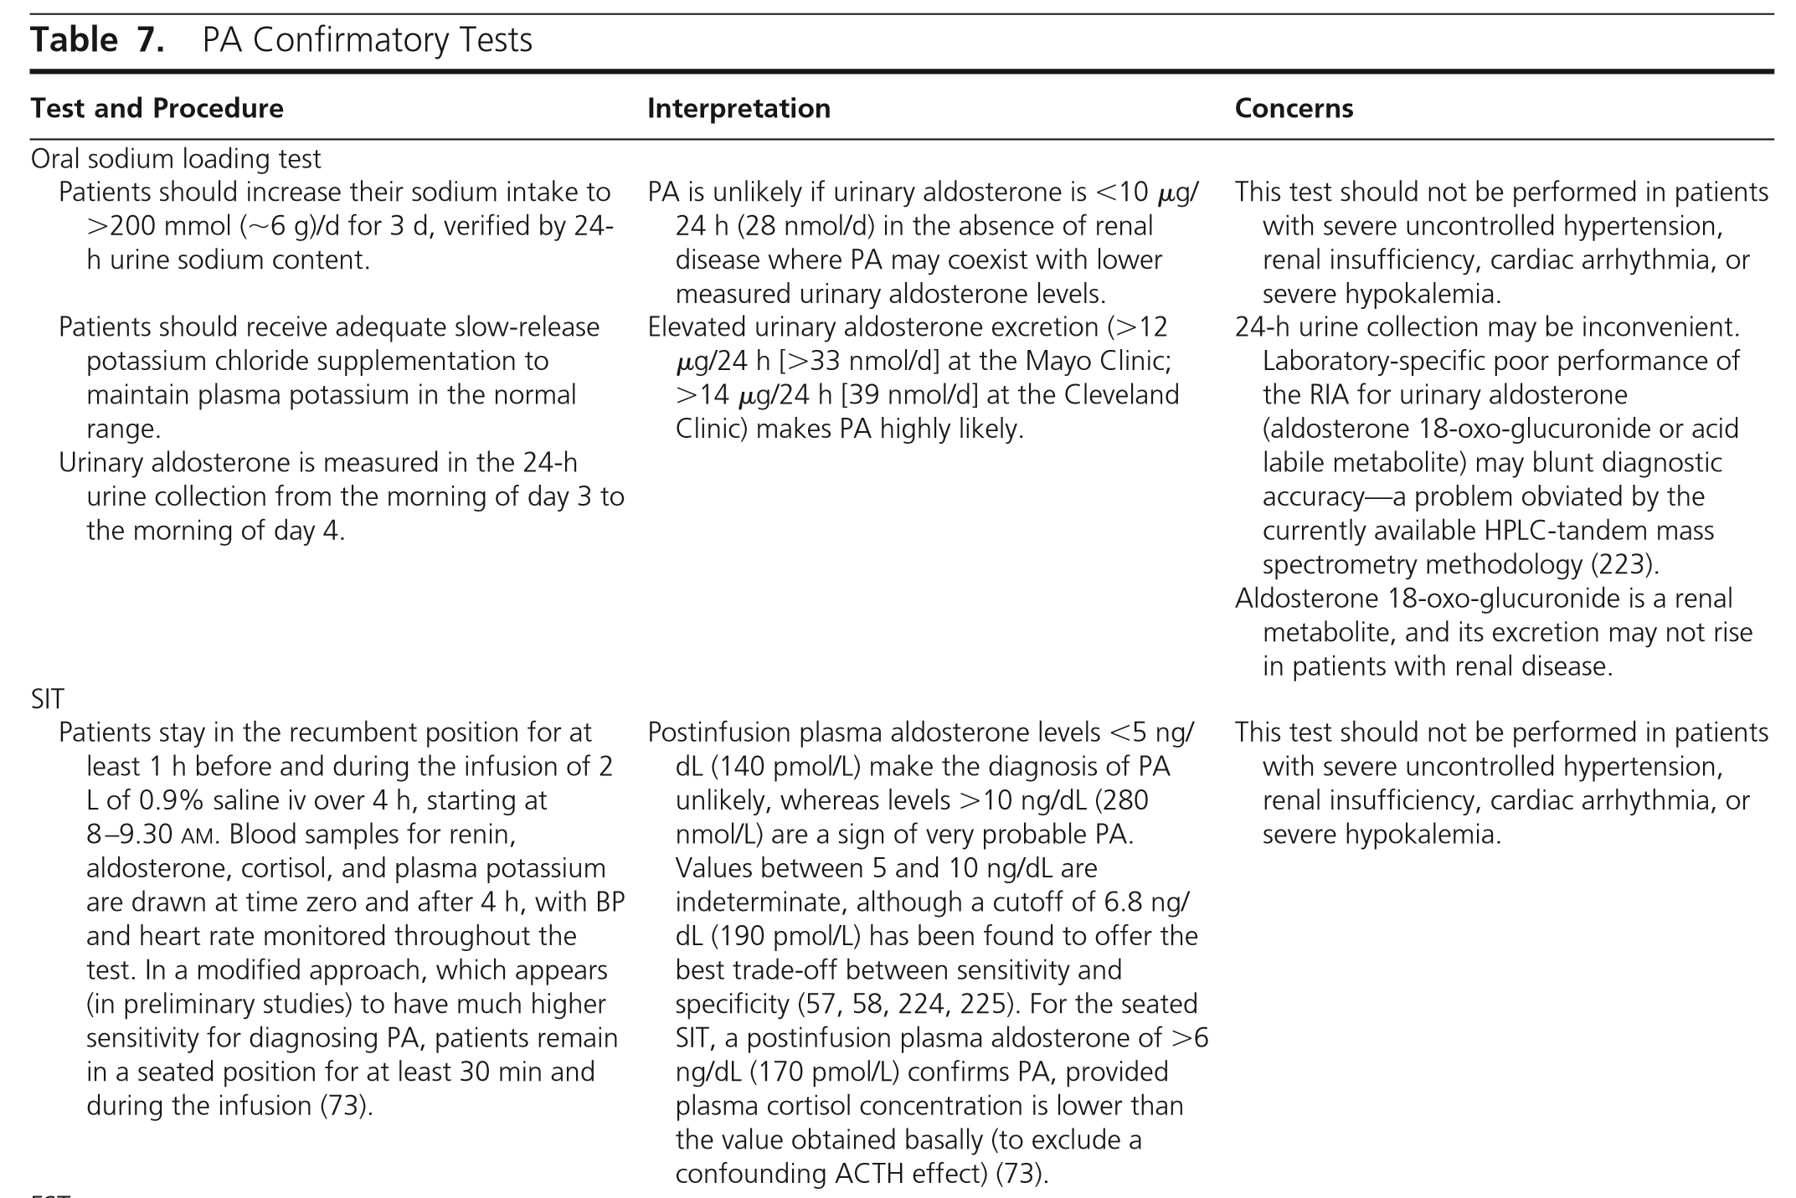

Slide 23
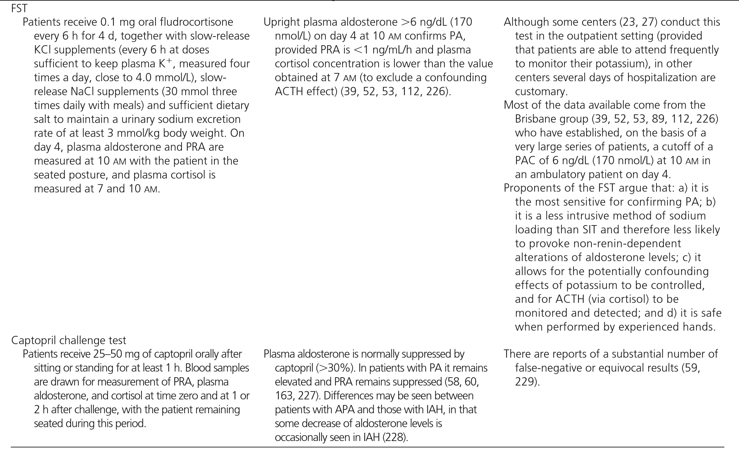

Slide 24
3.0 Subtype classification
3.1 We recommend that all patients with PA under go adrenal CT as the initial study in subtype testing to exclude large masses that may represent adrenocortical carcinoma and to assist the interventional radiologist and surgeon where anatomically appropriate(Figure1).

Slide 25
Evidence
Clinicians use the findings from adrenal CT—normal appearing adrenals, unilateral macroadenoma (1 cm), minimal unilateral adrenal limb thickening, unilateral micro adenomas (1 cm), or bilateral macro- or micro adenomas (or a combination of the two)—in conjunction with AVS and (if needed) ancillary tests to guide treatment decisions in patients with PA. APA may appear as small hypo dense nodules (usually< 2 cm in diameter) on CT.
Idiopathic adrenal hyperplasia (IAH) adrenal glands may be normal on CT or may show nodular changes.

Slide 26
In addition, nonfunctioning unilateral adrenal macro adenomas are not uncommon,especially in older patients( >age35years), and are indistinguishable from APAs on CT.

Slide 27
Remarks
3.2 We recommend that when surgical treatment is feasible and desired by the patient ,an experienced radiologist should use AVS to make the distinction between unilateral and bilateral adrenal disease
.Younger patients (age 35 years) with spontaneous hypokalemia, marked aldosterone excess, and unilateral adrenal lesions with radiological features consistent with a cortical adenoma on adrenal CT scan may not need AVS before proceeding to unilateral adrenalectomy.

Slide 28
Evidence
in most patients, making AVS the most accurate means of differentiating unilateral from bilateral forms of PA. AVS is expensive and invasive, and so it is highly desirable to avoid this test in patients who do not have PA .
The sensitivity and specificity of AVS (95 and 100%, respectively) for detecting unilateral aldosterone excess are superior to that of adrenal CT (78 and 75%, respectively).
AVS is the“goldstandard”test to distinguish unilateral (APA or UAH) from bilateral (IHA) disease in patients with PA .

Slide 29
Remarks
A radiologist experienced with and dedicated to AVS is necessary to implement this recommendation.
There are three protocols for AVS: 1) unstimulated sequential or simultaneous bilateral AVS;
2)unstimulated sequential or simultaneous bilateral AVS followed by bolus cosyntropin-stimulated sequential or simultaneous bilateral AVS;
3) continuous cosyntropin infusion with sequential bilateral AVS.

Slide 30
clinicians use a cut off of the cortisol-corrected aldosterone ratio from high-side to low-side of more than 4:1 to indicate unilateral aldosterone excess;a ratio of 3:1 is suggestive of bilateral aldosterone hyper secretion.
Some investigators consider a cortisol-corrected aldosterone lateralization ratio(high to low side) of more than 2:1 in the absence of cosyntropin as consistent with unilateral disease.

Slide 31
Cosyntropin use
For continuous cosyntropin, clinicians should begin an infusion of 50 microg/h of cosyntropin 30 minutes before adrenal vein catheterization and continue it throughout the procedure
The bolus cosyntropin technique involves AVS before and after the iv administration of 250 microg of cosyntropin.

Slide 32
Iodocholesterol scintigraphy
iodomethyl-19-norcholesterol(NP-59),performed with dexamethasone suppression, had the putative advantage of correlating function with anatomical abnormalities.
the sensitivity of this test depends heavily on the size of the adenoma Because tracer uptake is poor in adenomas smaller than 1.5 cm in diameter, this method often is not helpful in interpreting micronodular findings obtained with high-resolution CT and rarely plays a role in subtype evaluation.

Slide 33
18-Hydroxycorticosterone levels
Patients with APA generally have recumbent plasma 18-OHB levels greater than 100 ng/dL at 8:00 a.m., whereas patients with IAH have levels that are usually less than 100 ng/dL .

Slide 34
(11)C-Metomidate positron emission tomography-computed tomography
Metomidate is a potent inhibitor of adrenal steroidogenic enzymes. A study of 25 patients with PA that used (11)C-metomidate—a positron emission tomography radiotracer—reported a specificity of 87% and sensitivity of 76% for APA .
In the future, APA-specific positron emission tomography radiotracers may have a major role in the subtype evaluation of PA.

Slide 35
3.3 In patients with an onset of confirmed PA earlier than 20 years of age and in those who have a family history of PA or strokes at a young age (40 years), we suggest genetic testing for FH-I(GRA).
In very young patients with PA, we suggest testing for germline mutations in KCNJ5 causing FH-III.

Slide 36
Evidence
Testing for familial forms of primary aldosteronism: familial hyperaldosteronism type 1 (glucocorticoid remediable aldosteronism)
The FH-I syndrome is inherited in an autosomal dominant fashion and is responsible for 1% of cases of PA . The mutation in patients with GRA is fusion of the promoter region of the gene for CYP11B1 and the coding sequences of CYP11B2, resulting in a CYP11B1/ CYP11B2 chimeric gene.
GRA is a form of hyper aldosteronism in which the hypersecretion of aldosteroneis dependent upon endogenous ACTH secretion.

Slide 37
Testing for familial forms of primary aldosteronism: familial hyperaldosteronism type II
FH-II is an autosomal dominant disorder and possibly genetically heterogeneous
Although FH-II is more common than FH-I, accounting for atleast 7% of patients with PA in one series, its true prevalence is unknown.
The molecular basis for FH-II is unclear.

Slide 38
Testing for familial forms of primary aldosteronism: familial hyperaldosteronism type III
FH-III was first described in a family characterized by severe hypertension in early childhood associated with hyper aldosteronism, hypokalemia, and resistance to antihypertensive therapy, requiring bilateral adrenalectomy
The cause of FH-IIIisamutation in the KCNJ5 gene encoding the potassium channel .

Slide 39
Multiple endocrine neoplasia type 1
Finally, APA may rarely but on occasion be seen in multiple endocrine neoplasia type 1.

Slide 40
4. Treatment
Cardiovascular complications
Hypertension is the rule in patients diagnosed with PA and is cured or improved by unilateral adrenalectomy in patients with unilateral disease and improved by MR antagonists in the remaining patients.
aldosterone excess has deleterious effects on the cardiovascular system, at least partly independent of its effects on BP.
Such studies showed increased left ventricular (LV) dimensions and myocardial fibrosis, increased carotid intima-media thickness, and increased femoral pulse wave velocity and reduced endothelial function.

Slide 41
4.1 We recommend unilateral laparoscopic adrenalectomy for patients with documented unilateral PA.
If a patient is unable or unwilling to undergo surgery, we recommend medical treatment including a MR antagonist .
If an ARR-positive patient is unwilling or unable to undergo further investigations, we similarly recommend medical treatment including an MR antagonist.

Slide 42
Evidence
Clinicians use unilateral laparoscopic adrenalectomy in patients with unilateral PA because BP and serum potassium concentrations improve in nearly 100% of patients postoperatively.
Factors associated with hypertension resolution in the postoperative period include having one or no first-degree relative with hypertension and preoperative use of two or fewer antihypertensived rugs.
duration of hypertension <5 years , higher PAC : PRA ratio preoperatively ( higher urinary aldosterone secretion , or positive preoperative response to spironolactone .

Slide 43
Preoperative management
Both hypertension and hypokalemia should be well controlled before patients undergo surgery.
Obtaining such control may require a delay in surgery and the addition of an MR antagonist.

Slide 44
Postoperative management
Clinicians should measure plasma aldosterone and renin activity levels shortly after surgery as an early indication of biochemical response,although renin levels may not fall immediately.
They should also withdraw potassium supplementation on postoperative day 1, discontinue spironolactone, and reduce antihypertensive therapy, if appropriate.
Postoperative iv fluids should be normal saline without potassium chloride unless serum potassium levels remain very low (ie,< 3.0 mmol/L);
during the first few weeks after surgery, clinicians should recommend a generous sodium diet to avoid the hyperkalemia that can develop from hypoaldosteronism due to chronic contralateral adrenal gland suppression.

Slide 45
BP typically normalizes or shows maximum improvement in 1–6 months after unilateral adrenalectomy for unilateral APA but can continue to fall for up to 1 year in some patients.
Some investigators have employed post operative FST (performed at least 3 months after surgery to permit recovery of the contralateral gland) to assess whether the PA has been cured from a biochemical perspective.

Slide 46
4.2 In patients with PA due to bilateral adrenal disease, we recommend medical treatment with an MR antagonist
we suggest spironolactone as the primary agent, with eplerenone as an alternative(Figure 1)

Slide 47
Evidence
A randomized controlled trial has demonstrated that spironolactone may be more effective than eplerenone in controlling BP in patients with PA.

Slide 48
MR antagonists
MR antagonists appear to be effective at controlling BP and protecting target organs independent of effects on BP.
Spironolactone
mean reductions in systolic BP of 25% and diastolic BP of 22% in response to spironolactone 50–400 mg/d for 1–96 months.

Slide 49
The incidence of gynecomastia with spironolactone therapy is dose-related, with one study reporting an incidence after 6 months of 6.9% at a dose 50mg/d and 52% at a dose 150 mg/d (188).
In addition, a small dose of a thiazide diuretic, triamterene, or amiloride can be added to attempt to avoid a higher dose of spironolactone, which may cause side effects.

Slide 50
Eplerenone
Eplerenone is a newer, selective MR antagonist without antiandrogen and progesterone agonist effects
It has been approved for the treatment of primary (essential) hypertension in the United States and Japan.
Eplerenone in vivo has 50% of the MR antagonist potency of spironolactone.
Its better tolerability profile needs to be balanced against its higher cost and the possibility that spironolactone may lower BP more effectively than eplerenonein the medical treatment of PA
Reflecting its shorter half-life, eplerenone should be given twice daily for optimal effect.

Slide 51
Other agents
two available epithelial sodium channel antagonists amiloride and triamterene
Although less efficacious than spironolactone .
It lacks the sex steroid-related side effects of spironolactone but does not provide the beneficial effects on endothelial function .

Slide 52
Remarks
The starting dose for spironolactone should be 12.5to 25mg/d in a single dose.
The lowest effective dose should be found by very gradually titrating up ward,ifnecessary, to a maximum dose of 100 mg/d.
The starting dose for eplerenone is 25 mg twice daily. In patients with stage III chronic kidney disease (ie, glomerular filtration rate 60 mL/min/1.73 m2), clinicians should administer spironolactone and eplerenone with caution because of the risk of hyperkalemia.
clinicians should avoid administering MR antagonists in patients with stage IV disease.

