Slide 1
American Association of Clinical Endocrinology And Associazione Medici Endocrinologi Thyroid Nodule Algorithmic Tool
Dr. Amir Reza Goharian
Endocrinologist
21/3/1400

Slide 2
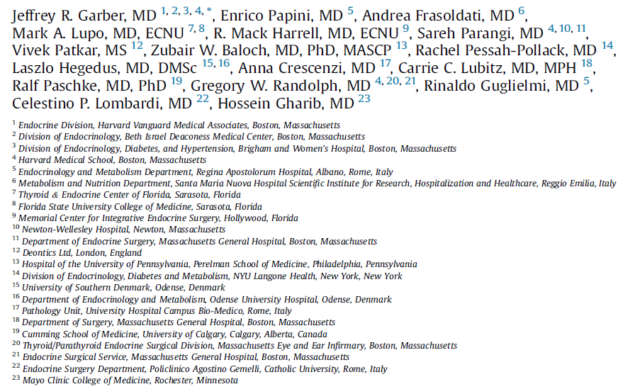

Slide 4
Introduction
Thyroid nodules are common. (1)
They are predominantly benign and asymptomatic and do not require evaluation, treatment, or monitoring, while the majority of thyroid malignancies are low-risk neoplasms that do not have an impact on survival. (2)

Slide 5
In the United States, well over 500 000 fine-needle aspirations (FNAs) of thyroid nodules are performed per year, with as many as 200 000 of them being unnecessary. (3)
Similarly, in European countries, such as Germany and France, with well-functioning National Health Services , the vast majority of thyroidectomies performed for nodular thyroid disease have benign histopathology, (4,5) while the minority that proves to be malignant is predominantly composed of low-risk thyroid cancers. (6,7)

Slide 6
TNAPP
We designed a novel electronic algorithmic tool, termed TNAPP (Thyroid Nodule App, pronounced “tee nap”).

Slide 7
Exclusion Factors

Slide 8
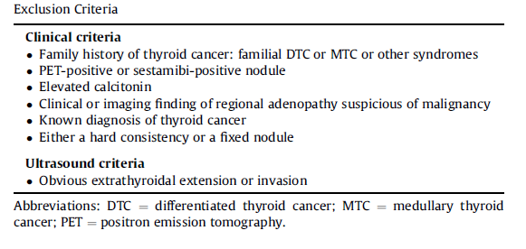

Slide 9
Clinical Factors

Slide 10
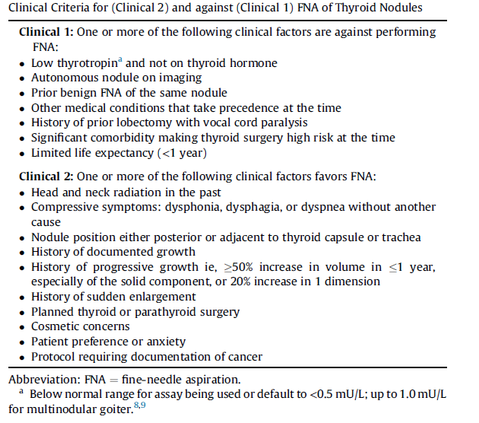

Slide 11
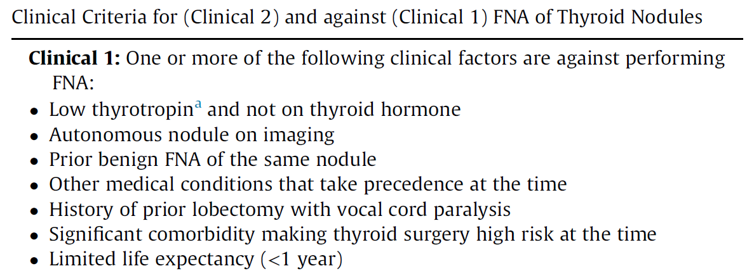

Slide 12
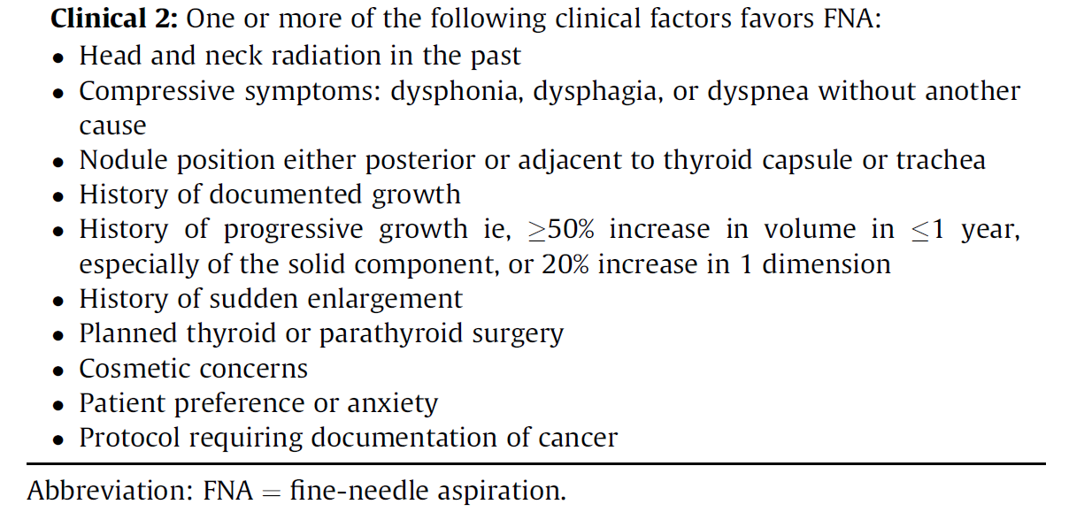

Slide 13
US Characteristics

Slide 14
US images & Cartoons
A numeric scoring system based on the risk of malignancy associated with each US feature was created to categorize each nodule as US 1, 2, or 3 (low, intermediate, or high risk, respectively).
In the algorithmic tool, American College of Radiology Thyroid Imaging Reporting and Data System (ACR TI-RADS) scores are simultaneously displayed if a sufficient number of criteria to generate a score are entered.

Slide 18
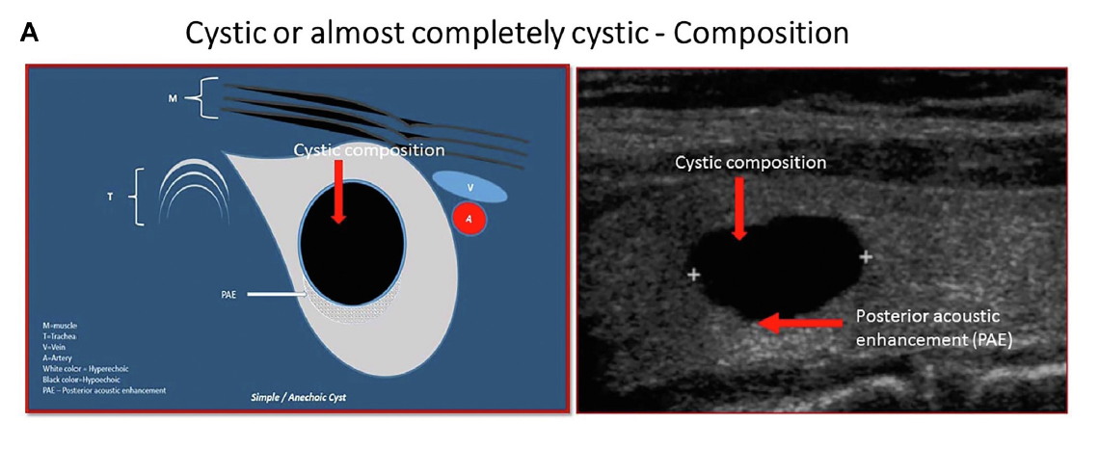

Slide 19
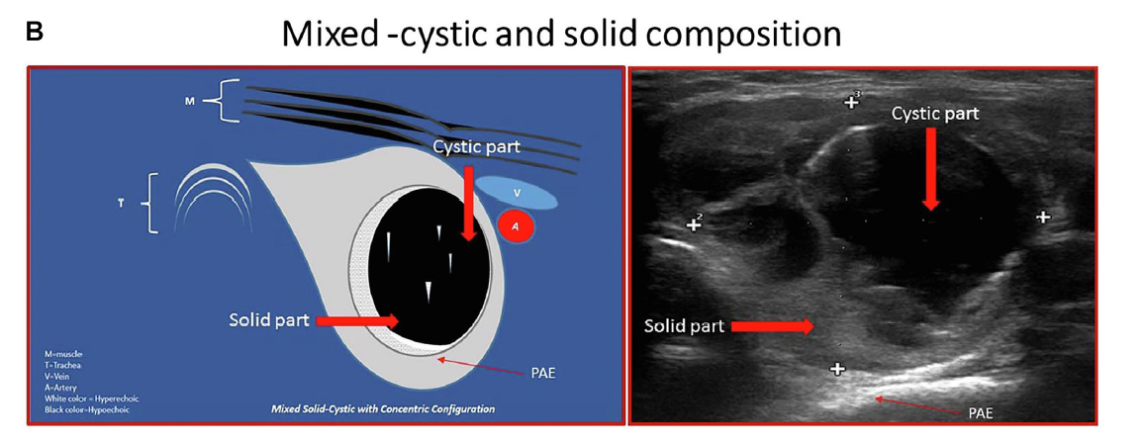

Slide 20
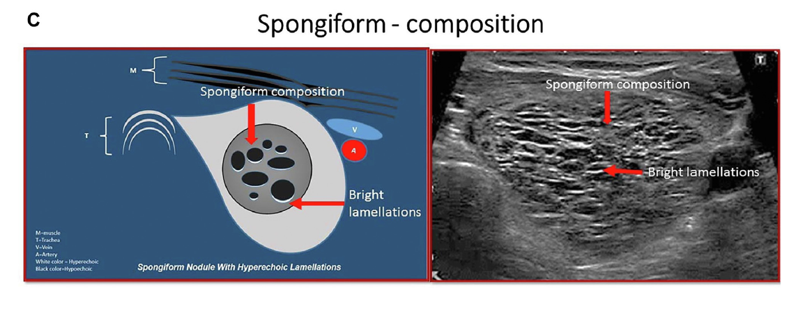

Slide 21
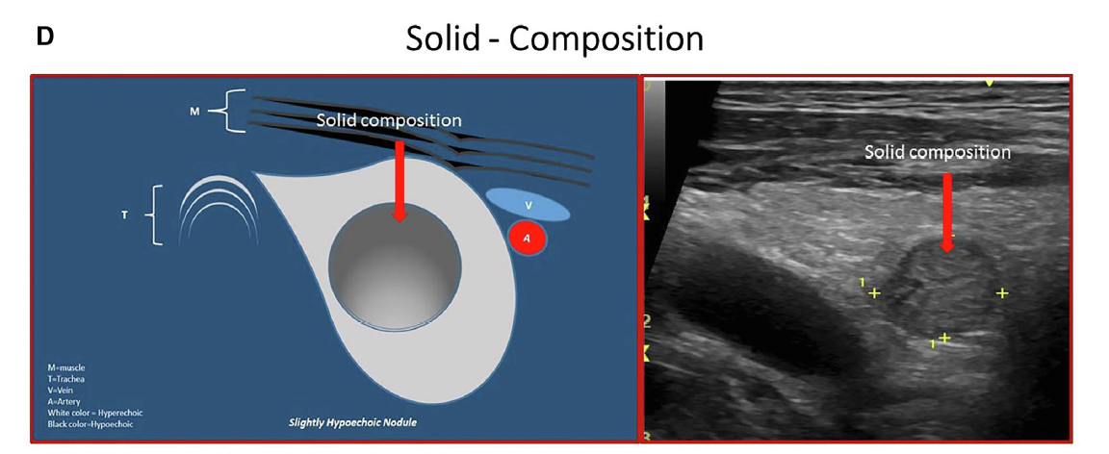

Slide 24
Cytology

Slide 25
FNA
Bethesda cytology categories I-VI were used to classify findings. (34)

Slide 26
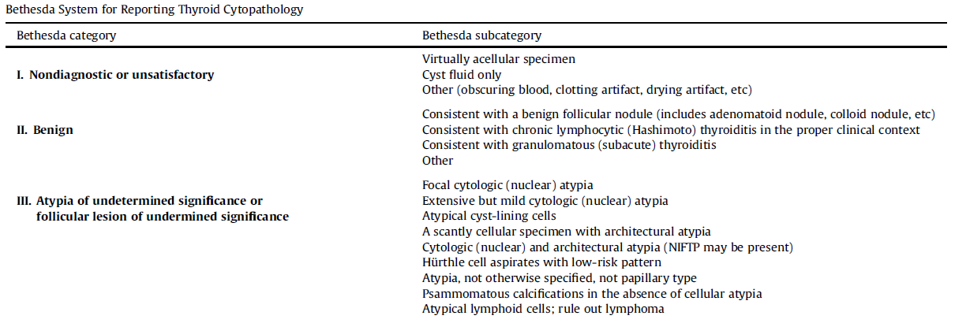

Slide 27
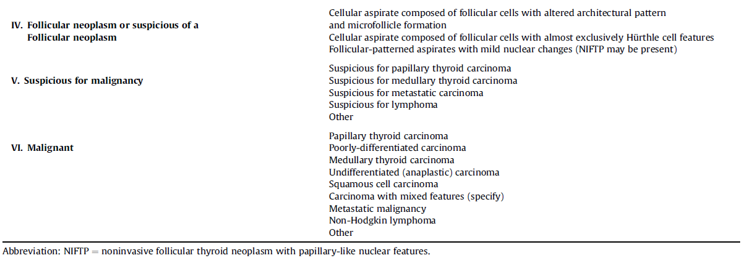

Slide 28
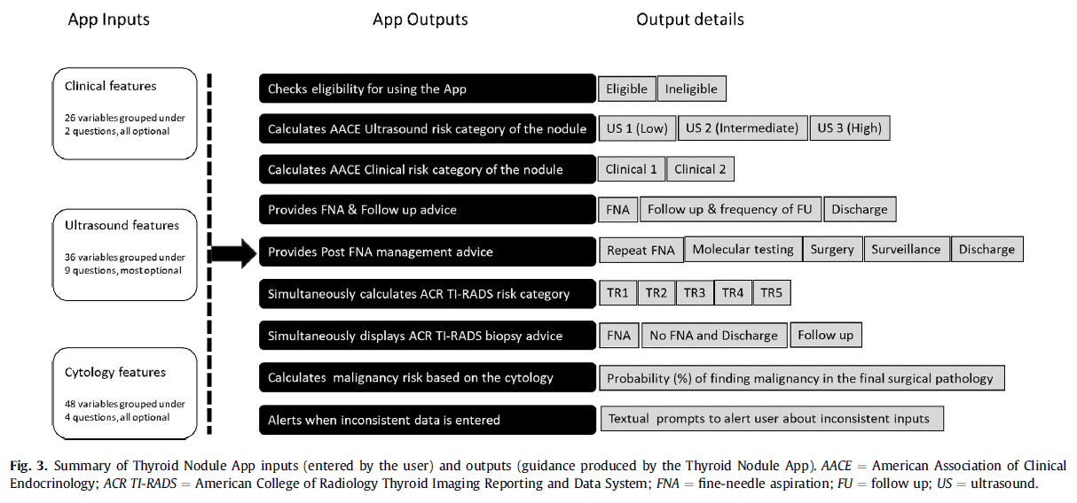

Slide 29
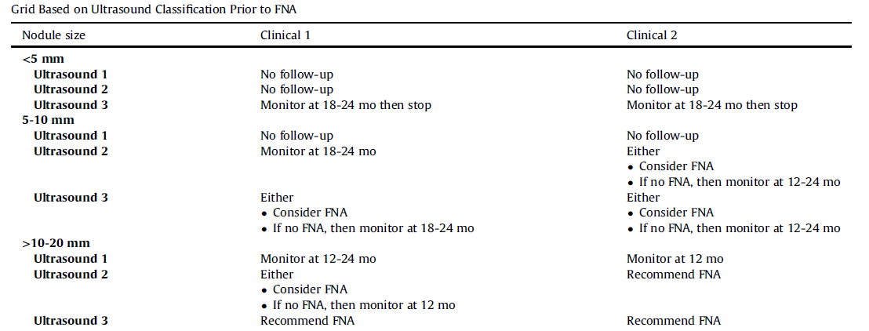

Slide 31
Cross-checking TNAPP

Slide 32
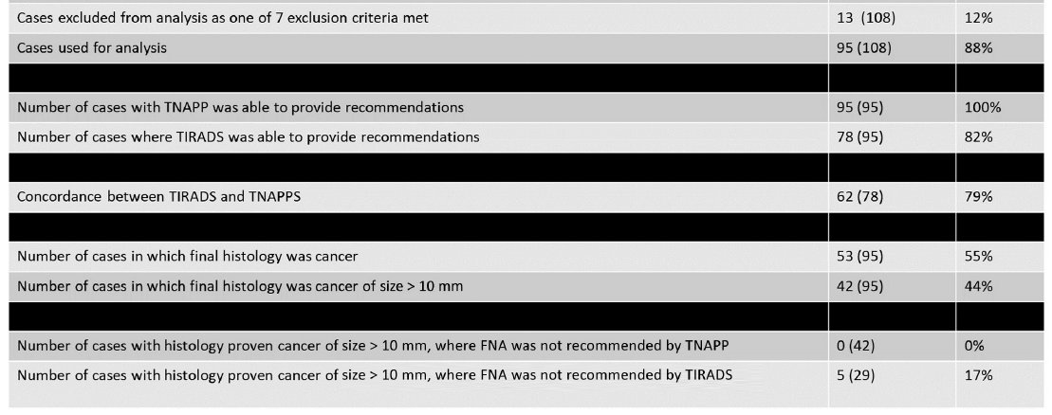

Slide 33
باتشکرازتوجه وهمراهی شماعزیزان

Slide 34
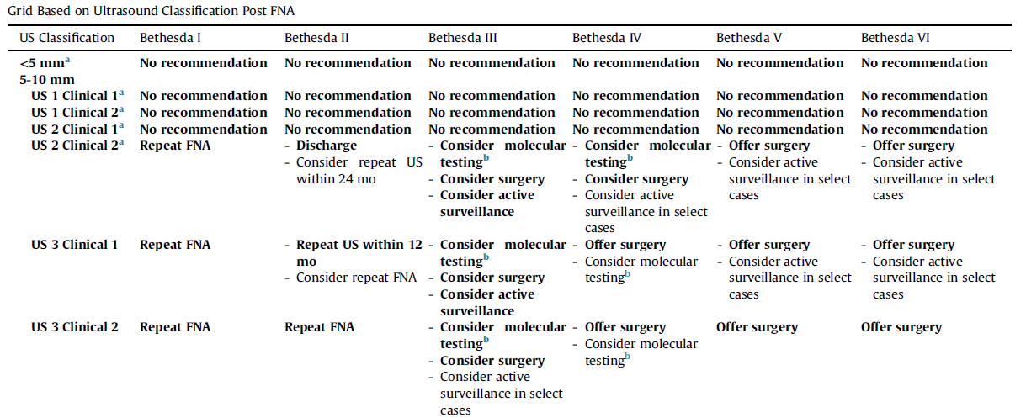

Slide 37
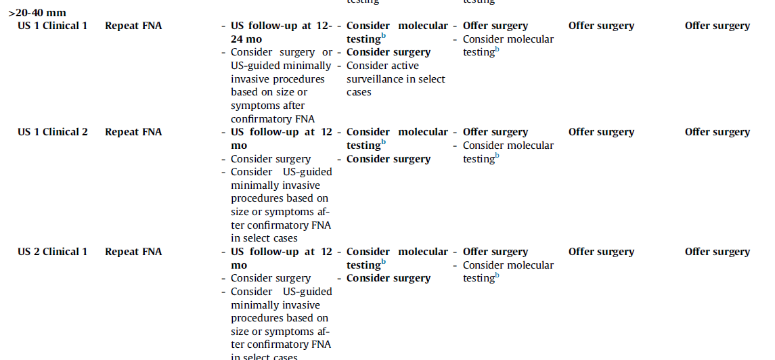

Slide 39
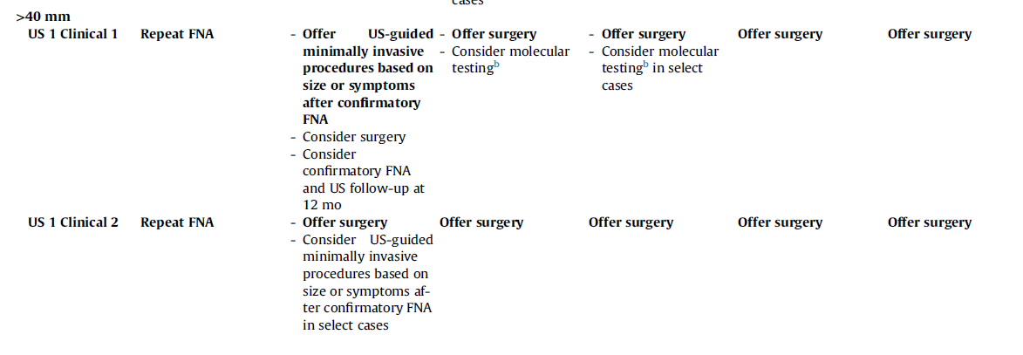

Slide 40
