Slide 1

In the name of ALLAH
Vitamin D Update

Slide 2
Refrences
Vitamin D deﬁciency : an update on the current status worldwide
European Journal of Clinical Nutrition (2020) 74:1498–1513
REVIEW ARTICLE
Vitamin D Update
14 October 2020
Current Dermatology Reports

Slide 3
Introduction

Slide 4
Vitamin D testing has exponentially increased in recent years
The deﬁnition and relevance of vitamin D deﬁciency are still under debate.
Recent large observational data have suggested that ~40% of Europeans are vitamin D deﬁcient, and 13% are severely deﬁcient
The relevance of this widespread deﬁciency and necessity for supplementation has been questioned

Slide 5
Certainly, vitamin D is not a panacea.
but the large amount of observational data currently available are also accompanied by pathophysiological associations of vitamin D with energy homeostasis, and regulation of the immune and endocrine systems

Slide 6
Vitamin D Basics

Slide 7
Some would urge us to move away from the nomenclature of vitamin as a vitamin and,instead,acknowledge that vitamin D3 is a prohormone produced in skin through ultraviolet irradiation of 7-dehydrocholesterol (7DHC or provitamin D3)
This previtamin D3 is biologically inert and must undergo thermal isomerization and two hydroxylations

Slide 8
The first hydroxylation occurs in the liver and converts vitamin D to 25-hydroxyvitamin D [25(OH)D], also known as calcidiol.
Physiologically active 1,25-dihydroxyvitamin D [1,25(OH)2D], or calcitriol, is then synthesized primarily in the kidney.

Slide 9
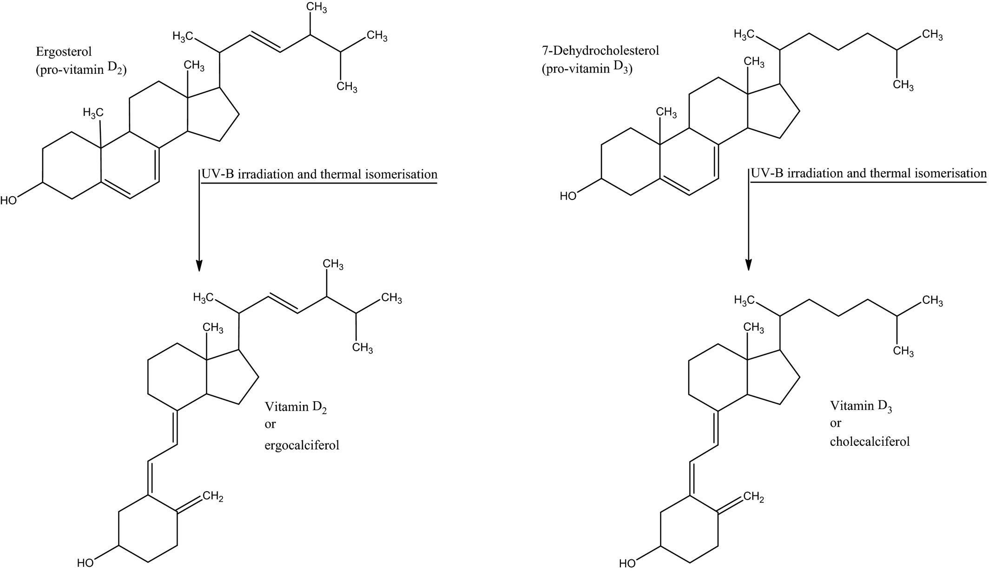

Slide 10
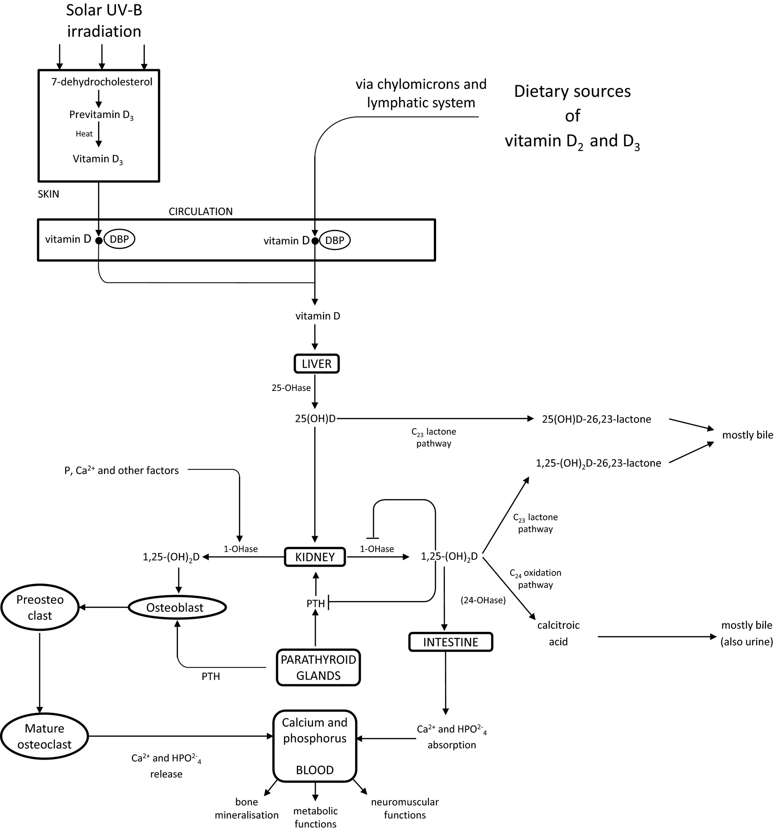

Slide 11
Deﬁnition of vitamin D deﬁciency

Slide 12
Serum 25(OH)D is considered to be the best marker for assessing vitamin D status, and reliably reﬂects the free fractions of the vitamin D metabolites, despite the fact that, in theory, the bioavailable fractions may be more clinically informative .

Slide 13
A range of below 75nmol/L (or 30ng/ml) of serum/plasma 25(OH)D concentration is considered vitamin D deﬁciency by most authors
A cutoff of <25 or <30nmol/L (or 10/12ng/ml) increases the risk of osteomalacia and nutritional rickets dramatically, and therefore is considered to determine severe vitamin D deﬁciency

Slide 14
According to the NIH, serum concentration of 25(OH)D is the best indicator of vitamin D status.
It reflects total vitamin D produced cutaneously as well as obtained through food and supplements and has a fairly long circulating half-life of 15 days.

Slide 15
In contrast to 25(OH)D, circulating 1,25(OH)2D is not a good indicator of vitamin D status.
Levels of 1,25(OH)2D do not typically decrease until vitamin D deficiency is severe.

Slide 16
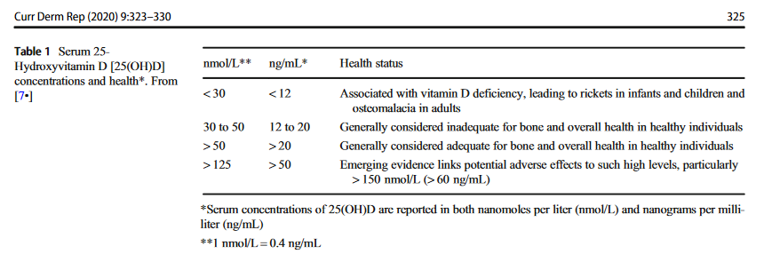
Table 1 shows the current serum concentrations and interpretations from the Institute of Medicine

Slide 17
The clinical practice guidelines of the Endocrine Society Task Force on Vitamin D have deﬁned a cutoff level of 50nmol/L as vitamin D deﬁcient.
Furthermore, different societies and expert bodies have deﬁned 50nmol/L as “vitamin D requirement of nearly all normal healthy persons,” by using bone health as the main basis.

Slide 18
For example, a cutoff level of 50nmol/L is recommended by the Institute of Medicine (IOM, USA) in their “Dietary Reference Intakes”.
Vitamin D levels of <30nmol/ L (or 12ng/ml) should likely be prevented with a public health approach

Slide 19
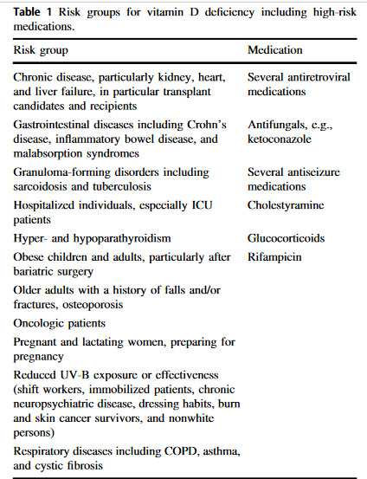

Slide 20
Prevalence of vitamin D deﬁciency worldwide

Slide 21
Prevalence rates of severe vitamin D deﬁciency, deﬁned as 25(OH)D <30nmol/L (or 12ng/ml), of 5.9% (US) , 7.4% (Canada) and 13% (Europe) have been reported.
Estimates of the prevalence of 25(OH)D levels <50nmol/L (or 20ng/ml) have been reported as 24% (US), 37% (Canada), and 40% (Europe) .

Slide 22
This may vary by age, with lower levels in childhood and the elderly , and also ethnicity in different regions, for example, European Caucasians show lower rates of vitamin D deﬁciency compared with nonwhite individuals .

Slide 23
Patients with chronic renal failure and on hemodialysis, renal transplant recipients affected with liver disease or after liver transplantation may have a prevalence of vitamin D deﬁciency ranging from 85 to 99%

Slide 24
Vitamin D deﬁciency in critical illness

Slide 25
Similarly, critically ill patients have a very high prevalence of vitamin D deﬁciency, and low vitamin D levels are clearly associated with greater illness severity, morbidity, and mortality in both adult and pediatric intensive care unit (ICU) patients, as well as medical and surgical ICUs .

Slide 26
The association between vitamin D deﬁciency and chronic illness, and its likely progressive decline with intensive care unit stay due to sunlight and dietary depletion is well-known.
Despite this knowledge, vitamin D deﬁciency is seldom considered and rarely replaced adequately, if at all, in critically ill patients

Slide 27
However, as in most other populations, the most important question remains unanswered:
whether low vitamin D is an innocent bystander, simply reﬂecting greater disease severity, or
represents an independent and modiﬁable risk factor amenable to rapid normalization through loading dose supplementation

Slide 28
The question is meaningful, since in this subgroup of patients, many factors contribute to low levels:
hemodilution,
reduced production and conversion by the liver,
reduced synthesis of vitamin D-binding protein,

Slide 29
higher consumption during the acute phase of disease and systemic inﬂammation,
and increased tissue demand
and enhanced catabolism of metabolites

Slide 30
Hypocalcaemia, even after adjustment for protein and pH (i.e. ionized calcium), is common in critically ill patients and has been found in 15–88% in adults in intensive care units .
Risk factors include sepsis, burns, pancreatitis and rhabdomyolysis .
As calcium is important in many physiological processes, it is not surprising that hypocalcaemia may be associated with disease severity and mortality .

Slide 31
However, parenteral calcium supplementation has not been shown to improve the outcome of intensive care patients, as noted in a recent Cochrane review
The reasons for this lack of beneﬁt are unclear but hypocalcaemia may be a sign of disease severity rather than a causal factor per se

Slide 32
although various mechanisms have been proposed to explain how hypocalcaemia occurs in critical illness, including intracellular sequestration of calcium and relative hypoparathyroidism, it is unclear why hypocalcaemia occurs.

Slide 33
Severe hypocalcaemia is an uncommon ﬁnding in non critically ill patients, due to the presence of multiple compensatory mechanisms to maintain normocalcaemia.
The ability to maintain calcium homeostasis is dependent on a sufﬁcient and responsive parathyroid hormone (PTH)-vitamin D axis.
Calcium-sensing receptors in the parathyroid glands are exquisitely sensitive to changes in serum calcium concentration.

Slide 34
Hypocalcaemia is prevented by increase in intestinal calcium absorption, renal calcium re-absorption and release of calcium from the skeleton through bone resorption, mediated by 1,25(OH)2-vitamin D (1,25-(OH)2D).
The skeleton is an important reservoir for calcium.

Slide 35
Hypocalcaemia therefore does not occur unless PTH action is insufﬁcient, as in:
hypoparathyroidism
or PTH resistance (e.g hypomagnesaemia, renal failure resulting in inadequate renal 1a-hydroxylation),
or if vitamin D is severely deﬁcient not allowing adequate formation of 1,25-(OH)2D despite maximal PTH stimulation

Slide 36
the critical role of vitamin D in glucose and calcium homeostasis may explain the association between vitamin D deﬁciency and diabetes and osteomalacia or osteoporosis in the general population;
in critically ill patients, however, vitamin D deﬁciency may lead to hyperglycaemia and hypocalcaemia.

Slide 37
At an organ level, vitamin D deﬁciency is associated with cardiac failure and chronic airway diseases in ambulatory patients, but may result in the cardiac dysfunction and acute lung injury seen in some critically ill patients.

Slide 38
On a whole body level, vitamin D deﬁciency leads to immune dysfunction and has been implicated in the pathogenesis of systemic infection such as tuberculosis and autoimmune diseases.
In critically ill patients, such immunopathy may manifest as increased susceptibility to nosocomial infections such as ventilator associated pneumonia and central line infections, sepsis and the systemic inﬂammatory response syndrome.

Slide 39
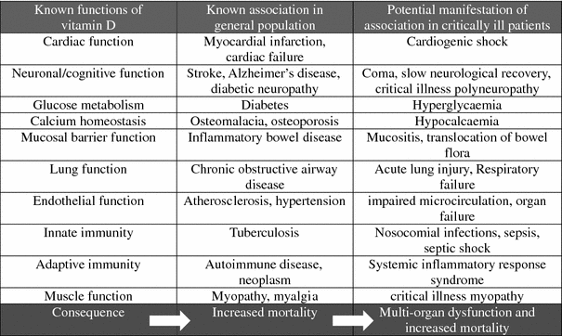
Table 1 Potential manifestation amongst critically ill patients of known association of vitamin D deficiency seen in the general population

Slide 40
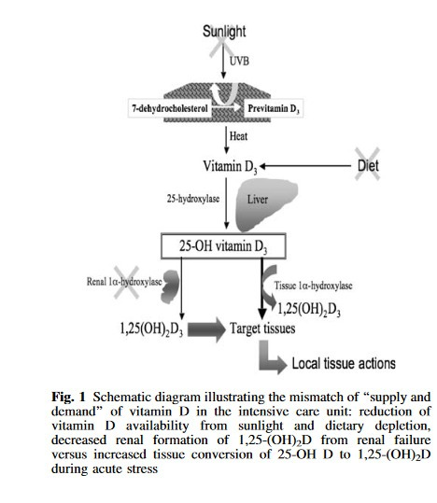

Slide 41
Formation of 1,25-(OH)2D from 25-OH D is under both endocrine and paracrine regulation by PTH .
25-OH D is the hepatic metabolite of vitamin D and substrate of 1a-hydroxylase.
In addition to its classic location in the kidneys, the activating enzyme, 1a-hydroxylase, is found in almost all mammalian cells.

Slide 42
While renal 1a-hydroxylase activation may be important for circulating 1,25-(OH)2D levels;
locally, 1,25-(OH)2D formed by tissue 1a-hydroxylase may be critical in mediating the pleiotropic actions of vitamin D.
Circulating vitamin D sufﬁciency is required for both the endocrine and paracrine arms of the PTH-vitamin D axis to function effectively.

Slide 43
Critical illness is characterized by:
different degrees of local and systemic inﬂammation, as well as metabolic and immune dysfunction; functions over which vitamin D exerts important regulatory actions .
In states of normal circulating vitamin D level, individual target tissues are possibly able to increase local formation of 1,25-(OH)2D to meet tissue demand during critical illness
Also, failure to up-regulate PTH vitamin D axis due to circulating vitamin D insufﬁciency may contribute to metabolic and immune dysfunction and ultimately multi-organ failure, which is the cause of morbidity and mortality in intensive care

Slide 44
Both hypocalcaemia and hyperparathyroidism are markers of vitamin D insufﬁciency, but it is vitamin D insufﬁciency, the cause of hypocalcaemia, which leads to wide spread tissue dysfunction.
In addition, vitamin D has beneﬁts on bone health. Vitamin D supplementation may reduce bone loss, which is common in immobile intensive care patients frequently treated with high dose steroids .

Slide 45
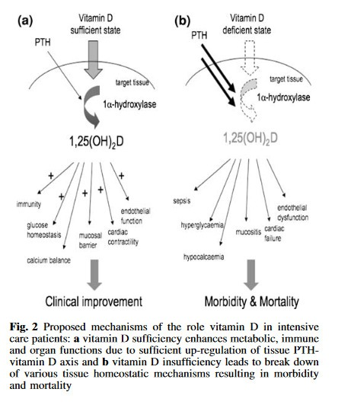

Slide 46
Vitamin D replacement

Slide 47
Interval, target level, and dose
For some time, bolus dosing was en vogue because it was thought to be interesting for practical reasons.
With the exception of critical care, bolus doses with long dosing intervals are not used.
They are no longer recommended because of the higher risk of adverse effects (falls and fractures) associated with them .

Slide 48
Moreover, the 2017 individual patient data meta-analysis by Martineau et al. showed a clear beneﬁt for vitamin D on acute respiratory infection when daily or weekly dosing was used, but not with longer dosing intervals .
In the intensive care, however, a typical daily dose is inefﬁcient, and an upfront loading dose (followed by a daily dose) is necessary to improve vitamin D levels rapidly

Slide 49
It is also important to note that different dosing regimes may have different effects on clinical outcomes.
Because a daily dose leads to stable availability of various vitamin D metabolites, this could be an important explanation for many of the negative vitamin D intervention trials.

Slide 50
To maintain optimal vitamin D status, use of vitamin D supplementation is often required, as sunlight exposure and dietary intake alone is usually insufﬁcient in most individuals .
Currently, there is no international consensus on the optimal level for vitamin D supplementation.

Slide 51
Recommendations differ in many countries, and range from 400 to 2000IU daily .
A safe and commonly available dose of 25μg of vitamin D3 (1000IU) raises 25hydroxyvitamin D [25(OH)D] serum level by 15–25nmol/ L on average (over weeks/months) ;

Slide 52
By using the above-mentioned recommended vitamin D supplementation levels, there is no need to monitor serum or urinary calcium or renal function .
There is no international consensus on the safe upper level for vitamin D supplementation.
While the upper daily limit given by the Endocrine Society is 10,000IU , the IOM and The European Food and Safety Authority recommend staying below 4000IU/day (100µg) .

Slide 53
Most countries have prudently set the safe upper level at 50μg daily (2000IU) for adults .
However, this level was set despite the availability of adequate studies of dose–response relationships or toxicity.
There is no convincing evidence that daily intakes of up to 125μg (5000IU) elicit severe adverse effects .

Slide 54
It has been reported that an intake of 1250µg (50,000IU) once every 2 weeks for several years, equivalent to 89.3µg (3571IU) daily, did not cause hypercalcemia or other evidence of hypervitaminosis D

Slide 55
Small studies showed that even a daily consumption of up to 250μg (10,000IU) of vitamin D over long periods did not cause adverse effects in healthy adults , though some studies revealed a negative impact on bone mineral density by using high-dose vitamin D supplementation of 10,000IU/day

Slide 56
Nevertheless, supplementation of>10,000IU of vitamin D is rarely necessary in clinical practice.
As there is no evidence that increasing the recommended daily dose of vitamin D supplementation up to 50μg (2000IU) would cause severe side effects in the general population, and considering that 20μg (800IU) is the lowest dose consistently associated with a bone beneﬁt, it seems reasonable to recommend a daily dose of 20–50μg (800–2000IU)

Slide 57
In general, a daily vitamin D of 800IU appears to be sufﬁcient to achieve a target 25(OH)D level of at least 50nmol/L (or 20ng/mL) in most healthy individuals, whereas 2000IU is sufﬁcient to achieve a level of at least 75nmol/L (or 30ng/mL).
Some data suggest that a higher 25(OH)D level than 50nmol/L (or 20ng/mL) may be required for optimal risk reduction for various endpoints

Slide 58
The optimum vitamin D intake varies by age:
for children under 1 year, the RDA is 400 IU/day;
between 1 year and 70 years, the RDA is 600 IU/day;
and for people over 70, the RDA is 800 IU/day.
These RDA guidelines are based on AAD guidelines that promote minimal or no sun exposure primarily due to the risk of skin cancer associated with sun exposure.

Slide 59
Toxicity

Slide 60
The use of vitamin D supplementation has increased substantially.
Growing awareness of vitamin D in the general population, and over-the-counter vitamin D with partially very high doses, include the risk for uncontrolled use and exogenous hypervitaminosis D, resulting in high concentrations of serum 25(OH)D or free 1,25-dihydroxyvitamin D [1,25(OH)2D], leading to hypercalciuria and ﬁnally hypercalcemia .

Slide 61
Reports of vitamin D overdose are rare in the literature.
Serum 25(OH)D usually exceeds 375nmol/l (or 150ng/ml), and factors such as high-calcium intake contribute to the risk of hypercalcemia

Slide 62
However, there are also endogenous causes of hypervitaminosis D, such as increased production of 1,25(OH)2D as part of granulomatous disorders or lymphomas .
Having a long half-life in the tissues, vitamin D accumulation due to excessive intake lasts up to 18 months , and may cause chronic toxic effects such as nephrocalcinosis following hypercalcemia and hypercalciuria

Slide 63
Since the 1930s, public health ofﬁcials in the United States and the United Kingdom have recommended routine fortiﬁcation of foods like milk to prevent vitamin D deﬁciency and low vitamin D status, which was expected to be an effective public health strategy .
However, there was an increased incidence of hypercalcemia due to massive intakes of vitamin D from various food fortiﬁcations.

Slide 64
In some cases, hypercalcemia was associated with drinking vitamin D-fortiﬁed milk, revealing a fortiﬁcation of up to 232,565IU instead of standard 400IU/quart, and consequently, prohibition of milk fortiﬁcation .
However, current evidence suggests that vitamin D fortiﬁcation prevents deﬁciency safely and effectively .
Feeding animals might represent an additional source of vitamin D without compromising product quality.

Slide 65
For example, consumption of vitamin D-enriched eggs from hens fed with additional vitamin D3 resulted in a zero prevalence <25nmol/L, while the control group showed an usual seasonal decline in winter with 22% being <25nmol/L .

Slide 66
Selected target organs, conditions, and endpoints

Slide 67
Mortality
Vitamin D deﬁciency has been strongly associated with various health outcomes, including all-cause mortality .
A 2014 Cochrane meta-analysis showed a relevant and signiﬁcant lower all-cause mortality of ~7% and cancer mortality of ~13% in patients who received vitamin D3
The results of a meta-analysis by using individual participant data conducted by Gaksch et al., analyzing almost 17,000 individuals, showed a strong association between low 25(OH)D and increased risk of all-cause mortality .

Slide 68
Using a Mendelian randomization with genetic variants in the vitamin D synthesis pathway, the analysis of Aspelund et al. supports a causal relationship between vitamin D deﬁciency and increased all-cause mortality.
However, despite a cohort of >10,000 participants, it was still too underpowered to conﬁrm a causal relationship .

Slide 69
Lung
The effect of vitamin D on the lungs has a strong rationale, demonstrated by basic science, due
its immunomodulant,
anti-inﬂammatory,
and anti-infective role that has been highlighted in patients with
community-acquired infections,
acute respiratory failure,
as well as in lung transplantation recipients (this is a very speciﬁc model for severe infective and inﬂammatory lung disease).

Slide 70
Vitamin D supplementation reveals direct antiinﬂammatory properties in the lungs.
This is due to local inhibition of nuclear factor-κB and mitogen-activated protein kinase activity, reducing the secretion of inﬂammatory cytokines and chemokines involved in the lung inﬂammatory process and extravascular leaking, such as interleukin (IL)-1β, IL-6, and IL-8.
This, in turn, also inﬂuences the number of inﬂammatory cells inﬁltrating the interstitial space

Slide 71
Moreover, 1,25(OH)2D is also implicated in the reduction of oxidative stress
by inhibiting anti-protease activity, and acting on the nuclear factor erythroid-
related factor 2, a transcriptional regulator of most antioxidant genes.

Slide 72
Moreover, vitamin D acts with well-known anti infectious properties by
increasing proliferation of monocytes to macrophages (acting as a ﬁne-tuner
of the innate and adaptive immunity), and determining a transcriptional
upregulation of cathelicidin also in the airway epithelial cells.

Slide 73
Finally, 1,25(OH)2D inhibits the expression of several metalloproteinases in
airway smooth-muscle cells and alveolar macrophages, thus being involved in
the tissue remodeling pathway by regulating the process of bronchial airway
muscle activation and extracellular matrix deposition by ﬁbroblasts.

Slide 74
All these complex pathways, partially modiﬁed by vitamin D, warrant
supplementation in patients with respiratory disease.
Signiﬁcant beneﬁts have already been shown in adults and children with
asthma, and for the prevention of respiratory tract infections, particularly in
severe vitamin D deﬁciency.

Slide 75
Sepsis
Sepsis, a complication of severe infection, is characterized by signs of systemic inﬂammation expressed with failure of organs often remote from the site of the initial infection.
Septic patients have high mortality and lower circulating levels of vitamin D.
The interest in vitamin D for infection has risen after the recognition of the expression of the vitamin D receptor, ubiquitous in cells of the innate and adaptive immune system.
Vitamin D is an important link between Toll-like receptor activation and antibacterial responses..

Slide 76
The in vivo supplementation of a high dose of cholecalciferol (400.000IU as a single bolus) in the early stage of sepsis and septic shock has been shown able to safely and rapidly increase the level of vitamin D, as well as the circulating level of cathelicidin, a vitamin D-dependent endogenous anti-microbial and endotoxin-binding peptide largely found in human neutrophils .
These ﬁndings were corroborated by the signiﬁcant reduction of IL-1β and IL-6, which play important roles in the early inﬂammatory response

Slide 77
Organ transplantation recipients
Several studies have highlighted that lower 25(OH)D levels are associated with prolonged hospitalization and mortality, also in the postsurgical setting.
Given its wide immunobiological effects, vitamin D has been frequently considered a potential modulating factor after solid organ (and stem cell) transplantation (mainly liver, kidney, and lung).

Slide 78
The transplantation recipient population is particularly prone to:
infections, mainly in the early stage after transplantation, due to immunomodulation/chronic immunosuppressive therapy
and to long-term bone dysfunction.

Slide 79
The recipients of solid organ transplantation are, by deﬁnition, vitamin D insufﬁcient for manifold reasons, including:
limited sunlight exposure,
limited physical activity,
reduced dietary intake of vitamin D in food,
as well as liver and kidney dysfunction according to their main disease

Slide 80
As an example, in liver transplantation recipients (a group of patients with very low vitamin D levels), osteoporosis has a high prevalence, with a large decline in bone mineral density in the ﬁrst year after transplantation.
Moreover, a negative association between low vitamin D levels and graft function, as well as a role of vitamin D in reducing the recurrence of hepatitis C virus infection, has been demonstrated.

Slide 81
Several interventional trials on vitamin D supplementation in lung and kidney recipients are ongoing under the hypothesis that vitamin D supplementation may contribute to reducing the occurrence of rejection by its
immunomodulating action

Slide 82
Pregnancy
In 2019, two Cochrane analyses on vitamin D and pregnancy were published. They suggested that vitamin D supplementation may reduce:
gestational diabetes,
low birthweight,
and preeclampsia,
but a higher than currently recommended dose appeared to have no additional beneﬁt except for possible further reduction of gestational diabetes .

Slide 83
It has been demonstrated that vitamin D supplementation is able to reduce adverse pregnancy outcomes when a higher level is achieved, with an increasing efﬁcacy when the target level is raised from 20 to 40ng/mL or 50ng/mL.
Interestingly, the maximum change is achieved 6–8 weeks after initiating the treatment, likely exerting the genomic actions of vitamin D

Slide 84
Three major adverse pregnancy outcomes appear to improve with vitamin D supplementation:
a 60% reduction in preeclampsia,
a 50% reduction in gestational diabetes,
and a 40% reduction in preterm delivery .

Slide 85
The placenta can convert 25(OH)D to the active form 1,25(OH) 2D, similarly to the kidneys;
The FDA has recently approved the statement “Pregnant women who have higher serum vitamin D levels have a decreased risk of preterm birth.”

Slide 86
Taking into account the recent literature, vitamin D deﬁciency is associated with worse outcomes during pregnancy, and at least 400–600IU of daily vitamin D supplementation is reasonable for women with a vitamin D level <40ng/mL, with higher required doses in more severe deﬁciency.

Slide 87
Cancer
Vitamin D supplementation as a strategy for preventing cancer was considered, as results from several observational studies suggested an association between vitamin D deﬁciency and risk for several types of cancer
It was already assumed in 1980 that calcitriol could inhibit the growth of malignant melanoma cells
Ecologic studies revealed a decreased cancer mortality in areas with greater sun exposure .
Over the decades, vitamin D and its anticancer action was investigated for various malignancies resulting in mixed ﬁndings .

Slide 88
Hence, the cancerprotective effect of vitamin D remained unclear.
In 2014, two meta-analyses revealed no signiﬁcant decrease in the incidence of cancer in association with vitamin D supplementation, but a signiﬁcant reduction in the rate of death from cancer .
However, as most of the data derive from observational studies, correlation does not imply causation.

Slide 89
Investigating cancer incidence following vitamin D plus calcium supplementation, Lappe et al. revealed a non-, but nearly signiﬁcant (hazard ratio 0.70; 95% CI 0.47–1.02) 30% risk reduction compared with placebo
A recent large RCT using a daily dose of 2000IU vitamin D3 conducted by Manson et al. , analyzing the incidence of cancer following vitamin D supplementation in over 25,000 participants, did not reveal a signiﬁcant reduction neither of invasive cancer of any type nor in the rate of death from any cause.

Slide 90
However, subgroup analyses revealed a signiﬁcant lower cancer incidence in normal weight individuals.
Considering that the study was not adjusted for this comparison, this ﬁnding should be considered hypothesis-generating.
An ongoing long-term RCT , investigating vitamin D supplementation and the incidence of cancer and precancerous lesions in a high-risk population (overweight adults with prediabetes), will provide further and important data on the causality.

Slide 91
Diabetes
Several studies demonstrated a link between 25(OH)D levels and diabetes, and revealed a higher frequency of vitamin D deﬁciency in patients with type 1 diabetes mellitus (T1DM) compared with healthy individuals .
Investigating prenatal vitamin D exposure of the fetus, a lower gestational 25(OH)D level or avoiding vitamin D-fortiﬁed food was signiﬁcantly associated with higher risk of developing T1DM.
In infancy, vitamin D supplementation or vitamin D-fortiﬁed margarine was shown to reduce the risk of developing type 1 diabetes mellitus.

Slide 92
The effect of vitamin D supplementation on T1DM onset seems to be dependent on life stage.
Supplementation between 7 and 12 months of age resulted in an almost twofold lower risk of developing T1DM compared with earlier supplementation .
In adolescents, many studies revealed no association between 25(OH)D level and onset of T1DM .

Slide 93
However, there is a clear effect of vitamin D in young adults, as low 25(OH)D levels were signiﬁcantly associated with developing T1DM .
However, according to the available literature, the cause and -effect relationship is inconclusive.

Slide 94
On the other hand, diabetes per se results in physiological changes too, such as increased renal elimination of vitamin D-binding protein compared with healthy individuals .
Therefore, the value of hypovitaminosis D as a trigger for developing T1DM remains unclear.
Vitamin D deﬁciency was also shown to have a negative impact on insulin resistance .
Hence, a higher risk of developing type 2 diabetes mellitus (T2DM) in individuals with low 25(OH)D levels was assumed.

Slide 95
However, vitamin D supplementation did overall not result in a lower risk of developing T2DM .
In the recent D2D study by Pittas et al., vitamin D did not signiﬁcantly reduce new onset of diabetes, but vitamin D deﬁciency was no inclusion criterion, and only a minority of included patients had a 25(OH)D level <50nmol//L (or 20ng/mL).

Slide 96
Musculoskeletal effects of vitamin D
The detrimental effects of vitamin D deﬁciency on the musculoskeletal system were the ﬁrst visible mode of action that was attributed to vitamin D (i.e., rickets in children).
The necessity of an adequate vitamin D status for muscle and bone health is undebated, and therefore not discussed in detail in this review

Slide 97
Vitamin D intoxication and hypersensitivity
Vitamin D intoxication is rare and usually only occurs at very high supplementation doses .
However, various mutations in vitamin D metabolizing enzymes that may lead to increased sensitivity to standard vitamin D supplementation or even endogenous vitamin D intoxication with hypercalcemia, hypercalciuria, and nephrocalcinosis/ chronic renal insufﬁciency have been described .

Slide 98
Typically, these mutations affect CYP24A1, the enzyme that catabolizes 1,25OHD2 to the inactive metabolite 24,25OHD2.
Therefore, a diagnosis can be made by using the ratio of 24,25:25 D and does not necessarily require genetic testing.

Slide 99
This condition has been termed idiopathic infantile hypercalcemia, but due to the greatly varying clinical phenotypes, patients may well become symptomatic only in adulthood.
Currently, no causal treatment is available, but avoidance of a high-calcium diet, UV-B exposure, and vitamin D or calcium supplements is advised.

Slide 100
And whoever trusts in Allah is his compassionate
Tnx for your attention

