Slide 1


Slide 2
Diagnosis and treatment of NCCAH due to 21-hydroxylase deficiency

Slide 3
Nonclassic CAH
More prevalent than classic CAH
It is one of the most common autosomal recessive diseases
Frequency varies by ethnicity.
prevalence Among the white populations, 1 in 1000 to 1 in 100
Higher among Hispanics, Yugoslavs, and Ashkenazi Jews.
10 percent in countries in the Mediterranean region and Middle East
prevalence in men with idiopathic oligospermia is not established
There were no cases found in either 222 subjects with abnormal semen analysis

Slide 4
Nonclassic CAH
May be diagnosed in late childhood or adolescence or even in adulthood
The residual enzymatic activity is estimated to be about 20–70%

Slide 5
When is the age of onset of symptoms?
Before the age of 10 11%
Between the ages of 10-40 80%
First symptoms should occur after the age of 5

Slide 6
Clinical features as adrenal mass
Mimic virilizing ovarian or adrenal tumor
Patients with adenomas identified incidentally should be first evaluated for NCAH/CAH before any attempt of surgical treatment

Slide 7
Clinical features in Infants
Is rare
Recently, has been detected in newborns screening
Mild-to-moderate elevations in 17-OHP observed in infants who had no symptoms other than mild clitoromegaly in some affected girls

Slide 8
Clinical manifestation in childhood and adolescence
Remain asymptomatic
Normal reproductive function
Only become aware of NCCAH due to the diagnosis of another family member and consequent testing

Slide 9
Clinical manifestation in childhood
Premature pubarche 23- 87 %
prepubertal Gynaecomastia
increased penile length
precocious puberty
Rare Adrenal rest tumors
permanent teeth eruption occurred at a mean age of 5.7±0.53

Slide 10
Other causes of premature pubarche such as
precocious puberty
Other forms of CAH
Cortisone reductase deficiency
DHEA sulphotransferase deficiency
Aromataze deficiency
Ovarian steroid cell tumor

Slide 11
Clinical features in late childhood
Bone age advanced more than 2.0 SD for age
Accelerated growth with tall stature as children
Oily skin
Adult type body odor
Medication-resistant cystic acne

Slide 12
Clinical features in adolescent and adult female
Hirsutism 59 %
Infertility 13 %
Abortions 25 %
Clitoromegaly 6-20 %
Enlarged ovaries 44%
primary amenorrhea 4 %
PCOS-like picture
Oligomenorrhea 54 %

Slide 13
Clinical features in adolescent and adult female
Adrenal incidentaloma
Hoarseness of voice
infrequent male habitus
Short stature
Severe acne 33 %
Oily skin
Diffuse hair loss in centro-parietal and/or fronto-temporal regions 8 %

Slide 14
Alopecia
The prevalence of alopecia increase with age, from 6% during the second decade of their life to 19% in the fifth, indicating again the progressive nature of the disease

Slide 15
prevalence of Hirsutism
increased significantly with age, from 70 percent in adolescents to 90 percent in 40- to 49-year-old women.

Slide 16
Infertility
subfertility is milder in women with the NCCAH
Continuous elevation of progesterone produces a contraceptive effect, unfavorable cervical mucus
A long-standing excess of adrenal androgens may lead to endometrial atrophy ,oocytes dysfunction and PCOS-like
Elevated androgen and 17OHP result in menstrual irregularities and anovulatory cycles

Slide 17
PCOS
prevalence of NCCAH in women who present with apparent PCOS is variable, depending upon the population studied
Many NCCAH symptoms resemble those of PCOs that it is not surprising that NCCAH has been dubbed the big mimicker of PCOs.

Slide 18
Fertility
53–68% of the women conceived spontaneously before diagnosis and treatment
10–30% have fertility complaints
Many women conceive spontaneously

Slide 19
Miscarriage
Increased miscarriage rate (~30%) if untreated
presumably because of the deleterious effect of chronically elevated androgens on the oocytes and/or the presence of PCOS
Miscarriage when on treatment 6%

Slide 20
The risk of virilized female newborns
Placental aromatase activity protected against mild to moderate endogenous maternal hyperandrogenemia

Slide 21
Clinical features in Men
it can be difficult to differentiate between non SV forms of "classic" CYP21A2 and NCCAH
Adrenal incidentaloma
Almost always have normal testicular function and normal fertility
Some do present with testicular adrenal rests and infertility& oligospermia

Slide 22
Puberty and growth
Untreated patients enter puberty earlier than the average in the general population 2.3 years
That results in short stature
Age at diagnosis was negatively correlated with final height SDS corrected for parental height
Bone age advancement &accelerated growth at diagnosis associated with shorter height
Individuals with compound heterozygous had a significantly shorter final height

Slide 23
Final Adult Height
Cases in whom treatment was initiated
One year prior to onset of puberty
Who had a bone age below 9
Final height remained within the genetic potential height
Most children with NCCAH were reported to reach an
adult height within their target height

Slide 24
pathophysiology

Slide 25
Adrenal Dysfunction in NCCAH
pathophysiology of NCCAH may be more complex
NCCAH is essentially a hyperandrogenic disorder, without overt abnormality in the GC and mineralocorticoid pathways.
In patients with NCCAH, enzymatic activity is 20–70% but sufficient to maintain normal GC and mineralocorticoid production, at the expense of excessive androgen production
The severity of disease relates to the degree to which the mutations compromise enzyme activity

Slide 26
Adrenal Dysfunction in NCCAH
A few patients present with increased ACTH and have the same pathophysiological mechanisms of CAH
The defective conversion of 17-OHP to 11-deoxycortisol in patients with CYP21A2 deficiency results in decreased cortisol synthesis and increased ACTH
The resulting adrenal stimulation leads to increased production of androgens.
Patients with NCCAH are both hyperandrogenic and hyperprogestogenic

Slide 27
subtle oversecretion of ACTH
May be a factor in the androgen excess and hyperprogesteronemia
Adrenocortical adenoma or hyperplasia can be detected in up to 40% of patients with NCCAH due to a subtle degree of cortisol deficiency and/or ACTH hypersecretion

Slide 28
Normal ACTH production
in the majority of the affected subjects
ACTH production is normal

Slide 29
ACTH-independent intra-adrenal abnormalities
. It has been difficult to understand how increased adrenal androgen secretion may be maintained in the absence of increased ACTH
The intrinsic change in P450c21 (enzyme) kinetics. due to missense mutations
The mutated enzyme is transcribed and translated into a protein, but the enzyme protein is less efficient than the wild type.
The diminished kinetic efficiency of P450c21 is sufficient to cause an increase in the amount of precursor hormone without requiring increased ACTH

Slide 30
ACTH-independent intra-adrenal abnormalities
The net result is an increased precursor to product ratio, independent of ACTH levels
Much of the intra-adrenal abnormalities in NCCAH may be ACTH-independent
Adrenal hyperactivity depending on altered enzyme kinetics without increased ACTH
This concept is important in treatment because normalization of 17OHP levels may lead to excessive glucocorticoid administration

Slide 31
ACTH-independent intra-adrenal abnormalities
. This may explain why some patients continue to demonstrate a chronic elevation in 17-HP despite adequate glucocorticoid replacement doses

Slide 32
Androgen secretion rate
Adrenal androgenes secretion and its response to ACTH are increased in NCCAH
increase Androstenedione ,testosterone and DHT similar to the levels found in PCOs

Slide 33
Androgen secretion rate
increase 5-a reductase expression in the ovaries
Both progesterone and 17-OHP may be converted into more potent androgens such as dihydrotestosterone (DHT)

Slide 34
Hypothalamic–pituitary–ovarian axis
Excess androgens or progesterone produced by the adrenal may act on the hypothalamic–pituitary–ovarian axis

Slide 35
Mild luteinizing hormone hypersecretion
The exaggerated adrenal secretion of progesterone and androgens might disrupt the hypothalamic–pituitary–ovarian axis favoring rapid GnRH pulse frequency and LH hypersecretion contributing to ovarian androgen excess
Excessive androgen impairs the progesterone sensitivity of the hypothalamus (reduced hypothalamic progesterone receptor expression) and increases LH secretion (inhibiting LH pulsatility) with rapid GnRH pulses
Production of androgen from ovarian theca cells increases due to LH hypersecretion

Slide 36
Ovarian Dysfunction
Polycystic ovarian morphology is a frequent finding in women with NCCAH
Excessive extra-ovarian androgens may alter ovarian follicular maturation and induce morphological features of PCOS
Ovarian dysfunction may contribute to androgen excess
Demonstrated by the improvement of clinical and biochemical hyperandrogenism after ovarian suppression

Slide 37
Ovarian Dysfunction
Adrenal rests of the ovaries seem responsible for functional ovarian hyperandrogenism and polycystic ovaries

Slide 38
insulin Resistance
Chronic androgen excess, and glucocorticoid administration around puberty in certain cases, may
Favor abdominal visceral adiposity, insulin resistance
insulin resistance exacerbate adrenal and ovarian androgen production
Fasting insulin correlated significantly and positively with the circulating levels of 17-OHP.

Slide 39
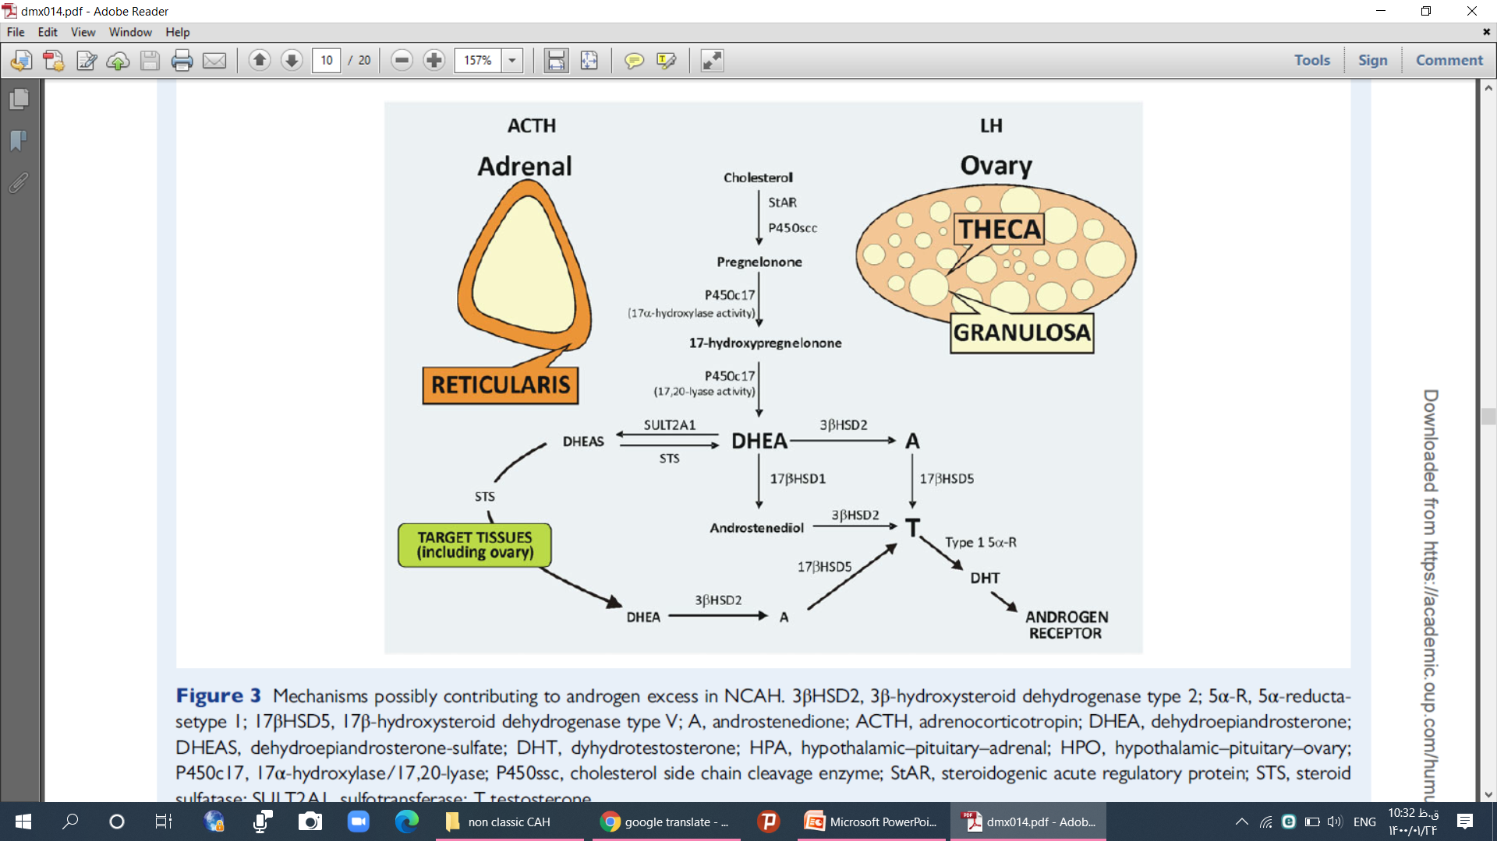

Slide 40
Cortisol response to ACTH
Normal response to ACTH
A sluggish cortisol response to prolonged ACTH stimulation
Over-responsive glucocorticoid response to ACTH stimulation

Slide 41
Adrenomedullary function
Adrenomedullary function in NCCAH was not significantly different from that in normal controls
Hence, should not be at increased risk of developing hypoglycaemia

Slide 42
PCOs like features
prevalence PCOS-like features is disputed
No consensual definition of PCOs
PCOs is far more common than NCCAH
The prevalence of CAH in women who present with apparent PCOs is variable
in two different regions of Turkey, the prevalence ranged from 9.5 to 66 percent

Slide 43
Distinguish NCCAH and PCOs
Basal levels 17-OHP may overlap
ACTH stimulation testing works well to distinguish between the two
Exaggerated ratio of LH to FSH was less frequent

Slide 44
Distinguish between NCCAH and PCOS
Insulin resistance may be more severe, but probably not more common in polycystic ovarian syndrome
Obesity is more common in women with polycystic ovary disease
Polycystic ovaries on ultrasound are less common in NCCAH 40 versus 70%
Sonography showed that 25% of women with NCCAH had a PCOs morphology

Slide 45
PCOs-like features
Despite good adrenal control of hyperandrogenism by GC
Gonadotropin abnormalities persisted
suggesting the effect of prenatal masculinization on neuroendocrine function
This mechanism may not be pertinent to NCCAH,
Because hyperandrogenism appears later and is milder

Slide 46
Who Should be Tested?
Children with
premature pubarche
or accelerated growth velocity (crossing growth percentiles) with advanced bone age

Slide 47
Who Should be Tested?
patients with adrenal incidentaloma or bilateral adrenal masses with a history consistent with NCCAH
Family history of CAH

Slide 48
Who Should be Tested?
Women
Women with oligomenorrhea
Hyperandrogenism (acne and/or hirsutism)

Slide 49
Who Should be Tested?
All women who present with a PCOS-type picture
Higher-risk groups including Mediterranean, Hispanic, and Ashkenazi Jewish women.

Slide 50
DIAGNOSIS
Children
17-OHP >2 ng/ml taken at 8:00 AM has 92 to 98 % sensitivity and specificity for NCCAH
17-OHP< 1.15 ng/ml for prepubertal children excludes NCCAH with approximately 95 % confidence.

Slide 51
DIAGNOSIS
A slightly high level 17-OHP 1.15-1.5 -2 ng/ml is atypical but consistent with premature pubarche
The patient should be followed clinically to determine if further testing is indicated
If the clinical picture suggests progressive bone age advancement or virilization
ACTH test should be done

Slide 52
DIAGNOSIS
A moderately 17OHP 2-15ng/ml
suggests possible NCCAH.
An ACTH test is recommended to confirm the diagnosis
.

Slide 53
DIAGNOSIS
A basal 17-OHP level over 5 ng/mL is regarded as a quite high value

Slide 54
DIAGNOSIS
17-OHP 10 -15 ng/ml
suggests possible NCCAH.
An ACTH Stimulation test is recommended to confirm the diagnosis
A very elevated 17-OHP >15 ng/ml is diagnostic of NCCAH.

Slide 55
Diagnosis of NCCAH
Adult women
a basal 17-OHP >2 ng/ml is strongly suggested and confirmed with an ACTH Stimulation test
For initial screening, a morning (7:30 to 8 AM) serum 17-OHP should be obtained during the follicular phase of the menstrual cycle if the woman is cycling regularly.
For women with amenorrhea or infrequent menses, the sample can be drawn on a random day
.

Slide 56
Diagnosis of NCCAH
A basal value between 1.7 and 3.0 ng/mL is sufficient for diagnosis
A 17OHP value of >1.70 ng/ml is suggestive of NCCAH in an anovulatory cycle

Slide 57
ACTH Stimulation test
An abnormal screening test is not diagnostic but requires a cosyntropin stimulation test to confirm the diagnosis of CAH, unless the basal 17OHP level is >10 ng/ml

Slide 58
ACTH Stimulation test
. ACTH stimulation test (250 ug of cosyntropin i.v.), with a measurement of 17OHP & cortisol at 60 min.
This is considered to be the gold standard for the diagnosis
ACTH is applied intramuscularly or intravenously in a dose of 250 ug/1.73 m2 and a second sample is taken after 60 minutes

Slide 59
ACTH Stimulation test
if the result test is between 10 -15 ng/ml
This range is inconclusive, and the diagnosis should be confirmed with genotyping of the CYP21A2 gene
The response to ACTH is exaggerated in NCCAH
17-OHP exceeding 15 ng/ml confirms the diagnosis
Cortisol level of less than 18ug/dl might justify daily glucocorticoid supplementation and defined a condition at risk of adrenal failure in stress situations

Slide 60
ACTH Stimulation test
post-ACTH cutoff 17-OHP
>15 ng/ml Diagnosis confirmed
>10 ng/ml False-positive rate is high.
Considered to be diagnostic
Adrenal incidentalomas
10 - 15 ng/ml we perform genotyping
Heterozygotes mutations
functional ovarian and/or adrenal hyperandrogenism
< 10 ng/ml Excludes NCCAH

Slide 61
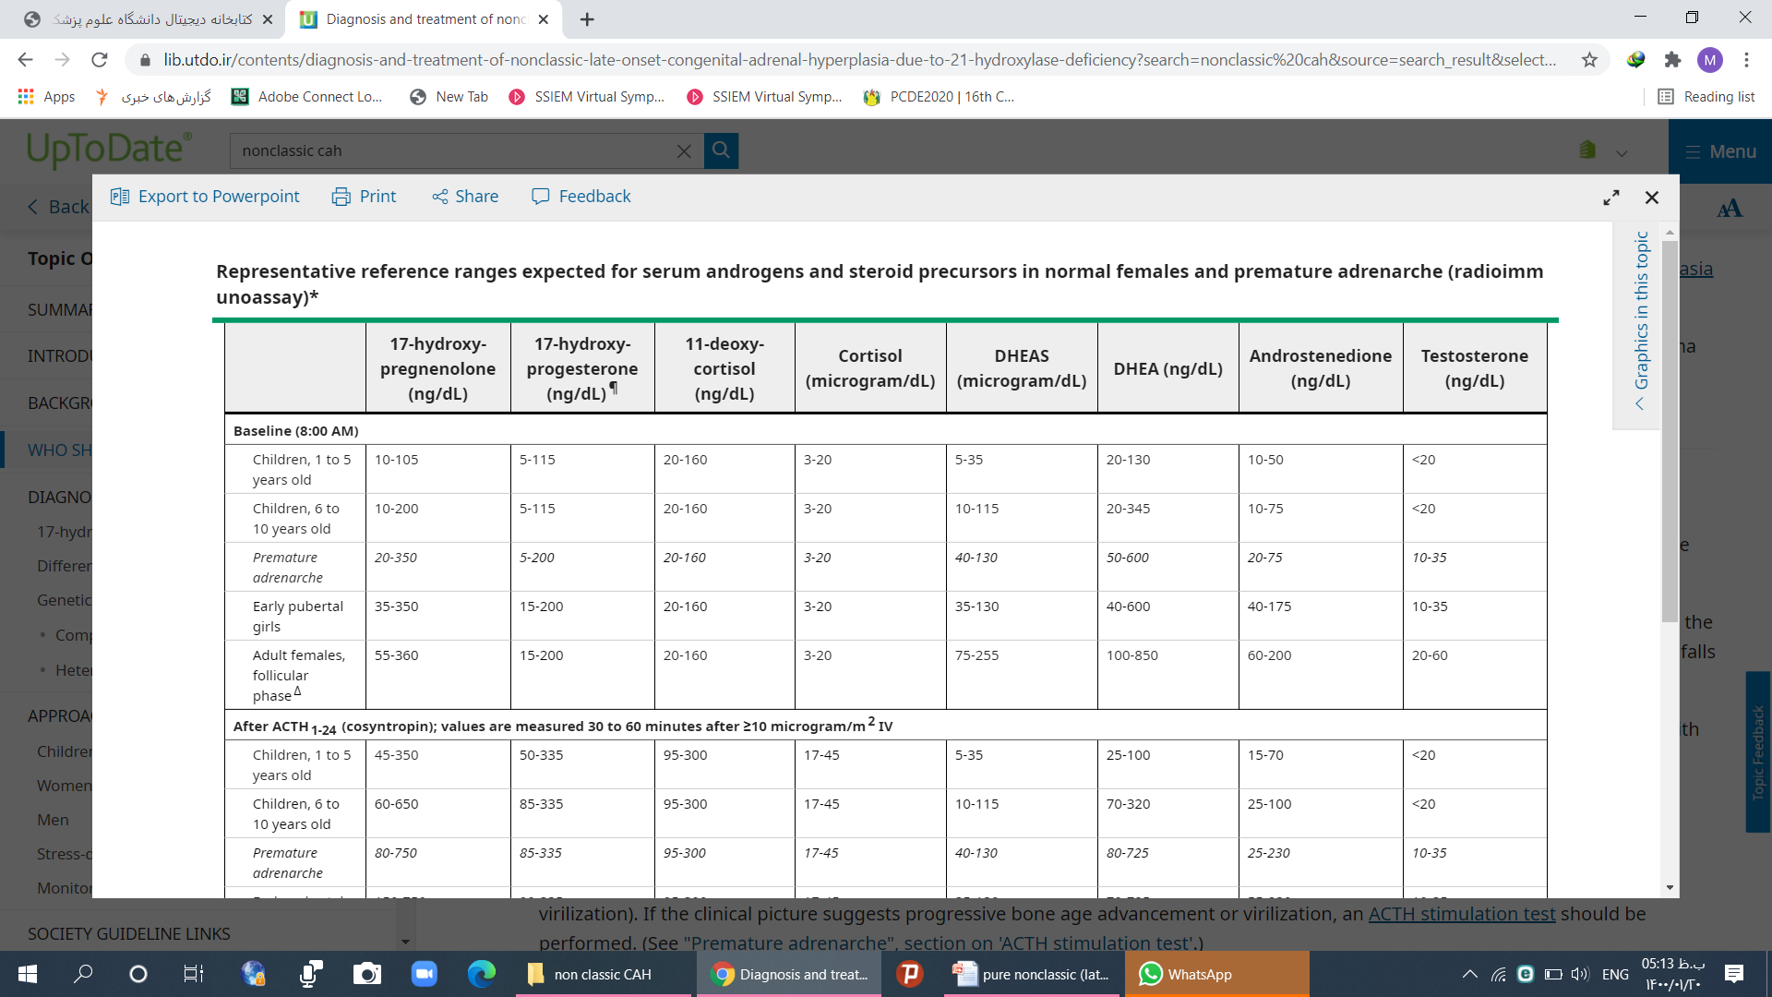

Slide 62
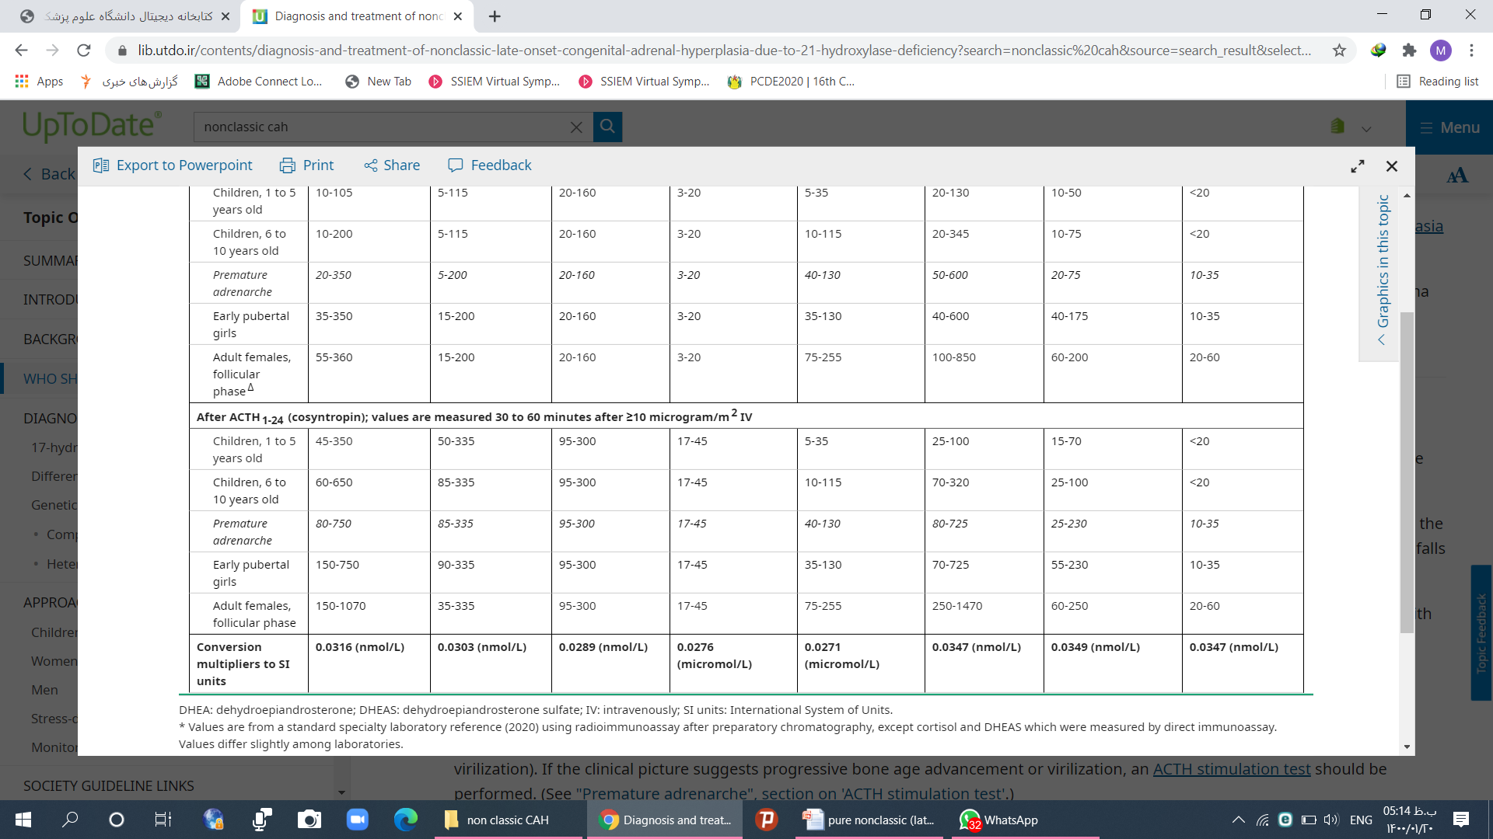

Slide 63
Fertility Planning
Need genetic testing of the prospective parents
Females with NCCAH who desire to conceive should be aware of the risk of giving birth to an infant with the classical form of the disease.

Slide 64
Genetic mutations
To date, over 200 CYP21A2 mutations have been reported
Approximately 10-19 mutations account for the majority of affected alleles

Slide 65
Genetic testing
Genetic testing is not considered to be a primary diagnostic tool for NCCAH.
it may be used when biochemical results are borderline or when genetic counseling is needed prior to conception
Genetic analysis can be a useful adjunct to newborn screening for family studies
To accurately distinguish between heterozygous mutation carriers and affected individuals

Slide 66
Genetic testing
If genetic testing has not been performed by a couple prior to conception
The birth of an affected infant should prompt consideration of genotyping and consideration of prenatal diagnosis in subsequent pregnancies.

Slide 67
Genetic of NCCAH
Compound heterozygotes
Homozygotes
Allowing for 20 to 60 % of normal enzymatic activity

Slide 68
Compound heterozygotes
Two-thirds of NCCAH patients are compound heterozygotes
The majority of patients carry one mutation causing severe enzyme deficiency(<2% wild-type activity) in one allele( classic mutation ) and one mutation encoding a mild defect in the other allele (20–50% of wild-type activity)

Slide 69
Homozygotes
. Approximately 25–50% of individuals with NCCAH are reported to have mild mutations on both alleles

Slide 70
Risk of classic CAH in offspring
The overall risk of
Severe (classic) 21-hydroxylase deficiency in a child of a mother with the Compound heterozygotes has been estimated at 2.5%
while the risk of NCCAH is 15%
The risk to the child will depend on whether the father is a heterozygote or not
if this is the case, whether he bears a mild or severe allele.
Antepartum maternal glucocorticoid suppression be recommended
Classic CAH risk: 1/60*1/2*50%*1/2= 1/480
Non Classic CAH risk:1/16*1/2*100%= 1/32

Slide 71
Risk of classic CAH in offspring
Women who carry the classic (severe) mutation whose partner also carries the classic mutation are at risk of having an infant who is homozygous for the severe mutation.

Slide 72
Risk of classic CAH in offspring
If the NCCAH-affected mother is a homozygote with two mild alleles
There is no risk that her daughter will have classic CAH
Although she may have NCCAH if the father is heterozygous for the CYP12A2 mutations

Slide 73
Risk of CAH in offspring
The predicted chances of parents if mother is Compound heterozygotes
Giving birth to a child with CAH is 1 in 120 for unknown paternal genotype
zero if the father has no relevant mutation
½ CAH if father has a heterozygous mutation
¼ classic CAH if father has a classic mutation
. As a result, genetic testing of the partners of these women is essential to assess the risk of giving birth to a child with the classical form of CAH
Risk of CAH =1/60*1/2*100% = 1/120

Slide 74
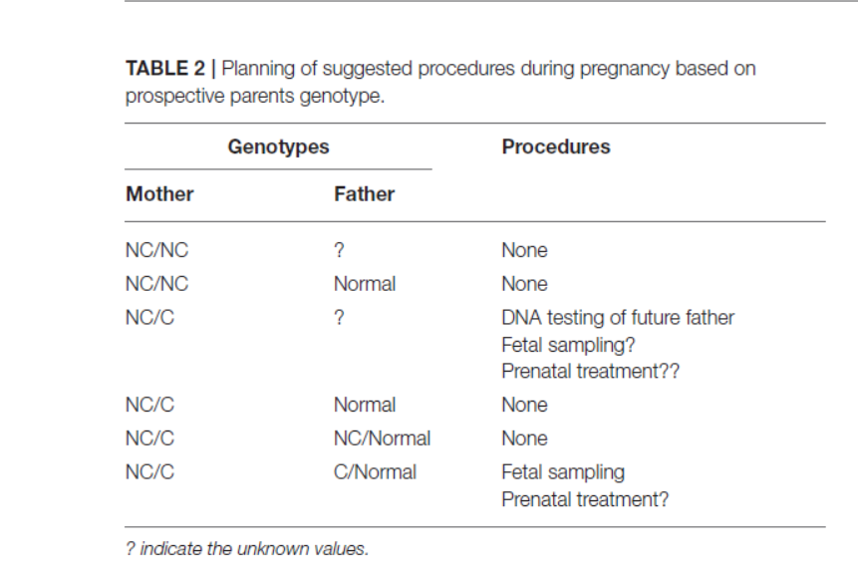

Slide 75
it should be noted that carrier status is 2–15% in different populations and half of these individuals carry a severe mutation.

Slide 76
Heterozygote carriers
it is important to document the presence of a carrier state for genetic counseling
Biochemical testing has been used to identify heterozygote carriers
But results may be misleading and do not correlate well with results of genotyping.

Slide 77
Heterozygote carriers
No clear consensus as to whether heterozygote carriers are at increased risk of developing hyperandrogenic symptoms.
In several studies of women with hirsutism, 8 to 30% were identified as heterozygote carriers
The frequency of heterozygote carriers has been reported to be about 1 in 60 to 80 in some studies but closer to 1 in 10 in another study

Slide 78
Heterozygote carriers
we should keep in mind that about half of subjects with premature pubarche may be heterozygote carriers of a CYP21A2 mutation

Slide 79
Heterozygote carriers
ACTH-stimulated
17-OHP may be exaggerated and even overlap with some nonclassic patients
Exhibit slightly elevated 17 OHP levels post ACTH stimulation
Overlap with unaffected subjects

Slide 80
Genotype versus phenotype
Women who are compound heterozygotes usually have the phenotype associated with the less severe of the two genetic defects
Obligate heterozygote carriers may have mild biochemical abnormalities, but no clinically important endocrine disorder.

Slide 81
Genotype versus phenotype
Despite these general correlations
CYP21A2 deficiency phenotype does not always correlate precisely with the genotype, suggesting that other genes influence the clinical manifestations
Correlation between Genotype versus phenotype
for the null genotype form 100%
for the simple virilising form 95%
for NCCAH 70%

Slide 82
Treatment
Clinical features should guide management
Hormonal and molecular findings do not necessarily predict clinical severity

Slide 83
Glucocorticoid Treatment in Children
Glucocorticoids should be administered to children with
Early-onset or rapid progression of pubarche
And/or accelerated growth velocity
with bone maturation significantly advanced (two or more years advanced) to adversely affect adult height
Early and inappropriate pubertal onset with rapid progression of adrenarche
Episodes with severe exaggerated fatigue during inter-current illnesses

Slide 84
Which children should not be treated?
Premature pubarche without advanced bone maturation can be monitored every six months without treatment
Apocrine body odor alone is not an indication for treatment
Asymptomatic children who are diagnosed genetically due to family genotyping studies do not require treatment

Slide 85
Glucocorticoid Treatment in children with a suboptimal cortisol response
Synacthen/ cosynthropin stimulated cortisol <18ug/dl
One-third of the diagnosed patients with NCCAH have a partial cortisol insufficiency
Glucocorticoids can be recommended during severe illness at least for those with a suboptimal stimulation response
There is a need for increased glucocorticoid doses and sometimes i.v. administration during stress
Routine systemic hydrocortisone not recommended

Slide 86
Glucocorticoid Treatment in Children
Chronic glucocorticoid suppression may also be recommended in those NCCAH patients whose adrenals are hyperplastic adenomatous on computed tomography to prevent any further growth

Slide 87
Glucocorticoid Treatment in Children
Children with precocious puberty
in some cases, elevated androgen may lead to secondary activation of GnRH axis, leading to precocious puberty.
In such a case, a parallel course with GnRH analog may be prescribed if
Bone age is significantly higher than chronological age
And/or projected final height is disproportionate to target height

Slide 88
GH prescription
GH prescription resulted in attainment of target height
The above-described therapy is recommended only for those the predicted height SD is −2.25 < the target height or even lower

Slide 89
Glucocorticoids treatment
in children, hydrocortisone 6 -10 to 15 mg/m² divided into three daily doses.

Slide 90
Children follow up
.
Bone age every 1 years
Central obesity
Regarding biochemical/ hormonal profile
Poor growth as well as Cushingoid features means over dosage of GC
Blood pressure
Weight
Growth velocity, every 3–12 months

Slide 91
Hormonal follow up
Androstenedione and testosterone levels in the mid to upper ranges for bone age are considered better markers of adequate GC replacement therapy in children with NCCAH
DHEAS values are decreased with very small doses
whereas the suppression of 17 OHP levels requires very high GC doses.
It should be noted that 17 OHP values are crucial for the diagnosis, but not helpful during follow–up
. However, due to the perplexity of the disease and its multifaceted nature, there are no specific guidelines for the timing of regimen changes or cessation of glucocorticoid therapy in children.

Slide 92
Discontinue GC therapy
Treatment may be discontinued during
Early to mid-puberty for boys
Two to three years postmenarche for girls
When boys reach Tanner stage 3 (testis volume 8-10 mL),
Hydrocortisone is discontinued and normal development of pubertal height is ensured

Slide 93
Discontinue GC therapy
According to the Endocrine Society guidelines
NCCAH patients should be given the option to discontinue GC therapy when symptoms resolve
These patients should not be lost to follow-up, while treatment should be reinitiated in the event of recurrence of the symptoms.

Slide 94
Goals of treatment in adolescent & adult female
A patient oriented approach is highly recommended
Focusing on the main complaints of the patient
Regular menstrual
Slowing the progression of hirsutism
Decrease Acne
improvement of fertility

Slide 95
Indications for treatment During Adolescence& adult females
Severe acne
Hirsutism
Androgen alopecia
Clitoromegaly
A history of growth acceleration in the absence of central puberty and markedly accelerated bone age
Episodes of exaggerated fatigue during illnesses
Menstrual irregularities persisting more than 2 years after menarche
Oligomenorrhea,
Primary amenorrhea
Synacthen/ cosynthropin stimulated cortisol <18ug/dl
Fertility issues

Slide 96
Hyperandrogenism Treatment
Most available data suggest that, in these patients, both peripheral androgen blockade or ovarian androgen suppression are more effective than glucocorticoids in reducing circulating androgens

Slide 97
Hyperandrogenism Treatment
OCs, which suppress ovarian androgens, also suppress ACTH and adrenal androgens
More effective for hirsutism than glucocorticoids
Antiandrogens, such as spironolactone, are also effective, but we suggest against antiandrogen monotherapy because of their potential teratogenicity
Spironolactone is the most commonly used
while cyproterone acetate is typically used in other countries

Slide 98
Glucocorticoids Treatment in adolescence& adult females
Glucocorticoids alone may not be sufficient to improve their hyperandrogenism, particularly if they have developed PCOS-like features and ovarian hyperandrogenism
Long-term treatment with GC will improve the androgen symptoms but have complications, such as obesity, insulin resistance, hypertension, osteoporosis and fractures , secondary adrenal insufficiency and the need for stress dosing

Slide 99
Response to Glucocorticoids in adolescence
irregular menses and acne are reversed within 3 months after the initiation of the glucocorticoid
Hirsutism requires nearly 30 months
in adolescence, longer-acting steroids are often used and regimens of 5mg of prednisolone or 0.25mg of dexamethasone are recommended

Slide 100
Treatment of Hirsutism
Hirsutism
The main reason that OCs are first-line therapy
Because hirsutism typically requires long-term therapy, and GC have a number of potential risks and side effects.
OCs decrease in testosterone 40–60%

Slide 101
Treatment of Hirsutism
Hirsutism and acne
We suggest combined estrogen-progestin OCs as first-line therapy for hyperandrogenic symptoms and management of oligomenorrhea. (Drospirenone )
Antiandrogens can be added if the response to OCs is inadequate.

Slide 102
Treatment of Hirsutism
In two trials in women with NCCAH
GC were more effective than an OCs or a antiandrogen (cyproterone acetate),
for suppressing adrenal androgen [DHEA, DHEAS but less effective for decreasing hirsutism scores
CPA associated with ethinylestradiol was found to
be superior to dexamethasone

Slide 103
Treatment of Hirsutism
In cases with severe hirsutism,
A course of 6 to 12 months with OCs
Effects of OCPs on SHBG liver production and the decrease of androgen release from the ovary.
Clinical improvement will be expected following at least 2–3 months of OCPs initiation
If OCPs fail as the first line approach
Antiandrogens spironolactone, flutamide, bicalutamide, cyproterone acetate, and finasteride may be added
Bicalutamide has achieved significant improvement in cases of severe acne

Slide 104
Treatment of oligomenorrhea
If fertility is not desired, we suggest OCs agents rather than GC therapy for menstrual cycle management
GC restore ovulation and regular cycles, they do not provide contraception

Slide 105
Glucocorticoid treatment in Women
Glucocorticoid therapy should only be used for those who
Do not respond to OCs and antiandrogen therapy
or cannot tolerate OCs and antiandrogen therapy
Dexamethasone 0.25 mg given once daily or prednisone 4 to 6 mg per day
The lowest dose that ameliorates the sign or symptom being treated should be used

Slide 106
Anovulatory infertility
We suggest GC as the initial treatment for ovulation induction
After the start of hydrocortisone treatment, most women (78%) became pregnant without ovulation stimulation
Clomiphene citrate added if glucocorticoid therapy alone is ineffective
Dexamethasone is not inactivated by placental HSD11B2
we suggest, hydrocortisone, prednisone for ovulation induction

Slide 107
Management of pregnancy in NCCAH
Early pregnancy losses might be lower when patients are on glucocorticoid therapy and these data support continuing GC during pregnancy
.

Slide 108
Treatment During Pregnancy
At the time of conception, the hydrocortisone dose should be increased to 20–25 mg/day ,prednisone dose of 2.5–5 mg/day and dose modifications are carried out every 6–8 weeks with the aim of keeping testosterone levels at the upper normal levels of the pregnancy trimester
Regular clinical check-up, including control of blood pressure and gestational diabetes, are recommended

Slide 109
Treatment after pregnancy
GC may be discontinued when an adult woman no longer seeks fertility.
Switching to OCs in women being treated only for oligomenorrhea and/or hyperandrogenism

Slide 110
Treatment in men
TARTs
infertility
Severe acne
Episodes with severe exaggerated fatigue during inter-current illnesses
Synacthen/ cosynthropin stimulated cortisol <18ug/dl

Slide 111
Treatment in men
Treatment is not necessary for men unless there is oligospermia
we suggest starting with dexamethasone 0.25 mg or prednisolone 4 to 6 mg per day
While testicular adrenal rest tumors and infertility are common in men with classic CAH,
They are thought to be very rare in men with NCCAH.
Testicular ultrasound in males every 5 years

Slide 112
Stress-dose glucocorticoids
Stress doses of GC are not required for patients with NCCAH unless they have been receiving GC therapy, which could suppress their hypothalamic-pituitary-adrenal axis

Slide 113
Monitoring treatment for NCCAH
Standards have not been established
Goal of treatment is normalizing androstenedione and testosterone levels not 17-OHP in the mid to upper ranges for bone age
17 OHP values are crucial for the diagnosis, but not helpful during follow–up
.

Slide 114
Monitoring treatment for NCCAH
In both children and women,
17-OHP
Androstenedione
Testosterone
Sex hormone-binding globulin
Fasting glucose (or HbA1c)

Slide 115
Monitoring treatment for NCCAH
Suppressed 17-OHP indicate overtreatment
17-OHP two or three times the upper limit of normal is acceptable
in females, a ratio of testosterone to sexual hormone globulin (SHBG) of less than 0.05

Slide 116
Monitoring treatment for NCCAH
At least annual physical examination
Symptoms and signs of Cushing's syndrome.
Measurements of bone mineral density periodically to look for bone loss every 3–5 years if on glucocorticoids

Slide 117
BMD
in children &adults with NCCAH had a normal BMD or at least a better one than adults with a classic CAH
Other studies found decreased BMD in NCCAH, compared to classic CAH
patients with NCCAH have appeared to have fewer fractures than those with classic forms

Slide 118
Obesity
The frequency of obesity did not differ between patients with NCCAH and classic CAH in some studies
Some studies lower BMI in patients with NCCAH
increased lean mass and decreased fat mass, compared to children with classic CAH

Slide 119
Cardiovascular disease and diabetes
Cardiovascular diseases were more common than in controls, especially stroke
Heart failure and venous thromboembolism
There was a tendency for gestational diabetes
Type two diabetes was four times more frequent
insulin resistance
Reduced insulin sensitivity
Increased intima media thickness as a marker of atherosclerosis

Slide 120
Blood pressure
Systolic blood pressure in children and adolescents is elevated
Elevated systolic blood pressure correlates with the degree of overweight and obesity
In adults more common especially in men with elevated 17OHP

Slide 121
Psychiatric diseases
phobic anxiety disorders were increased in women with NCCAH
Psychotic disorders in males with NCAH compared to controls

Slide 122
Voice pathology in females
Prolonged hyperandrogenism may affect the laryngeal tissue mass
Among the women, 50% had, subjectively, a ‘dark’ (low-pitched) voice

Slide 123
Mortality
Two-thirds died of a cardiovascular condition
One-third of an adrenal crisis
But all with a cardiovascular condition had a concurrent infection noted on the death certificate
Thus, all deaths in NCCAH patients may have been related to an adrenal crisis

Slide 124
Adrenal tumors
Adrenal incidentaloma have sometimes been the initial presentation of NCCAH
of these women will demonstrate radiological evidence of adrenal abnormalities 40–50%
Adrenal adenomas are a frequent finding

Slide 125
Key point
We recommend screening for NCCAH due to 21-hydroxylase deficiency in all patients presenting with signs and symptoms of androgen excess
We recommend the clinical diagnosis of NCCAH due to 21-hydroxylase deficiency to require a circulating 17-OHP above 10 ng/ml either basally or 15 ng/ml after cosyntropin-stimulation.
.

Slide 126
Key point
We recommend CYP21A2 genotyping in patients presenting with circulating 17-OHP above 10 ng/ml with the aim of confirming the diagnosis and identifying severe alleles that may increase the risk of CAH in the offspring of NCCAH patients

Slide 127
Key point
.If these are not available, conducting cosyntropin-stimulation in patients presenting with basal 17-OHP above 2 ng/ml would identify most patients with the disorder.
We recommend against making any conclusion about the CYP21A2 carrier status of any person based on the results of a cosyntropin-stimulation

Slide 128
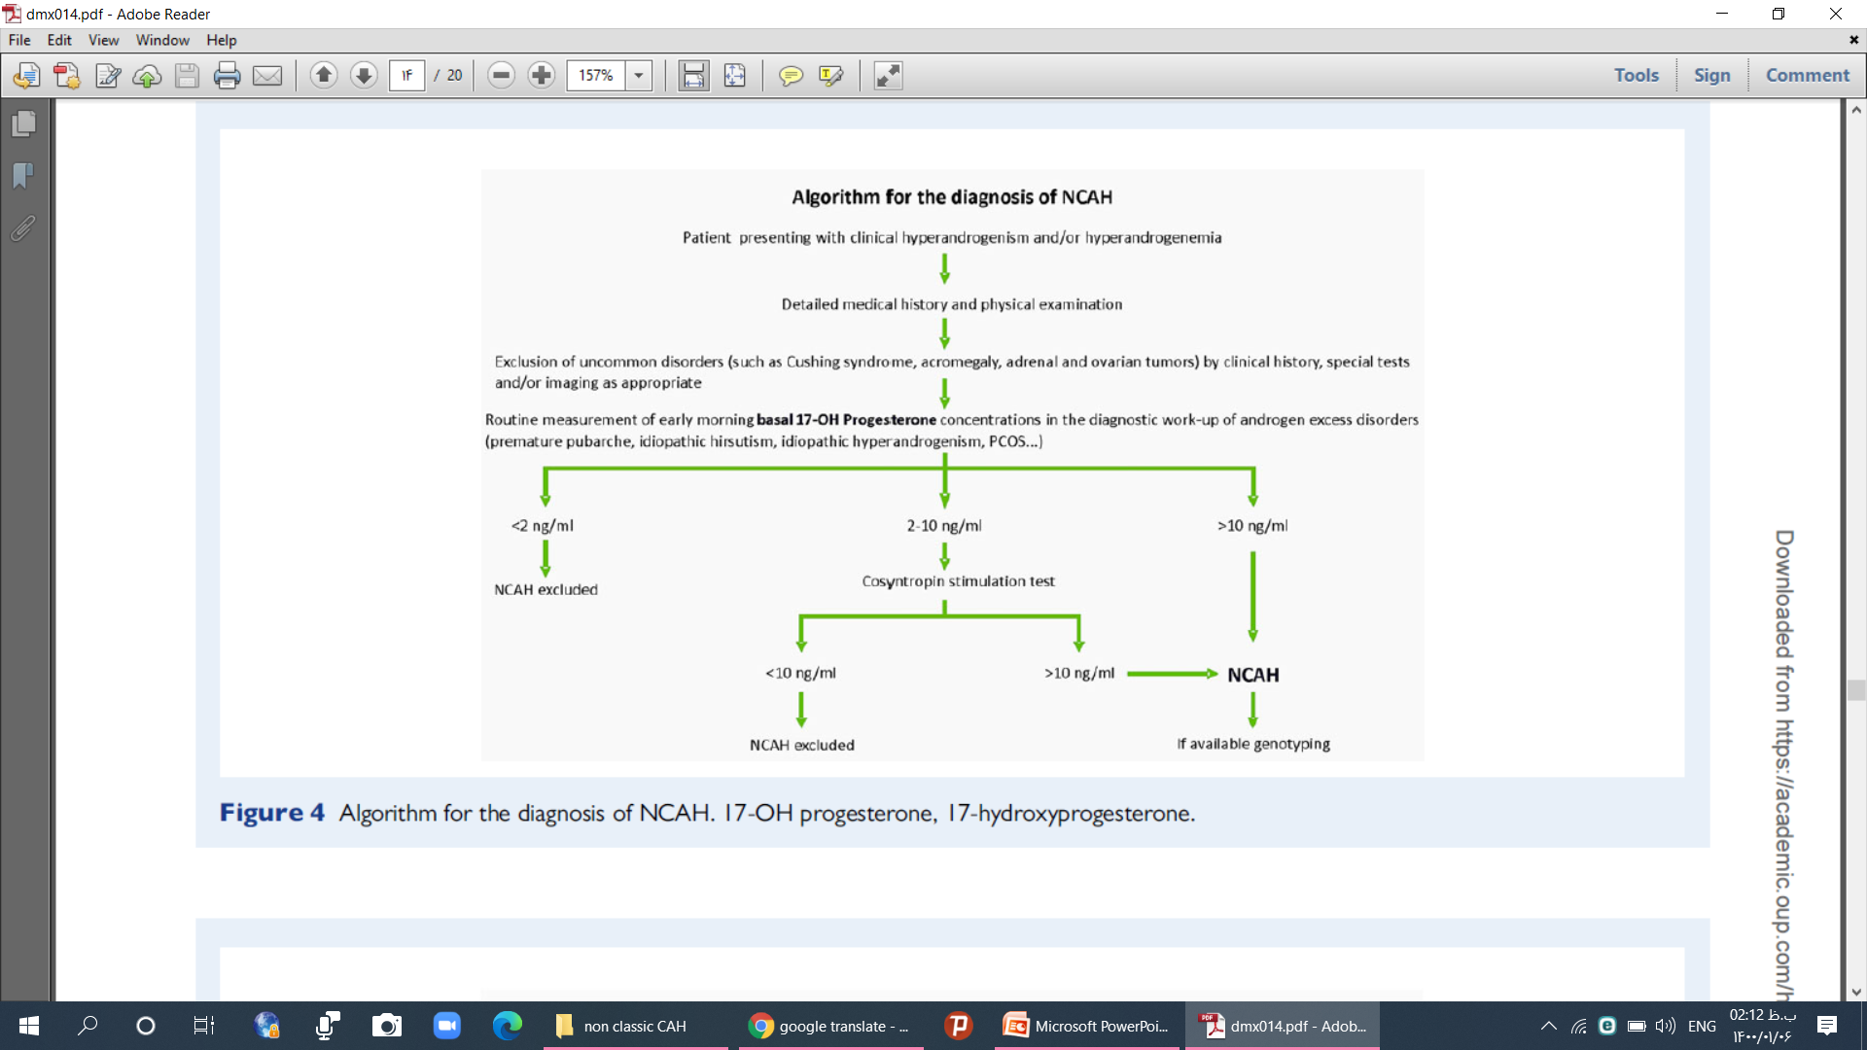

Slide 129
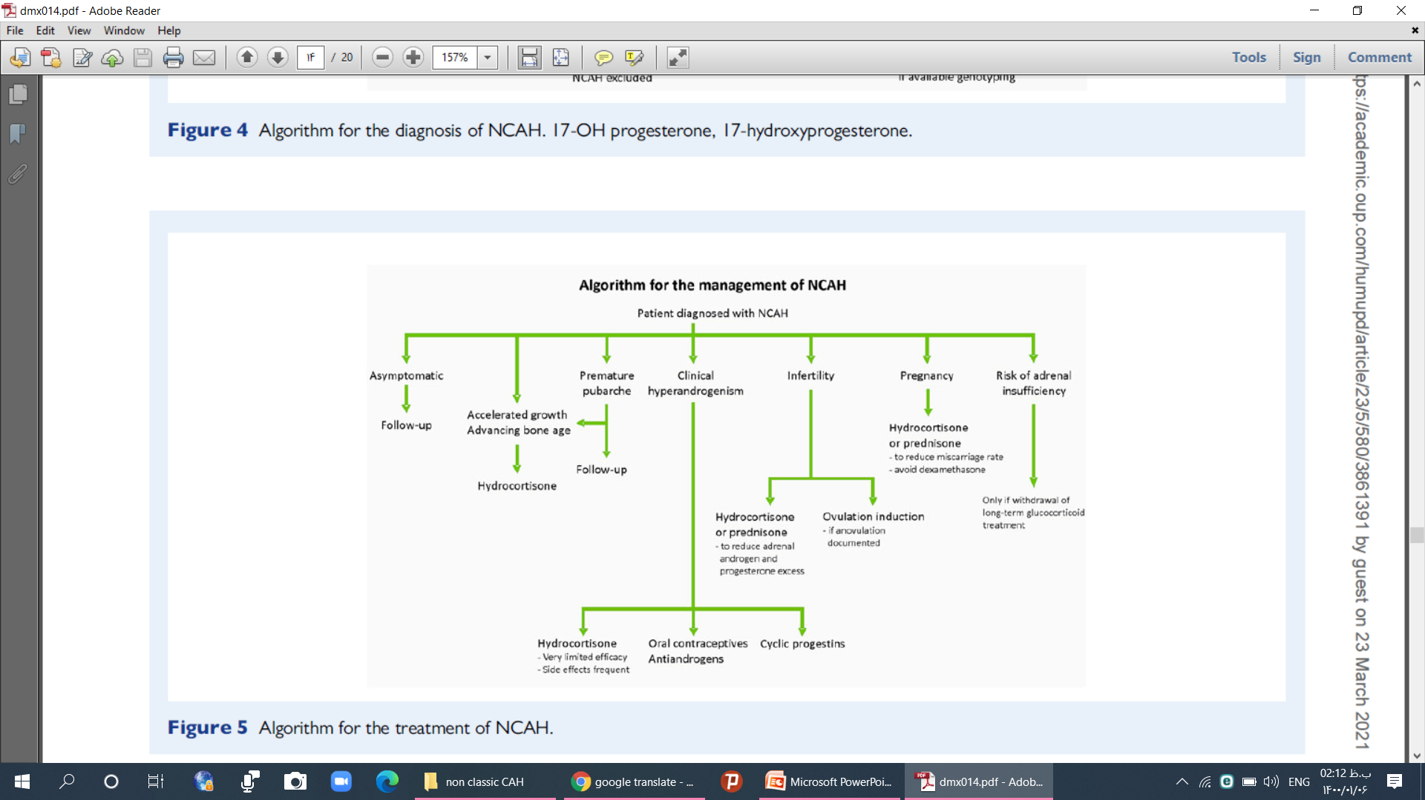

Slide 130
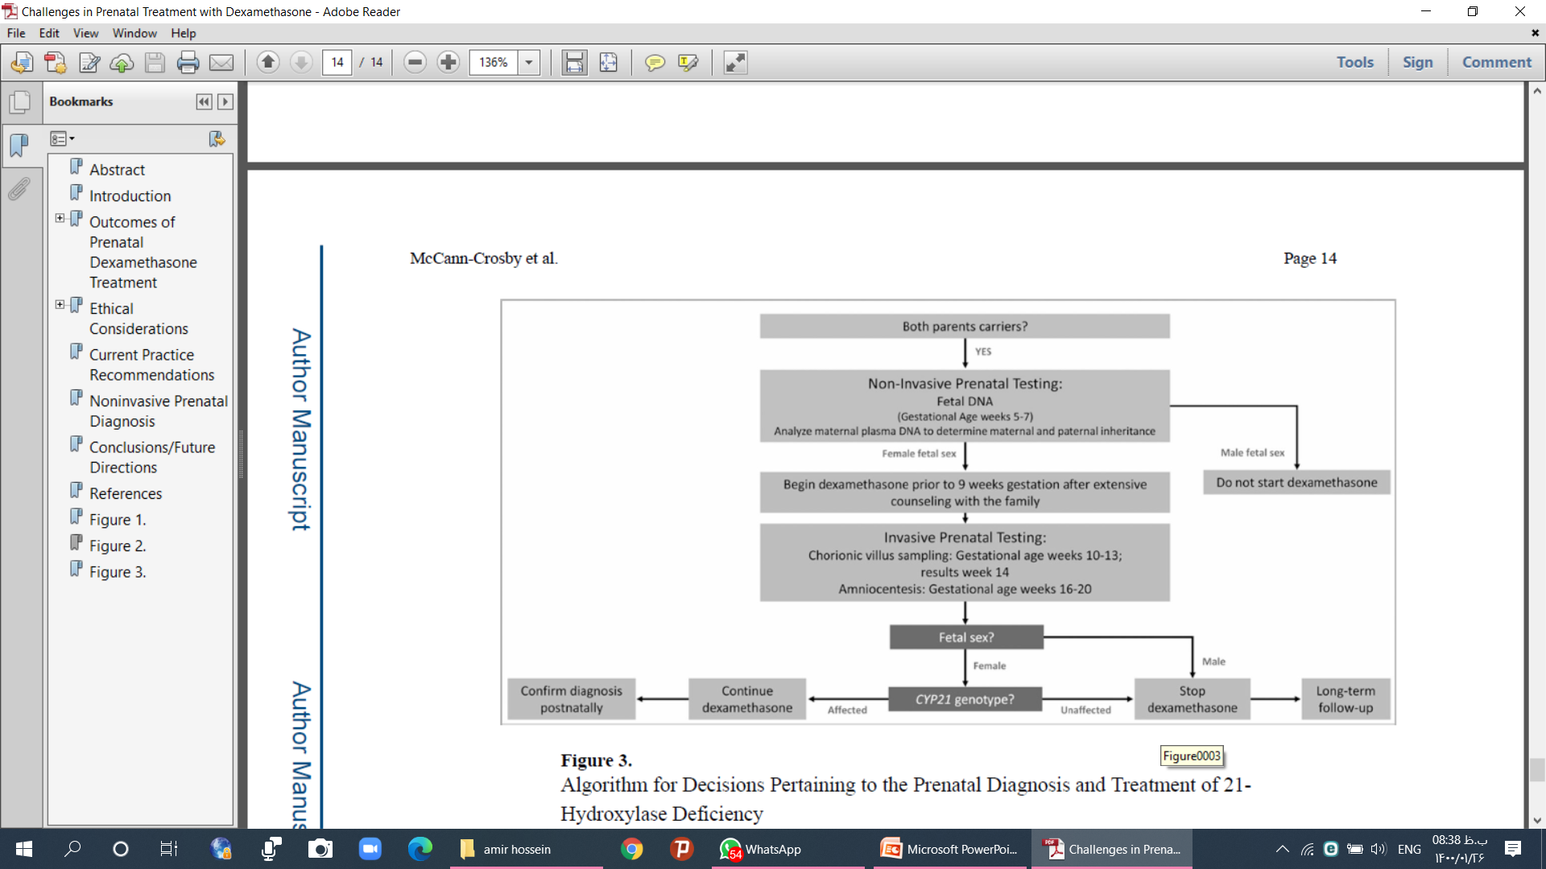

Slide 131
References
up to date 2021
European Journal of Endocrinology (2019
J Clin Res Pediatr Endocrinol 2017
Horm Res Paediatr 2020
Human Reproduction Update 2017
Contemporary Endocrinology: Androgen Excess Disorders in Women: Polycystic Ovary Syndrome and Other Disorders, Second Edition Edited by: R. Azziz et al. © Humana Press Inc., Totowa, NJ
Frontiers in endocrinology 2019

Slide 132


Slide 133
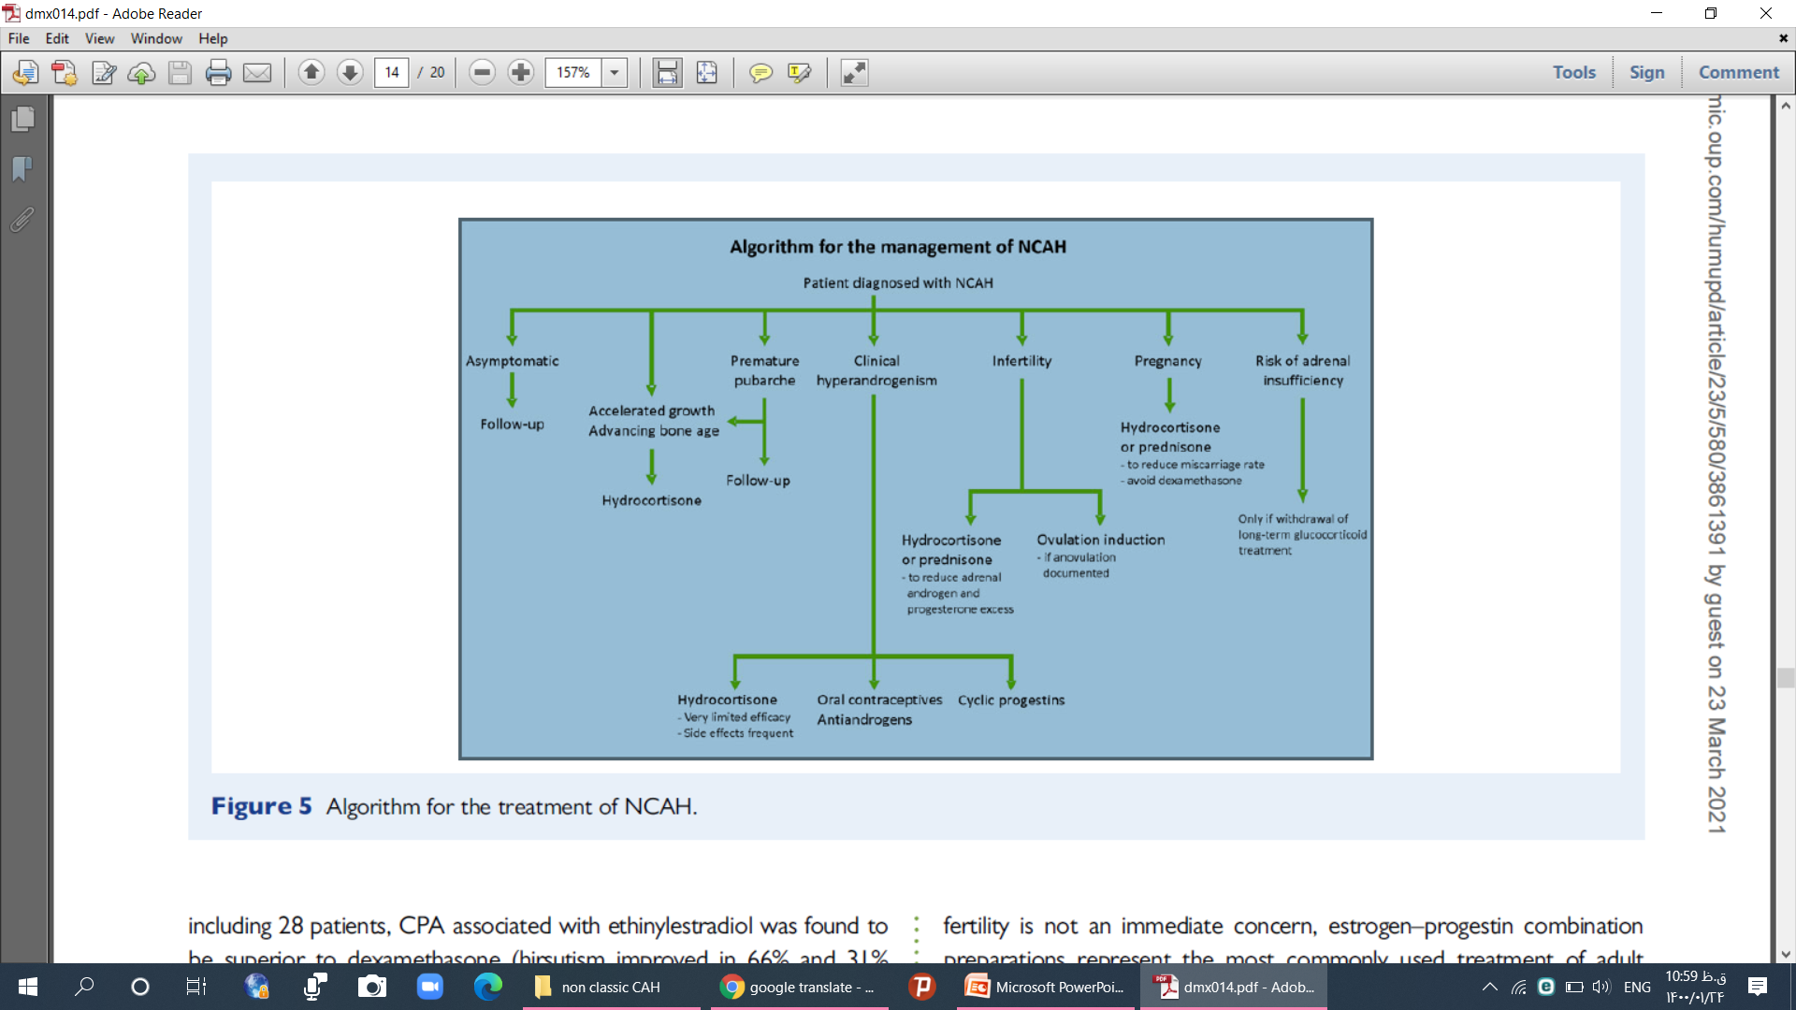

Slide 134
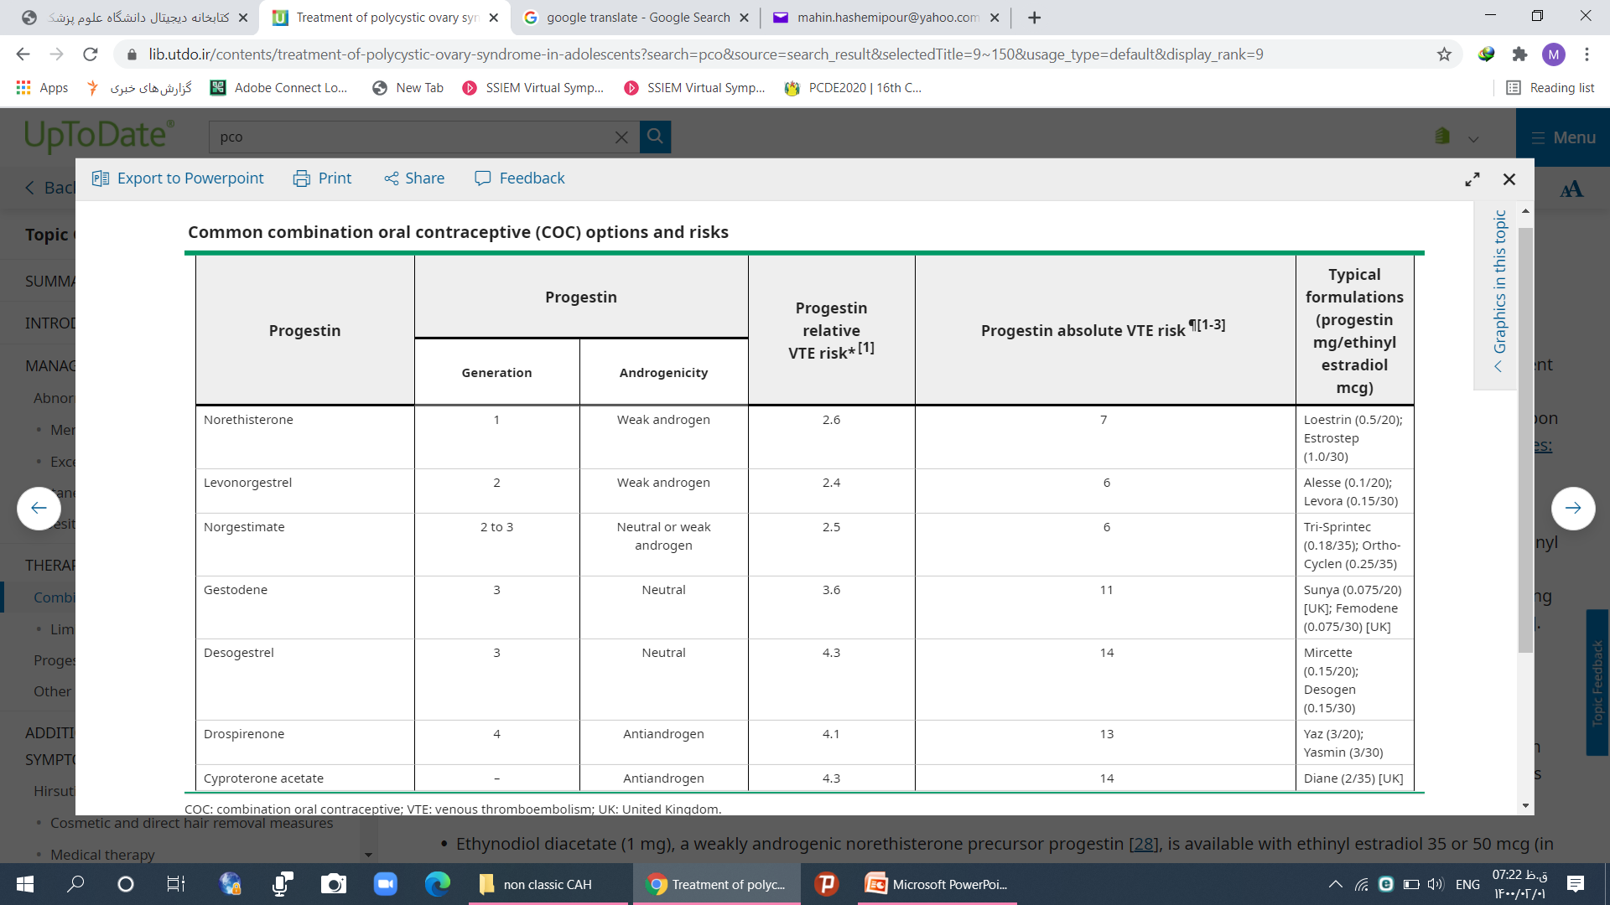

Slide 135
50 درصد بیماران کامپاند هتروزیگوت هستند یک شدید یک خفیف
ناقلی یک جهش شدید در جمعیت یک به 60 است یعنی یک به 60 ممکن است اقا ناقل چهش شدید باشد
  یک خانم کامپاند هتروزیگوت هم به احتمال 50 درصد ناقل یک جهش شدیدباشد
  هر کدام ممکن است یک دوم این را به فرزندشان منتقل کنند احتمتل این که فرزند کلاسیک را بگیرد یک به 480 است این تیوری است
  ولی 2.5 درصد واقعی است در یک جمعیت بررسی کرده اند 2.5 درصد شانس کلاسیک است

Slide 136
primary amenorrhea – Defined as lack of menarche by 15 years of age or more than three years after the onset of breast development.
Secondary amenorrhea – Defined as >90 days without a menstrual period, after previously menstruating.
Oligomenorrhea – During the first five postmenarcheal years, oligomenorrhea is defined as:
Year 0 to <1 postmenarche: Fewer than six periods in the year (average cycle length >60 days between menstrual periods
Year 1 to <3 postmenarche: Fewer than eight periods per year average cycle length >45 days
Year 3 to perimenopause: Fewer than nine periods per year, average cycle length >38 days.

Slide 137
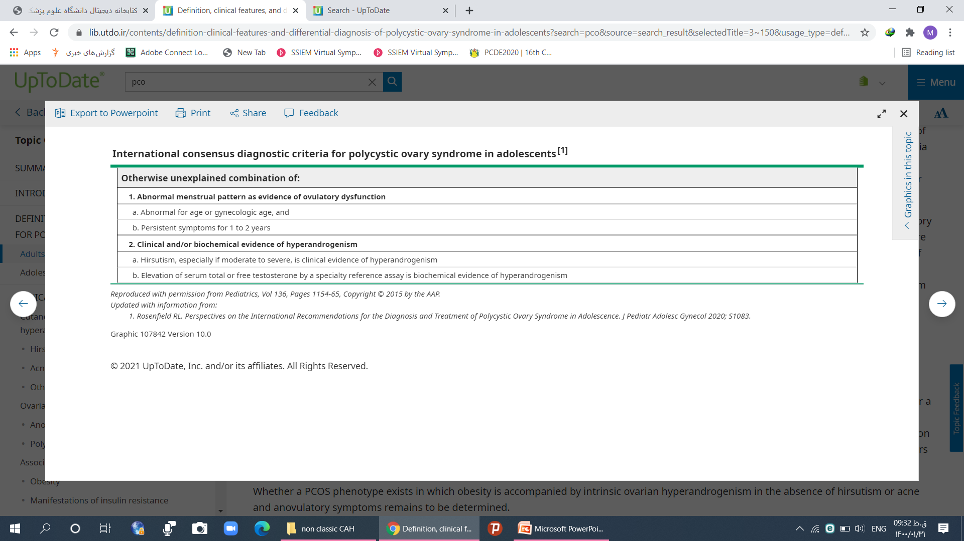

Slide 138
