Slide 1


Slide 2
Physiological and molecular responses to bariatric surgery: markers or mechanisms underlying
T2DM resolution?

Slide 3
Introduction
Obesity and type 2 diabetes mellitus (T2DM) are epidemic in Western societies and are among the most costly and urgent health crises worldwide.
At best, lifestyle intervention achieves only 5% weight loss, and this can increase to 10% if combined with one of the few pharmacotherapy options.
Bariatric surgery is the most effective treatment that targets both obesity and T2DM simultaneously.
In fact, weight loss after bariatric surgery is three times greater than that seen with behavioral modification or pharmaceutical therapy and is sustained over a 10-year period.

Slide 4
Bariatric procedures reduce overall mortality, through the reduction of obesity comorbidities, such as heart disease,cancer, and T2DM.
This surgeries improve T2DM through mechanisms that are at least partly independent of weight loss, as remission in T2DM is often seen before patients are released from the hospital.
The precise mechanisms by which bariatric surgery causes sustained weight loss and resolves T2DM remain elusive.
The original hypothesis for the success of bariatric surgeries was focused on the anatomical changes induced by the respective surgeries.
If a surgery reduced stomach size, then the surgery was believed to cause weight loss by restriction of the stomach and, thus,meal size, consequently limiting the number of calories that could be consumed.

Slide 5
If surgery included rearrangement of the intestinal anatomy, then the surgery was thought to be malabsorptive owing to a loss of calories in the feces.
In fact, the substantial metabolic improvements after bariatric surgery that surpass the effects of weight loss alone have led to these operations to often be referred to as “metabolic surgeries
In addition, there are widespread physiological effects of surgery, including the 10-fold increases in postprandial gut peptide levels,increases in circulating bile acids,changes in the microbiome composition, change in intestinal morphology.

Slide 6
The anatomy of VSG and RYGB
Several variations of bariatric surgery are currently performed;
some alter both stomach and intestinal anatomy, while others only alter stomach anatomy.
Perhaps the best-studied surgery is Roux-en-Y gastric bypass (RYGB).
In this surgery, a small stomach pouch is surgically created from the proximal stomach and sutured to the mid-jejunum, while the remaining 95% of the stomach and the proximal intestine remain in the peritoneal cavity but are bypassed from nutritional access.
In the minigastric bypass, instead of apouch, a long gastric tube is formed and sutured to the mid-jejunum so that nutrient flow will bypass most of the stomach and the upper intestine.
This surgery was designed to be a simpler and safer surgery with fewer major complications as compared with RYGB.

Slide 7
Despite the greater simplicity, the degree of weight loss and improvements in obesity-related comorbidities over a 10- year period are similar to RYGB.
the biliopancreatic diversion with duodenal switch, 70% of the stomach is removed along the greater curvature and the intestine is rerouted similar to RYGB.
This surgery results in robust weight loss and a greater remission of T2DM compared with RYGB yet causes significantly greater macro and micronutrient malabsorption such that malnutrition
bariatric surgeries that do not involve intestinal rearrangement include laparoscopic adjustable gastric banding and vertical sleeve gastrectomy (VSG).
In VSG,80% of the stomach along the greater curvature is removed, and intestinal structure is unaltered.
In contrast, both human and rodent data suggest that VSG is nearly as effective as RYBG for resolving T2DM and inducing sustained weight loss.

Slide 8
Bariatric surgery, glucose homeostasis, and T2DM resolution
The degree of T2DM remission reported after bariatric surgery ranges from 38% to 77%and depends on the type of surgery the duration of disease, and the criteria used to define remission.
the reported rate of remission is greatest with biliopancreatic diversion> then RYGB>, and finally VSG, and is more frequent in patients with greater weight loss and a shorter duration of disease.
That bariatric surgery causes significant improvements in glucose homeostasis.
Early proponents of the weight loss–independent effects of surgery pointed to the rapid resolution of T2DM, which occurs within days postoperatively and before significant weight loss.

Slide 9
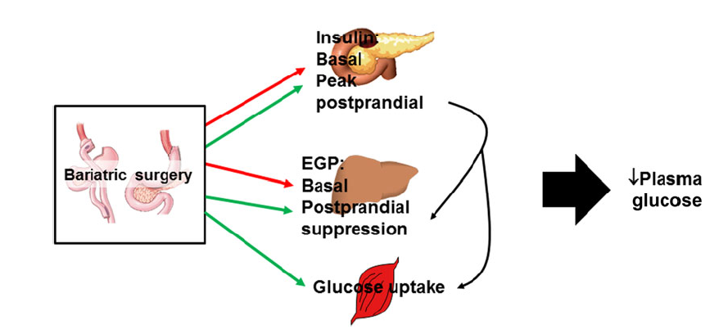

Slide 10
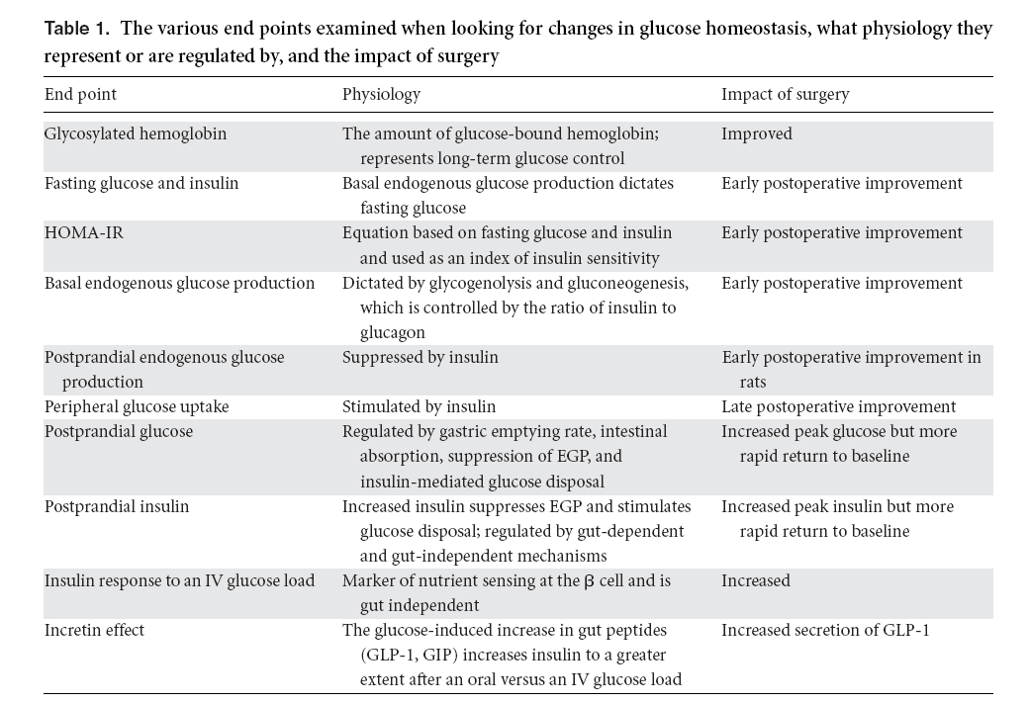

Slide 11
Targeted glucoregulatory processes of bariatric surgery
Regulation of glucose homeostasis is a multiorgan integrative process forwhich bariatric surgery seems to act on several levels (Fig. 1)
Early after surgery (days to 2 weeks) the most robust change in glucose homeostasis in patients with frank diabetes or with impaired glucose tolerance is the reduction in fasting plasma glucose and/or insulin levels and consequently homeostatic model assessment for assessing -cell function and insulin resistance (HOMA-IR).
Some of this rapid improvement could certainly occur through removal of glucotoxicity, which affects insulin secretion and insulin-mediated glucose disposal.
RYGB and VSG both decreased hepatic gluconeogenic gene expression 8 weeks postoperatively.

Slide 12
Gastric emptying is very rapid after both RYGB and VSG, and thus peak glucose levels, in both patients and rodents, are not typically reduced after surgery.
there is a more rapid return to baseline compared with obese control.
These authors also found that branched-chain amino acids, thought to have an independent effect impairing glucose tolerance, were decreased more after RYGB compared with dietary intervention patients.
The amount of insulin secreted in response to a nutrient load is essential to suppress EGP and stimulate glucose clearance.
Postprandial plasma insulin levels are often reported to be elevated after both RYGB and VSG.
To distinguish between the impact of changes in insulin sensitivity and insulin secretion on glucose homeostasis, investigators often use a frequently sampled intravenous (IV) glucose tolerance test where plasma glucose and insulin levels are repeatedly measured after an IV glucose load.

Slide 13
When this was done in patients 3 years postoperatively, RYGB lowered the insulin response to an IV glucose load but increased the response to oral glucose.
Together, these results suggested that gut factors, such as the surgery-induced increases in glucagon-like peptide-1 (GLP-1), are critical for maintaining normal insulin secretion and, consequently, postprandial glucose homeostasis.
In fact, long-term weight loss–adjusted results suggest that weight loss–independent metabolic effects are important early after surgery but that the sustained weight loss is more of a factor for the long-term reductions in basal glucose and insulin and consequent reductions in HOMAIR.

Slide 14
T2DM: cure or postponing
the majority of evidence points to metabolic surgery producing long-term weight loss 20% of patients either fail to lose weight or regain weight after bariatric surgery.
In one study, while 72% of RYGB patients had T2DM remission the first 2 years postoperatively, this was down to 30% of RYGB patients 15 years postoperatively .
These data suggest that bariatric surgery postpones rather than cures T2DM.

Slide 15
Gut peptides
These gut peptides have a variety of functions, including playing key roles in regulating glucose and energy hemostasis.
Ghrelin
Ghrelin is secreted by enteroendocrine cells within the stomach, duodenum, and pancreas and plasma levels are highest during fasting.
Ghrelin acts on receptors within the central nervous system (CNS), such as the hypothalamus and nucleus accumbens, to regulate food reward and long-term energy balance, and is the only GI peptide that, when given exogenously, increased food intake es in humans and rodents.

Slide 16
Exogenous ghrelin administration has also been found to inhibit glucose stimulated insulin release and reduce insulin sensitivity in peripheral tissues.
Bariatric surgeries like RYGB and VSG remove nutrient access to a large portion of the stomach and proximal gut in the case of RYGB, and this led to the hypothesis that removal of ghrelin is an underlying mechanism driving the success of bariatric surgery.
In humans and rodents, plasma ghrelin levels have been found to be substantially reduced after VSG but not after RYGB

Slide 17
GLP-1
GLP-1 is secreted from enteroendocrine L cells in a nutrient-dependent manner
GLP-1 has been shown to increase insulin and decrease glucagon secretion, a hormonal change that has a potent effect on inhibiting EGP and restraining postprandial glucose homeostasis.
GLP-1 also delays gastric emptying and intestinal transit and reduces meal size through a G protein–coupled receptor .
Nutrient-driven increases in plasma GLP-1 are dramatic after both RYGB and VSG, increasing 10-fold over controls in a manner that is both conserved across species.

Slide 18
GLP-1 has therefore been implicated as a mechanism underlying weight loss and improvements in glucose homeostasis after bariatric surgery.
GLP-1 receptors are located on B cells but are also widely expressed in the CNS, and both populations of receptors have been found to play roles in glucose homeostasis
CNS administration of a GLP-1 receptor antagonist in rats had no impact on changes in body mass or food intake in response to RYGB.
Such an outcome indicates that increases in GLP-1 are not necessary for the major metabolic effects of either VSG or RYGB.

Slide 19
there is a small population of patients, primarily after RYGB, that over time has increasing incidence of postprandial hypoglycemia or dumping syndrome, with both autonomic (sweating and heart palpitations) and neuroglycopenic (confusion) symptoms.
Data are accumulating that suggest that enhanced GLP-1 receptor signaling causes patients to be more susceptible to this condition and that administration of a GLP-1 antagonist prevents postprandial hypoglycemia in these patients.
This is an important finding, as dumping syndrome is an extremely limiting complication of RYGB that sometimes leads to surgery revision. Thus, although mouse studies suggest thatGLP-1 is not necessary for the success of bariatric surgery.

Slide 20
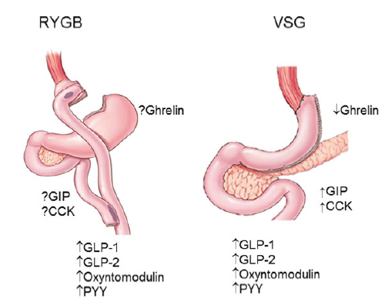
Other GI peptides
OtherGI peptides that have been found to be altered after bariatric surgery include cholecystokinin (CCK), glucose inhibitory peptide, GLP- 2 and peptide YY.

Slide 21
Under physiological conditions, GLP-1 acts primarily to augment insulin secretion after an oral glucose load.
Importantly, GLP-1 has also been shown to decrease glucagon secretion, stimulate the growth and differentiation of pancreatic B-cells, and exert cytoprotective and antiapoptotic effects on B-cells.
It could be hypothesized that in individuals undergoing Roux-en-Y gastric bypass surgery, the exposure to a steadily enlarged GLP-1 response to meal intake could result in the long-term in the development of an inappropriate-cell mass and/or function.
Severe postprandial hypoglycemia with hyperinsulinemia has recently been described as a rare complication of Roux-en-Y gastric bypass.
it has been suggested that an inappropriately enlarged -cell mass and/or -cell function is the histopathological hallmark underlying this complication of Roux-en-Y gastric bypass.

Slide 22
Our study shows, that although the GLP-1 response to meal intake is steadily elevated after Roux-en-Y gastric bypass, this does not necessarily result over time in the development of an inappropriate insulin secretion relative to the prevailing insulin sensitivity.
Moreover, our data suggest that asymptomatic postprandial hypoglycemic episodes in Roux-en-Y gastric bypass operated women do not relate to an inappropriate relationship between -cell function and insulin sensitivity.
It has been proposed that a potential mechanism for that response is the acceleration of gastric emptying and intestinal transit time after this type of bariatric surgery technique.

Slide 23
Our data failed to support the hypothesis that the sustained increase in the postprandial GLP-1 response results in an inappropriate insulin secretion relative to the prevailing insulin sensitivity.
As previously shown by others,we found a paradoxically enlarged glucagon response to meal intake after Roux-en-Y gastric bypass.
Interestingly, the increased glucagon response was observed despite the marked increase in GLP-1, a gut hormone that inhibits glucagon release.
our data would not support an association between Roux-en-Y gastric bypass and a progressive impairment of the glucagon release by the pancreatic a-cells.

Slide 24
Bile acids
Bile acids are derivatives of cholesterol synthesized in the liver and secreted into the duodenum that function to emulsify lipids, enabling digestion and absorption.
After lipid absorption, bile acids remain in the intestinal lumen until they reach the terminal ileum, where they are reabsorbed into the bloodstream and recycled within the liver.
Cholesterol derived primary bile acids are secreted by the liver, while secondary bile acids are a product of bile acid hydroxylation by intestinal microbiota (Fig. 3).
All bile acids can be conjugated to glycine or taurine within the liver to form bile salts.

Slide 25
Bile acid signaling influences several physiological processes associated with improvements in T2DM, including regulation of glucose and lipid metabolism, release of gut peptides, insulin sensitivity, and regulation of energy expenditure.
Bariatric surgery has been shown to alter multiple aspects of bile acid flux, including the amount, the composition, and the circulation of bile acids.
RYGB increased the amount of total and specifically conjugated bile acids within the plasma in a weight loss– independent manner.
In addition, the peaks in plasma bile acids were higher and occurred earlier after a meal compared to weight-matched control patients.
An interesting possibility is that it is not necessarily true that bariatric surgery increases bile acids, but rather that obesity reduces them and surgery returns the levels to normal.

Slide 26
As signaling molecules, bile acids activate two different types of receptors.
One is a nuclear transcription factor called farnesoid X receptor (FXR), which is highly expressed in the intestine, liver, adipose tissue, pancreas, and adrenal gland.
Once activated by bile acids, FXR drives secretion of fibroblast growth factor 19 (FGF19) in humans (or FGF15 in rodents)109 (Fig. 3).

Slide 27
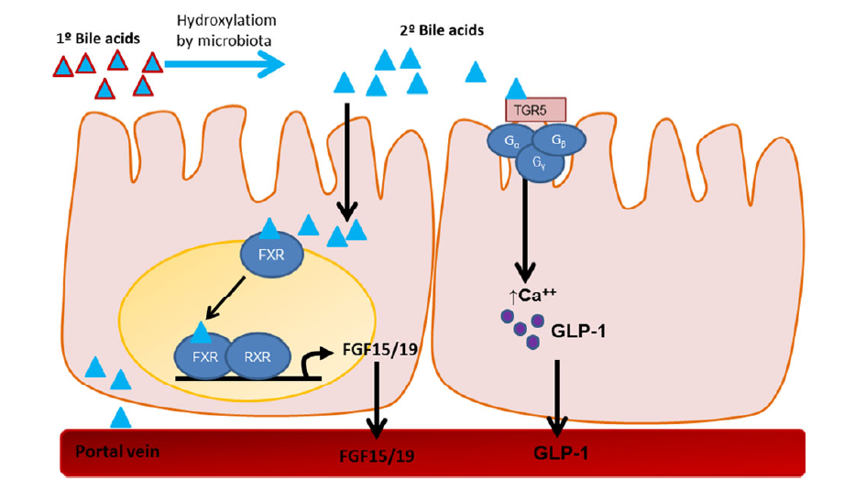

Slide 28
FGF19/15, in turn, enters the circulation and provides negative feedback to inhibit bile acid synthesis in the liver.
FGF19 is significantly increased after RYGB and VSG in rodents and human patients.
Bile acids also activate a cell-surface G protein– coupled receptor called TGR5 (also GPBAR1 (Fig. 3)).
These receptors are mainly expressed in the gall bladder, ileum, colon, brown and white adipose tissue, and to a lesser extent in skeletal muscle, liver, and immune cells.
Bile acids act on TGR5 receptors to increase plasma GLP-1 and also to regulate glucose and lipid metabolism.

Slide 29
While FXR is necessary for both weight loss and improvements in glucose homeostasis after bariatric surgery, TGR5 plays only a partial role.
While we know that bile acids activate both FXR and TGR5, it seems that activation of FXR is a more important overall signaling mechanism underlying the success of bariatric surgery. Thus, targeting FXR signaling is an important avenue for drug development to treat both obesity and T2DM.
Changes in the microbiome
The microbiome houses approximately three trillion bacteria and has been shown to regulate host metabolism.
obesity itself has also been found to alter the microbiome by reducing microbial diversity and bacterial gene richness.

Slide 30
Bariatric surgeries manipulate the intestinal environment and also cause weight loss, and therefore have the potential to either directly or indirectly (through weight loss) influence the balance of bacterial composition and diversity within the gut.
These authors identified a phylum-level compositional shift in the microbiome, with a relative decrease in the abundance of Firmicutes and an increase in the abundance of Gammaproteobacteria in RYGB individuals.
Subsequent studies have found a temporal shift in the microbiome with an increase in the phylum Proteobacteria by 3 months, and this was maintained at 6 months postsurgery compared with pre-RYGB
While all of these data indicate that bariatric surgery is conducive to changes in the gut microbiome, they do not clarify whether this is due to a direct effect of the operation or whether it is indirect via surgery-induced weight loss, the reduced caloric intake, or even changes in macronutrient content of the diet, all factors shown to induce changes in the microbiome.

Slide 31
Short-chain fatty acids, such as butyrate, are fermented by gut bacteria, and recent evidence suggests an association between butyrate-producing bacteria and the beneficial effects on metabolism in both mice and humans.
Furthermore, diabetic mice colonized with feces from RYGB mice demonstrated improvements in glucose and lipid metabolism, and this was associated with increases in butyrate-producing bacteria.
Several aspects of bariatric surgery, independent of weight loss, could induce a shift in microbial composition. For example, changes in the pH (as the number of acid-secreting cells in the stomach is reduced), changes in bile acid composition, alterations in nutrient handling and sensing, and changes in GI motility are all factors that could influence the microbiome.

Slide 32
Intestinal morphology
The intestinal mucosa is a highly plastic system where the turnover of human epithelial cells occurs every 3–5 days
Changes in the balance of proliferation to atrophy lead to changes in overall mucosal mass and can involve changes in villus height, crypt depth, mucosal surface area, and/or intestinal weight
Resection of the majority of the proximal bowel in rats increases glucose uptake in the ileum and is associated with an increase in villus height and intestinal length rather than increased gene expression of glucose transporters.

Slide 33
Thus, functional removal of one portion of the GI tract causes a compensatory response in the remaining tissue.
the degree of changes in intestinal proliferation in humans after bariatric surgery remains unknown
Surgically induced cell proliferation requires surgical manipulation of the intestine, as VSG does not affect intestinal morphology in rats and mice.
Given that RYGB and VSG often drive similar metabolic improvements, these data could indicate that changes in intestinal morphology are not necessary for surgical outcome.
Thus, if both obesity and bariatric surgery drive intestinal proliferation, it is intriguing to consider that each circumstance drives a differential stem cell niche, one for which there are negative consequences (obesity-induced cancer) and one for which there are positive consequences (weight loss, improved metabolism).

Slide 34
Conclusions
We believe that weight loss–independent and weight loss–dependent mechanisms are both crucial to cause sustained remission in T2DM after surgery.
Understanding the weight loss–independent mechanisms is important for a basic understanding of the pathology of the disease.
the goal is to find simpler strategies, either surgical or pharmacological, that could be more widely implemented to treat the enormity of the health crisis caused by obesity and T2DM.
While the increase in gut peptides, especially GLP-1, has been implicated as a mechanism for the success of surgery, other widespread physiological effects, including changes in bile acids and in the microbiome, seem to be more robust when pooling insights obtained from both clinical and preclinical data.

Slide 35


