Slide 1
Management of Osteoporosis
Clinical Practice
Presented by:
Saeed Behradmanesh, MD
Internist, Endocrinologist
Iran, Isfahan, Feb. 2017

Slide 2
Definition:
► A disease characterized by low bone mass and microarchitectural deterioration of bone tissue, leading to:
- enhanced bone fragility
- increased fracture risk.
► Lack of bone mass, both in mineral and organic contents.

Slide 3
Diagnostic Criteria

Slide 8
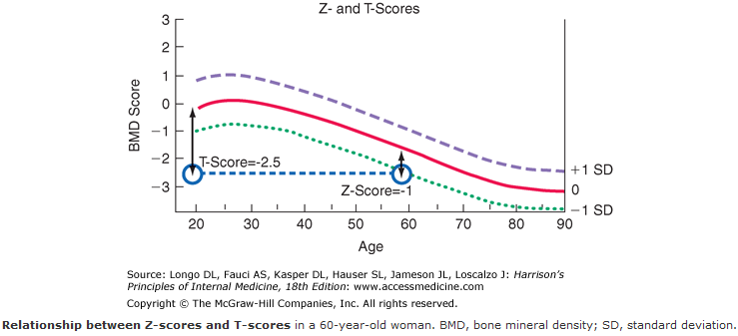

Slide 9
In premenopausal women, men aged ˂ 50 and children, the Z-scores should be used rather than the T scores in identifying those with low bone density.
According to the International Society for Clinical Densitometry:
♦ Z-score ≤ -2.0 :"below the expected range for age”
♦ Z-score ˃ -2.0 : "within the expected range for age."
Ref: The International Society for Clinical Densitometry, 2007

Slide 10
NOGG: NATIONAL OSTEOPOROSIS GUIDELINE GROUP
Guideline for the diagnosis and management of osteoporosis in postmenopausal women and men from the age of 50 years in the UK
Updated January 2016

Slide 11
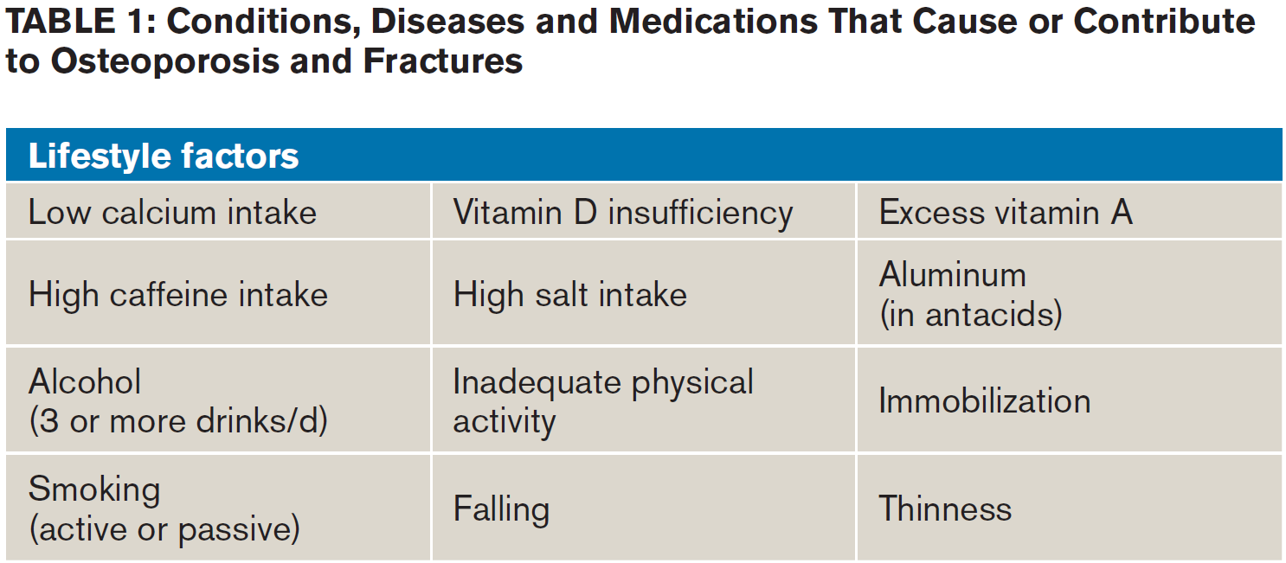

Slide 12
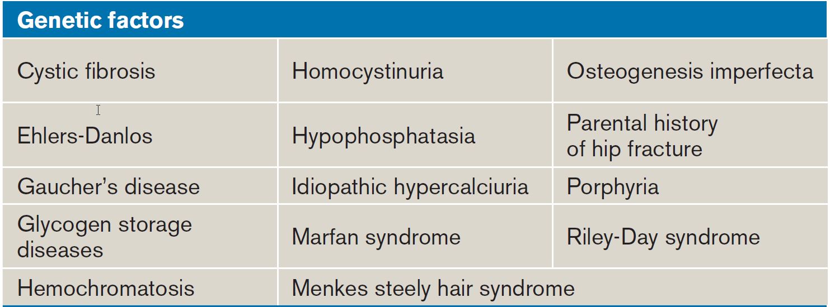

Slide 13
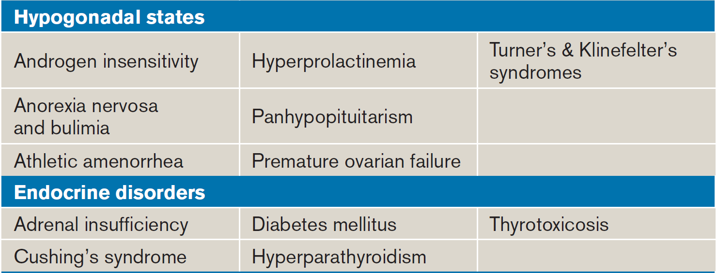
Acromegaly

Slide 14
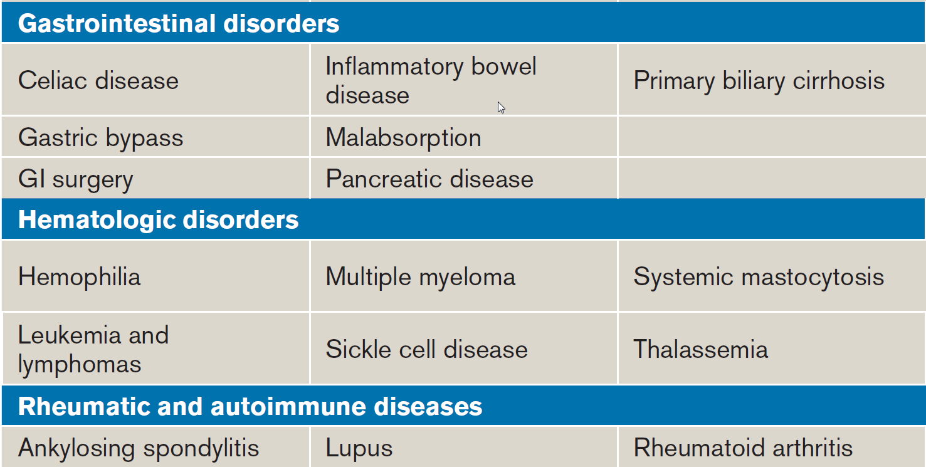

Slide 15
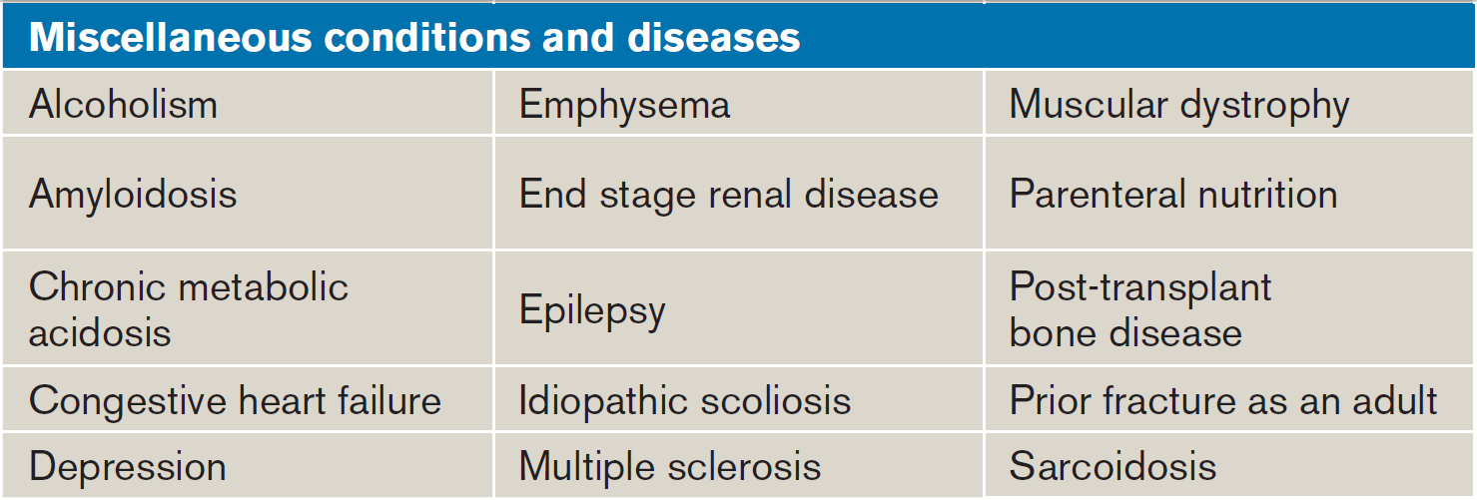

Slide 16
Warfarin

Slide 17
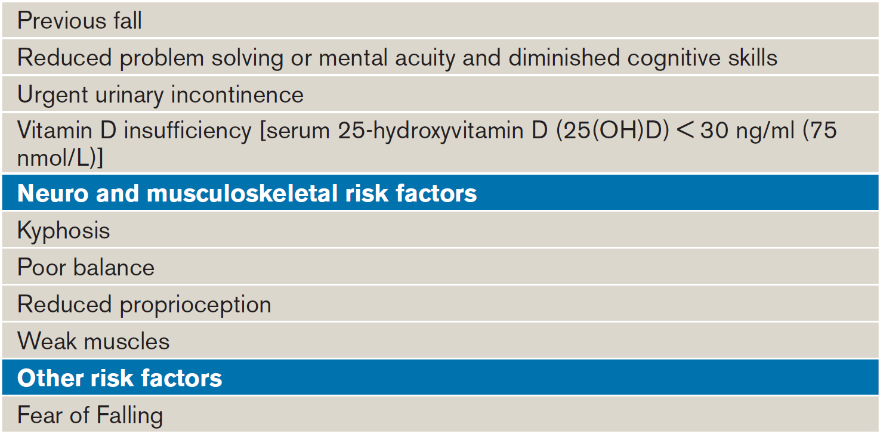

Slide 18
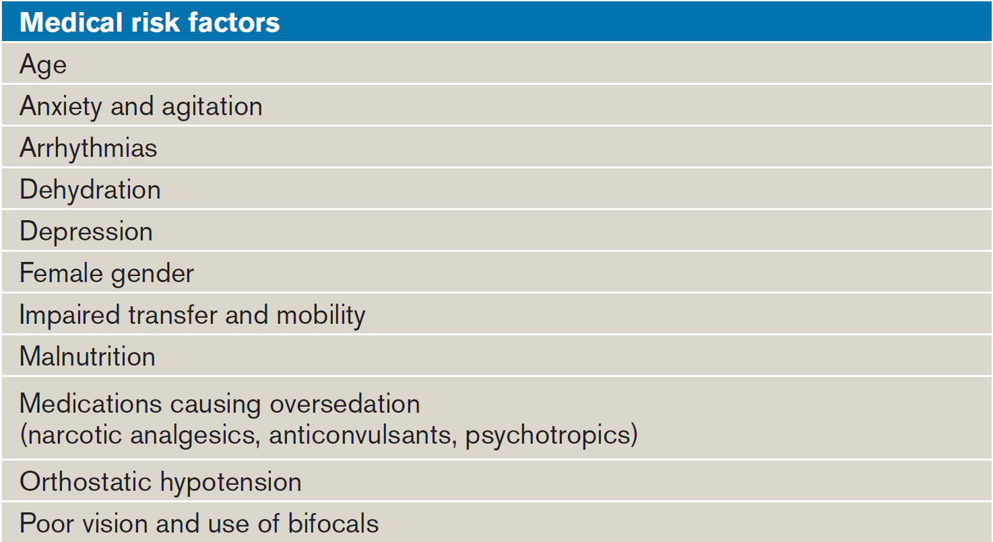

Slide 19
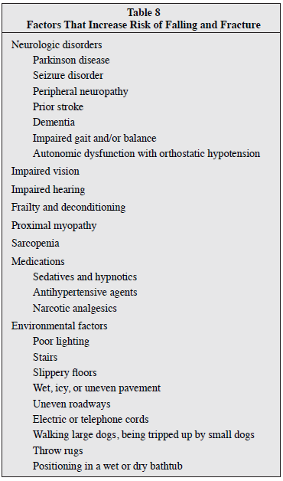

Slide 21
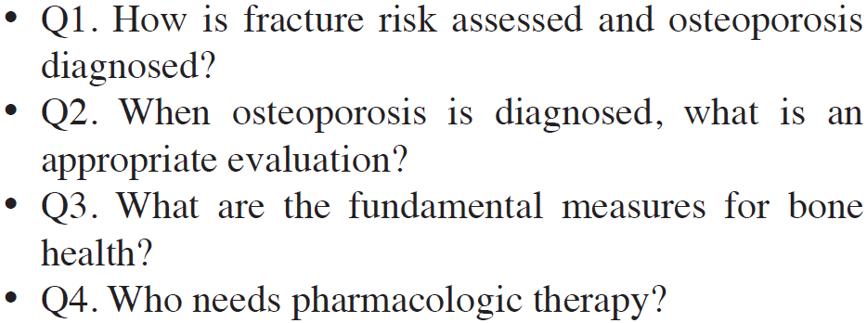

Slide 22
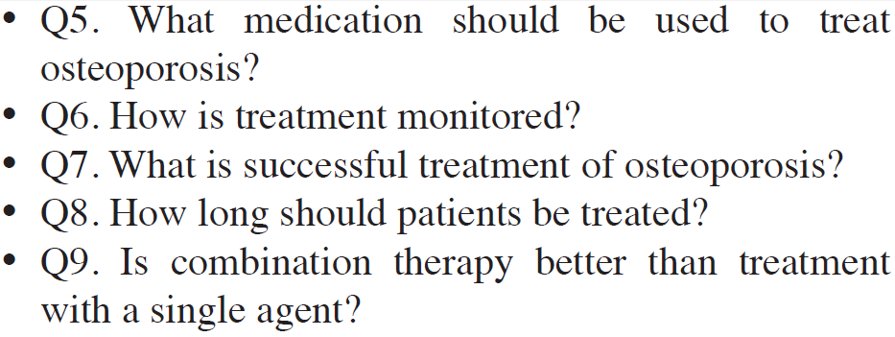

Slide 24
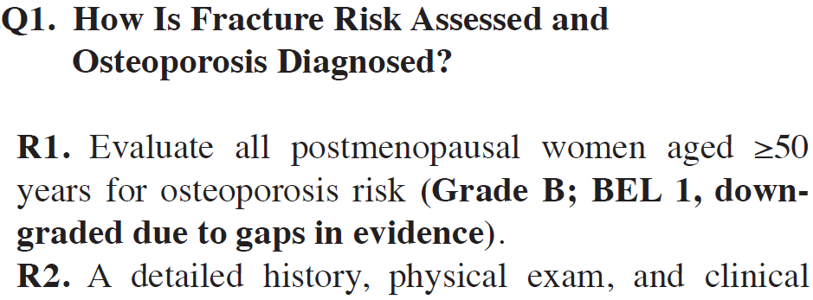
R2. A detailed history, physical exam, and clinical fracture risk assessment with the WHO Fracture Risk Assessment Tool (FRAX®) should be included in the initial evaluation for osteoporosis (Grade B; BEL 2).

Slide 26
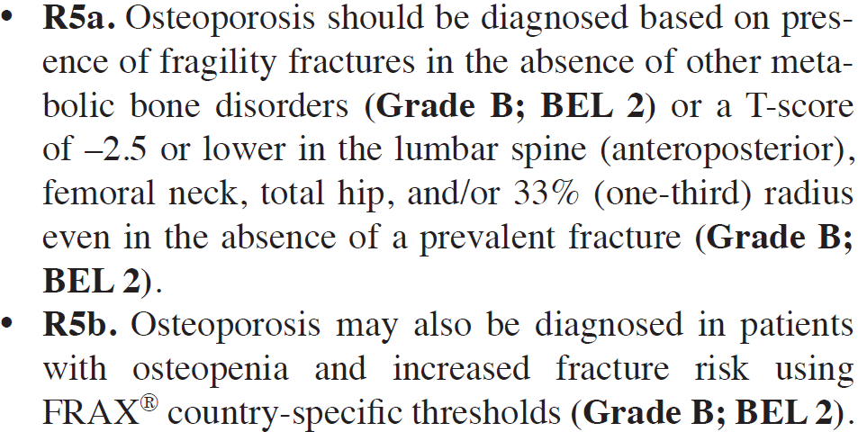

Slide 27
The WHO & the IOF recommend that the reference technology for the diagnosis of osteoporosis is dual energy X-ray absorptiometry (DXA) applied to the femoral neck.
NOGG, UK, 2016

Slide 28
The normal reference range in men and women is that derived from the NHANES survey for Caucasian women aged 20-29 years (Grade C recommendation).
The same diagnostic cut-off values for BMD can be applied to men since observational studies indicate (EL 1a) that the absolute risk of fracture for any given BMD and age is similar in men to that in women (Grade A recommendation). NOGG, UK, 2016

Slide 29
The FRAX tool computes the 10-year probability of hip fx or a major osteoporotic fx (clinical spine, hip, forearm or humerus).
Probabilities can be computed for several European, Asian & Middle Eastern countries.
(www.shef.ac.uk/FRAX)
FRAX = Fracture Risk Assessment Tool

Slide 30
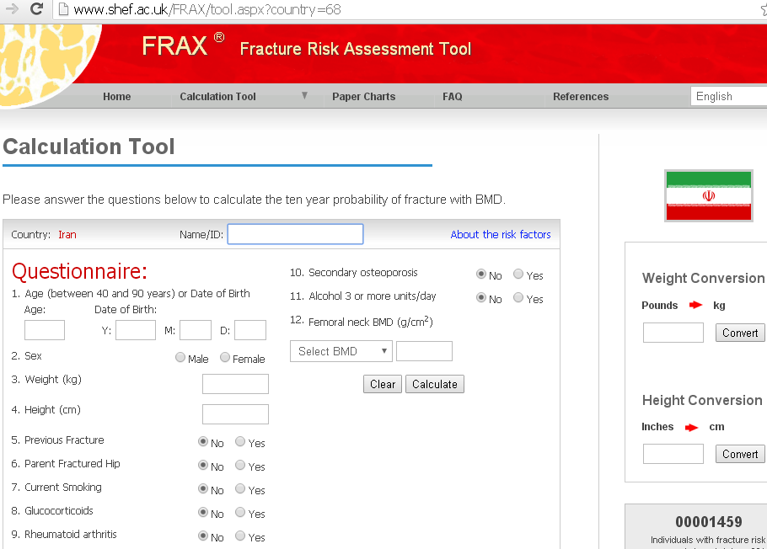

Slide 31
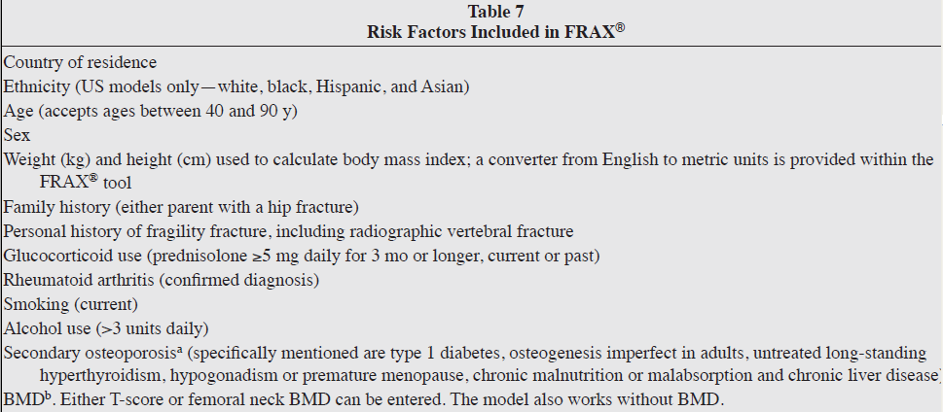

Slide 32
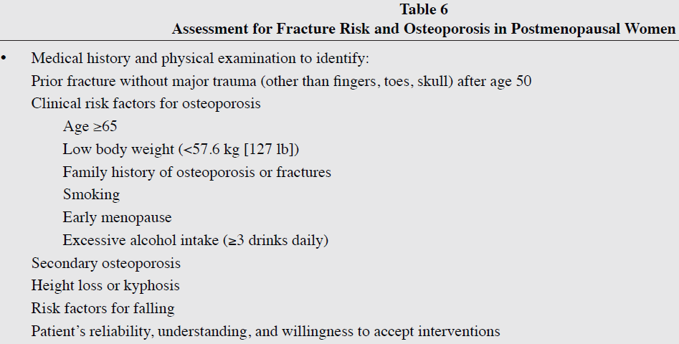

Slide 33
Assessment by the FRAX tool should be undertaken in:
Men ≥ 50 y/o (with or without fx) but with a WHO risk factor or a BMI < 19kg/m².
All postmenopausal women without fx but with a WHO risk factor or a BMI < 19kg/m².
The patient may be classified to be at low, intermediate or high risk. NOGG, 2016

Slide 34
Low risk :
Reassure and reassess in 5 years or less depending on the clinical context.
Intermediate risk :
Measure BMD and recalculate the fx risk to determine whether an individual's risk lies above or below the intervention threshold.

Slide 35
High risk:
► A 10-year hip fx probability ≥ 3%
► A 10-year major osteoporosis-related fx probability ≥ 20%
Can be considered for treatment without the need for BMD.
BMD measurement may sometimes be appropriate, particularly in younger postmenopausal women.

Slide 36
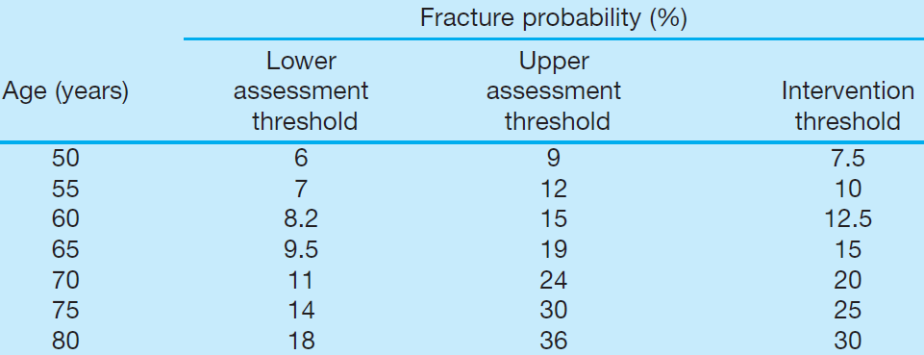

Slide 37
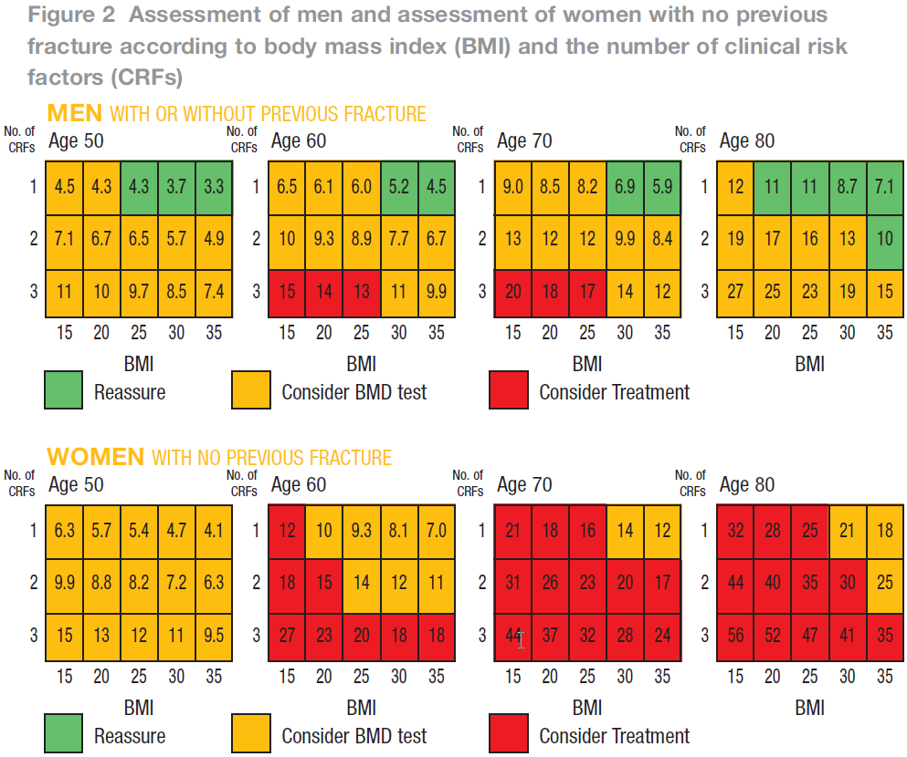

Slide 38
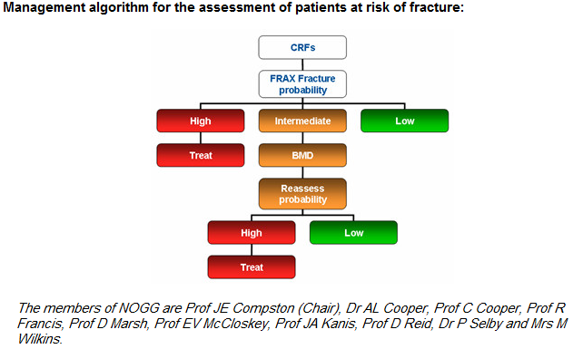

Slide 39
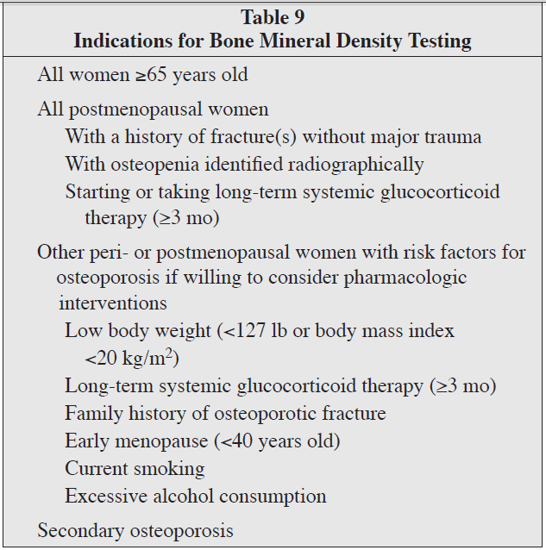

Slide 40
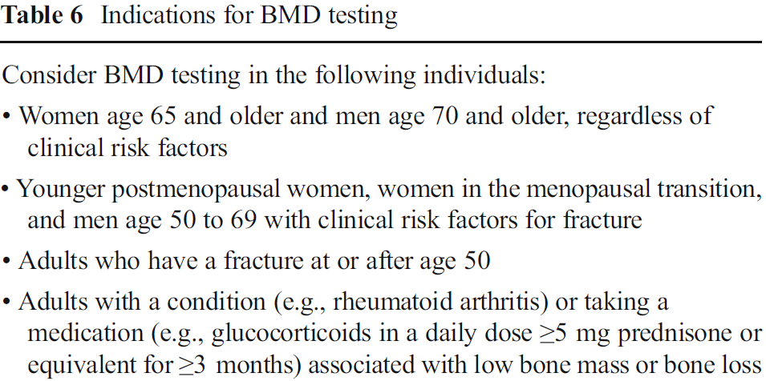
Osteoporosis International (2014) 25:2359–2381; NOF Guidelines

Slide 41
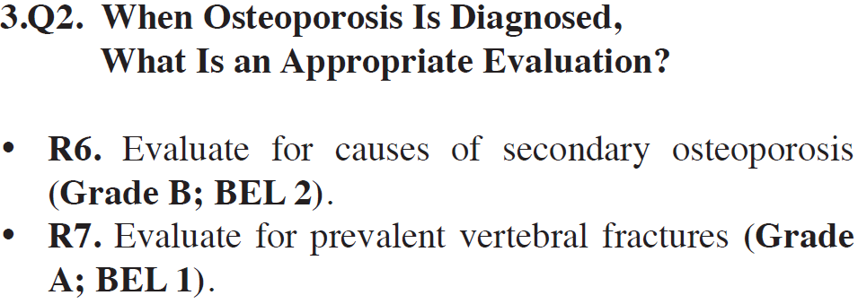

Slide 44
Laboratory Tests to Consider in Detecting Secondary Osteoporosis
CBC, Diff.
Serum:
Calcium
Phosph.
Total protein
Albumin,
LFTs
Alk. Phos.
Cr.
Electrolytes
25OHD
24-h U collection for:
Calcium
Sodium
Creatinine excretion (to identify calcium malabsorption or hypercalciuria)

Slide 45
Additional tests if clinically indicated might include (but not limited to):
Serum iPTH
Serum TSH
Anti- tTG Ab
SPIE and free kappa and lambda light chains
UFC or other tests (adrenal hypersecretion)
Serum tryptase, urine N-methylhistidine, or other tests for mastocytosis
BMA & BMBx.
Genetic testing for unusual features that suggest rare metabolic bone diseases

Slide 46
Undecalcified iliac crest bone biopsy with double tetracycline labeling:
Recommended for patients with bone disease and renal failure to establish the correct diagnosis and direct management
May be helpful in the assessment of patients with the following:
Suspected osteomalacia or mastocytosis when laboratory test results are inconclusive
Fracture without major trauma despite normal or high bone density
Vitamin D-resistant osteomalacia and similar disorders to assess response to treatment

Slide 47
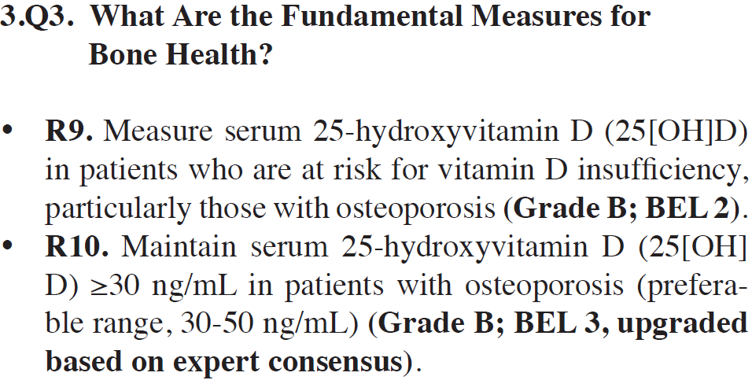

Slide 48
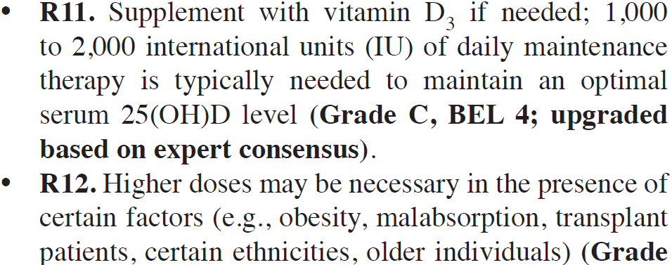

Slide 49
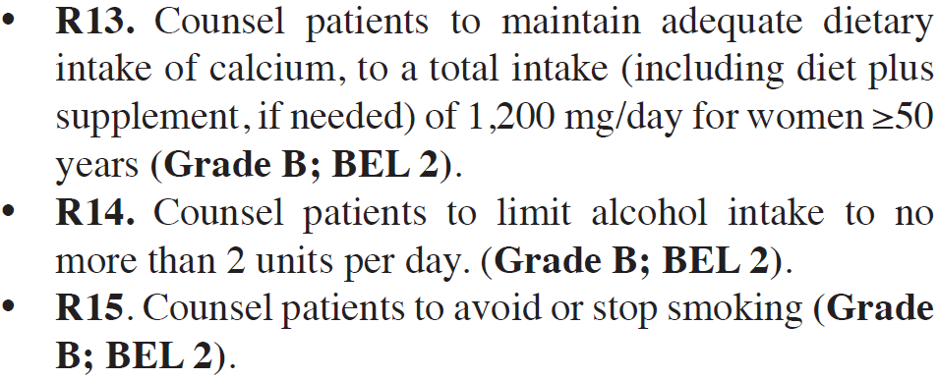

Slide 51
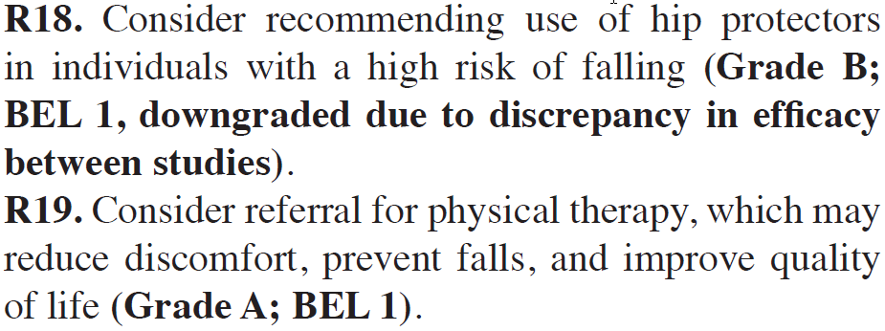

Slide 52
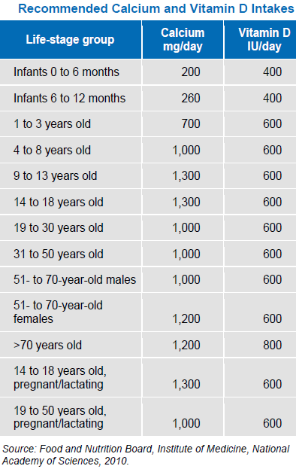

Slide 53
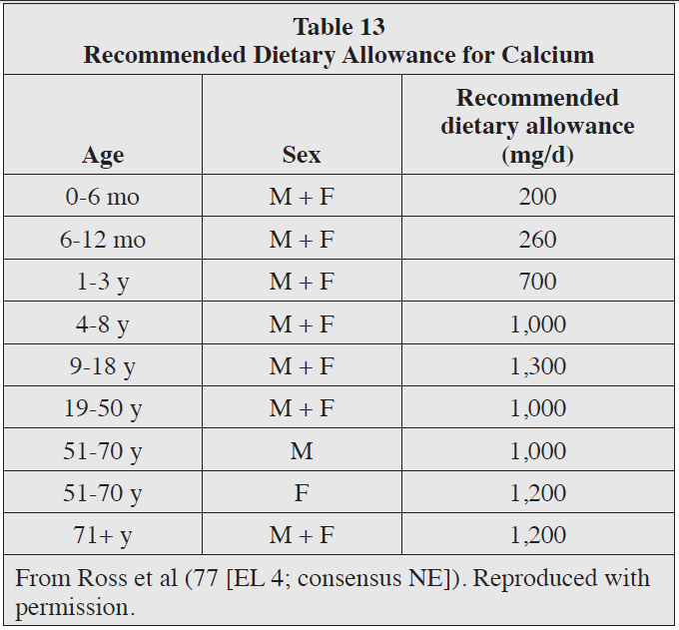

Slide 55
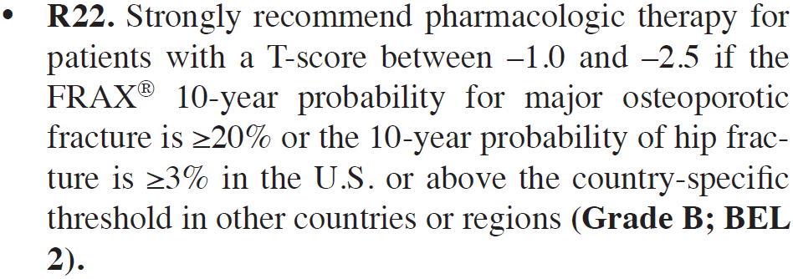

Slide 56
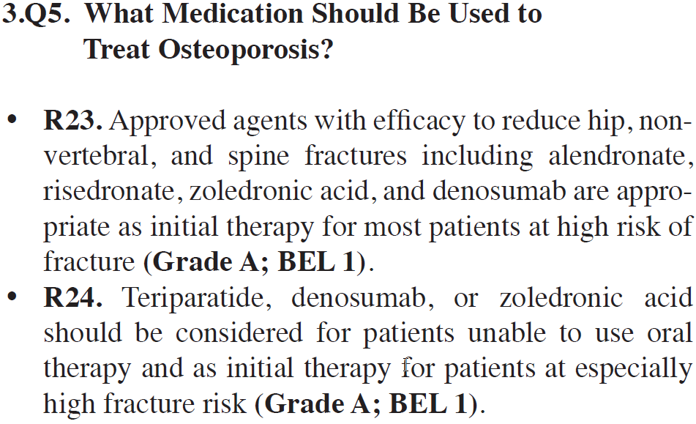

Slide 57
Current FDA-approved pharmacologic options for osteoporosis prevention and/or treatment:
► Bisphosphonates (for both men & women)
Alendronate
Ibandronate
Risedronate
Zoledronic acid (Zoledronate)
► Calcitonin (just for treatment in postmenopausal women)
► Estrogens and/or hormone therapy (just for postmenopausal women)

Slide 58
► PTH (teriparatide 1-34, for both men & women)
► Estrogen Agonist/Antagonist (raloxifene, just for postmenopausal women)
► Denusomab (for both men & women)

Slide 59
Endocrinology & Metabolism Clinics of North America. 41, (2012): 487–506

Slide 60
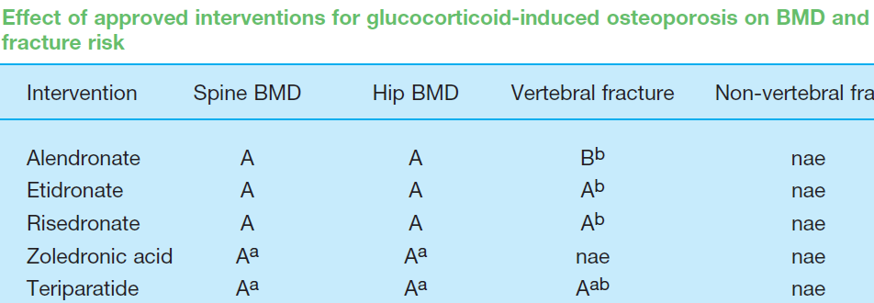

Slide 61
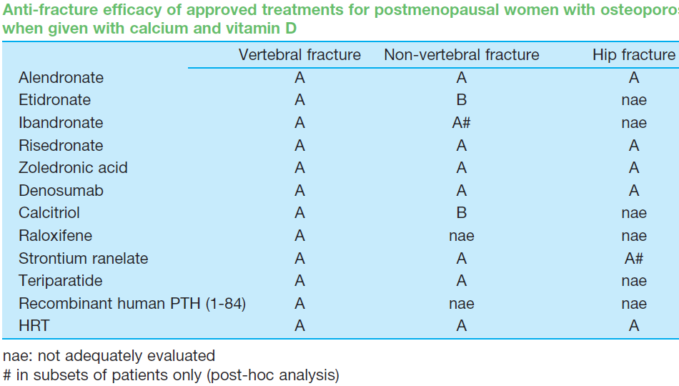

Slide 62
Endocrinology & Metabolism Clinics of North America. 41, (2012): 487–506

Slide 64
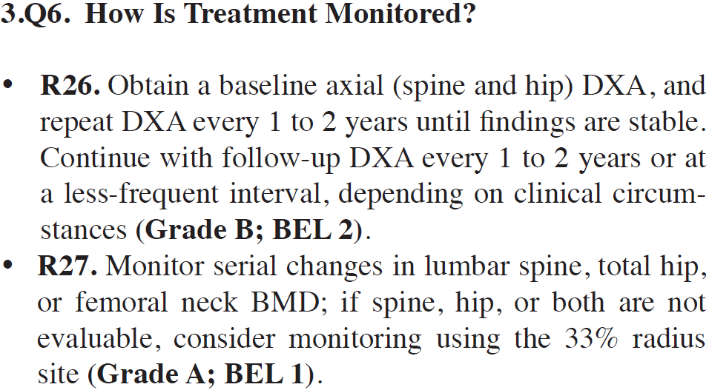

Slide 65
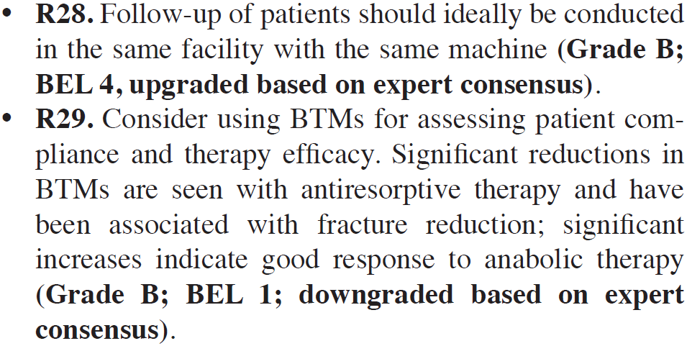

Slide 66
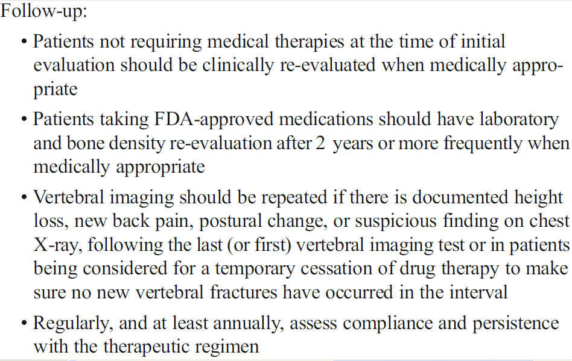

Slide 67
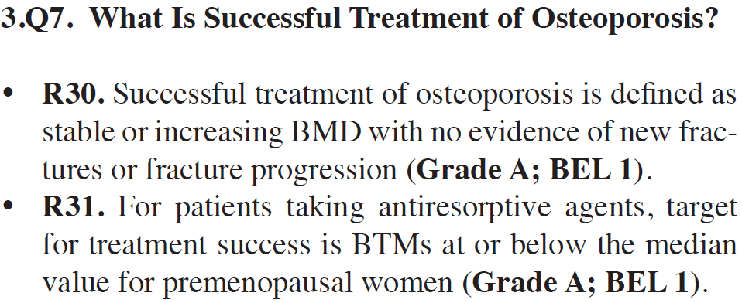

Slide 68
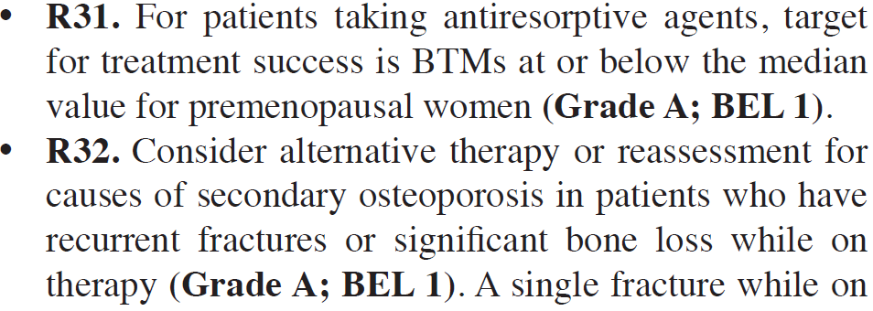

Slide 69
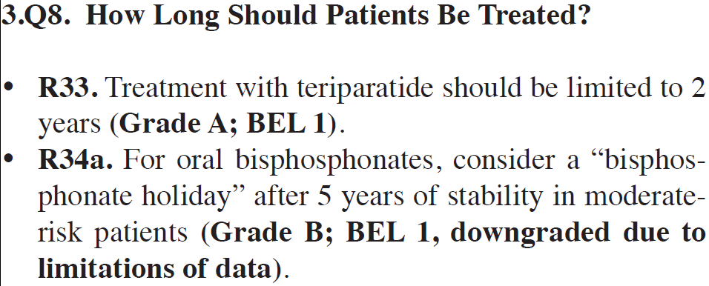

Slide 70
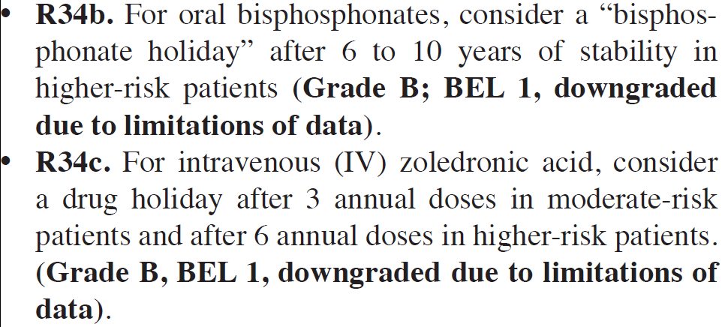

Slide 71
R34d. Teriparatide or raloxifene may be used during the “bisphosphonate holiday” period for higher-risk patients (Grade D; BEL 4).
R34e. A drug “holiday” is not recommended with denosumab (Grade A; BEL 1).

Slide 72
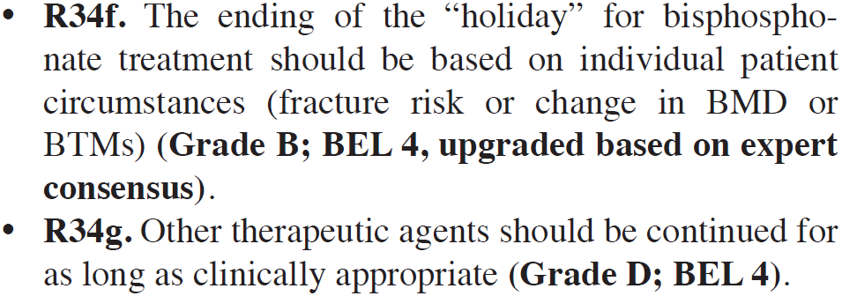

Slide 73
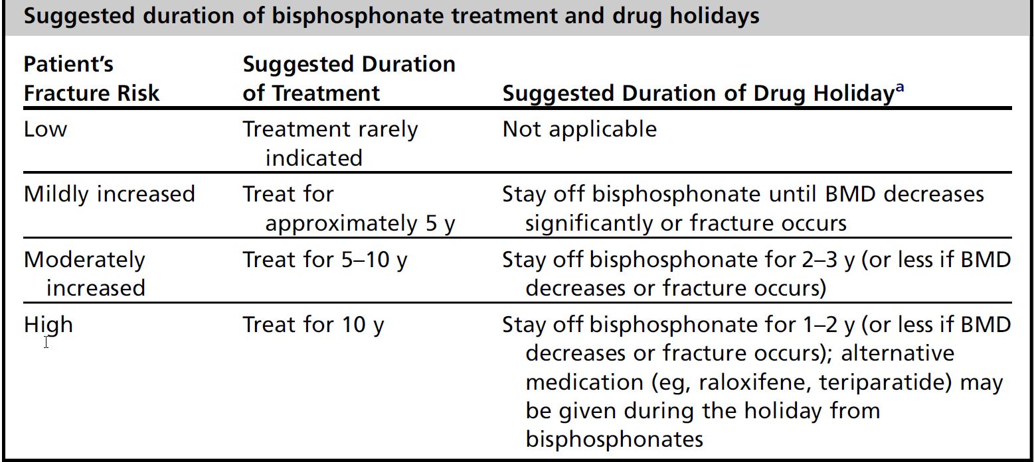

Slide 74
Conjugated Estrogens/Bazedoxifene (DUAVEE)
CE/BZA tablets contain 0.45 mg CE & 20 mg bazedoxifene
This combination is approved for once-daily dosing both for:
vasomotor symptoms associated with menopause
the prevention of postmenopausal osteoporosis
CE/BZA should be limited to those women who are at a significant risk of osteoporosis.

Slide 75
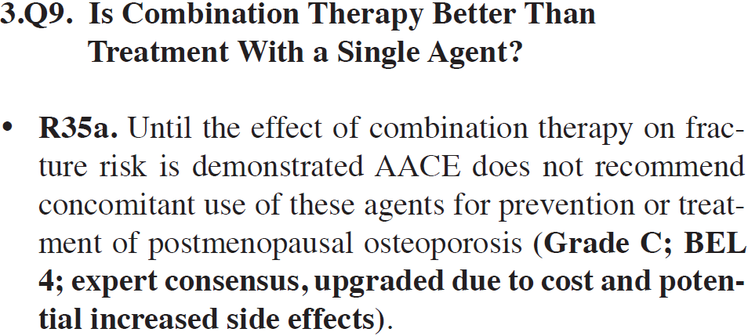

Slide 76
RISK?

Slide 79
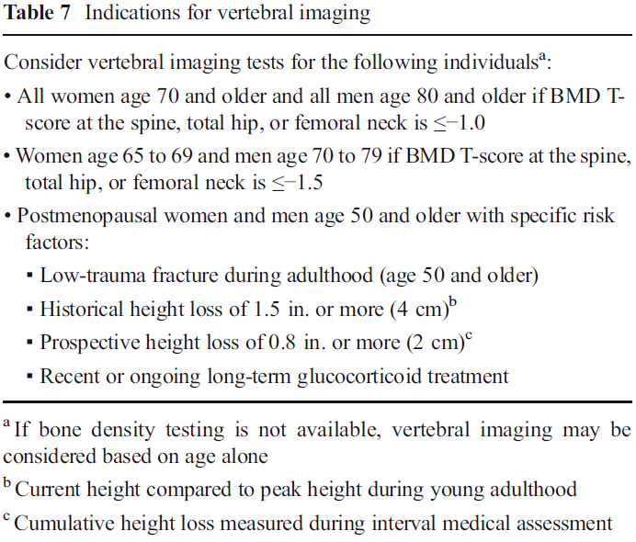

Slide 82
Prolia (Denosumab)
A RANKL inhibitor (human monoclonal Ab)
Injection, for SC use (60 mg q 6 month)
INDICATIONS:
1) Treatment of postmenopausal women with osteoporosis at high risk for fx.
2) Treatment of men at high risk for fx, who receiving androgen deprivation therapy for nonmetastatic prostate cancer.

Slide 83
3) Treatment of women at high risk for fx, who receiving adjuvant aromatase inhibitors for breast cancer.
4) Treatment of men with osteoporosis who are at high risk for fx (The FDA approval: Sept 27, 2012).

Slide 84
Estrogen Agonist/Antagonists (Selective Estrogen Receptor Modulators = SERM)
The only approved drug of this class : Raloxifene.
→ prevention and treatment of postmenopausal osteoporosis.
→increase in BMD and reduced the risk of vertebral fxs.
The risk of non-vertebral fxs did not differ between placebo and raloxifene.

Slide 85
→ increased risk of VTE compared with placebo.
No difference in overall mortality, cardiovascular events, cancer or non-vertebral fracture rates.
Drug of choice for women with osteoporosis if the main risk is of spinal fracture and there is an elevated risk of breast cancer.

Slide 86
Calcitonin
Treatment of osteoporosis in postmenopausal women
Nasal salmon-calcitonin 200 IU/d has shown a 33% risk reduction in new vertebral fxs.
No significant effects on BMD.
Increase spinal bone mass in postmenopausal women with established osteoporosis but not in early postmenopausal women.

