Slide 1
IN THE NAME OF GOD

Slide 2
Diabetic Sensory and Motor Neuropathy
By: Dr Mozhgan Karimifar
Assistant Prof. of Endocrinology
Isfahan University Of Medical Sciences

Slide 3
CASE

Slide 4
A 65-year-old woman with a 5-year history of diabetes (a recent hemoglobin A1C level was 9.5%) reports the recent onset of burning, tingling, and stabbing pain in her feet that is worse at night and interferes with sleep and activities of daily living. Her medications include 500 mg of metformin and 2 mg of glimepiride, each taken twice daily. On physical examination, the patient is alert and oriented to person, place, and time. Her blood pressure is 140/90 mm Hg. She has reduced sensation to pinpricks in the knees, reduced ability to detect vibration from a 128-Hz tuning fork, and a loss of proprioception and of sensation to a 1-g monofilament (bu not to a 10-g monofilament) in her toes. Strength in the lower legs is 5 out of 5 (normal) proximally and 4 out of 5 distally, and there is slightly weak dorsiflexion of both big toes, with no indication of entrapment. Her ankle reflexes are absent. She has no foot ulcers, and her pulses are easily palpable.
How should her case be further evaluated and managed?

Slide 5
Neuropathy in diabetes
►Heterogeneous condition
► It may occur in:
proximal or distal nerve fibers
Mononeuritis or entrapments involving small or large fibers
The somatic or autonomic nervous system
R1=Diabetic Sensory and Motor Neuropathy
N engl j med 374;15 nejm.org April 14, 2016

Slide 6
Distal symmetric polyneuropathy
The most common form of diabetic neuropathy
a chronic
nerve-length–dependent
sensorimotor polyneuropathy
at least one third of persons with type 1 or type 2 diabetes
up to one quarter of persons with IGT
progressive reduction in the intraepidermal nerve fibers
this reduction is seen even in persons with prediabetes.

Slide 8
Distal Symmetric Polyneuropathy
The symptoms are predominantly sensory and can be classified as
positive
tingling
Burning
stabbing pain
other abnormal sensation
or
negative
Sensory loss
Weakness
numbness
Motor symptoms are less common and occur later in the disease process.
Decreased sensation →a predisposition to painless foot ulcers and subsequent amputations

Slide 9
The lifetime risk of a foot lesion in persons with DSP
►ulcer or gangrene (15 to 25% )
► imbalance and unsteadiness in gait (fall, lacerations, fractures, or traumatic brain injury)
DSP= distal symmetric polyneuropathy

Slide 10
Diabetic Sensory and Motor Neuropathy
• Symptoms of distal symmetric motor and sensory polyneuropathy may be “positive” (manifested as sensations of tingling, burning, or stabbing pain) or “negative” (manifested as sensory loss, weakness, or numbness). These symptoms occur in one third of patients with type 1 or 2 diabetes.
• Decreased sensation confers a predisposition to painless foot ulcers and to amputations. Proprioceptive impairment leads to imbalance and unsteadiness in gait and to an increased likelihood of falls and serious traumatic injury.
• Laboratory testing should be used to rule out other causes of neuropathy, including vitamin B12 deficiency, which may occur with metformin use.
• Lifestyle interventions (diet and exercise) may restore nerve fibers, and exercises that improve strength and balance may reduce the risk of falls.
• Medications most commonly used in pain management include anticonvulsants (particularly gabapentin and pregabalin), tricyclic antidepressants, and serotonin–norepinephrine reuptake inhibitors.
• Treatment choices should take into account coexisting conditions, such as insomnia, depression, and anxiety.

Slide 11
Distal Symmetric Polyneuropathy
Alternatively, some persons with distal symmetric polyneuropathy may be asymptomatic, and signs of disease may be detected only by means of a detailed neurologic examination.

Slide 12
The Norfolk quality-of-lif questionnaire for diabetic neuropathy
25,000 patients with diabetes:
13,854 patients were aware of the presence of
neuropathy
6600 patients reported symptoms of neuropathy but were neither aware that the symptoms were related to neuropathy nor had been informed of this relationship by their health care provider.

Slide 13
Painful diabetic peripheral neuropathy
Occurs in 10 to 26%
can have a profound negative effect on:
quality of life
Sleep
mood
small-fiber dysfunction
large-fiber dysfunction

Slide 14
Small-fiber dysfunction
usually causes:
burning sensations
superficialis
often worse at night
and is associated with allodynia
Paresthesias
sensation of bees stinging through socks or of standing on hot coals.

Slide 15
Large-fiber dysfunction
deep-seated
Dog were gnawing at the bones of the feet
their feet were encased in concrete

Slide 16
Pain occurs more often in patients with
blood glucose levels
Age
Obesity
Smoking
Hypertension
dyslipidemia
peripheral artery disease

Slide 17
Diagnosis and Evaluation
Diagnosis and Evaluation
Early diagnosis of distal symmetric polyneuropathy is imperative to preven irreversible damage.
Diagnosis is primarily clinical and involves a
thorough history and physical examination with
a focus on vascular and neurologic tests, along
with a detailed assessment of the feet.

Slide 18
Distal Symmetric Polyneuropathy
All sensory perceptions can be affected, particularly:
vibration
touch
the perception of position
all of which can be affected by damage to:
large, A-type α- and β-fibers.

Slide 19
Distal Symmetric Polyneuropathy
Damage to:
small, thinly myelinated A-type δ-fibers and small, unmyelinated C-type fibers →
Pain
abnormal perceptions of hot and cold temperatures

Slide 20
Evaluation OF DSP
128-Hz tuning fork(early indicator of neuropathy)
A 1-g Semmes–Weinstein monofilament
10-g monofilament
Examination of the feet
Deep-tendon reflexes
Mild muscle wasting
Hands may be involved
severe weakness is rare

Slide 21
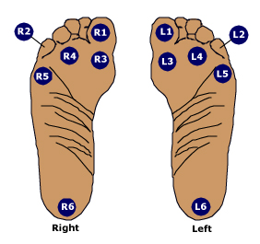
Testing sites for pressure sensation in evaluation of diabetic foot
The monofilament used to evaluate pressure sensation should be tested at each of the 12 sites shown, which represent the most common sites of ulcer formation. Failure to detect cutaneous pressure at any site indicates that the patient is at high risk for future ulceration.
2016 UpToDate

Slide 22
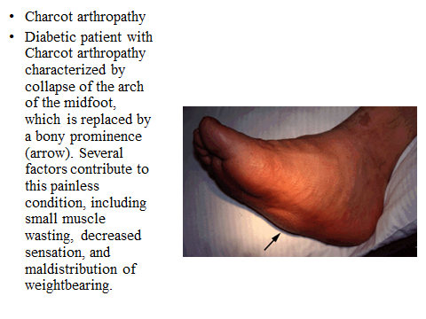

Slide 23
Should be carefully assessed for other conditions
Asymmetric symptoms or signs
Greater impairment of motor function than sensory function,
Entrapment
Rapid progression
Severe weakness

Slide 24
History
Drug
Chemical exposures
Family history of inherited neuropathies

Slide 25
Objective testing for neuropathy
quantitative sensory testing
measurement of nerve-conduction velocities
tests of autonomic function
is required to make a definitive diagnosis of neuropathy, although it is not essential for clinical care.

Slide 26
Laboratory studies
TSH
CBC
serum levels of folate and vitamin B12
Glucose, Hemoglobin A1C1, lipid
Serum immunoelectrophoresis
The results of which are often abnormal in patients with chronic inflammatory demyelinating polyneuropathy, which is a common condition in persons with diabetes.

Slide 28
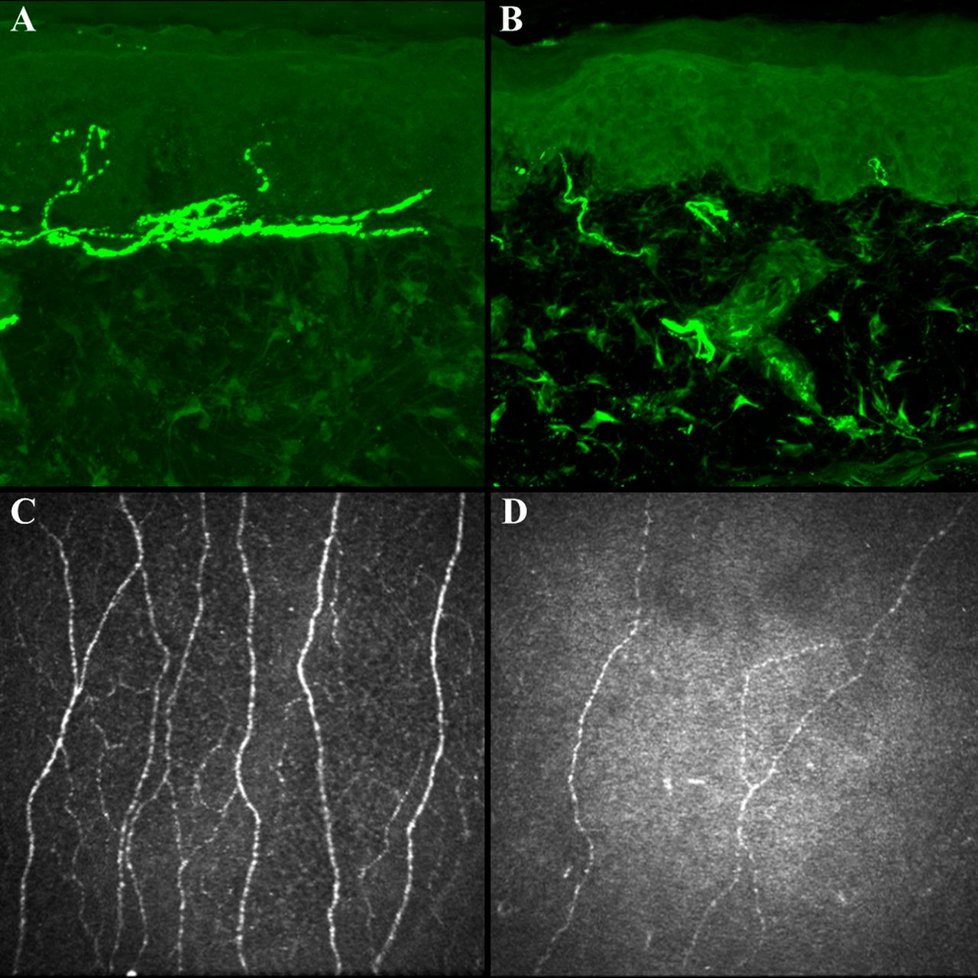
Quantitative measures of small fiber nerves.
Roni M. Shtein, and Brian C. Callaghan Diabetes 2013;62:25-26
©2013 by American Diabetes Association
Notes:
Quantitative measures of small fiber nerves. Quantitative measures of small fiber nerves include immunohistochemical stain (PGP 9.5, magnification ×40) of skin biopsy specimens from the distal leg to illustrate IENFD in a healthy subject (A) and a patient with severe diabetic neuropathy (B), and representative CCM images from a healthy subject (C) and a patient with severe diabetic neuropathy (D).

Slide 29
Clinical Management of painful distal symmetric polyneuropathy
Nonpharmacologic
Pharmacologic
Approaches to minimize disease progression and relieve symptoms

Slide 30
Lifestyle
Lifestyle interventions may prevent or possibly reverse neuropathy.
diet
exercise

Slide 31
Although overzealous control of :
blood pressure
and blood glucose levels
should be avoided
rational glycemic control is recommended to manage symptoms and prevent further damage, including falls and foot ulcers.

Slide 32
Tight glucose control
type 1 diabetes
reduced the risk of the development of neuropathy by 78%
type 2 diabetes (less clear)

Slide 33
Rapid lowering of blood glucose
An overly rapid lowering of blood glucose levels (a reduction of >1% per month in hemoglobin A1C level) may induce a neuritis with severe pain, although the neuritis generally resolves within 6 months.

Slide 34
Pharmacotherapy
First-line monotherapy frequently does not provide satisfactory relief at maximally tolerated doses.
Switching to a different agent within the same class
Switching to a new class
Adding a second agent.

Slide 35
Pharmacotherapy
Anticonvulsants
Antidepressants
SNRIs
Tricyclic agents
Opioids
Capsaicin 8.0% patch

Slide 39
Topical Capsaicin
Capsaicin 0.075% cream (was not effective)
An 8.0% patch (pain relief)
Might damage C-type fibers originating in the skin
pain relief that began within a few days and
persisted for 3 to 6 months after a single application

Slide 40
Anticonvulsants
Gabapentin and pregabalin are:
α2δ2 voltage-gated calcium modulators
improving sleep

Slide 41
pregabalin
In contrast to gabapentin, pregabalin has
linear and dose-proportional absorption in the therapeutic dose range (150 to 600 mg per day);
more rapid onset of action than gabapentin
more limited dose range that requires less adjustment.

Slide 42
Gabapentin
Gradual adjustment to the dose that is usually clinically effective (1800 to 3600 mg per day)

Slide 43
Topiramate
reduce the intensity of pain
improve sleep
stimulates the growth of intraepidermal nerve fibers of 0.5 to 2.0 fibers per millimeter per year, as compared with a decline of 0.5 to 1.0 fibers per millimeter per year in untreated patients
weight loss (improvements in lipid levels
and blood pressure )

Slide 44
Tricyclic Antidepressants
mechanisms that are unrelated to their antidepressant effects
adverse cholinergic effects
nortriptyline and desipramine > amitriptyline or imipramine
used with caution (suspected cardiac disease)
ECG (QT-interval prolongation and rhythm disturbances)

Slide 45
Serotonin–Norepinephrine Reuptake Inhibitors (SNRIs)
Venlafaxine
Duloxetine
quality of life

Slide 46
Opioid Analgesics
risks of abuse addiction, and diversion
only in selected cases and only after other medications have failed to be effective

Slide 47
Tramadol
an atypical opiate analgesic
inhibits the reuptake of norepinephrine
and serotonin
only in selected cases
lower potential for abuse than other opioids

Slide 48
tapentadol
Extended-release tapentadol
has similar actions and has been approved
for the treatment of diabetic neuropathic
pain by the Food and Drug Administration

Slide 49
Gabapentin + sustained-release morphine
better analgesia at lower doses of each drug than the use of either drug alone
but was
accompanied by an increase in adverse effects, including constipation, sedation, and dry mouth.

Slide 50
Coexisting Conditions and Choice of Therapy
choosing therapy:
sleep loss →pregabalin and gabapentin
depression→SNRI or a TCA
anxiety→Pregabalin, gabapentin, or an SNRI
Age

Slide 51
Areas of Uncertainty
only a month
enduring effects
compare the effects
individual patient
Benefits and risks of agents
Combination of methylcobalamin, methylfolate, and pyridoxal phosphate
Metformin
oxidative and nitrosative stress

Slide 52
vitamin B12 deficiency
Whereas neuropathy associated with vitamin B12 deficiency has typically been considered to occur at levels below 250 pg per milliliter, one study indicated that the threshold for the development of impaired nerve conduction is approximately 450 pg per milliliter.(need for more study)

Slide 53
Guidelines
recommendations for the management of pain resulting from DSP
first-line agents:
anticonvulsant agents, SNRIs, and other antidepressants

Slide 55
Summary and Recommendations 1
this patient
Laboratory tests
Quantitative tests of sensory and autonomic function
In patients with distal predominantly sensory Neuropathy:
lifestyle changes (diet and exercise)
to improve glycemic control, lipid levels, and blood pressure
should be avoided(rapid lowering of the hemoglobin A1C level (by more than 1% per month) and the development of hypotension should be avoided

Slide 56
Summary and Recommendations 2
Physical therapy
pregabalin or gabapentin (sleep disturbance)
but monitoring will be required for:
weight gain
fluid retention
diminished glycemic control

Slide 57
Summary and Recommendations 3
lower doses (e.g., 75 mg of pregabalin twice daily) and to adjust the dose upward if there is no reduction in pain within the first 2 weeks
If there is no response after 1 month of treatment, a switch to an agent from another drug class would be advisable

Slide 58
Summary and Recommendations 4
If the vitamin B12 level is below 450 pg per milliliter, supplementation with oral methylcobalamin (2000 μg per day) could be initiated, although there are as yet no data that show that supplementation reduces neuropathy in the absence of frank deficiency.
Alpha lipoic acid can be given to relieve pain (starting at a twice-daily oral dose of 300 mg)

Slide 61
Serotonin syndrome
Serotonin syndrome encompasses a spectrum of disease where the intensity of clinical findings is thought to reflect the degree of serotonergic activity. Mental status changes can include anxiety, agitated delirium, restlessness, and disorientation. Patients may startle easily. Autonomic manifestations can include diaphoresis, tachycardia, hyperthermia, hypertension, vomiting, and diarrhea . Neuromuscular hyperactivity can manifest as tremor, muscle rigidity, myoclonus, hyperreflexia, and bilateral Babinski sign. Hyperreflexia and clonus are particularly common; these findings, as well as rigidity, are more often pronounced in the lower extremities .

Slide 62
Risk classification based on the comprehensive foot examination LOPS: loss of protective sensation; PAD: peripheral arterial disease.
Risk category | Definition | Treatment recommendations | Suggested follow-up
0 | No LOPS, no PAD, no deformity | Patient education including advice on appropriate footwear. | Annually (by generalist and/or specialist)
1 | LOPS ± deformity | Consider prescriptive or accommodative footwear. Consider prophylactic surgery if deformity is not able to be safely accommodated in shoes. Continue patient education. | Annually (by generalist and/or specialist)
2 | LOPS ± deformity | Consider prescriptive or accommodative footwear. Consider vascular consultation for combined follow-up. | Annually (by generalist and/or specialist)
3 | History of ulcer or amputation | Same as category 1. Consider vascular consultation for combined follow-up if PAD present. | Every one to two months (by specialist)

Slide 63
Key components of the diabetic foot exam
Inspection
Dermatologic
Skin status: color, thickness, dryness, cracking
Sweating
Infection: check between toes for fungal infection
Ulceration
Calluses/blistering: hemorrhage into callus?
Musculoskeletal
Deformity, eg, claw toes, prominent metatarsal heads, Charcot joint
Muscle wasting (guttering between metatarsals)
Neurological assessment
10 g monofilament + one of the following four
Vibration using 128 Hz tuning fork
Pinprick sensation
Ankle reflexes
VPT
Vascular assessment
Foot pulses
ABI, if indicated

Slide 66
Charcot arthropathy
Diabetic patient with Charcot arthropathy characterized by collapse of the arch of the midfoot, which is replaced by a bony prominence (arrow). Several factors contribute to this painless condition, including small muscle wasting, decreased sensation, and maldistribution of weightbearing.

Slide 68
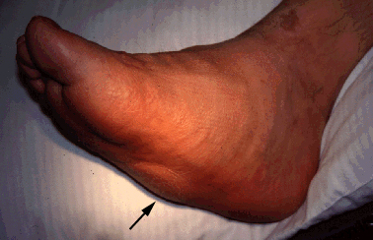
Charcot arthropathy
Diabetic patient with Charcot arthropathy characterized by collapse of the arch of the midfoot, which is replaced by a bony prominence (arrow). Several factors contribute to this painless condition, including small muscle wasting, decreased sensation, and maldistribution of weightbearing.
2016 UpToDate

Slide 69
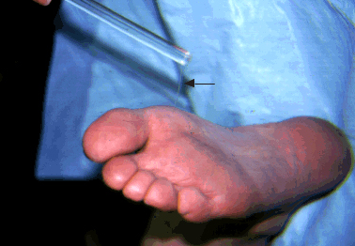
Monofilament estimation of pressure sensation
Use of the monofilament pressure esthesiometer for quantitative assessment of the cutaneous pressure perception threshold in the foot. The filament (arrow) is placed at a right angle to the skin on the plantar surface of the foot; pressure is then gradually increased until the filament buckles, indicating that a known amount of pressure (determined by the stiffness of the filament) has been applied. The patient is asked if the pressure has been felt. Diabetic patients with insensitivity to the monofilament are at increased risk for foot ulcers.
2016 UpToDate

