Slide 1
I
IN THE NAME of GOD

Slide 2
Medical Treatment with Somatostatin Analogues & PREDICTIVE MARKERS FOR POST-SURGICAL MEDICAL MANAGEMENT OF ACROMEGALY

Slide 3
Acromegaly
Acromegaly is a chronic disease caused by hypersecretion of growth hormone (GH), and GH-secreting pituitary tumors are found in 95% of acromegaly patients.
Acromegaly is a rare disease with an annual incidence of 3.3 cases per million persons, and estimated prevalence of 40 to 130 per million persons
Medical Treatment with Somatostatin Analogues in Acromegaly: Position Statement
Endocrinol Metab 2019;34:53-62
pISSN 2093-596X · eISSN 2093-5978

Slide 4
The primary treatment for acromegaly
The primary treatment for patients with acromegaly caused by pituitary tumors excessively secreting GH is surgery to remove the tumor through a trans-sphenoidal adenomectomy.
Medical Treatment with Somatostatin Analogues in Acromegaly: Position Statement
Endocrinol Metab 2019;34:53-62
pISSN 2093-596X · eISSN 2093-5978

Slide 5
The success rate of surgical treatment
varies depending on the
size of tumor
extent of tumor invasion and
the proficiency of the neurosurgeon performing the surgery
Medical Treatment with Somatostatin Analogues in Acromegaly: Position Statement
Endocrinol Metab 2019;34:53-62
pISSN 2093-596X · eISSN 2093-5978

Slide 6
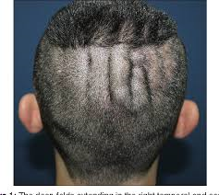
Approximately 70% of the patients with pituitary microadenomas are able to maintain their serum GH and insulin-like growth factor-1 (IGF-1) concentrations within the normal range after surgery
only 50% of the patients with pituitary macroadenomas
Medical Treatment with Somatostatin Analogues in Acromegaly: Position Statement
Endocrinol Metab 2019;34:53-62
pISSN 2093-596X · eISSN 2093-5978

Slide 7
Treatment outcome goals
The Korean Endocrine Society (KES)
Serum GH concentrations are not reduced to 1 μg/L or lower based on the 75-g oral glucose tolerance test 3 months after surgery, indicating the likely presence of residual tumor
1)Medical Treatment with Somatostatin Analogues in Acromegaly: Position Statement
Endocrinol Metab 2019;34:53-62
pISSN 2093-596X · eISSN 2093-5978

Slide 8
Factors that affected GH
GH nadir levels during an OGTT are also affected by factors such as
patient age
BMI
sex and
oestrogen use
and we recommend that these factors are considered when interpreting results of this test (discretionary recommendation (DR)).
A Consensus Statement on acromegaly therapeutic outcomes NATuRE REvIEWS | EndoCrinoloGy SEPTEMBER 2018 | volume 14

Slide 9
Treatment outcome goals A Consensus Statement on acromegaly therapeutic outcomes
Monitoring biochemical control by measuring both:
GH and IGF1 levels (SR).
As GH levels remain elevated with pegvisomant therapy, measuring GH in patients receiving pegvisomant should not be done (high quality (HQ)).
performing an OGTT in patients treated with an SRL is not likely to be clinically useful.
It is recommended that, whenever possible, endocrinologists use the same assay when monitoring IGF1 levels over time and that the selected assays adhere to accepted performance standards (strong recommendation (SR)).
IGF1 levels assay : Mass spectrometry better than older immunoassays
When ultrasensitive GH assays are available, we recommend an OGTT GH cut- off of 0.4 μg/l (SR).
A Consensus Statement on acromegaly therapeutic outcomes NATuRE REvIEWS | EndoCrinoloGy SEPTEMBER 2018 | volume 14

Slide 10
Clinical symptoms
We recommend assessing and aggressively managing disease- associated comorbidities, specifically hypertension and cardiac hypertrophy, diabetes mellitus and glucose intolerance, sleep apnoea and osteopathy (SR)
A Consensus Statement on acromegaly therapeutic outcomes NATuRE REvIEWS

Slide 11
Management of the patient with acromegaly

Slide 13
GH: growth hormone; IGF-1: insulin-like growth factor-1; MRI: magnetic resonance imaging. * The diagnosis of acromegaly should be suspected in patients with typical features of GH excess (ie, enlarged jaw, hands, and feet; coarse facial features), pituitary mass, and elevated serum IGF-1. The diagnosis may then be confirmed by inadequate suppression of serum GH after a glucose load. ¶ Refer to UpToDate topics on medical therapy for acromegaly. Δ Stereotactic radiotherapy - single-dose radiotherapy; most common method is the Gamma Knife. Normalization of serum IGF-1 may take >10 years. Medical therapy continued in the interim. Refer to UpToDate topics on medical therapy for acromegaly.
Graphic 116165 Version 1.0

Slide 14
Medical treatment
Medical treatment options for these patients include:
Somatostatin analogues
{first-generation SSAs (octreotide, lanreotide), and second-generation SSA, (pasireotide)}
GH receptor antagonists (pegvisomant)
Oral dopamine agonists (cabergoline)

Slide 15
Somatostatin Analogues
SSAs are preferred for tumors that cause mass effects (e.g., visual disturbance or headache) due to their location or invasiveness
Pasireotide has the added potential of worsening hyperglycemia and contributing to the development of frank diabetes.
PREDICTIVE MARKERS FOR POST-SURGICAL MEDICAL MANAGEMENT OF ACROMEGALY: A SYSTEMATIC REVIEW AND CONSENSUS TREATMENT GUIDELINE
DOI:10.4158/EP-2018-0500
© 2018 AACE.

Slide 16
Dopamine agonists (DAs)
Cabergoline
a second drug class
As with the SSAs, DAs can directly suppress GH expression by the tumor. These agents are widely used to inhibit prolactin release under various conditions.
tumors that produce prolactin in addition to GH (the so called mammosomatotroph tumors and mixed somatotroph-lactotroph tumors).
DA monotherapy has limited effect on pure somatotroph tumors and is generally reserved for individuals with modest IGF-1 elevation. (1)
1)PREDICTIVE MARKERS FOR POST-SURGICAL MEDICAL MANAGEMENT OF ACROMEGALY: A SYSTEMATIC REVIEW AND CONSENSUS TREATMENT GUIDELINE
DOI:10.4158/EP-2018-0500
© 2018 AACE.

Slide 17
Dopamine agonists (DAs)
However, the benefits are largely limited to patients with mildly elevated levels of IGF1 at baseline, with the greatest benefit seen in those with IGF1 levels .1.5 times the upper limit of normal (MQ).
We recommend that cabergoline should therefore be considered as a first- line medical therapy or as an addition to first- generation SRL in patients with IGF1 levels <2.5 times the upper limit of normal (DR).
A Consensus Statement on acromegaly therapeutic outcomes NATuRE REvIEWS
DR= Discretionary recommendation (DR): based on VLQ or LQ evidence

Slide 18
GH receptor antagonist (GHRA)
pegvisomant is used to
block the action of GH on target tissues.
does not reduce GH levels or tumor size
but reduces IGF-1 production.
Pegvisomant dosage is typically titrated until IGF-1 is within the age-adjusted normative range (1).
(from 10 mg per day to 30 mg per day).
age and BMI(2)
1)PREDICTIVE MARKERS FOR POST-SURGICAL MEDICAL MANAGEMENT OF ACROMEGALY: A SYSTEMATIC REVIEW AND CONSENSUS TREATMENT GUIDELINE
DOI:10.4158/EP-2018-0500
© 2018 AACE.
2) A Consensus Statement on acromegaly therapeutic outcomes . NATuRE REvIEWS | EndoCrinoloGy. volume 14 | SEPTEMBER 2018 |

Slide 19
Oestrogens and SERMs
Oestrogens and selective oestrogen receptor modulators (SERMs) reduce levels of IGF1 in patients with acromegaly when used alone or in combination with
an SRL or cabergoline (VLQ).
SERMs might have an additional benefit in men with acromegaly and hypogonadism, as these agents also increase levels of testosterone (VLQ).
However, as published evidence is limited, optimal use of these agents remains undetermined, and sex- specific adverse effects should also be considered.
A Consensus Statement on acromegaly therapeutic outcomes . NATuRE REvIEWS | EndoCrinoloGy. volume 14 | SEPTEMBER 2018

Slide 20
The treatment goals for acromegaly
reduce the tumor size
and to maintain GH and IGF-1 within normal ranges as well as
to improve the clinical symptoms and signs of acromegaly(1)
Consider the effect of therapy on disease- related morbidity and mortality(2)
1)Medical Treatment with Somatostatin Analogues in Acromegaly: Position Statement
Endocrinol Metab 2019;34:53-62
pISSN 2093-596X · eISSN 2093-5978
2) A Consensus Statement on acromegaly therapeutic outcomes . NATuRE REvIEWS | EndoCrinoloGy. volume 14 | SEPTEMBER 2018 |

Slide 21
SOMATOSTATIN AND THE SOMATOSTATIN RECEPTOR

Slide 22
SOMATOSTATIN AND THE SOMATOSTATIN RECEPTOR
The secretion of GH from the anterior pituitary gland is inhibited by many factors including: somatostatin
from the hypothalamus (14 amino acids )
GI tract (28 amino acids from δ-cells at the duodenum and jejunum )
Medical Treatment with Somatostatin Analogues in Acromegaly: Position Statement
Endocrinol Metab 2019;34:53-62
pISSN 2093-596X · eISSN 2093-5978

Slide 23
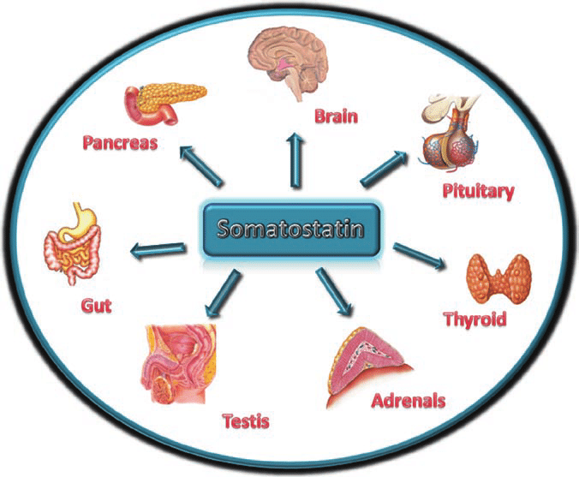
Somatostatin exerts inhibitory effects on all of hormone secretions from the pituitary, pancreas, gut, and gallbladder by binding to somatostatin receptors (SSTR).

Slide 24
Somatostatin receptors (SSTR)
Five subtypes of the SSTR have been identified.
GH-secreting pituitary tumor cells mainly express SSTR type 2 (SSTR2, >95%) and type 5 receptors (SSTR5, >85%)
while type 3 (SSTR3) and type 1 receptors (SSTR1) are each expressed on 40% of GH-secreting tumors
type 4 receptors (SSTR4) are rarely expressed
SSTR2 > SSTR5 > SSTR3 and SSTR1 > SSTR4
↓ ↓ ↓ ↓
95% 85% 45% rarely
Medical Treatment with Somatostatin Analogues in Acromegaly: Position Statement
Endocrinol Metab 2019;34:53-62
pISSN 2093-596X · eISSN 2093-5978

Slide 25
SSTR
In addition, SSTR has been confirmed to be expressed within:
the CNS
GI tract
inflammatory, immune cells
endocrine cells
Medical Treatment with Somatostatin Analogues in Acromegaly: Position Statement
Endocrinol Metab 2019;34:53-62
pISSN 2093-596X · eISSN 2093-5978

Slide 26
SOMATOSTATIN ANALOGUES

Slide 27
Endogenous somatostatin
Short half-life (only 3 to 5 minutes in vivo)
Persistent intravenous administration is required in order to maintain therapeutic levels.
In addition, the use of endogenous somatostatin may be limited by potential induction of rebound secretion of GH, insulin and glucagon following infusion.
Medical Treatment with Somatostatin Analogues in Acromegaly: Position Statement
Endocrinol Metab 2019;34:53-62
pISSN 2093-596X · eISSN 2093-5978

Slide 28
Somatostatin analogues
Extended half-lives, such as
Octreotide
Lanreotide
Medical Treatment with Somatostatin Analogues in Acromegaly: Position Statement
Endocrinol Metab 2019;34:53-62
pISSN 2093-596X · eISSN 2093-5978

Slide 29
Somatostatin analogues
Both analogues were developed to lengthen their half-lives while maintain the β-turn structure (tetrapeptide Phe-Trp-Lys-Thr) and the disulfide bridge connecting amino acids (cysteine) at position 3 and 14 of endogenous somatostatin, which plays a critical role in the functions of somatostatin.
Medical Treatment with Somatostatin Analogues in Acromegaly: Position Statement
Endocrinol Metab 2019;34:53-62
pISSN 2093-596X · eISSN 2093-5978
Phenylalanine-Tryptophan-Lysine-Threonine

Slide 30
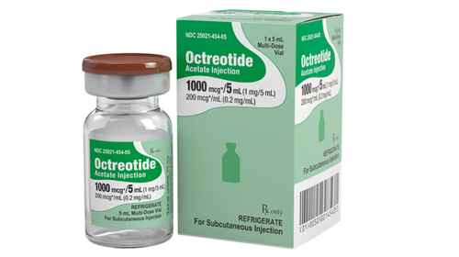
Octreotide
SC Injection
IV Injection
The affinity of octreotide for SSTR2 is 45 times greater than that of endogenous somatostatin (Kd=0.4 pM).
The initial dose is 100 to 250 μg with every 8 hours; the dose may be increased to 1.5 mg/day
Its peak plasma concentrations are achieved 40 minutes following administration, and the half-life is approximately 2 hours.
Medical Treatment with Somatostatin Analogues in Acromegaly: Position Statement
Endocrinol Metab 2019;34:53-62
pISSN 2093-596X · eISSN 2093-5978

Slide 31
Octreotide LAR
is mixed with a diluent (carboxymethylcellulose sodium, mannitol, water) and microspheres of biodegradable glucose polymer
IM injection
maximum plasma concentrations are achieved within 1 hour of administration
Octreotide LAR is released in a biphasic manner, such that the plasma concentration declines within 12 hours of administration, remains at sub-therapeutic levels for about 7 days, and then increases to reach its peak concentration on day 14 post-injection.
Medical Treatment with Somatostatin Analogues in Acromegaly: Position Statement
Endocrinol Metab 2019;34:53-62
pISSN 2093-596X · eISSN 2093-5978

Slide 32
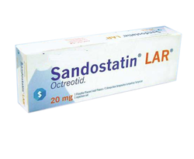
Octreotide LAR
Since plasma concentrations remain elevated for about 35 to 60 days and decrease gradually, octreotide LAR is administered at intervals of 4 weeks, and plasma concentrations reach steady state after three injections.
Medical Treatment with Somatostatin Analogues in Acromegaly: Position Statement
Endocrinol Metab 2019;34:53-62
pISSN 2093-596X · eISSN 2093-5978

Slide 33
Lanreotide
Sustained-release (SR) type of somatostatin analogue
a biodegradable lactide/glycolide copolymer with high affinity for SSTR2 and a half-life of approximately 5 days.
IM injection
dose of 30 or 60 mg every 7 to 14 days.
Medical Treatment with Somatostatin Analogues in Acromegaly: Position Statement
Endocrinol Metab 2019;34:53-62
pISSN 2093-596X · eISSN 2093-5978

Slide 34
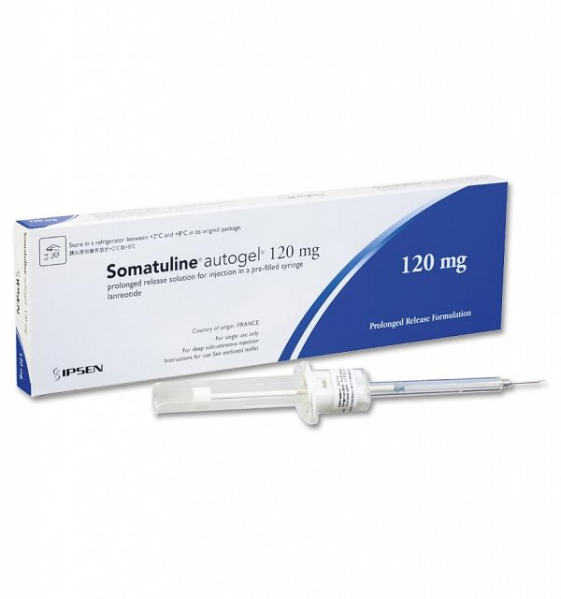
The lanreotide ATG
The lanreotide ATG formulation consists of a supersaturated aqueous solution prepared in a prefilled syringe, which extends the dosing interval to 4 weeks with deep subcutaneous injection
Its half-life is approximately 23 to 29 days with reaching its steady-state after four injections .
Medical Treatment with Somatostatin Analogues in Acromegaly: Position Statement
Endocrinol Metab 2019;34:53-62
pISSN 2093-596X · eISSN 2093-5978

Slide 35
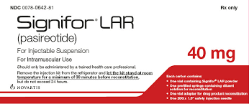
Pasireotide
Greater affinity for SSTR5 and other SSTR subtypes
the second generation somatostatin analogue
Pasireotide is a cyclohexapeptide with a molecular weight of 1,047 Da, and the chemical formula of [(2-aminoethyl)aminocarbonyloxy]-L-proline, phenylglycine, and tyrosine (benzyl) .
Medical Treatment with Somatostatin Analogues in Acromegaly: Position Statement
Endocrinol Metab 2019;34:53-62
pISSN 2093-596X · eISSN 2093-5978

Slide 36
Pasireotide
Pasireotide has 40-, 30- and 5-fold greater binding affinity for SSTR5, SSTR1, and SSTR3, respectively, than octreotide or lanreotide, and approximately 2.5 times lower affinity for SSTR2
SSTR5
Pasireotide vs octreotide | SSTR5 | SSTR1 | SSTR3 | SSTR2
Affinity for SSTR by pasireotide | 40 fold | 30 | 5 | ~ 2.5 times lower affinity
Medical Treatment with Somatostatin Analogues in Acromegaly: Position Statement
Endocrinol Metab 2019;34:53-62
pISSN 2093-596X · eISSN 2093-5978

Slide 37
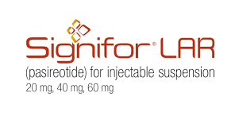
Pasireotide LAR
Plasma concentrations reach an initial maximum 24 hours after administration, and the concentration declines for the next 7 days, and then increase again to reach a second maximum on day 21 post-injection .
Similar to octreotide LAR, plasma pasireotide concentrations reach steady state after three injections when administered at 4-week intervals.

Slide 38
drug | Octreotide | octreotide LAR | Lanreotide | lanreotide ATG formulation | Pasireotide LAR
Type of somatostatin analogue |  |  |  |  | second generation
peak plasma concentrations | 40 minutes | 1 hour |  |  | Subcutaneous: 0.25 to 0.5 hours
half-life | 2 hours |  | 5 days | 23 to 29 days | Subcutaneous: ~12 hours
administration | SC or IM | IM | IM | deep subcutaneous injection | IM & SC
administered at intervals of | every 8 hours | 4 weeks | every 7 to 14 days | 4 weeks | 4 weeks
The initial dose | 100 to 250 μg |  | 30 or 60 mg |  | 40 mg
Maximum dose | 1.5 mg/day |  |  |  | 60 mg
steady state of plasma concentrations |  | after three injections |  | four injections | after three injections

Slide 39
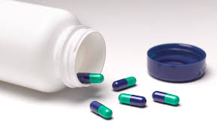
Oral octreotide
transient permeability enhancer that enables bioactive GI absorption appears to be effective in some patients with acromegaly, but perhaps less so than long-acting injectable preparations.
UPTODATE2020

Slide 40
Oral octreotide
In an open-label study of 155 patients previously controlled on injectable somatostatin analogs, patients were switched to oral octreotide capsules (40 mg/day in two divided doses, increased up to 80 mg/day as needed) .
Sixty-five percent (98 of 151) of the intent-to-treat population achieved the primary endpoint of GH/IGF-1 control, compared with 91 percent (138 of 151) while taking long-acting injectable somatostatin analogs
UPTODATE2020

Slide 41
Oral octreotide
This preparation has not been approved but has been used in pregnancy for tumor and headache control.
UPTODATE2020

Slide 42
Somatostatin analogues
in the pituitary gland:
inhibition of GH secretion
cell division
play a role to suppress IGF-1 production in the liver
may reduce tumor size through the apoptosis by induction of ZAC1 protein expression or reduction of the Ki67 index which leads to the decreased cell cycling of GH-secreting pituitary tumor cells.
Medical Treatment with Somatostatin Analogues in Acromegaly: Position Statement
Endocrinol Metab 2019;34:53-62
pISSN 2093-596X · eISSN 2093-5978

Slide 43
Somatostatin before or after surgery
The routine use of preoperative somatostatin analogues prior to surgical excision of pituitary adenomas is not recommended however, when surgical treatment is not available or refused, medical treatment may be considered as primary therapy (A).
Medical Treatment with Somatostatin Analogues in Acromegaly: Position Statement
Endocrinol Metab 2019;34:53-62
pISSN 2093-596X · eISSN 2093-5978

Slide 44
Failed to meet the treatment goal after 12 months
Octreotide LAR → pasireotide LAR→after 26 additional months→ 17.3% achieved biochemical control
Pasireotide LAR → octreotide LAR →after 26 additional months → 0%
Medical Treatment with Somatostatin Analogues in Acromegaly: Position Statement
Endocrinol Metab 2019;34:53-62
pISSN 2093-596X · eISSN 2093-5978

Slide 45
PAOLA study
In addition, the pasireotide versus continued treatment with octreotide or lanreotide in patients with inadequately controlled acromegaly (PAOLA) study, which investigated the effects of pasireotide LAR in patients who failed to meet the treatment goals with either octreotide LAR or lanreotide ATG, reported that approximately 20% of patients who were switched to pasireotide LAR 60 mg met the treatment goals .
Medical Treatment with Somatostatin Analogues in Acromegaly: Position Statement
Endocrinol Metab 2019;34:53-62
pISSN 2093-596X · eISSN 2093-5978

Slide 46
INITIAL DOSE AND DOSE ADJUSTMENT DURING SOMATOSTATIN ANALOGUE TREATMENT

Slide 47
The Korean Endocrine Society (KES) statement
Medical Treatment with Somatostatin Analogues in Acromegaly: Position Statement Endocrinol Metab 2019;34:53-62 pISSN 2093-596X · eISSN 2093-5978

Slide 48
octreotide LAR
The initial dose → 20 mg every 4-week intervals
after the first 3 months → GH levels > 2.5 μg/L→ 30 mg every 4 weeks
The maximum dose is 40 mg every 4 weeks
Medical Treatment with Somatostatin Analogues in Acromegaly: Position Statement
Endocrinol Metab 2019;34:53-62
pISSN 2093-596X · eISSN 2093-5978

Slide 49
The Korean Endocrine Society (KES) statement
When GH < 1.0 μg/L→ Mortality rate of patients with acromegaly similar to general population
KES statement employs a cut-off GH level of 2.5 μg/L for the changes of drugs and their doses.
It is because:
the accuracy and standardization of the GH assay kits currently available have not yet been established
Medical Treatment with Somatostatin Analogues in Acromegaly: Position Statement
Endocrinol Metab 2019;34:53-62 pISSN 2093-596X · eISSN 2093-5978

Slide 50
The Korean Endocrine Society (KES) statement
When the GH level remains suppressed below 1 μg/L after using 20 mg of octreotide LAR every 4 weeks for 3 months or longer and symptoms and signs of excessive GH are alleviated, the dose can be reduced to 10 mg every 4 weeks.
Medical Treatment with Somatostatin Analogues in Acromegaly: Position Statement
Endocrinol Metab 2019;34:53-62
pISSN 2093-596X · eISSN 2093-5978

Slide 51
During somatostatin analogue treatment
KES:
The patient’s biochemical parameters, clinical signs, and symptoms should be assessed on a regular basis during somatostatin analogue treatment (expert opinion).
Medical Treatment with Somatostatin Analogues in Acromegaly: Position Statement
Endocrinol Metab 2019;34:53-62
pISSN 2093-596X · eISSN 2093-5978

Slide 52
Lanreotide ATG
The initial dose of lanreotide ATG is 60, 90, or 120 mg every 4 weeks. If serum GH levels are not reduced to 2.5 μg/L or less after using 60 or 90 mg every 4 weeks for 3 months, the dose may be gradually increased to a maximum of 120 mg every 4 weeks.
When the GH levels are found to remain suppressed within normal range, the dose may be reduced to 60 mg every 4 weeks, or the 120 mg dose be selected with the dose interval extended to 6 to 8 weeks; in either case, patient symptoms and biochemical parameters should be monitored to verify the continued adequacy of treatment (expert opinion).
Medical Treatment with Somatostatin Analogues in Acromegaly: Position Statement
Endocrinol Metab 2019;34:53-62
pISSN 2093-596X · eISSN 2093-5978

Slide 53
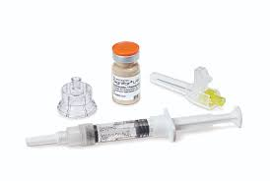
Pasireotide LAR
The initial dose of pasireotide LAR is 40 mg every 4 weeks. If serum GH levels are not suppressed after the first 3 months, the dose may be increased to 60 mg every 4 weeks.
Medical Treatment with Somatostatin Analogues in Acromegaly: Position Statement
Endocrinol Metab 2019;34:53-62
pISSN 2093-596X · eISSN 2093-5978

Slide 54
SWITCHING SOMATOSTATIN ANALOGUES

Slide 55
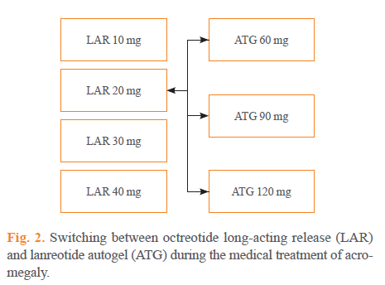
The Korean Endocrine Society (KES) statement
Medical Treatment with Somatostatin Analogues in Acromegaly: Position Statement
Endocrinol Metab 2019;34:53-62
pISSN 2093-596X · eISSN 2093-5978

Slide 56
Switched to pasireotide LAR
When GH secretion is not effectively suppressed after at least 6 months of treatment at the maximum dose of octreotide LAR or lanreotide ATG, the drug may be switched to pasireotide LAR.
Medical Treatment with Somatostatin Analogues in Acromegaly: Position Statement
Endocrinol Metab 2019;34:53-62
pISSN 2093-596X · eISSN 2093-5978

Slide 57
Stable disease activity
KES
in patients who showed stable disease activity after more than 6 months of treatment
Medical Treatment with Somatostatin Analogues in Acromegaly: Position Statement
Endocrinol Metab 2019;34:53-62
pISSN 2093-596X · eISSN 2093-5978

Slide 58
SWITCHING SOMATOSTATIN ANALOGUES
There is no head-to-head study which has directly compared the therapeutic effects of octreotide LAR and lanreotide ATG during treatment of patients with acromegaly.
However, a number of small-scale studies have reported that both therapeutic agents produced similar effects on the improvement of biochemical parameters and reduction of tumor size.
In addition, this study found octreotide LAR and lanreotide ATG did not have common adverse effects , and it may therefore be beneficial to switch to another somatostatin analogue when one fails to achieve the treatment goals or shows certain adverse effects.
Medical Treatment with Somatostatin Analogues in Acromegaly: Position Statement
Endocrinol Metab 2019;34:53-62
pISSN 2093-596X · eISSN 2093-5978

Slide 59
EXTENDED DOSE INTERVAL (EDI)FOR LANREOTIDE ATG
dose interval may be extended when the treatment goals are achieved with low-dose somatostatin analogues.
Lanreotide ATG is the only somatostatin analogue of which the extension of the dose interval has been approved for medical treatment of acromegaly
Medical Treatment with Somatostatin Analogues in Acromegaly: Position Statement
Endocrinol Metab 2019;34:53-62
pISSN 2093-596X · eISSN 2093-5978

Slide 60
EXTENDED DOSE INTERVAL (EDI)FOR LANREOTIDE ATG
KES:
Therefore, for patients whose serum GH concentration is below 2.5 μg/L and clinical symptoms are sufficiently well controlled with octreotide LAR or lanreotide ATG for 3 months or longer, their dose interval may be extended to 8 weeks by switching to lanreotide ATG 120 mg regardless of the dose of somatostatin analogues previously prescribed (expert opinion). The patient’s biochemical parameters, clinical signs and symptoms should be assessed on a regular basis during the use of lanreotide ATG with EDI (expert opinion).
Medical Treatment with Somatostatin Analogues in Acromegaly: Position Statement
Endocrinol Metab 2019;34:53-62
pISSN 2093-596X · eISSN 2093-5978

Slide 61
SPECIAL CIRCUMSTANCES

Slide 62
Adverse effects of somatostatin analogues
may be associated with its inhibition of
Peristalsis and of pancreatic and gastrointestinal peptide secretion
Include:
nausea
diarrhea
abdominal pain
gastrointestinal paralysis
biliary sludge
gallstones
bradycardia
Medical Treatment with Somatostatin Analogues in Acromegaly: Position Statement
Endocrinol Metab 2019;34:53-62
pISSN 2093-596X · eISSN 2093-5978

Slide 63
Adverse effects of somatostatin analogues
in most cases are mild and can be mitigated by reducing the dose or ceasing administration of the drug.
Medical Treatment with Somatostatin Analogues in Acromegaly: Position Statement
Endocrinol Metab 2019;34:53-62
pISSN 2093-596X · eISSN 2093-5978

Slide 64
Blood glucose & somatostatin analogues
It has been reported that SSTR2, a major binding receptor of octreotide or lanreotide, is also expressed in pancreatic α-cells , and somatostatin analogs do not significantly affect the secretion of insulin in pancreatic β-cells, and rarely results in worsening of glucose control.
There are a number of case reports indicating glucose control improved as excessive secretion of GH and IGF-1 was resolved.
Medical Treatment with Somatostatin Analogues in Acromegaly: Position Statement
Endocrinol Metab 2019;34:53-62
pISSN 2093-596X · eISSN 2093-5978

Slide 65
Octreotide
Glucose regulation: Somatostatin analogs may affect glucose regulation.
In type I diabetes, severe hypoglycemia may occur;
in type II diabetes or patients without diabetes, hyperglycemia may occur.
Insulin and other hypoglycemic medication requirements may change.
Octreotide may worsen hypoglycemia in patients with insulinomas; use with caution.
Endocrine & metabolic: Hyperglycemia (2% to 27%), hypothyroidism (2% to 12%)
UP TODATE2020

Slide 66
Lanreotide
Endocrine & metabolic: Diabetes mellitus (≤14%), hyperglycemia (≤14%), hypoglycemia (≤14%), weight loss (5% to 11%)
UP TODATE2020

Slide 67
Blood glucose & somatostatin analogues
On the other hand, it was shown that patients administered pasireotide LAR were more likely to experience hyperglycemia or to develop diabetes when compared with those treated with octreotide LAR.
Unlike SSTR2 in α-cells, pancreatic β-cells and intestinal L-cells secreting glucagon-like peptide 1 (GLP-1) express SSTR5 to which pasireotide binds with high affinity. Therefore, insulin secretion was found to be reduced by pasireotide, possibly leading to the deterioration of glucose control.
Medical Treatment with Somatostatin Analogues in Acromegaly: Position Statement
Endocrinol Metab 2019;34:53-62
pISSN 2093-596X · eISSN 2093-5978

Slide 68
Pasireotide
Endocrine & metabolic: Hyperglycemia (29% to 47%), diabetes mellitus (long-acting release: 21% to 31%; immediate release: 6% to 20%), hypoglycemia (3% to 15%)
UP TODATE

Slide 69
Hyperglycemia during somatostatin analogue therapy
However, insulin sensitivity was not affected .
Metformin is the preferred treatment for patients who become hyperglycemic during somatostatin analogue therapy; dipeptidyl-peptidase-4 inhibitors or GLP-1 receptor agonists are also recommended .
Medical Treatment with Somatostatin Analogues in Acromegaly: Position Statement
Endocrinol Metab 2019;34:53-62
pISSN 2093-596X · eISSN 2093-5978

Slide 70
Pregnancy during the use of somatostatin analogues
there have been 50 cases reported with treatment using somatostatin analogues at the time of conception but no malformations have been found in their children.
However, it is of note that octreotide can bind to SSTR in the placenta and cross the placenta , possibly affecting the fetal development.
Reduced blood flow in uterine artery when treated with short-acting octreotide and intrauterine growth retardation after using a lower dose of octreotide LAR have been reported.
Medical Treatment with Somatostatin Analogues in Acromegaly: Position Statement
Endocrinol Metab 2019;34:53-62
pISSN 2093-596X · eISSN 2093-5978

Slide 71
Pregnancy during the use of somatostatin analogues
KES
Due to the limited data available regarding the safety, it is recommended to use contraception when these drugs are administered and to discontinue somatostatin analogues if pregnancy is considered.
Considering the prolonged nature of the disease course, interruption of medical therapy using somatostatin analogues for 9 to 12 months in patients with acromegaly should not have adverse effects on the long-term outcome.
Medical Treatment with Somatostatin Analogues in Acromegaly: Position Statement
Endocrinol Metab 2019;34:53-62
pISSN 2093-596X · eISSN 2093-5978

Slide 72
Review Article PREDICTIVE MARKERS FOR POST-SURGICAL MEDICAL MANAGEMENT OF ACROMEGALY: A SYSTEMATIC REVIEW AND CONSENSUS TREATMENT GUIDELINE
ENDOCRINE PRACTICE Rapid Electronic Article in Press
DOI:10.4158/EP-2018-0500 © 2018 AACE.

Slide 73
Selection of medical therapy
To clarify selection of medical therapy following transsphenoidal surgery in patients with acromegaly, based on growth hormone/insulin like growth factor -1 (GH/IGF-1) response and glucometabolic control.

Slide 74
Canadian acromegaly specialists
This group has focused on three potential predictive markers:
Pituitary tumor SSTR expression
Tumor pathologic classification based on cell granulation and keratin pattern and
T2-weighted MRI signal intensity
PREDICTIVE MARKERS FOR POST-SURGICAL MEDICAL MANAGEMENT OF ACROMEGALY: A SYSTEMATIC REVIEW AND CONSENSUS TREATMENT GUIDELINE
DOI:10.4158/EP-2018-0500
© 2018 AACE.

Slide 75
Expression of SSTR protein
Overall, these studies suggest that absence and low-level expression of SSTR protein are strongly associated with treatment failure, whereas positive staining is associated with clinical success in approximately half of cases.
PREDICTIVE MARKERS FOR POST-SURGICAL MEDICAL MANAGEMENT OF ACROMEGALY: A SYSTEMATIC REVIEW AND CONSENSUS TREATMENT GUIDELINE
DOI:10.4158/EP-2018-0500
© 2018 AACE.

Slide 76
Cytokeratin staining pattern
The pituitary tumor morphologic classificatio may represent a stronger positive predictor of SSA response. Early evidence that morphologic phenotype might affect clinical response came from a case series by Bando et al. showing that cytokeratin staining pattern in pituitary adenomas correlated strongly with acute biochemical response to octreotide.
PREDICTIVE MARKERS FOR POST-SURGICAL MEDICAL MANAGEMENT OF ACROMEGALY: A SYSTEMATIC REVIEW AND CONSENSUS TREATMENT GUIDELINE
DOI:10.4158/EP-2018-0500
© 2018 AACE

Slide 77
Densely granulated phenotype (DG)
Reports quantifying IGF-1 or GH reduction following short- or long-term SSA treatment were likewise consistent, showing that the DG phenotype was associated with greater IGF-1 reduction, relative to the SG phenotype and a significantly more robust acute reduction in GH in an octreotide challenge
The effect of tumor classification on SSA response appeared similar in the pre-and post-surgical settings.
SG=sparsely granulated
PREDICTIVE MARKERS FOR POST-SURGICAL MEDICAL MANAGEMENT OF ACROMEGALY: A SYSTEMATIC REVIEW AND CONSENSUS TREATMENT GUIDELINE
DOI:10.4158/EP-2018-0500
© 2018 AACE.

Slide 78
Sparsely granulated (SG) tumors
Thus, among 11 patients failing on octreotide or lanreotide, GH/IGF-1 biochemical and clinical response rates following transition to pasireotide treatment were significantly greater in patients with SG tumors, relative to DG tumors
SG=sparsely granulated
PREDICTIVE MARKERS FOR POST-SURGICAL MEDICAL MANAGEMENT OF ACROMEGALY: A SYSTEMATIC REVIEW AND CONSENSUS TREATMENT GUIDELINE
DOI:10.4158/EP-2018-0500
© 2018 AACE

Slide 79
DG tumors
In studies reporting three morphologic phenotypes (DG, intermediate or transitional, and SG), the intermediate group resembled the DG tumors in showing a vigorous short- and long-term reduction in GH and IGF-1, whereas SG adenomas showed a blunted or even negative response to SSA treatment
PREDICTIVE MARKERS FOR POST-SURGICAL MEDICAL MANAGEMENT OF ACROMEGALY: A SYSTEMATIC REVIEW AND CONSENSUS TREATMENT GUIDELINE
DOI:10.4158/EP-2018-0500
© 2018 AACE

Slide 80
SSTR2 expression
Thus, across three directly comparable studies, biochemical response rate was approximately 50% - 53% for SSTR2-high vs. 15% - 20% for SSTR2-moderate vs. 0% for SSTR-negative tumors (p<0.05 in all studies) .
As noted above regarding tumor morphologic classification, SSTR2 expression correlated with improved SSA response, evaluated either pre- or post-surgically
PREDICTIVE MARKERS FOR POST-SURGICAL MEDICAL MANAGEMENT OF ACROMEGALY: A SYSTEMATIC REVIEW AND CONSENSUS TREATMENT GUIDELINE
DOI:10.4158/EP-2018-0500
© 2018 AACE

Slide 81
SSTR protein
Overall, these studies suggest that absence and low-level expression of SSTR protein are strongly associated with treatment failure, whereas positive staining is associated with clinical success in approximately half of cases.
PREDICTIVE MARKERS FOR POST-SURGICAL MEDICAL MANAGEMENT OF ACROMEGALY: A SYSTEMATIC REVIEW AND CONSENSUS TREATMENT GUIDELINE
DOI:10.4158/EP-2018-0500
© 2018 AACE

Slide 82
SSTR2 is clearly insufficient
SSTR2 expression, as expected, is essential for SSA responsiveness, specifically for clinical effects of first-generation SSAs
However, SSTR2 is clearly insufficient, as half of the SSTR2-positive tumors fail to respond to this treatment
Among the potential reasons for treatment failure, one or more intracellular targets may be absent or inactive, even in SSTR2-expressing tumors.
PREDICTIVE MARKERS FOR POST-SURGICAL MEDICAL MANAGEMENT OF ACROMEGALY: A SYSTEMATIC REVIEW AND CONSENSUS TREATMENT GUIDELINE
DOI:10.4158/EP-2018-0500
© 2018 AACE

Slide 83
DG tumors & SSTR2
DG tumors typically express SSTRs, particularly SSTR2 , whereas SG tumors may express SSTR5 at a higher level ; such SSTR5-positive tumors may be sensitive to pasireotide, particularly if refractory to first-generation SSAs
PREDICTIVE MARKERS FOR POST-SURGICAL MEDICAL MANAGEMENT OF ACROMEGALY: A SYSTEMATIC REVIEW AND CONSENSUS TREATMENT GUIDELINE
DOI:10.4158/EP-2018-0500
© 2018 AACE

Slide 84
MRI T2 hypointensity
Low T2 intensity was consistently associated with greater biochemical response to SSA response.
Isointense adenomas showed an intermediate response in some but not all studies.
PREDICTIVE MARKERS FOR POST-SURGICAL MEDICAL MANAGEMENT OF ACROMEGALY: A SYSTEMATIC REVIEW AND CONSENSUS TREATMENT GUIDELINE
DOI:10.4158/EP-2018-0500
© 2018 AACE

Slide 85
MRI
In general, the literature suggests an inverse relationship between T2 signal intensity and SSA clinical and biochemical response, with hypointense tumors showing similar or better response rate relative to iso-intense tumors, and both being superior to hyperintense tumors
Hypointense tumors ≥ Iso-intense tumors>Hyperintense tumors
PREDICTIVE MARKERS FOR POST-SURGICAL MEDICAL MANAGEMENT OF ACROMEGALY: A SYSTEMATIC REVIEW AND CONSENSUS TREATMENT GUIDELINE
DOI:10.4158/EP-2018-0500
© 2018 AACE

Slide 86
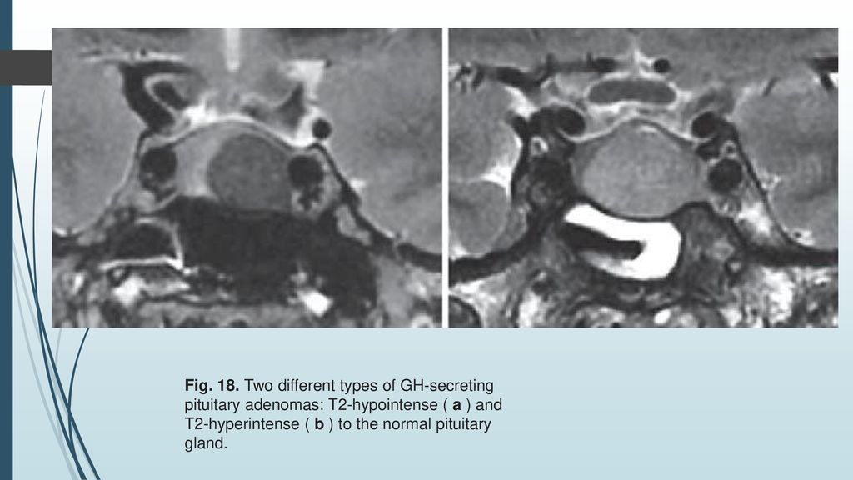

Slide 87
Fail to respond to SSA treatment
MRI and histologic markers may prove better surrogates for these fundamental characteristics, relative to SSTR expression alone. Thus, SG/hyperintense adenomas may maintain measurable SSTR expression but still fail to respond to SSA treatment, due to signaling abnormalities or other post-receptor defects yet to be defined.
PREDICTIVE MARKERS FOR POST-SURGICAL MEDICAL MANAGEMENT OF ACROMEGALY: A SYSTEMATIC REVIEW AND CONSENSUS TREATMENT GUIDELINE
DOI:10.4158/EP-2018-0500
© 2018 AACE

Slide 88
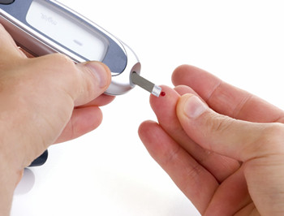
Glucose metabolism
Although changes were non-significant in some studies, fasting glucose and HbA1c levels generally worsened with SSA treatment and improved when patients transitioned to GHRA.
PREDICTIVE MARKERS FOR POST-SURGICAL MEDICAL MANAGEMENT OF ACROMEGALY: A SYSTEMATIC REVIEW AND CONSENSUS TREATMENT GUIDELINE
DOI:10.4158/EP-2018-0500
© 2018 AACE

Slide 89
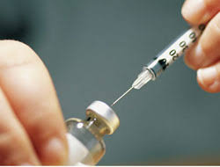
Glucose metabolism
Diabetes developing while on SSAs can be reversed by introducing GHRA monotherapy.
Patients with and without diabetes experienced improvement in glycemic indices 8 to 28 weeks after transition to GHRA . In patients who remain diabetic, insulin dose may decline .
PREDICTIVE MARKERS FOR POST-SURGICAL MEDICAL MANAGEMENT OF ACROMEGALY: A SYSTEMATIC REVIEW AND CONSENSUS TREATMENT GUIDELINE
DOI:10.4158/EP-2018-0500
© 2018 AACE

Slide 90
SSTR expression, coupled with histologic or MRI findings model
Identify the morphologic phenotype, can be used in selecting an initial post-surgical medical option
Several additional considerations apply:
First, SSAs directly reduce tumor size, an important clinical target in some patients with extensive or fast-growing residual tumor mass, and for those who experience headaches or compressive symptoms associated with pituitary tumor mass effects.
Second, DA treatment represents a reasonable option for patients with modest IGF-1 excess.
Third, loss of glycemic control with first- and second-generation SSAs contrasts with improved glycemic control and remission or amelioration of diabetes following GHRA monotherapy.
PREDICTIVE MARKERS FOR POST-SURGICAL MEDICAL MANAGEMENT OF ACROMEGALY: A SYSTEMATIC REVIEW AND CONSENSUS TREATMENT GUIDELINE
DOI:10.4158/EP-2018-0500
© 2018 AACE

Slide 91
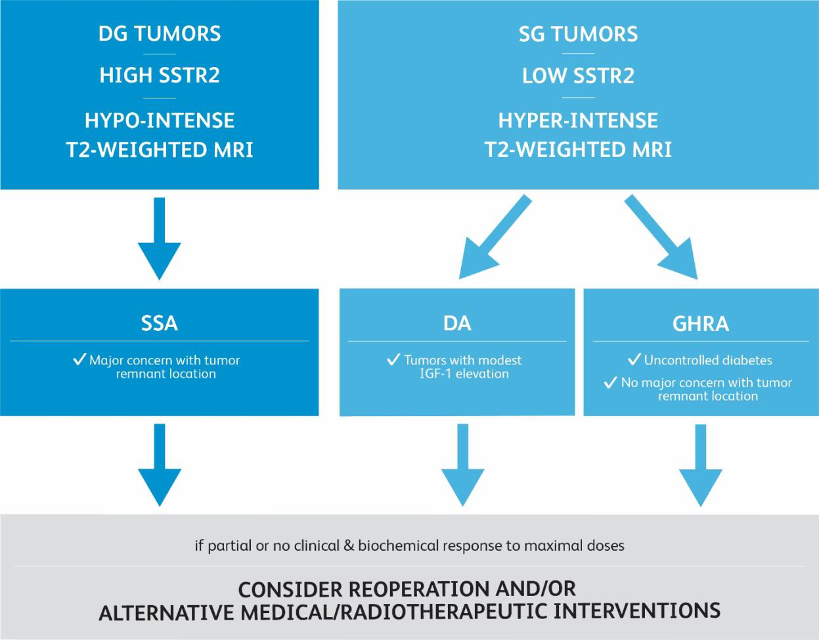
PREDICTIVE MARKERS FOR POST-SURGICAL MEDICAL MANAGEMENT OF ACROMEGALY: A SYSTEMATIC REVIEW AND CONSENSUS TREATMENT GUIDELINE
DOI:10.4158/EP-2018-0500
© 2018 AACE

Slide 93
Inadequate control from initial therapy,
Adjunctive radiotherapy or surgical debulking should be considered
combination therapy :
Potent IGF-1 suppression with GHRA treatment, plus tumor growth suppression with an SSA or suppression of hyperprolactinemia with a DA.
However, it does not appear that combination of SSAs with pegvisomant offsets risk of SSA-induced hyperglycemia.
PREDICTIVE MARKERS FOR POST-SURGICAL MEDICAL MANAGEMENT OF ACROMEGALY: A SYSTEMATIC REVIEW AND CONSENSUS TREATMENT GUIDELINE
DOI:10.4158/EP-2018-0500
© 2018 AACE

Slide 94
Stereotactic radiation therapy (RT)
— If medical therapy is ineffective or not tolerated
Other indications for RT include :
●An adenoma increasing in size despite medical therapy (ie, somatostatin analog plus pegvisomant)
●Aggressive or atypical adenomas
●Patient desire to avoid the cost and administration of long-term medical therapy
UP TODATE2020

Slide 95
Thanks for your attention

