Slide 1
IN THE NAME OF GOD

Slide 2
PRINCIPLES OF DXA SCAN INTERPRETATION
Dr Mozhgan Karimifar Assistant Prof. of Endocrinology Isfahan University of Medical Sciences

Slide 3
Skeletal Anatomy in Densitometry

Slide 4
CHARACTERIZING THE SKELETON IN DENSITOMETRY
A skeletal site may be described as:
Axial or appendicular
Weight-bearing or nonweight-bearing
Central or peripheral
Predominantly cortical or trabecular
R= BONE DENSITOMETRY IN CLINICAL PRACTICE

Slide 5
The axial and appendicular skeleton
Notes:
The axial skeleton includes the skull, ribs, sternum, and spine
In densitometry, “axial bone density study” has traditionally referred to the lumbar spine and PA lumbar spine bone density studies.
The appendicular skeleton includes:extremities and the limb girdles, scapulae, pelvis, proximal femur
R= BONE DENSITOMETRY IN CLINICAL PRACTICE

Slide 6
The Weight-Bearing
The cervical, thoracic, and lumbar spine
Lower extremities
Portions of the pelvis
The small calcaneus
R= BONE DENSITOMETRY IN CLINICAL PRACTICE
Notes:
The small calcaneus is also part of the weight-bearing
skeleton and is perhaps the most sensitive of all the bones to the effects of weight-bearing forces.

Slide 7
The Central and Peripheral Skeleton
This classification is unique to densitometry
Notes:
Central site 1-the spine, in either the PA or lateral projection, 2-the proximal femur
Peripheral sites:1-The calcaneus 2-the various forearm sites
R= BONE DENSITOMETRY IN CLINICAL PRACTICE

Slide 8
The Trabecular/Cortical Composition of the Skeleton
Cortical bone(compact bone, or haversian bone), 80%
Trabecular bone (cancellous or spongious bone ), 20%
R= BONE DENSITOMETRY IN CLINICAL PRACTICE
Notes:
Cortical bone:It is typically found in the shafts of long bones and the vertebral endplates.
Trabecular bone:vertebral bodies, pelvis, and distal ends of long bones.
Trabecular bone contains hematopoietic or fatty marrow.

Slide 9
Skeletal metabolism
Cortical bone = Trabecular bone
R= BONE DENSITOMETRY IN CLINICAL PRACTICE

Slide 10
The greatest magnitude of change (BMD)
Axial trabecular bone > Appendicular trabecular bone
R= BONE DENSITOMETRY IN CLINICAL PRACTICE

Slide 11
Followed over time for changes in the BMD
from a disease process or therapeutic intervention:
Trabecular bone > Cortical bone
R= BONE DENSITOMETRY IN CLINICAL PRACTICE
Notes:
If a patient is being followed over time to look for changes in the BMD from a disease
process or therapeutic intervention, the greatest magnitude of change will generally be
seen at a site that is predominantly trabecular bone.

Slide 12
Hyperparathyroidism
May cause demineralization at predominantly cortical sites, like the femoral neck or 33% radial site.
R= BONE DENSITOMETRY IN CLINICAL PRACTICE

Slide 13
Cushing’s disease
may preferentially destroy the trabecular bone of the axial skeleton.
R= BONE DENSITOMETRY IN CLINICAL PRACTICE

Slide 14
Acromegaly
hypogonadism may cause a profound decrease in the trabecular bone of the spine
while excessive growth hormone causes an increase in the density of the cortical bone of the appendicular skeleton.
R= BONE DENSITOMETRY IN CLINICAL PRACTICE

Slide 15
Percentage of Trabecular Bone at Central and Peripheral Sites
Notes:
a These percentages are for DXA PA spine studies only. A volumetric measurement of 100% trabecular bone could be obtained with QCT.
b These sites are considered to be highly trabecular but the exact percentage of trabecular bone is not known.
c This site is often called the “proximal” site.
d This site is often called the “distal” site.
e Distance in mm indicates the separation distance between the radius and ulna at the site in question.
f This site is often called the ultradistal site, but may be called simply “distal” as well.
R= BONE DENSITOMETRY IN CLINICAL PRACTICE

Slide 16
Skeletal anatomy relevant to DXA
Mostly cancelleous:
Lateral spine, PA(AP)spine-Vertebral bodies
Distal forearm
Femoral trochanter
Calcaneous
Mostly cortical:
Proximal forearm
Total hip, Phalanges

Slide 17
Dual-energy x-ray absorptiometry BMD

Slide 18
BMD
DEXA is the technique of choice in the assessment of bone mineral density (BMD, the average concentration of mineral in a defined section of bone.
Dual-Energy X-Ray Absorptiometry in the Diagnosis of Osteoporosis: A Practical Guide(AJR:196, April 2011)

Slide 19
DEXA
Quick method
Accurate (exact measurement of BMD)
Precise (reproducible)
Flexible (different regions can be scanned)
Low radiation dose
Dual-Energy X-Ray Absorptiometry in the Diagnosis of Osteoporosis: A Practical Guide(AJR:196, April 2011)

Slide 20
DXA Technology
A DEXA scanner consists of a low-dose x-ray tube with two energies for separating mineral and soft-tissue components and a high-resolution multi detector array.
Dual-Energy X-Ray Absorptiometry in the Diagnosis of Osteoporosis: A Practical Guide(AJR:196, April 2011)

Slide 21
DXA Technology
Detector (detects 2 tissue types - bone and soft tissue)
Very low radiation to patient.
Very little scatter radiation to technologist
Patient
Collimator (pinhole for pencil beam, slit for fan beam)
Photons
X-ray Source (produces 2 photon energies with different attenuation profiles)

Slide 22
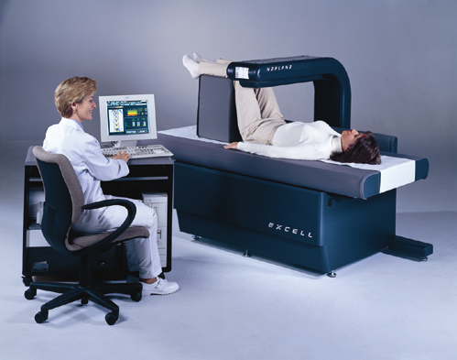
ISCD

Slide 23
Areas Scanned
Lumbar spine
Proximal femur
Forearm
Two regions should be measured so that if one is unevaluable, the forearm can be imaged.
Dual-Energy X-Ray Absorptiometry in the Diagnosis of Osteoporosis: A Practical Guide(AJR:196, April 2011)

Slide 24
For children (younger than 20 years)
Only the lumbar spine
Variability in femoral maturation results in lack of reproducibility in the hip region
so the reference database is available only for the spine
Dual-Energy X-Ray Absorptiometry in the Diagnosis of Osteoporosis: A Practical Guide(AJR:196, April 2011)

Slide 25
Analysis of BMD
Five steps:
1- Identification character
2- Good scan criterion
3- Region of Interest (ROI)
4- Area
5- Interpretation
Notes:
ISCD( INTERNATIONAL SOCIETY OF CLINICAL DENSITOMETRY)

Slide 26
Identification character
Name
Age
BW
Height
Reference population

Slide 27
Reference population
Ethnicity
ISCD:
Spine → Caucasian
White (If it was not avaliable)
HIP → NANHENS ΙΙΙ
ISCD( INTERNATIONAL SOCIETY OF CLINICAL DENSITOMETRY)

Slide 28
Good scan criterion
1- Appropriate patient positioning
2- Artifact
3- Scan Range
Upper
Lower
Lateral

Slide 29
Positioning for PA(AP) spine:
Center patient on scanner table
Align patient with scanner axis
Raise legs with positioning block
PA spine, optimal positioning:
Spine is centered
Spine is straight (not tilted)
Both iliac crests are visible
Scan includes (middle of L5 and middle of T12)

Slide 30
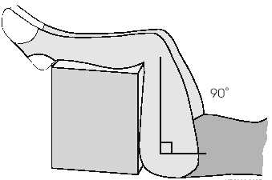
AP lumbar spine
Positioning aids:
Knee positioner
Helps to keep the back flat reduces lordotic curve of spine
3 different patient heights: small, medium, large
Place the positioner to the good side to adjust the size of patient’s legs

Slide 31
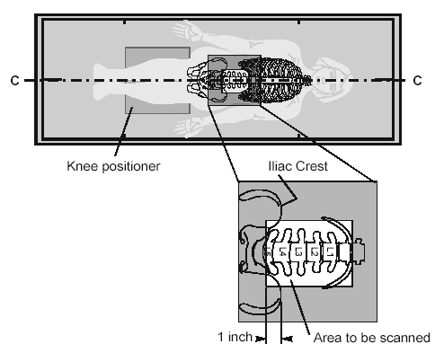
AP lumbar spine

Slide 32
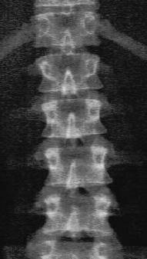
AP lumbar spine
AP Lumbar spine
Criteria:
Start in the middle of L5
The iliac crest: in both lower corners
AP lumbar spine is centered in the middle of the scan window
Even amount of soft tissue on each side of spine
Stop where ribs attach to T12
Notes:
Dual-Energy X-Ray Absorptiometry in the Diagnosis of Osteoporosis: A Practical Guide

Slide 33
A graphic illustration of the characteristic shapes of the lumbar vertebrae as seen on a DXA PA spine study.
R= BONE DENSITOMETRY IN CLINICAL PRACTICE
Notes:
The unique shapes of the posterior elements of the various lumbar vertebrae can be used as an aid in identifying the lumbar vertebrae. The posterior elements of L1, L2, and L3 have a U- or Y-shaped appearance. L4 can be described as looking like a block H or X. L5 has the appearance of a block I on its side. Although the transverse processes are generally not seen on a spine bone density study, the processes at L3 will sometimes be partially visible because this vertebra tends to have the largest transverse processes.

Slide 34
AP lumbar spine
½ T12
→2cm←
½ L5

Slide 35
Lumbar spine
Posteroanterior images of the lumbar spine include vertebral bodies L1–L4.
Dual-Energy X-Ray Absorptiometry in the Diagnosis of Osteoporosis: A Practical Guide

Slide 36
Hip scan
Photograph shows position for imaging of proximal femur: supine with lower extremity internally rotated 15°–30° and slightly abducted to keep femoral axis straight.
Place shaft of femur parallel to scanner axis

Slide 37
Proper rotation of hip
The size of the lesser trochanter is the best indication of the degree of rotation
BMD values →degree of rotation of proximal femur and the position of the femoral neck ROI
Internal or external rotation →↑ BMD
BONE DENSITOMETRY IN CLINICAL PRACTICE APPLICATION AND INTERPRETATION SECOND EDITION

Slide 38
Proximal femur
Either hip
The lowest-level data on the femoral neck and total hip are used for diagnosis.
Total hip is the most reproducible measurement of the hip.

Slide 39
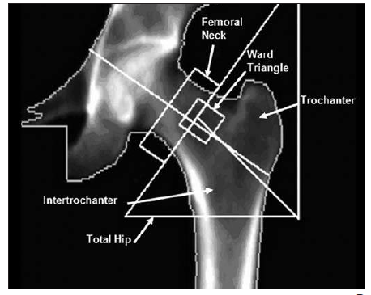
Notes:
and Ward triangle. Total hip image comprises four ROIs. Image includes all of femoral head and at least 1 cm
under region of lesser trochanter, which should not be seen owing to rotation. Femoral axis is straight.
R=Dual-Energy X-Ray Absorptiometry in the Diagnosis of Osteoporosis: A Practical Guide

Slide 40
Forearm
is used in three conditions:
when the hip and spine cannot be measured the data interpreted
in examinations of patients with hyperparathyroidism
Those whose weight exceeds the limit for the table
Dual-Energy X-Ray Absorptiometry in the Diagnosis of Osteoporosis: A Practical Guide

Slide 41
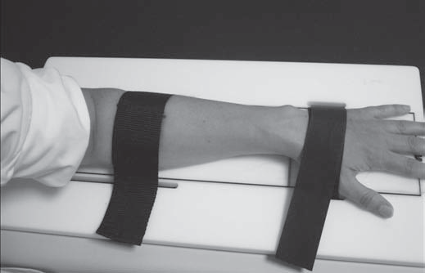
Photograph shows position for imaging of forearm: sitting beside table with forearm resting on table, hand pronated and held by straps.
Notes:
Dual-Energy X-Ray Absorptiometry in the Diagnosis of Osteoporosis: A Practical Guide(AJR:196, April 2011)

Slide 42
Forearm scan
Optimal positioning:
Forearm is centered
Radius and ulna straight
Distal cortex of radius and ulna visible
Check for artifacts

Slide 43
Primary hyperparathyroidism
The areas imaged are
total bone
one third of the radius
the ultradistal radius, and the ulna

Slide 44
Primary hyperparathyroidism
The most useful measurements are
the ultradistal portion of the radius as an indicator of trabecular bone loss and
the distal one third of the radius (distal radial diaphysis, excluding the ultradistal portion) as an indicator of cortical bone mineral loss.

Slide 45
Primary hyperparathyroidism
According to the International Society
for Clinical Densitometry, the distal one
third (33% radius) of the nondominant forearm
is the region of choice in the assessment of osteoporosis.

Slide 46
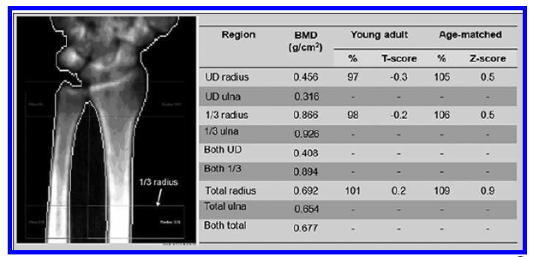
DEXA image of left forearm. Most important ROI is one-third (1/3) radius (arrow). Image should include 2 cm of diaphysis over one third of forearm and part of carpal bones. Axis is straight and centered.
Dual-Energy X-Ray Absorptiometry in the Diagnosis of Osteoporosis: A Practical Guide(AJR:196, April 2011)

Slide 47
Vertebral Anatomy

Slide 48
Notes:
(A) A DXA PA spine image acquired on the Lunar DPX. This is the spine image from
the study shown in Fig. 2-4, with the intervertebral disk markers and bone-edge markers removed
for clarity. (B) The shapes have been outlined for emphasis.

Slide 49
Notes:
A DXA PA spine study acquired on the Lunar DPX. The shapes of the vertebrae in this
image are primarily created by the posterior elements. The shapes in this study are classic. The
expected increase in BMC and area is also seen from L1 to L4. The increase in BMD from L1 to
L3, with a decline from L3 to L4, is also typical.

Slide 50
L1 frequently has the lowest BMC and BMD
the BMC increased between L1–L2, L2–3, and L3–4 although the increase
between L3–4 was roughly half that seen at the other levels
The largest increase in BMD occurred between L1–2.

Slide 51
Incremental Change in BMC and BMD Between Adjacent Vertebrae in 148 Normal Women Ages 50–60 as Measured by DXA
a Not statistically significant

Slide 52
The majority of individuals have five lumbar vertebrae with the lowest set of ribs on T12

Slide 53
Percentage of Women with Various Combinations of Numbers of Lumbar Vertebrae and Position of Lowest Ribs
No. of Lumbar Vertebrae | Position of Lowest Ribs | % of Women
5 | T12 | 83.5%
5 | T11 | 7.2%
4 | T12 | 2.1
4 | TT11 | 5.3%
6 | T12 | 1.1%
6 | L1 | 0.8%
Notes:
Reprinted ref. 12 with permission from the American Society for Bone and Mineral Research.

Slide 54
Notes:
A DXA PA spine study acquired on the Lunar DPX. The vertebra labeled L4 has a classic
block H or X shape. No ribs are seen however, protruding from the vertebra that should be T12.
It is far more likely that this represents five lumbar vertebrae with the lowest ribs on T11 than six
lumbar vertebrae with the lowest ribs on T12. Also note that the BMD at L1 is higher than at L2,
which is unusual. A lateral lumbar spine X ray of this patient, shown in Fig. 2-9, confirmed a
fracture at L1.

Slide 56
Artifacts in PA or AP Spine Densitometry

Slide 57
VERTEBRAL FRACTURES
The BMD of a fractured vertebra will be increased
Vertebral fractures in osteoporosis frequently occur in the:
T7–T9
T12–L2

Slide 58
VERTEBRAL FRACTURES
FX lumbar vertebra can be excluded
↓ the maximum number of contiguous vertebrae
For reasons of statistical accuracy and precision, the BMD for three or four contiguous vertebrae is preferred over two-vertebrae averages or the BMD of a single vertebra.

Slide 59
Notes:
A DXA PA spine study acquired on the Norland XR-36. The image suggests a loss of
vertebral height and increased sclerosis at L3. Although the BMD at L3 is expected to be higher
than at L2, the BMD at L3 here is markedly higher. These findings suggest a fracture at this level
but this must be confirmed. In any case, the L2–L4 BMD will be increased by this structural
change. Case courtesy of Norland, a CooperSurgical Company, Ft. Atkinson, WI.

Slide 60
DEGENERATIVE CHANGES AND DYSTROPHIC CALCIFICATION
↑ BMD:
Osteophytes and facet scleros
Aortic calcification

Slide 61
A DXA PA spine study acquired on the Lunar DPX. The image dramatically suggests the sclerotic process seen on the X ray in Fig. 2-12. There is a marked increase in the BMD at L2 and L3 compared to L1 and L4.

Slide 62
Effect of Aortic Calcification on BMD.
Although it did not significantly increase
BMD, vascular calcification was seen in 24.3% of the 144 postmenopausal women
studied by Rand et al.
The percentage with any degree of aortic calcification
was extremely low under age 60 but increased dramatically in women aged 60 and
older.

Slide 63
Notes:
PA and lateral DXA lumbar spine images acquired on the Hologic QDR-4500. The
arrow seen in (A) indicates the faint outline of the calcified aorta that is easily seen on the lateral
study in (B).

Slide 64
Effect of Facet Sclerosis on BMD
Notes:
A DXA PA lumbar spine study acquired on the GE Lunar DPX. There is a marked
increase in the BMD between L2 and L3, which is maintained at L4. The image faintly suggests
sclerosis in the region of the facet joints at L3 and L4. This is more dramatically seen in the plain
film of this patient shown in Fig. 2-18.

Slide 65
THE VERTEBRAL ROTATION AND PA LUMBAR SPINE BONE DENSITY
Rotation of the vertebral bodies is often a component of idiopathic scoliosis, although
it is not frequently seen in adult-onset degenerative scoliosis.
In clinical practice then, rotation of the spine for any reason, should be expected to cause
an apparent decrease in bone density when measured with DXA.

Slide 66
increases in the BMD
pancreatic calcifications
Renal stones
gall stones
contrast agents
ingested calcium tablets in addition to osteophytes
aortic calcification
fractures.

Slide 67
THE PROXIMAL FEMUR IN DENSITOMETRY
the femoral neck
Ward’s area
the trochanteric region and
the shaft

Slide 68
In positioning the patient for a proximal femur study, internally rotating the femur
15 to 20° will bring the femoral neck parallel to the plane of the scan table.
If the femoral neck rotation is increased or decreased from this position, the femoral neck BMD value will increase.

Slide 69
Notes:
Images of the proximal femur acquired during a DXA study. In (A) the lesser trochanter
is clearly seen but is small and rounded, indicating proper internal rotation of the proximal femur
during positioning. Compare this lesser trochanter to the lesser trochanter seen in (B). This is the
same patient seen in (A) but here the proximal femur was not rotated internally sufficiently causing
the lesser trochanter to appear large and pointed.

Slide 70
Effect of Leg Dominance on BMD in the Proximal Femur
In general, there does not seem to be a significant difference in the BMD in the regions of the proximal femur between the right and left legs of normal individuals

Slide 71
Effect of Scoliosis, Osteoarthritis, Osteophytes, Surgery, and Fracture on BMD in the Proximal Femur
Osteoarthritic change in the hip joint→↑BMD

Slide 72
the preferred site to evaluate in patients with osteoarthritis of the hip
The trochanteric region(not apparently affected)
Notes:
Osteoarthritic change in the hip joint may
cause thickening of the medial cortex and hypertrophy of the trabeculae in the femoral
neck, which may increase the BMD in the femoral neck and Ward’s area

Slide 73
In patients with scoliosis
however, lower bone densities have been
reported on the side of the convexity.
If a “worst-case” measurement is desired, the
bone density in the proximal femur should be measured in the femur on the side of the
convexity.

Slide 74
THE FOREARM IN DENSITOMETRY

Slide 75
The forearm is used in three conditions:
The hip and spine cannot be measured or the data interpreted
Patients with hyperparathyroidism
Whose weight exceeds the limit for the table
Dual-Energy X-Ray Absorptiometry in the Diagnosis of Osteoporosis: A Practical Guide(AJR:196, April 2011)

Slide 76
Primary hyperparathyroidism
Recommendations include measurement at the three sites (hip, spine, and radius) for diagnosis and for follow-up after surgical and medical treatment.

Slide 77
Commonly measured sites are the 33% or 1/3rd site3, the
50%, and 10% sites, the 5-mm and 8-mm sites, and the ultradistal site. The sites designated
by a percentage are named based on the location of the site in relation to the overall
length of the ulna.

Slide 78
Proximal sites
Distal site
ultradistal site
Notes:
The forearm. The scale at the bottom of the figure indicates ulnar length. The numbers
reflect the percentage of ulnar length at which commonly measured sites are centered on either bone.
The arrow between the two bones indicates the 8-mm separation point. R identifies the radius.
U identifies the ulna. (Adapted from McMinn RMH, Hutchings RT, Pegington J, and Abrahams PH.
[1993] Colour Atlas of Human Anatomy, 3rd edition, p. 110. By permission of the publisher Mosby.)

Slide 79
Norland
Notes:
A DXA study of the forearm acquired on the Norland pDEXA. Note the location of the
regions of interest called the distal (dist.) and proximal (prox.) regions of interest. BMD values are
given for the radius and ulna combined at both regions and for the radius alone at the proximal
region of interest.

Slide 80
A DXA study of the forearm acquired on the Lunar DPX. The two primary regions of interest are the ultradistal (UD) and 33% regions.

Slide 81
Three regions of interest are shown here. An ultradistal (UD), mid, and 1/3 region of interest are indicated.
Notes:
Note
that the mid-region here is clearly not located at a point that would correspond to 50% of ulnar
length. It is between the ultradistal and 1/3 sites.

Slide 82
Effect of Arm Dominance on Forearm BMD
Unlike the proximal femur, arm dominance has a pronounced effect on the bone density
in the forearm. In healthy individuals, the BMC at the 33% radial site differs by 6 to 9%
between the dominant and nondominant arms.
A difference of 3% has been reported
at the 8-mm site

Slide 83
Because
of these recognized differences, the nondominant arm has traditionally been studied when
the bone content or density is quantified for the purposes of diagnosis or fracture risk
assessment.

Slide 84
Some manufacturers supply databases for the dominant arm that can
be used for comparisons if the dominant arm is to be studied. The operator’s manual for the
densitometry device should be consulted to determine which arm was used to create the
database(s) provided by the manufacturer.

Slide 85
The effect of movement during a forearm scan
The presence of a prior fracture → ↑BMD
Movement artifact appeared to slightly decrease the measured BMD

Slide 86
THE STANDARDIZED BMD

Slide 87
Conversion Formulas for L2-L4 BMDs of the PA Spine Between DXA Devices
Bone Densitometry for Technologists(Third Edition)
Notes:
Adapted from the Journal of Bone and Mineral Research 1994; 9: 1503–1514 with permission
from the American Society for Bone and Mineral Research

Slide 88
Formulas for the Conversion of Manufacturer-Speci fi c L2–L4 PA Spine BMDs to the Standardized BMD (sBMD)
Bone Densitometry for Technologists(Third Edition)

Slide 89
Formulas for the Conversion of Manufacturer-Speci fi c Total Femur BMD to the Standardized BMD (sBMD)
Bone Densitometry for Technologists(Third Edition)

Slide 90
The Utility of the sBMD
The sBMD is attractive as a means of comparing a BMD value obtained on one manufacturer’s device with a BMD value obtained on another.
This is useful in large population studies and clinical trials in which devices from several manufacturers must be used.
Bone Densitometry for Technologists(Third Edition)

Slide 91
Interpretation of BMD
BMD g/cm ²
T-score, which represents the SD by which the BMD differs from the mean BMD of a young adult reference population of the same ethnicity and sex
Dual-Energy X-Ray Absorptiometry in the Diagnosis of Osteoporosis: A Practical Guide(AJR:196, April 2011)

Slide 92
Interpretation of BMD
Z-score, which is the SD by which the BMD differs from the mean BMD of a healthy population of the same ethnicity, sex, and age as the person undergoing DEXA.
Dual-Energy X-Ray Absorptiometry in the Diagnosis of Osteoporosis: A Practical Guide(AJR:196, April 2011)

Slide 93
Estimation of fracture risk
each SD in T-score increases risk by a factor of 2
Fracture Risk = 2 ^{T-score}
Dual-Energy X-Ray Absorptiometry in the Diagnosis of Osteoporosis: A Practical Guide(AJR:196, April 2011)

Slide 94
DEFINITION of Osteoporosis WHO
among postmenopausal women and
men ≥50 years
diagnosis is based on T-score:
Normal > –1.0
Osteopenia→ –1 to –2.5
Osteoporosis < –2.5.
Dual-Energy X-Ray Absorptiometry in the Diagnosis of Osteoporosis: A Practical Guide(AJR:196, April 2011)

Slide 95
World Health Organization
Z-scores are used:
premenopausal women
Men younger than 50 years
children and teenagers (younger than 20 years)
Dual-Energy X-Ray Absorptiometry in the Diagnosis of Osteoporosis: A Practical Guide(AJR:196, April 2011)

Slide 96
Z-score
Osteoporosis
should not be diagnosed on the basis of densitometric criteria alone.
A Z-score less than –2 indicates the diagnosis is below the expected range for age (adults)
or
low bone density for chronologic age (children).
Dual-Energy X-Ray Absorptiometry in the Diagnosis of Osteoporosis: A Practical Guide(AJR:196, April 2011)

Slide 97
Z-score
low BMD Z-scores (age-matched comparison) identify individuals requiring further evaluation for secondary causes of osteoporosis.
UP TO DATE ( Feb 2019)

