Slide 1

The Diagnosis and Management of
Nonalcoholic Fatty Liver Disease:
Practice Guidance From the American
Association for the Study of Liver Diseases
N. Chalasani, et al., HEPATOLOGY, VOL. 67, NO. 1, 2018.
Presented by G. Taghipour, MD

Slide 2
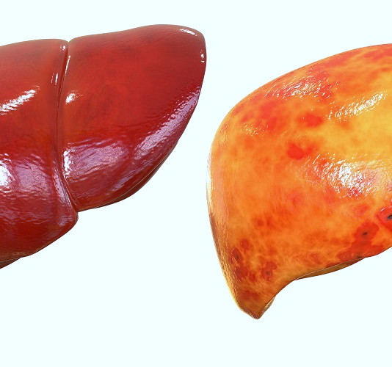
Nonalcoholic fatty liver disease
(NAFLD)
Encompasses the entire spectrum of FLD in individuals without significant alcohol consumption, ranging from fatty liver to SH to cirrhosis.
Notes:
© Copyright Showeet.com – Free PowerPoint Templates

Slide 3

Ongoing or recent alcohol consumption
>21 standard drinks on average per week in men
>14 standard drinks on average per week in women
A standard alcoholic drink is any drink that contains about 14 g of pure alcohol.
Notes:
© Copyright Showeet.com – Free PowerPoint Templates

Slide 4
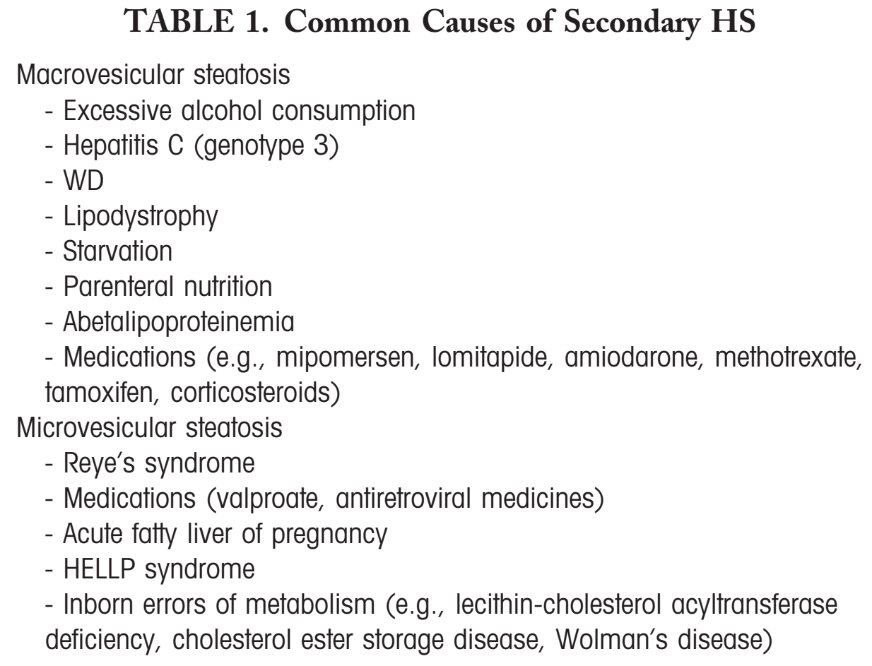
NAFLD Definitions
Evidence of hepatic steatosis (HS), either by imaging or histology,
Lack of secondary causes of hepatic fat accumulation such as significant alcohol consumption, longterm use of a steatogenic medication, or monogenichereditary disorders
Notes:
© Copyright Showeet.com – Free PowerPoint Templates

Slide 5
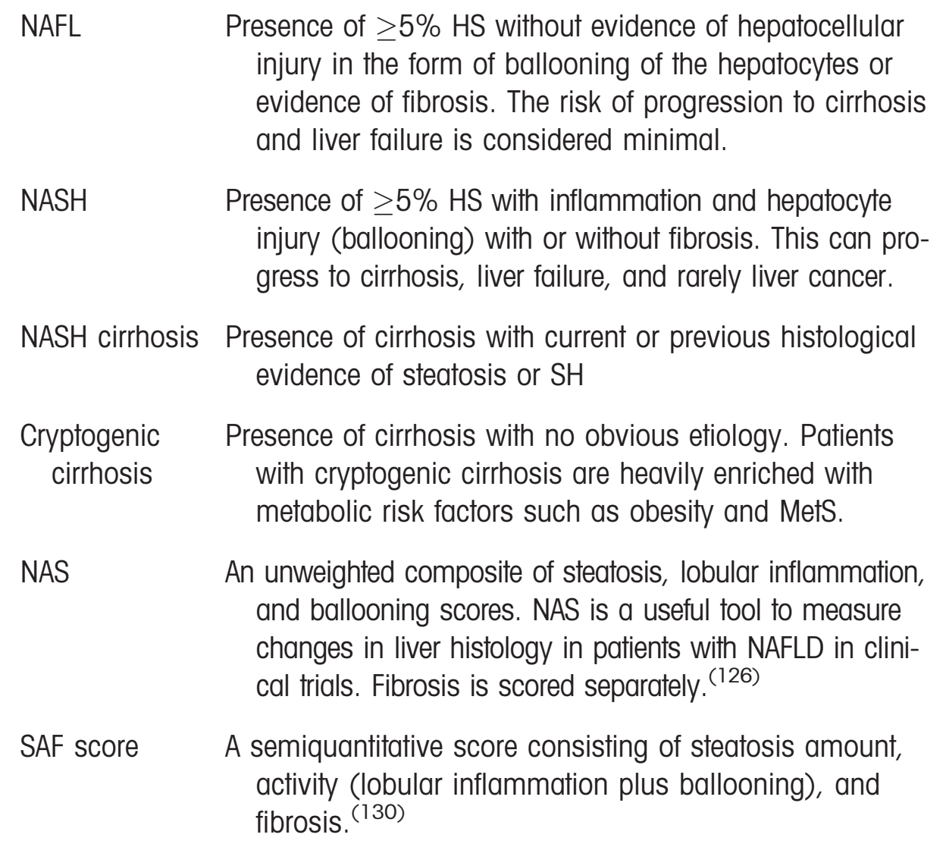
NAFLD
In the majority of patients, NAFLD is commonly associated with metabolic comorbidities such as
Obesity,
Diabetes mellitus,
and Dyslipidemia.
Notes:
© Copyright Showeet.com – Free PowerPoint Templates

Slide 6
Incidence and Prevalence of
NAFLD
The prevalence of NASH among NAFLD
patients who had liver biopsy for a “clinical
indication” is estimated to be 59.10% (95% CI,47.55-69.73).
The prevalence of NASH among NAFLD patients who had liver biopsy without a specific “clinical indication” (random biopsy for living related donors, etc.) is estimated from 6.67% (95% CI, 2.17-18.73) to 29.85% (95% CI, 22.72-38.12).
Given these estimates, one estimates that the prevalence of NASH in the general population ranges between 1.5% and 6.45%.
The gold standard for diagnosing NASH remains a liver biopsy. Given that liver biopsy is not feasible in studies of the general population, there is no direct assessment of the incidence or prevalence of NASH.
Notes:
© Copyright Showeet.com – Free PowerPoint Templates

Slide 7
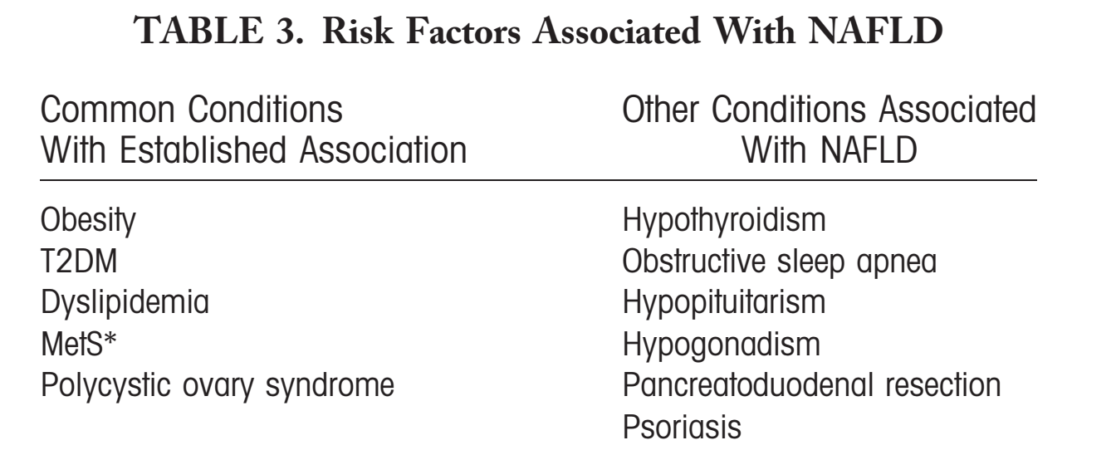
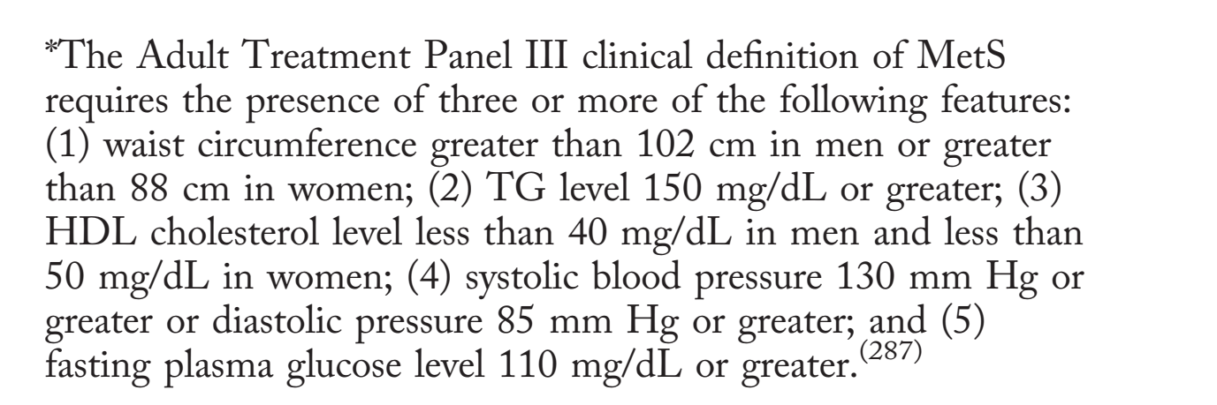
Prevalence of NAFLD in
High-Risk Groups
Features of metabolic syndrome (MetS) are not only highly prevalent in patients with NAFLD, but components of MetS also increase the risk of developing NAFLD.
This bidirectional association between NAFLD and components of MetS has been strongly established.
Notes:
© Copyright Showeet.com – Free PowerPoint Templates

Slide 8
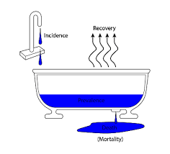
Incidence and Prevalence of
NAFLD
Although controversial, male sex has been considered a risk factor for NAFLD. Furthermore, the prevalence of NAFLD in men is 2 times higher than in women.
Hispanic individuals have a significantly higher prevalence of NAFLD, whereas non-Hispanic blacks have a significantly lower prevalence of NAFLD.
In summary, the incidence of NAFLD varies across the world, ranging from 28.01 per 1,000 person-years (95% CI, 19.34-40.57) to 52.34 per 1,000 personyears (95% CI, 28.31-96.77).
Notes:
© Copyright Showeet.com – Free PowerPoint Templates

Slide 9
Outcomes of NAFLD
Although liver-related mortality is the 12th leading cause of death in the general population, it is the second or third cause of death among patients with NAFLD.
Cancer-related mortality is among the top three causes of death in subjects with NAFLD.
Patients with histological NASH have an increased liver-related mortality rate.
The most important histological feature of NAFLD associated with long-term mortality is fibrosis; specifically, zone 3 sinusoidal fibrosis plus periportal fibrosis (stage 2) to advanced (bridging fibrosis [stage 3] or cirrhosis [stage 4]).
Patients with NAFLD have increased overall mortality compared to matched control populations without NAFLD.
The most common cause of death in patients with NAFLD is cardiovascular disease (CVD), independent of other metabolic comorbidities.
Notes:
© Copyright Showeet.com – Free PowerPoint Templates

Slide 10
Outcomes of NAFLD
NAFLD is now considered the third-most common cause of hepatocellular carcinoma (HCC) in the USA.
Given the growing epidemic of obesity, the incidence of NAFLD-related HCC has been shown to increase at a 9% annual rate.
Patients with NAFLD-related HCC are older, have a shorter survival time, more often have heart disease, and are more likely to die from their primary liver cancer than other HCC patients.
Notes:
© Copyright Showeet.com – Free PowerPoint Templates

Slide 11
Outcomes of NAFLD
NASH is now ranked as the second-most common cause of LT a.
Another important, long-term outcome of liver disease is the development of HCC. The current HCC incidence rate among NAFLD patients was determined to be 0.44 (range, 0.29-0.66) per 1,000 person-years.
It is estimated that the risk for developing HCC in NAFLD patients without cirrhosis is very small.
Notes:
© Copyright Showeet.com – Free PowerPoint Templates

Slide 12
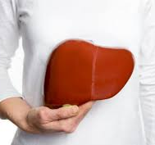
EVALUATION OF INCIDENTALLY
DISCOVERED HEPATIC
STEATOSIS (HS)
Some patients undergoing thoracic and abdominal imaging for reasons other than liver symptoms, signs, or abnormal biochemistry may demonstrate unsuspected HS.
Notes:
© Copyright Showeet.com – Free PowerPoint Templates

Slide 13
EVALUATION OF INCIDENTALLY
DISCOVERED HEPATIC STEATOSIS
Patients with unsuspected HS detected on imaging who have symptoms or signs attributable to liver disease or have abnormal liver chemistries should be evaluated as though they have suspected NAFLD and worked up accordingly.
Patients with incidental HS detected on imaging who lack any liver-related symptoms or signs and have normal liver biochemistries should be assessed for metabolic risk factors (e.g., obesity, diabetes mellitus, or dyslipidemia) and alternate causes for HS such as significant alcohol consumption or medications.
Notes:
© Copyright Showeet.com – Free PowerPoint Templates

Slide 14
Screening for NAFLD
Routine Screening for NAFLD in high-risk groups attending primary care, diabetes, or obesity clinics is not advised at this time because of uncertainties surrounding diagnostic tests and treatment options, along with lack of knowledge related to long-term benefits and cost-effectiveness of screening.
There should be a high index of suspicion for NAFLD and NASH in patients with type 2 diabetes.
Clinical decision aids such as NFS or fibrosis-4 index (FIB-4) or vibration controlled transient elastography (VCTE) can be used to identify those at low or high risk for advanced fibrosis (bridging fibrosis or cirrhosis).
.
Notes:
© Copyright Showeet.com – Free PowerPoint Templates

Slide 15
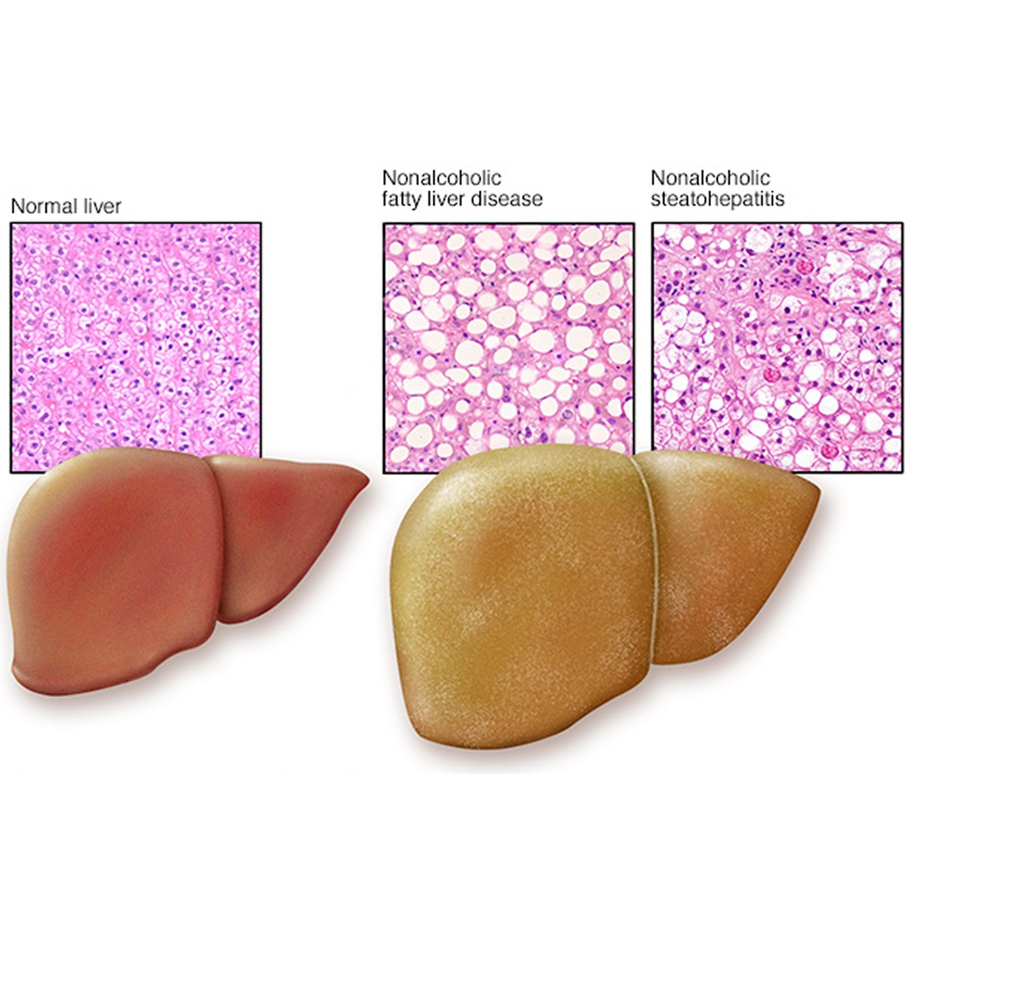
Initial Evaluation of the Patient With Suspected NAFLD
The diagnosis of NAFLD requires that
(1) there is HS by imaging or histology,
(2) there is no significant alcohol consumption,
(3) there are no competing etiologies for HS,
(4) there are no coexisting causes of
CLD.
Notes:
© Copyright Showeet.com – Free PowerPoint Templates

Slide 16
Initial Evaluation of the Patient With Suspected NAFLD
When evaluating a patient with suspected NAFLD, it is essential to exclude competing etiologies for steatosis and coexisting common CLD.
In patients with suspected NAFLD, persistently high serum ferritin, and increased iron saturation, especially in the context of homozygote or heterozygote C282Y HFE mutation, a liver biopsy should be considered.
Notes:
© Copyright Showeet.com – Free PowerPoint Templates

Slide 17
Initial Evaluation of the Patient With Suspected NAFLD
High serum titers of autoantibodies in association with other features suggestive of autoimmune liver disease (>5 ULN aminotransferases, high globulins, or high total protein to albumin ratio) should prompt a work-up for autoimmune liver disease.
Initial evaluation of patients with suspected NAFLD should carefully consider the presence of commonly associated comorbidities such as obesity, dyslipidemia, IR or diabetes, hypothyroidism, polycystic ovary syndrome, and sleep apnea.
When evaluating a patient with suspected NAFLD, it is essential to exclude competing etiologies for steatosis and coexisting common CLD.
Notes:
© Copyright Showeet.com – Free PowerPoint Templates

Slide 18
Noninvasive Assessment
The natural history of NAFLD is fairly dichotomous—NAFL is generally benign, whereas NASH can progress to cirrhosis, liver failure, and liver cancer.
Notes:
© Copyright Showeet.com – Free PowerPoint Templates

Slide 19
Noninvasive Assessment
Liver biopsy is currently the most reliable approach for identifying the presence of steatohepatitis (SH) and fibrosis in patients with NAFLD, but it is generally acknowledged that biopsy is limited by cost, sampling error, and procedure-related morbidity and mortality.
Serum aminotransferase levels and imaging tests, such as ultrasound, computed tomography (CT), and MR, do not reliably reflect the spectrum of liver histology in patients with NAFLD.
There has been significant interest in developing clinical prediction rules and noninvasive biomarkers for identifying SH in patients with NAFLD.
Notes:
© Copyright Showeet.com – Free PowerPoint Templates

Slide 20
Noninvasive Assessment
MR imaging, either by spectroscopy or by proton density fat fraction, is an excellent noninvasive modality for quantifying HS and is being widely used in NAFLD clinical trials.
The use of TE to obtain continuous attenuation parameters is a promising tool for quantifying hepatic fat in an ambulatory setting.
Circulating levels of cytokeratin-18 fragments have been investigated extensively as novel biomarkers for the presence of SH in patients with NAFLD.
The presence of MetS is a strong predictor for the presence of SH in patients with NAFLD.
Patients with NAFLD and multiple risk factors such as T2DM and hypertension are at the highest risk for adverse outcomes.
Notes:
© Copyright Showeet.com – Free PowerPoint Templates

Slide 21
Noninvasive Assessment
The commonly investigated noninvasive tools for the presence of advanced fibrosis in NAFLD include
Clinical decision aids (e.g., NAFLD fibrosis score, FIB-4 index, aspartate aminotransferase [AST] to platelet ratio index [APRI]),
Serum biomarkers (Enhanced Liver Fibrosis [ELF] panel, Fibrometer, FibroTest, and Hepascore),
Imaging (eg, TE, MR elastography [MRE], acoustic radiation force impulse imaging, and supersonic shear wave elastography).
Notes:
© Copyright Showeet.com – Free PowerPoint Templates

Slide 22
Noninvasive Assessment
Formula :
-1.675 + 0.037 × age (years) + 0.094 × BMI (kg/m²) + 1.13 × IFG/diabetes (yes = 1, no = 0) + 0.99 × AST/ALT ratio – 0.013 × platelet (×109/l) – 0.66 × albumin (g/dl)
Explanation of Result :
NAFLD Score < -1.455 = F0-F2
NAFLD Score -1.455 – 0.675 = indeterminate score
NAFLD Score > 0.675 = F3-F4
Ref: http://gihep.com/calculators/hepatology/nafld-fibrosis-score/
The NFS is based on six readily available variables (age, BMI, hyperglycemia, platelet count, albumin, and AST/ALT ratio)
A score <–1.455 had 90% sensitivity and 60% specificity to exclude advanced fibrosis, whereas a score >0.676 had 67% sensitivity and 97% specificity to identify the presence of advanced fibrosis.
Notes:
© Copyright Showeet.com – Free PowerPoint Templates

Slide 23
Noninvasive Assessment
Formula :
( Age x AST ) / ( Platelts x ( sqr ( ALT ) )
Explanation of Result :
For NASH :
Fib4 score < 1.30 = F0-F1
Fib4 score > 2.67 = F3-F4
For HCV with or without HIV :
Fib4 score < 1.45 = F0-F1
Fib4 score > 3.25 = F3-F4
Ref: http://gihep.com/calculators/hepatology/fibrosis-4-score/
FIB-4 index is an algorithm based on platelet count, age, AST, and ALT that offers dual cut-off values (patients with score <1.45 are unlikely, whereas patients with score >3.25 are likely to have advanced fibrosis).
Notes:
© Copyright Showeet.com – Free PowerPoint Templates

Slide 24
Noninvasive Assessment
The ELF panel consists of plasma levels of 3 matrix turnover proteins (hyaluronic acid, tissue inhibitor of metalloproteinase 1, and N-terminal procollagen IIIpeptide) had an AUROC of 0.90 with 80% sensitivity and 90% specificity for detecting advanced fibrosis (bridging fibrosis or cirrhosis).
This panel has been recently approved for commercial use in Europe, but is not available for clinical use in the United States.
ELF: Enhanced Liver Fibrosis
MRE: magnetic resonance elastography
NFS and FIB-4 were better than other indices such as BARD, APRI, and AST/ALT ratio and as good as MRE for predicting advanced fibrosis in patients with biopsy-proven NAFLD.
Notes:
© Copyright Showeet.com – Free PowerPoint Templates

Slide 25
Noninvasive Assessment
VCTE (FibroScan), which measures liver stiffness noninvasively, was recently approved by the U.S. Food and Drug Administration (FDA) for use in both adults and children with liver diseases.
MRE is excellent for identifying varying degrees of fibrosis in patients with NAFLD.
MRE performed better than VCTE for identifying fibrosis stage 2 or above, but they both performed equally well in identifying fibrosis stage 3 or above (i.e., bridging fibrosis).
AUROCs for TE and MRE were 0.88 and 0.89, respectively
AUROC: area under the receiver operating curve
VCTE: vibration controlled transient elastography
VCTE or MRE are clinically useful tools for identifying advanced fibrosis in patients with NAFLD.
Notes:
© Copyright Showeet.com – Free PowerPoint Templates

Slide 26
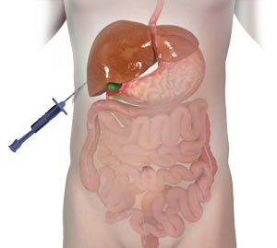
When to Obtain a Liver Biopsy in Patients With NAFLD
biopsy is expensive, requires expertise for interpretation, and carries some morbidity and very rare mortality risk. Thus, it should be performed in those who would benefit the most from diagnostis, therapeutic guidance, and prognostic information.
Notes:
© Copyright Showeet.com – Free PowerPoint Templates

Slide 27
Liver Biopsy
Liver biopsy should be considered in patients with NAFLD who are at increased risk of having SH and/or advanced fibrosis.
The presence of MetS, NFS or FIB-4, or liver stiffness measured by VCTE or MRE may be used for identifying patients who are at risk for SH and/or advanced fibrosis.
Liver biopsy should be considered in patients with suspected NAFLD in whom competing etiologies for HS and the presence and/or severity of coexisting CLDs cannot be excluded without a liver biopsy.
Notes:
© Copyright Showeet.com – Free PowerPoint Templates

Slide 28
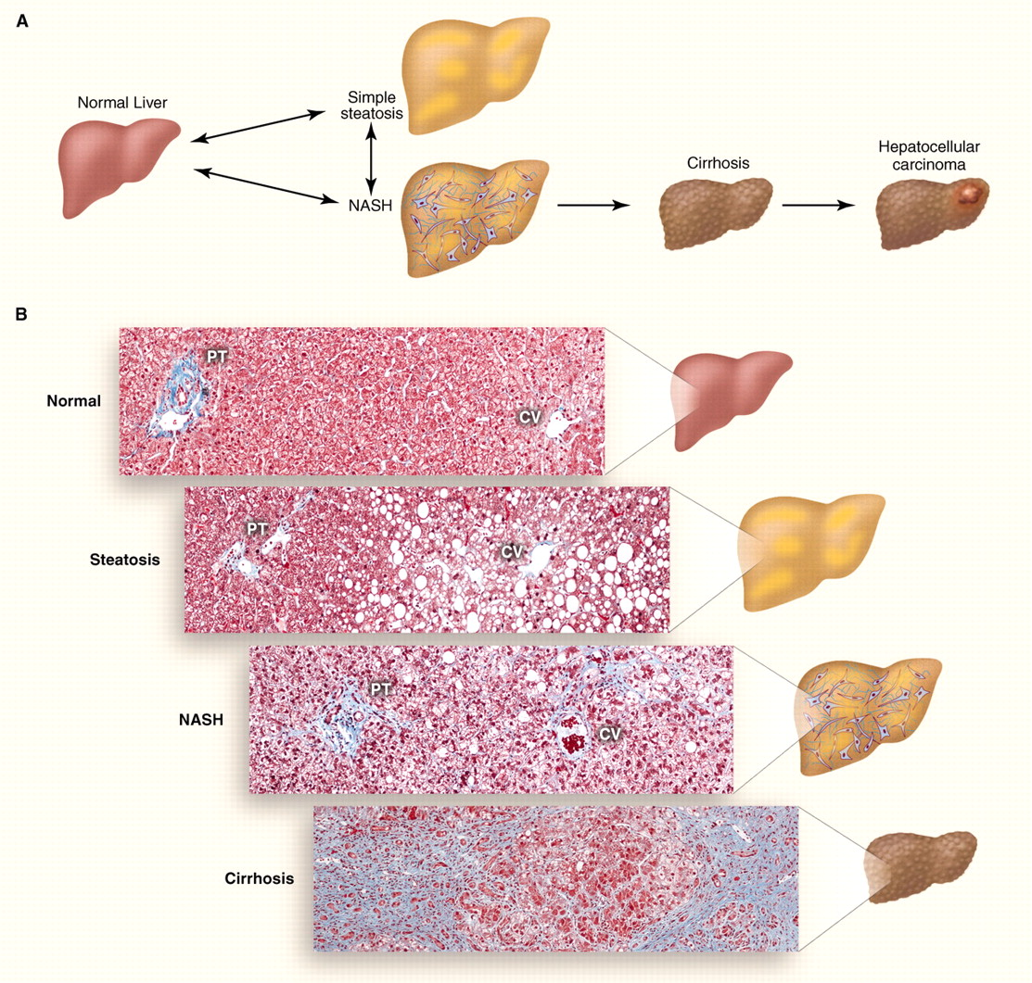
Histopathology of Adult NAFLD
The goals for histopathological evaluation of liver biopsy in a subject with suspected NAFLD include confirming or excluding the diagnosis and providing commentary on severity of the disease.
Notes:
© Copyright Showeet.com – Free PowerPoint Templates

Slide 29
NASH CRN
Not NAFLD (<5% steatosis, by definition);
NAFL, not NASH (5% steatosis, with or without lobular and portal inflammation);
Borderline steatohepatitis, zone 3 or Borderline steatohepatitis, zone 1 (most, but not all criteria for SH present, with accentuation of steatosis or injury in zone 3 or zone 1, respectively);
Definite steatohepatitis (all criteria present, including steatosis, hepatocellular ballooning, and lobular inflammation)
NASH Clinical Research Network:
Not NAFLD, may have no fibrosis or any amount of fibrosis up to cirrhosis.
Stage 1 is zone 3 (perivenular), perisinusoidal, or periportal fibrosis;
Stage 2 is both zone 3 and periportal fibrosis;
Stage 3 is bridging fibrosis with nodularity;
Stage 4 is cirrhosis
Notes:
© Copyright Showeet.com – Free PowerPoint Templates

Slide 30
semiquantitative assessment of necroinflammatory lesions in NAFLD
Sampling “error,” however, remains a concern for diagnosis and for clinical trials with histologically based entry criteria and outcomes.
Approaches to lessen the effects of sampling error include large needle size (e.g., 2-3 cm in length and 16 gauge) and at least one core biopsy.
NAFLD Activity Score (NAS):
Developed as a method of comparing biopsies in clinical trials,;
Steatosis Activity Fibrosis (SAF):
utilizes the score for diagnosis as well as for use in clinical trials.
Notes:
© Copyright Showeet.com – Free PowerPoint Templates

Slide 31
Histopathology of Adult NAFLD
Clinically useful pathology reporting should include a distinction between NAFL (steatosis), NAFL with inflammation, and NASH (steatosis with lobular and portal inflammation and hepatocellular ballooning).
A comment on severity (mild, moderate, or severe) may be useful. Specific scoring systems such as NAS and/or SAF may be used as deemed appropriate.
The presence or absence of fibrosis should be described. If present, a further statement related to location, amount, and parenchymal remodeling is warranted.
Notes:
© Copyright Showeet.com – Free PowerPoint Templates

Slide 32

Management of Patients
With NAFLD
The management of NAFLD should consist of treating liver disease as well as the associated metabolic comorbidities such as obesity, hyperlipidemia, IR, and T2DM.
Notes:
© Copyright Showeet.com – Free PowerPoint Templates

Slide 33
Management of Patients With NAFLD
WHOM TO TREAT
LIFESTYLE INTERVENTION
Pharmacological treatments aimed primarily at improving liver disease should generally be limited to those with biopsy-proven NASH and fibrosis.
Weight loss generally reduces HS, achieved either by hypocaloric diet alone or in conjunction with increased physical activity.
A combination of a hypocaloric diet (daily reduction by 500-1,000 kcal) and moderate-intensity exercise is likely to provide the best likelihood of sustaining weight loss over time.

Slide 34
LIFESTYLE INTERVENTION
Weight loss of at least 3%-5% of body weight appears necessary to improve steatosis, but a greater weight loss (7%-10%) is needed to improve the majority of the histopathological features of NASH, including fibrosis.
Exercise alone in adults with NAFLD may prevent or reduce HS, but its ability to improve other
aspects of liver histology remains unknown.
Patients who maintain physical activity more than 150 minutes/ week or increase their activity level by more than 60 minutes/week have more pronounced decrement in serum aminotransferases, independent of weight loss.
Lifestyle modification consisting of diet, exercise, and weight loss has been advocated to treat patients with NAFLD.
Notes:
© Copyright Showeet.com – Free PowerPoint Templates

Slide 35

Insulin Sensitizers

Slide 36
Insulin Sensitizers
METFORMIN
THIAZOLIDINEDIONES
Metformin is not recommended for treating NASH in adult patients.
Thiazolidinediones are ligands for the nuclear transcription factor peroxisome proliferator-activated receptor gamma (PPAR)-c with broad effects on glucose and lipid metabolism, as well as on vascular biology and inflammation.
The ability of thiazolidinediones to reverse adipose tissue dysfunction and IR in obesity and T2DM have led to RCTs exploring their role in NASH.

Slide 37
Insulin Sensitizers
THIAZOLIDINEDIONES
However, resolution of NASH, a key secondary endpoint, was achieved in a significantly higher number of patients receiving pioglitazone than receiving placebo. Vitamin E and pioglitazone were well tolerated and there were no differences in other adverse events.

Slide 38
Insulin Sensitizers
THIAZOLIDINEDIONES
Pioglitazone improves liver histology in patients with and without T2DM with biopsy-proven NASH.
Therefore, it may be used to treat these patients. Risks and benefits should be discussed with each patient before starting therapy.
Until further data support its safety and efficacy, pioglitazone should not be used to treat NAFLD without biopsy-proven NASH.

Slide 39
Insulin Sensitizers
GLUCAGON-LIKE PEPTIDE-1 ANALOGUES
VITAMIN E
liraglutide was associated with greater weight loss, but also gastrointestinal side effects.
It is premature to consider GLP-1 agonists to specifically treat liver disease in patients with NAFLD or NASH.
The use of vitamin E is associated with a decrease in aminotransferases in subjects with NASH,
Studies in which histological endpoints were evaluated indicate that vitamin E results in improvement in steatosis, inflammation, and ballooning and resolution of SH in a proportion of nondiabetic adults with NASH,
Vitamin E did not have an effect on HF.

Slide 40
Insulin Sensitizers
VITAMIN E
Vitamin E administered at a dose of 400 IU/day was unexpectedly and unexplainably associated with a modest increase in the risk of prostate cancer, and this risk may be modified by baseline selenium concentration or genetic variants associated with vitamin metabolism.
Vitamin E (rrr α-tocopherol) administered at a daily dose of 800 IU/day improves liver histology in nondiabetic adults with biopsy-proven NASH and therefore may be considered for this patient population. Risks and benefits should be discussed with each patient before starting therapy.
Until further data supporting its effectiveness become available, vitamin E is not recommended to treat NASH in diabetic patients, NAFLD without liver biopsy, NASH cirrhosis, or cryptogenic cirrhosis.

Slide 41
Insulin Sensitizers
BARIATRIC SURGERY
NAFLD at all stages is more common in those who meet criteria for bariatric surgery. Nonsurgical weight loss is effective in improving all histological features of NAFLD, including fibrosis, though most patients had early-stage fibrosis.
Bariatric surgery improves or eliminates comorbid disease in most patients and improves long-term survival and death from CVD and malignancy, the two most common causes of death in NAFLD.
The majority of patients undergoing bariatric surgery appear to improve or completely resolve the histopathological features of steatosis, inflammation, and ballooning. Fibrosis also improved by a weighted mean decrease by 11.9% in the incidence of fibrosis.

Slide 42
Insulin Sensitizers
BARIATRIC SURGERY
Foregut bariatric surgery can be considered in otherwise eligible obese individuals with NAFLD or NASH.
It is premature to consider foregut bariatric surgery as an established option to specifically treat NASH.
The type, safety, and efficacy of foregut bariatric surgery in otherwise eligible obese individuals with established cirrhosis attributed to NAFLD are not established.
In otherwise eligible patients with compensated NASH or cryptogenic cirrhosis, foregut bariatric surgery may be considered on a case-by-case basis by an experienced bariatric surgery program.

Slide 43
Insulin Sensitizers
URSODEOXYCHOLIC ACID, OMEGA-3 FATTY ACIDS, AND MISCELLANEOUS AGENTS
UCDA is not recommended for the treatment of NAFLD or NASH.
Omega-3 fatty acids should not be used as a specific treatment of NAFLD or NASH, but they may be considered to treat hypertriglyceridemia in patients with NAFLD.

Slide 44
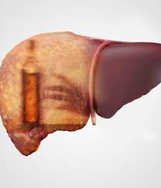
Alcohol Use in Patients
With NAFLD and NASH
Heavy alcohol consumption is a risk factor for CLD and should be avoided by patients with NAFLD and NASH.

Slide 45
NIAAA defines heavy or at-risk drinking as
More than 4 standard drinks on any day or more than 14 drinks per week in men or more than 3 drinks on any day or 7 drinks per week in women.
Notes:
© Copyright Showeet.com – Free PowerPoint Templates

Slide 46
Alcohol Use
Patients with NAFLD should not consume heavy amounts of alcohol.
There are insufficient data to make recommendations with regard to non-heavy consumption of alcohol by individuals with NAFLD.
Notes:
© Copyright Showeet.com – Free PowerPoint Templates

Slide 47

MANAGEMENT OF CVD AND
DYSLIPIDEMIA
There is a strong association between NAFLD and increased risk of CVD events and mortality
Notes:
© Copyright Showeet.com – Free PowerPoint Templates

Slide 48
MANAGEMENT OF CVD AND
DYSLIPIDEMIA
Patients with NAFLD have a proatherogenic lipid profile characterized by high TG, increased very-lowdensity lipoprotein (LDL), and high apolipoprotein B to apolipoprotein A-1 ratio, as well as a higher concentration of small dense LDL coupled with low highdensity lipoprotein (HDL) concentration.
These changes seem to be driven by hepatic lipid concentration and IR, predominately at the level of adipose tissue, rather than by the presence of NASH, per se.
Notes:
© Copyright Showeet.com – Free PowerPoint Templates

Slide 49
MANAGEMENT OF CVD AND
DYSLIPIDEMIA
It is reasonable to incorporate lipid-lowering therapy in patients with NAFLD who meet criteria based on current recommendations.
several studies have established the safety of statins in patients with liver disease regardless of baseline elevation in liver chemistries.
Furthermore, the risk of statin-induced hepatotoxicity is not higher in those with CLD. Although elevated aminotransferases are not uncommon in patients receiving statins, serious liver injury from statins is quite rare in clinical practice.
GREACE:
Statins significantly improved aminotransferases and cardiovascular outcomes in patients with elevated aminotransferases presumed attributed to NAFLD.
IDEAL:
Benefit of high-dose Statins in those with baseline elevation in ALT compared to moderate-intensity statins.
Notes:
© Copyright Showeet.com – Free PowerPoint Templates

Slide 50
MANAGEMENT OF CVD AND
DYSLIPIDEMIA
Patients with NAFLD are at high risk for cardiovascular morbidity and mortality. Thus, aggressive modification of CVD risk factors should be considered in all patients with NAFLD.
Patients with NAFLD or NASH are not at
higher risk for serious liver injury from statins. Thus, statins can be used to treat dyslipidemia in patients with NAFLD and NASH. While statins may be used in patients with NASH cirrhosis, they should be avoided in patients with decompensated cirrhosis.
Notes:
© Copyright Showeet.com – Free PowerPoint Templates

Slide 51
NASH, Obesity, and LIVER
TRANSPLANTATION (LT)
NASH and cryptogenic cirrhosis are highly prevalent among patients awaiting LT.

Slide 52
PRE-LIVER
TRANSPLANTATION
higher frequency of post transplant complications and increased graft loss and mortality among patients with class III obesity (BMI >40 kg/m²) at the time of transplant, when corrected for ascites, higher BMI does not appear to independently confer an increased risk of mortality or allograft failure.
The effects of fluid retention on BMI and variability in the distribution of body fat reduce the utility of BMI as a sole factor in determining transplant candidacy.
Higher BMI, common among patients with NASH, is associated with an increased risk of clinical decompensation while awaiting LT and may present technical challenges to performing LT.
Notes:
© Copyright Showeet.com – Free PowerPoint Templates

Slide 53
PRE-LIVER
TRANSPLANTATION
Obesity is strongly associated with sarcopenia, which has been consistently identified as an independent predictor of post transplant mortality and graft loss.
Preoperative nutritional status assessment with
some combination of CT, dual-energy X-ray
absorptiometry, hand-grip strength, and triceps skinfold thickness have all been reported to be useful in this setting.
Noninvasive functional cardiac testing (e.g., with dobutamine stress echocardiography) is recommended in patients with NASH cirrhosis, with progression to coronary angiography when noninvasive testing is abnormal or inconclusive.
Notes:
© Copyright Showeet.com – Free PowerPoint Templates

Slide 54
PRE-LIVER
TRANSPLANTATION
NASH is also associated with an increased prevalence of chronic kidney disease and is, in fact, the most rapidly growing indication for simultaneous liver kidney transplantation in the United States.
Because of the high prevalence of sarcopenia among patients with NASH, serum creatinine may overestimate glomerular filtration rate (GFR).
Direct measures of GFR or determination of cystatin C (e.g., with the creatinine-cystatin C equation) is more accurate than estimates of renal function that are derived from serum creatinine alone.
Notes:
© Copyright Showeet.com – Free PowerPoint Templates

Slide 55
POST-LIVER
TRANSPLANTATION
The excellent 5-year graft survival suggests that recurrence of NASH is an uncommon cause of mortality and graft loss, at least in midterm.
Some histological evidence of NAFLD is common following LT.
Steatosis at or above grade 2 (34%-66% by biopsy), for example, is observed in ~60% of recipients by the end of the second ostoperative year, a rate that is higher than observed among patients undergoing LT for indications other than NASH.
In general, management recommendations for LT recipients are similar to those for other patients with NASH.
Notes:
© Copyright Showeet.com – Free PowerPoint Templates

Slide 56
POST-LIVER
TRANSPLANTATION
Ongoing attention to, and assistance with, achieving and maintaining a healthy weight and diet are important in the management of post transplant NASH given that weight gain is common following LT, exacerbated by immunosuppression and debility.
MetS is very common in LT recipients, particularly those with a history of NASH.
There are some important pharmacological considerations that relate to the high prevalence of MetS among patients.
Calcineurin inhibitors and corticosteroids exacerbate diabetes and impair insulin secretion.
Patients with NASH cirrhosis have high prevalence of CVD.
Thus, careful attention should be paid to identifying CVD, whether clinically apparent or occult, during the transplant evaluation process.
Notes:
© Copyright Showeet.com – Free PowerPoint Templates

Slide 57
Miscellaneous Guidance
Statements Pertinent to Clinical Practice
Patients with NASH cirrhosis should be screened for gastroesophageal varices according to the AASLD and ACG practice guidelines.
Patients with cirrhosis suspected because of NAFLD should be considered for HCC screening according to the AASLD practice guidelines.
Current evidence does not support routine screening and surveillance for HCC in patients with non-cirrhotic NASH.
Current evidence does not support routinely repeating a liver biopsy in patients with NAFL or NASH, but this may be considered on a case-by-case basis.
Notes:
© Copyright Showeet.com – Free PowerPoint Templates

Slide 58

THANK
YOU

