Slide 1
PERIPHERAL PRECOCITY
Peripheral precocious puberty
Gonadotropin-independent precocious puberty
Dr. Payam Samei

Slide 2
References
1. Williams 2016
2. Sperling 2014
3. Up to Date 2017

Slide 3
INTRODUCTION
Precocious puberty is the onset of pubertal development at an age that is 2 to 2.5 standard deviations (SD) earlier than population norms.

Slide 4
DEFINITION
Precocious puberty is traditionally defined as the onset of secondary sexual characteristics before the age of eight years in girls and nine years in boys.

Slide 5
DEFINITION
Definition of precocious puberty is problematic, at least in girls; Not only depend on age ;
Clinical features
Race/ethnicity
Presence/absence of obesity

Slide 6
DEFINITION
(Age of Puberty)
Caucasian girls seven years of age
African-American girls six years of age. (controversial)

Slide 7
DEFINITION
There is a strong female predominance of children with precocious puberty.
Children referred for evaluation of precocious puberty, 87 percent were female.

Slide 8
EPIDEMIOLOGY
Prevalence rate should be around 2 percent, or 2 in every 100 children.

Slide 9
CLASSIFICATION
Central precocious puberty
Peripheral precocity
Benign or non-progressive pubertal variants

Slide 10
Central precocious puberty
(CPP)
Central precocious puberty is caused by early maturation of the hypothalamic-pituitary-gonadal axis.

Slide 11
CPP
In these patients, the sexual characteristics are appropriate for the child's gender (isosexual).

Slide 12
Peripheral precocity
Peripheral precocity :
Excess secretion of sex hormones (estrogens or androgens) from the gonads or adrenal glands
Exogenous sources of sex steroids
Ectopic production of gonadotropin from a germ cell tumor (eg, human chorionic gonadotropin, hCG)

Slide 13
Peripheral precocity
Further characterization is based upon whether the sexual characteristics are appropriate for the child's gender (isosexual) or inappropriate, with virilization of girls and feminization of boys (contrasexual).

Slide 14
Peripheral precocity
Follicle-stimulating hormone (FSH) and luteinizing hormone (LH) levels are suppressed (in the prepubertal range) and do not increase substantially with gonadotropin-releasing hormone (GnRH) stimulation.

Slide 15
Peripheral precocity
The approach to treatment for peripheral precocity depends on the cause.
GnRH agonist therapy is ineffective, in contrast to patients with central precocious puberty (CPP).

Slide 16
Benign or non-progressive pubertal variants
Benign pubertal variants :
Isolated breast development in girls (premature thelarche)
Isolated androgen-mediated sexual characteristics (such as pubic and/or axillary hair, acne, and apocrine odor)

Slide 17
Peripheral precocity
Girls only
Boys only
Girls and boys

Slide 18
Girls only
Ovarian cysts
Ovarian tumor

Slide 19
Boys only
Leydig cell tumor
hCG-secreting germ cell tumors
Familial male-limited precocious puberty

Slide 20
Girls and boys
Exogenous sex steroids (estradiol and testosterone creams)
McCune-Albright syndrome (girls>boys)
Primary hypothyroidism
Congenital adrenal hyperplasia (untreated)
Virilizing adrenal tumor

Slide 21
Girls

Slide 22
Ovarian cysts
A large functioning follicular cyst of the ovaries is the most common cause of peripheral precocity in girls.
Affected patients often present with breast development, followed by an episode of vaginal bleeding, which occurs due to estrogen withdrawal once the cyst has regressed.

Slide 23
Ovarian cysts
Chronic abdominal aching pain, either periumbilical or localized to a lower quadrant, may be present.

Slide 24
Ovarian cysts
These cysts may appear and regress spontaneously, so conservative management is usually appropriate.
Large cysts may predispose to ovarian torsion.

Slide 25
Ovarian cysts
An ovarian mass that is:
Purely cystic
Few internal echoes
No complex features (septation, increased solid tissue, or calcification)
Almost certainly benign and can be managed by observation.

Slide 26
Ovarian cysts
A follow-up ultrasound examination in four to eight weeks should be performed.
If the cyst has not resolved and the ultrasonic characteristics are still reassuring, then continued observation is appropriate as long as the girl remains asymptomatic.

Slide 27
Ovarian cysts
Torsion :
Nausea
Vomiting
Pallor
Leukocytosis (with left shift)
Followed by less severe localized pain

Slide 28
Ovarian cysts
Autonomously functioning ovarian follicular cysts, whether recurrent or manifesting in an isolated episode, often respond to treatment with oral medroxyprogesterone acetate, which seems to prevent recurrence, to accelerate involution of the follicular cysts, and to reduce the risk of torsion.

Slide 29
Ovarian cysts
The use of a potent aromatase inhibitor such as letrozole to reduce estradiol secretion is another potential approach to treatment.

Slide 30
Ovarian tumors
Ovarian tumors are a rare cause of peripheral precocity in girls.
Granulosa cell tumors, the most common type, typically present as isosexual precocity.

Slide 31
Boys

Slide 32
Leydig cell tumors
Leydig cell tumor should be considered in any boy with asymmetric testicular enlargement.
These testosterone-secreting tumors are almost always benign and are readily cured by surgical removal

Slide 33
hCG-secreting germ cell tumors
Germ-cell tumors secrete hCG, which in boys activates LH receptors on the Leydig cells, resulting in increased testosterone production.

Slide 34
hCG-secreting germ cell tumors
The increase in testicular size (usually only to an early pubertal size) is less than expected for the serum testosterone concentration and degree of pubertal development.
This is because most of the testis is made up of tubular elements whose maturation depends upon FSH.

Slide 35
hCG-secreting germ cell tumors
In girls, hCG-secreting tumors do not lead to precocious puberty because activation of both FSH and LH receptors is needed for estrogen biosynthesis.

Slide 36
hCG-secreting germ cell tumors
All males with anterior mediastinal germinomas should have a karyotype because these tumors may be associated with Klinefelter syndrome.

Slide 37
Familial male-limited precocious puberty
(Familial testotoxicosis)
Activating mutation in the LH receptor gene, which results in premature Leydig cell maturation and testosterone secretion.
Inherited as an autosomal dominant.

Slide 38
Familial testotoxicosis
Affected boys typically present between one to four years of age.

Slide 39
Both girls and boys

Slide 40
Primary hypothyroidism
Children with severe, long-standing primary hypothyroidism occasionally present with precocious puberty.
(Van Wyk–Grumbach syndrome)

Slide 41
Primary hypothyroidism
In girls, this syndrome is often characterized by :
Galactorrhea : Often not spontaneous; a few drops of milky fluid may become apparent only upon “milking” the subareolar ductal tissue.
Multicystic ovaries : Often demonstrable by ultrasonography.
Recurrent vaginal bleeding

Slide 42
Primary hypothyroidism
In boys present with:
Premature testicular enlargement

Slide 43
Primary hypothyroidism
A unique diagnostic feature of the Van Wyk–Grumbach syndrome is the combination of delayed bone age with apparent sexual precocity.

Slide 44
Primary hypothyroidism
Boys with this syndrome have macroorchidism without significant virilization.

Slide 45
Primary hypothyroidism
A proposed mechanism is cross-reactivity and stimulation of the FSH receptor by high serum thyrotropin (TSH) concentrations, given that both TSH and FSH share a common alpha subunit.
The signs of pubertal development regress with thyroxine therapy.

Slide 46
Exogenous sex steroids
Feminization, including gynecomastia in boys, has been attributed to excess estrogen exposure from creams, ointments, and sprays.
Caretakers using these topical estrogens to treat menopausal symptoms may inadvertently expose children to the hormones.

Slide 47
Exogenous sex steroids
A short course of application of estrogen cream is used to treat labial adhesions, but long courses may lead to breast development or even withdrawal bleeding.

Slide 48
Exogenous sex steroids
In addition to breast development, pigmentation of the areolae and the linea alba and the appearance of pubic hair may be seen in children exposed to dermal estrogen.

Slide 49
Exogenous sex steroids
FDA guidelines define a limit of not more than 1% of normal daily estrogen production in prepubertal children as a safe intake of estrogen:
Boys : 0.43 ng/day
Girls : 3.24 ng/day

Slide 50
Exogenous sex steroids
Children who touch the skin or the towels of men using androgen gel therapy may themselves develop virilization.

Slide 51
Exogenous sex steroids
Other possible sources of estrogen exposure include contamination of food with hormones, phytoestrogens (eg, in soy), and folk remedies such as lavender oil and tea tree oil.
Similarly, virilization of young children has been described following inadvertent exposure to androgen-containing creams.

Slide 52
Adrenal pathology
Adrenal causes of excess androgen production include:
Androgen-secreting tumors
Enzymatic defects in adrenal steroid biosynthesis (congenital adrenal hyperplasia)

Slide 53
Adrenal pathology
21-hydroxylase deficiency
11-beta hydroxylase deficiency
3-beta hydroxysteroid dehydrogenase type 2 deficiency

Slide 54
Adrenal pathology
Estrogen production:
Intra-adrenal aromatization of androgen
Production of enough androgen that is peripherally aromatized to estrogen
Causing both male and female pubertal changes.

Slide 55
Adrenal pathology
Boys who have an adrenal cause for their precocity will not have testicular enlargement (testes will be <4 mL testicular volume or <2.5 cm in diameter).

Slide 56
Peutz-Jeghers Syndrome
This condition is characterized by mucocutaneous pigmentation of the lips, buccal mucosa, fingers, and toes; gastrointestinal hamartomatous polyposis; and a predisposition to malignancy.

Slide 57
Peutz-Jeghers Syndrome
It is associated with a rare, distinctive sex cord tumor with annular tubules in both boys and girls.
Estrogen secretion by the tumor may lead to feminization in girls and incomplete sexual precocity in boys.

Slide 58
McCune-Albright syndrome
TRIAD :
Peripheral precocious puberty,
Irregular café-au-lait ("Coast of Maine") skin pigmentation
Fibrous dysplasia of bone

Slide 59
MAS
MAS is less common in males than females, and about 15 percent of affected boys develop precocious puberty, which is due to over-production of testosterone .

Slide 60
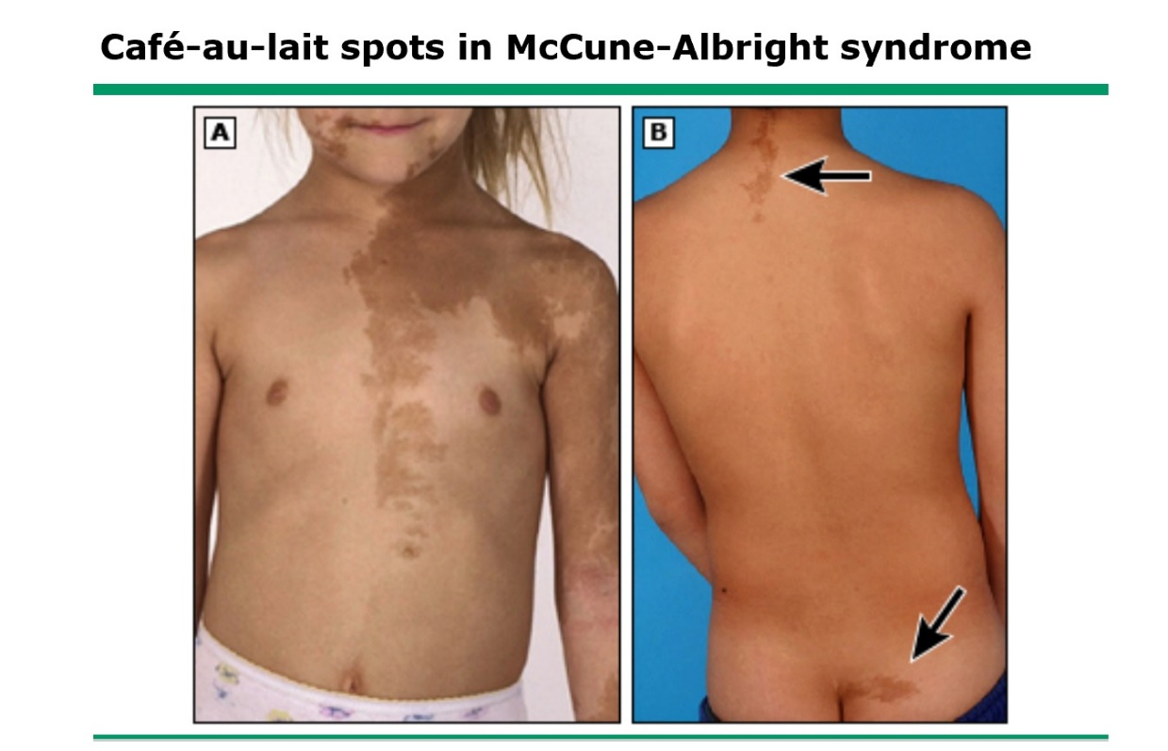

Slide 61
MAS
MAS should be considered in girls with recurrent formation of follicular cysts and cyclic menses.
The skin manifestations and bone lesions may increase over time.
Precocious puberty is the most commonly reported manifestation.

Slide 62
MAS
In girls presenting with vaginal bleeding, the ovarian enlargement has often been mistaken for an ovarian tumor, leading to unnecessary oophorectomy.
Girls presenting with premature vaginal bleeding should therefore be evaluated for features of McCune-Albright syndrome to avoid this potential mistake

Slide 63
MAS
As in other forms of peripheral precocity, the sequence of pubertal progression may be abnormal, in that vaginal bleeding often precedes significant breast development.

Slide 64
MAS
Prolonged exposure to elevated levels of sex steroids may cause:
Accelerated growth
Advanced skeletal maturation
Compromised adult height

Slide 65
MAS
In boys with MAS, while sexual precocity is less common, there is a high prevalence of testicular pathology on ultrasound, including:
Hyper-and hypoechoic lesions (most likely representing areas of Leydig cell hyperplasia)
Microlithiasis, and focal calcifications

Slide 66
MAS
Mechanism
Patients with MAS have a somatic (postzygotic) mutation of the alpha subunit of the G3 protein that activates adenylyl cyclase.

Slide 67
MAS
This mutation leads to continued stimulation of endocrine function eg:
Precocious puberty
Thyrotoxicosis
Gigantism or acromegaly
Cushing syndrome
Hypophosphatemic rickets
in various combinations.

Slide 68
MAS
Mutations can be found in other non-endocrine organs (liver and heart) resulting in:
Cholestasis and/or hepatitis
Intestinal polyps
Cardiac arrhythmias

Slide 69
EVALUATION

Slide 70
1. Who should be evaluated?
Evaluation is warranted in children presenting with signs of secondary sexual development younger than the age of eight (girls) or nine (boys) years.
The concern and extent of evaluation should increase with decreasing age at presentation.

Slide 71
Who should be evaluated?
In girls who are between the ages of seven and eight, a comprehensive history and physical examination may be sufficient if this examination does not raise any additional concerns.

Slide 72
2. Is the cause of precocity central or peripheral?
The sequence of pubertal development in children with central precocious puberty (CPP) recapitulates normal pubertal development but at an earlier age.

Slide 73
Is the cause of precocity central or peripheral?
By contrast, individuals with peripheral precocity have a peripheral source of gonadal hormones and are more likely to display deviations from the normal sequence and/or pace of puberty

Slide 74
3. How quickly is the puberty progressing?
A rapid rate of linear growth and skeletal maturation (measured as advanced bone age) suggests either CPP or peripheral precocity with high concentrations of sex steroids.

Slide 75
Initial evaluation
Medical history
Physical examination
Pubertal staging
Bone age

Slide 76
Initial laboratory evaluation
Basal serum LH
Basal serum FSH
Serum estradiol
Serum testosterone

Slide 77
Subsequent laboratory testing
Serum LH concentrations after GnRH agonist stimulation
Serum adrenal steroids
Other biochemical tests

Slide 78
Imaging:
Peripheral precocity
In girls with progressive peripheral precocity, a pelvic ultrasound can be performed to help identify the presence of an ovarian cyst or tumor.

Slide 79
Imaging:Peripheral precocity
For suspected adrenal pathology, for example when there is rapid virilization, an adrenal ultrasound should be strongly considered.

Slide 80
Imaging: Peripheral precocity
Ultrasound examination of the testes can be performed in boys with peripheral precocity to evaluate for the possibility of a Leydig-cell tumor.

Slide 81
Imaging: Peripheral precocity
In children where an adrenal tumor is suspected (due to evidence of progressive virilization and elevated serum adrenal androgens, eg, DHEAS), an abdominal ultrasound and/or computerized tomography (CT) abdomen should be performed.

Slide 82
TREATMENT

Slide 83
TREATMENT FOR PERIPHERAL PRECOCITY
Peripheral precocity does not respond to gonadotropin-releasing hormone (GnRH) agonist therapy.
Treatment is directed at removing or blocking the production of and/or response to the excess sex steroids, depending on the cause.

Slide 84
Surgery
Tumors of the:
Testis
Adrenal gland
Ovary
hCG-secreting tumors may also require radiation therapy and chemotherapy.

Slide 85
Functioning follicular cysts of the ovary
These develop and regress spontaneously.
Management:
Conservative without surgery

Slide 86
Exposure to exogenous sex steroids
The source should be identified and removed.
After removal, the pubertal changes are likely to regress.

Slide 87
McCune-Albright syndrome
Girls
Aromatase inhibitors :
Letrozole : The episodes of vaginal bleeding either ceased or decreased and there was a decrease in bone age advancement.

Slide 88
Aromatase inhibitors
Testolactone: Partially effective for reducing the recurrence of ovarian cysts and slowing pubertal progression, but there is a loss of efficacy over time.
Fadrozole and anastrozole, are largely ineffective for long-term treatment.

Slide 89
Blockers of estrogen action
Tamoxifen:
A selective estrogen receptor modulator (SERM), has been shown to decrease the vaginal bleeding episodes and slow the rate of bone age advancement.

Slide 90
Pure estrogen receptor antagonist
Fulvestrant:
Pure estrogen receptor antagonist
Reduction or cessation of bleeding
Decreased rates of bone age advancement significantly

Slide 91
McCune-Albright syndrome
Boys
Treatment similar to the regimen used for familial male-limited precocious puberty.

Slide 92
Familial male-limited precocious puberty
(Familial testotoxicosis)
Bicalutamide:highly selective non-steroidal antiandrogen
Anastrozole: third-generation aromatase inhibitor
Spironolactone-testolactone
Ketoconazole:inhibitor of steroid synthesis

Slide 93
