Slide 1


Slide 2
Gestational Diabetes Mellitus
By Karen L. Whalen, Pharm.D., BCPS, CDE, FAPhA;
and James R. Taylor, Pharm.D., BCACP, CDE

Slide 3
INTRODUCTION:
In the past, any hyperglycemia initially detected during pregnancy was considered gestational diabetes mellitus (GDM), regardless of whether the condition actually existed before the pregnancy or continued after the pregnancy.

Slide 4
Today, GDM is diabetes that is diagnosed in the second or, more commonly, third trimester and is distinct from type 1 and type 2 diabetes.
Diabetes developing during the first trimester is generally considered type 2 diabetes, although it can be type 1 . (ADA 2017a).

Slide 5
Because of variations in reporting, the population being studied, and the lack of universal diagnostic criteria, the exact prevalence of GDM is difficult to determine.
A recent CDC report found prevalence rates of 4.6% and 9.2%, depending on the data sources used .

Slide 6
A history of GDM is the most significant risk factor for GDM. Other risk factors include Asian, Native American, Pacific Islander, African American, or Hispanic ethnicity; BMI of 25 kg/m2 or greater; diabetes in a first-degree relative;

Slide 7
Excessive early gestational weight gain (first-trimester weight gain of 2 kg plus second-trimester weight gain per week of 0.6 kg for underweight, 0.45 kg for normal weight, 0.32 kg for overweight, and 0.27 kg for women with obesity); macrosomia in a previous pregnancy; maternal age older than 35; and weight gain of more than 5 kg since 18 years of age .

Slide 8
Women with GDM are often asymptomatic, so screening is important for detection.
In a normal pregnancy, insulin resistance develops in the second trimester and continues until birth.

Slide 9
The mechanism is not fully understood but is believed to be related to the production of hormones, cytokines, or adipokines by the placenta.
Insulin secretion also increases, resulting in normal glucose concentrations.

Slide 10
Gestational diabetes typically develops because of preexisting increased insulin resistance and diminished insulin secretion.

Slide 11
MATERNAL AND FETAL
COMPLICATIONS

Slide 12
Maternal Complications
Potential maternal complications associated with GDM include gestational hypertension, preeclampsia, and non-elective cesarean delivery.

Slide 13
Regarding long-term complications, up to 50% of women with GDM will develop type 2 diabetes later in life.
On average, this occurs 22–28 years after pregnancy .
Ethnicity and obesity (BMI > 30 kg/m2) may play a role in the risk and timing of the subsequent diagnosis of diabetes.

Slide 14
Fetal Complications:
Neonates of women with GDM are at increased risk of macrosomia, which is defined as a birth weight over 4000 g, as well as neonatal hypoglycemia, hyperbilirubinemia, birth trauma, respiratory distress syndrome, and shoulder dystocia
.

Slide 15
Macrosomia is the most common fetal complication, with a reported incidence of 15%–45%, followed by hyperbilirubinemia in 10%–13% of neonates .

Slide 16
Hypoglycemia can occur in 3%–5% of infants as a result of increased fetal insulin production in response to maternal hyperglycemia, which can increase the risk of seizures.
Shoulder dystocia is a rare, but serious complication that can lead to brachial plexus injury.

Slide 17
Long-term complications of infants born to mothers with GDM include increased risk of impaired glucose tolerance, type 2 diabetes, hypertension, obesity, and dyslipidemia .

Slide 18
Benefits of Treatment :
Few well-designed studies have evaluated the benefit of treating GDM. Trials to date have included treatment strategies of self-monitoring blood glucose, medical nutrition therapy, and insulin.
Outcomes data using other treatment modalities are lacking.

Slide 19
Treatment of GDM reduces the risk of maternal hypertensive disorders by 40% .
Rates of cesarean delivery are unaffected by treatment.
Evidence on maternal long-term complications, such as type 2 diabetes and obesity, is lacking.

Slide 20
A meta-analysis of five randomized clinical trials found that treating GDM results in a 50% reduction in risk of macrosomia in infants, although the absolute mean difference in birth weight was less than 150 g (Hartling 2013).

Slide 21
Risk of shoulder dystocia was reduced by 60%, although the overall events were rare (Hartling 2013).
No difference was found for neonatal hypoglycemia, birth injury, or risk of eventually developing glucose intolerance.

Slide 22
Patient Care Scenario :
A 34-year-old Hispanic woman at 30 weeks’ gestation
in her first pregnancy presents for a follow-up visit. She
was given a diagnosis of GDM at 28 weeks’ gestation, and
her fasting glucose at diagnosis was 107 mg/dL. At that
time, she was counseled to begin nutritional therapy and
a moderate exercise regimen. Given the following glucose
values over the past week, what is the best option for GDM
management in this patient?
Fasting glucose (mg/dL): 94, 102, 98, 97, 100, 93, 107
One hour after breakfast: 137, 140, 142, 135
One hour after lunch: 132, 141, 148
Two hours after dinner: 129, 120, 118, 124

Slide 23
SCREENING AND DIAGNOSIS OF GDM:
Women who are at risk of preexisting diabetes should be screened at their first prenatal visit using the diagnostic criteria for nonpregnant adults.

Slide 24
This includes overweight women or women with obesity with at least one additional risk factor, such as physical inactivity, family history of diabetes, hig hrisk ethnicity, history of GDM, hypertension, or hyperlipidemia

Slide 25
Screening Methods
Screening and diagnosis of GDM may consist of either a one or a two-step approach .

Slide 26
The one-step approach was initially recommended by the ADA in 2011 for use in all pregnant women without preexisting diabetes.
It involves a 75-g OGTT at 24–28 weeks’ gestation.

Slide 27
The two-step approach has been recommended by ACOG and an NIH consensus development program (ACOG 2013).

Slide 28
Controversies Regarding Best Screening Method :
The IADPSG and ADA recognize that using the one-step approach would likely increase the number of women with a GDM diagnosis because only one abnormal value is needed for diagnosis.
Although this may lead to increased health care costs, the ADA believes that the benefits outweigh these disadvantages.
International Association of Diabetes and Pregnancy Study Group (IADPSG)

Slide 29
Data are unavailable from randomized controlled trials regarding outcomes for these additional women whose GDM would be diagnosed by the one-step method.

Slide 30
In the two-step approach, two different sets of glucose thresholds exist: Carpenter-Coustan and National Diabetes Data Group (NDDG).

Slide 31
The Carpenter-Coustan thresholds are lower than the NDDG thresholds, resulting in higher rates of GDM diagnoses.
Use of the Carpenter-Coustan criteria increases diagnosis by 30%–50% (Gokcel 2002; Magee 1993).

Slide 32
Comparative trials are limited, making it difficult to recommend one criteria over another.
Clinicians and institutions should select one criteria to use consistently, with local rates of diabetes and availability of resources for managing GDM factored into that decision.

Slide 33
The authors concluded that higher glucose thresholds did not consistently have higher maternal or fetal risks, and further research is needed to determine which diagnostic criteria are associated with the best outcomes.

Slide 34
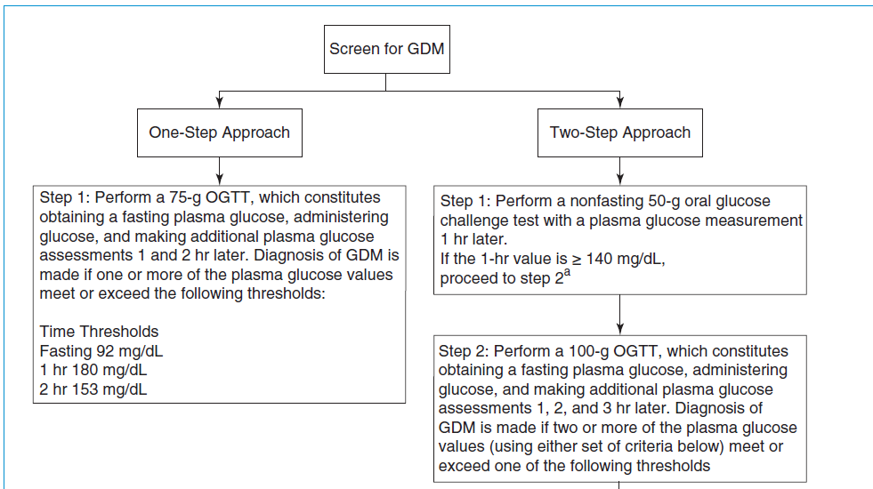

Slide 35
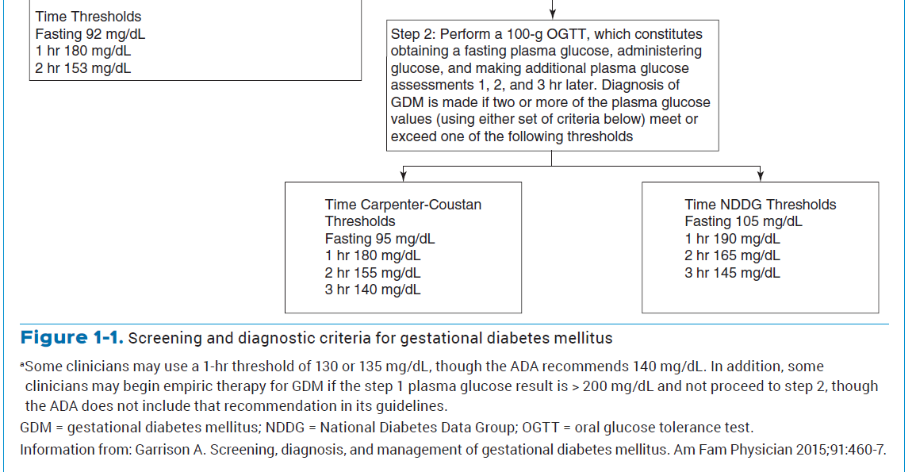

Slide 36
MONITORING IN GDM:
Blood Glucose Monitoring
Once a woman has a diagnosis of GDM, routine glucose monitoring should begin.
Evidence is lacking regarding the optimal frequency of testing, but the general recommendation is to monitor four times a day .

Slide 37
This would consist of daily monitoring of fasting glucose and 1 or 2 hours after each meal.
Data are insufficient regarding whether 1- versus 2-hour postprandial monitoring is superior.

Slide 38
Postprandial glucose control is associated with better overall glycemic control and may be more predictive of maternal and fetal complications.
Individuals with GDM that is diet controlled can monitor less often.

Slide 39
Glucose Goals and Other Monitoring Values:
Observational studies show that A1C concentrations less than 6%–6.5% are associated with the lowest rates of fetal complications, but trials have not evaluated the risk-benefit of achieving these targets.

Slide 40
Hemoglobin A1C concentrations during normal pregnancy fall by as much as 0.5% because of increased RBC turnover .
Furthermore, because postprandial glucose is a better indicator of risk of complications, A1C is not as useful.

Slide 41
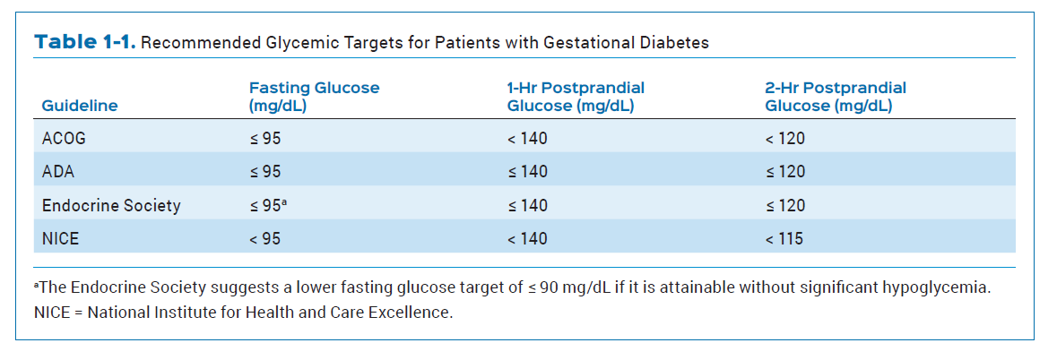

Slide 42
NONPHARMACOLOGIC
MANAGEMENT

Slide 43
Nutritional Therapy:
Medical nutrition therapy is the cornerstone of treatment for GDM .
Dietary intervention, in combination with insulin therapy as needed, reduces the risk of LGA infants, fetal macrosomia, preeclampsia, and serious perinatal complications .

Slide 44
All women with GDM should receive dietary counseling at the time of diagnosis, preferably provided by a registered dietitian or nutritionist experienced in GDM management.

Slide 45
The goals of dietary modification in GDM are to attain the desired level of glycemic control; provide adequate weight gain, which contributes to maternal and fetal well-being; and prevent the development of ketosis .

Slide 46
Suggested weight gain during pregnancy for patients with GDM varies according to the pre-pregnancy BMI.
The ADA recommends a weight gain of 6.8–11.3 kg for overweight women and 4.5–9.1 kg for women with obesity.

Slide 47
Excessive weight gain is associated with a greater risk of fetal macrosomia and should be avoided.
Conversely, women who gained less weight than recommended had a greater risk of delivering a small-for-gestational-age infant.

Slide 48
More severe restriction of caloric intake may result in ketosis.
Weight loss during pregnancy is not generally recommended .
Weekly weight checks can be used to identify excessive or insufficient weight gain.

Slide 49
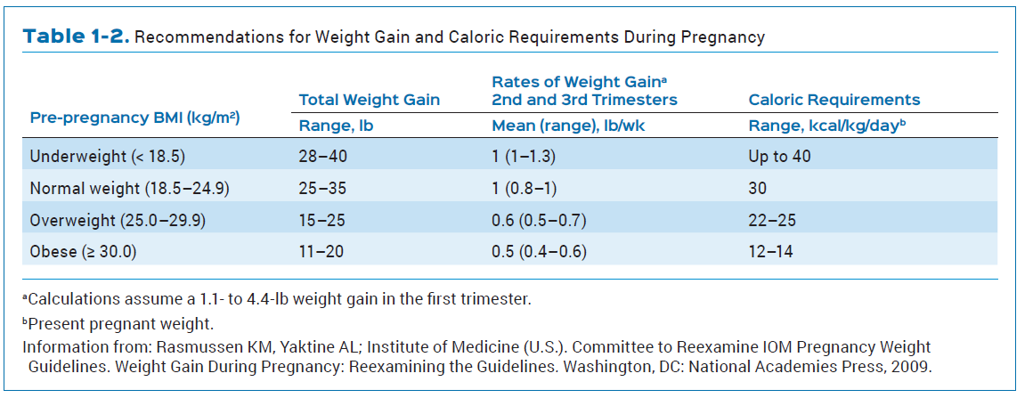

Slide 50
Medical nutrition therapy for women with GDM should emphasize distribution of calories, with a focus on restriction of carbohydrates.

Slide 51
The ACOG guidelines recommend a caloric distribution of 33%–40% carbohydrates, 20% protein, and 40% fat (ACOG 2013).
Strong evidence for the optimal proportion of carbohydrates in GDM is lacking, and the Endocrine Society suggests a slightly less restrictive carbohydrate intake of 35%–45% of total calories (Blumer 2013).

Slide 52
Other sources recommend a minimum intake of 175 g of carbohydrates per day, although this is greater than the recommended daily carbohydrate consumption (130 g) for nonpregnant women (Blumer 2013; ADA 2008; IOM 2002).

Slide 53
Regardless of the strategy used to determine initial carbohydrate intake in GDM, adjustment of carbohydrate consumption should be ongoing and based on clinical measures such as blood glucose concentrations, ketone concentrations, and weight gain (ADA 2008).

Slide 54
A typical daily meal plan for women with GDM includes three small to moderate-sized meals and two to four snacks, one of which should be at bedtime to prevent the development of ketosis overnight .

Slide 55
Meal plans should consider cultural preferences as well as desired weight gain and level of physical activity .

Slide 56
A suggested recommendation for caloric distribution across meals and snacks consists of 10% of total calories at breakfast, 30% at lunch, 30% at dinner, and 30% divided between the snacks.

Slide 57
In general, carbohydrate intake should be distributed throughout the day to reduce postprandial hyperglycemia, and protein should be included with all meals and snacks to promote satiety.

Slide 58
Glucose may be more difficult to control in the morning due to the dawn phenomenon.
Therefore, women with GDM may require lower carbohydrate consumption to attain desired glucose concentrations after breakfast compared with other meals.

Slide 59
Patients with GDM should be trained in carbohydrate counting, and blood glucose concentrations should be interpreted in the context of food logs that document carbohydrate intake .

Slide 60
When insulin therapy is needed, consistency of carbohydrate intake with meals and snacks is an important focus .

Slide 61
In addition to the amount of carbohydrates ingested, the type of carbohydrates is important.

Slide 62
Intake of complex carbohydrates is preferred to intake of simple carbohydrates because complex carbohydrates are less likely to cause postprandial hyperglycemia .

Slide 63
Food sources that are higher in complex carbohydrates tend to have a lower glycemic index, which blunts the rise in postprandial glucose.

Slide 64
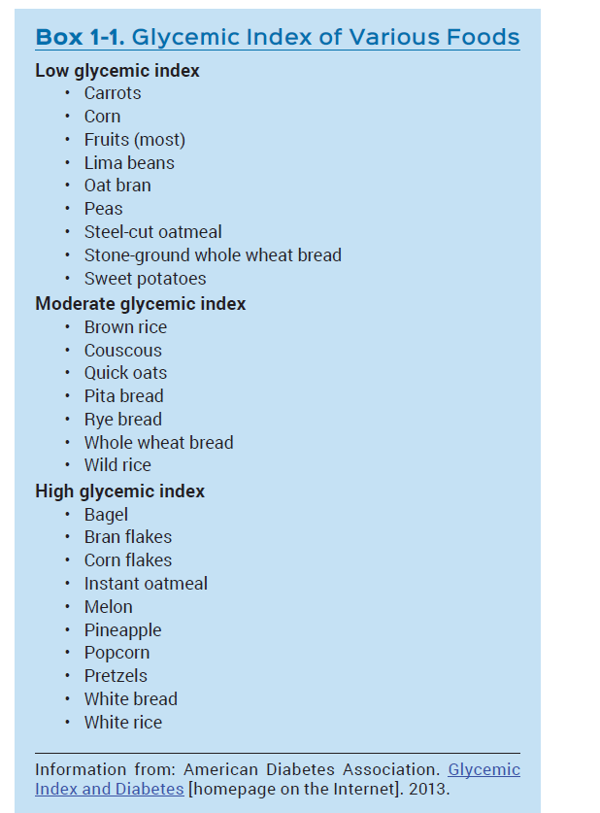

Slide 65
Physical Activity

Slide 66
Together with medical nutrition therapy, physical activity is a key component in initial GDM management.

Slide 67
Physical activity improves insulin sensitivity and reduces both fasting and postprandial glucose concentrations in patients with diabetes.

Slide 68
The ADA, ACOG, and Endocrine Society guidelines recommend a program of moderate exercise consisting of 30 minutes most days of the week for women with GDM who have no medical or obstetric contraindications to physical activity .

Slide 69
Examples of moderate exercise include brisk walking, recumbent bicycling, or 10 minutes of seated arm exercises after each meal.

Slide 70
Although many randomized controlled trials support the benefits of physical activity in nonpregnant adults with diabetes, evidence of improved outcomes in GDM is limited.

Slide 71
Although evidence is limited for improvement in maternal and perinatal outcomes, a regimen of moderate exercise helps control maternal blood glucose and should be recommended for most women with GDM.

Slide 72
DRUG THERAPY FOR GDM

Slide 73
Suggested Thresholds for Initiation:
With appropriate lifestyle modification, 70%–85% of women with GDM can achieve adequate glucose control .

Slide 74
Drug therapy should be considered when medical nutrition therapy and moderate physical activity fail to achieve glucose goals within 1–2 weeks.

Slide 75
Little consensus exists regarding the threshold glucose values that should trigger initiation of drug therapy.
A systematic review and meta-analysis found no evidence to support that maternal and infant outcomes were affected by the glucose concentration at initiation of drug therapy for GDM .

Slide 76
One approach is to initiate pharmacologic therapy if most glucose values within a 1-week period are elevated (Landon 2009).

Slide 77
The ACOG guidelines support initiating drug therapy for GDM if fasting glucose concentrations routinely exceed 95 mg/dL (five of seven during the past week), 1-hour glucose concentrations routinely exceed 140 mg/dL (three of seven), or 2-hour glucose concentrations routinely exceed 120 mg/dL (two of four).

Slide 78
A third approach involves initiating drug therapy if two or more fasting or postprandial blood glucose values exceed 100 mg/dL or 126 mg/dL, respectively, in a 2-week period (Crowther 2005).

Slide 79
Overall, a defined threshold of initiation for drug therapy in GDM does not exist, and clinicians should consider the severity and frequency of hyperglycemia, fetal growth, and patient factors when deciding to initiate pharmacotherapy (Garrison 2015; ACOG 2013).

Slide 80
Insulin :
Human insulin crosses the placenta in insignificant amounts and is considered safe for use in pregnancy.
Both the ADA and ACOG guidelines recommend insulin as a first-line treatment for GDM uncontrolled by nutritional therapy.

Slide 81
The National Institute for Health and Care Excellence (NICE) guideline advises initial treatment with insulin, either with or without metformin, for any patient with a fasting glucose of 7 mmol/L (126 mg/dL) or greater at diagnosis (NICE 2015).

Slide 82
The NICE guideline also suggests consideration of insulin, either with or without metformin, for women with complications of GDM such as macrosomia and a fasting glucose of 6.0–6.9 mmol/L (108–125 mg/dL).

Slide 83
Options for basal insulin coverage in GDM treatment include intermediate-acting neutral protamine Hagedorn (NPH) insulin and the long-acting analogs insulin glargine and insulin detemir (Table 1-3).

Slide 84
Insulin degludec has not been studied in pregnant women.
Because NPH insulin was used in initial studies of GDM, it is the standard with which the long-acting insulin analogs have been compared, and several guidelines continue to recommend its use.

Slide 85
Both ACOG and the Endocrine Society suggest the use of NPH insulin for the treatment of women with GDM (ACOG 2013; Blumer 2013), whereas the ADA does not specify a preferred basal insulin (ADA 2016b).

Slide 86
In the general nonpregnant population, long-acting insulin analogs are associated with a lower risk of hypoglycemia than NPH insulin, making them an option for GDM management.

Slide 87
However, as with any agent for use in pregnant women, the longer-acting insulin analogs needed to overcome safety concerns before use could be endorsed in this specialty population.

Slide 88
Use of insulin detemir in pregnancy was first investigated in women with type 1 diabetes.
In a randomized open-label trial of 310 pregnant patients with type 1 diabetes, insulin detemir was compared with NPH insulin, both used in combination with mealtime insulin in a basal-bolus regimen (Hod 2014).

Slide 89
Overall, maternal and perinatal outcomes were similar in both groups.
No significant safety concerns were identified in the insulin detemir group.

Slide 90
The Endocrine Society suggests use of insulin detemir in women with known or potential problematic hypoglycemia with NPH insulin (Blumer 2013).

Slide 91
In the United States, insulin detemir is rated FDA pregnancy risk category B, and the European Medicines Agency permits its use during pregnancy.

Slide 92
The FDA has instituted a change in the pregnancy information required within prescription drug labeling (Pregnancy and Lactation Labeling Rule – PLLR); the current pregnancy risk categories are gradually being phased out in favor of more comprehensive information.

Slide 93
Currently, however, the pregnancy risk categories are still in the labeling of many prescription drug products.

Slide 94
A concern with the use of insulin glargine in pregnancy is its increased affinity for the insulin-like growth factor (IGF-1) receptor (Pollex 2011).

Slide 95
The IGF-1 receptor is structurally similar to the insulin receptor, and insulin analogs have modifications in amino acid sequence or structure that may increase or diminish the binding affinity for IGF-1 receptors (Jovanovic 2007).

Slide 96
Insulin glargine has a 6-fold affinity for the IGF-1 receptor compared with human insulin, and insulin detemir has about one-sixth the affinity.

Slide 97
During pregnancy, IGF-1 plays a role in implantation and mediates the effects of human placental growth hormone on the fetus.

Slide 98
Thus, disruption of the normal function of IGF-1 raises concerns of potential enhanced mitogenic activity.

Slide 99
However, in therapeutic doses, insulin glargine is unlikely to cross the placenta, and studies to date have not shown an increased fetal risk with the use of this agent during pregnancy.

Slide 100
A systematic review and meta-analysis of eight studies involving 702 women with pregestational diabetes (existing type 1 or type 2 diabetes before pregnancy) or GDM who received insulin glargine in pregnancy concluded that fetal outcomes did not differ significantly from those of women treated with NPH insulin (Pollex 2011).

Slide 101
A second meta-analysis examining the use of insulin glargine in eight observational studies of pregestational diabetes or GDM showed no significant difference in birth weight, neonatal outcomes, or severe maternal hypoglycemia compared with NPH insulin (Lv 2015).

Slide 102
In summary, randomized controlled trials using insulin glargine in GDM are lacking, and insulin glargine should only be used if the benefits outweigh the risk of adverse effects to the mother and fetus.

Slide 103
The rapid-acting analogs insulin aspart and insulin lispro are preferred to regular insulin for mealtime coverage (ACOG 2013).
Both analogs improve postprandial glucose control compared with regular insulin and may have a reduced risk of delayed postprandial hypoglycemia (Metzger 2007).

Slide 104
The analogs are also more convenient to administer preprandially, as opposed to regular insulin, which should be administered 30 minutes before meals for optimal postprandial coverage (Cheng 2008a).

Slide 105
Glulisine is the only rapid-acting insulin without human data in pregnancy.
As a result, glulisine is the only rapid-acting analog rated as FDA pregnancy risk category C; aspart and lispro are category B.

Slide 106
The Endocrine Society states that insulin glulisine should not be used in pregnancy because it offers no added benefit over other rapid-acting analogs (Blumer 2013).

Slide 107
According to the available evidence, the rapid-acting insulin analogs, aspart and lispro, have efficacy and safety comparable with regular insulin.

Slide 108
They are preferred in GDM management because of the convenience of mealtime administration and potentially lower risk of delayed hypoglycemia.

Slide 109
Insulin requirements can vary widely during pregnancy, particularly during the second trimester when insulin resistance may rise rapidly (ADA 2016b).

Slide 110
For women who have mild fasting hyperglycemia, an injection of intermediate- or long-acting insulin (0.15–0.2 unit/kg) at bedtime can be used to control elevated fasting glucose.

Slide 111
Mild postprandial elevations in glucose can typically be managed with administration of 2–4 units of rapid-acting insulin before meals.

Slide 112
Alternatively, elevated glucose after lunch may be treated with an intermediate-acting insulin before breakfast (Cheng 2008a).

Slide 113
For women with marked hyperglycemia, several daily injections provide optimal glucose control.
A typical starting dose of insulin is 0.7–1 unit/kg/day , administered in divided doses (ACOG 2013; Hone 2010).

Slide 114
Higher insulin doses may be required in women with obesity or multiple gestation pregnancies.

Slide 115
Once the total daily insulin dose is calculated, 50% is administered as basal insulin using NPH or long-acting insulin analogs, and the remaining 50% is administered in three preprandial injections of rapid-acting insulin (Hone 2010).

Slide 116
According to initial studies with NPH in pregnancy some sources recommend that if NPH is selected as the basal insulin, it should be divided into three equal doses given before breakfast, before dinner, and at bedtime (Hone 2010).

Slide 117
However, a twice-daily regimen of NPH is commonly used for basal control. For women with limited financial resources, a regimen of NPH and regular insulin may be more affordable.

Slide 118
Regardless of the initial regimen, the dose should be titrated often, using data from self-monitoring of blood glucose.

Slide 119
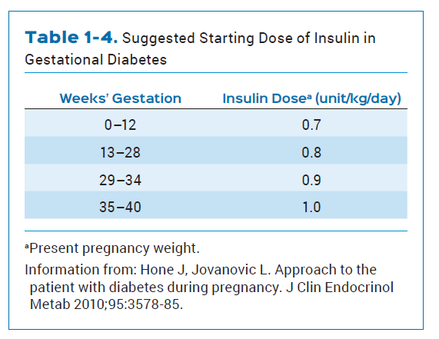

Slide 120
Metformin :
Because many women with GDM have mild hyperglycemia, treatment with oral medications such as metformin is also an acceptable option when medical nutrition therapy and exercise fail to control glucose adequately.

Slide 121
However, more recent studies have not noted similar safety concerns with metformin use in pregnancy, and the drug is currently rated as FDA pregnancy risk category B. Management of GDM is an off-label indication of metformin.

Slide 122
The metformin dose was initiated at 500 mg once or twice daily with food and titrated over 1–2 weeks, depending on glycemic goals, to a maximum daily dosage of 2500 mg.

Slide 123
Recommendations for the role of metformin in GDM treatment differ, according to the various guidelines.

Slide 124
The ACOG guidelines recommend metformin as an appropriate first-line therapy for GDM management, and the NICE guideline also supports metformin as initial therapy in women with GDM and a fasting glucose below 126 mg/dL at diagnosis
(NICE 2015; ACOG 2013).

Slide 125
In contrast, the Endocrine Society suggests metformin as an alternative in women who refuse or have contraindications to insulin or glyburide (Blumer 2013).

Slide 126
The rationale for this recommendation includes the higher failure rate of metformin and the unknown long-term safety profile in offspring of women treated with metformin.

Slide 127
The ADA recommends insulin as a first-line agent and proposes metformin as an acceptable alternative if glucose control is sufficient (ADA 2016b).
The ADA cites the slightly higher risk of prematurity and unknown long-term effects on offspring as concerns with metformin use in GDM.

Slide 128
Although metformin has an acceptable safety profile with short-term use in GDM management, it crosses the placenta readily, and the long-term effects of fetal exposure to an insulin sensitizing agent are unknown.

Slide 129
Glyburide :
Glyburide has been extensively studied for GDM management.
Glyburide is the only sulfonylurea that crosses the placenta to a minimal extent, likely because of high protein binding (Metzger 2007).

Slide 130
Depending on the manufacturer, glyburide is rated as FDA pregnancy risk category B or C. Management of GDM is an off-label use of glyburide.

Slide 131
When used in GDM treatment, the initial glyburide dose is typically 2.5–5 mg once daily in the morning.
The dose is titrated according to glucose readings to a maximum of 20 mg daily, usually given in two divided doses (ACOG 2013).

Slide 132
For best efficacy, glyburide should be administered 30–60 minutes before meals, and the drug’s activity should be carefully balanced with meals and snacks to minimize the risk of hypoglycemia (Caritis 2013).

Slide 133
Supplemental insulin therapy may be required in 5%–20% of patients with GDM managed with glyburide.
When selecting therapy, practitioners should consider that glyburide may be less effective in women with higher fasting glucose concentrations at diagnosis and those with a history of GDM or GDM diagnosed before 26 weeks’ gestation (Harper 2016a).

Slide 134
The ADA continues to endorse insulin as a first-line agent for GDM management, stating that glyburide may be inferior to insulin and metformin because of the increased risk of macrosomia and neonatal hypoglycemia (ADA 2016b).

Slide 135
Women with GDM who are initiated on glyburide should be counseled about the potential increased risk of macrosomia and neonatal hypoglycemia, as well as the risk of maternal hypoglycemia and strategies for managing hypoglycemia with this agent.

Slide 136
In addition, they should be informed that glyburide crosses the placenta in trace amounts, and long-term safety data are lacking.

Slide 137
Other Agents :
Other agents such as the meglitinides, thiazolidinediones, dipeptidyl peptidase-4 inhibitors, glucagon-like peptide-1 receptor agonists, and sodium glucose cotransporter-2 inhibitors have limited or no human data in pregnancy and should not be considered for GDM management.

Slide 138
Intrapartum Glucose Control :
Maternal hyperglycemia during labor and delivery can contribute to the risk of neonatal hypoglycemia (Blumer 2013).
Thus, prevention of neonatal hypoglycemia is a primary goal of intrapartum glucose management.
Hypoglycemia in the mother should be avoided if a long-acting insulin is used during labor (Cheng 2008a).

Slide 139
Of note, insulin requirements are usually decreased during labor because the woman is typically fasting, and the work of labor requires energy expenditure.
Therefore, for women with GDM managed with insulin, it may be reasonable to omit the dose of long-acting insulin or give only one-half of the usual dose on the day of delivery (Garrison 2015; Cheng 2008a).

Slide 140
Both the Endocrine Society and NICE guidelines recommend a target plasma glucose concentration of 72–126 mg/dL during labor and delivery, whereas ACOG recommends a target of 70–110 mg/dL (ACOG 2005).

Slide 141
Women with diet-controlled GDM are unlikely to require intrapartum administration of insulin.
Glucose concentrations in most women with GDM return to near-normal concentrations shortly after delivery, and glucose-lowering therapies should be discontinued immediately after birth (NICE 2015).

Slide 142
POSTPARTUM MANAGEMENT:
Postpartum Screening
Within 24–72 hours of delivery and before returning to community care, women should have a glucose assessment (fasting plasma glucose or self-monitored glucose) to exclude ongoing hyperglycemia (NICE 2015; Blumer 2013).

Slide 143
Because women with a history of GDM are at a greater risk of developing prediabetes or type 2 diabetes, most guidelines recommend screening at 6–12 weeks postpartum using the one-step approach (2-hour 75-g OGTT) previously described
(ADA 2016b; ACOG 2013; Blumer 2013).

Slide 144
The NICE guideline differs, advocating screening with fasting blood glucose rather than the 2-hour 75-g OGTT, and advises against the routine use of the OGTT (NICE 2015).

Slide 145
Studies evaluating the use of A1C, with or without fasting glucose, to diagnose postpartum glucose intolerance have not had consistent results with respect to its sensitivity, and, at least initially, A1C may still be affected by the increased RBC turnover during pregnancy
(ADA 2016b; Benhalima 2015).

Slide 146
After the initial postpartum screening, some sources recommend continued use of the 2-hour 75-g OGTT, whereas others, such as the ADA, indicate that A1C, fasting glucose, or the 2-hour 75-g OGTT may be used.

Slide 147
Screening should be repeated every 1–3 years and continued lifelong.
The frequency of screening may depend on other risk factors for GDM or plans for subsequent pregnancies (ADA 2016b).

Slide 148
Furthermore, both metformin and intensive lifestyle intervention prevent or delay progression to diabetes in women with glucose intolerance and a history of GDM (ADA 2016b).

Slide 149
Metformin reduced progression by 40%, whereas lifestyle intervention provided a 35% reduction (Aroda 2015).
Thus, women with a history of GDM who are identified with glucose intolerance should be referred for preventive therapy.

Slide 150
Patient Counseling :
As stated earlier, women with a history of GDM should be counseled on lifestyle modifications that support weight loss after delivery and reduce the future risk of metabolic syndrome and type 2 diabetes.

Slide 151
These patients should also be informed of the importance of repeated screening for glucose intolerance, particularly before considering another pregnancy.

Slide 152
The need for contraception should be emphasized to reduce the incidence of unplanned pregnancy.
The choice of contraceptive should not be influenced by the history of GDM, but should be based on other medical conditions or contraindications present in the patient.

Slide 153
In addition, women with a history of GDM should be encouraged to breastfeed because this can assist with weight loss in the postpartum period and may reduce the risk of progression to type 2 diabetes later in life (Garrison 2015; Blumer 2013).

Slide 154
Metformin should be initiated at a dose of 500 mg once or twice daily and titrated over 1–2 weeks, depending on glucose concentrations and patient tolerance. If target glucose concentrations are not achieved with metformin, insulin should be added. The patient should be counseled that many women with GDM treated with metformin may require supplemental insulin to obtain adequate glucose control (20%–45%).

Slide 155


